Slide 1

Hackathon Project Presentation
Zohaib Sattar — BS Artificial Intelligence
PYTHON · PANDAS · MACHINE LEARNING

Slide 2
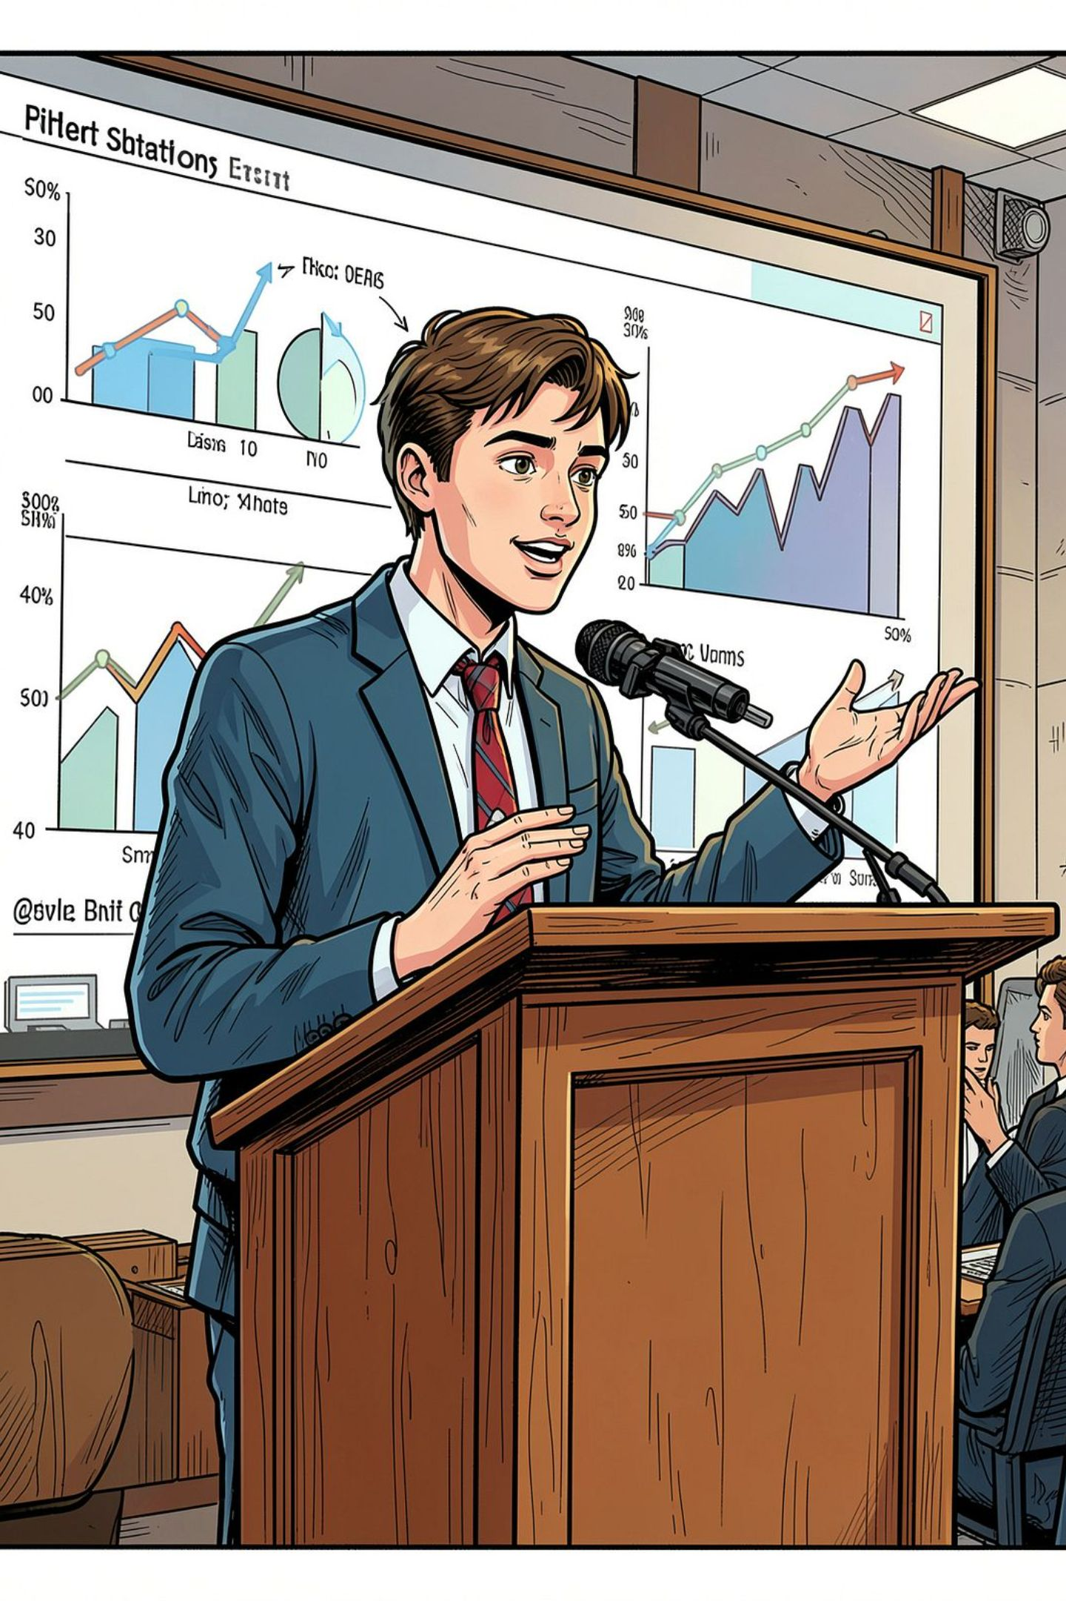
Assalam-o-Alaikum — Meet Zohaib
BS Artificial Intelligence student presenting three hackathon tasks: Python fundamentals, data cleaning, and a Machine Learning project for customer churn prediction.
Task 1
Task 2
Smart Attendance System
Inventory Management System
Task 3
Customer Churn Prediction

Slide 3
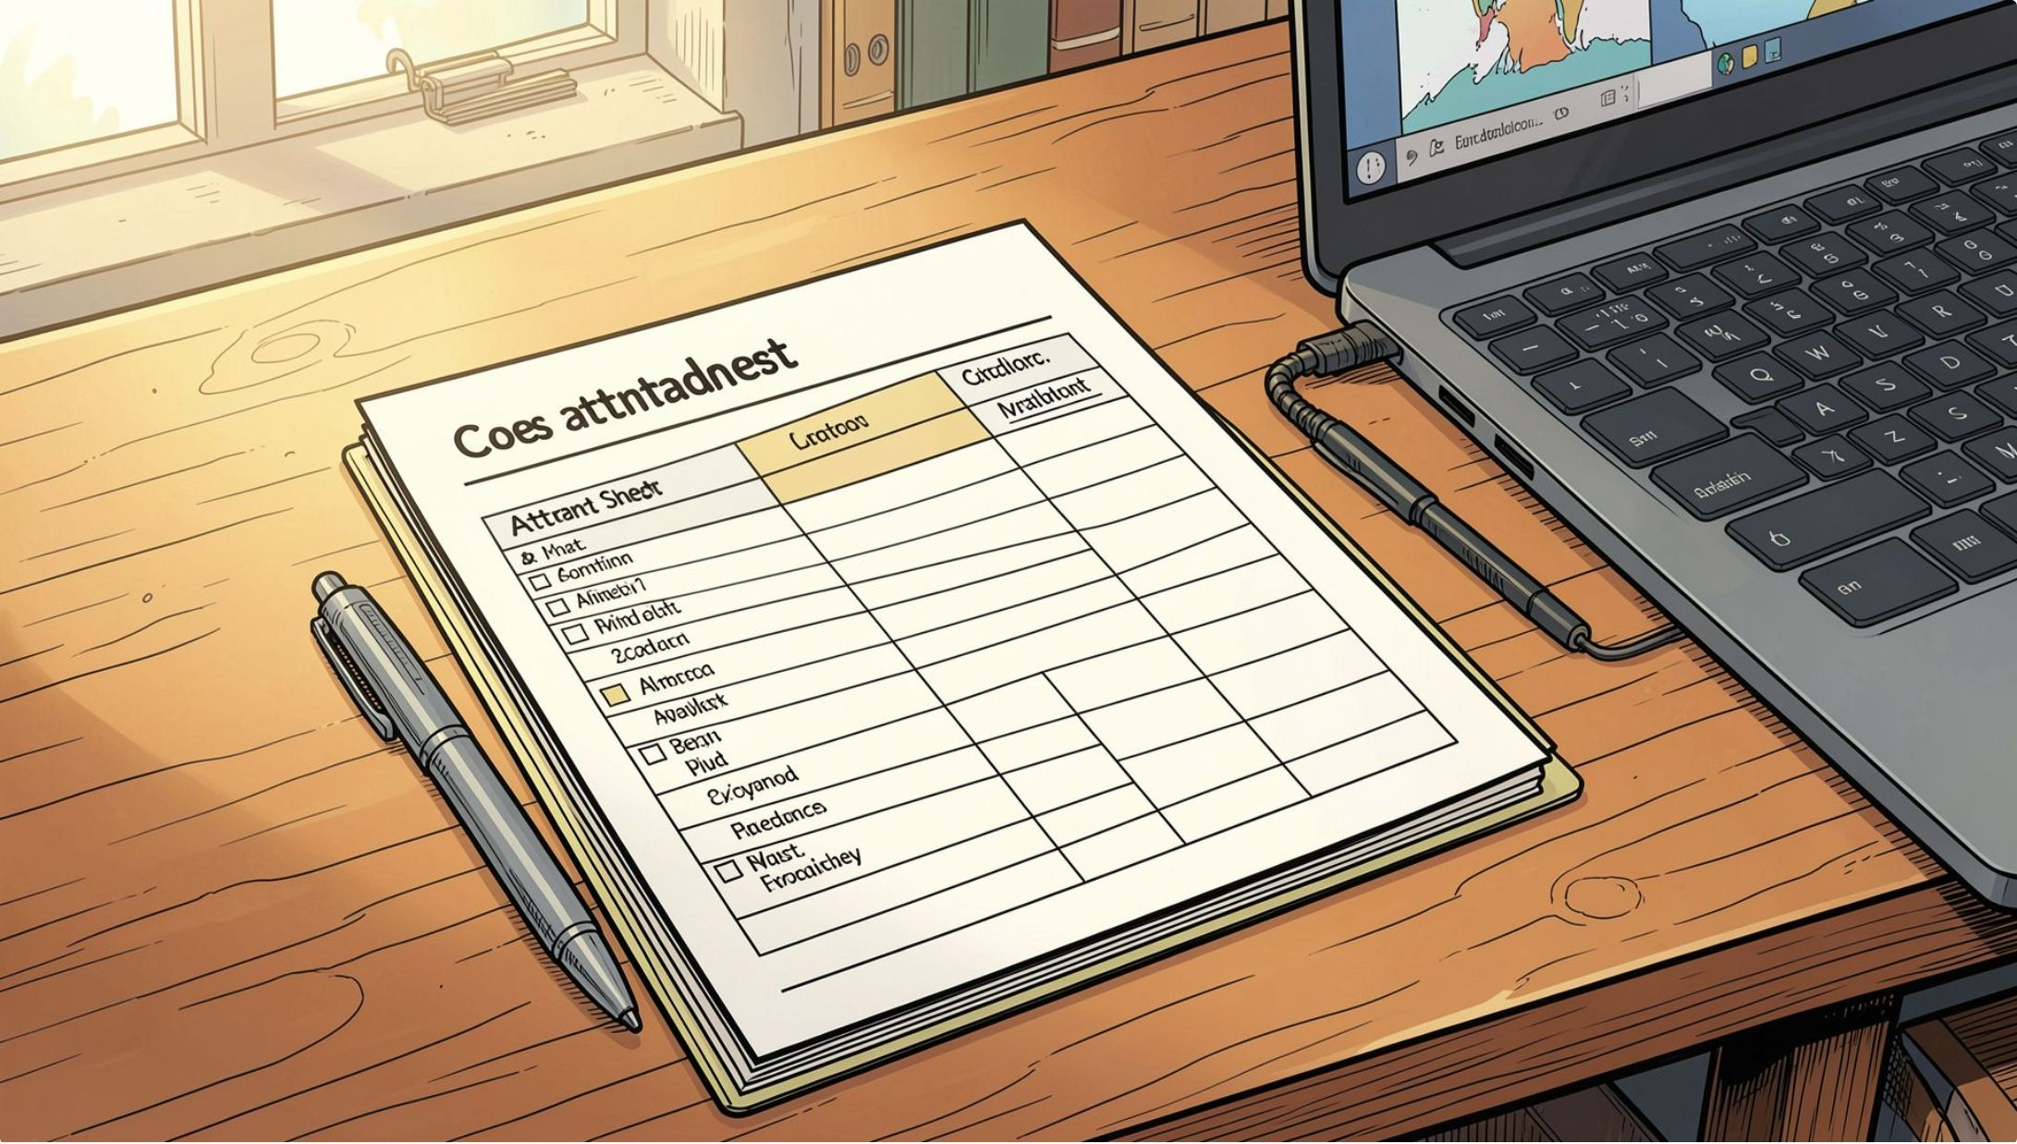
TASK 1
Smart Attendance System
Problem
Process student attendance records to count present/absent students, calculate percentages, and flag those below the 75% threshold.
Status Categories
≥ 90% — Excellent
75% – 89% — Good
< 75% — Warning
Implementation
Used Python and Pandas: cleaned data (removed spaces, standardized capitalization, eliminated duplicates), grouped by student, calculated attendance percentage, and assigned status via a custom function.

Slide 4
TASK 2
Inventory Management System
Problem
Implementation
Build a menu-driven system for a small shop to manage products — each storing a name, price, and quantity.
Products stored in a Python dictionary (name as key, price and quantity as values). Helper functions: clean_name() for text normalization, ask_number() for validated numeric input, and total_inventory_value() computing price × quantity. A loop-driven menu lets users select operations until Exit.
Features
Display all products
Add a new product
Update product quantity
Calculate total inventory value

Slide 5

TASK 3
Customer Churn Prediction
The Business Problem
Customers leave the bank by closing their accounts — a costly problem. This project builds a Machine Learning model to predict which customers are likely to churn before it happens.
Target Variable
Exited = 0
Exited = 1
Customer stayed
Customer churned

Slide 6
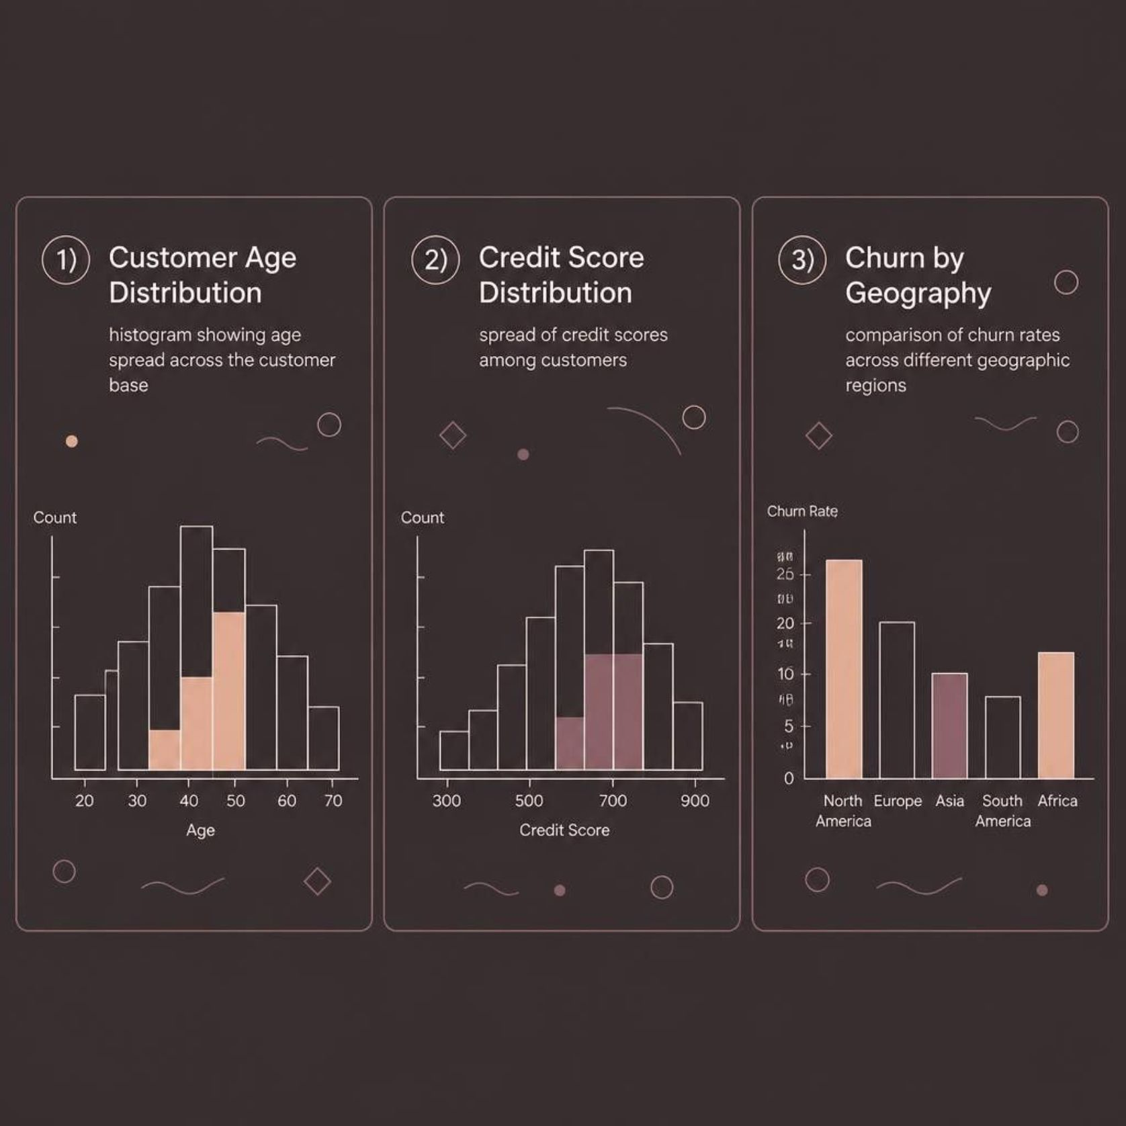
TASK 3 — EDA
Dataset & Exploratory Data Analysis
Dataset Overview
10,000 rows × 14 columns covering customer demographics and financial behavior.
Credit Score, Age, Tenure, Balance
Geography, Gender, Credit Card status
Active Member, Estimated Salary
EDA Checks
Row/column count and data types
Missing values and duplicates
Basic statistics and distributions

Slide 7

TASK 3 — CLEANING & ENGINEERING
Data Cleaning & Feature Engineering
Cleaning Steps
Feature Engineering
Median imputation for numerical columns (Credit Score, Age, Balance)
Mode imputation for categorical columns (Gender, Surname)
Standardized Gender capitalization; trimmed whitespace
Removed 1 malformed record (invalid Customer ID and Age 45,446)
Dropped RowNumber, CustomerId, Surname
One-Hot Encoding for Geography and Gender
StandardScaler for numerical features
80/20 stratified split → 7,999 train / 2,000 test
Pipeline fitted on training data only to prevent data leakage.
Result: 9,999 valid records

Slide 8
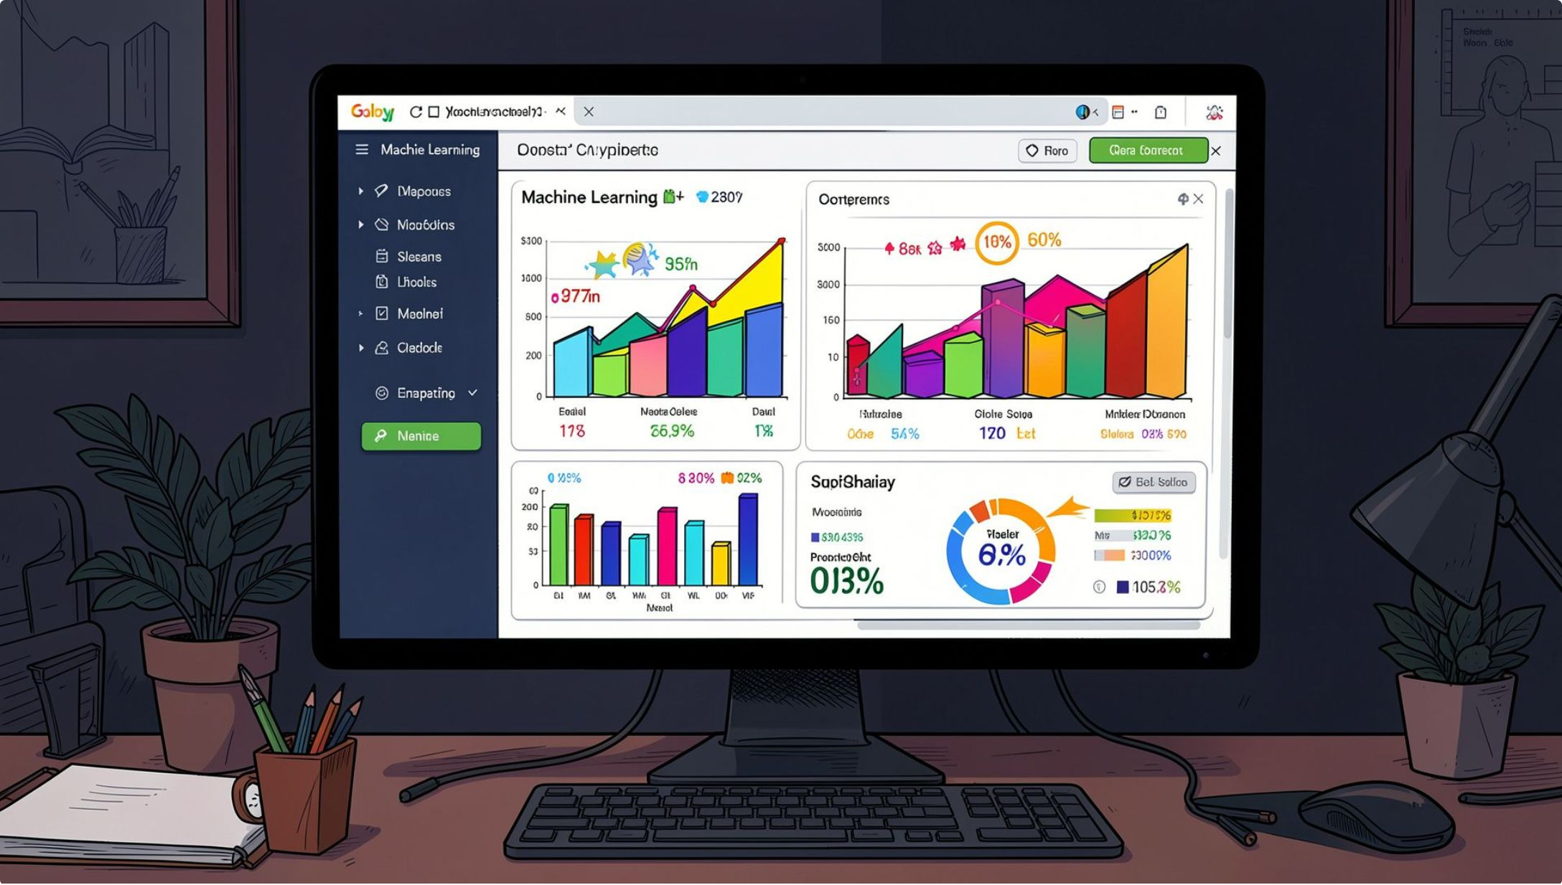
TASK 3 — MODELING
Model Training & Evaluation
Models Trained
Logistic Regression — baseline linear model
Decision Tree — rule-based splits
Random Forest — ensemble of trees
Evaluation Metrics
Accuracy — overall correctness
Precision — correctness of positive predictions
Recall — ability to detect churners
F1-Score — balance of precision and recall

Slide 9



TASK 3 — RESULTS
Results & Observations
The Random Forest model achieved the best overall performance, outperforming Logistic Regression and Decision Tree on most metrics. Logistic Regression performed the weakest.
Strong Recall
The model successfully identified most customers who actually churned.
Key Insight
Random Forest is well-suited for tabular customer data with mixed feature types.
Takeaway
Ensemble methods consistently outperform single-model approaches on this dataset.

Slide 10
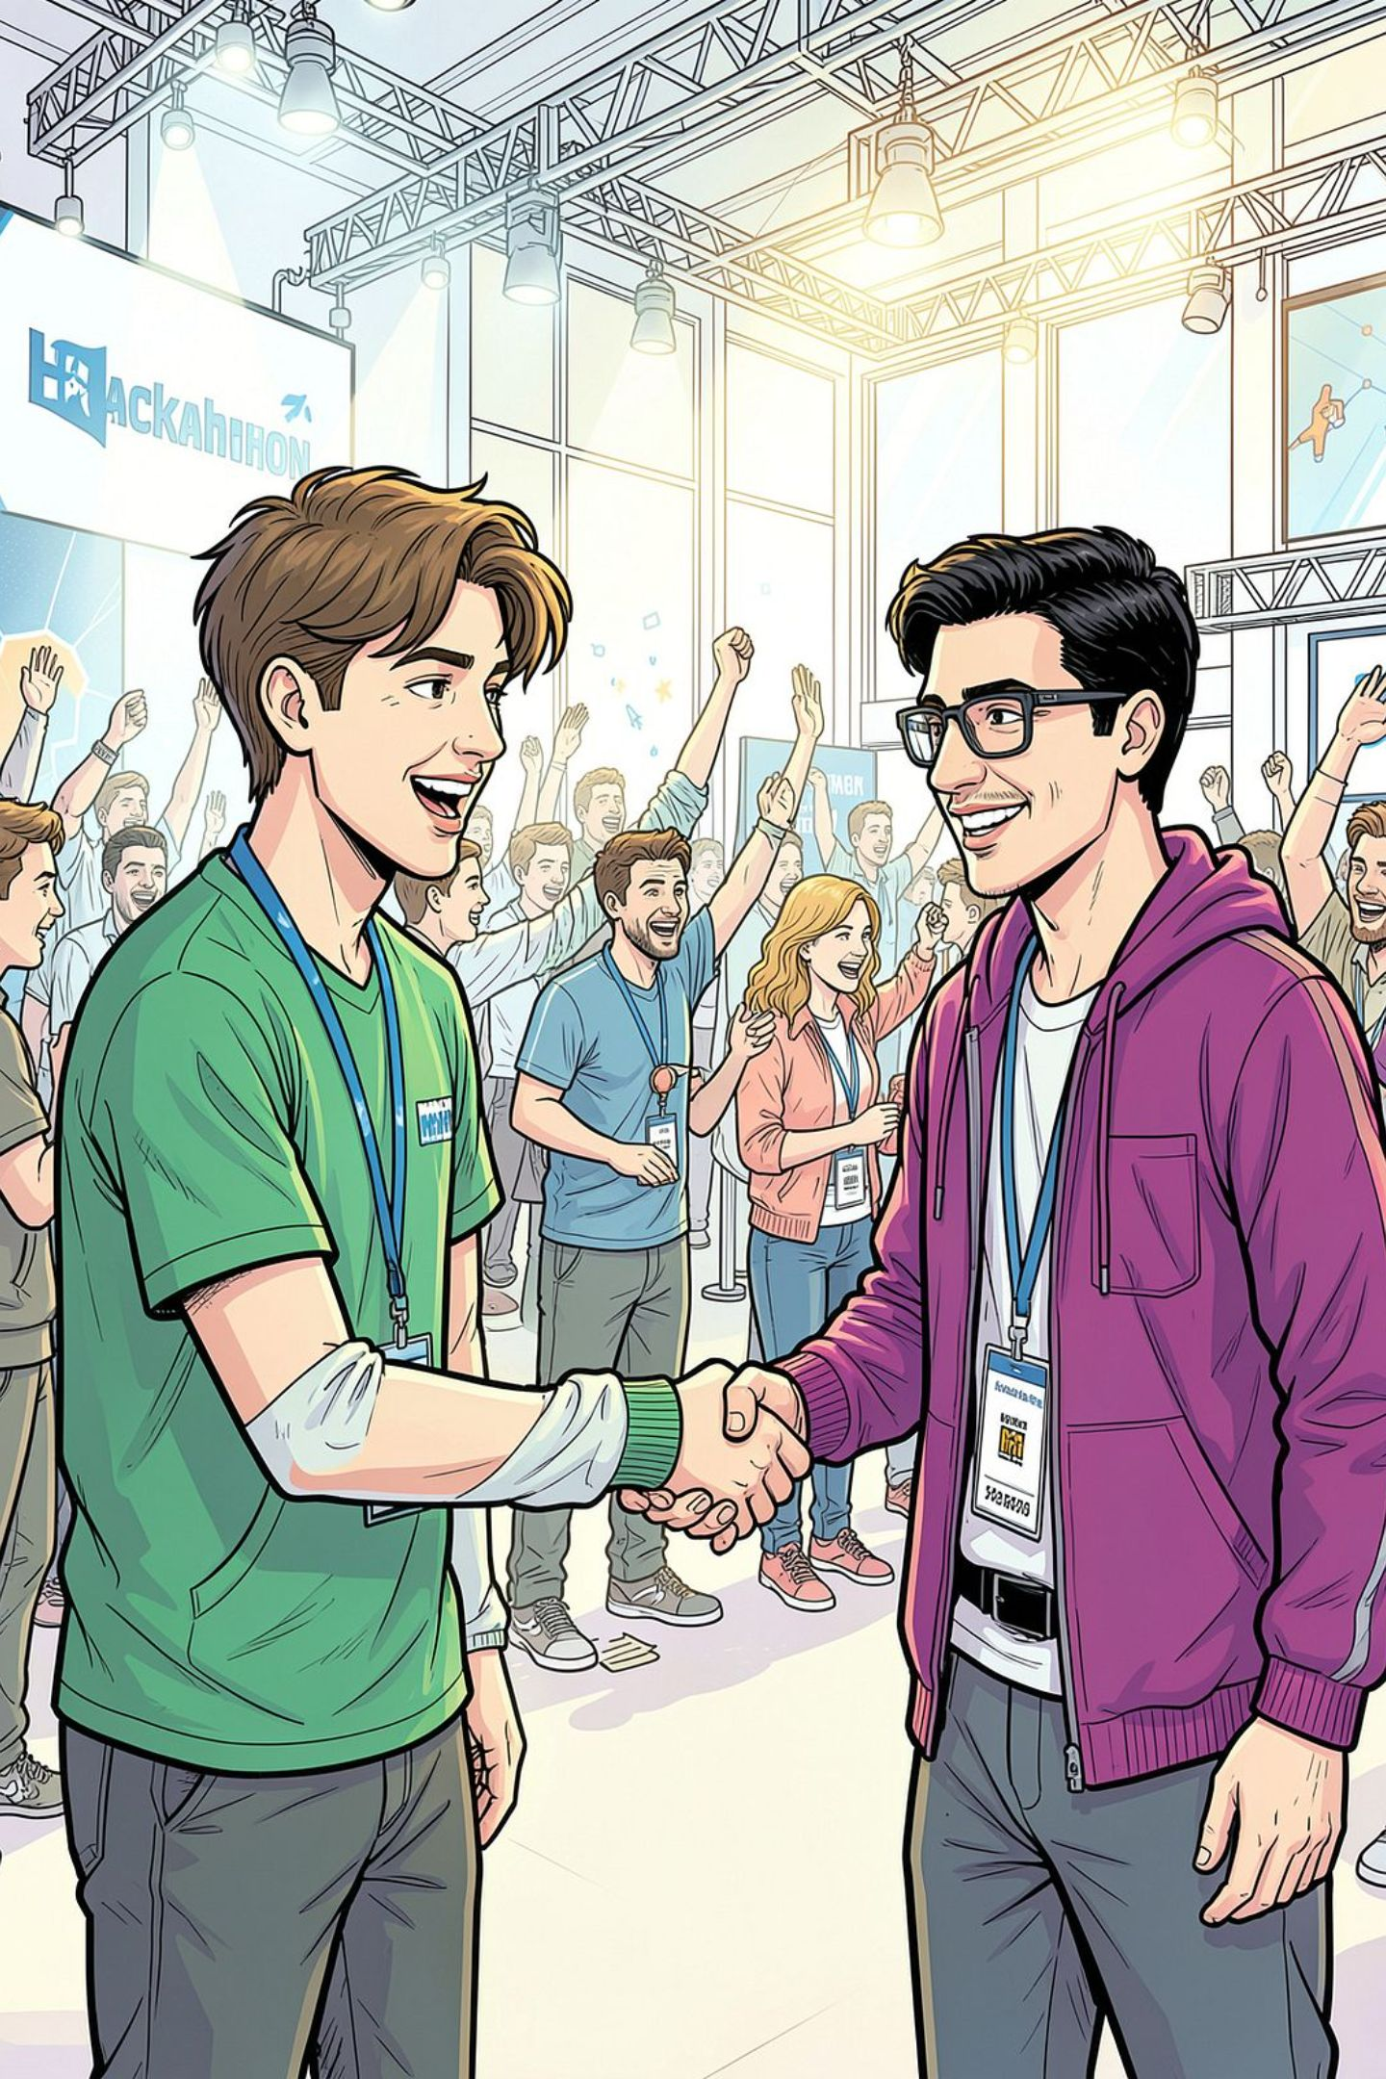
Thank You
This presentation covered three tasks — a Smart Attendance System, an Inventory Management System, and a Customer Churn Prediction model. Each task demonstrates Python programming, data cleaning, and Machine Learning skills.
Zohaib Sattar — BS Artificial Intelligence

