Slide 1
Software Re Engineering
Reuse and Domain Engineering
Notes:
Handouts
------------------------------------------------------------------
------------------------------------------------------------------
-------------------------------------------------------------------
--------------------------------------------------------------------

Slide 2
9.1 General Idea
Formal software reuse (off-the-self components) was first introduced by Dough McIlroy.
Early development of reuse include the concept of program families introduced by David Parnas.
A set of programs with several common attributes and features is known as a program family.
At the same time the concepts of domain and domain analysis introduced by Jim Neighbors.
Domain analysis means finding objects and operations of a set of similar software systems in a specific problem domain.
In this context, software reuse involves two main activities: software development with reuse and software development for reuse.
Notes:
Handouts

Slide 3
9.1 General Idea
There are four types of reusable artifacts as follows:
Data reuse: It involves a standardization of data formats. A standard data interchange format is necessary to design reusable functions.
Architectural reuse: This means developing: (i) a set of generic design styles about the logical structure of software; and (ii) a set of functional elements and reuse those elements in new systems.
Design reuse: This deals with the reuse of abstract design. A selected abstract design is custom implemented to meet the application requirements.
Program reuse: This means reusing executable code. For example, one may reuse a pattern-matching system, that was developed as part of a text processing tool, in a database management system.
Notes:
Handouts

Slide 4
9.1 General Idea
The reusability property of a software asset indicates the degree to which the asset can be reused in another project.
For a software component to be reusable, it needs to exhibit the following properties that directly encourage its use in similar situations
    Environmental independence.
    High cohesion.
    Low coupling.
    Adaptability.
    Understandability.
    Reliability.
    Portability.
Notes:
Handouts

Slide 5
9.1.1 Benefits of Reuse
One benefits in several ways from software reuse.
The most obvious advantage of reuse is economic benefit.
Other tangible benefits of reuse are as follows:
    1. Increased reliability.
    2. Reduced process risk.
    3. Increase productivity.
    4. Compliance with standards.
    5. Accelerated development.
    6. Improved maintainability.
    7. Less maintenance effort and time.
Notes:
Handouts

Slide 6
9.1.2 Reuse Models
Development of assets with the potential to be reused requires additional capital investment.
The organization can select one or more reuse models that best meet their business objectives, engineering realities, and management styles.
Reuse models are classified as:
    Proactive.
    Reactive.
    Extractive.
Notes:
Handouts

Slide 7
9.1.2 Reuse Models
Proactive approaches
In proactive approaches to developing reusable components, the system is designed and implemented for all conceivable variations; this includes design of reusable assets.
A proactive approach is to product lines what the Waterfall model is to conventional software.
The term product line development, which is also known as domain engineering, refers to a “development-for-reuse” process to create reusable software assets (RSA)
This approach might be adopted by organizations that can accurately estimate the long-term requirements for their product line.
This approach faces an investment risk if the future product requirements are not aligned with the projected requirements.
Notes:
Handouts

Slide 8
9.1.2 Reuse Models
Reactive approaches
In this approach, while developing products, reusable assets are developed if a reuse opportunity arises.
This approach works, if
  (i) it is difficult to perform long-term predictions of requirements for product variations.
  (ii) an organization needs to maintain an aggressive production schedule with not much resources to develop reusable assets. The cost to develop assets can be amortized over several products.
However, in the absence of a common, solid product architecture in a domain, continuous reengineering of products can render this approach more expensive.
Notes:
Handouts

Slide 9
9.1.2 Reuse Models
Extractive approaches
The extractive approaches fall in between the proactive approaches and the reactive ones.
To make a domain engineering’s initial baseline, an extractive approach reuses some operational software products.
Therefore, this approach applies to organizations that have accumulated both artifacts and experiences in a domain, and want to rapidly move from traditional to domain engineering.
Notes:
Handouts

Slide 10
9.1.3 Factors Influencing Reuse
Reuse factors are the practices that can be applied to increase the reuse of artifacts.
Frakes and Gandel identified four major factors for systematic software reuse: managerial, legal, economic and technical.
Managerial
Systematic reuse requires upper management support, because:
  (i) it may need years of investment before it pays off.
  (ii) it involves changes in organization funding and management structure that can only be implemented with executive management support.
Legal
This factor is linked with cultural, social, and political factors, and it presents very difficult problems.
Potential problems include proprietary and copyright issues, liabilities and responsibilities of reusable software, and contractual requirements involving reuse.
Notes:
Handouts

Slide 11
9.1.3 Factors Influencing Reuse
Economic
Software reuse will succeed only if it provides economic benefits.
A study by Favaro found that some artifacts need to be reused more than 13 times to recoup the extra cost of developing reusable components.
Technical
This factor has received much attention from the researchers actively engaged in library development, object-oriented development paradigm, and domain engineering.
A reuse library stores reusable assets and provides an interface to search the repository.
One can collect library assets in a number of ways: (i) reengineer the existing system components; (ii) design and build new assets; and (iii) purchase assets from other sources.
Notes:
Handouts

Slide 12
9.1.4 Success Factors of Reuse
The following steps aid organizations in running a successful reuse program:
Develop software with the product line approach.
Develop software architectures to standardize data formats and product interfaces.
Develop generic software architectures for product lines.
Incorporate off-the-shelf components.
Perform domain modeling of reusable components.
Follow a software reuse methodology and measurement process.
Ensure that management understands reuse issues at technical and non- technical levels.
Support reuse by means of tools and methods.
Support reuse by placing reuse advocates in senior management.
Practice reusing requirements and design in addition to reusing code.
Notes:
Handouts

Slide 13
9.2 Domain Engineering
The term domain engineering refers to a development-for-reuse process to create reusable software assets (RSA).
It is also referred to as product line development.
Domain engineering is the set of activities that are executed to create reusable software assets to be used in specific software projects.
For a software product family, the requirements of the family are identified and a reusable, generic software structure is designed to develop members of the family.
In the following slides, we explain analysis, design, and implementation activities of domain engineering.
Notes:
Handouts

Slide 14
9.2 Domain Engineering
Domain Analysis
Domain analysis comprises three main steps:
  identify the family of products to be constructed;
  determine the variable and common features in the family of products;
  develop the specifications of the product family.
The Feature Oriented Domain Analysis (FODA) method developed at the Software Engineering Institute is a well-known method for domain analysis.
The FODA method describes a process for domain analysis to discover, analyze, and document commonality and differences within a domain.
Notes:
Handouts

Slide 15
9.2 Domain Engineering
Domain Design
Domain design comprises two main steps:
  develop a generic software architecture for the family of products under consideration; and
  develop a plan to create individual systems based on reusable assets.
The design activity emphasizes a common architecture of related systems.
The common architecture becomes the basis for system construction and incremental growth.
The design activities are supported by architecture description languages (ADLs), namely, Acme, and interface definition languages (IDLs), such as Facebook’s Thrift.
Notes:
Handouts

Slide 16
9.2 Domain Engineering
Domain Implementation
Domain implementation involves the following broad activities:
  identify reusable components based on the outcome of domain analysis;
  acquire and create reusable assets by applying the domain knowledge acquired in the process of domain analysis and the generic software architecture constructed in the domain design phase;
  catalogue the reusable assets into a component library.
Development, management, and maintenance of a repository of reusable assets make up the core of domain implementation.
Notes:
Handouts

Slide 17
9.2 Domain Engineering
Application Engineering
Application engineering (a.k.a. product development) is complementary to domain engineering.
It refers to a development-with-reuse process to create specific systems by using the fabricated assets defined in domain engineering.
Application engineering composes specific application systems by:
  (i) reusing existing assets;
  (ii) developing any new components that are needed;
  (iii) reengineering some existent software; and
  (iv) testing the overall system.
Similar to the standard practices in software engineering, it begins by eliciting requirements, analyzing the requirements, and writing a specification.
Notes:
Handouts

Slide 18

9.2 Domain Engineering
Relationship Between Application & Domain Engineering
Both domain and application engineering processes feed on each other, as illustrated in Figure 9.1.
Application engineering is fed with reusable assets from domain engineering, whereas domain engineering is fed with new requirements from application engineering.
Figure 9.1 Feedback between domain and application Engineering
Notes:
Handouts

Slide 19
9.2 Domain Engineering
Domain Engineering Approaches
The following nine domain engineering approaches reported in literature:
  Draco
  Domain Analysis and Reuse Environment (DARE)
  Familyoriented Abstraction, Specification, and Transportation (FAST)
  Feature-Oriented ReuseMethod(FORM)
  ”Komponentbasierte Anwendungsentwicklung” (KobrA)
  Product line UML-basedsoftware engineering (PLUS)
  Product Line Software Engineering (PuLSE)
  Koala
  Reusedriven Software Engineering Business (RSEB)
Notes:
Handouts

Slide 20
9.3 Reuse Capability
Reuse capability concerns gaining a comprehensive understanding of the development process of an organization with respect to reusing assets and establishing priorities for improving the extent of reuse.
The concept of reuse opportunities is used as a basis to define reuse efficiency and reuse proficiency.
An asset provides a reuse opportunity when the asset – to be developed or existing – satisfies an anticipated or current need.
There are two broad kinds of reuse opportunities:
  Targeted reuse opportunities are those reuse opportunities on which the organization explicitly spends much efforts.
  Potential reuse opportunities are those reuse opportunities which will turn into actual reuse, if exploited. Not always a targeted opportunity turns into a potential opportunity.
Notes:
Handouts

Slide 21
9.3 Reuse Capability
We define reuse proficiency and reuse efficiency by means of R_{A}, R_{P} , and R_{T} , where
  R_{A} counts the actual reuse opportunities exploited.
  R_{P} counts the potential opportunities for reuse.
  R_{T} counts the targeted opportunities for reuse.
Reuse proficiency is the ratio R_{A}/R_{P} .
Reuse efficiency is the ratio R_{A}/R_{T} .
Reuse effectiveness is represented as: N (C_{NR} − C_{R})/C_{D}, where:
  N = number of products, systems, or versions developed with the reusable assets.
  C_{NR} = cost of developing new assets without using reusable assets.
  C_{R} = cost of utilizing, that is, identifying, assessing, and adapting reusable assets.
  C_{D} = cost of domain engineering, that is, developing assets for reuse and building a reuse infrastructure.
Notes:
Handouts

Slide 22
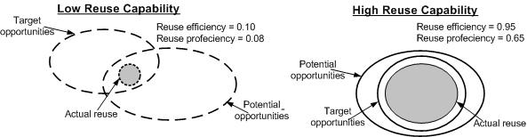
9.3 Reuse Capability
The linkage between the two concepts: efficiency, proficiency and reuse capability has been illustrated in Figure 9.2.
Assume that the areas of the ovals denote the counts of the assets corresponding to those opportunities.
In terms of the elements of the figure, reuse efficiency is calculated by dividing the area of the actual reuse oval by the area of the target oval.
Reuse proficiency is calculated by dividing the area of the actual reuse oval by the area of the oval representing potential reuse.
Figure 9.2 Re-use capability
Notes:
Handouts

Slide 23
9.5 Economic Models of Software Reuse
Project managers and financial managers can use the general economics model of software reuse in their planning for investments in software reuse.
The project manager needs to estimate the costs and potential payoffs to justify systematic reuse.
Increased productivity is an example of payoff of reuse.
We will discuss cost model of Gaffney and Durek, application system cost model of Gaffney and Cruickshank, and business model of Poulin and Caruso.
Notes:
Handouts

Slide 24
9.5.1 Cost Model of Gaffney and Durek
Two cost and productivity models proposed by Gaffney and Durek for software reuse are:
  first order reuse cost model.
  higher order cost model.
The cost of reusing software components has been modeled in the first order reuse cost model.
Whereas the higher order cost model considers the cost of developing reusable assets.
Notes:
Handouts

Slide 25
9.5.1 Cost Model of Gaffney and Durek
First Order Reuse Cost Model
In this model, we assume the following conditions:
  The reused software satisfies the black-box requirements in the sense that it is stable and reliable.
  Users of the reusable components have adequate expertise in the context of reuse.
  There is adequate documentation of the components to be reused.
  The cost of reusing the components is negligible.
Three broad categories of program code are used in a project:
  S_{n}: It represents the new code added to the system.
  S_{o}: It represents the original source code from the pre-existing system. S_{o} includes both lifted code and modified code. Lifted code means unchanged, original code taken from past releases of a product. The source code from modified (partial) parts are not considered as reused code.
  S_{r}: It represents the reuse source code that are not developed or maintained by the organization. The reuse code is obtained from completely unmodified components normally located in a reuse library.
Notes:
Handouts

Slide 26
9.5.1 Cost Model of Gaffney and Durek
First Order Reuse Cost Model
The effective size, denoted by S_{e}, is an adjusted combination of the modified source code and the new source code, as given in the following equation:
  S_{e} = S_{n} + S_{o}(A_{d} × F_{d} + A_{i} × F_{i} + A_{t} × F_{t})
  where:
  A_{d} = is a normalized measure of design activity,
  A_{i} = is a normalized measure of integration activity,
  A_{t} = is a normalized measure of testing activity, and
  A_{d} + A_{i} + A_{t} = 1.
Letting S_{r} denote the estimated size of reusable components, the relative sizes of reusable components is given by R, where R is expressed as follows:
    R = S_{r} / (S_{e} + S_{r})
Notes:
Handouts

Slide 27
9.5.1 Cost Model of Gaffney and Durek
First Order Reuse Cost Model
Let C be the cost of software development for a given product relative to that for all new code (for which C = 1).
Let R be the proportion of reused code in the product as defined earlier (R ≤ 1).
Let b be the cost, relative to that for all new code, of incorporating the reused code into the new product. Note that b = 1 for all new code.
The relative cost for software development is:
  [(relative cost of all new code) * (proportion of new code)]
  +
  [(relative cost of reused software) * (proportion of reused software)].
Therefore: C = (1)(1 − R) + (b) (R)
= (b − 1)R + 1
and the associated relative productivity is:
P = 1 / C = 1 / (b − 1)R + 1
  b must be < 1 for reuse to be cost effective.
Notes:
Handouts

Slide 28
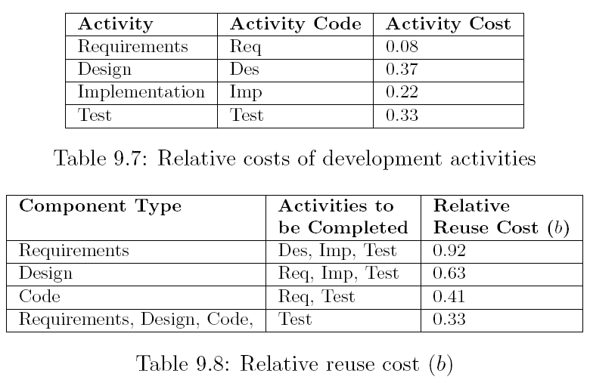
9.5.1 Cost Model of Gaffney and Durek
First Order Reuse Cost Model: Example
If we want to reuse a requirements component, the relative cost to reuse requirements is b = (0.37 + 0.22 + 0.33) = 0.92.
If code is reused, then the additional tasks will involve requirements and testing, the relative cost to reuse code is b = (0.08 + 0.33) = 0.41.
Notes:
Handouts

Slide 29
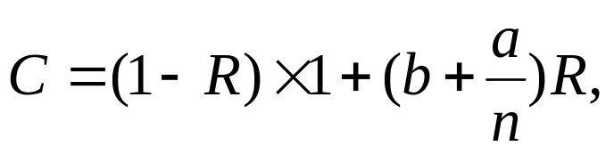
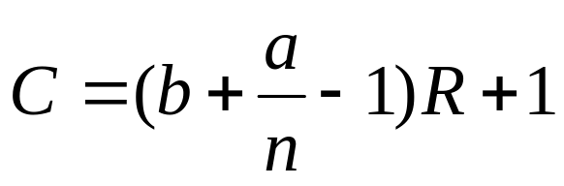
9.5.1 Cost Model of Gaffney and Durek
Higher Order Reuse Cost Model
Estimating the cost of developing reusable components is key to formulating a reuse cost model.
By combining the development cost of the reusable components into the economic model, we have:
where a is the cost of developing reusable components relative to the cost of building new non-reusable components from the scratch, and n is the number of uses over which the cost of reusable components is amortized.
Now, the model can be rewritten as:
Notes:
Handouts

Slide 30
9.5.3 Business Model of Poulin and Caruso
Poulin and Caruso developed a model at IBM to improve measurement and reporting software reuse. Their results are based on a set of data points as follows:
Shipped source instruction (SSI): SSI is the total count of executable code lines in the source files of a product.
Changed source instruction (CSI): CSI is the total count of executable code lines that are new, added, or modified in a new release of a product.
Reused source instruction (RSI): RSI is the total source instructions shipped but not developed or maintained by the reporting organization.
Source instruction reused by others (SIRBO): SIRBO is the total lines of source instructions of an organization reused by others. It is calculated as follows:
  SIRBO = (Source instructions per part) × (The number of organizations using the part)
Notes:
Handouts

Slide 31
9.5.3 Business Model of Poulin and Caruso
Software development cost (Cost per LOC): This metric concerns the development of new software, and it is calculated in two steps:
  Let S denote the total cost of the organization, including overhead; and divide S by the total outputs of the organization in number of lines of code (LOC).
Software development error rate (Error rate): It is a historical average number of errors uncovered in the products. To estimate the cost of avoiding maintenance, a historical average value is used.
Cost per error: To quantify the advantage of better quality reusable assets, the historical mean cost of maintaining components with traditional development methods is used as a base line. Now, the cost per error metric is calculated in two steps:
  let S denote the sum of all costs; and divide S by the number of errors repaired.
Notes:
Handouts

Slide 32
9.5.3 Business Model of Poulin and Caruso
The discussed metrics are combined to form three derived metrics:
  reuse percent.
  reuse cost avoidance.
  reuse value added.
Notes:
Handouts

Slide 33
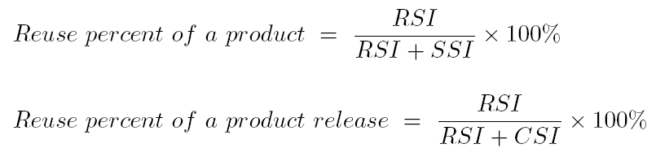
9.5.3 Business Model of Poulin and Caruso
Reuse Percent
Notes:
Handouts

Slide 34
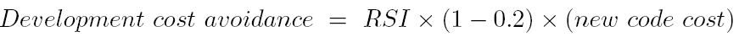

9.5.3 Business Model of Poulin and Caruso
Reuse Cost Avoidance
The purpose of this metric is to measure reduced total product costs as a result of reuse.
One must retrieve and evaluate the reusable assets to choose the appropriate ones to be integrated into the system being developed.
For example, the cost of integrating a reusable software element is 20% of the cost of developing the same element anew.
The financial benefit due to adopting reuse in the development phase of a project is calculated as follows:
In addition, saving in maintenance cost attributed to reuse is much more than those during software development, because of the fewer defects in reused components. The saving is:
Notes:
Handouts

Slide 35
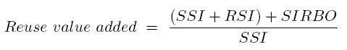
9.5.3 Business Model of Poulin and Caruso
Reuse Value Added
The main idea behind RVA is to provide a metric to reward an organization that reuses software components and helps other organizations by developing reusable components.
Reuse value added is derived from SSI, RSI, and SIRBO:
Organizations with no involvement in reuse have an RVA = 1.
An RVA = 2 indicates the organization is twice as effective as it would be without reuse.
Notes:
Handouts

Slide 36
Summary
General Idea
Domain Engineering
Reuse Capability
Maturity Models
Economic Models of Software Reuse
Notes:
Handouts

