Slide 1
SIMPLEX ALGORITHM FOR SOLVING LP PROBLEMS
By 19SW42

Slide 2
INtroduction
The Simplex Method/Algorithm, developed by George Dantzig in 1947, is used to solve LP problems.
With only two decision variables we can use graphical method to solve LP problems but most real life LP problems are too complex to solve using graphical methods in that case we need ‘SIMPLEX METHOD’ to solve them.
The simplex method examines the corner points using basic algebraic concepts.
It does this in an iterative manner until an optimal solution is found.

Slide 3
BASIC terms
Slack Variable: A variable added to convert an inequality of ‘less than or equal to’ type(≤) to equality.
Surplus Variable: A variable subtracted to convert an inequality of ‘greater than or equal to’ type(≥) to equality.

Slide 4
Particulars | Slack Variable | Surplus Variable
Meaning | Unused resources or Unutilized resources | Excess amount of resources utilized
When to be used | (≤) inequality | (≥) inequality
Co-efficient in the constraint | +1 | -1
Co-efficient in the Objective function Z | 0 | 0

Slide 5
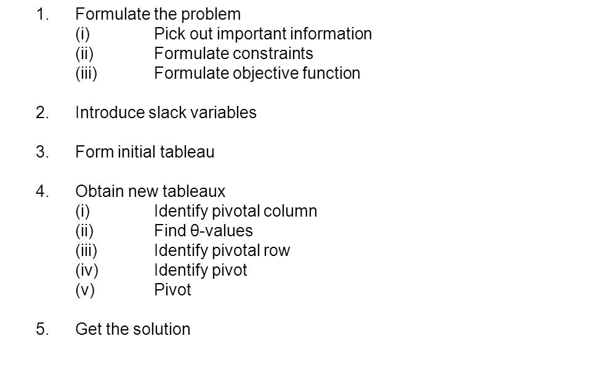
Steps

Slide 6
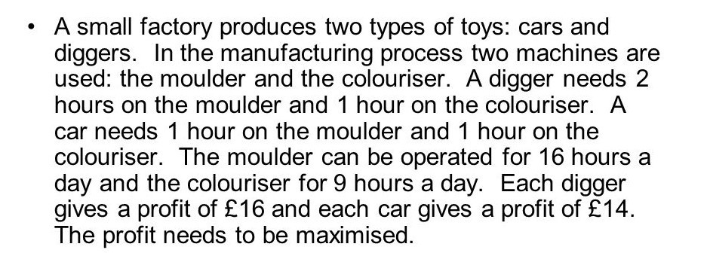
Example Problem

Slide 7
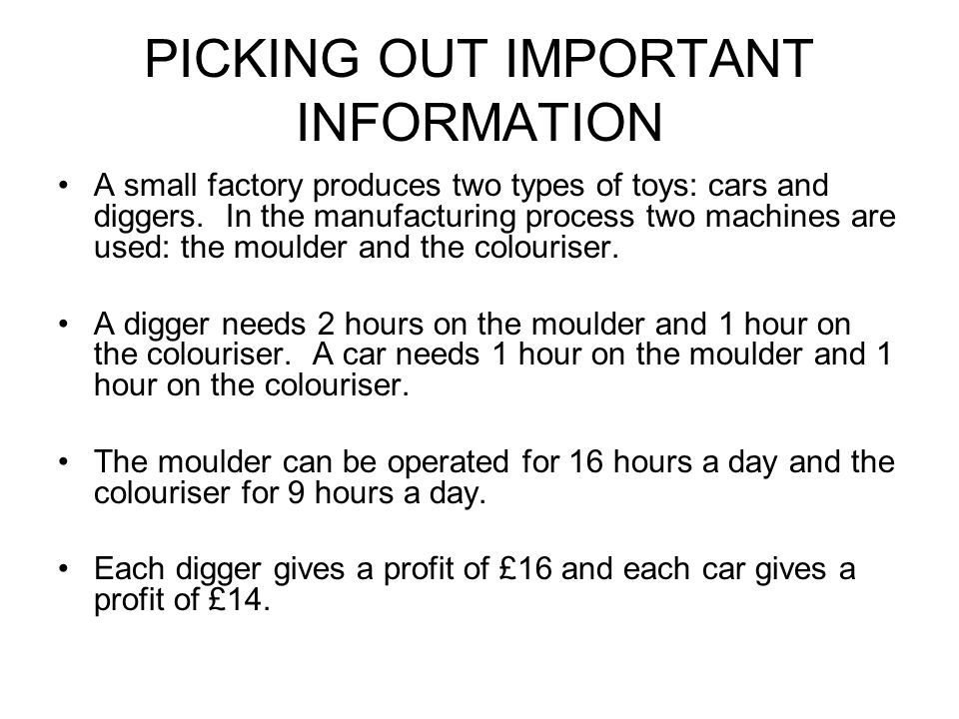
Step-1 (FORMULATING PROBLEM)

Slide 8
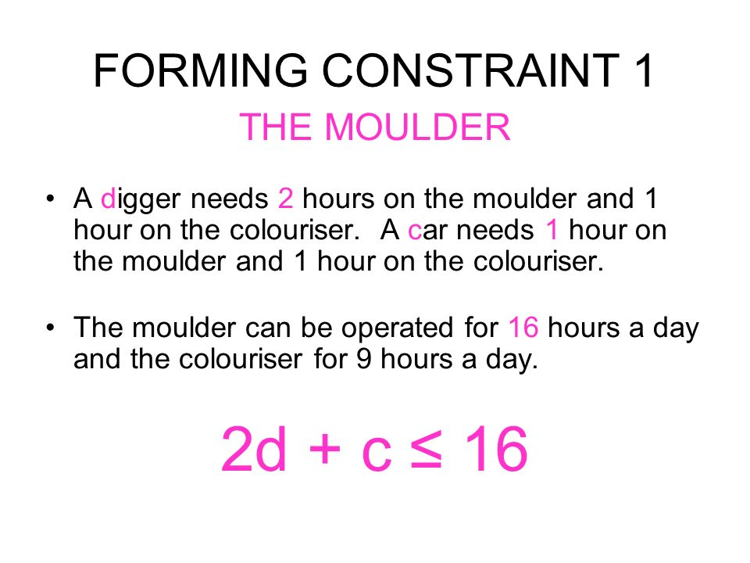
Step-1 Continued…

Slide 9
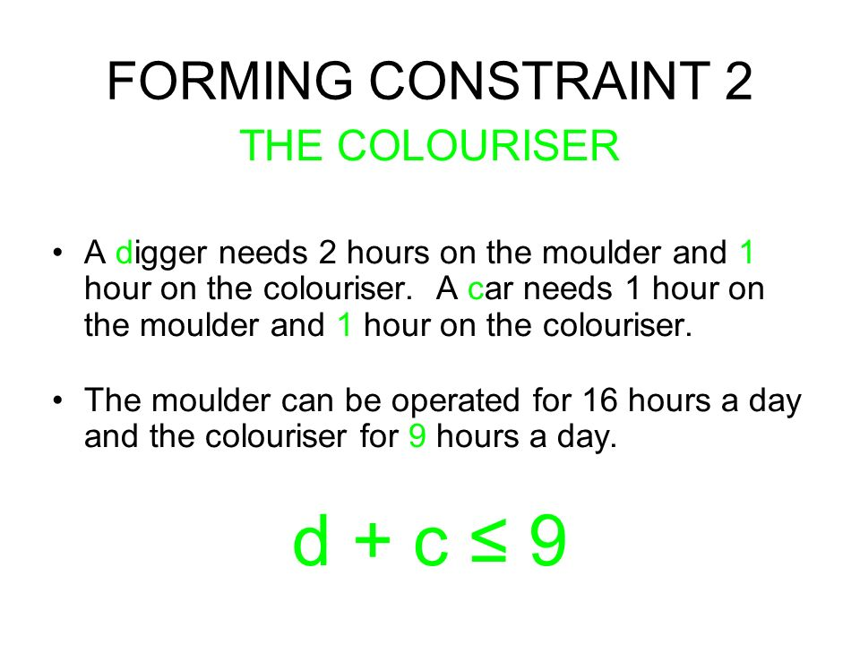
Step-1 Continued…

Slide 10
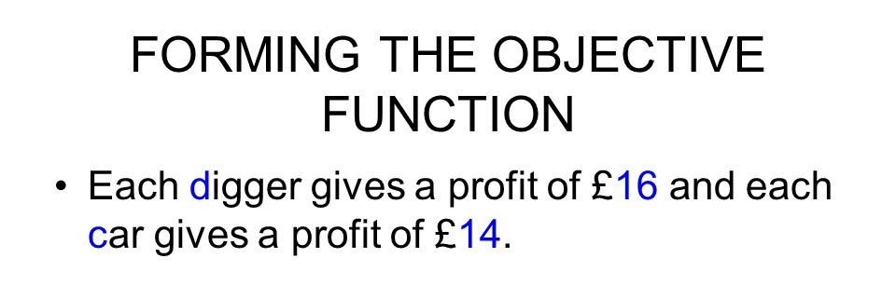
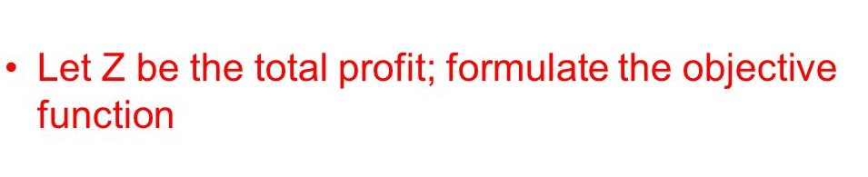

Step-1 Continued…

Slide 11
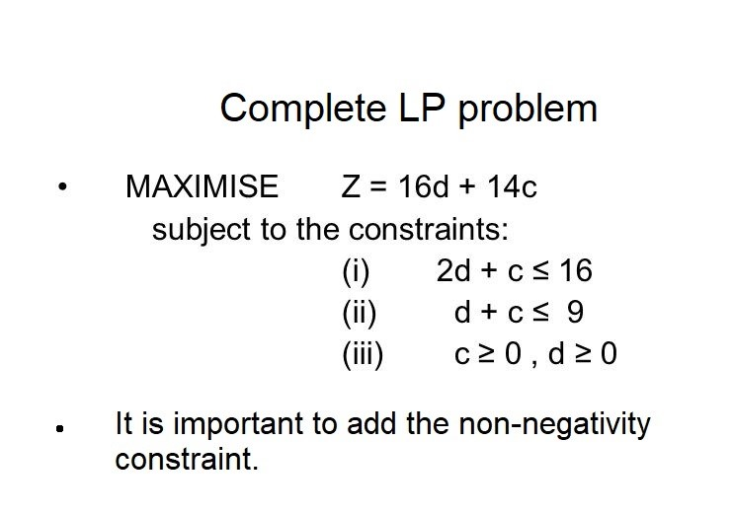
Step-1 Continued…

Slide 12
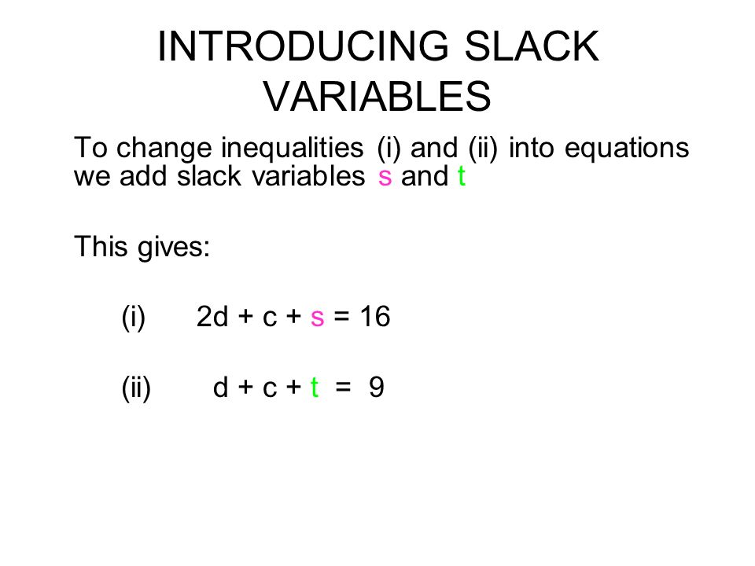
Step-2

Slide 13
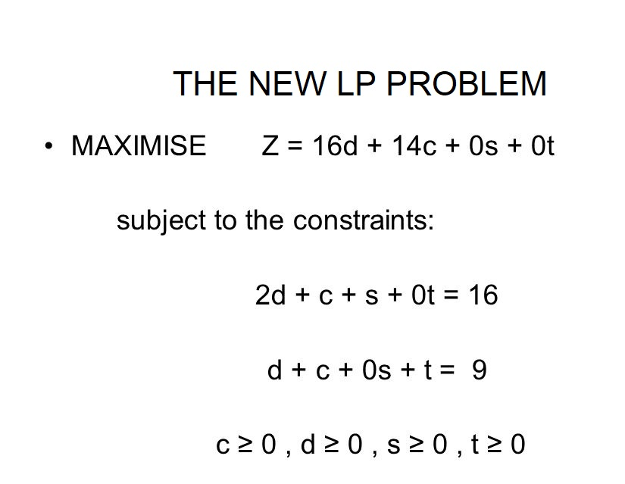
Step-2 Continued…

Slide 14
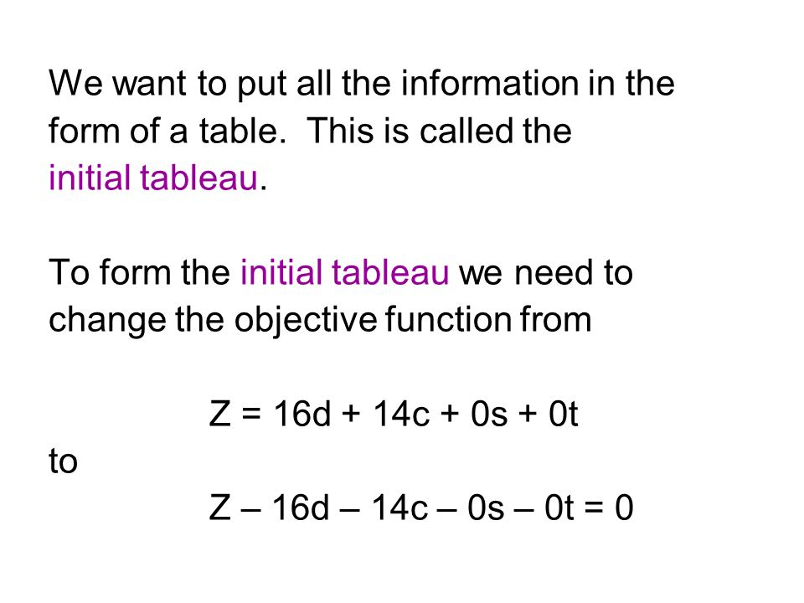
Step-3 (FORM INITIAL TABLEAU)

Slide 15
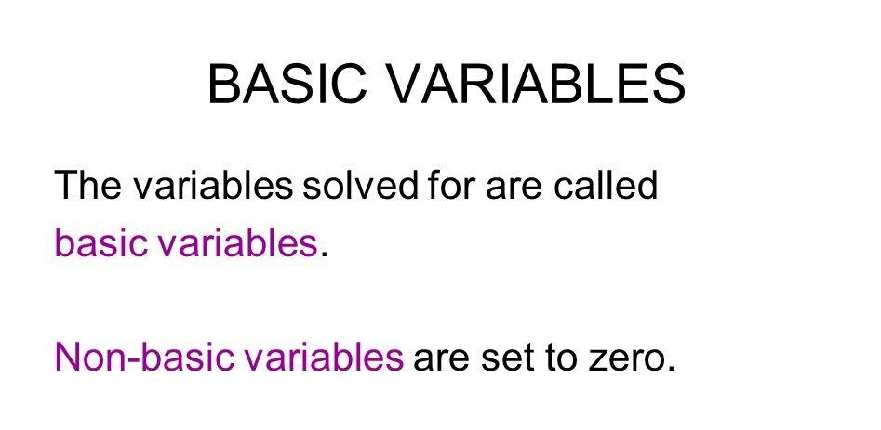
Step-3 Continued…

Slide 16
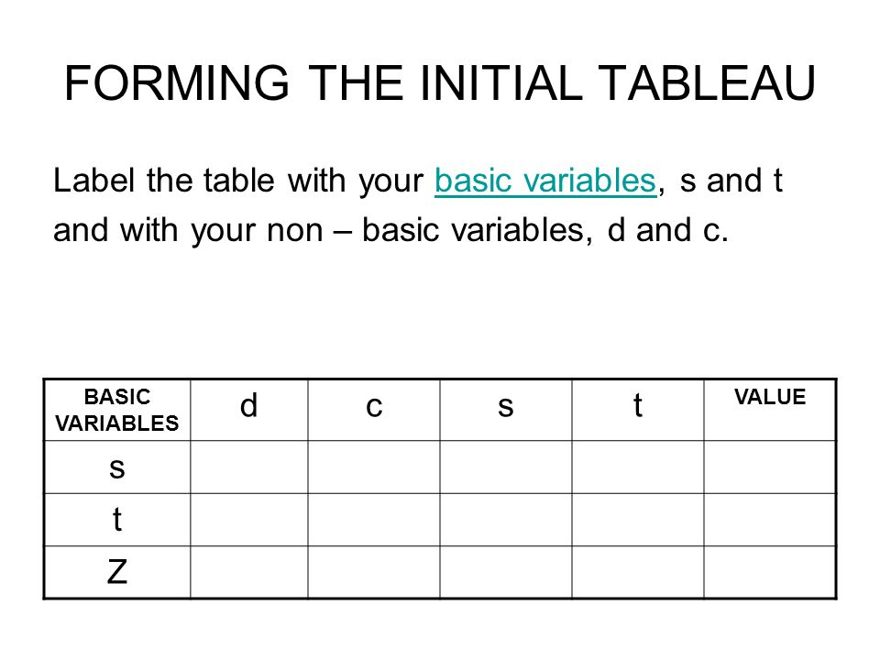
Step-3 Continued…

Slide 17
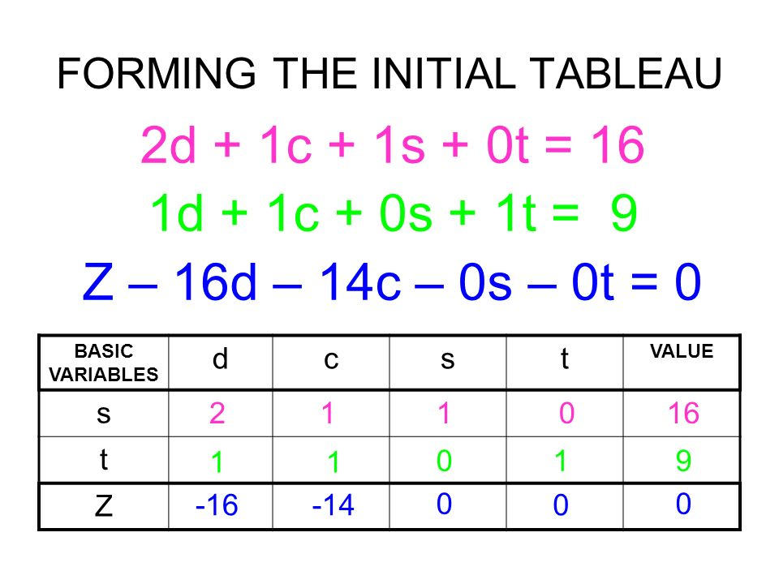
Step-3 Continued…

Slide 18
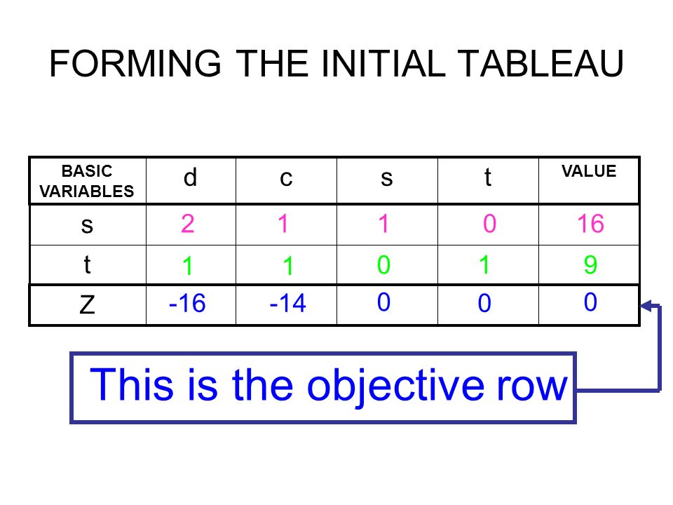
Step-3 Continued…

Slide 19
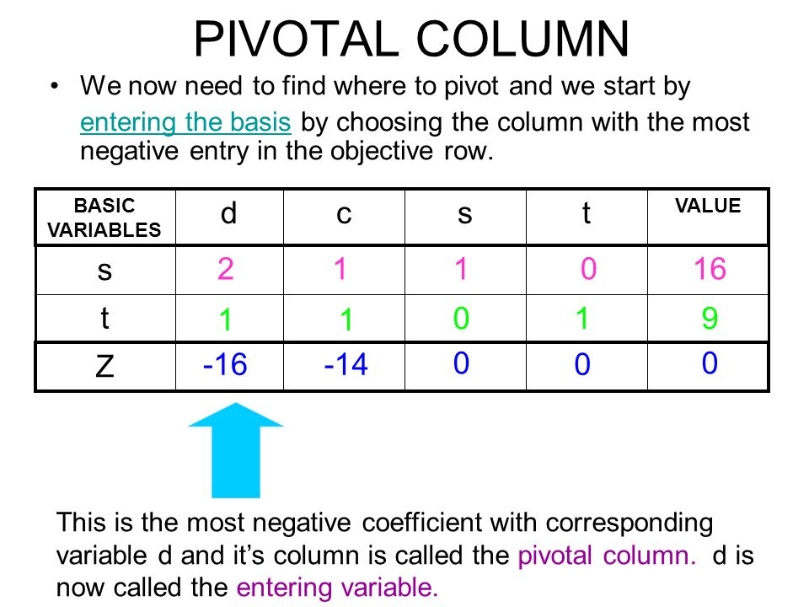
Step-4 (Obtain new tableaux)

Slide 20
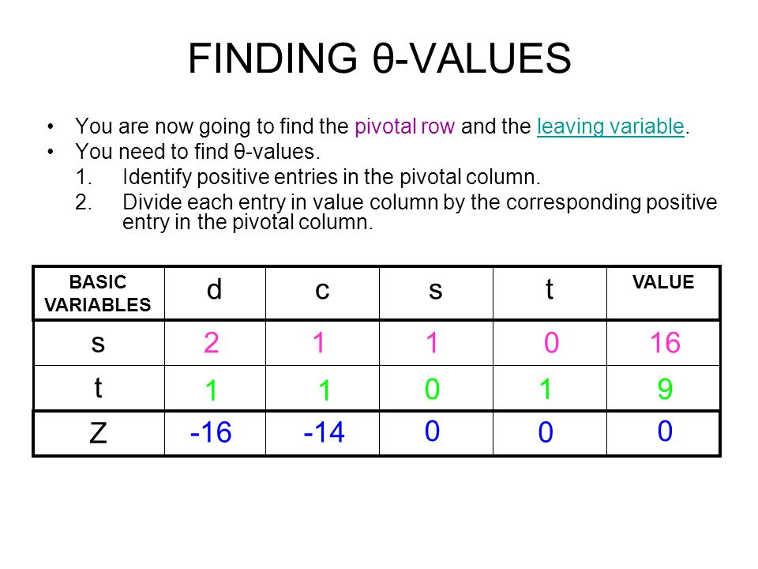
Step-4 Continued…

Slide 21
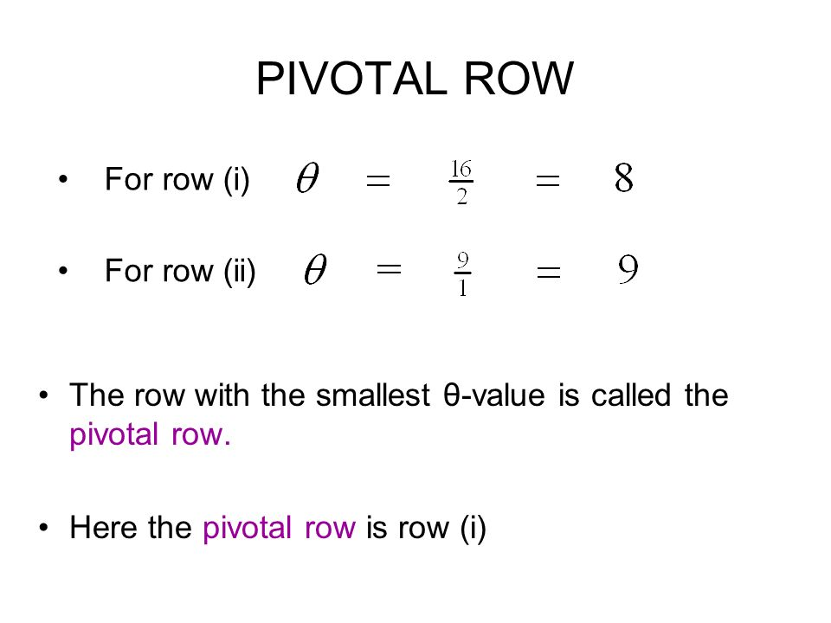
Step-4 Continued…

Slide 22
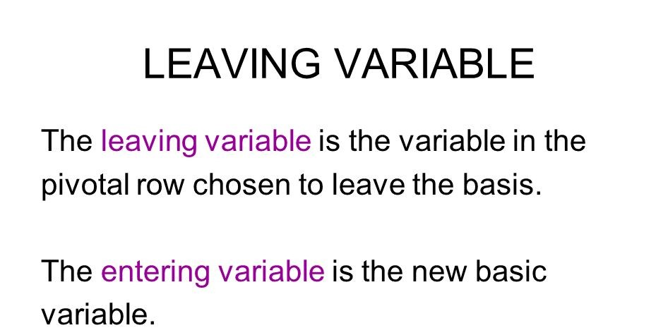
Step-4 Continued…

Slide 23
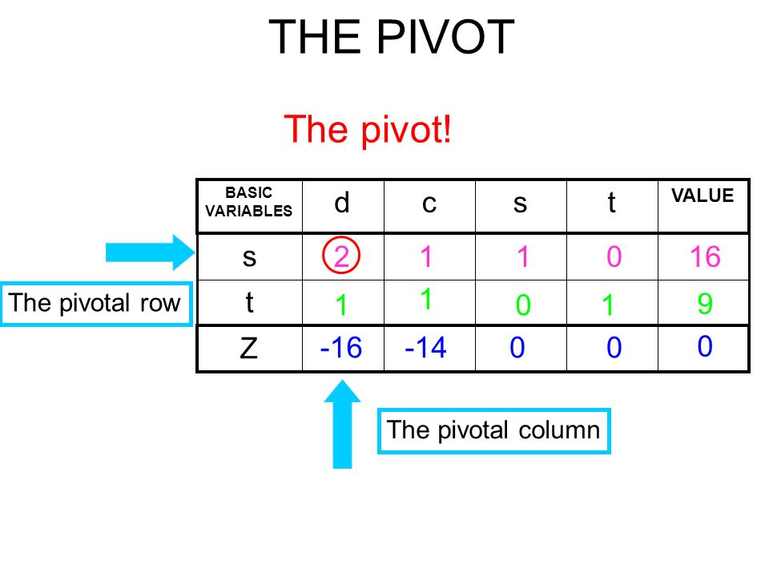
Step-4 Continued…

Slide 24
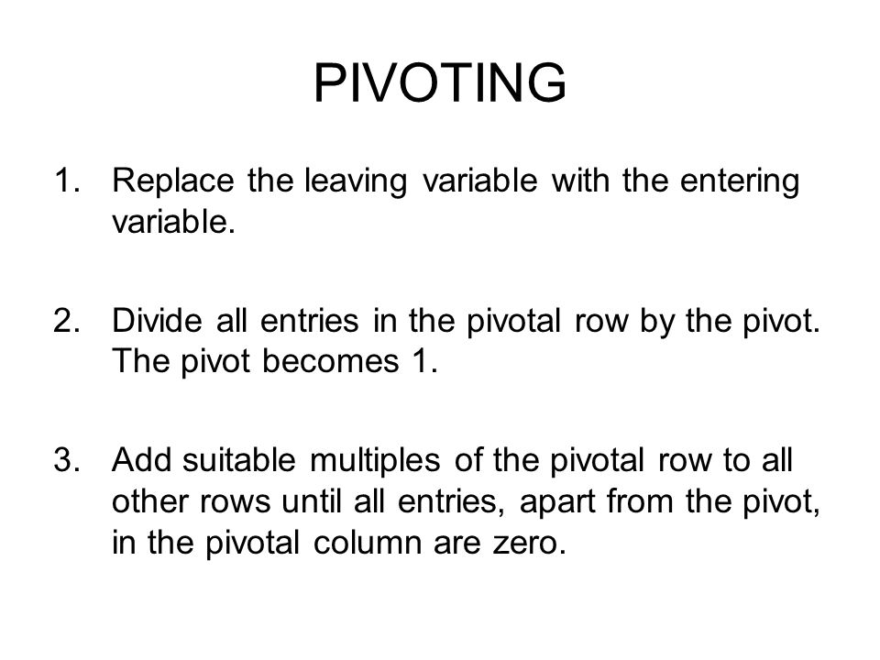
Step-4 Continued…

Slide 25
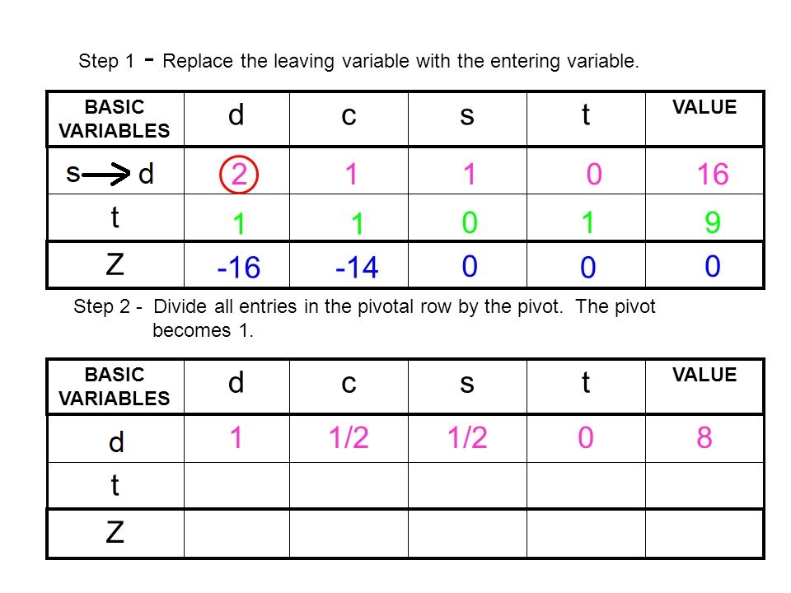
Step-4 Continued…

Slide 26
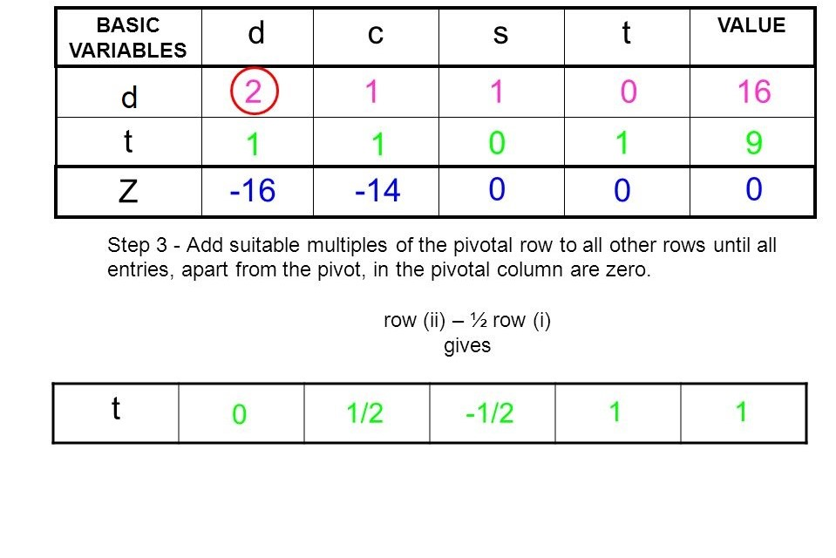
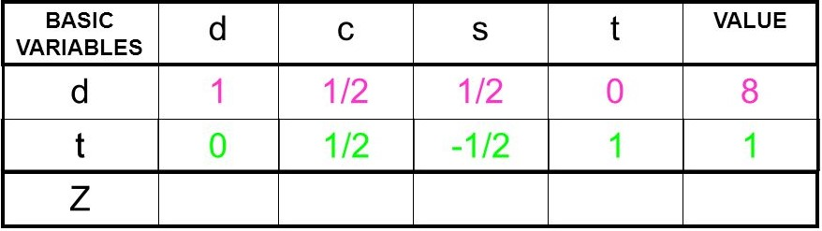
Step-4 Continued…

Slide 27
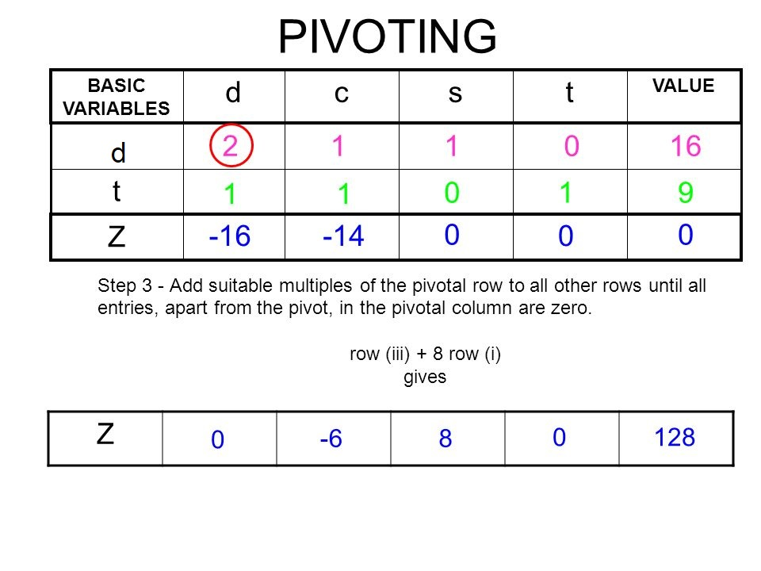
Step-4 Continued…

Slide 28
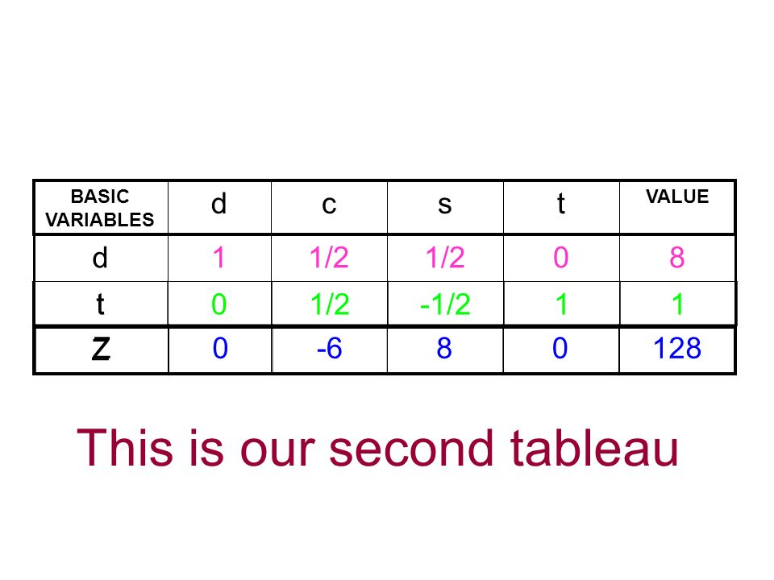
Step-4 Continued…

Slide 29
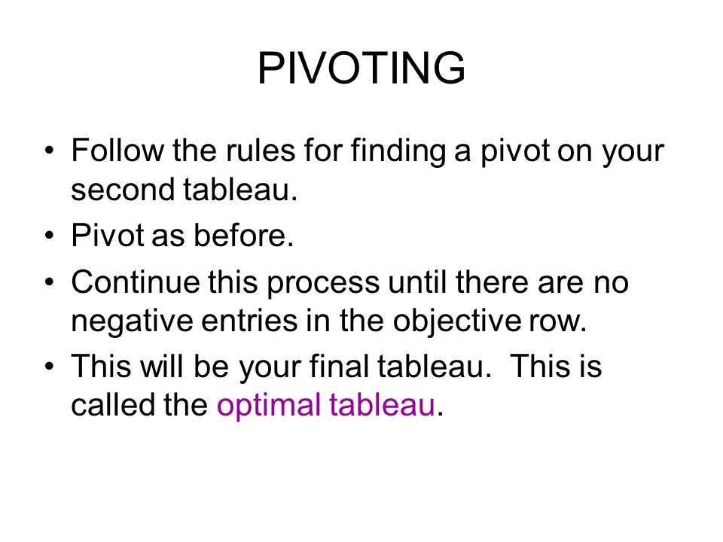
Step-4 Continued…

Slide 30
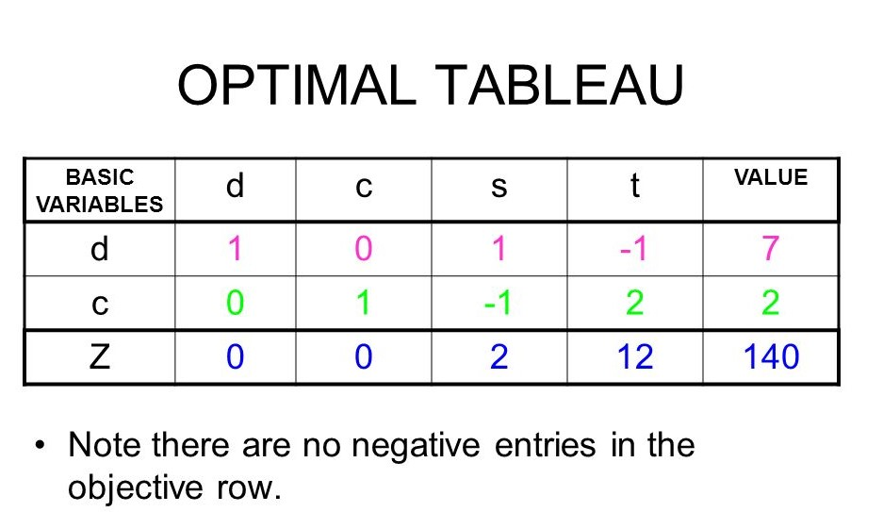
Step-4 Continued…

Slide 31
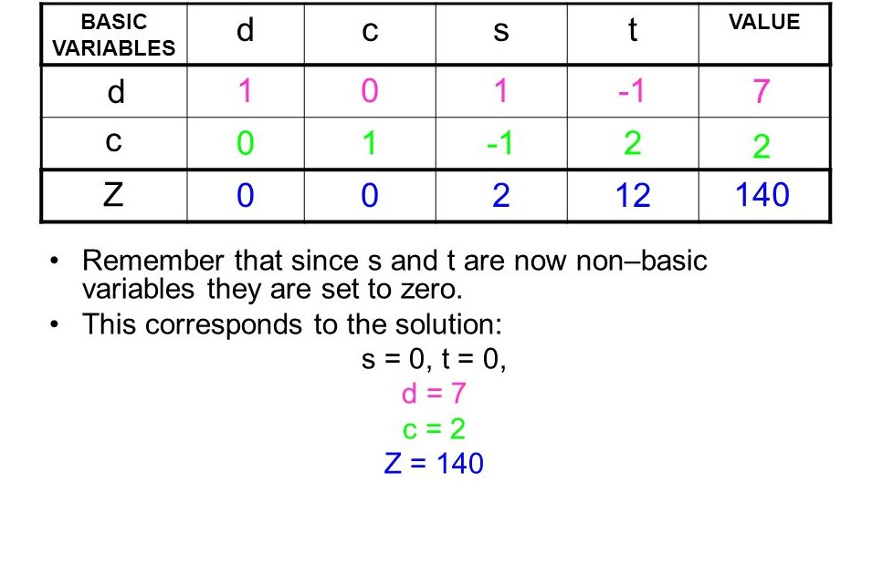
Step-5 (Get the solution)

Slide 32
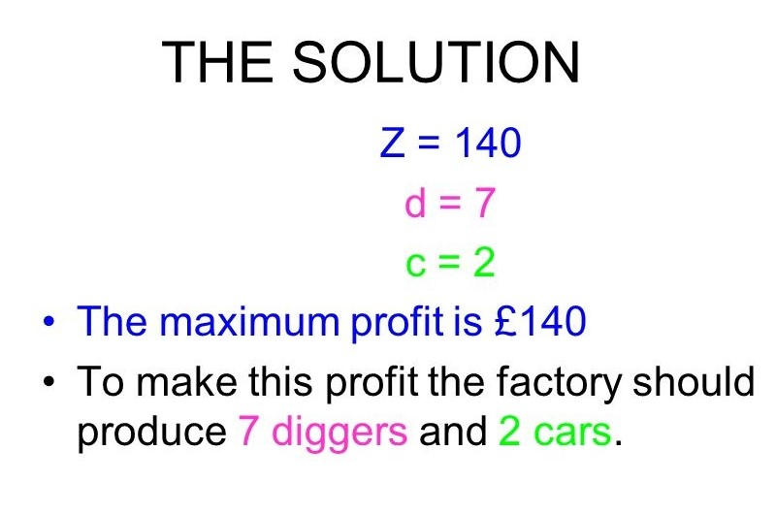
Step-5 Continued…

Slide 33
(:☺ THANKS☺:)

