Slide 1
Marketing of Zoom
By 19SW42

Slide 2

Introduction To Zoom
Zoom is a video conferencing service that you can use to virtually meet with others; either by video or audio only or both, all while conducting live chats.
It provides you ability to record those sessions to view later.

Slide 3
Features
One-on-one meetings: Host unlimited one-on-one meetings even with free plan.
Group-video conferences: Host up to 500 participants(if you purchase the “Large meeting add-on” ). However the free plan, allows you to host video conferences of up to 40 minutes and up to 100 participants.
Screen Sharing: Meet one-on-one or with large groups and share your screen with them so they see what you see.
Recording: You can record your meetings or events too.
If you don’t have access to download apps then you can run Zoom in a browser too.

Slide 4
Availability
The desktop app is available for windows and macOS, while the mobile app is available for android and iOS.

Slide 5
Why our product?
It assures security of users by providing many security features.
One can set password for a meeting so that only allowed participants can join meeting.
One can lock the meeting after it has started so that no new members will be able to join it.
It also provides other security tools like removing a participant, muting participants, reporting participants(who are causing trouble), disabling chat etc.
Zoom allows you to adjust the audio and remove unnecessary & unwanted background noise.
Zoom offers you virtual backgrounds like space, ocean-side views etc. If you want to customize then you can also do that.
You can also add filters to zoom calls, which can be either simple color shades(sepia, black, white etc) or snapchat filters.

Slide 6
Why our product? (continued…)
Zoom offers you with 49-person gallery view.
You can use various shortcut keys to access features/change settings easily.
Alt+A ->mute/unmute audio, Alt+M ->mute/unmute audio for everyone except host, Alt+S -> start screen sharing, Alt+R -> start/stop recording, Alt+p -> pause/resume recording and many more.
It has a feature of remote access control that is you can control screen of host just by sending him a request of access control.

Slide 7
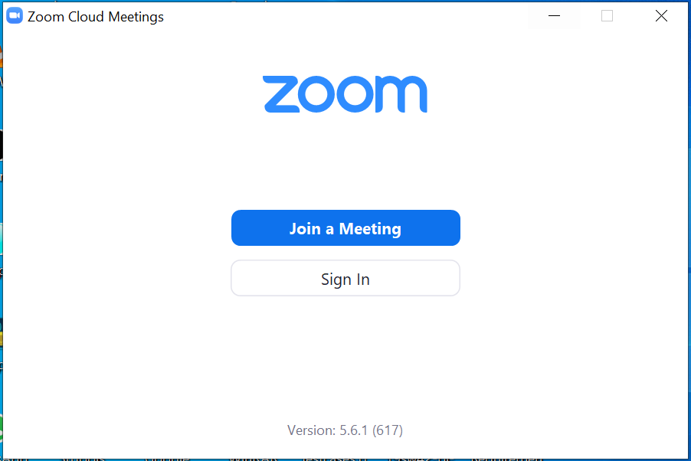
Why our product? (continued…)
Zoom interface

Slide 8
Why our product? (continued…)
Zoom is easy to use than other softwares.
Moreover you can join a meeting without providing any login credentials. To do so you just need to provide the link/meeting ID of the meeting that you are going to join and the Name that will be displayed on .
However if you want to create your own meeting then you have multiple choices to login with(i.e Zoom account, Facebook account or Google account).

Slide 9
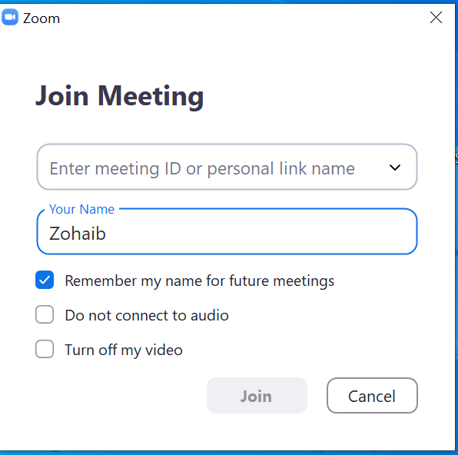
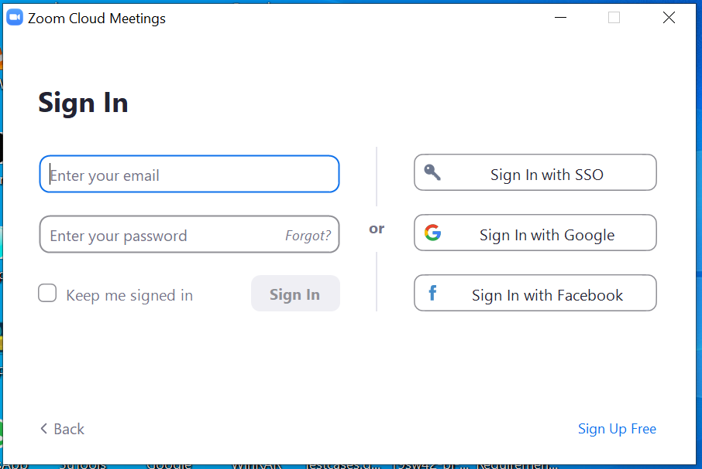
Why our product? (continued…)
Join meeting without login
Sign-in to create meetings

Slide 10
(:☺ THANKS☺:)

