Slide 1
Facilitated application specific technique (FAST)
Using question and answer meeting to identify and refine requirements ,there may be misunderstandings, omissions of information and a successful working relationship is never established.
Therefore a team-oriented approach is used to requirements gatherings that is applied during early stages of analysis and specification.

Slide 2
Facilitated application specific technique
FAST is a technique used to accomplish a team-oriented approach.
Using such approach the communication between them can be improved very much which has the direct affect on the whole sole software.
A meeting is conducted at a neutral site and attended by both software engineers and customers
Proper discussion rather then Q&A.
Bridge the expectation gap
Notes:
they must have the proper discussions in spite of this Q& A session and they should think it as their own work.
It’s objective is to bridge the expectation gap – difference between what the developers think they are supposed to build and what customers think they are going to get.

Slide 3

FAST
Notes:
The best place to meet with your client is at their office or work location. There is so much you can learn just by being in their workspace with their colleagues that it’s usually worth it to go to your client for a meeting. why meeting in your client’s office is useful, and how you can leverage being in their workspace.
The exception, however, makes the rule. A neutral location can have advantages. Here are seven:
It’s often less formal. A meeting at a restaurant or a café or an industry conference is usually a more informal environment than an office. It’s a more personal experience that can be more conducive to starting a relationship.
Your client will be less distracted. The office has lots of reminders of things they need to get done, not to mention the possibility of interruptions by co-workers for tasks unrelated to your meeting.
It’s geographically desirable. It can save you time to meet at a place that works for them and is nearer to a place you have to be anyway.
It might imply a higher level of commitment. Rather than just being in their office when you come by, your client is making an effort to meet you.
You can pick up the check. Everyone likes to be treated.
It’s easier to leave. If the meeting turns out to be a waste of time, it’s easier to depart when you’re not being hosted by your prospect in their space.
Because your prospective client also knows it’s easier for them to leave as well, it may be easier to get a yes to your request for a meeting, (It’s a lot easier to drink your coffee and go than it is to get a tenacious salesman out of your office.)
Like anything the right decision is contextual. Yes, in general it’s better to meet at your client’s office, but there are reasons that make an offsite preferable. The key is to get face to face with your prospective client. Where you are face to face is secondary.
The ideas from this post come from Never be Closing. We hope you found them useful.

Slide 4
FAST
Why meeting in your client’s office is useful?
The best place to meet with your client is at their office or work location.
There is so much you can learn just by being in their workspace with their colleagues that it’s usually worth it to go to your client for a meeting.
The exception, however, makes the rule. A neutral location can have advantages

Slide 5
Reasons of meeting client at neutral site
?

Slide 6
Reasons of meeting client at neutral site
You control the environment.
when you meet at their office you’re in their territory.
That means you have no control of the environment, such as distractions by employees or their phone ringing. You may also feel a bit intimidated because you’re talking to them because they’re staring at you from behind their desk.
If this is the plan — try to schedule a lunch meeting. In this way you control the environment and the meeting.
Notes:
When it comes to scheduling a meeting there are no shortage of options. You can schedule a phone or Skype call. Book a conference room. Or just plan to meet in an office or local coffee shop.
Let’s say that you recently got connected to a potential high-profile client, business partner, or mentor. They agree to meet with you.

Slide 7
Reasons of meeting client at neutral site
You’re on equal footing.
when you meet others in their office — it feels like they have all the powers.
They make you wait for them to enter.
When you meet with them in their office their chair is higher than yours.
Both of these can make you feel small — and even insignificant.
Notes:
When it comes to scheduling a meeting there are no shortage of options. You can schedule a phone or Skype call. Book a conference room. Or just plan to meet in an office or local coffee shop.
Let’s say that you recently got connected to a potential high-profile client, business partner, or mentor. They agree to meet with you.

Slide 8
Reasons of meeting client at neutral site
There aren’t as many distractions.
Ringing phones, Office chatter, Assistants knocking on the door.
These are all frequent office distractions that prevent meetings from being productive.
Notes:
Bonus tip: Don’t put your phone on the table. Keep it in your pocket or purse. This way you won’t be distracted by texts, emails, or phone calls. It also shows the other party that they have you full attention. Hopefully they’ll rcepticate

Slide 9
Facilitated application specific technique
FAST is an approach that encourages :
– the creation of a joint team of customers and developers,
who works together to identify the problem,
– propose elements to the solution
– negotiate different approaches and
– specify a preliminary set of solution requirements.

Slide 10
Facilitated application specific technique
Each participant prepares his/her list.
Different lists are then combined, redundant entries are eliminated.
Team is divided into smaller sub-teams to develop mini-specifications and finally a draft of specifications is written down using all the inputs from the meeting.

Slide 11
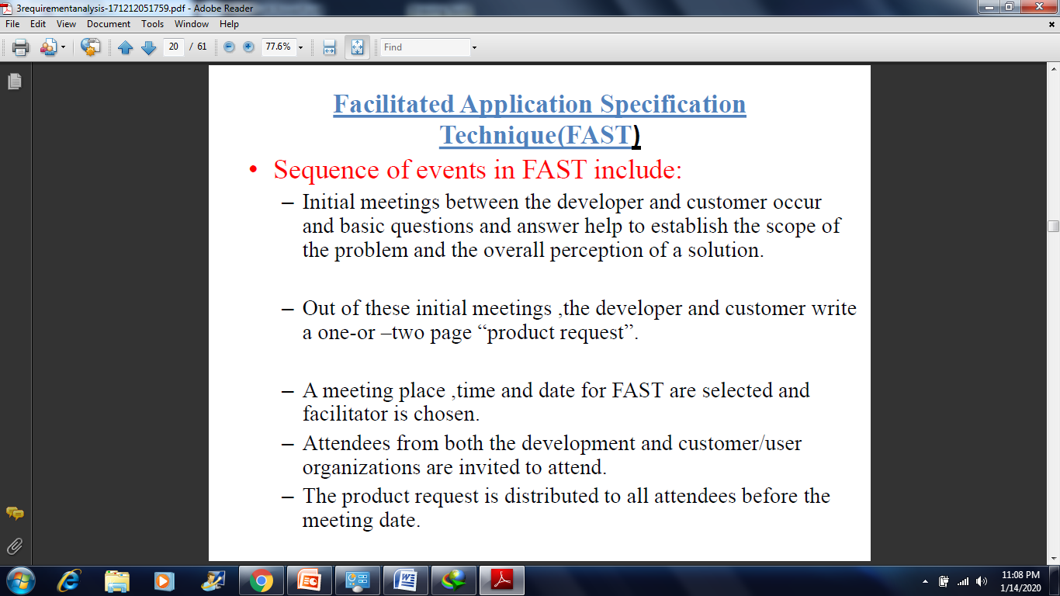
Determine the sequence of events:
Notes:
In it, you will outline specifics about the project, your requirements, even expected deliverable dates.

Slide 12
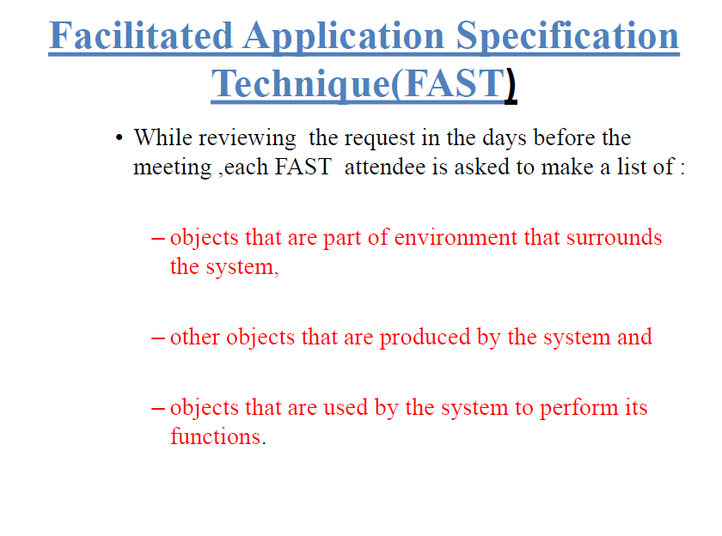

Slide 13
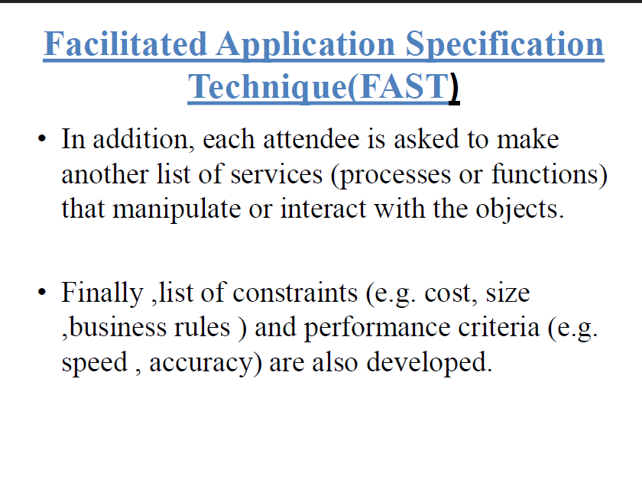

Slide 14
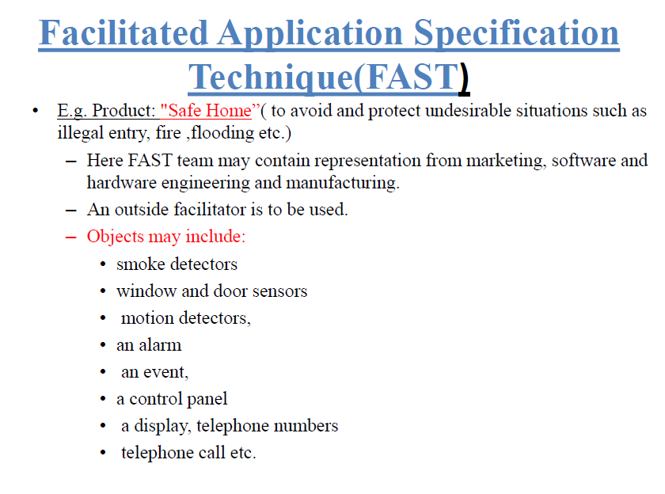

Slide 15
