Slide 1
FAIR USE NOTICE
The material used in this presentation i.e., pictures/graphs/text, etc. is solely intended for educational/teaching purpose, offered free of cost to the students for use under special circumstances of Online Education due to COVID-19 Lockdown situation and may include copyrighted material - the use of which may not have been specifically authorised by Copyright Owners. Its application constitutes Fair Use of any such copyrighted material as provided in globally accepted law of many countries. The contents of presentations are intended only for the attendees of the class being conducted by the presenter.

Slide 2
Data Structure & Algorithms
Practical # 01

Slide 3
Contents
Control Structures
Conditional statements
If
If . . .else
Switch
Nested If
Iteration Statement
For
While
Do . . . while
Jump Statements
Break
Continue

Slide 4
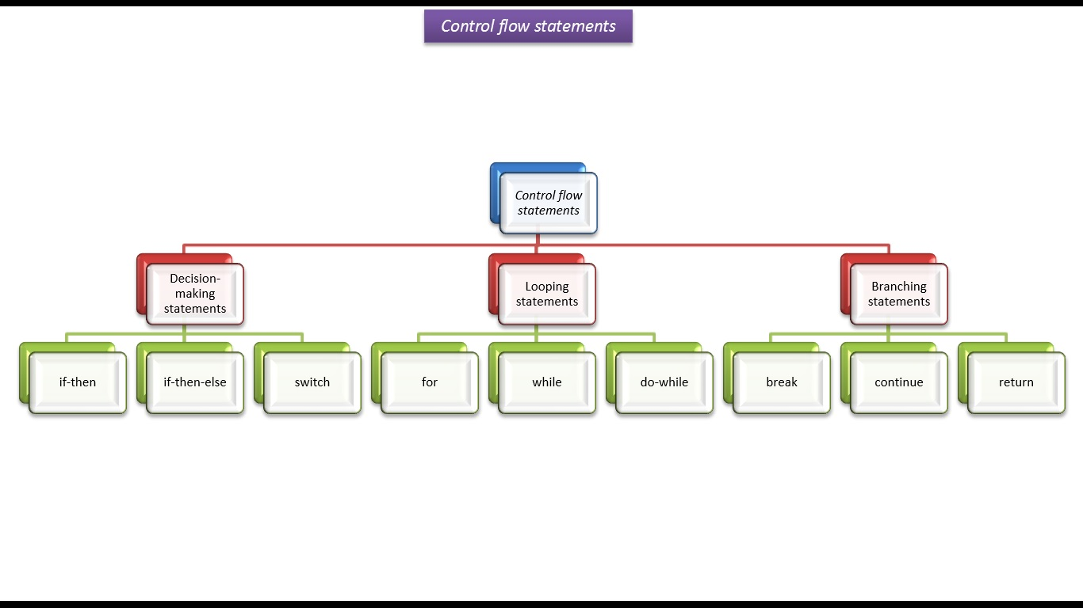
Control Structures
The execution of the program is linear.
Control Structures are used to alter/change the flow of program.

Slide 5
Selection Statements
There are three selection statements supported by java
1. If
2. If . . .else
3. switch

Slide 6
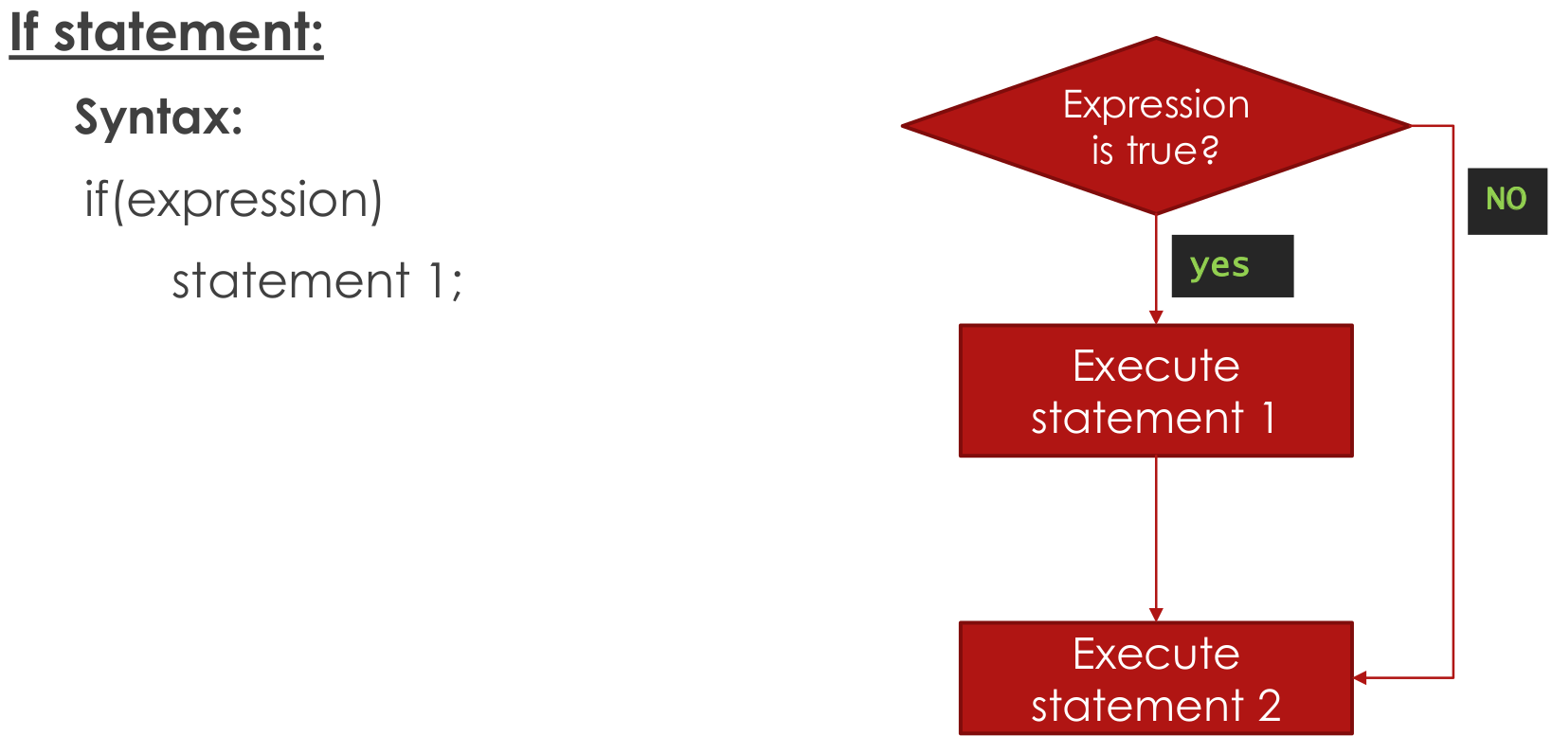
Selection Statements

Slide 7
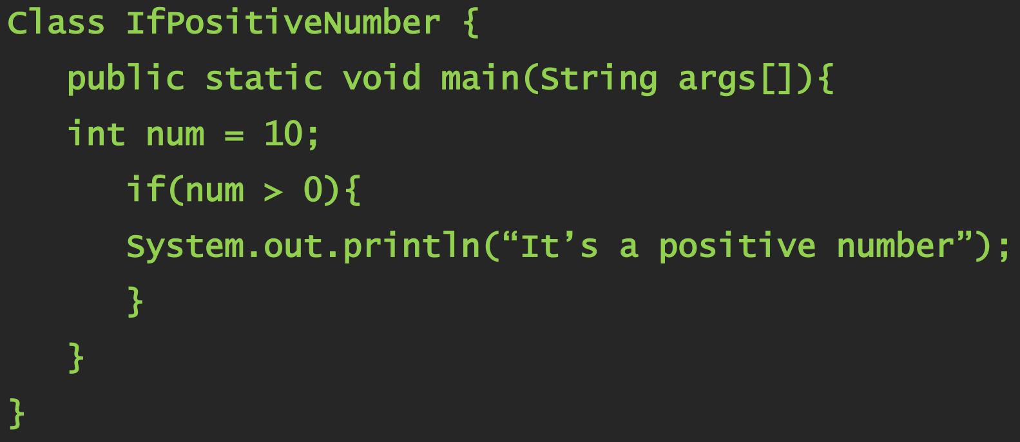
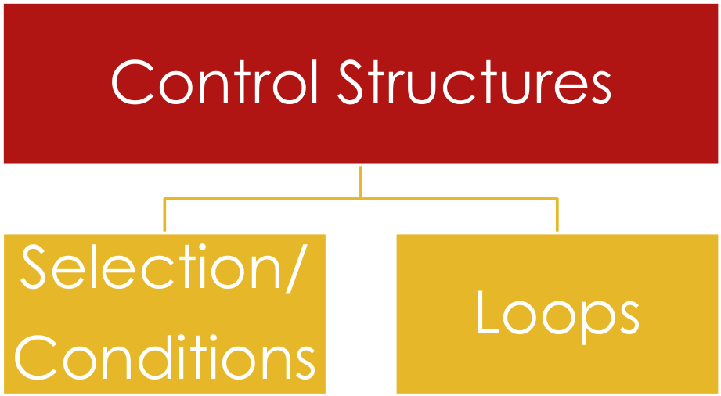
Selection Statements

Slide 8
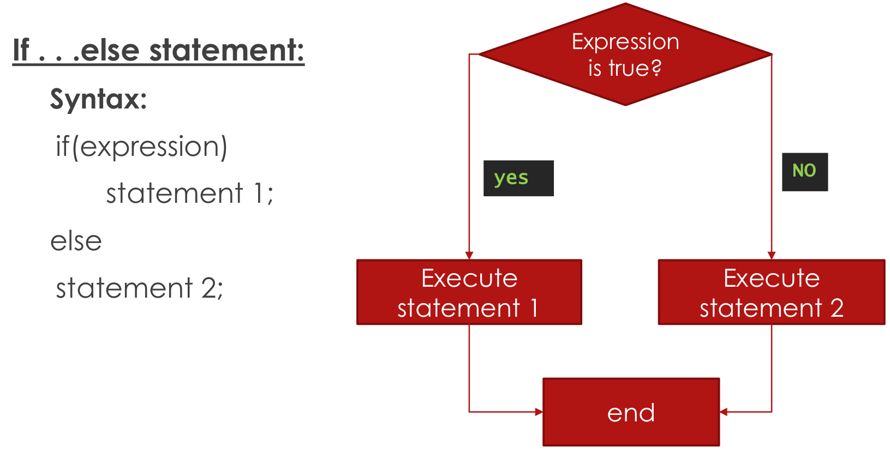
Selection Statements

Slide 9
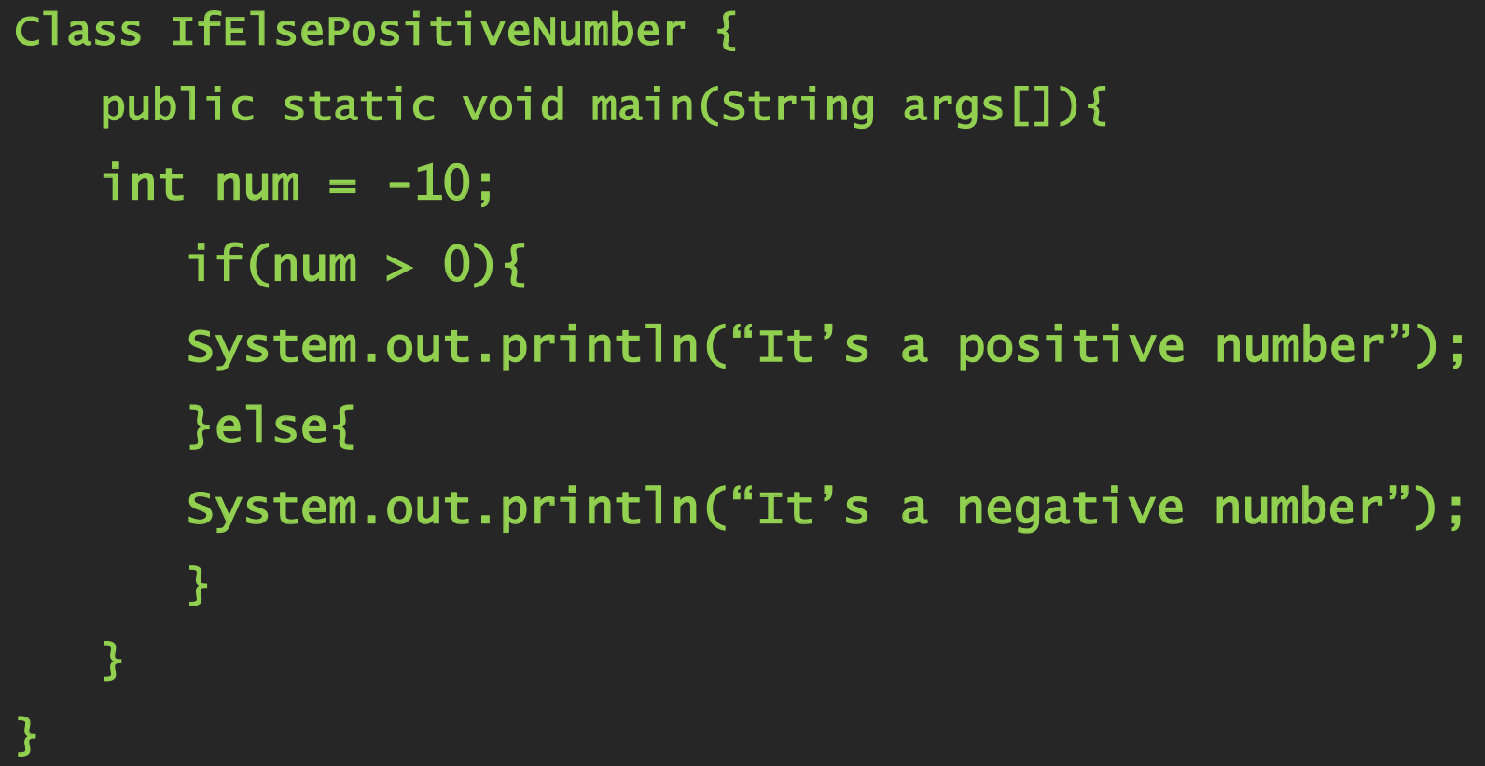
Selection Statements

Slide 10
Selection Statements
Nested if
A nested if is an if statement that is the target of another if or else.
if(condition1)
{
if(condition2)
{
}
if(condition3)
{
}
}

Slide 11
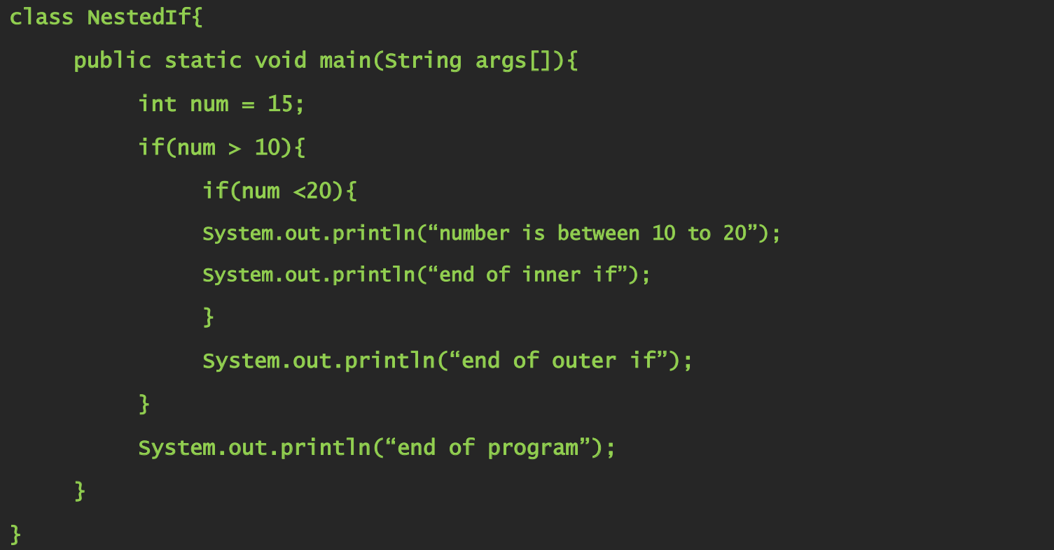
Selection Statements

Slide 12
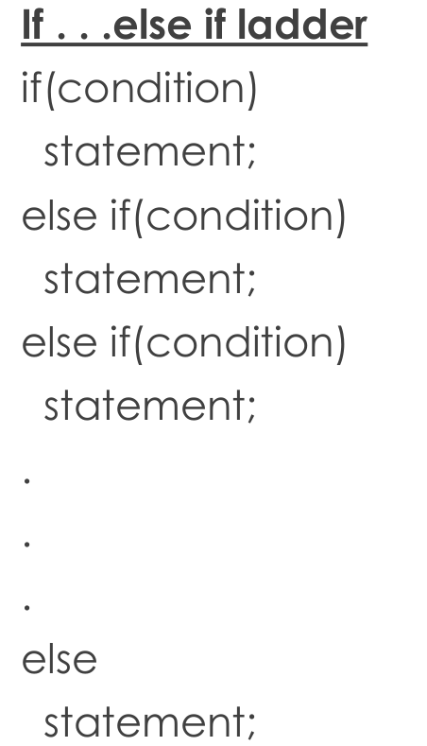
Selection Statements

Slide 13
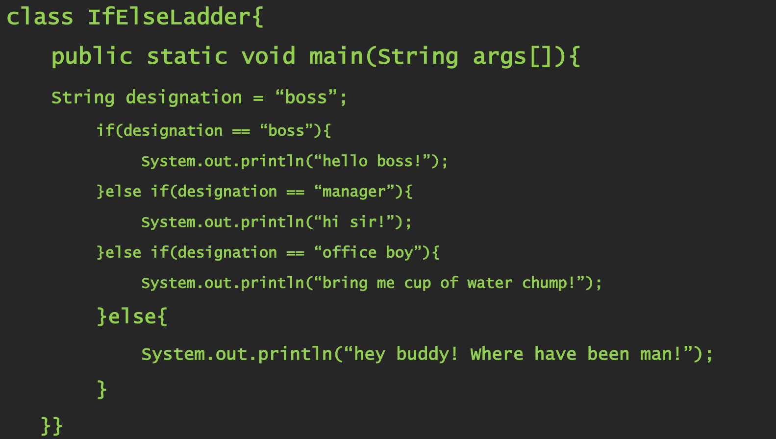
Selection Statements

Slide 14
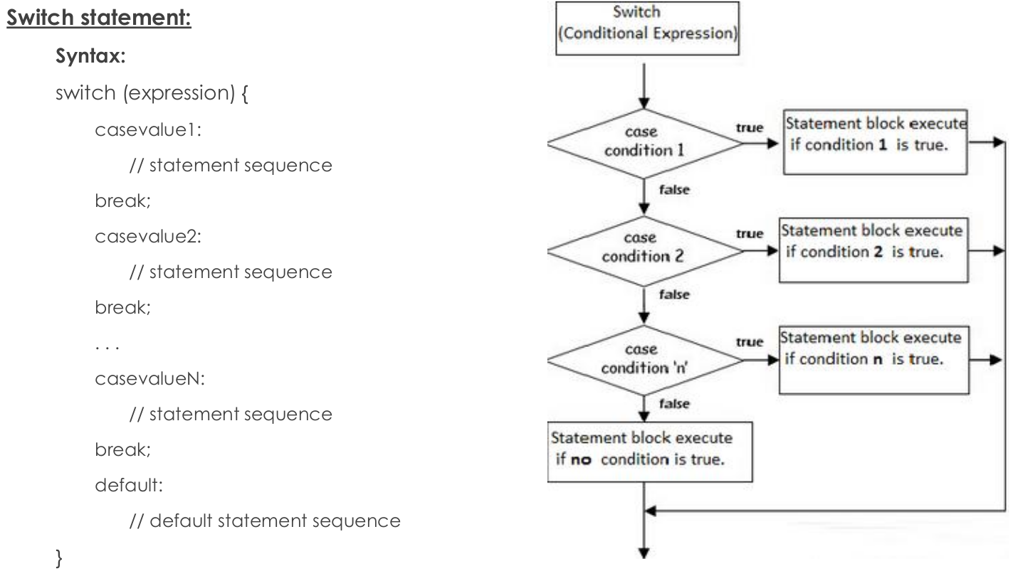
Selection Statements

Slide 15
Selection Statements
Switch
The switch statement is Java’s multiway branch statement.
The expression must be of type byte, short, int, or char.
If none of the constants matches the value of the expression, then the default statement is executed.
The default statement is optional.

Slide 16
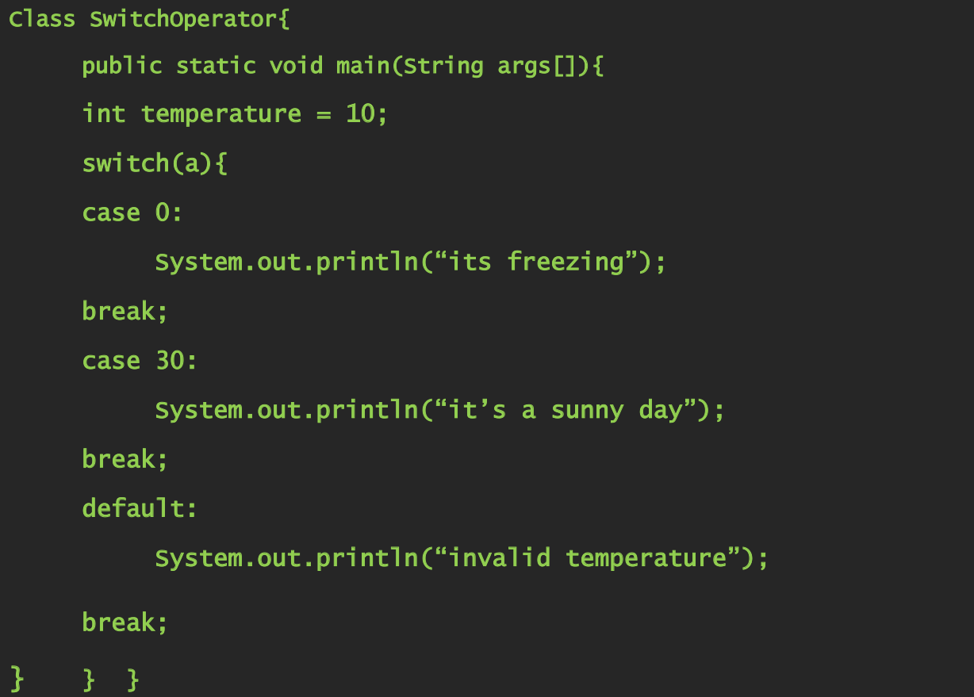
Selection Statements

Slide 17
Class Activity
Write a program that prints the designation of the employee according to their pay scale:
10000 – 20000 Manager Operations
20000 – 30000 Manager
30000 – 40000 Area Manager
40000 – 50000 Regional Manager

Slide 18
Iteration Statements
While
A while statement repeats action again and again as long as a controlling boolean expression is true.
When condition becomes false, control passes to the next line of code immediately following the loop.
Syntax
while(condition) {
// body of loop
}

Slide 19
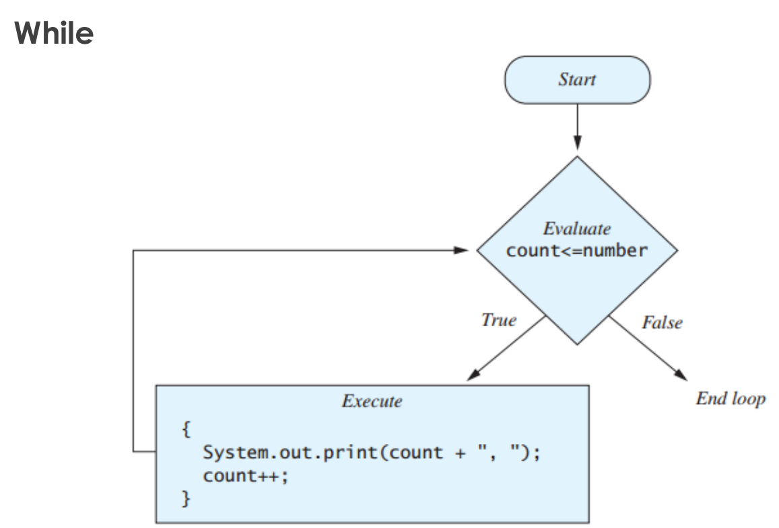
Iteration Statements

Slide 20
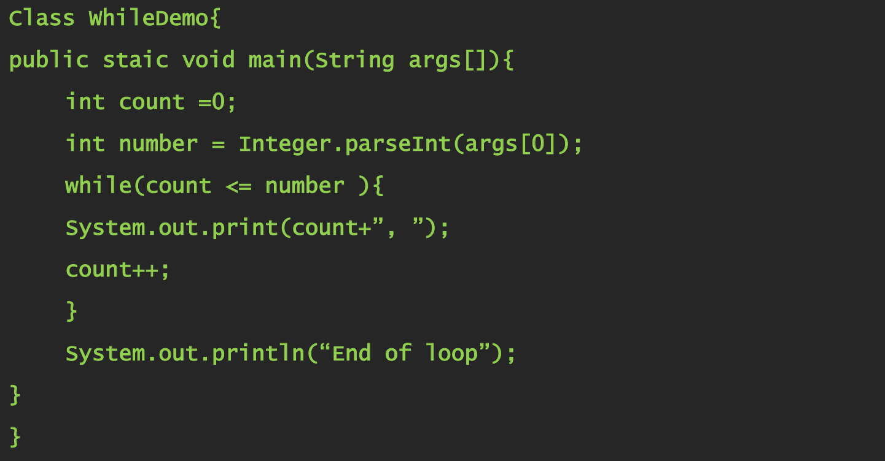
Iteration Statements

Slide 21
Iteration Statements
Do...While
The body of a do-while loop is always executed at least once.
Syntax
do{
First_Statement
Second_Statement
. . .
Last_Statement
} while(Boolean_Expression);

Slide 22
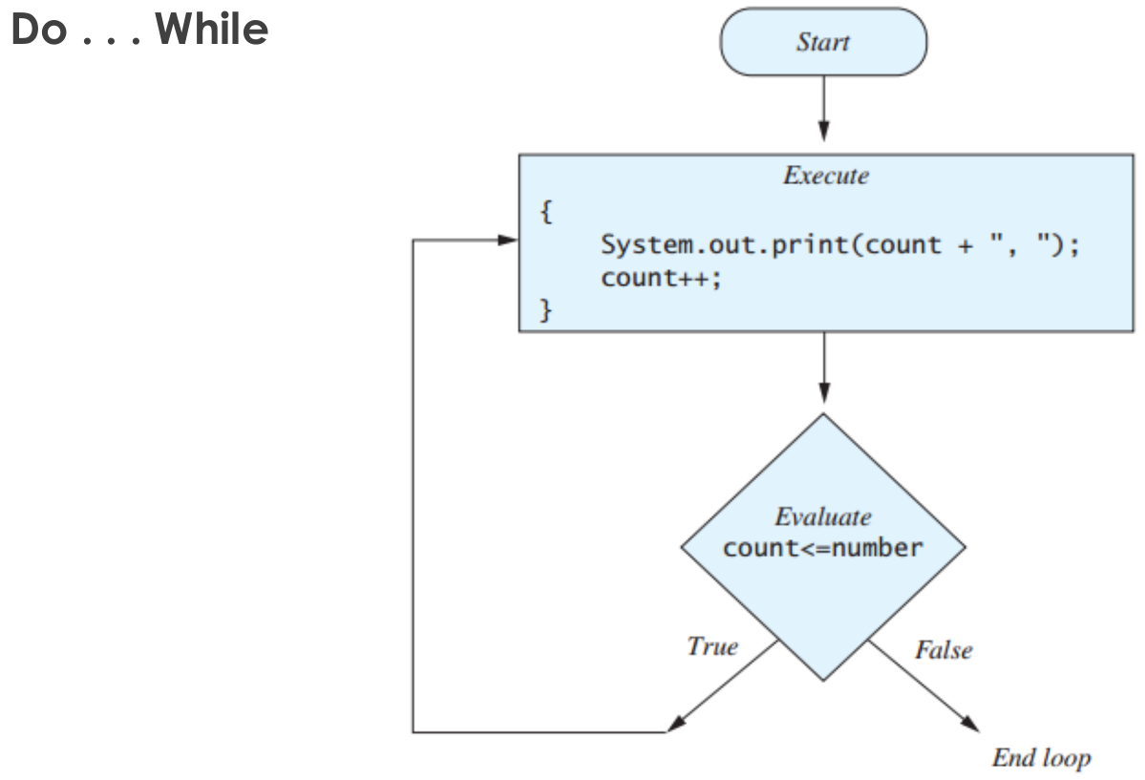
Iteration Statements

Slide 23
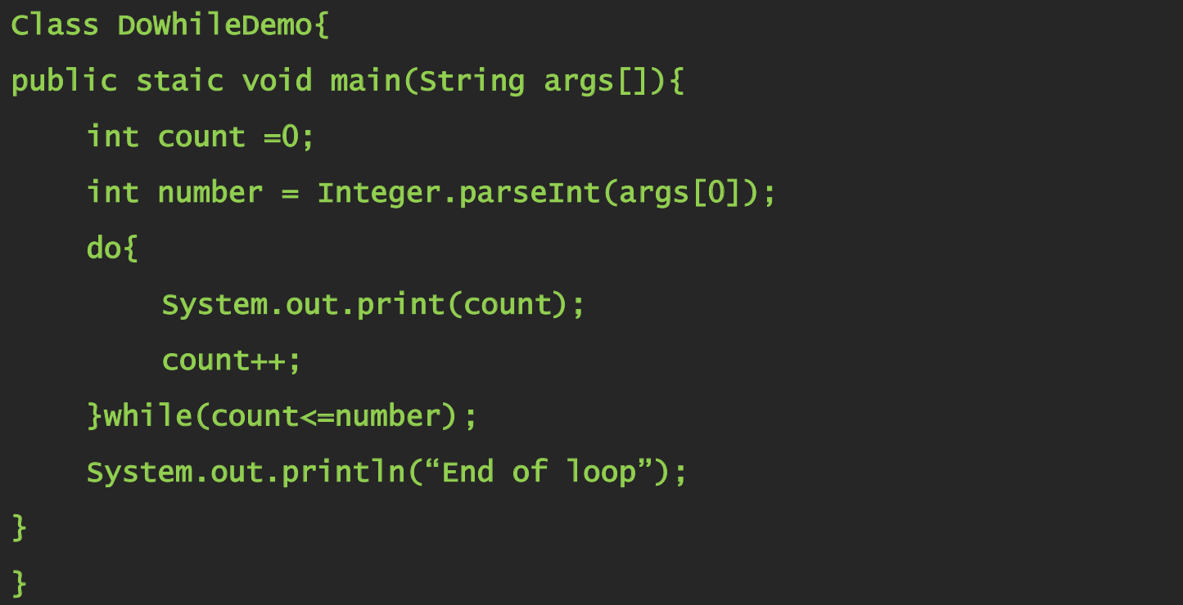
Iteration Statements

Slide 24
Iteration Statements
For
Syntax
for(initialization; condition; iteration) {
// body
}
The loop first starts, the initialization portion of the loop is executed and sets the value of the loop control variable.
The condition is evaluated and this must be a Boolean expression.
Iteration is an expression that increments or decrements the loop control variable.

Slide 25
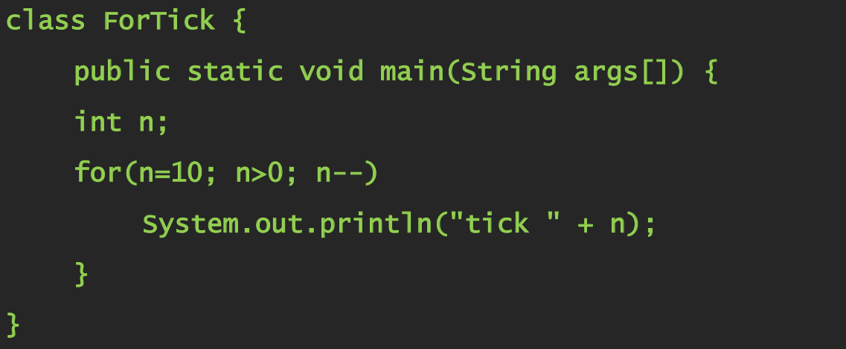
Iteration Statements

Slide 26
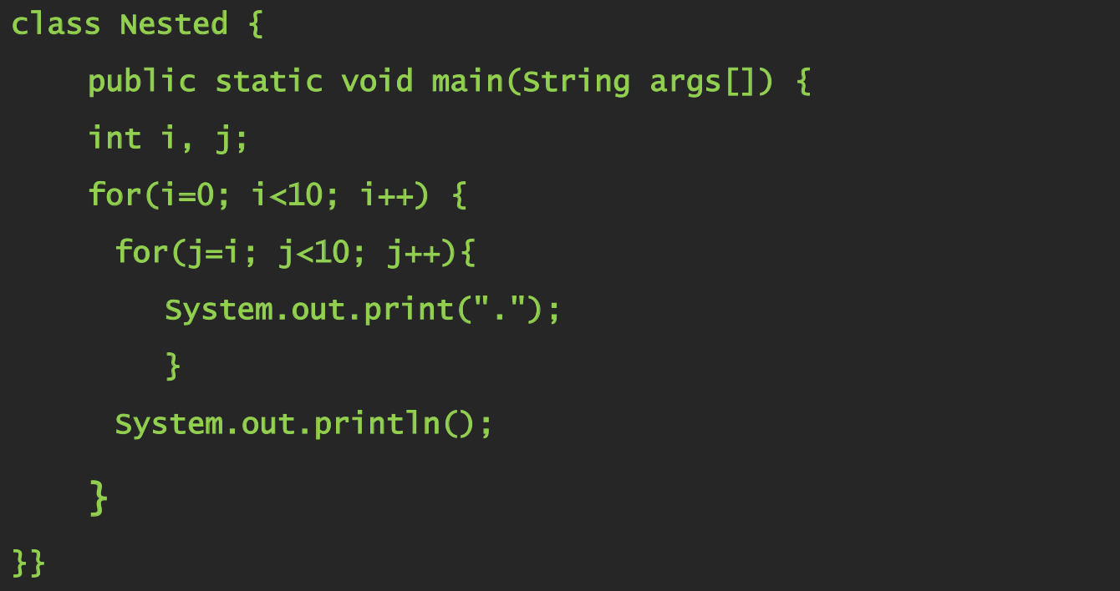
Iteration Statements
Nested loops

Slide 27
Jump Statements
The jumping statements are the control statements which transfer the program execution control to a specific statements.
Java has three types of jumping statements they are
Break
Continue
Return
These statements transfer execution control to another part of the program.

Slide 28
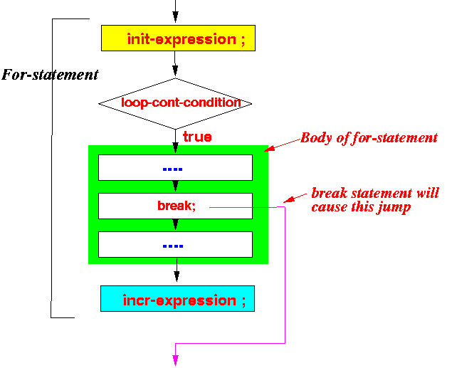
Break Statement
When the break statement is executed inside a loop-statement, the loop-statement is terminated immediately
The execution of the program will continue with the statement following the loop-statement
Syntax
break;

Slide 29
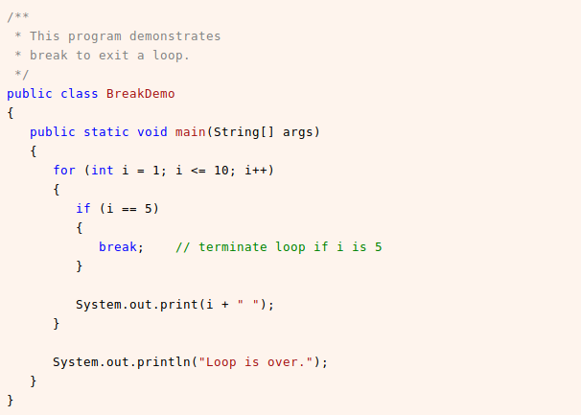
Break Statement

Slide 30
Continue Statement
The continue statement skips the current iteration of a loop (for, while, and do...while loop).
When continue statement is executed, control of the program jumps to the end of the loop.
Then, the test expression that controls the loop is evaluated.
In case of for loop, the update statement is executed before the test expression is evaluated.
Syntax
continue;

Slide 31
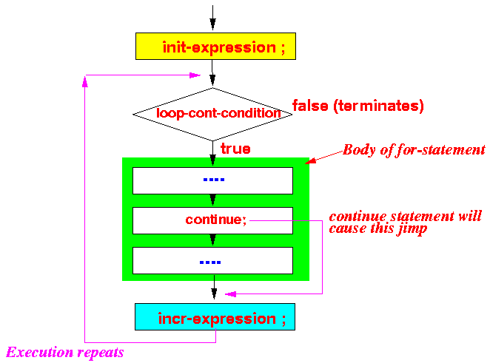
Continue Statement

Slide 32
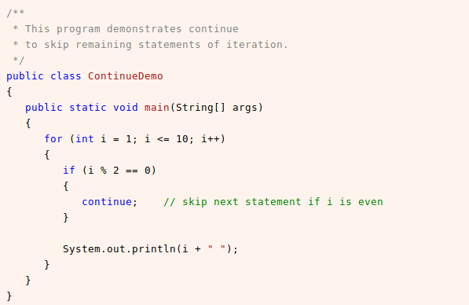
Continue Statement

Slide 33
Java Labeled Break and Continue
In the case of nested loops to break and continue a particular loop we should go for labeled break and continue statements. The Java labeled loops allows transferring to a particular line or statement.

Slide 34
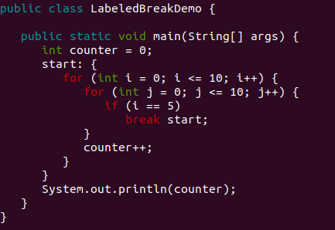
Break with Label

Slide 35
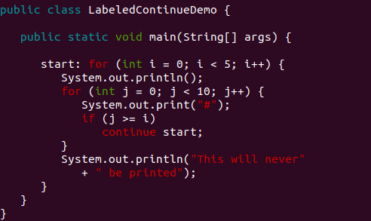
Continue with Label

Slide 36
Thank You!

