Slide 1
Data Structures Algorithms
Practical # 02

Slide 2
Contents
Object Oriented Programming
Polymorphism
Inheritance
Encapsulation
Abstraction

Slide 3
Object Oriented Programming
Object-oriented programming (OOP) refers to a type of computer programming (software design) in which programmers define the data type of a data structure, and also the types of operations (functions) that can be applied to the data structure.[1]
In this way, the data structure becomes an object that includes both data and functions. In addition, programmers can create relationships between one object and another. For example, objects can inherit characteristics from other objects.[1]

Slide 4
Object Oriented Programming Terms
Class: A class is a user defined blueprint or prototype from which objects are created. It represents the set of properties or methods that are common to all objects of one type. In general, class declarations can include these components, in order:
Modifiers: A class can be public or has default access (Refer this for details).
Class name: The name should begin with a initial letter (capitalized by convention).
Superclass(if any): The name of the class’s parent (superclass), if any, preceded by the keyword extends. A class can only extend (subclass) one parent.
Interfaces(if any): A comma-separated list of interfaces implemented by the class, if any, preceded by the keyword implements. A class can implement more than one interface.
Body: The class body surrounded by braces, { }

Slide 5
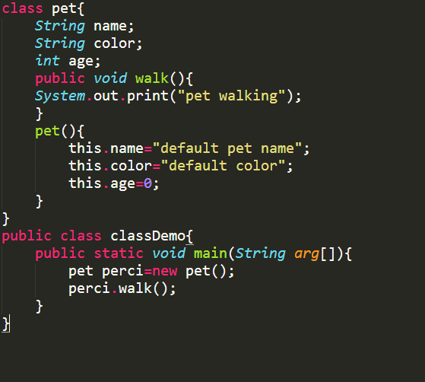

Slide 6
Cont..
Object: It is a basic unit of Object Oriented Programming and represents the real life entities. A typical Java program creates many objects, which as you know, interact by invoking methods. An object consists of:State : It is represented by attributes of an object. It also reflects the properties of an object.
Behavior : It is represented by methods of an object. It also reflects the response of an object with other objects.
Identity : It gives a unique name to an object and enables one object to interact with other objects.

Slide 7
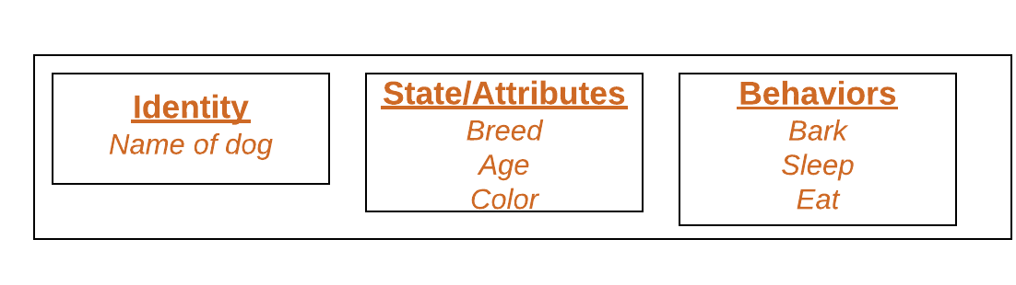

Slide 8
Object Oriented Programming Terms
Polymorphism: Polymorphism refers to the ability of OOPs programming languages to differentiate between entities with the same name efficiently. This is done by Java with the help of the signature and declaration of these entities[2].
Polymorphism in Java are mainly of 2 types:
Overloading in Java
Overriding in Java

Slide 9
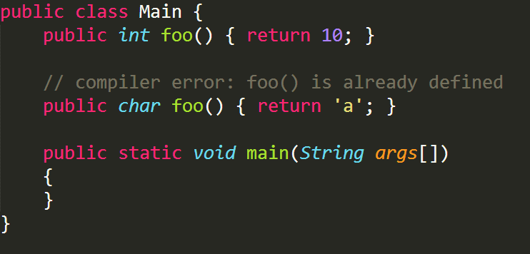
Overloading in Java..
Overloading allows different methods to have the same name, but different signatures where the signature can differ by the number of input parameters or type of input parameters or both. Overloading is related to compile-time (or static) polymorphism.
Can we overload methods on return type?

Slide 10
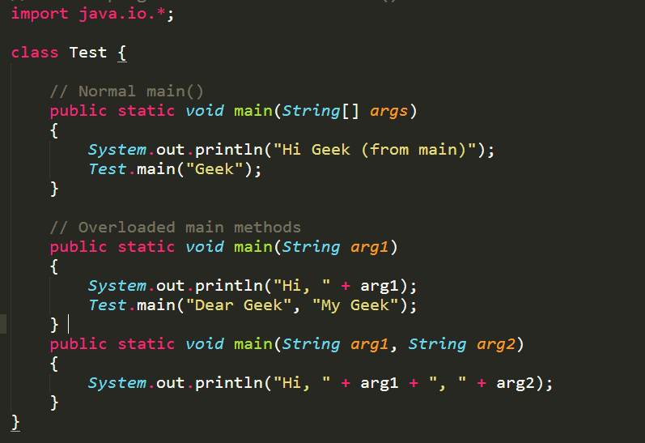
Cont..
Can we overload static methods?
Can we overload methods that differ only by static keyword?
Can we overload main() in Java?

Slide 11
Overriding in Java
In any object-oriented programming language, Overriding is a feature that allows a subclass or child class to provide a specific implementation of a method that is already provided by one of its super-classes or parent classes.
When a method in a subclass has the same name, same parameters or signature and same return type(or sub-type) as a method in its super-class, then the method in the subclass is said to override the method in the super-class.

Slide 12
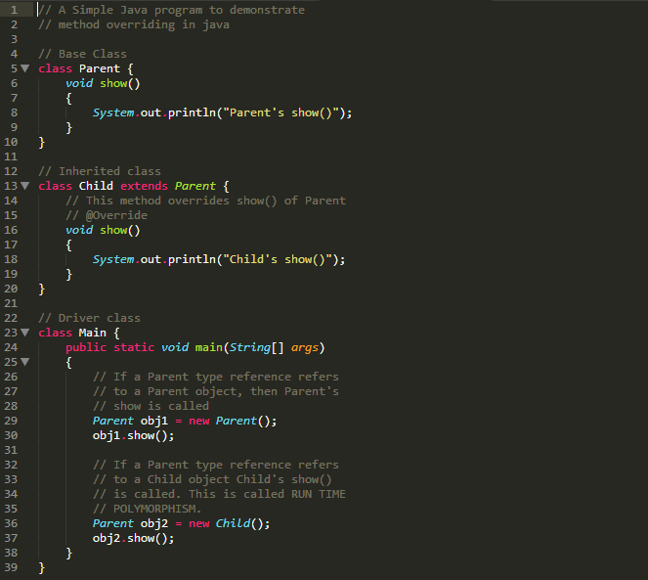
Overriding in Java
In any object-oriented programming language, Overriding is a feature that allows a subclass or child class to provide a specific implementation of a method that is already provided by one of its super-classes or parent classes.
When a method in a subclass has the same name, same parameters or signature and same return type(or sub-type) as a method in its super-class, then the method in the subclass is said to override the method in the super-class.

Slide 13
Overriding in Java
private methods are not overridden
Final methods can not be overridden
The overriding method must have same return type
Invoking overridden method from sub-class
We can not override constructor as parent and child class can never have constructor with same name(Constructor name must always be same as Class name).
We can have multilevel method-overriding

Slide 14
Overriding in Java
Inheritence: Inheritance is an important pillar of OOP(Object Oriented Programming). It is the mechanism in java by which one class is allow to inherit the features(fields and methods) of another class. Important terminology: Super Class: The class whose features are inherited is known as superclass(or a base class or a parent class).
Sub Class: The class that inherits the other class is known as subclass(or a derived class, extended class, or child class). The subclass can add its own fields and methods in addition to the superclass fields and methods.
Reusability: Inheritance supports the concept of “reusability”, i.e. when we want to create a new class and there is already a class that includes some of the code that we want, we can derive our new class from the existing class. By doing this, we are reusing the fields and methods of the existing class.
The keyword used for inheritance is extends

Slide 15
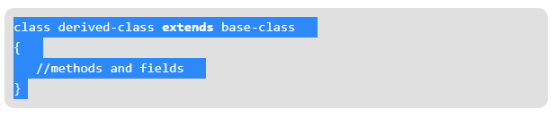
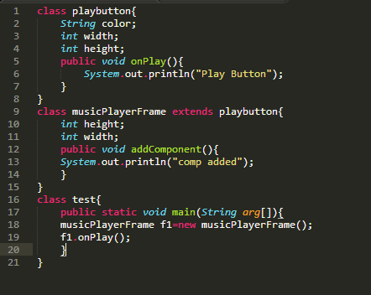

Slide 16
Cont..
Encapsulation: Encapsulation is defined as the wrapping up of data under a single unit. It is the mechanism that binds together code and the data it manipulates. Another way to think about encapsulation is, it is a protective shield that prevents the data from being accessed by the code outside this shield.Technically in encapsulation, the variables or data of a class is hidden from any other class and can be accessed only through any member function of own class in which they are declared.
As in encapsulation, the data in a class is hidden from other classes, so it is also known as data-hiding.
Encapsulation can be achieved by Declaring all the variables in the class as private and writing public methods in the class to set and get the values of variables.

Slide 17
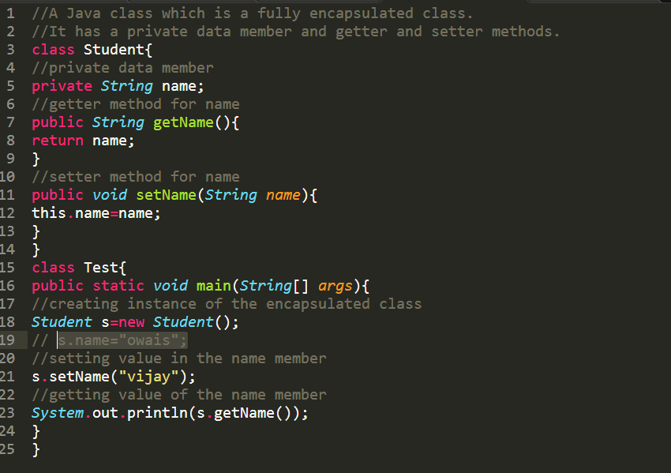

Slide 18
Cont..
Abstraction: Data Abstraction is the property by virtue of which only the essential details are displayed to the user. The trivial or the non-essentials units are not displayed to the user. Ex: A car is viewed as a car rather than its individual components. Data Abstraction may also be defined as the process of identifying only the required characteristics of an object ignoring the irrelevant details. The properties and behaviours of an object differentiate it from other objects of similar type and also help in classifying/grouping the objects.
Consider a real-life example of a man driving a car. The man only knows that pressing the accelerators will increase the speed of car or applying brakes will stop the car but he does not know about how on pressing the accelerator the speed is actually increasing, he does not know about the inner mechanism of the car or the implementation of accelerator, brakes etc in the car. This is what abstraction is.

Slide 19
Cont..
In java, abstraction is achieved by interfaces and abstract classes. We can achieve 100% abstraction using interfaces.

Slide 20
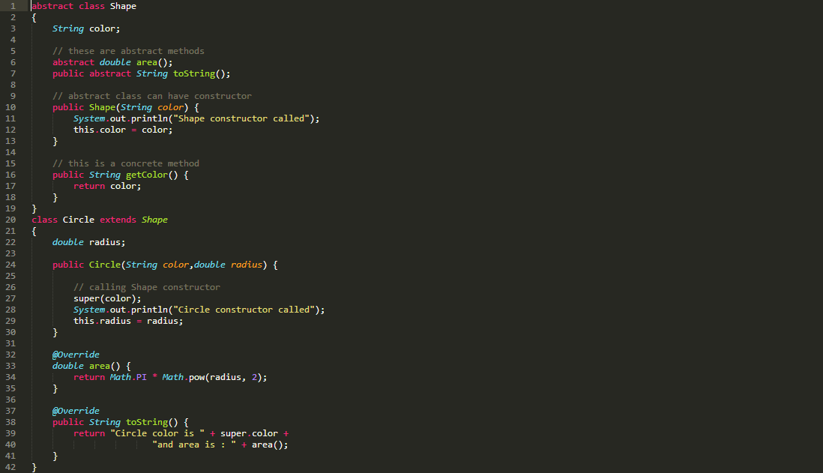

Slide 21
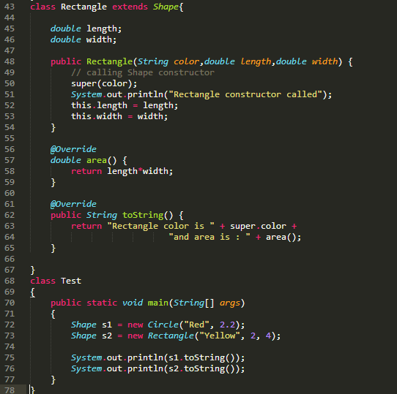

Slide 22
UML
An object-oriented design specifies the classes that will be instantiated in the software. That design can be facilitated and illustrated by the Unified Modeling Language (UML). In UML, each class is represented by a rectangle with separate parts for listing the class’s name, its fields, and its methods and constructors.

Slide 23
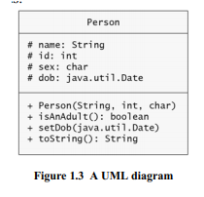
UML

Slide 24
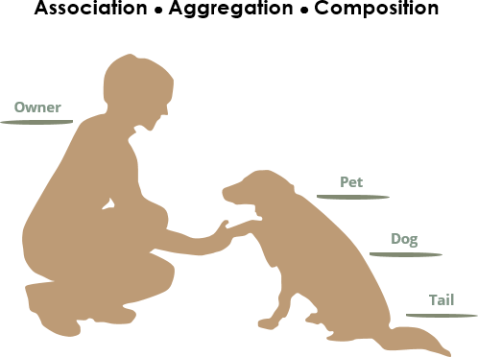
UML
Consider the differences and similarities between the classes of the following objects: pets, dogs, tails, owners.

Slide 25
UML
We see the following relationships:
owners feed pets, pets please owners (association)
a tail is a part of both dogs and cats (aggregation / composition)
a dog is a kind of pet (inheritance / generalization)

Slide 26
UML - Association
If two classes in a model need to communicate with each other, there must be a link between them, and that can be represented by an association (connector).
Association can be represented by a line between these classes with an arrow indicating the navigation direction. In case an arrow is on both sides, the association is known as a bidirectional association.
We can indicate the multiplicity of an association by adding multiplicity adornments to the line denoting the association.

Slide 27
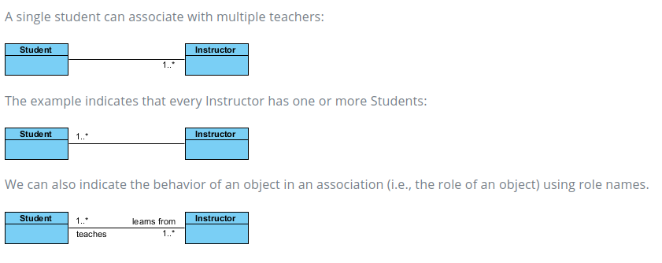
UML – Association (Examples)

Slide 28
UML – Aggregation vs Composition
Aggregation and Composition are subsets of association meaning they are specific cases of association. In both aggregation and composition object of one class "owns" object of another class. But there is a subtle difference:
Aggregation implies a relationship where the child can exist independently of the parent. Example: Class (parent) and Student (child). Delete the Class and the Students still exist.
Composition implies a relationship where the child cannot exist independent of the parent. Example: House (parent) and Room (child). Rooms don't exist separate to a House.

Slide 29
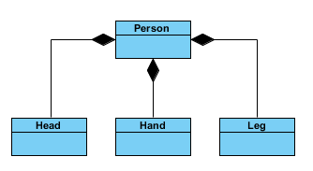
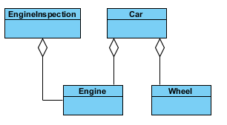
UML – Aggregation vs Composition (Example)
Composition
Aggregation

Slide 30
UML – Generalization vs Specialization
Generalization (Inheritance) is a mechanism for combining similar classes of objects into a single, more general class. Generalization identifies commonalities among a set of entities. The commonality may be of attributes, behavior, or both.
In other words, a superclass has the most general attributes, operations, and relationships that may be shared with subclasses.
A subclass may have more specialized attributes and operations.
Specialization is the reverse process of Generalization means creating new sub-classes from an existing class.
For Example, a Bank Account is of two types - Savings Account and Credit Card Account. Savings Account and Credit Card Account inherit the common/ generalized properties like Account Number, Account Balance, etc. from a Bank Account and also have their specialized properties like unsettled payment etc.

Slide 31
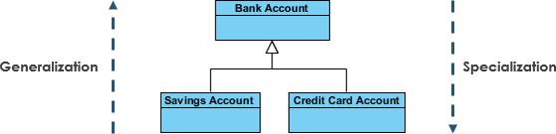
UML – Generalization vs Specialization (Example)
For Example
A Bank Account is of two types - Savings Account and Credit Card Account.
Savings Account and Credit Card Account inherit the common/ generalized properties like Account Number, Account Balance, etc. from a Bank Account and also have their specialized properties like unsettled payment etc.

Slide 32
Exercise
Write a program by creating an 'Employee' class having the following methods and print the final salary. 1 - 'getInfo()' which takes the salary, number of hours of work per day of employee as parameter 2 - 'AddSal()' which adds $10 to salary of the employee if it is less than $500. 3 - 'AddWork()' which adds $5 to salary of employee if the number of hours of work per day is more than 6 hours.
Write a program to print the area of a rectangle by creating a class named 'Area' having two methods. First method named as 'setDim' takes length and breadth of rectangle as parameters and the second method named as 'getArea' returns the area of the rectangle. Length and breadth of rectangle are entered through keyboard.
Write a program to print the area of a rectangle by creating a class named 'Area' taking the values of its length and breadth as parameters of its constructor and having a method named 'returnArea' which returns the area of the rectangle. Length and breadth of rectangle are entered through keyboard

Slide 34
Lab Rubrics
Rubrics | Proficient | Adequate | Poor
Accuracy | Accurately completed the task (0.4) | Partially correct outputs (0.2) | Unable to complete taks (0.0)
Originality | Submitted work shows large amount of original thought (0.3) | Submitted work shows some amount of original thought (0.2) | Submitted work shows no original thought (0.0)
Troubleshooting | Easily traced and corrected faults (0.3) | Traced and corrected faults with some guidance (0.2) | No troubleshooting skills (0.0)

Slide 35
Reference
https://www.webopedia.com/TERM/O/object_oriented_programming_OOP.html#targetText=Object%2Doriented%20programming%20(OOP),applied%20to%20the%20data%20structure.
https://www.geeksforgeeks.org/object-oriented-programming-oops-concept-in-java/

