Slide 1
Fair Use Notice
The material used in this presentation i.e., pictures/graphs/text, etc. is solely intended for educational/teaching purpose, offered free of cost to the students for use under special circumstances of Online Education due to COVID-19 Lockdown situation and may include copyrighted material - the use of which may not have been specifically authorised by Copyright Owners. Its application constitutes Fair Use of any such copyrighted material as provided in globally accepted law of many countries. The contents of presentations are intended only for the attendees of the class being conducted by the presenter.

Slide 2
Arrays
Data Structure and Algorithms
Practical # 03

Slide 3
Array Data Structure
An array is an indexed sequence of components
Typically, the array occupies sequential storage locations
The length of the array is determined when the array is created, and cannot be changed
Each component of the array has a fixed, unique index
Indices range from a lower bound to an upper bound
Any component of the array can be inspected or updated by using its index
This is an efficient operation: O(1) = constant time

Slide 4
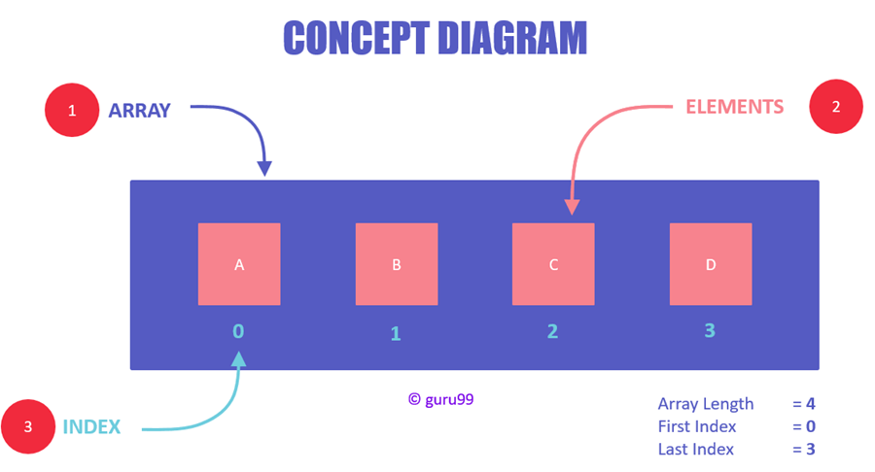
Concept Diagram

Slide 5
Abstract Data Types
Abstract data types, commonly abbreviated ADTs, are a way of classifying data structures based on how they are used and the behaviors they provide.
They do not specify how the data structure must be implemented but simply provide a minimal expected interface and set of behaviors.

Slide 6
Array as an ADT
An array is an Abstract Data Type
The array type has a set of values
The values are all the possible arrays
The array type has a set of operations that can be applied uniformly to each of these values
The only operation is indexing
Alternatively, this can be viewed as two operations:
inspecting an indexed location
storing into an indexed location
It’s abstract because the implementation is hidden: all access is via the defined operations

Slide 7
Other Operations in Arrays
Traversal: Processing each element in the list
Searching: Finding the location of the element with a given value or the record with a given key.
Insertion: Adding a new element
Deletion: Removing an element
Sorting: Arranging the elements in some type of order.

Slide 8
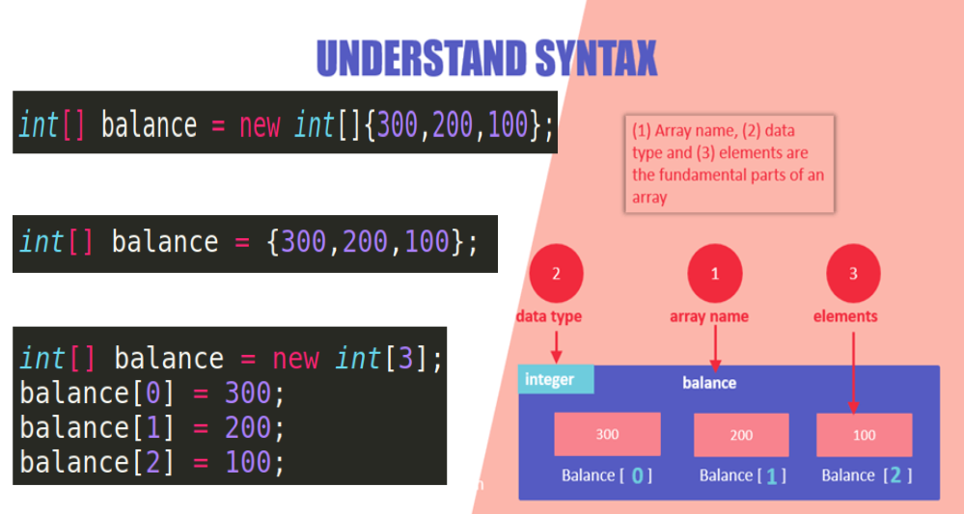

Slide 9
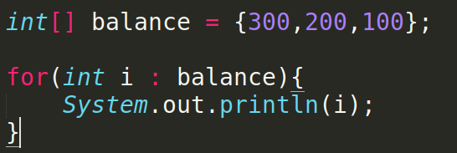
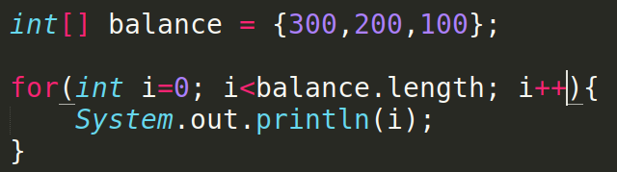
Traversing an Array
OR

Slide 10
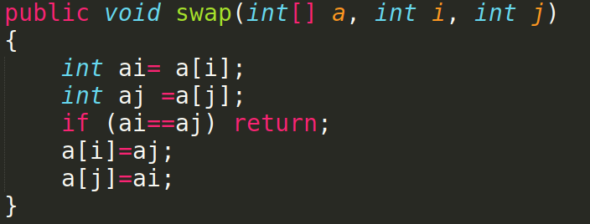
Swapping Elements

Slide 11
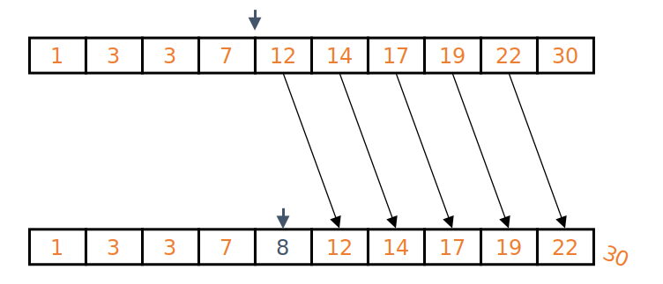
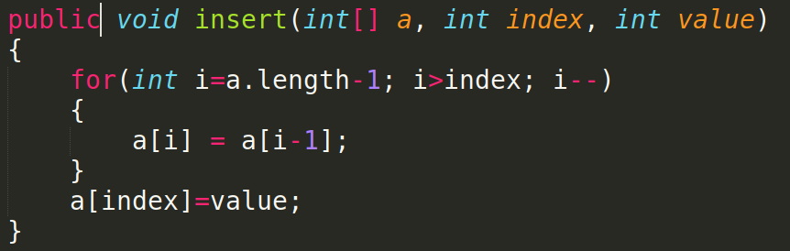
Insertion in Array

Slide 12
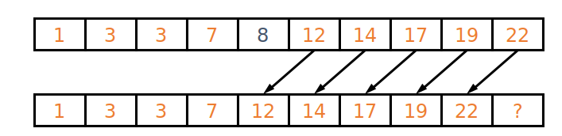
Deletion in Arrays

Slide 13
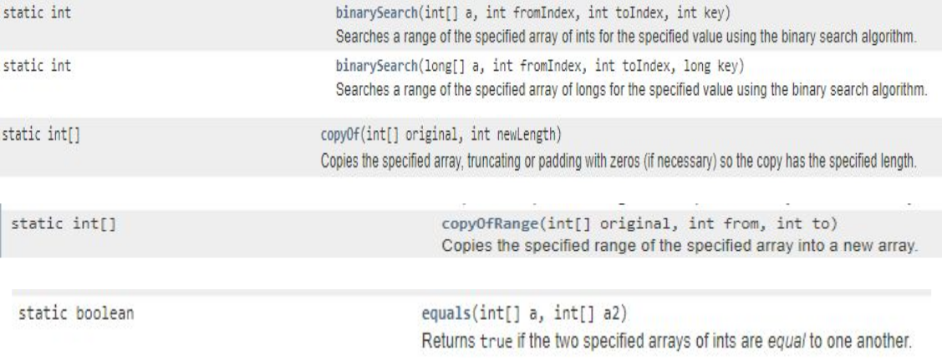
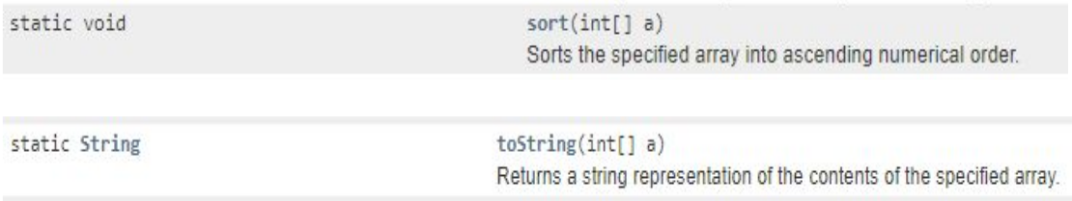
Array Methods provided by Java

Slide 14
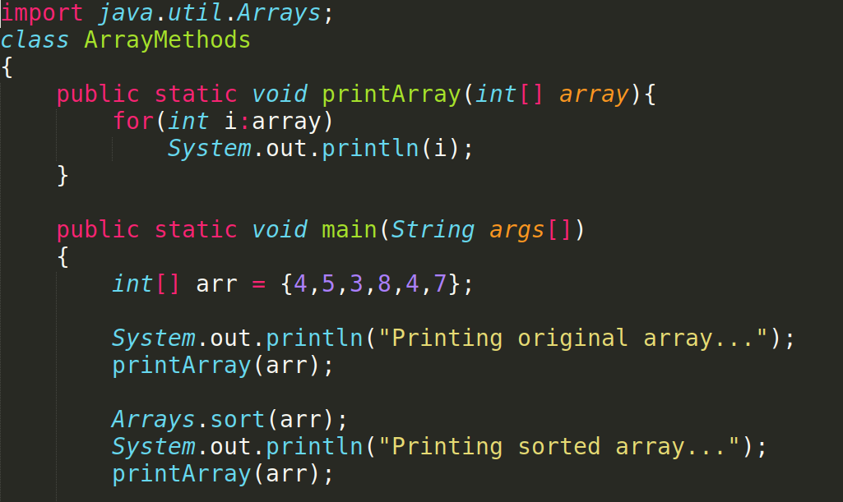

Slide 15
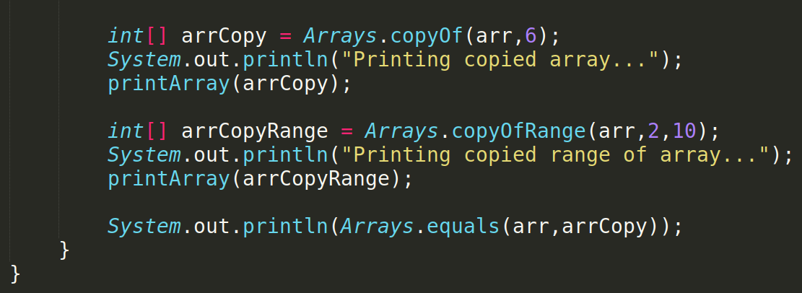

Slide 16
Multi-Dimensional Arrays
Multidimensional arrays are arrays of arrays with each element of the array holding the reference of other array.
A multidimensional array is created by appending one set of square brackets ([]) per dimension.

Slide 17
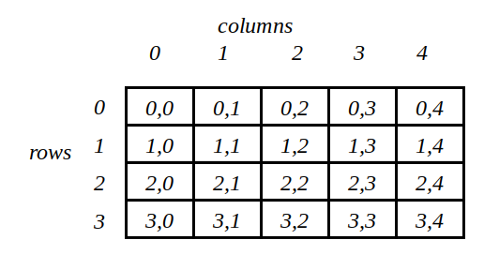
Two Dimensional Array
Two dimensional arrays allows us to store data that are recorded in table. For example:
Table contains 12 items, we can think of this as a matrix consisting of 4 rows and 3 columns.
 | Item1 | Item2 | Item3 | Item4
Salesgirl #1 | 10 | 15 | 30 | 10
Salesgirl #2 | 14 | 30 | 33 | 50
Salesgirl #3 | 200 | 32 | 1 | 4

Slide 18
2-D Array Manipulations
Declaration:
int myArray [][];
Creation:
myArray = new int[4][3]; // OR
int myArray [][] = new int[4][3];
Initialization:
Single Value;
myArray[0][0] = 10;
Multiple values:
int tableA[2][3] = {{10, 15, 30}, {14, 30, 33}};
int tableA[][] = {{10, 15, 30}, {14, 30, 33}};

Slide 19
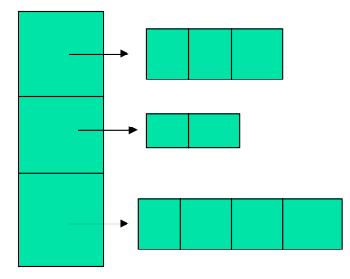
Variable Size 2-D Arrays
Java treats multidimensional arrays as “arrays of arrays”. It is possible to declare a 2D arrays as follows:
int a[][] = new int [3][];
a[0]= new int [3];
a[1]= new int [2];
a[2]= new int [4];

Slide 20
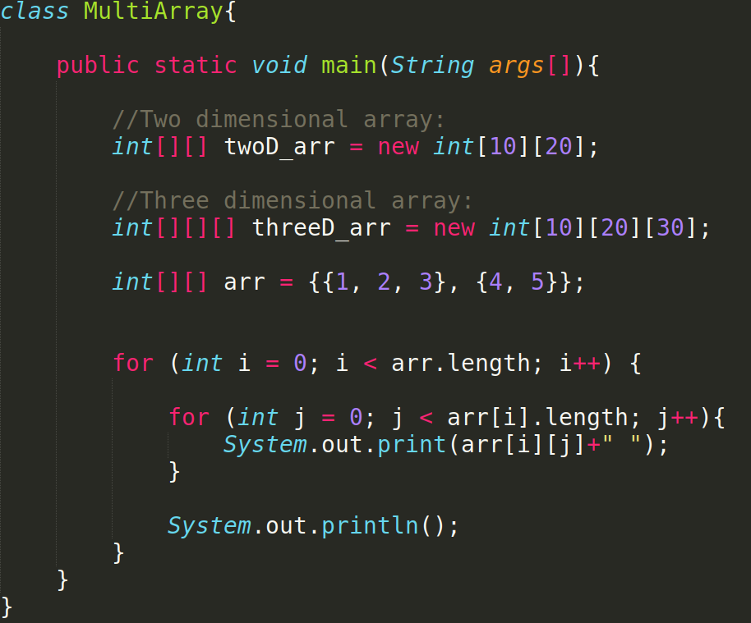
Traversing a 2-D Array

Slide 21
Lab Tasks
Write a Java Code a Array of length 100 and fill it with Random int Values for testing purpose
Write a Java program to check if two arrays are equal.
Use all of the array method discussed above in your java code but array should not be of type integer.
Write a method in java with float as its return type that takes array as input and return average as output.
Write a method in Java program to find the second largest element in an array. Method should take array as input and return index
Write a java program to sort a matrix (Two dimensional array)
Write a Java program to remove the duplicate elements of a given array and return the new length of the array.
Write a java program that demonstrates matrix multiplication.
Sample array: [20, 20, 30, 40, 50, 50, 50]
Output:
New Array: 20, 30, 40, 50
Length: 4

Slide 22
Lab Rubrics
Rubrics | Proficient | Adequate | Poor
Programming Algorithms | Produce correct results with efficient algorithms (0.4) | Produce results with inefficient algorithms (0.2) | Unable to design algorithms (0.0)
Originality | Submitted work shows large amount of original thought (0.3) | Submitted work shows some amount of original thought (0.2) | Submitted work shows no original thought (0.0)
Troubleshooting | Easily traced and corrected faults (0.3) | Traced and corrected faults with some guidance (0.2) | No troubleshooting skills (0.0)

Slide 23
Thank You

