Slide 1
Fair Use Notice
The material used in this presentation i.e., pictures/graphs/text, etc. is solely intended for educational/teaching purpose, offered free of cost to the students for use under special circumstances of Online Education due to COVID-19 Lockdown situation and may include copyrighted material - the use of which may not have been specifically authorised by Copyright Owners. Its application constitutes Fair Use of any such copyrighted material as provided in globally accepted law of many countries. The contents of presentations are intended only for the attendees of the class being conducted by the presenter.

Slide 2
Search Algorithms
Data Structure and Algorithms
Practical # 04

Slide 3
Linear Search
Linear search is a very basic and simple search algorithm. In Linear search, we search an element or value in a given array by traversing the array from the starting, till the desired element or value is found.
Linear search is used on a collections of items. It relies on the technique of traversing a list from start to end by exploring properties of all the elements that are found on the way.
Time Complexity:
The time complexity of the linear search is O(N) because each element in an array is compared only once.

Slide 4
Time Complexity
Time complexity is simply a measure of the time it takes for a function or expression to complete its task, as well as the name of the process to measure that time
It can be applied to almost any algorithm or function but is more useful for recursive functions.
Example to understand
Imagine a classroom of 100 students in which you gave your pen to one person. Now, you want that pen. Here are some ways to find the pen and what the O order is.
O(n²): You go and ask the first person of the class, if he has the pen. Also, you ask this person about other 99 people in the classroom if they have that pen and so on, This is what we call O(n²).

Slide 5
Time Complexity
O(n): Going and asking each student individually is O(N).
O(log n): Now I divide the class into two groups, then ask: “Is it on the left side, or the right side of the classroom?” Then I take that group and divide it into two and ask again, and so on. Repeat the process till you are left with one student who has your pen. This is what you mean by O(log n).

Slide 6
Linear Search Algotithm
To find which (if any) component of array a with n elements is equal to target:
for i=0 to n-1, repeat:
If target is equal to a[i], terminate with answer i
Terminate with answer none

Slide 7
Binary search
Binary search is a fast search algorithm
This search algorithm works on the principle of divide and conquer. For this algorithm to work properly, the data collection should be in the sorted form
Binary search looks for a particular item by comparing the middle most item of the collection. If a match occurs, then the index of item is returned. If the middle item is greater than the item, then the item is searched in the sub-array to the left of the middle item. Otherwise, the item is searched for in the sub-array to the right of the middle item. This process continues on the sub-array as well until the size of the subarray reduces to zero

Slide 8
Binary Search Algorithm
To find which (if any) component of a[left..right] is equal to target (where a is sorted):
Set l = left, and set r = right
While l <= r, repeat:
Let m be an integer about midway between l and r
If target is equal to a[m], terminate with answer m
If target is less than a[m], set r = m–1
If target is greater than a[m], set l = m+1
Terminate with answer none
l
m-1
m
m+1
r
• • •
?
• • •

Slide 9
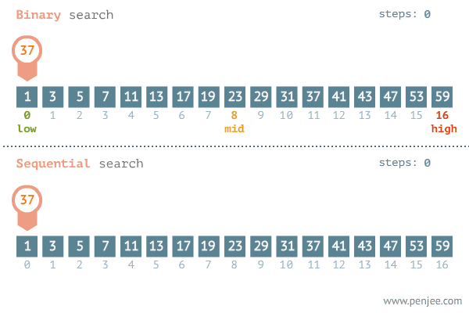
Average Case for Binary Search
Search 37 in the array
(0+16)/2 = 8; a[8] = 23;
23 < 37; 9..16
(9+16)/2 = 12.5 = 12; a[12] = 41;
41 > 37; 9..11
(9+11)/2 = 10; a[10] = 31;
31 < 37; 11..11
(11+11)/2 = 11; a[11] = 37;
37 = 37; return 11;

Slide 10
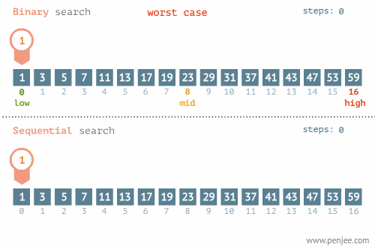
Worst Case for Binary Search

Slide 11
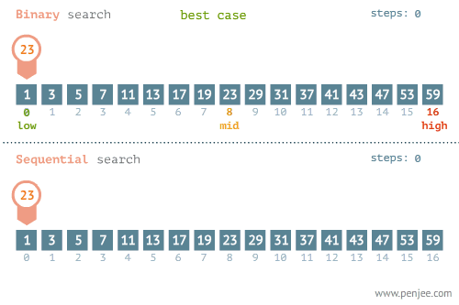
Best Case for Binary Search

Slide 12
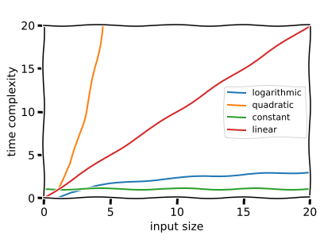

Slide 13
Exercise
Apply linear and binary search algorithm on array of string and characters also print execution time of each result.
Apply linear and binary search algorithm on an array of any user defined object of your choice.
Apply linear and binary search algorithm on a 2-D integer array. (+1 Mark)

Slide 14
Lab Rubrics
Rubrics | Proficient | Adequate | Poor
Programming Algorithms | Correct implementation of algorithms (0.4) | Partially correct implementation of algorithms (0.2) | Unable to implement algorithms (0.0)
Originality | Submitted work shows large amount of original thought (0.3) | Submitted work shows some amount of original thought (0.2) | Submitted work shows no original thought (0.0)
Troubleshooting | Easily traced and corrected faults (0.3) | Traced and corrected faults with some guidance (0.2) | No troubleshooting skills (0.0)

Slide 15
Thank You!

