Slide 1
ROLLNO: 19SW42
ZOHAIB HASSAN SOOMRO

Slide 2
FUNDAMENTALS OF EXCEPTIONS HANDLING:
Exception:
Exception in java is any abnormal error or unexpected output that is obtained at runtime(time of execution).
When an exception is occurred, the program is terminated and the remaining code is not executed. Hence, the normal flow of the program is disrupted.
Exception is an object which is thrown at runtime.
Exception handling:
Exception handling is a mechanism to handle these runtime errors.
Normal flow of program can be maintained with this technique.
Exception handling is done with the exception object that is thrown.

Slide 3
CLASS HIREARCHY:
Throwable
Error
Exception
Many classes…
ClassNotFoundException
IOException
RuntimeException
And many other classes…
And many more classes…
IndexOutOfBoundsException
NullPointerException
ArithmeticException

Slide 4
TYPES OF EXCEPTIONS:
There are mainly two types of exceptions:
Checked exceptions:
These exceptions are checked at compile-time. Classes that extend Throwable class except RuntimeException and Error are known as checked exceptions. Checked exceptions means that compiler forces the programmer to check and deal with the exceptions.
E.g : IOException , SQLException etc.
Unchecked exceptions:
These exceptions are not checked at compile-time rather they are checked at runtime. . Classes that extend RuntimeException, Error and their subclasses are known as unchecked exceptions.
E.g : ArithmeticException , NullPointerException, ArrayIndexOutOfBoundsException etc.

Slide 5
UNCAUGHT EXCEPTIONS:
The exceptions that are not handled or caught manually are called uncaught exceptions.
These exceptions are handled by the default handler provided by the java run-time system.
The default exception handler displays a string describing the exception, prints hirearchy of methods where the exception is occurred(i.e method , line number, error message.) and causes our program to be terminated.

Slide 6
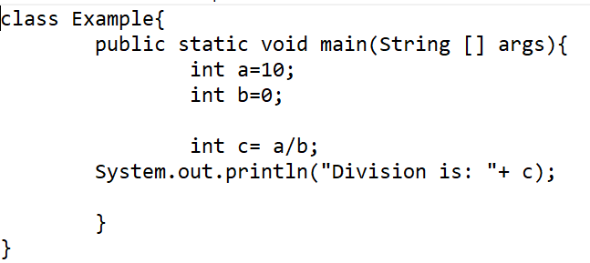
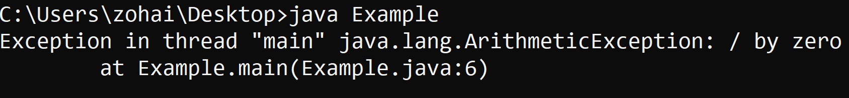
Example of uncaught exception:
Code:
Output :

Slide 7
USING TRY AND CATCH.
The try-catch mechanism is used to handle the exceptions occurred in program.
Try is used to enclose segment of code that may produce an exception where as catch is placed directly after the try block to handle one or more exception types.
Java exceptions are handled within a catch block.
We can handle our previous “divide by zero” exception with the help of a “try-catch” block .

Slide 8
try-catch syntax:
try {
//code which might throw an exception
}
catch(ExceptionClass obj){
//code to handle an exception
}
The statements in try after the point where an exception is occurred are never executed.

Slide 9
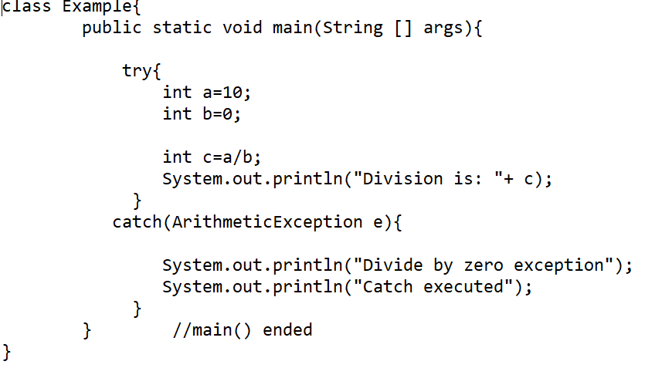
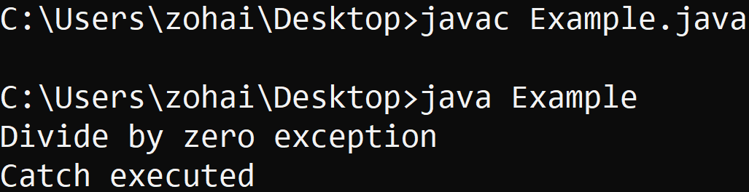
To handle exception using try-catch block:
Code:
Output:

Slide 10
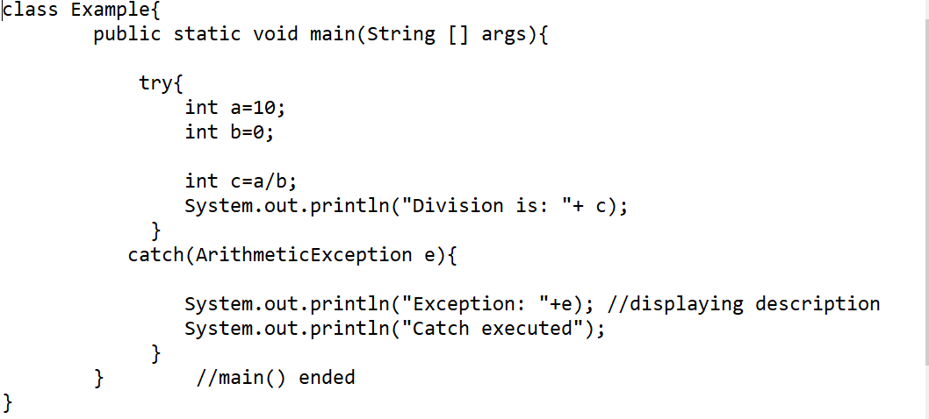
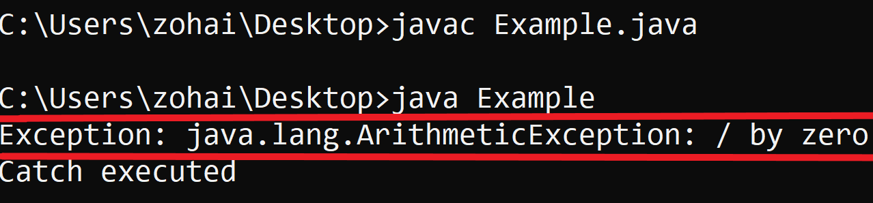
Displaying a description of an Exception:
It is necessary to display the description of an exception, when we have to experiment with exceptions or to debug a program.
But we can also display the description of an exception in any program for the sake of understanding.
E.g: Code: output:

Slide 11
Multiple-catch clauses/blocks:
If more than one exception can occur within a segment of code, then we use multiple catch blocks.
When an exception is thrown, each catch statement is inspected (checked for match of thrown object) in order, and the very first catch whose type is matched with the thrown exception object is executed.
If one catch block is executed, then others will be skipped and the statement following the try-catch block will be executed.

Slide 12
Multiple catch clauses syntax:
try {
//code which might throw an exception
}
catch(ExceptionClass object1){
//code to handle an exception
}
catch(ExceptionClass object2){
//code to handle an exception
}
catch(ExceptionClass object3){
//code to handle an exception
}
Only that catch will be executed whose object will be matched with the thrown object.

Slide 13
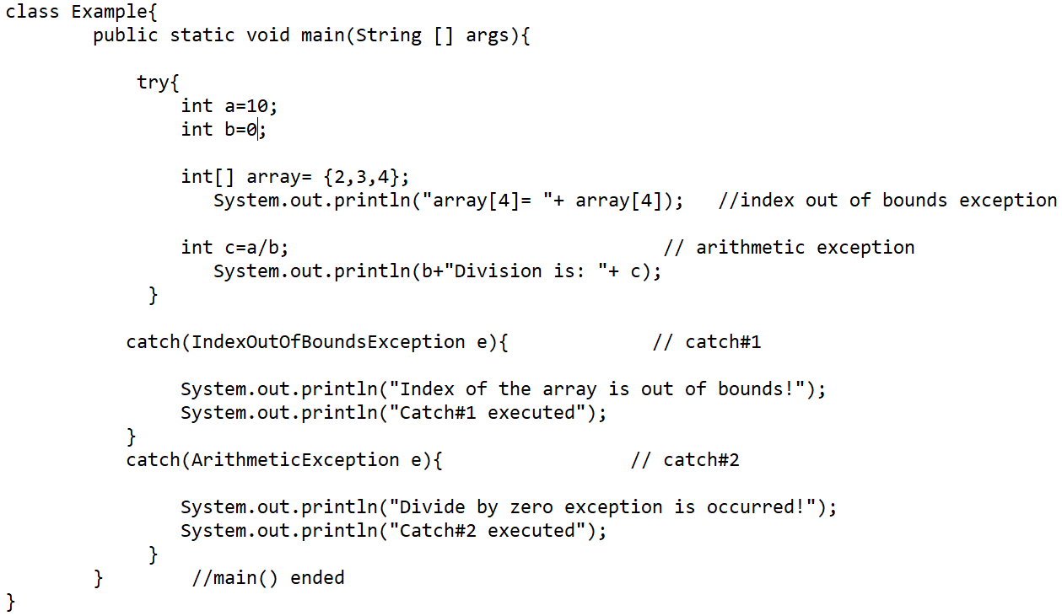
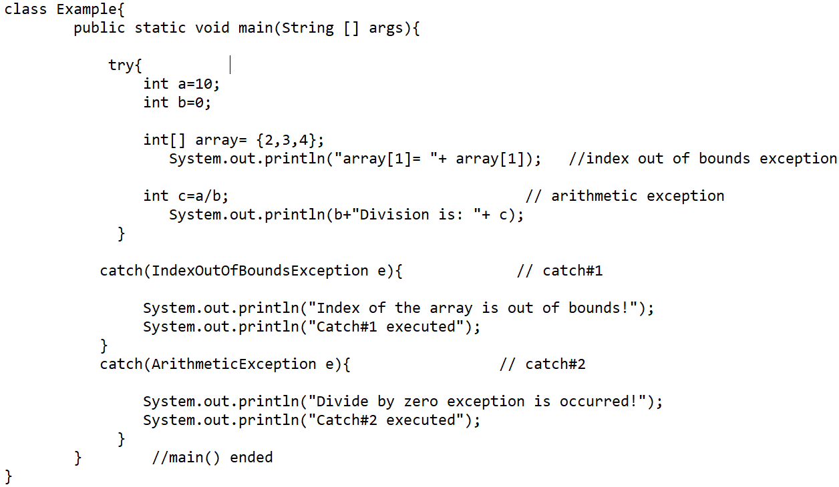
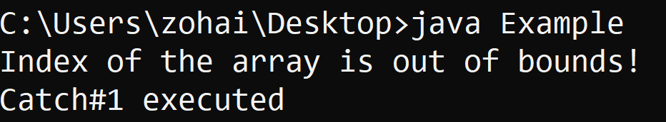
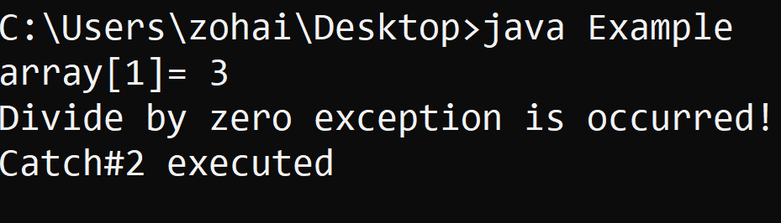
Example of multiple catch clauses:
a. When catch#1 is executed:
b. When catch#2 is executed:

Slide 14
Nested try statements:
When a try-catch block is inside in another try block then it is called the nested try catch block.
If a nested try has not the catch block for handling the exception occurring in its body then the catch of outer(parent) try is inspected for that exception if it is matched then that catch block is executed.
If neither the inner catch and nor the outer catch is matched for the exception type then it is caught by the default handler. Hence, the program is terminated.

Slide 15
Syntax of nested try catch:
try{ //outer try block
statement 1;
statement 2;
try{ //nested try block
statement 3;
statement 4;
}
catch(Exception e1){ //catch of nested try
//code to handle exception
}
}
catch(Exception e2){ // catch of outer try
//code to handle exception
}

Slide 16
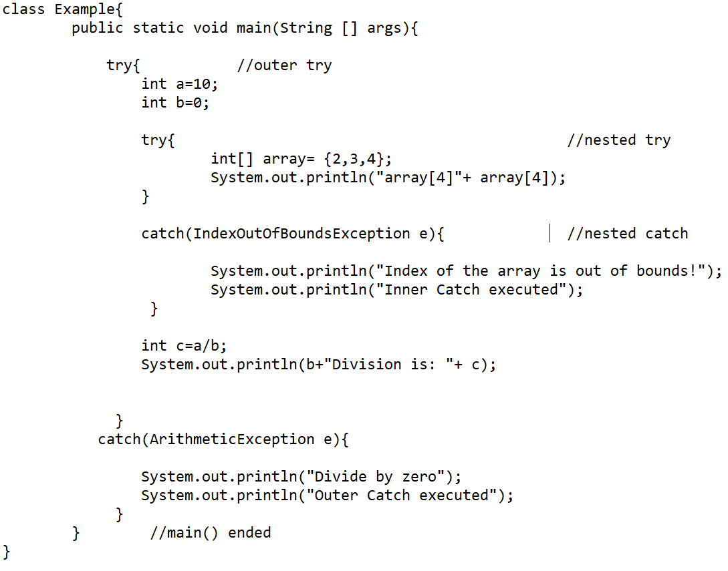
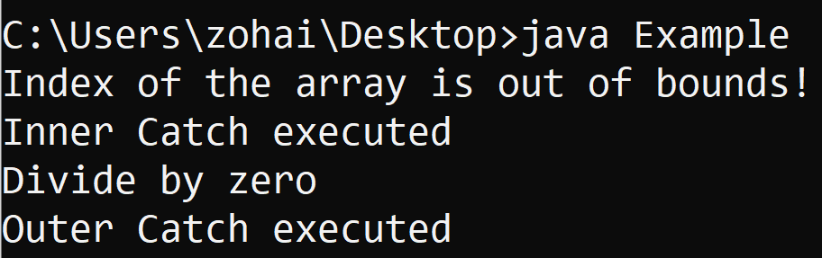
Example of nested try-catch:
Code :
Output:

Slide 17
Creating your own Exceptions:
For creating our own exceptions which are also called custom exceptions or user-defined exceptions we will need to create a class that is subclass of the Exception class.
With the help of custom exceptions ,we can have our own exceptions as well as displaying message.
They are needed when we are dealing with the business logic to help the developers or users to understand what the exact problem is.

Slide 18
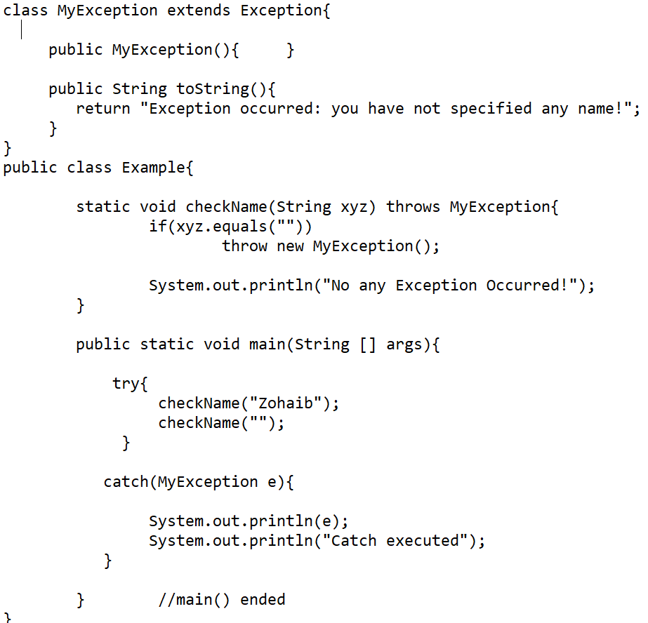
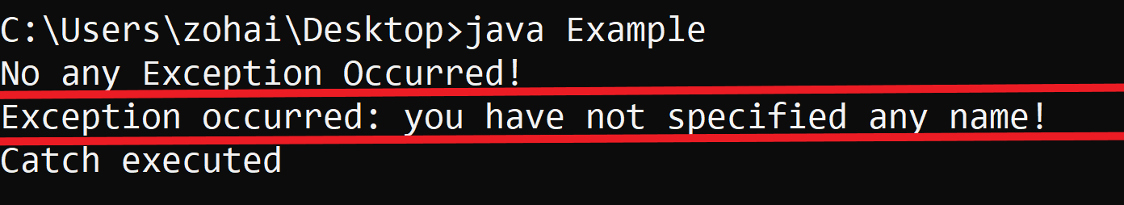
Example of creating our own exceptions:
Code: Output:

Slide 19
Using throw, throws and finally block
throw:
“throw” is used to explicitly throw an exception from a method or any block of code.
We can throw either checked or unchecked exceptions.
throw keyword is mainly used to throw custom exceptions/user-defined exceptions.
Syntax: throw new ClassName();
throws:
“throws” keyword is used to declare an exception.
It gives an information to the programmer that there may occur an exception so it is better to provide exception handling code so that normal flow of our program can be maintained..
Syntax: throws ClassName;

Slide 20
Continued…
finally:
“finally” block is always executed.
In finally block we write the code that will be executed after the try/catch block is executed.
finally block will be executed even if the exception is thrown or not.
Each try clause must follow at least one catch or finally clause.
Syntax:
try{ //code that may throw an exception }
catch(Exception e){ //code to handle it }
finally{ //this code is always executed }

Slide 21
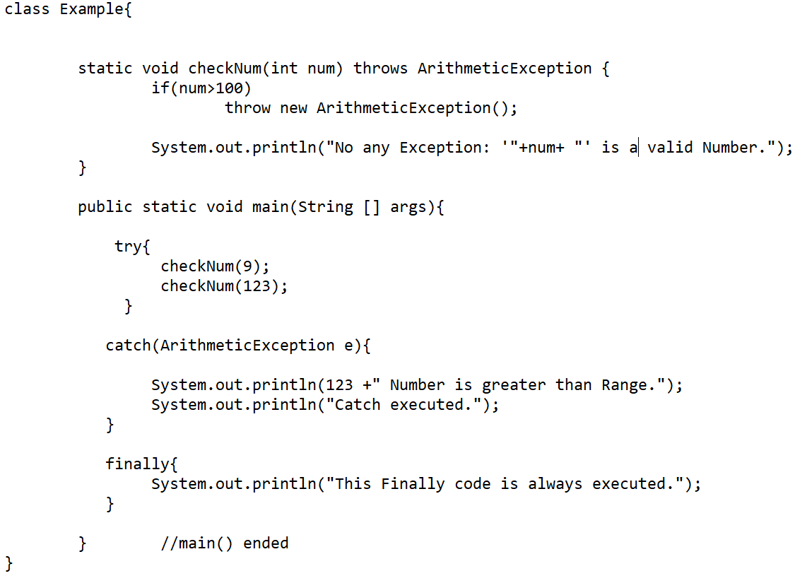
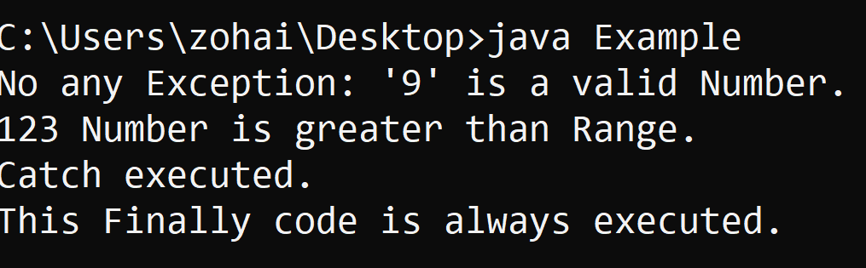
Example of using throw, throws and finally:
Code:
Output:

Slide 22
throw v/s throws:
throw:
throws:
“throw” is used to explicitly throw an exception.
throw is followed by an instance.
throw is used inside a method.
E.g: public void method(int a) {
//code
throw new object();
}
Multiple exceptions can not be thrown.
i.e this won’t be a valid code:
public void method()
{throw ArithmrticException(), ArrayIndexOutOfBounds();
//other code
}
“throws” is used to declare an exception.
throws is followed by class name.
throws is used with the method signature.
E.g: public void method(int a) throws ClassName {
//code
}
Multiple exceptions can be declared.
i.e public void method() throws IOException,SQLException, ClassNotFoundException etc
{ //code of method }

Slide 23
Any Question? ☹

Slide 24
THANK YOU ☺☺☺

