Slide 1
Continued… The Threat Environment: Attackers and Their Attacks
Reference:
Corporate & Network Security, Chapter 1
Raymond R. Panko
:

Slide 2
Agenda
The threat environment—attackers and their attacks
Basic security terminology
Employee and ex-employee threats
Traditional external attackers
The criminal era and competitor threats
Cyberwar and cyberterror

Slide 3
Trojan Horses and Rootkits
Trojan Horses
Rootkits
Take control of the super user account (root, administrator, etc.)
Can hide themselves from file system detection
Can hide malware from detection
Extremely difficult to detect (ordinary antivirus programs find few rootkits)
Rootkit detection programs often are specific to particular rootkits

Slide 4
Trojan Horses and Rootkits
Trojan Horses
Rootkits
In 2005 Sony BMG downloaded a rootkit onto the PCs of people playing Sony BMG media disks. The discovery of this digital rights management (DRM) rootkit generated extreme negative publicity. The negative publicity increased when it was discovered that the rootkit left the PC open to attack by anyone.
Lemos, http://www.securityfocus.com

Slide 5
2.3.3 Other Malware Attacks
Mobile Code
When you download a webpage it may contain executable code as well as text, images, sounds, and video. This is called mobile code because it executes on whatever machine downloads the webpage. In most cases mobile code is innocent and often is necessary if a user wishes to use a website’s functionality.

Slide 6
Other Malware Attacks
Mobile Code
Executable code on a webpage
Code is executed automatically when the webpage is downloaded
Javascript, Microsoft Active-X controls, etc.
Hostile code can do damage if computer has vulnerability

Slide 7
Other Malware Attacks
Social Engineering in Malware
Social engineering attacks take advantage of flawed human judgment by convincing the victim to take actions that are counter to security policies

Slide 8
Other Malware Attacks
Social Engineering in Malware
Social engineering is attempting to trick users into doing something that goes against security policies
For example if an employee receives an email message warning about a mass layoff being imminent, he or she may open an attachment and therefore download a virus, worm, or trojan horse.

Slide 9
Other Malware Attacks
Social Engineering in Malware
Several types of malware use social engineering
Spam
Phishing
Spear phishing (aimed at individuals or specific groups)
Hoaxes

Slide 10
Other Malware Attacks
Social Engineering in Malware
Spam
The bane of all email users is spam which is defined as unsolicited commercial e-mail.
In addition to being annoying, spam messages are often fraudulent or advertize dangerous products

Slide 11
Other Malware Attacks
Social Engineering in Malware
Spam
Spam has become a common vehicle for distributing viruses, worms, trojan horses, and many other types of malware
According to MessageLabs, 73% of all e-mail messages were spam in March 2009.
http://www.messagelabs.com

Slide 12
Other Malware Attacks
Social Engineering in Malware
Spam
Even the load on networks caused by simply transmitting and storing spam can be significant. New forms of spam consist of image bodies in stead of text bodies to avoid detection from scanning programs.
Image spam messages are much larger than traditional text spam messages.

Slide 13
Other Malware Attacks
Social Engineering in Malware
Phishing
In phishing attacks victims receive email messages that appear to come from a bank or another firm with which the victim does business. The message may even direct the victim to an authentic-looking website. The official appearance of the message and website often fool the victim into giving out sensitive information.
A Gartner survey in 2007 revealed that US consumers were scammed out of USD 3.2 billion that year.

Slide 14
Other Malware Attacks
Social Engineering in Malware
Phishing
In 2004 when phishing was fairly new but already well known to consumers, a study showed consumers a group of email messages and asked whether each email was a phishing attack or not.
The consumers judged 28% of the phishing messages to be legitimate messages. They also believed a fair number of legitimate messages were phishing messages.

Slide 15
Other Malware Attacks
Social Engineering in Malware
Spear phishing (aimed at individuals or specific groups)
Normally phishing attacks tend to appeal broadly to many people so they can dupe as many people as possible.
In one case a number of CEOs received a message disguising itself as a court order. The message directed the CEOs to a website uscourts.com. There the CEOs could find court documents and a plug-in to view the documents. The plug-in was spyware !
(http://www.pcworld.com) ; 2008

Slide 16
Other Malware Attacks
Social Engineering in Malware
Hoaxes
The sulfnbk.exe hoax told computers that a virus called AOL.exe was travelling around the Internet. The hoax said that they should delete the file sulfnbk.exe. Victims who did so were really deleting their AOL access
Other hoaxes have tried to persuade victims to delete their antivirus protection and even critical operating files needed for their computers operation.

Slide 17
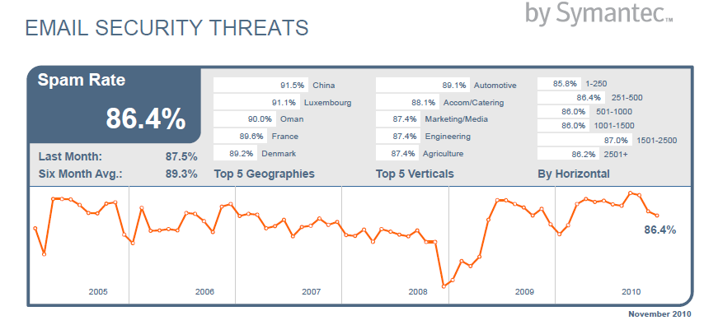
MessageLabs Intelligence http://www.messagelabs.com

Slide 18
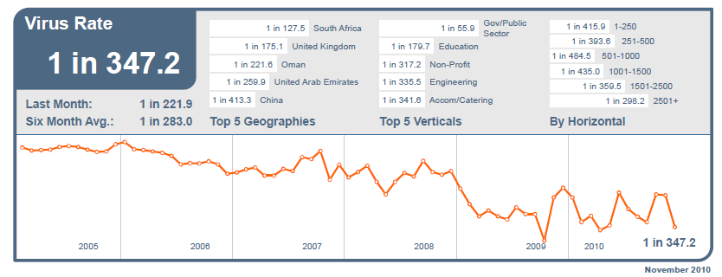
MessageLabs Intelligence http://www.messagelabs.com

Slide 19
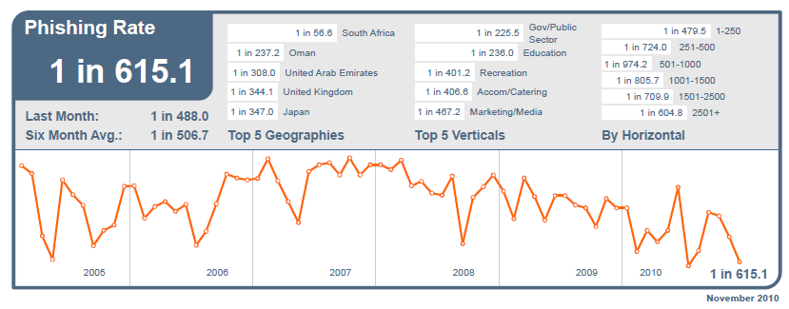
MessageLabs Intelligence http://www.messagelabs.com

Slide 20
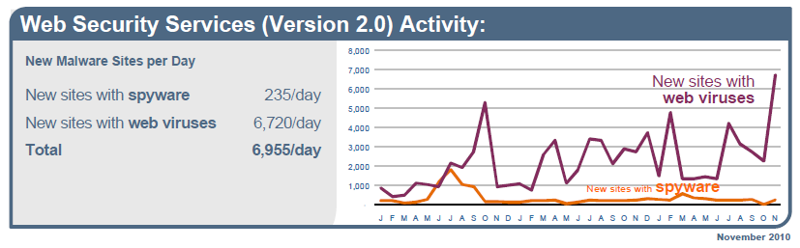
MessageLabs Intelligence http://www.messagelabs.com

Slide 21
McAfee Spam Checklist (Do…)
Unsubscribe from legitimate mailings that you no longer want to receive.
Be selective about the Web sites where you register your email address.
Avoid publishing your email address on the Internet.
Delete all spam.
Avoid clicking on suspicious links in email or IM messages as these may be links to spoofed websites.

Slide 22
McAfee Spam Checklist (Do not…)
Open unknown email attachments. These attachments could infect your computer.
Reply to spam. Typically the sender’s email address is forged, and replying may only result in more spam.
Fill out forms in messages that ask for personal or financial information or passwords
Buy products or services from spam messages.
Open spam messages.

