Slide 1
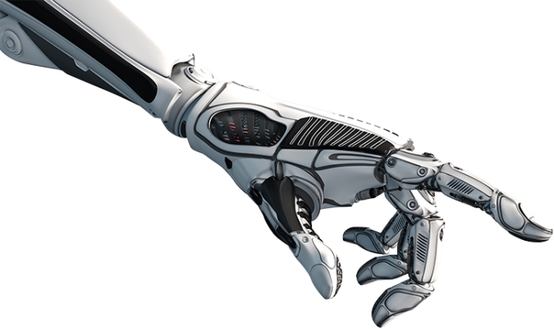
Robotics in-hand control by vibrations
Zohar Franco

Slide 2
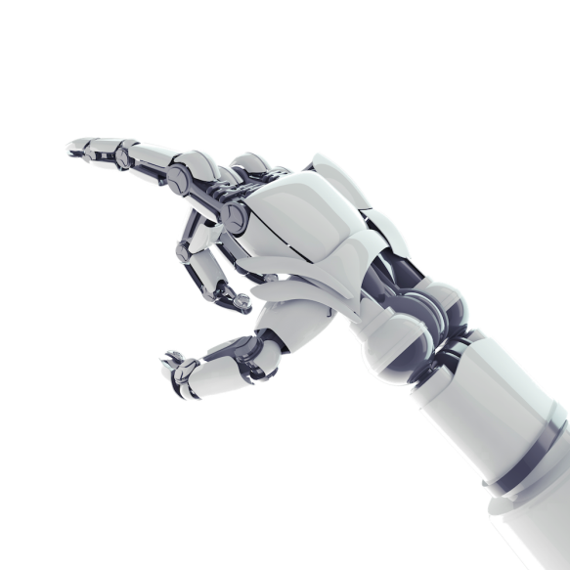
The research
The study is led by Noam Nahum
Robotics laboratory - Dr. Avishai Sintov.
In-hand manipulations is a field in robotics. It has many uses in variety of industries.
Today, most of the solutions are complex and sophisticated hands at high prices.
Way to enable in-hand manipulations using a simple hand.

Slide 3
The research solution
Vibration motor and simple hand.
Robotics vibrations - allows in-hand control.
Use finger vibrations for credit card repositioning.
Ability of in-hand control of different objects using an inexpensive hand.
Reduces costs of using the ability – use in new areas.

Slide 4
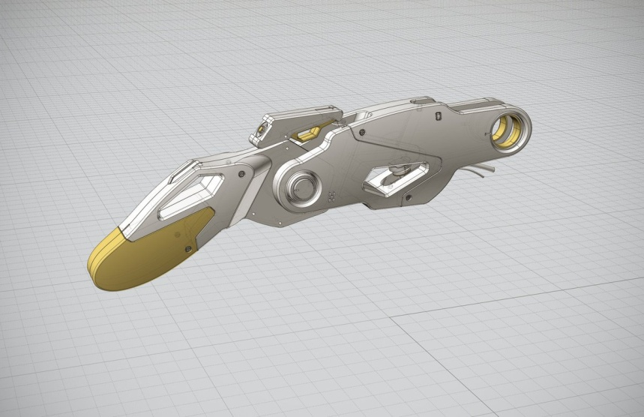
Need for research
There was a need to find the curve of the finger.
The motor activates vibrations that affect the curve of the finger.
In order to control the in-hand manipulations, the curve must be known and analyzed.
static state - constant force.
state of oscillation - curve depends on time.

Slide 5
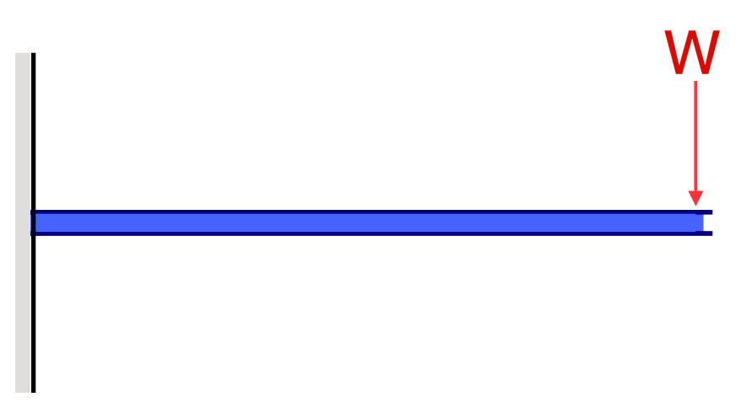
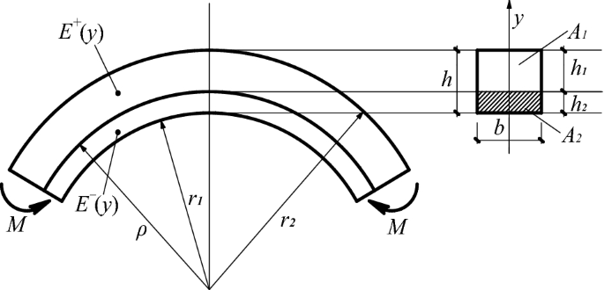
Bending beams
The Course ‘Solid Mechanics’.
The theory of small deformations and deflections.
Model the finger as a harness beam.
Calculating the curvature of the finger according to the theory.

Slide 6
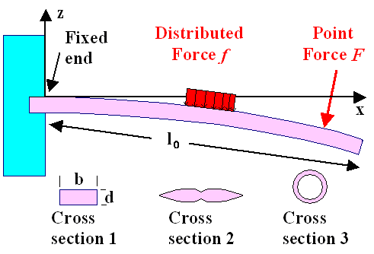
My work
Python program to represent a finger as a complex beam
Beam is made of different materials with different cross sections.
Calculates different attributes in static state.
Calculates finger curve in static state.

Slide 7
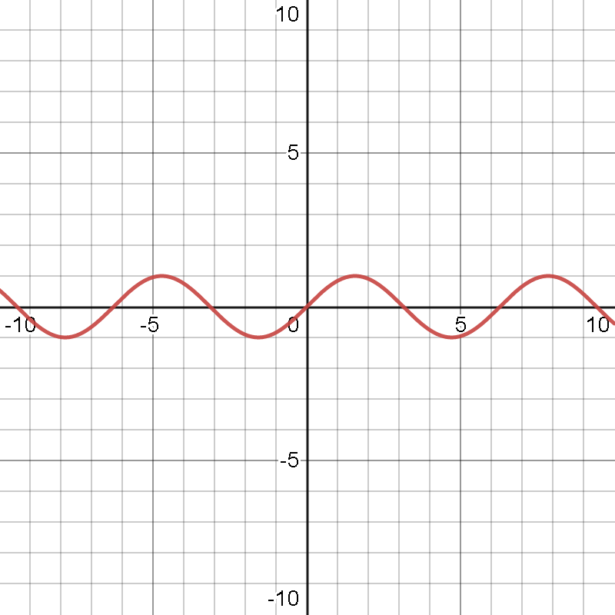
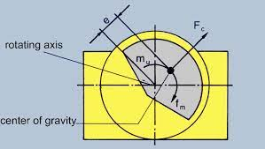
Vibrations
The real force acting on the finger is sinusoidal force.
The behavior of the object changes completely.
The beam curve should be analyzed using the theory of oscillations.
F(t) = Acos(wt)

Slide 8
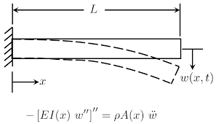
Future
I continued the program and built its foundation to adapt to the existing situation and address time-dependent force.
Until now the program can’t calculate the finger curve in vibrations dynamics.
I have to study vibrations theory in depth and then continue the program to find the vibrations curve.

Slide 9
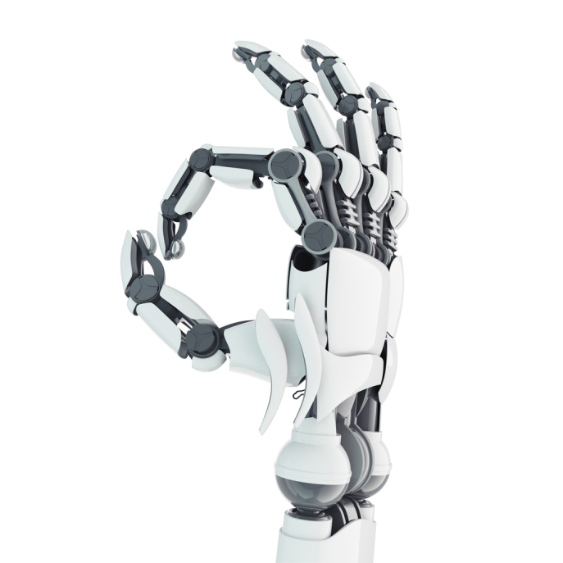
Thank you You

