Slide 1
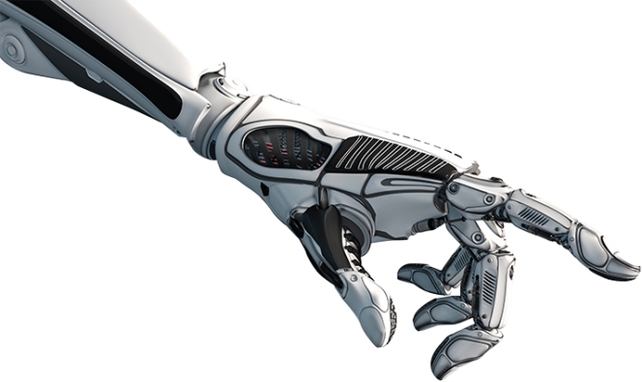
Tiltle
Zohar Franco

Slide 2
The problem
…
….

Slide 3
The solution
…
….

Slide 4
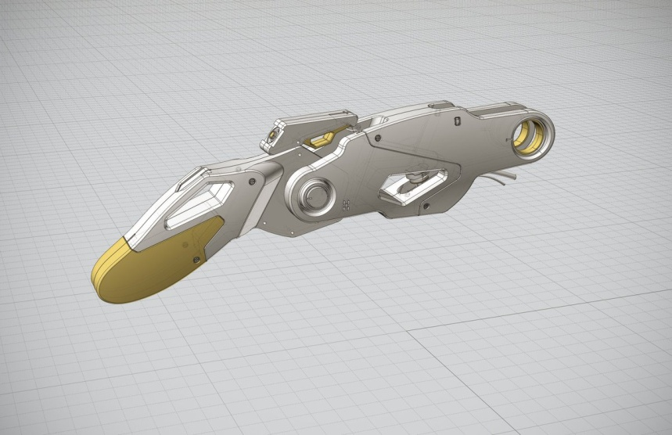
Need
…
….
…

Slide 5
Subject

Slide 6
My work

Slide 7
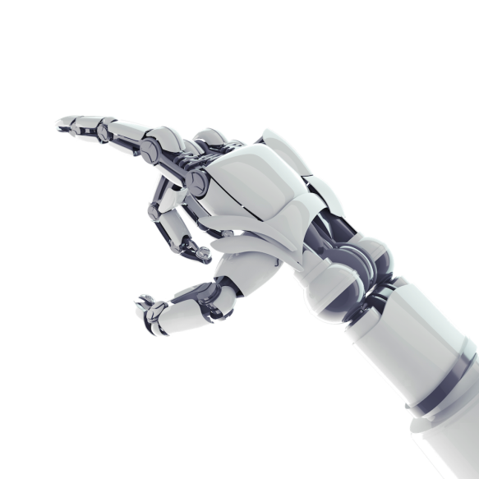
Future

Slide 8
Thank you You

