Slide 1

Introduce myself
Contents
1. Mindset and Goal
2. Timeline
3. Strengths and weakness
4. Results
5. Q&A
Presenter: Nguyen Thi Tham

Slide 2


1. Mindset and Goal
Health and knowledge are the only two objects that belong to yourself.
Become the successful manager
Wherever there is a willpower there is a pathfinder.
Communicate directly to customer
Notes:
Take care of your body. It’s the only place you have to live.

Slide 3




3. Timeline
Test leader and BA
Test leader and PM
Graduated and start working
Test leader
2013
2015
2016
2018

Slide 4
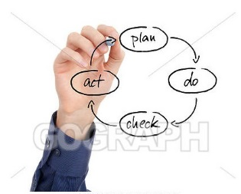

4. Strengths and weakness
4.1 Strengths
4.2 Weakness
Conservative
Perfectionist
Test skills
Test techniques,…
Test activities
Test levels, test types
Reality
Reading book, practice to listen more and more
Solf skills
Proactive, self motivation
Teamwork, communication, leadership
Careful, hardworking, serious, continual improvement
Action
Research and confirm the understanding of myself
Identity
Creativity
Each phase has a maximum two goals
Participate many project types
Design test cases with different approaches
Trainer in the test team
Analysis SRS and transfer for team
…
Experience
Reduce weakness and focus on my goal

Slide 5
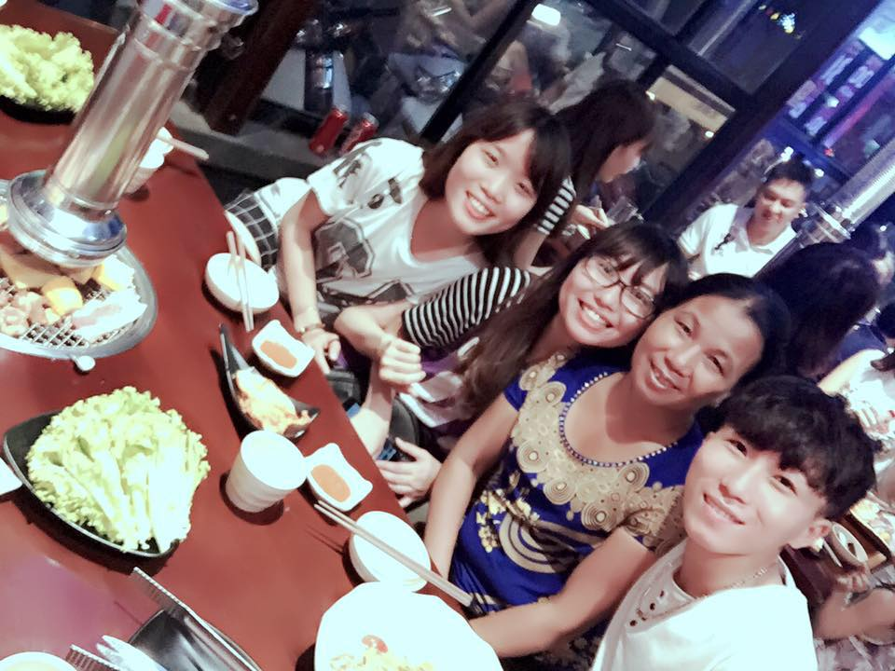




5. Results
Thank you so much for your listening!
Certificates
Effect
Family
ISTQB, Toeic 735, Pragmatic scrum
Become the best person in 2015 and 2017
Family is like music some high notes some low notes but always a beautiful song

