Slide 1

Seasonal Agriculture Performance Analysis
Zohra Sayyed Abed Ali
ID: STU6949018513bee1766392197

Slide 2

PROBLEM STATEMENT
(Agricultural activities are influenced by seasonal variations in environmental conditions, farming practices, resource availability and market conditions. As a result, agricultural performance may differ from one season to another. However, raw agricultural data does not clearly explain how agricultural performance changes across seasons or what patterns can be observed in different seasonal conditions. The problem is to analyze the given agricultural dataset and investigate seasonal differences in agricultural performance by identifying meaningful patterns, trends, relationships and variations within the available data.

Slide 3
Project Description
This project analyzes a seasonal agriculture performance dataset of 4,000 farm records across Kharif, Rabi, and Zaid seasons in India. Using Python (Pandas, Matplotlib, Seaborn), the dataset was cleaned, explored, and analyzed through univariate, bivariate, and multivariate techniques to uncover how rainfall, irrigation method, and other environmental factors influence crop yield, profitability, and disease/pest risk across seasons. The goal is to identify actionable, evidence-based seasonal patterns that can support better agricultural planning and decision-making.

Slide 4

WHO ARE THE END USERS?
Farmers & Agricultural Cooperatives — to plan crop and irrigation choices season-wise
Agricultural Policy Makers — to design seasonally-targeted support and subsidy programs
Agri-Finance & Insurance Providers — to assess seasonal risk before lending or insuring
Agricultural Researchers & Universities — to study seasonal crop performance patterns
Irrigation Equipment Suppliers — to recommend the right irrigation method per season

Slide 5

Technology Used
Python — core programming language for the analysis
Pandas & NumPy — data loading, cleaning, and manipulation
Matplotlib & Seaborn — data visualization (bar charts, histograms, heatmaps, scatter plots, box plots)
Jupyter Notebook / Google Colab — development environment for the analysis
GitHub — version control and project submission

Slide 6
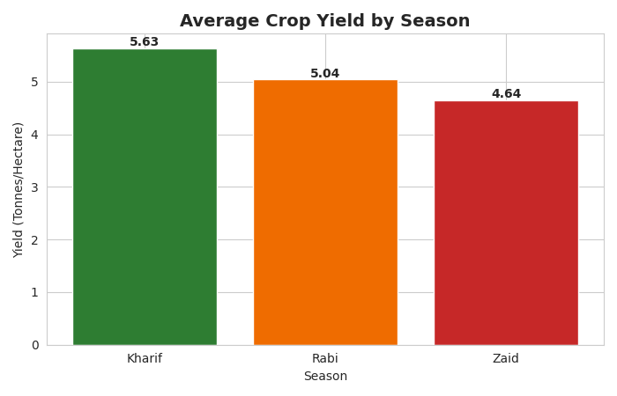
RESULTS
Kharif delivers the highest average yield (5.63 t/ha), followed by Rabi (5.04 t/ha) and Zaid (4.64 t/ha).

Slide 7
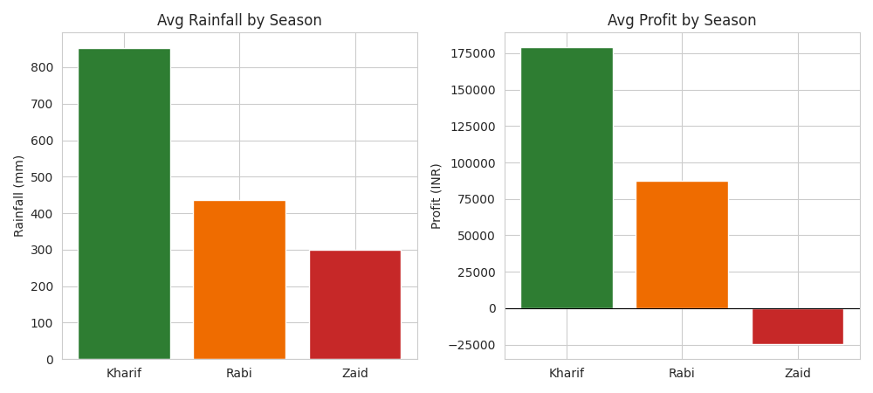
RESULTS
Kharif is the most profitable season (avg profit ₹1.79 lakh/farm); Zaid runs an average LOSS of ₹24,805/farm, with 64.5% of Zaid farms unprofitable.

Slide 8
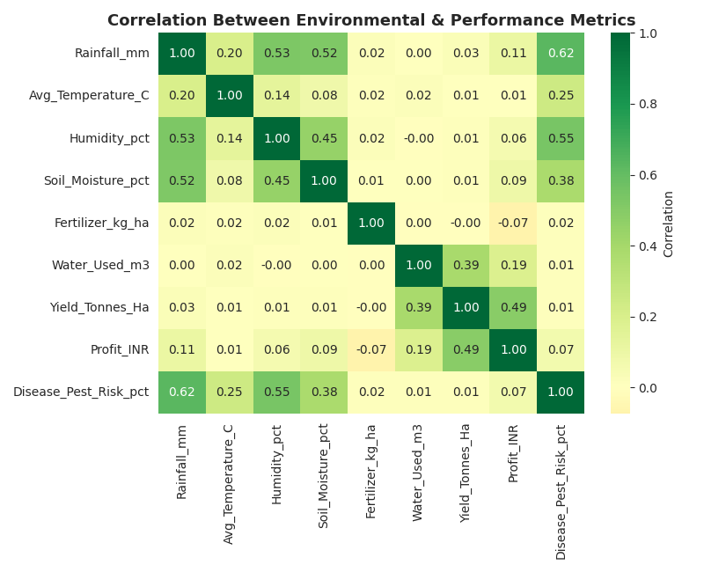
RESULTS
Rainfall correlates strongly with Disease/Pest Risk (r=0.62), while Yield is nearly independent of Rainfall (r=0.03) — irrigation matters more than rain.

Slide 9
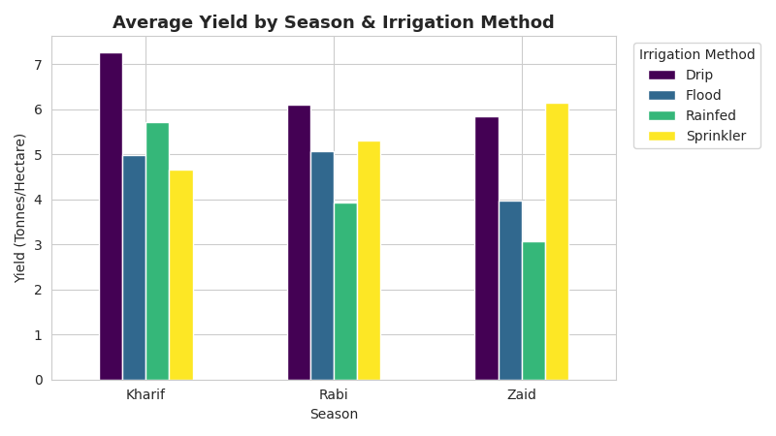
RESULTS
Drip irrigation performs best in Kharif & Rabi, but Sprinkler irrigation outperforms it in the hot, low-rainfall Zaid season.

Slide 10
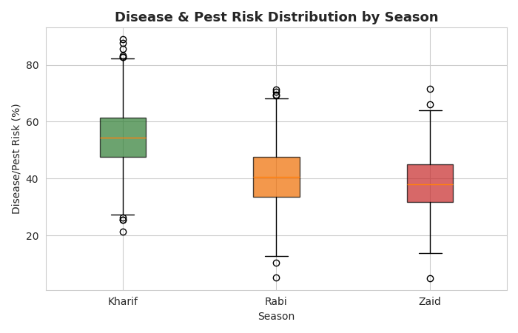
RESULTS
Kharif has the highest disease/pest risk (54.5%) due to high rainfall & humidity; Zaid has the lowest (38.2%).

Slide 11
Future scope
• Incorporate multi-year data to study year-over-year seasonal trends, not just a single cycle.
• Build a predictive model (e.g. regression) to forecast yield or profit based on season, irrigation method, and weather inputs.
• Add region/state-level drill-down dashboards for state-specific seasonal recommendations.
• Integrate real-time weather and market price feeds for dynamic, up-to-date seasonal planning.
• Extend the analysis to recommend an optimal crop + irrigation combination for each season and region.

Slide 12
GitHub Link
https://github.com/YOUR-GITHUB-USERNAME/Seasonal-Agriculture-Performance-Analysis

Slide 13
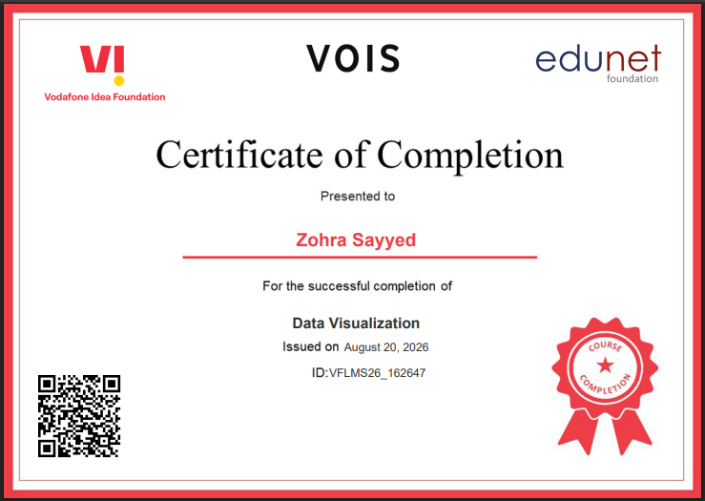
VOIS Course completion certificate -
Course name- Data Visualization

Slide 14
Thank you
.
.

