Slide 1
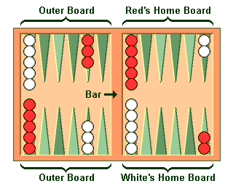
Backgammon bot
Introduction
Algorithm
Results
Backgammon is a game for two players, played on a board consisting of twenty-four narrow triangles called points. The triangles alternate in color and are grouped into four quadrants of six triangles each. The object of the game is to move all your checkers into your own home board and then bear them off. The first player to bear off all their checkers wins the game.
Algorithm used for this problem is Expectiminimax. Expectiminimax is used because backgammon is a stochastic game and not solely dependent on your skills at the game. Only drawback of this algorithm is a lack of pruning options, which leads to higher turn times especially in a game that has a branching factor of 250.
Expectiminimax bot played 2 sets of 100 games against a bot that has randomly chosen a move and in total it won 189 times out of 200. This is acceptable, because we need to factor in the luck of the dice roll which in real life can lead to a stronger player losing to a weaker one. Against a human it won 7 out of 10 games. Average turn time was 1.5s but for some particular turns, turn time can be up to 15s.
Problem
Even though the game does not seem that complicated with its pretty simple goal, there are a lot of move possibilities. If two dice with an equal value are thrown, we can have up to 4 moves if they are legal. Branching factor for a game like backgammon is 250.
Picture 1: Backgammon board
Chart 1: Comparing games won

