Slide 1
Market Analysis Tool
Agentic Streamlit Application

Slide 2
Problem & Value Proposition
🎯 What problem are we solving?
Investors often need to:
Gather stock price data
Review recent financial news
Interpret trends
Formulate an investment decision
This process is:
Time-consuming
Fragmented across multiple platforms
Hard to synthesize quickly
👥 Target Users
Financial analysts
Anyone evaluating publicly traded companies
💡 Value Proposition
Solution => The Market Analysis Tool
Collects relevant stock and news data automatically
Summarizes insights using an LLM
Produces a concise, tailored recommendation
Reduces research time significantly
It transforms data overload → actionable insight.

Slide 3
Agent design
Built using
Streamlit
GPT-4o-mini as LLM
Modular agent architecture
🧠 Agent Workflow
User submits a company-related question
Agent gathers:
Stock market data
Recent company news
Data is structured and passed to the LLM
LLM generates the summary and investment-oriented recommendation
Output displayed in Streamlit UI
Notes:
Memory & State Management
Current implementation:
❌ No long-term memory
❌ No persistent state
✅ Session-based execution only
Future extension possibilities:
Conversation memory
Portfolio tracking
Vector-based knowledge storage

Slide 4
Evaluation Strategy
Meaning of Success
Functional strategy
Does it return the relevant stock data and news?
Is the recommendation coherent?
Reliability
Ratio of successful and failed recommendations
User value
Time saved vs manual search
Output clarity
📊 Monitoring & Metrics
The application includes:
Session-based usage chart
Success vs. failed recommendation tracking
Threshold-based monitoring alert
If failure count exceeds predefined threshold:
Alert can be triggered
Logs can be exported to:
Amazon CloudWatch
Notes:
LLM-as-a-Judge can be used to validate the LLM recommendation

Slide 5
Deployment Plan
🏗 Hosting Requirements
Streamlit requires:
Persistent runtime
Long-running service
Container support
🚀 Recommended Architecture
Option 1 — Containerized Deployment
Dockerized application
Hosted on Amazon EC2 or ECS
Benefits: Stability, Scalability, Predictable performance
Secrets stored securely in AWS Secrets Manager
Notes:
Option 2 — Hybrid Serverless (If No State Needed)
Frontend on Amazon S3
Backend logic via AWS Lambda
Best suited when:
No persistent session required
Stateless design is sufficient

Slide 6
Logging & monitoring considerations
Recommended production setup:
Centralized logging (CloudWatch)
Track:
LLM latency
Error rate
API failures
Usage frequency
Alerting on:
High failure ratio
Excessive latency
Token usage spikes

Slide 7
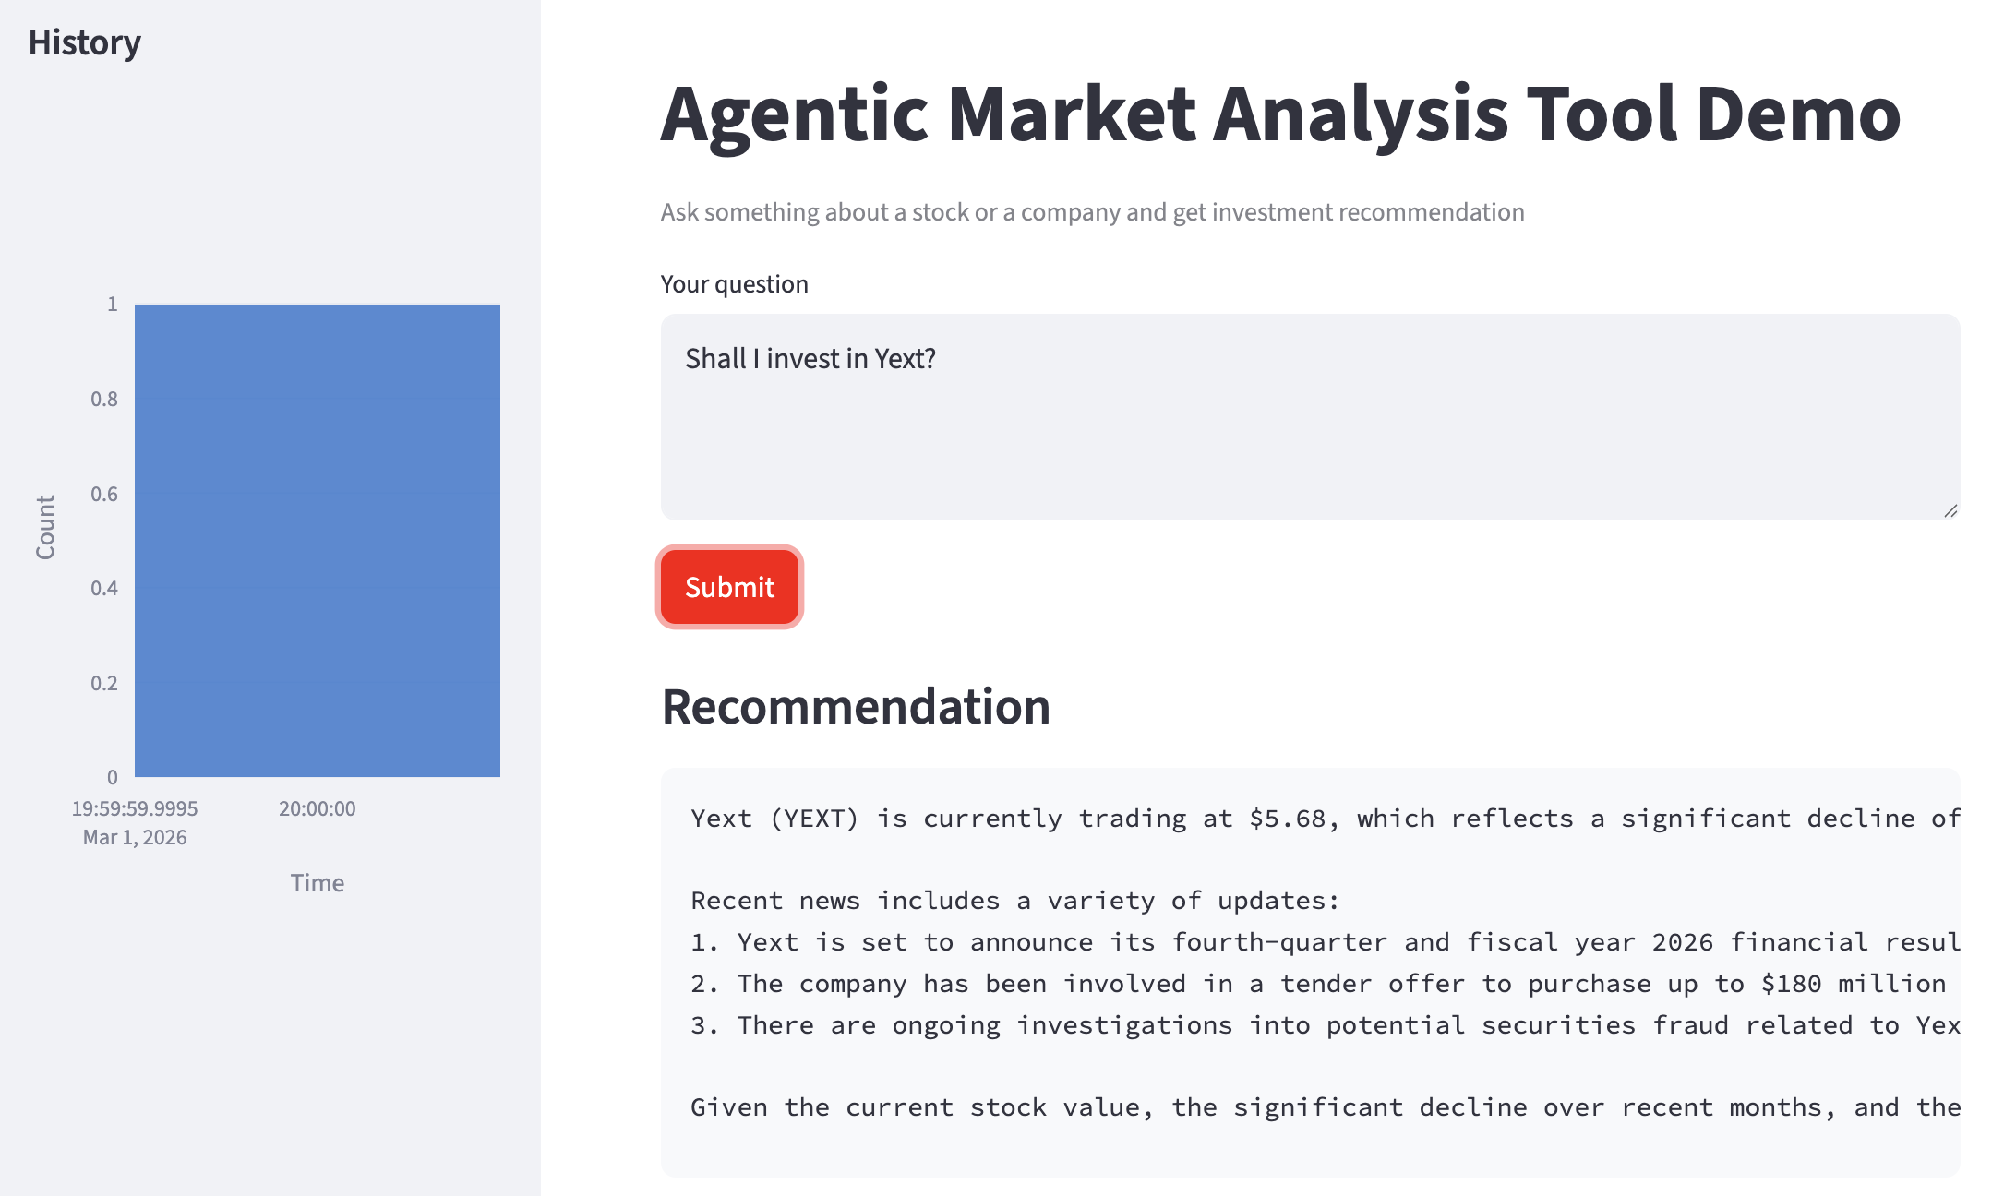
Running the App

Slide 8
Thank you

