Slide 1
Customer Behavior
Intelligence
Predictive Modeling & Customer Segmentation
on 5 Million Nigerian Banking Transactions

Slide 2
Dataset at a Glance
Nigerian banking transactions · Jan 2023 – Dec 2024 · 15 raw columns
5M
100K
92%
₦329B
Transactions
Customers
Success Rate
Total Volume
2 years of history
100K unique accounts
7% failed · 1% other
₦65.6K mean per txn
Channel Mix: Mobile 35% · POS 30% · ATM 20% · Web 10% · Branch 3%
Geography: Lagos 24.5% · Abuja 10.9% · Rivers 8.9% · 37 unique states

Slide 3
Data Cleaning & Exploratory Analysis
10-Step Cleaning Pipeline
Key EDA Findings
1
Remove duplicate rows & transaction IDs
Monthly Volume:
2
Validate timestamps — all 5M valid
~208K transactions/month (steady 2023–24)
Peak Hour:
3
Validate amounts — no negatives or zeros
2 – 4 PM daily · Weekdays dominate
Flag balance inconsistencies (6.93% of rows)
Top Channel:
4
Mobile 35% · POS 30% · ATM 20%
5
Standardise categoricals (lowercase, strip)
Geographic Hub:
Lagos 24.5% · Abuja 10.9% · Rivers 8.9%
6
Fill merchant nulls (60%) & device nulls (55%)
Balance Consistency:
7
Extract time features: hour, DOW, weekend flag
89.3% debit OK · 100% credit OK
Amount Profile:
8
Flag amount outliers via 3× IQR fence
Median ₦13,300 · Mean ₦65,622 · Max ₦5M
Outliers Flagged:
398,964 transactions above 3× IQR fence
Failed Transactions:
Agent banking has highest failure rate

Slide 4
Feature Engineering — 70 Customer-Level Features
Aggregated across 4.6M successful transactions · 100K customers · 10 behavioral feature groups
RFM
Txn Type
Channel
Temporal
Status
Recency, frequency,
monetary stats
Debit/credit counts
& ratios
Per-channel ratios,
primary + diversity
Tenure, peak hour,
entropy, weekend
Failed/pending/
reversed rates
Balance
Geography
Merchant
Monthly Trends
Outlier Behavior
Avg, max, min, std
of balance
Primary state,
unique states/LGAs
Unique merchants &
MCC counts
3M vs 6M trend,
monthly volatility
Large-amount
transaction ratio

Slide 5
Feature Importance — LightGBM + SHAP Analysis
Target: 3-month transaction count · 64 features · R² = 0.789 · MAE = 1.32 · LightGBM Regressor on 80K customers
Rank | Feature | SHAP Score | Gain Rank | Category
1 | frequency | 2.07 | #8 | RFM
2 | recency_days | 0.73 | #20 | RFM
3 | status_success_count | 0.42 | #10 | Status
4 | total_txn_all_status | 0.41 | #12 | Status
5 | txn_type_debit_count | 0.34 | #4 | Txn Type
6 | balance_inconsistent_count | 0.33 | #9 | Balance
7 | status_reversed_count | 0.33 | #1 | Status
8 | n_active_days | 0.30 | #11 | Temporal
9 | status_pending_count | 0.29 | #2 | Status
10 | monthly_count_mean | 0.27 | #21 | Trend
Frequency #1
Transaction count beats every monetary feature. Future engagement is predicted by past activity, not past spend.
Status Signals
4 of top 10 features are status-based. Friction (failures, reversals) is a leading indicator of disengagement.
Gain vs SHAP
Gain ranks status_reversed_count #1 (single-split impact); SHAP ranks frequency #1 (consistent across all rows).

Slide 6
Predictive Model — Next-Month Transaction Forecasting
LightGBM · Customer × Month panel · 2.4M rows · 47 time-series features · Strict temporal split
47 Time-Series Feature Categories
Model Performance
Lag Features (8)
0.924
0.919
Count & amount at t-1, t-2, t-3, t-6
Rolling Windows (6)
MAE
R²
3m/6m rolling mean & std of count
Seasonal / Calendar (6)
18%
< 1
Sin/cos month, Q1/Q4 flags, index
Current-Month Signals (16)
vs Baseline
Avg Error (txns)
Debit/credit, failed/pending/reversed
Trend Features (3)
Accuracy by Activity Segment
1m/3m count diffs, lagged debit ratio
Segment | Customers | MAE
Inactive (0 txns) | 83,023 | 0.68
Low (1–2) | 87,233 | 0.79
Medium (3–5) | 20,332 | 1.23
High (6–10) | 5,569 | 2.02
Very High (>10) | 3,832 | 4.50
Static Customer Profiles (8)
Monetary stats, balance, entropy

Slide 7
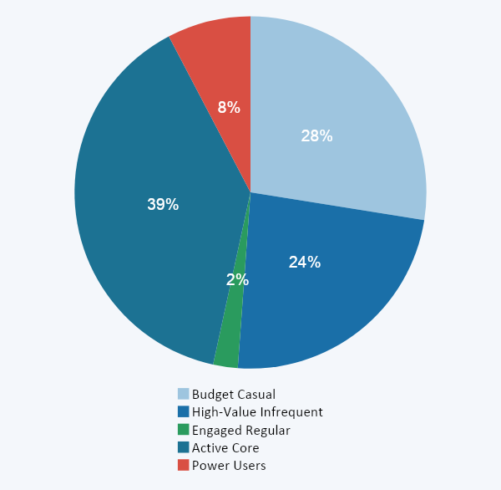
Customer Segmentation — 5 Behavioral Archetypes
K-Means · 25 features · 100K customers · K=5 selected (best Davies-Bouldin: 2.20) · Log-transform + StandardScaler
Budget Casual
~13 txns/yr · ₦29K avg
27,505 (27.5%)
8% failure rate · High friction
High-Value Infrequent
~14 txns/yr · ₦114K avg
23,649 (23.6%)
4× transaction size · Strategic priority
Engaged Regular
~17 txns/yr · ₦66K avg
2,259 (2.3%)
6.1% reversal rate · Investigate
Active Core
~34 txns/yr · ₦62K avg
38,905 (38.9%)
Highest growth trend (+0.42)
Power Users
~335 txns/yr · ₦67K avg
7,682 (7.7%)
Business/automated · All channels

Slide 8
Key Insights & Strategic Implications
01
02
03
Frequency Over Value
Hidden Revenue Segment
Rolling Averages Beat Lags
Count is the #1 predictor of future behavior — beats all monetary features. Engagement dashboards should lead with transaction frequency, not spend.
High-Value Infrequent customers (23.6%) make 4× larger transactions than Budget Casual yet have identical engagement metrics. Standard KPIs miss them entirely.
The 6-month rolling average outranks last month's raw count as the top time-series feature. Trajectory matters more than the most recent snapshot.
04
05
06
Friction Predicts Churn
Power Users Are Different
The Missing Middle Problem
Failed and reversed transactions concentrate in the least-engaged segments. It is a reinforcing cycle: friction leads to fewer transactions, which leads to more failures.
Even day-of-week distribution (entropy 2.78) and all-channel usage suggest business or automated accounts — requiring enterprise tools, API access, and SLA guarantees.
Only 2.3% of customers sit in the transition segment. The path from casual to active is binary — structural habits like auto-debits, not incremental nudges, are needed.

Slide 9
What We Delivered
1
Clean 5M-Row Dataset
Validated, deduplicated, standardised + 24 engineered columns ready for modeling
2
70 Behavioral Features
RFM, channel, temporal, status, balance, geography, merchant, trends across 100K customers
3
Time-Series Predictive Model
LightGBM · R² 0.919 · MAE 0.924 · 18% improvement over naive baseline
4
5-Segment Customer Map
Budget Casual · High-Value Infrequent · Engaged Regular · Active Core · Power Users

