Slide 1
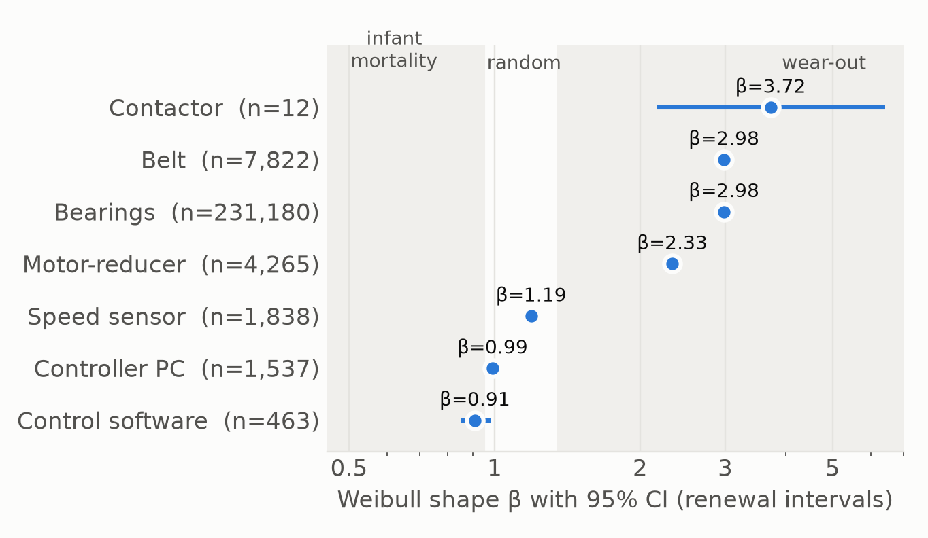
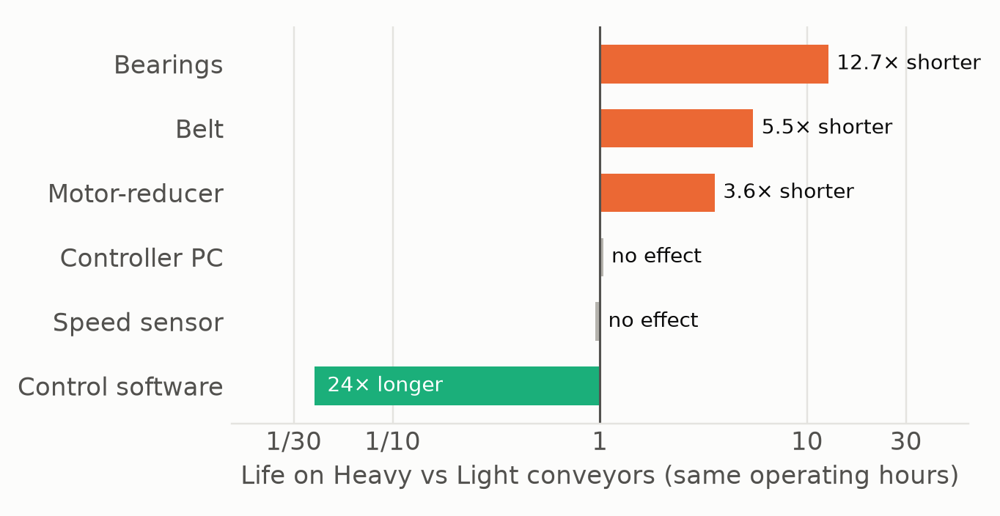
Bearings, belts and motor-reducers wear out, and load (not weather) sets how fast
Failure behaviour: 3 wear-out, 2 random, software infant mortality
Load is a stress multiplier, not just more hours
• Bearings cause 94% of failures (≈41 per conveyor-year); every failure costs exactly 36 h of downtime
• Every component renews perfectly: first-life and replacement lives are identical. The apparent 'shorter replacement belts' is Simpson's paradox (replacements happen mostly on Heavy conveyors)
• Weather does not drive failures: seasonal temperature steps and daily temp./humidity/voltage swings change failure rates by ≤ 5% (bearings: 0%)
Zoltan Hegyi, Jose Acosta Aldrete · Industrial Conveyor Reliability Data Challenge · fleet: 284 conveyors × 20 years

Slide 2
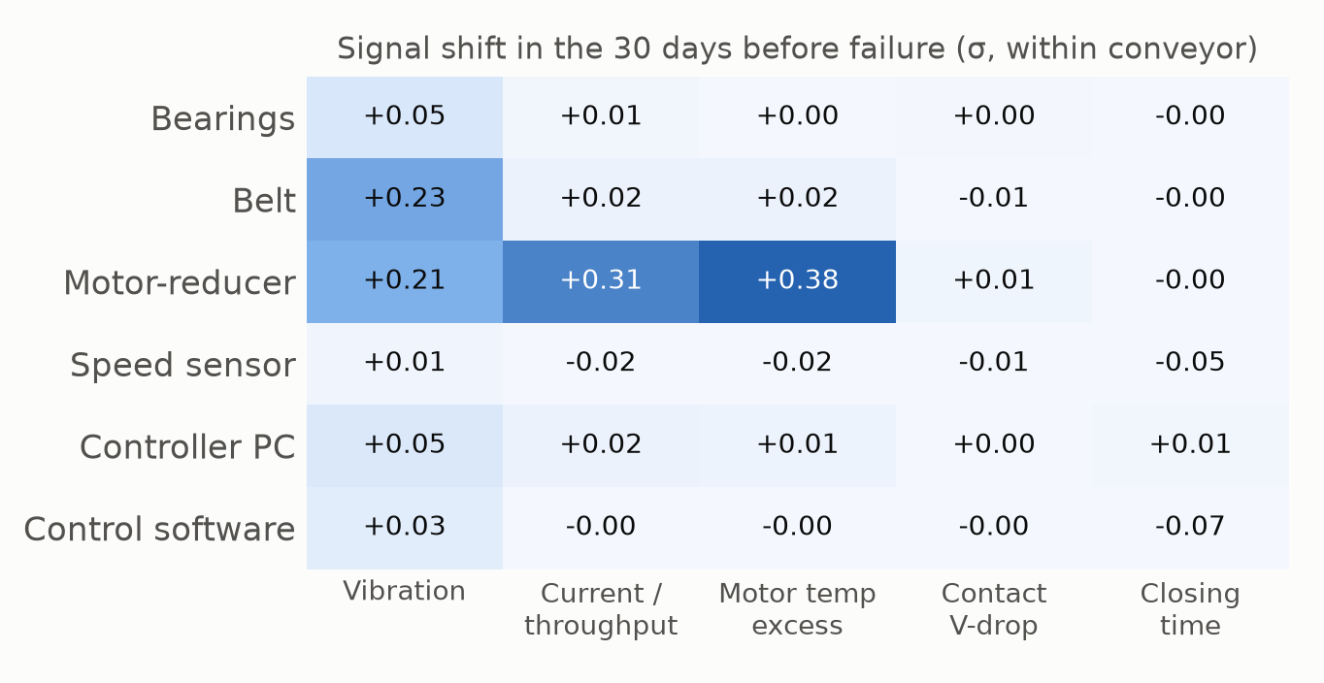
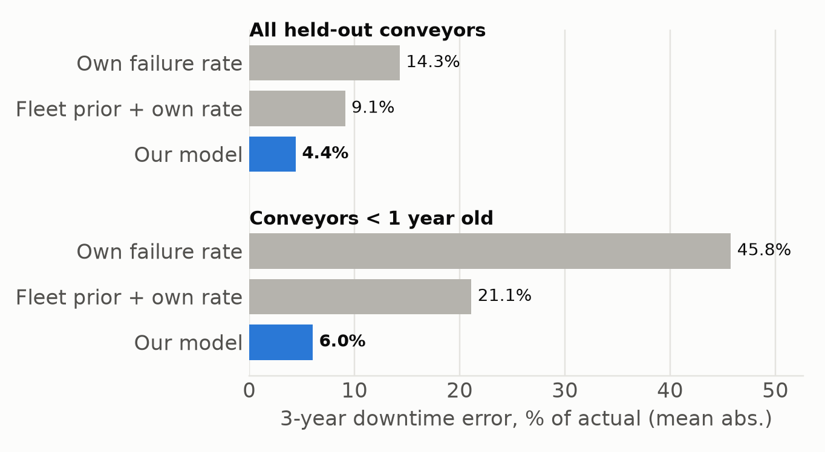
Downtime is a failure-count problem, and it is forecastable from the last observed day
Motor-reducer and belt failures announce themselves; bearing failures do not
Held-out conveyors (grouped CV): 3-year downtime error
• Downtime = 36 h × failures + 24 h × planned stops (3/yr, 15 Mar / 15 Jul / 15 Dec): forecasting it means forecasting the failure count
• Young conveyors ramp up: all bearings start new (β≈3), so failures rise through year 1 before settling. Tracking every bearing's age captures this
• Bad actors stay bad: a conveyor's failure rate vs. its load-class peers in years 1-10 predicts years 11-20 (r = 0.93), so each conveyor's own history is a key forecast input
• Contactor wear-out is emerging (12 failures, all on a restart after repair; β≈3.7, wide CI): watch it
Zoltan Hegyi, Jose Acosta Aldrete · Industrial Conveyor Reliability Data Challenge · fleet: 284 conveyors × 20 years

