Slide 1
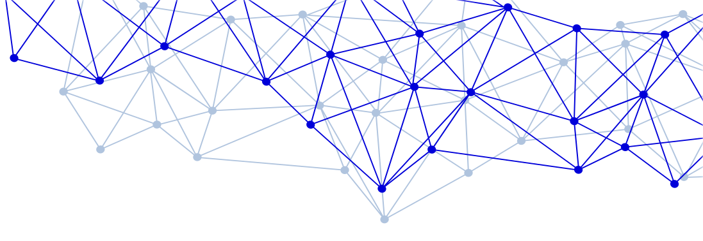

Social Network Analysis – “Second wave” (After the 90s)
Zoltán Brys
Masaryk University • Centre for the Digital Research of Religion
DISSINET – Dissident Networks Project
www.dissinet.cz

Slide 2
key questions
does the problem-solving require a relational-approach?
unit of analysis / unit of observation / unit of coding
state or event
boundaries of the network
ontology and context
(what does the network represent how was the data collected)

Slide 3
number of possible undirected binary graphs with 30 nodes?

Slide 4
number of possible undirected binary graphs with 30 nodes?
2^{(30 under two)} = 2⁴³⁵
(way more then the number of atoms in the observable universe)

Slide 5
First Wave of Quantitative SNA (~1970–~1990)

Slide 6
number of nodes (also isolated) / edges / density
average path length / diameter
reciprocity / recip cor coef
degree distribution
degree centrality
number of components
tie strength
…

Slide 7
betweenness centrality
closeness centrality
eigenvector centrality
clustering coefficient
edge weight analysis
community detection
core-periphery structure
…

Slide 8
Mantel Test
non-parametric matrix correlation test of two distance matrices
aplies node-permutation (randomly reassign node-order)
Mantel, N. (1967). The detection of disease clustering and a generalized regression approach.
Cancer research, 27:209-220.

Slide 9
MRQAP
Multiple Regression Quadratic Assignment Procedure
Extension of Mantel Test to multiple distance matrices
Still widely used [e.g. in health behavior, Arch of Sexual Behav (2021): 1-11.]

Slide 10
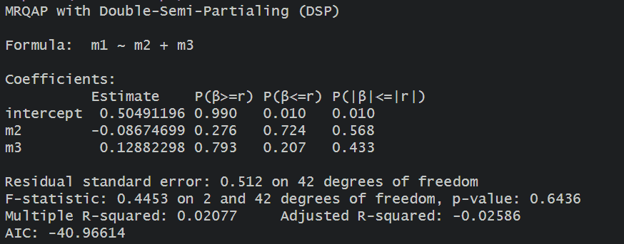
MRQAP

Slide 11
Second Wave (~1990–~2020)

Slide 12
ERGM | Exponential Random Graph Models | ergm
 | time-ERGM | tergm
 | Bayesian ERGM | bergm
 | Latent Order Logistic Graph Models | lolog
 | Signed ERGM | ergm.sign
 | ERGM to Egocentrically Sampled Data | ergm.ego
SAOM | Stochastic Actor-Oriented Models | RSiena
DyNAM | Dynamic Network Actor Models | goldfish
HREM | Relational Hyperevent Models | eventnet

Slide 13
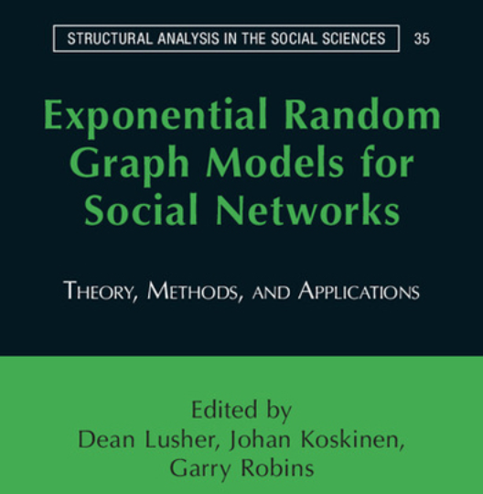

Slide 14
When to use ERGM
objective is to assess the aggregated outcome / long-term equilibrium of possible graph-generating mechanisms
primarily to understand states
input terms are the tie-generation functions of the graph
calculate the conditional log-odd probabilities of having an edge between two random nodes for all the given input terms

Slide 15
log(P(Y=y)) = θ⊤g(y)−logk(θ)
P(Y=y): probability of observing the specific network out of the set of all possible networks with the same node set.

Slide 16
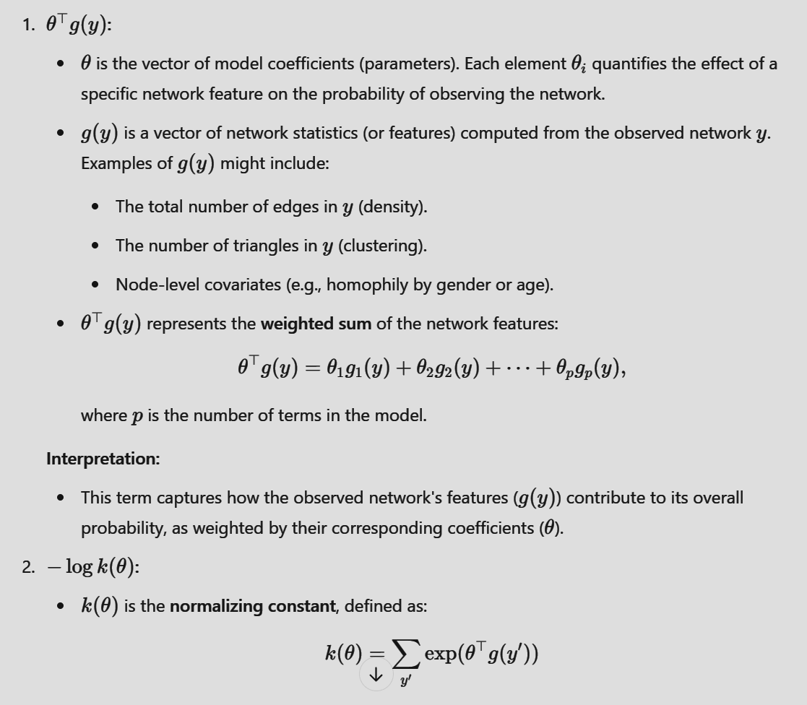

Slide 17
iterative
Maximum Likelihood Estimation
Markov Chain Monte Carlo (MCMC)
Convergence
why can the calculation take weeks?

Slide 18
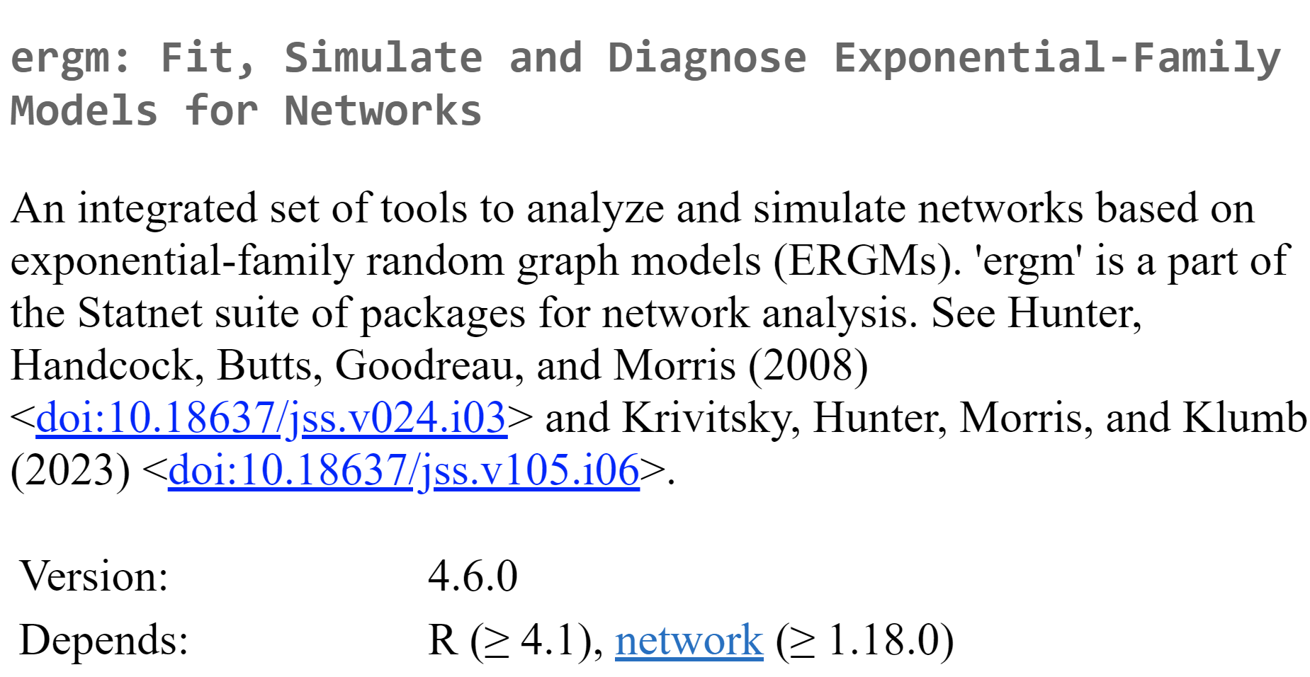
https://statnet.org/workshop-ergm/ergm_tutorial.html

Slide 19
practice

Slide 20
practice
load(“KRE_2025_ERGM.R”)

Slide 21
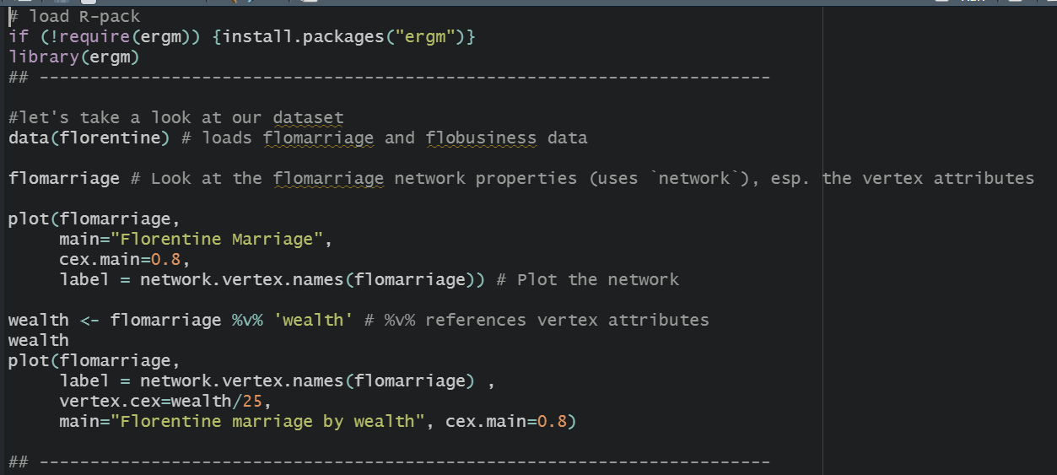

Slide 22
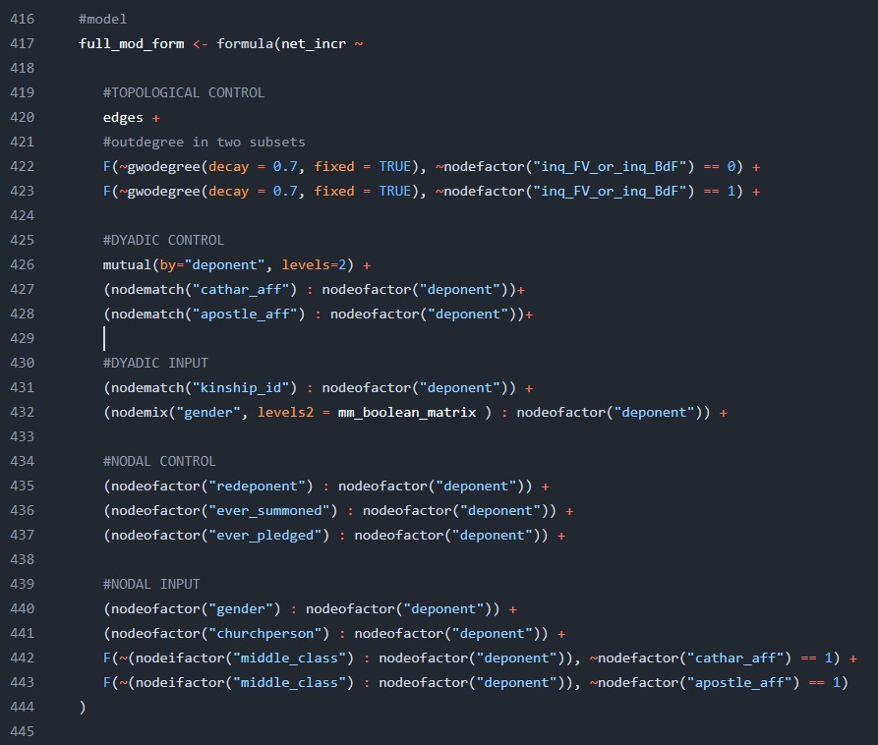

Slide 23
thx

Slide 24
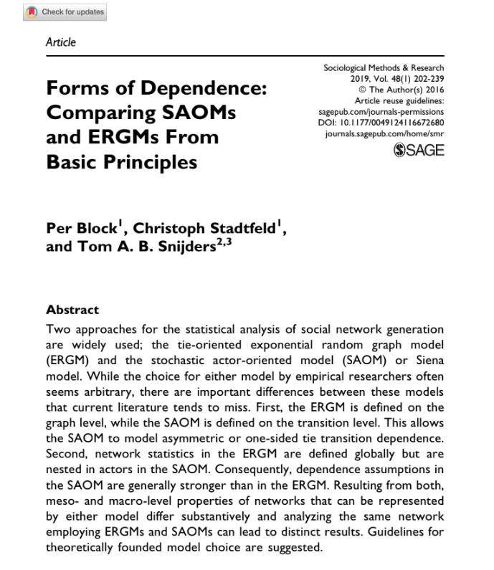
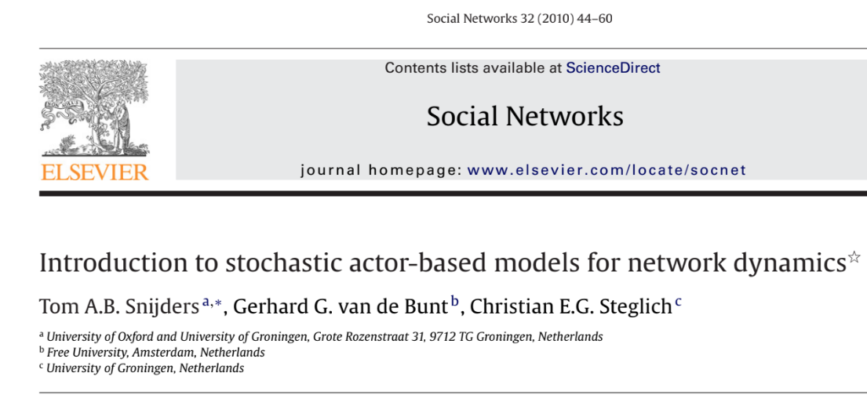
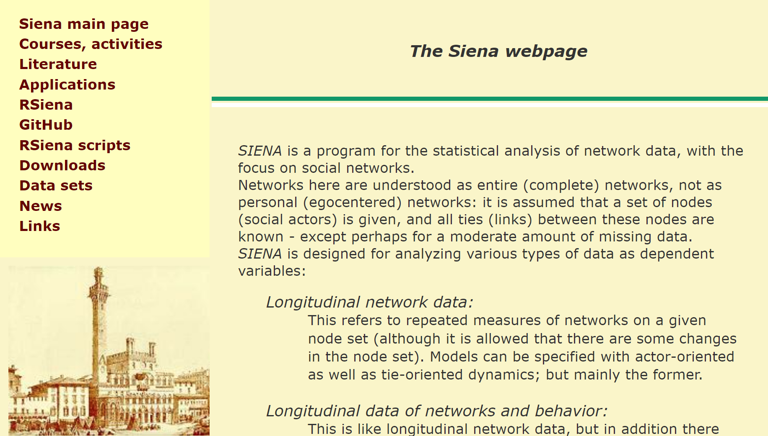

Slide 25
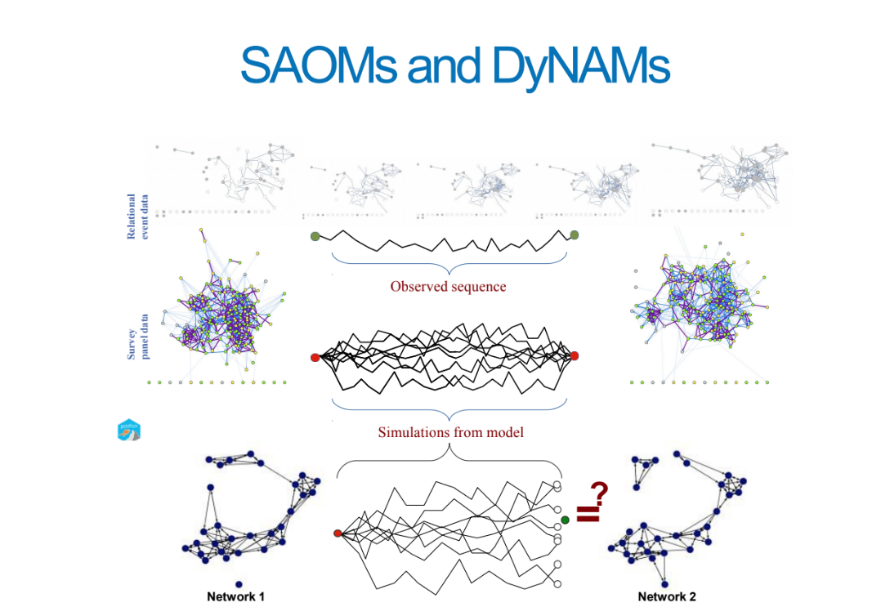

Slide from

Slide 26
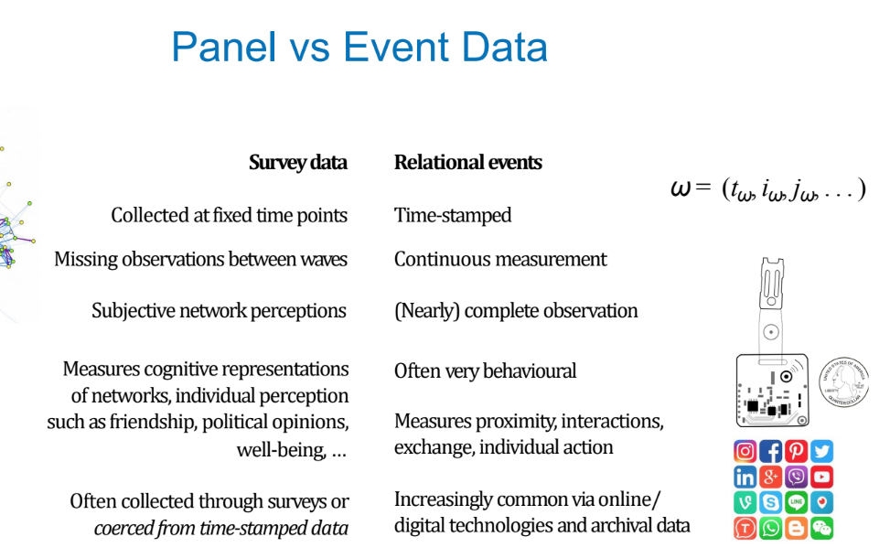
Slide from

Slide 27
HREM | Relational Hyperevent Models | eventnet

Slide 28
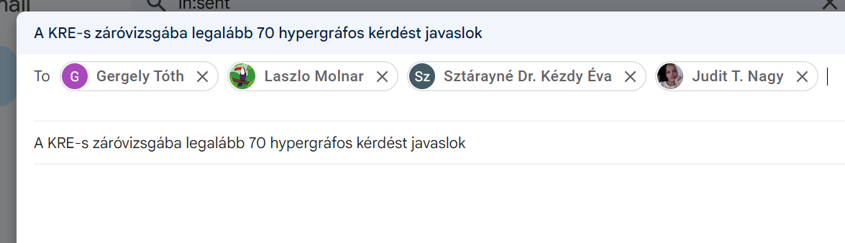
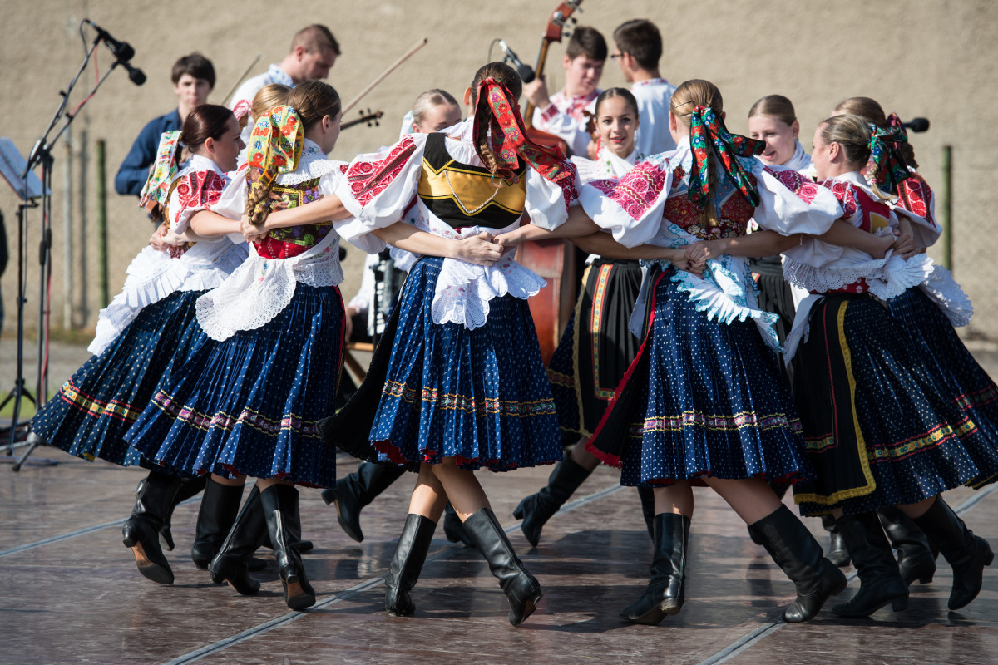
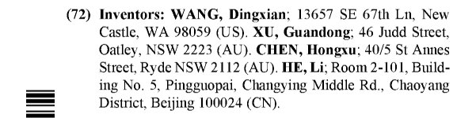

Slide 29
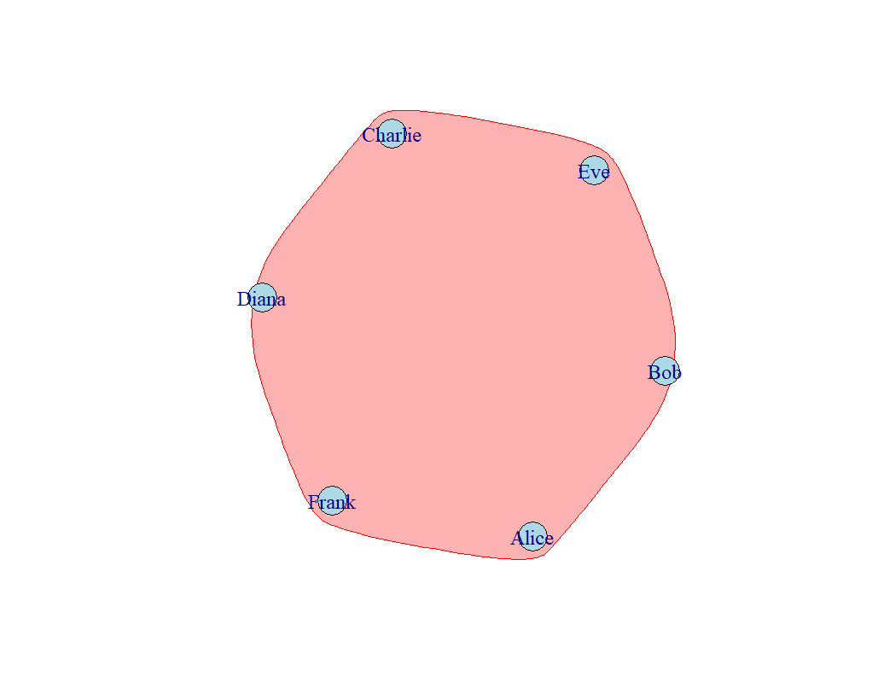
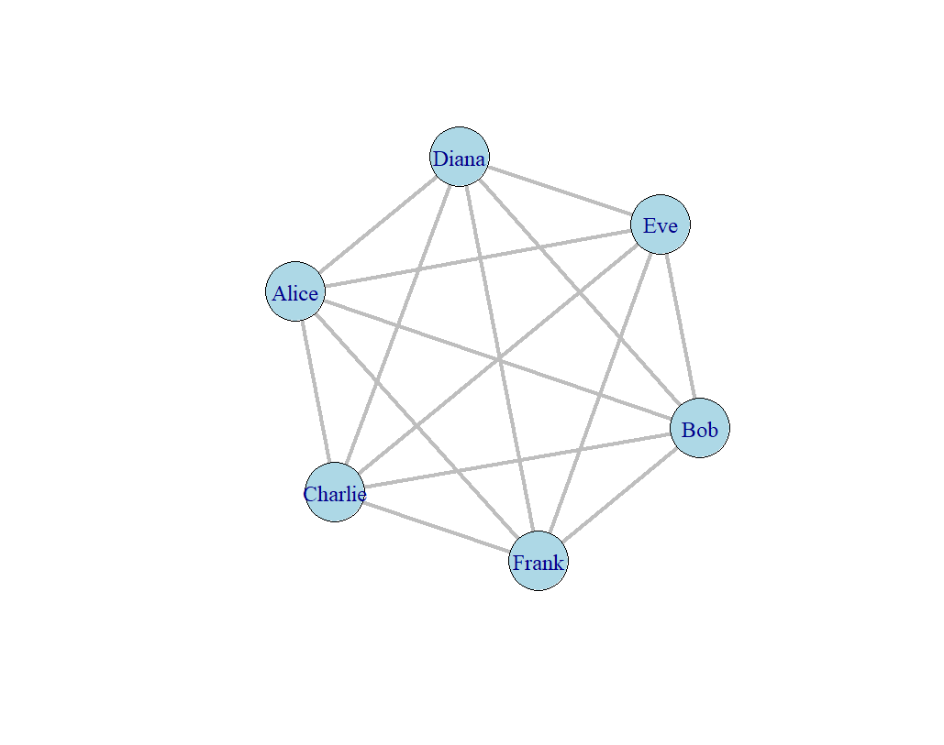
E₁ = {Diana;Eve}
E₂ = {Diana;Bob}
E₃ = {Diana;Frank}
…
E₁₅ = {Alice;Charlie}
E₁ = {Diana; Eve; Bob; Frank;Charlie; Alice}

Slide 30
generalization of a graph
in which
an edge can join any number of vertices

Slide 31
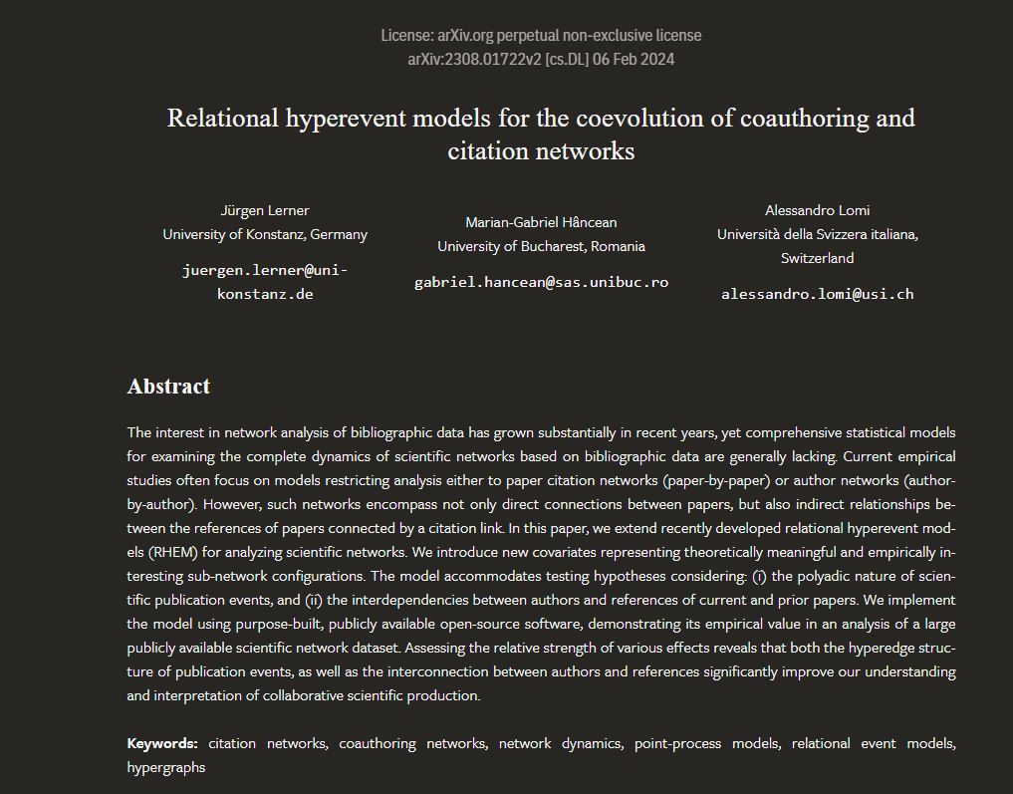

Slide 32
