Slide 1
Overview : Machine Downtime Analysis
Group 4

Slide 2
Content
01
02
02
Introduction
Data collection and Processing
01
03
04
03
04
Exploratory data Questions
Forecasting Analysis

Slide 3
Introduction
Machine downtime refers to the period when equipment is non-operational due to failures, maintenance, or unexpected breakdowns. It directly impacts production efficiency, increases operational costs, and can lead to significant delays in manufacturing and industrial processes.

Slide 4
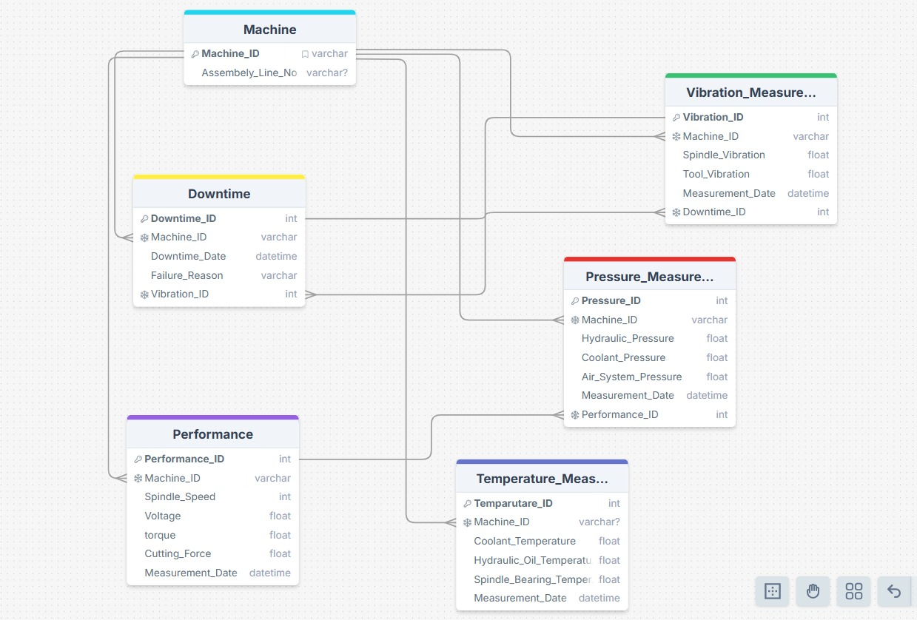
ERD for machine monitoring system database.
ERD
Temperature
Spindle Speed
Energy consumption
maintenance log
Vibration level
Torque

Slide 5
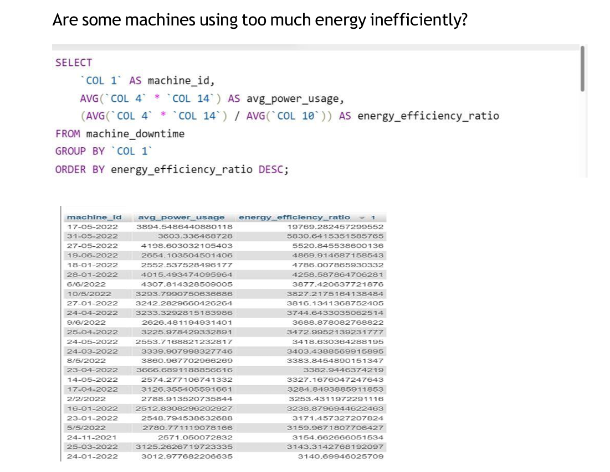
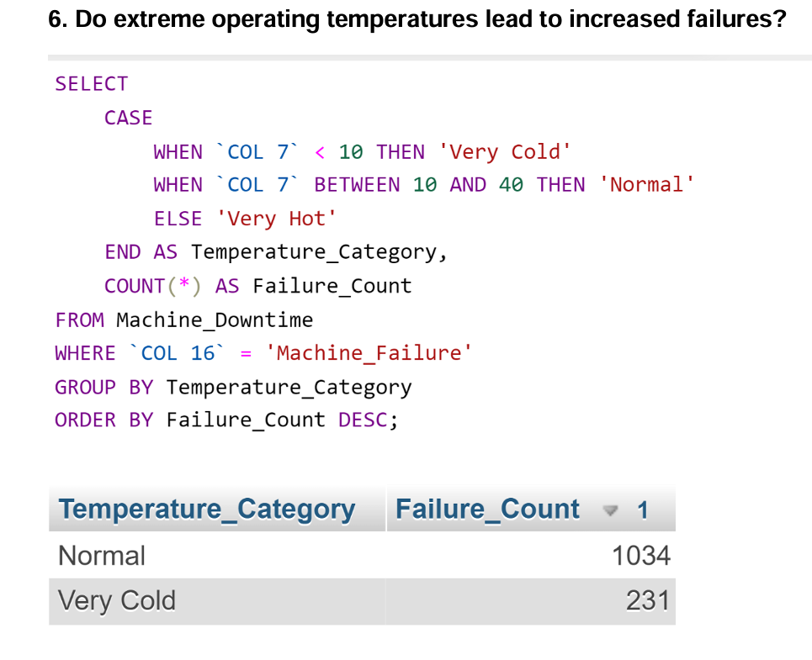
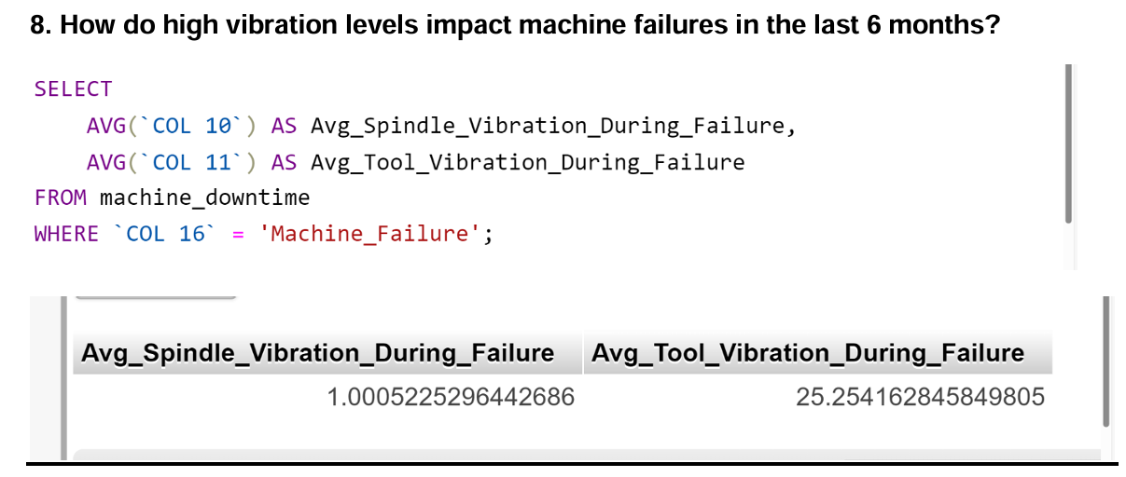
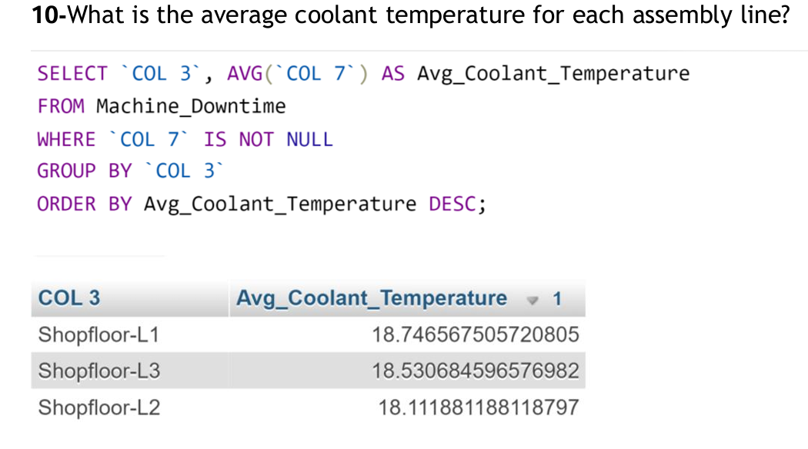
Exploratory data analysis in Main Factors affecting the machine downtime
Temperature
Spindle Speed
Energy consumption
maintenance log
Vibration level
Torque

Slide 6
Forecasting Analysis & Results
01
Predictive Downtime Analysis
How will machine downtime change in the next three months?
04
Impact of Failures on Performance
02
Performance Forecasting
How does Machine Failure influence Torque in the next 3 Months?
What is the forecasted performance of Spindle Speed for each machine in the next quarter?
05
Historical Trend Analysis
03
Failure Probability Estimation
How are daily miracle machine numbers forecasted over the next 30 days, based on historical data?
Show the forecast of the failure probability of each machine for the next 6 Months?

Slide 7
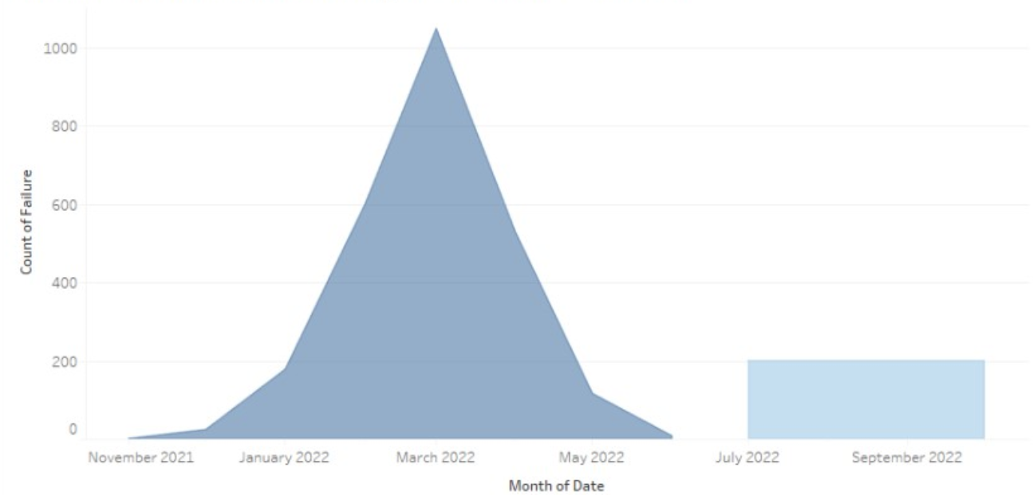
1- How will machine downtime change in the next three months?

Slide 8
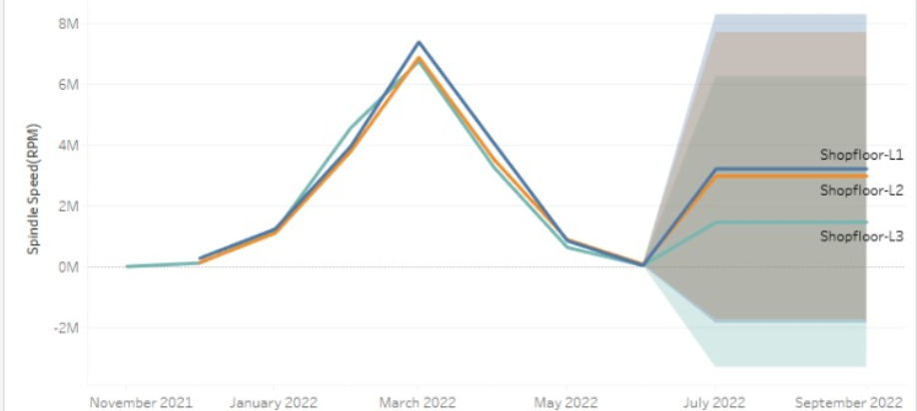
2- What is the forecasted performance of Spindle Speed for each machine in the next quarter?

Slide 9
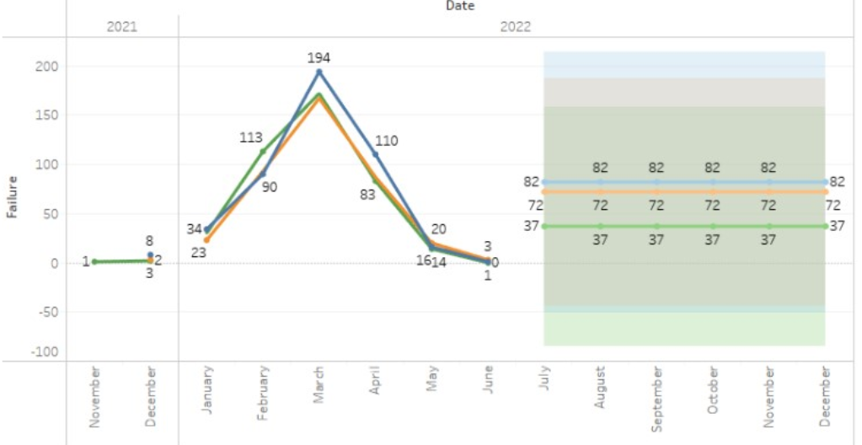
3- Show the forecast of the failure probability of each machine for the next 6 Months?

Slide 10
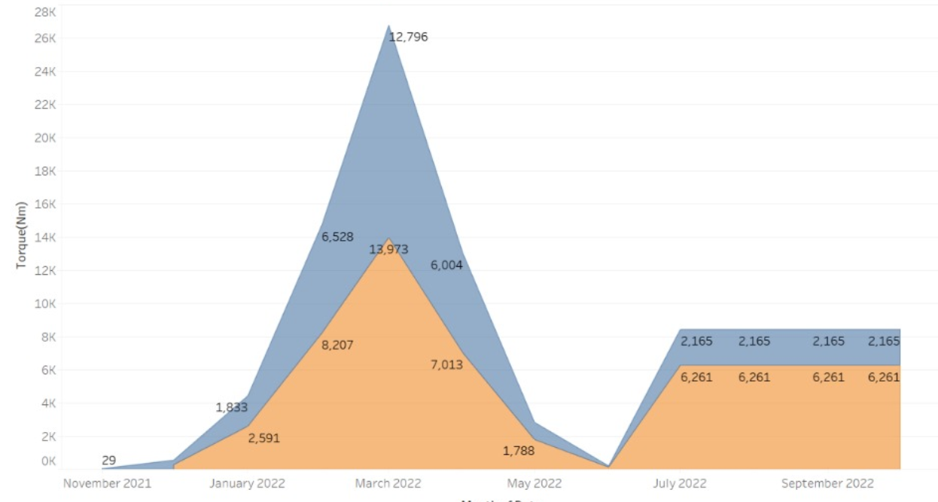
4- How does Machine Failure influence Torque in the next 3 Months?

Slide 11
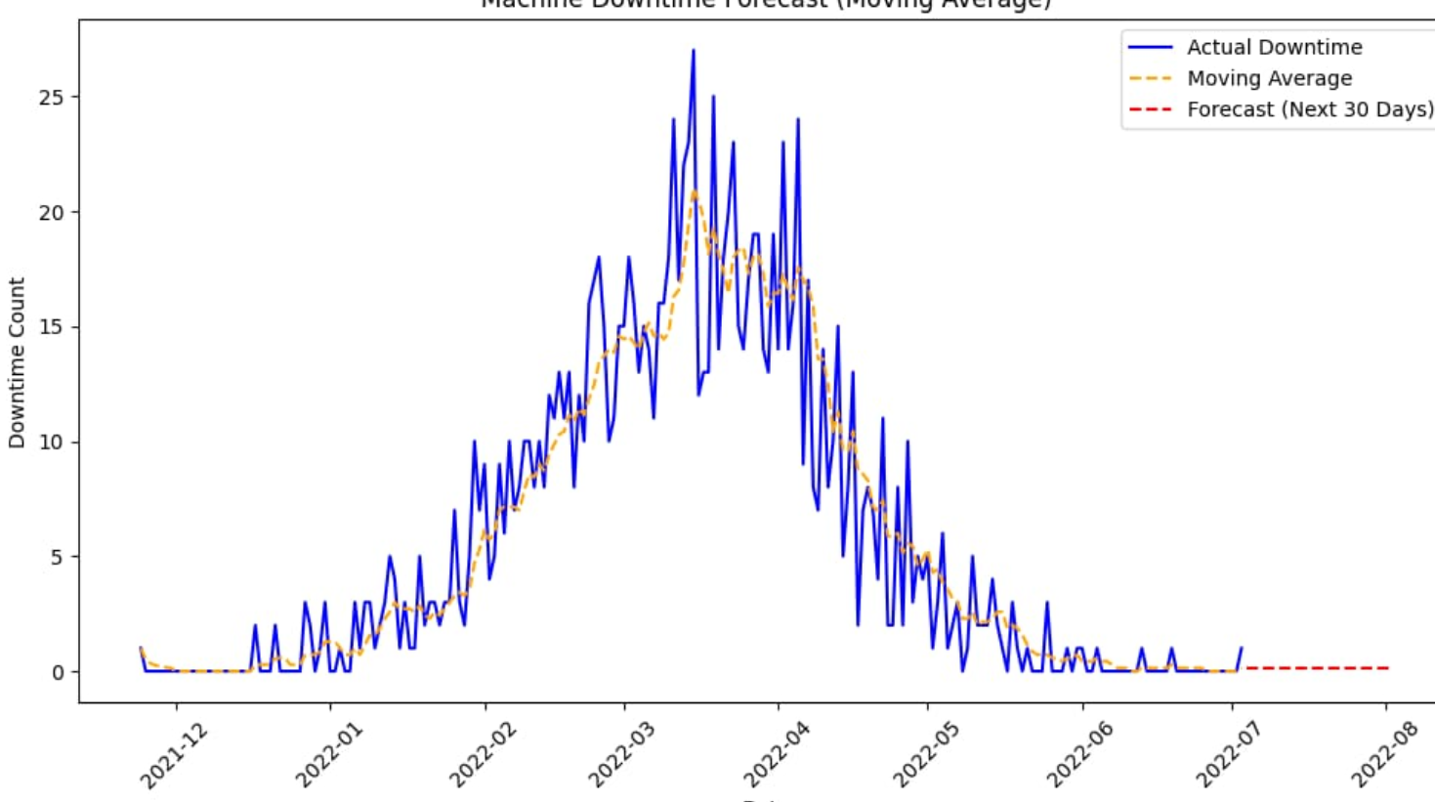
5- How are daily miracle machine numbers forecasted over the next 30 days, based on historical data?

Slide 12
Summary of Findings
4-Impact of Failures on Performance
2- Performance Forecasting
The contribution of failures to torque levels is significant, with a clear distinction between normal operating conditions and failure scenarios.
Spindle speed is projected to increase significantly in the next quarter, peaking at a high value before stabilizing.
1-Predictive Downtime Analysis
3- Failure Probability Estimation
The extreme March failure rate may have been caused by seasonal demand, lack of maintenance, or system overload.
The projected failure probabilities for the next six months show consistent values (82, 72, and 37 failures across different machines).

Slide 13
Thank you

