Slide 1


Python-Pipe
2019
Simple syntax for complex expressions

Slide 2
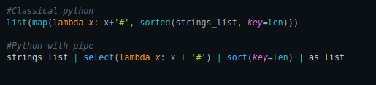
WHAT is Pipe lib?
2
8
Pipe is a little python lib, that allows to create intuitive functions chains instead of big
expressions with lot of brackets and other elements, that pollute code.
Let’s look at simple example. We need to sort list of strings by them length and add
symbol <#> to the end of every string:
It more easier to understand second variant, isn’t it?
Python-pipe

Slide 3

Some info about pipe methods
3
8
Every pipe method interact with incoming values by <|> symbol. It’s also possible to
set some additional properties as standard - in brackets.
There are some interesting methods from pipe library:
traverse (recursively unpack sequences)
Permutations (return all permutations of sequence elements)
dedup (deduplicate sequence values)
More methods are represented in file <show_lib_methods.py> in my git repository.
You also can view all pipe methods in official Pipe git repository.
P. S.
All links at the end of presentation.
Python-pipe

Slide 4



NEED MORE Gold Pipes
4
8
One of the most important possibilities of the library is implementing custom pipes.
This is very easy to do. It’s only enough to create ordinary function with special
decorator @Pipe provided by lib.
Let’s create a filter that discards all odd numbers of sequence.
How about pipe, that returns degree of number?
Or pipe, that transforms all letter in list of string to uppercase.
Python-pipe

Slide 5
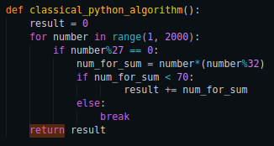
Lets compare
5
8
To show all advantages of coding using pipes, we implement the following algorithm
in three different ways.
Get all numbers from 0 to 2000. Than sum all received values, while x*x%32 < 70.
This is the first way - the most cumbersome:
The second – compact, but very hard to understand:
And the third – awesome:
Python-pipe

Slide 6

Thank you for your attention!
8
Official Pipe repository:
https://github.com/JulienPalard/Pipe
There you can find some additional material:
https://github.com/Zomba4okk/PipeGuide

