Slide 1

Predicting IPO Excess Returns: A Sentiment Analysis Approach

Slide 2





Problem Identification
Objective: Predict IPO excess returns for the years 2019 to 2021 across different time intervals using various predictor variables.
We are particularly interested in exploring whether a broad sentiment score, derived from Twitter sentiment analysis concerning tech giants Amazon, Apple, Google, Microsoft, and Tesla, can help predict IPO excess returns.
Can Twitter sentiment on tech giants predict IPO excess returns?

Slide 3
Context
Shift in Financial Dynamics: Emergence of social media platforms.
Significance: Investor sentiment influenced by virtual discussions.
Goal: Quantify the effect of social media sentiment on IPO returns.

Slide 4
Data Sources
University of Florida: Historical IPO data.
Kaggle: IPO offer price & raw tweets.
Yahoo Finance API: Stock price data.

Slide 5
Data Wrangling
Company IPO Dataframe: 1758 unique tickers, 437 unique dates.
IPO Age Dataframe: 386 unique tickers, 183 unique dates.
The primary dataset for our study is the ipo_age DataFrame.
For a deeper investigation, we integrated the IPO Price from the company_ipo dataset.
Successful matches between both datasets: 371 out of 386 IPOs in the ipo_age DataFrame.
Return Calculation: We calculate the excess return of each IPO using the Nasdaq 100 index as benchmark over different fixed periods: 1 day, 1 week, 1 month, 3 months, 6 months, and 1 year.

Slide 6

Sentiment Analysis
Tools:
Introduction to TextBlob and its significance.
Introduction to VADER and its relevance to social media sentiment analysis.
Method: Machine learning approach with pre-trained Naive Bayes classifier.
Focus: Sentiments in social media.

Slide 7
Exploratory Data Analysis (EDA)
Sentiment Aggregation: Average sentiment per date.
We will consider the sentiment for different periods leading up to the IPO date, 7, 14, 30 and 45 days.
Missing Values: After dropping rows with missing sentiment, we end with data for 134 of our IPOs
Key Observations: Each of the binary variables (Rollup, VC, Dual, Internet) has a different mean excess return for each category, suggesting they may be useful in predicting excess returns.

Slide 8
Modelling Process
Process: Build separate models for each excess return interval.
The factors that influence one-day excess return may be different from those that influence one-week or one-month excess return.
Building separate models for each excess return target will allow you to capture these unique characteristics for each time period.
Preparing Data: Separate dataframes for each target, dropping undefined values.
Splitting the Data: Training and testing sets division.
Standardizing: Predictor variables scaled for uniformity.
Models: Linear Regression, Ridge, Lasso, Random Forest.

Slide 9
Hyperparameter Tuning
Challenges: Limited computational resources.
Approach: Shift from GridSearchCV to RandomizedSearchCV.
Benefits: Faster, efficient sampling from hyperparameter space.
Focus Areas: Number of trees (n_estimators), tree depth (max_depth) for Random Forest.

Slide 10
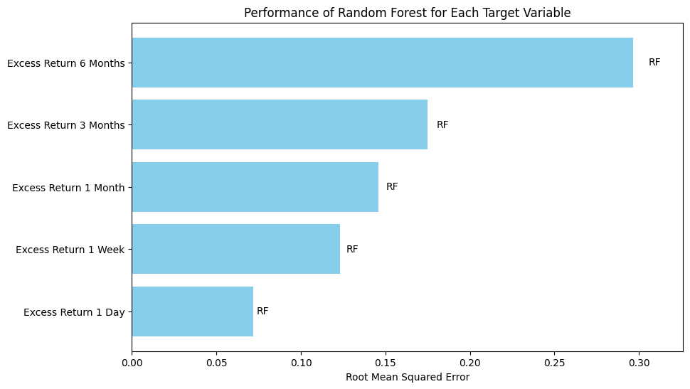
Model Selection
Best Performers: Random Forest model using RMSE:

Slide 11
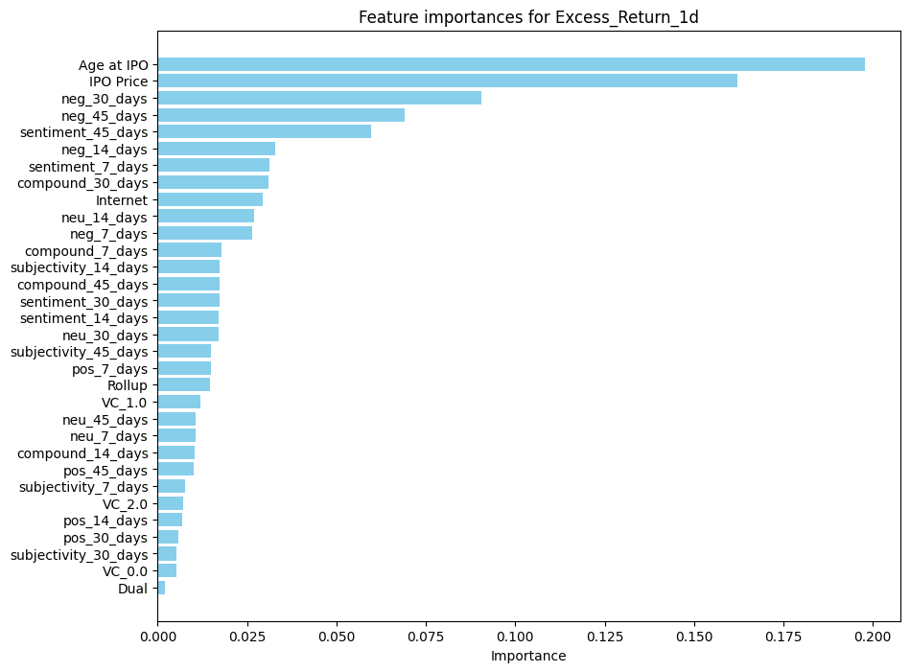
Key Model Results
We observed an increasing RMSE pattern as the time horizon for the excess returns extended.
Predictive accuracy diminishes for longer time horizons

Slide 12
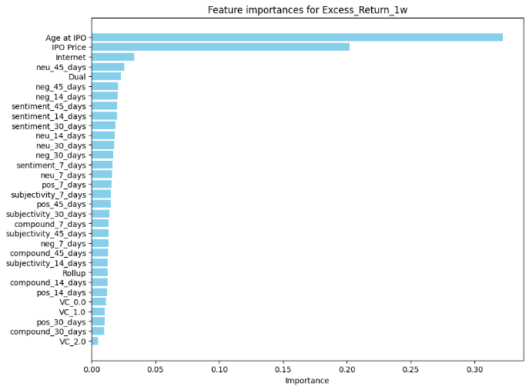
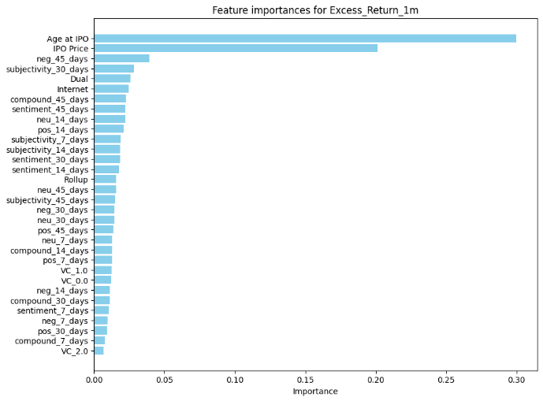
Key Model Results

Slide 13
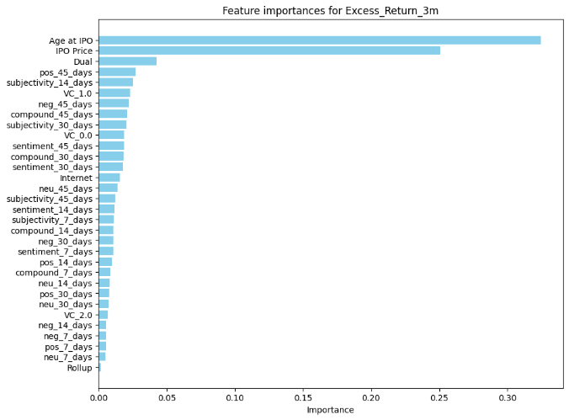
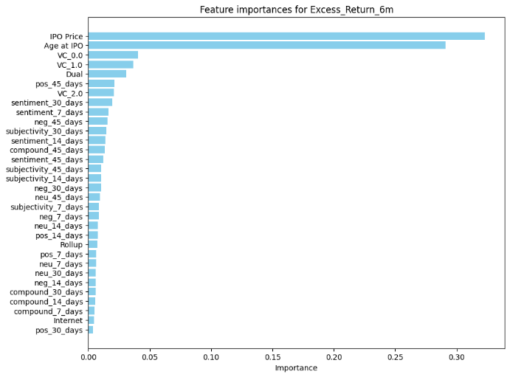
Key Model Results

Slide 14
Key Model Results
Impact of Sentiment Scores: The sentiment variables derived from TextBlob and VADER provided inconsistent results across different time intervals.
Sentiment scores from the past 45 days ('sentiment_45_days') were significantly influential in predicting 1-day and 1-week excess returns, but less so for longer periods.
Most Important Features: Most notably, the two dominant features across all models were 'Age at IPO' and 'IPO Price.' This underscores the role the company's characteristics play in influencing IPO performance.

Slide 15
Conclusions
Success: Predictive models successfully implemented, but results are not robust.
Limitations: Accuracy decreases over long-term horizons, indicating the complexity of financial markets.
Key Takeaway: Mix of traditional indicators and sentiment data can predict IPO excess returns.

Slide 16
Future Directions
Expanding Data Sample: Looking at a larger dataset of IPOs, considering more features, or integrating a larger collection of Twitter data could lead to more insightful findings.
Advanced Sentiment Analysis: Applying more advanced sentiment analysis techniques that consider the context and content of tweets might improve prediction accuracy.
Focus on Short-Term Predictions: Given the diminished accuracy for longer-term horizons, prioritize predictions for shorter periods.

