Slide 1


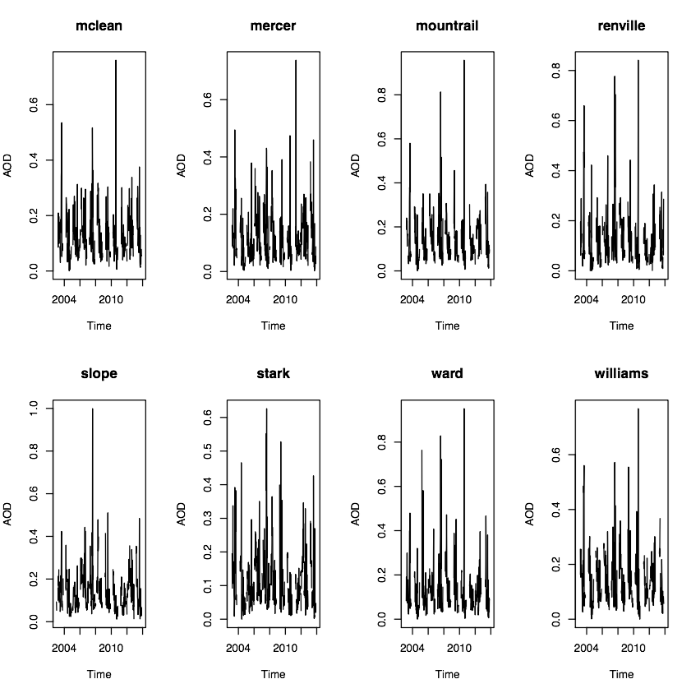
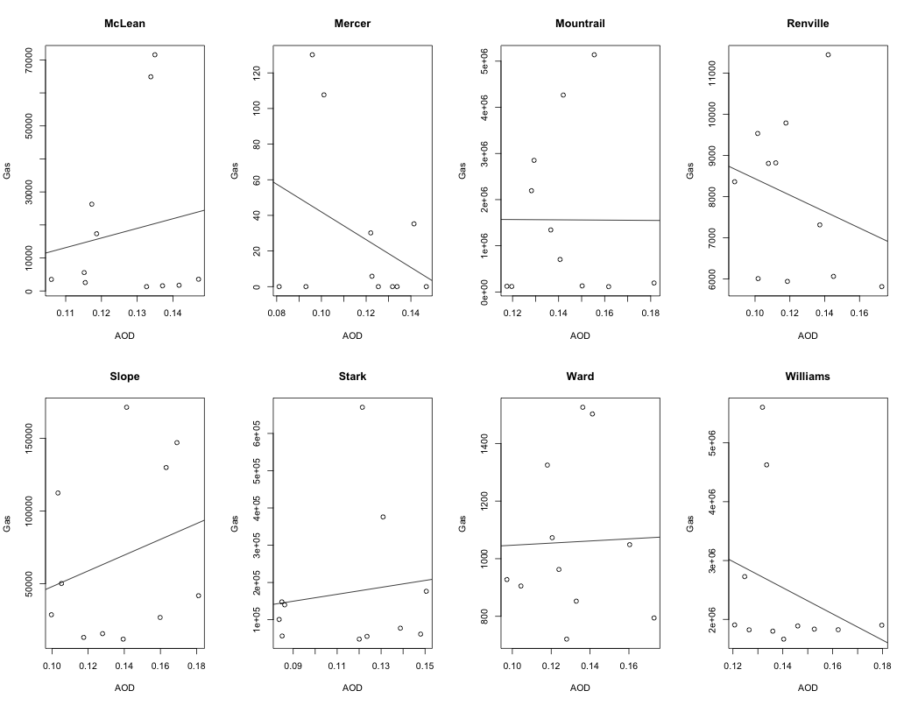
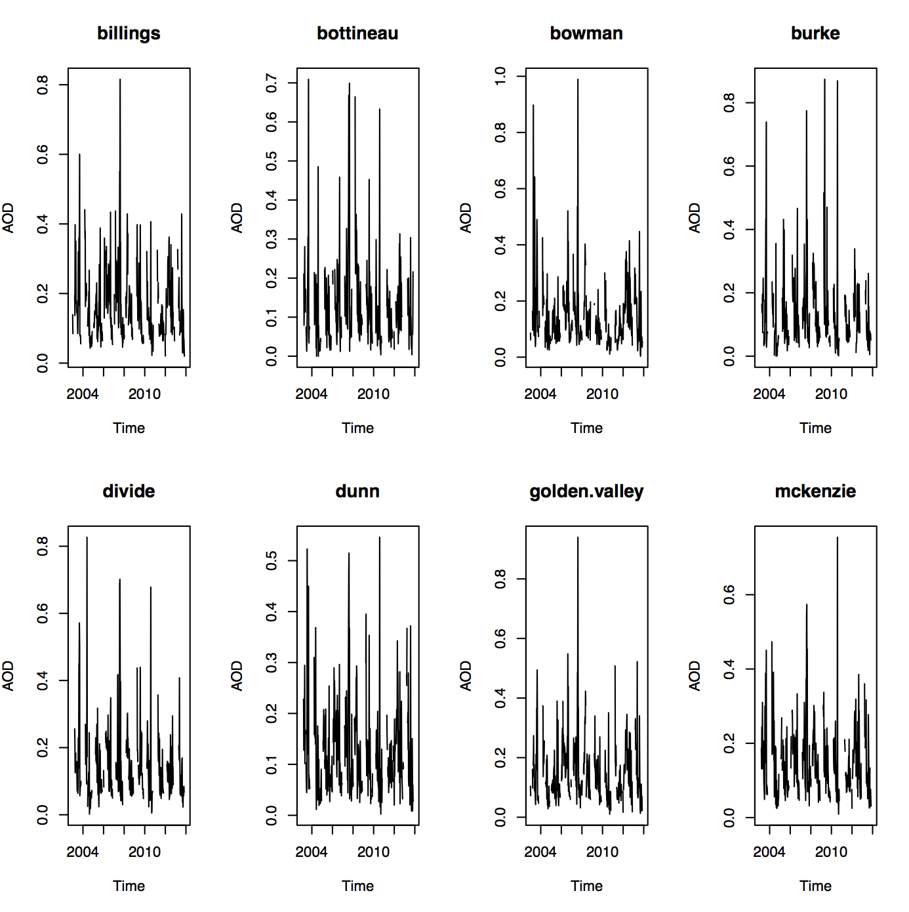
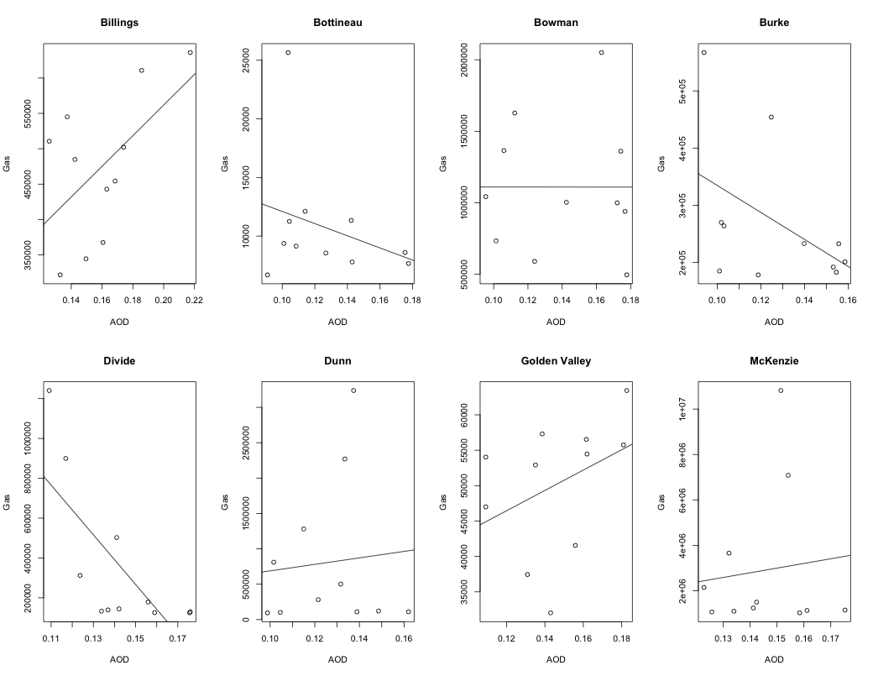
Aerosol Density and Unconventional Natural Gas Production
Bohan Zhang^{1,2}, Kaitlin Clarke², Baike Xi³, Kurt Zhang^{1,2}
¹ND INBRE Bioinformatics Core, ²Department of Pathology, ³Department of Atmospheric Sciences,
University of North Dakota, Grand Forks, ND 58202, USA
Introduction
Results
Aerosol optical thickness (AOT) is widely used to monitor the levels of air pollution that are caused by industrial production, traffic and biomass burning.
It is known that some types of aerosols, for example fine particulate matter, can induce cardiovascular and lung diseases.
It is not clear whether the booming natural gas production in west North Dakota raises new public health concerns.
In this study, we investigate the relationship of aerosol density and gas production using satellite technology. The satellite derived AOT data were obtained for each county of North Dakota over the period of 2002-2014.
AOT Levels Over 2002 to 2014 Figure2
Gas Production vs AOT Over 2002 to 2014 Figure2
Methods
We studied 16 ND counties that had reported gas production from North Dakota Association of Oil and Gas Producing Counties (NDAOGPC).
AOT values every 8 days were collected from NASA earth observation. Time series and regression analysis were performed .
The yearly AOT means were calculated using twelve month averages for the regression between gas production and AOT.
Only Billings County shows a significant positive correlation between gas production and AOT.
AOT values between 2002-2014 were plotted using time series smoothing technology.
All the graphs show a clear seasonal variation of AOT. However, regardless of the fast increase of gas production, AOTs do not show clear upper trend during the last 12 years.
The peak values are more likely affected by weather factors rather than gas production.
Results
Conclusions
AOT Levels Over 2002 to 2014 Figure1
Gas Production vs AOT Over 2002 to 2014 Figure1
A strong seasonal variation of AOT was observed for each county in the state of North Dakota, but there is no clear increasing trends over years.
We did not find significant correlation between gas production and AOT levels after summarizing the results from all counties.
Therefore, there is no evidence that the growing gas production affects aerosol levels based on the satellite derived AOT data of 2002-2014.
Acknowledgements
Research reported in this poster was supported by an Institutional Development Award (IDeA) from the National Institute of General Medical Sciences of the National Institutes of Health under grant number P20GM103442.

