Slide 1
MIDTERM
REVIEW
BPS5231 AI for Sustainable Building Design
Data Center Heatwave Resilience: A Machine-Learning Prediction Framework Based on EnergyPlus Data
Physics-based simulation
→ data generation
→ machine learning
Group C: Yang Baisong A0317341M Zhao Dingyi A0357194U
500
EnergyPlus cases

Slide 2
1. Problem Description
Heatwaves create a compound risk for data centers
External stress
Higher outdoor temperature increases envelope heat gain; the simplified model also accounts for cooling-capacity degradation as heatwave intensity rises.
DATA HALL
Research question
Thermal balance
& cooling capacity
Can physics-based simulations generate training data for ML models that rapidly predict thermal risk and cooling performance under different heatwave and operating conditions?
Internal stress
IT servers are 24/7 high-density heat sources; higher IT load increases the continuous heat-removal requirement.
Tmax
Risk hours
Cooling demand
Operational control
Cooling setpoint and available cooling capacity jointly determine whether the system can maintain a safe thermal environment.

Slide 3
2. Current Progress
1
2
3
4
5
DesignBuilder
EnergyPlus
Python Generator
500-case Dataset
ML / EDA
Data Hall + plenums
Singapore weather
IT / lighting / equipment
Baseline reproduction
Manual capacity validation
Hourly outputs
IDF / EPW modification
LHS sampling
Automated simulation & extraction
500 case
21 columns
5 physical inputs
Current stage
EDA → modelling
interpretation

Slide 4
3. Data Generation Design
Five independent inputs (Latin Hypercube Sampling)
Heatwave intensity
Duration
IT load
Capacity ratio
Cooling setpoint
0–10 °C
1–5 days
300–1000 W/m²
0.9–1.3
20–27 °C
Capacity formulation
Qdesign = 68.089 × IT / 600
× Capacity Ratio
× (1 − 0.02 ΔT)
= Available Capacity
Heatwave timing
Why this design?
All heatwaves are centred on the baseline peak-cooling day (May 21): 1 day = May 21; 5 days = May 19–23.
Heatwave timing is controlled to prevent date from becoming a hidden variable. Cooling capacity scales with IT load, while a 2%/°C derating strengthens heatwave–HVAC coupling.

Slide 5
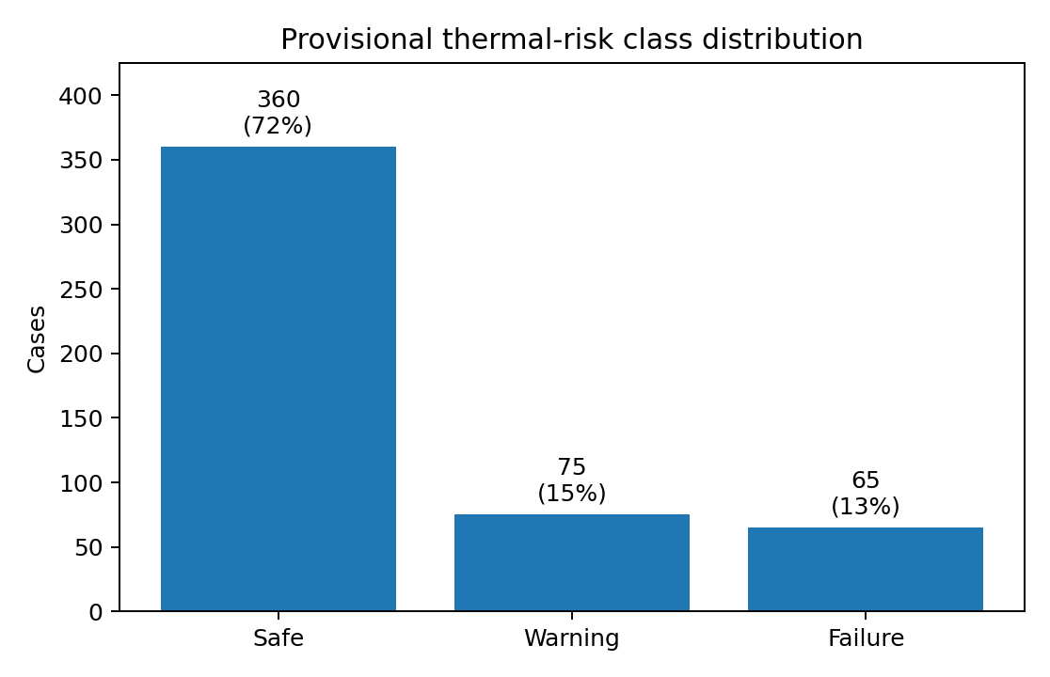
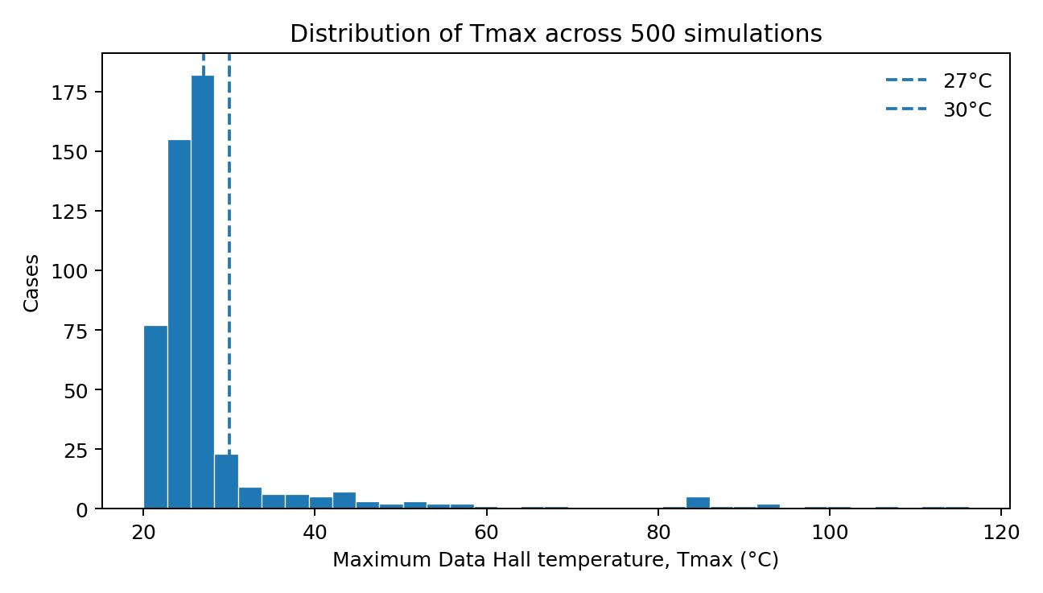
6. EDA — Thermal Risk Distribution
Provisional thresholds for EDA: Safe <27°C; Warning 27–30°C; Failure ≥30°C.
Safe 360
Warning 75
Failure 65

Slide 6
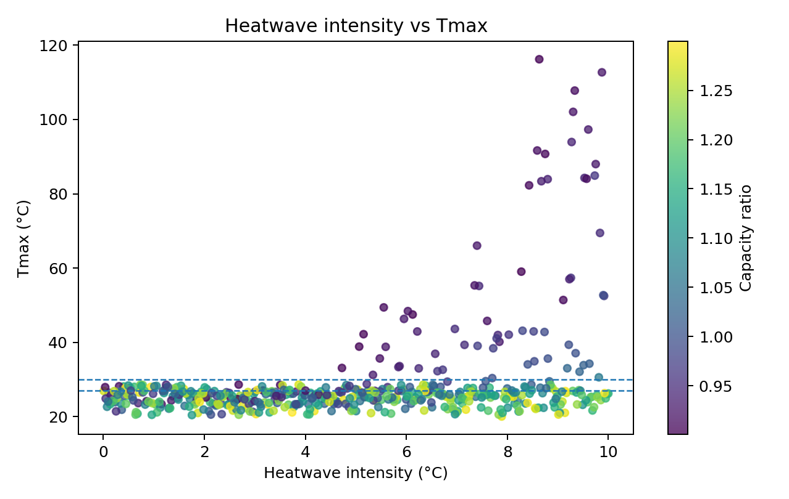
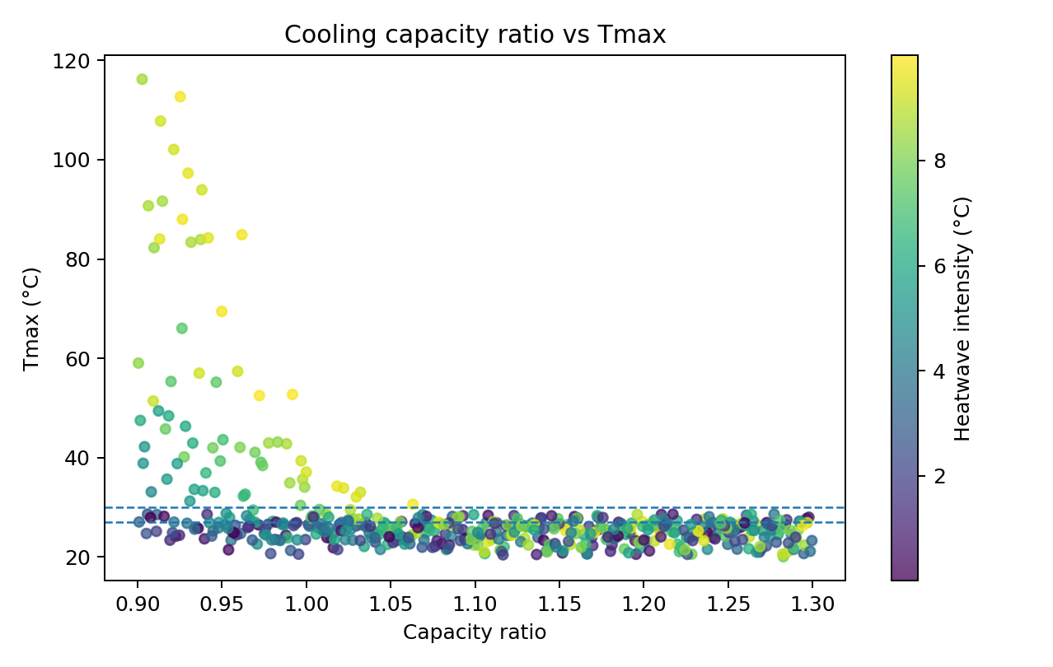
7. EDA — Key Relationships
Heatwave intensity ↑ generally raises risk
Capacity ratio ↑ generally suppresses risk
high intensity is most problematic when capacity margin is low.

Slide 7
10. Data Quality Note
Extreme Tmax is a model failure state, not an operating temperature
65
40
25
≥30°C
≥40°C
≥50°C
Why runaway occurs
Recommended ML treatment
The model maintains continuous IT heat release. When heat generation persistently exceeds available cooling, the zone heat balance continues to raise the temperature.
Retain the raw data and add a Thermal_Runaway flag . These cases remain Failure in classification; Tmax regression can report both the full dataset and a non-runaway subset.

Slide 8
11. Potential Method
Raw dataset
Pre-processing
Model training
Evaluation
Interpretation
500 cases
5 physical inputs
QC / labels
train-test split
Classification
Regression
Cross-validation
F1 / Recall
R² / MAE / RMSE
Feature importance
SHAP
Failure boundary
Candidate models
Logistic / Linear
Decision Tree
Random Forest
Gradient Boosting
XGBoost

