Slide 1

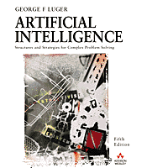
Artificial Intelligence:
Its Roots and Scope
1.1 From Eden to ENIAC: Attitudes toward intelligence, Knowledge, and Human Artifice
1.2 Overview of AI Application Areas
1.3 Artificial Intelligence – A Summary
1.4 Epilogue and References
1.5 Exercises
George F Luger
ARTIFICIAL INTELLIGENCE 5th edition
Structures and Strategies for Complex Problem Solving
Luger: Artificial Intelligence, 5th edition. © Pearson Education Limited, 2005
Notes:
OWEN: Insert chapter number

Slide 2
Course description
Introduction to AI and applications; exhaustive search methods; heuristic search methods; First order logic for knowledge representation; Programming in PROLOG; production rule systems; principles of expert systems; Expert Systems Programming in PROLOG; Knowledge acquisition.

Slide 3
Course contents
Part 0: Introduction – Chapter 1
Part 1. Knowledge Representation and Prolog Programming –Chapters 2, 13, 15
Part 2. Search and Problem-Solving – Chapters 3, 4
Part 3. Introduction to Knowledge-based and Expert Systems – Chapters 6, 8

Slide 4
Text book
Artificial Intelligence by Luger The Benjajmin/Cummings Publishing Company, 5th Edition or 6th Edition.

Slide 5
What is AI?
AI stands for Artificial Intelligence
AI may be defined as the branch of computer science that is concerned with the automation of intelligent behaviour.
Based on sound theoretical and applied principles of computer science:
  Data structures used in knowledge representation,
  The algorithms needed to apply that knowledge,
  The languages and programming techniques used in their implementation.

Slide 6
What is AI?
Who concerns about intelligence:
  Computer Science, Psychology, Biology, mathematicians, logic, linguistics.
Can machines be Intelligent? Debate

Slide 7
Definition of AI
AI: The branch of computer science that is concerned with the automation of intelligent behaviour.
  Ooops ... What is intelligent?
  Possibilities: Ability to solve a problem and ability to memorise and access the information.
AI: The collection of problems and methodologies studied by artificial intelligence researchers.

Slide 8
Questions
What is intelligence?
Is intelligence a single faculty or a collection of distinct and unrelated abilities?
What is creativity?
Can intelligence observed from behaviour or does it require evidence from an internal mechanism.
How knowledge is represented in the nerve tissue or living being?
Can computers be intelligent or does intelligence require the richness of sensation and experience of biological existence?
What does happen when learning occurs?

Slide 9
What is AI?
The goal of (weak) artificial intelligence is: Build intelligent entities (model intelligence).
Understand intelligent entities, and understand and engineer human intelligence (strong AI).

Slide 10
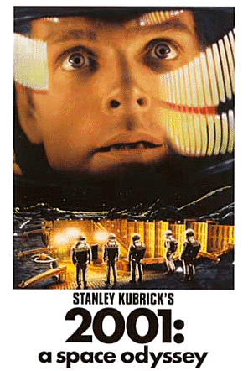

Dialogue system
Example (2001 a space odyssey film 1968)
Dave Bowman: Open the pod bay doors, HAL.
HAL: I'm sorry, Dave. I'm afraid I can't do that.
.
.
.
HAL: I know that you and Frank were planning to disconnect me, and I'm afraid that's something I cannot allow to happen.

Slide 11
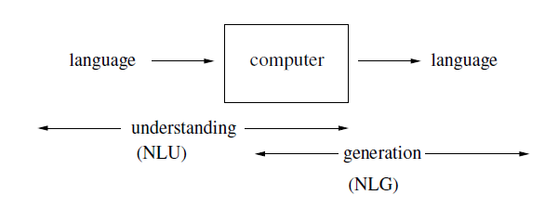
Dialogue System
We call programs like HAL that converse with humans in natural language conversational agents or dialogue systems.
Input: automatic speech recognition and natural language understanding.
Output: Dialogue and response planning and

Slide 12
What is Intelligent entity
Four possible definitions (Russel and Norvig):
Systems that act like humans. Strong
Systems that think like humans. Strong
Systems that think rationally, according to logic laws. Weak
Systems that act rationally, or do the right thing. Weak

Slide 13
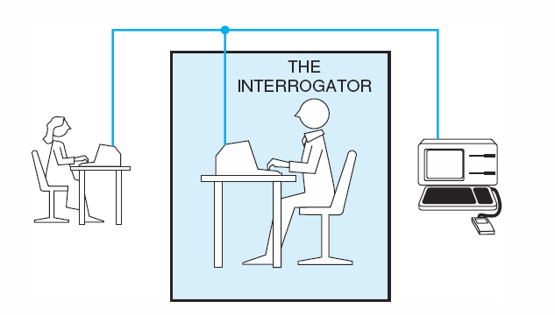
Figure 1.1 Turing Test: Objective measurement
Turing: An entity deemed intelligent if it demonstrates an ability to achieve human-level performance in all cognitive tasks, sufficient to fool an interrogator
Luger: Artificial Intelligence, 5th edition. © Pearson Education Limited, 2005

Slide 14
Turing test
Objective notion of intelligence and avoids the debate over the nature of intelligence.
Avoids the questions of whether a computer uses appropriate internal processes.
Focuses on the questions and answers and avoids of the question of living organisms / machine intelligence.

Slide 15
Requirements of a computer to Pass Turing test
Natural Language Processing capabilities.
Knowledge representation to store information provided before or during the interrogation.
Automated reasoning to use stored information to answer questions and draw new conclusions.
Learning capabilities.

Slide 16
ELIZA (Therapist system)
PERSON: My Wife says I’m often depressed.
ELIZA: I’m sorry to hear you are depressed.
PERSON: The Truth that I am quite unhappy.
ELIZA: Do you think coming here will help you not to be unhappy.
PERSON: Well, perhaps by talking to you I will find out why I hate my brother.
ELIZA: Tell me more about your family.

Slide 17
Eliza
ELIZA failed Turing test !

Slide 18
Specific Area
It is difficult to learn everything, intelligent entities should concentrate on a specific domain.
We need a domain expert

Slide 19
Important Research and Application Areas
1.2.1 Game Playing
1.2.2 Automated Reasoning and Theorem Proving
1.2.3 Expert Systems
1.2.4 Natural Language Understanding and Semantic Modeling
1.2.5 Modeling Human Performance
1.2.6 Planning and Robotics
1.2.7 Languages and Environments for AI
1.2.8 Machine Learning
1.2.9 Alternative Representations: Neural Nets and Genetic Algorithms
1.2.10 AI and Philosophy
Other areas
Luger: Artificial Intelligence, 5th edition. © Pearson Education Limited, 2005

Slide 20
Important Research and Application Areas (Continued)
1.2.1 Game Playing: Uses Heuristics (chapter 4), it searches a state space
Board games (played using well-defined rules):
e.g. Chess, 8-tile puzzle, 16-tile puzzle.
Initial state
1 | 5 | 2
4 |  | 3
7 | 8 | 6
1 |  | 2
4 | 5 | 3
7 | 8 | 6
1 | 5 | 2
4 | 8 | 3
7 |  | 6
Luger: Artificial Intelligence, 5th edition. © Pearson Education Limited, 2005

Slide 21
Important Research and Application Areas (Continued)
1.2.2 Automated Reasoning and Theorem Proving (more in Chapter 13)
E.g. Answering questions
R1 If I have enough time I will study
R2 If I study I will pass
R3 I have no time (fact)
Q: Shall I pass? Answer: No
Why: You have no time.
How: Explanation (Justification)
e.g. Mathematical reasoning, Program analysis, state transformation problem (liquid to solid)
Note: Theorem proving helped in formalizing search algorithms and the development of predicate calculus and Prolog
Luger: Artificial Intelligence, 5th edition. © Pearson Education Limited, 2005

Slide 22
Important Research and Application Areas (Continued)
1.2.3 Expert Systems (more in chapter 8)
Programs to do reasoning and to solve problems, diagnosis
Modelling an expert: Doctor (diagnose illness), Geologist (discover minerals)
We need domain-specific knowledge from a domain expert obtained from an AI specialist (knowledge engineer).
e.g. Dendral (Stanford University late 1960s). Infer the structure of organic molecular from their chemical formulas and other information.
e.g. MYCIN : Medical system developed in mid 1970s by the medical school at Stanford university. Discover bacterial infections with uncertain or incomplete information.
e.g. PROSPECTOR: Decides the probable location of minerals based on geological info.
e.g. INRWENIST, Dipmeter advisor, XCON (VAX configuration).
+ve: Save time, save money, replace the expert in rural areas or when not available, acquire experience from experts
Luger: Artificial Intelligence, 5th edition. © Pearson Education Limited, 2005

Slide 23



Important Research and Application Areas (Continued)
1.2.3 Expert Systems: example to solve a second order equations
ax² +bx + c = 0
Expert: mathematician
User: Student
Knowledge base:
Rule 1: If a<> 0 and b² – 4ac>0 then ,
Rule 2: If a<> 0 and b² – 4ac=0 then
Rule 3: If a<> 0 and b² – 4ac<0 then no solution
e.g. a=2,b=-3, c=1 → x1=1, x2=1/2
Luger: Artificial Intelligence, 5th edition. © Pearson Education Limited, 2005

Slide 24
Important Research and Application Areas (Continued)
1.2.3 Deficiencies of Expert Systems
Difficulty in obtaining deep knowledge
Lack of robustness and flexibility: Lack the ability of going around the problem.
Inability to provide deep explanation
Difficulty in verification.
Little learning from experience.
Luger: Artificial Intelligence, 5th edition. © Pearson Education Limited, 2005

Slide 25
Important Research and Application Areas (Continued)
1.2.4 Natural Language Understanding and Semantic Modelling (more in chapters 7, 14)
Programs capable of understanding and generating human language.
It is part of human intelligence.
Luger: Artificial Intelligence, 5th edition. © Pearson Education Limited, 2005

Slide 26
Introduction: Machine translation
e.g., Google Translation from Arabic
Revealed the Land Transport Authority for the start of the application of Intelligent Transportation Systems project beginning next year 2015 on all modes of public transport in all regions of the Kingdom.
The Director of the Liaison Unit and the media in the body, Dr. Abla mantle for "Ammon" This is a huge national project will include all modes of transport operating in the Kingdom.
It showed that the mantle Intelligent Transportation Systems seminal application aimed at improving the quality of public transport services and activating the direct control of the means of transport, and the application of an integrated and flexible system for the payment of wages.
It added that the components of the project include the controller and control means the ability to control and direct transport modes.
كشفت هيئة النقل البري عن بدء تطبيق مشروع انظمة النقل الذكية بداية العام المقبل 2015 وعلى جميع وسائط النقل العام في كافة مناطق المملكة.
وقالت مديرة وحدة الاتصال والاعلام في الهيئة الدكتورة عبلة الوشاح لـ"عمون" ان هذا مشروع وطني ضخم سيشمل كافة وسائط النقل العاملة في المملكة.
وبينت الوشاح ان انظمة النقل الذكية المنوي تطبيقها تهدف الى تحسين نوعية خدمات النقل العام وتفعيل الرقابة المباشرة على وسائط النقل، وتطبيق نظام متكامل ومرن لدفع الاجور.
وأضافت ان مكونات المشروع تشمل وحدة تحكم وسيطرة ما يعني القدرة على مراقبة وسائط النقل بشكل مباشر.

Slide 27
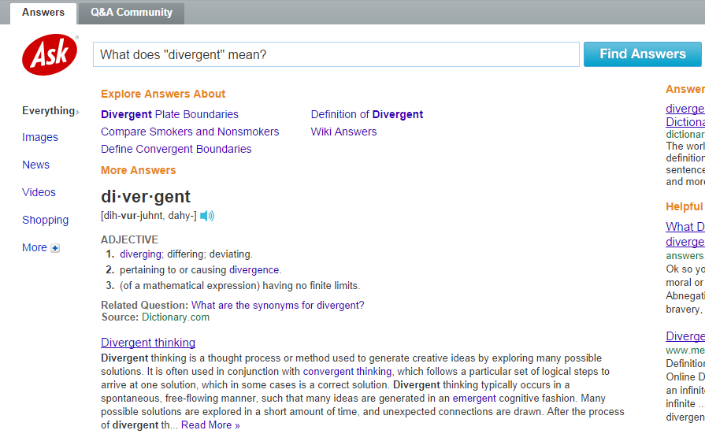
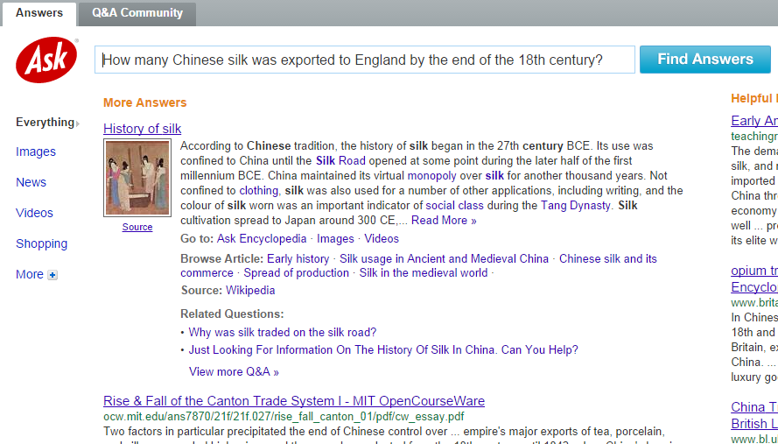
Introduction: Question Answering

Slide 28
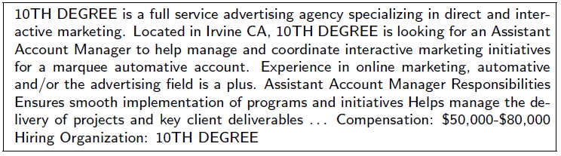
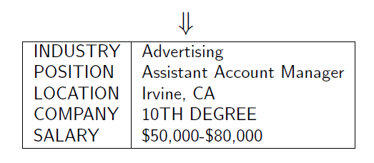
Information Extraction

Slide 29
Information Extraction
Goal: Map a document collection to structured database
Motivation:
  Complex searches (“Find me all the jobs in advertising paying at least $50,000 in Boston")
  Statistical queries (“How has the number of jobs in accounting changed over the years?")

Slide 30
Important Research and Application Areas (Continued)
1.2.5 Modelling Human Performance (more in chapter 17)
Design of systems explicitly model the organization of the human mind
1.2.6 Planning and Robotics
Hierarchical problem decomposition: Breaking the problem into smaller parts.
e.g. Going from Amman to Cairo
Go to Amman Airport through either taxi or bus
Go from Amman airport to Cairo airport using either Royal Jordanian plan or Egypt airways
Going to a hotel from Cairo airport through either a taxi or a shuttle bus.
Luger: Artificial Intelligence, 5th edition. © Pearson Education Limited, 2005

Slide 31
Important Research and Application Areas (Continued)
1.2.7 Languages and Environments for AI (LISP, Prolog) (more in chapters 15 and 16)
Prolog: Programmation en Logique (Logic Programming).
Alain Colmerauer 1973
LISP: List Programming.
Programming languages to help programming AI applications.
Characteristics of such languages:
Knowledge representation
Search (e.g. Unification technique)
Luger: Artificial Intelligence, 5th edition. © Pearson Education Limited, 2005

Slide 32
Important Research and Application Areas (Continued)
1.2.8 Machine Learning: (more in chapters 11 and 12)
Learning from previous experience
Expert system performs the same computations once and once again without remembering the solution it reached the first time.
Solution: Programs learn on their own from experience, analogy, examples or by being “told” what to do.
e.g. Techniques: Case Based Reasoning (CBR), Instance-Based Learning (IBL), exampler-based learning, ID3 trees.
e.g. Systems: Automated Mathematician, meta-DENDRAL, Teiresias,
Luger: Artificial Intelligence, 5th edition. © Pearson Education Limited, 2005

Slide 33
Important Research and Application Areas (Continued)
1.2.9 Alternative Representations: Neural Nets and Genetic Algorithms
Alternative: Knowledge is not represented explicitly.
Artificial Neural Networks: Parallel Distributed Processing.
Genetic Algorithms: Natural selection and evolution.
Fuzzy Logic: Things are not black and white, there is a grey too.
MATLAB® : ANNs, GAs, Fuzzy Logic toolboxes.
Luger: Artificial Intelligence, 5th edition. © Pearson Education Limited, 2005

Slide 34
A simple Neuron (Crick and Asanuma, 1986)
Synapse
Axon
Cell Body
Dendrite

Slide 35
Important Research and Application Areas (Continued)
1.2.10 AI and Philosophy
Philosophy and AI. Philosophy contributed in the development of AI.
Now, AI is affecting philosophy.
AI opens some deep philosophical questions about thinking and natural language understanding.
Other areas:
Perception: Voice recognition, Pattern recognition, image processing, character recognition
Vision: Surveillance, CCTV
Luger: Artificial Intelligence, 5th edition. © Pearson Education Limited, 2005

Slide 36
Important Features of Artificial Intelligence
The use of computers to do reasoning, pattern recognition, learning, or some other form of inference.
A focus on problems that do not respond to algorithmic solutions. This underlies the reliance on heuristic search as an AI problem-solving technique.
A concern with problem-solving using inexact, missing, or poorly defined information and the use of representational formalisms that enable the programmer to compensate for these problems.
Reasoning about the significant qualitative features of a situation.
An attempt to deal with issues of semantic meaning as well as syntactic form.
Answers that are neither exact nor optimal, but are in some sense “sufficient”. This is a result of the essential reliance on heuristic problem-solving methods in situations where optimal or exact results are either too expensive or not possible.
The use of large amounts of domain-specific knowledge in solving problems. This is the basis of expert systems.
The use of meta-level (knowledge about knowledge) to affect more sophisticated control of problem-solving strategies. Although this is a very difficult problem, addressed in relatively few current systems, it is emerging as an essential area of research.
Luger: Artificial Intelligence, 5th edition. © Pearson Education Limited, 2005

Slide 37
Domain Specific Knowledge
clear(c)
clear(a)
ontable(a)
ontable(b)
on(c,b)
cube(a)
cube(b)
pyramid(c)
For all X, there does not exist a Y such that on(X,Y) →clear(Y)
Movement definition:
  hand_clear, clear(X), clear(Y)→ on(X,Y)
c
a
b

Slide 38
Features of AI Programs
Knowledge representation:
  Knowledge is represented explicitly in AI using knowledge representation language e.g. Prolog.
  Knowledge acquisition methods such as Machine Learning.
Search Algorithm.
Use heuristics: may reach a suboptimal solution.
Symbolic Reasoning such as LISP and Prolog.

