Slide 1

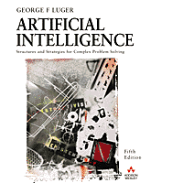
The Predicate Calculus
2.0 Introduction
2.1 The Propositional Calculus
2.2 The Predicate Calculus
2.3 Using Inference Rules to Produce Predicate Calculus Expressions
2.4 Application: A Logic-Based Financial Advisor
2.5 Epilogue and References
2.6 Exercises
George F Luger
ARTIFICIAL INTELLIGENCE 5th edition
Structures and Strategies for Complex Problem Solving
Luger: Artificial Intelligence, 5th edition. © Pearson Education Limited, 2005
Notes:
OWEN: Insert chapter number

Slide 2
Propositional & Predicate Calculus
Languages to express (represent) knowledge.
They use words, phrases, and sentences to represent knowledge and reason about properties and relationships of the world.

Slide 3
Propositional Calculus

Slide 4
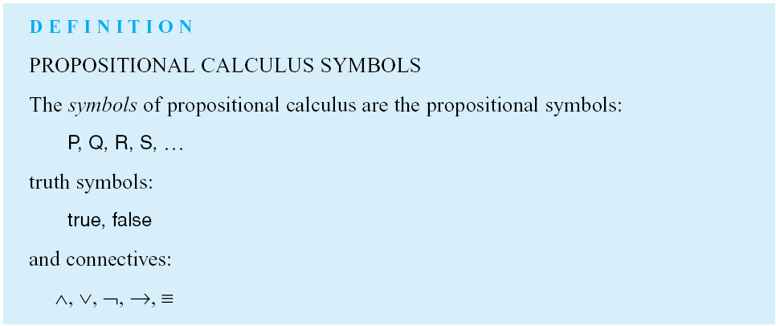
Luger: Artificial Intelligence, 5th edition. © Pearson Education Limited, 2005

Slide 5
Examples of sentences
P represents (denotes) “My car is green”
Q represents “It is raining”
R represents “I like my job”

Slide 6
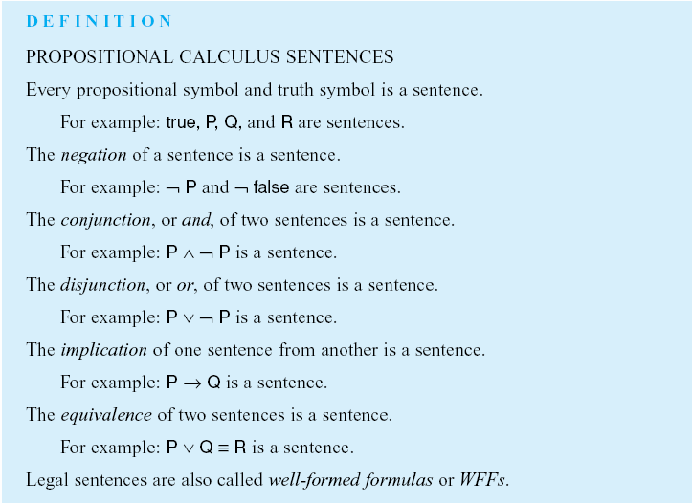

P ^ Q is a sentence
P: Premise or antecedent
Q: Conclusion or consequent
Luger: Artificial Intelligence, 5th edition. © Pearson Education Limited, 2005

Slide 7
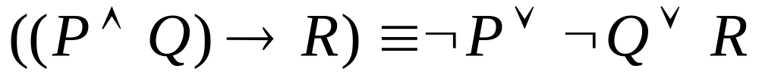
Example of a WFF

Slide 8
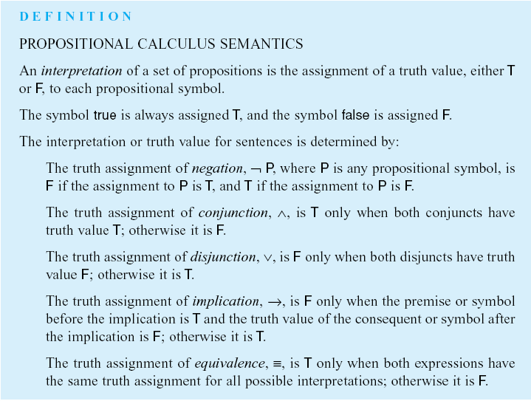
Luger: Artificial Intelligence, 5th edition. © Pearson Education Limited, 2005

Slide 9
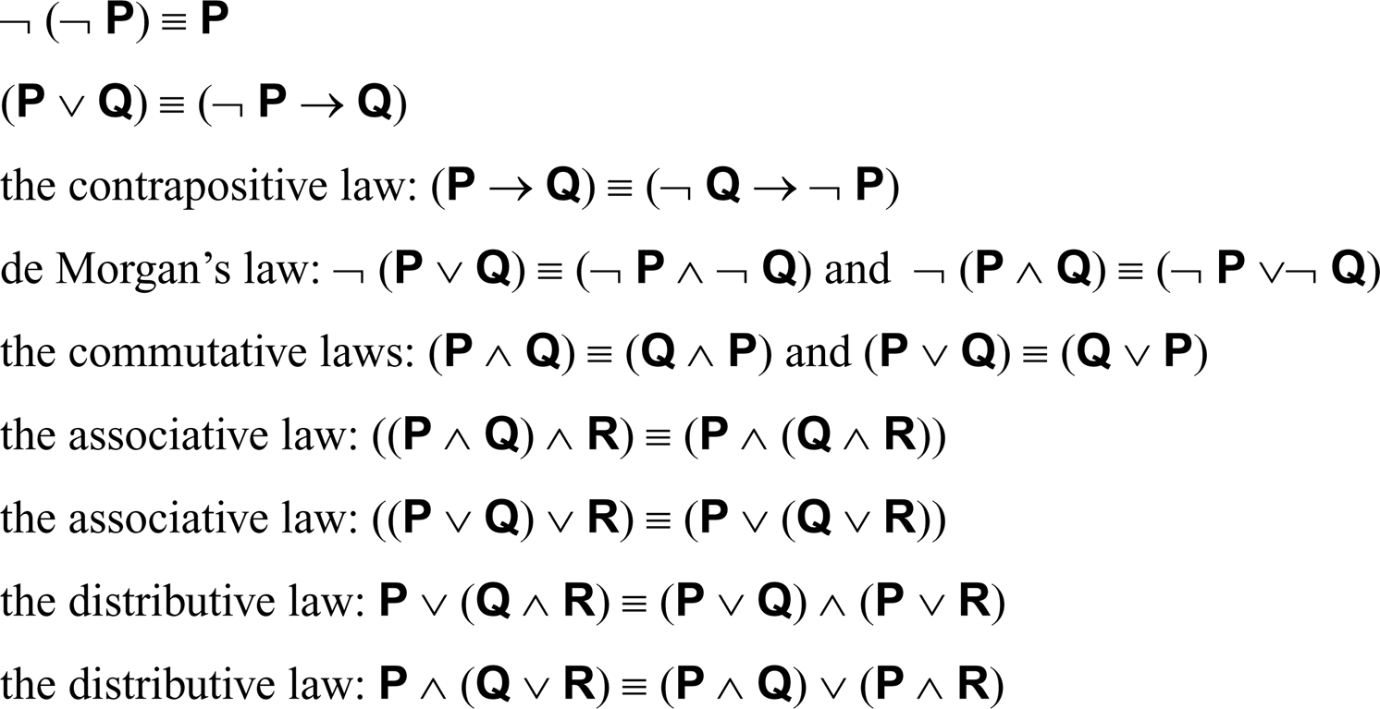
For propositional expressions P, Q and R:
Luger: Artificial Intelligence, 5th edition. © Pearson Education Limited, 2005

Slide 10
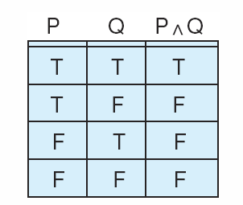
Figure 2.1: Truth table for the operator ∧.
Luger: Artificial Intelligence, 5th edition. © Pearson Education Limited, 2005

Slide 11

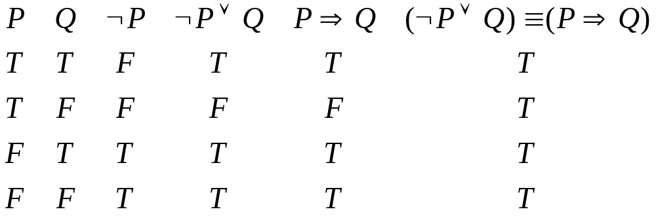
Figure 2.2: Truth table demonstrating the equivalence of:
Luger: Artificial Intelligence, 5th edition. © Pearson Education Limited, 2005

Slide 12
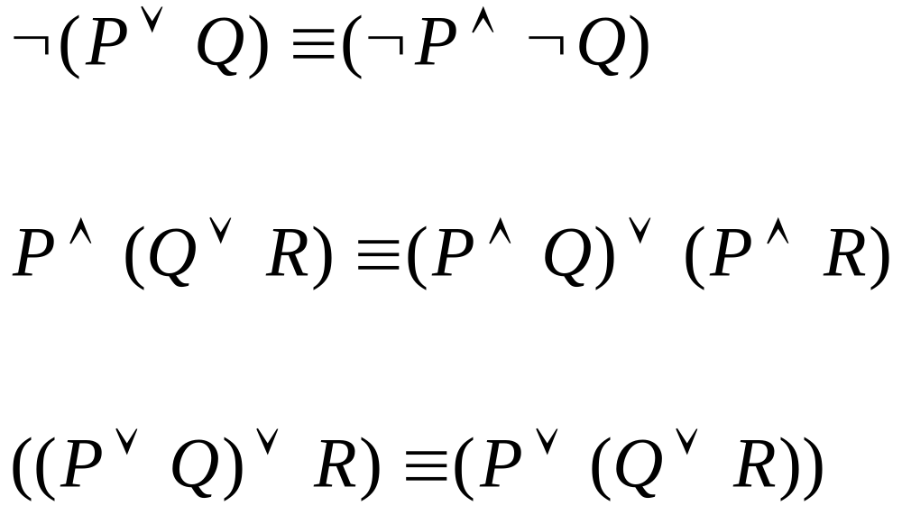
Prove the following

Slide 13
Give the representation for the following sentences
I will go to Aqaba or I will visit the zoo
Ali likes sweet and Ahmad doesn’t eat waffles
If Omar is ill then he goes to the doctor

Slide 14
Propositional Calculus
Also called propositional logic
Zero-order logic
  Does not contain variables
  Always uses constants
  Uses verb
    Action: eat, like
    Static: is, was

Slide 15
Propositional Calculus – Lack of enough power of representation
Example 1:
  All students are smart
  Ali is a student
  With propositional calculus we cannot conclude that Ali is smart
Example 2:
  Ali likes sweet
  Ali eats everything he likes
  We cannot conclude that Ali eats sweet

Slide 16
Examples of differences
Propositional calculus: “It rained on Tuesday”
  Single statement
Predicate calculus expression: weather(tuesday, rain)
  We can access single components
  Relationship between components
  Through inference rules, we can manipulate predicate access components and infer new rules.

Slide 17
Predicate Calculus (First-order logic)
Advantages:
More representation power.
Expressions may contain variables (General assertions).
Well-defined formal semantics.
Sound and Complete inference rules.

Slide 18
Predicate Calculus Example
For all values of X, where X is a day of the week, weather (X, rain) is true.
i.e. it rains everyday.

Slide 19
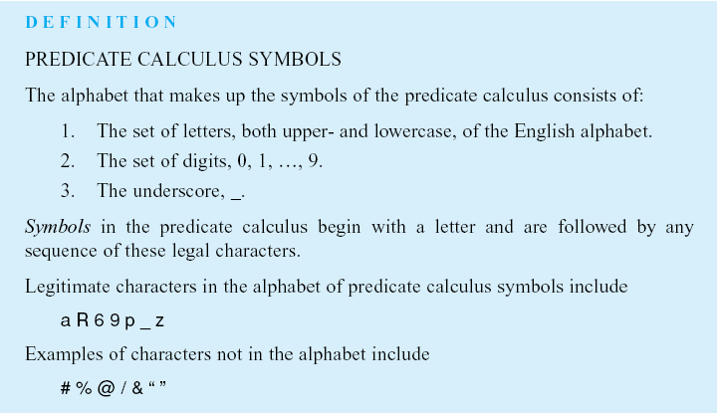
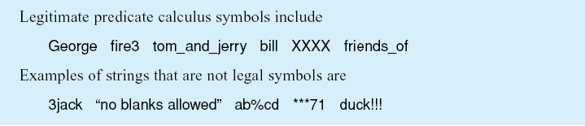
Luger: Artificial Intelligence, 5th edition. © Pearson Education Limited, 2005

Slide 20
Predicate calculus symbols
Symbols denote objects, properties, or relations.
Use meaningful names.
  w(tu,r) Vs. weather(tuesday, rain)

Slide 21
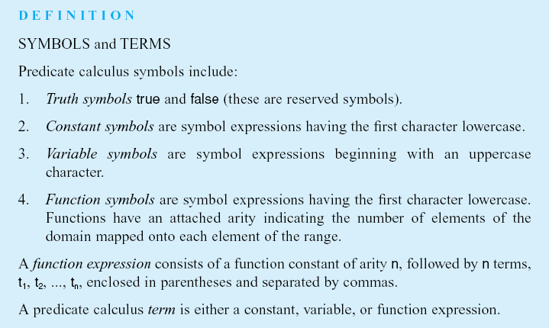
Luger: Artificial Intelligence, 5th edition. © Pearson Education Limited, 2005

Slide 22
Examples of predicate calculus terms
Terms are symbols which are either variables, constants, or function expressions.
Examples
  cat
  times(2,3)
  X
  blue
  mother(jane)
  kate

Slide 23
Examples of predicate calculus functions
father(ali) its value may be ahmad
plus(4, 5) its value may be 9
price(apple) its value may be 75
Replacing the function with its value is called evaluation.

Slide 24
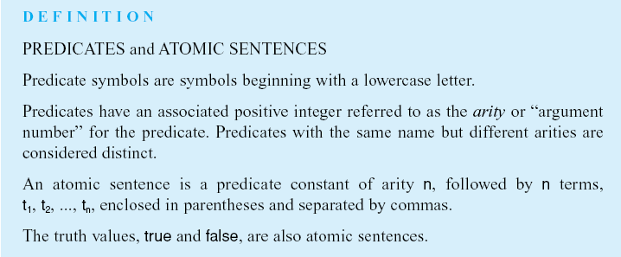
Luger: Artificial Intelligence, 5th edition. © Pearson Education Limited, 2005

Slide 25
Predicates
Begin with a lower case letter.
A predicate is a relationship between zero or more objects in the world.
  likes, equals, on, near, part_of
  red(book1) represents property
  on(labtop,table1) relationship between labtop and table

Slide 26
Atomic sentences, atoms, or propositions
Atomic sentences: predicate of arity n followed by n terms:
Examples:
  likes(george, kate)
  friends(ali,hasan)
  friends(farah,areej,school)
  helps(ahmad,faris)
  friends(father_of(ali), brother_of(ahmad))

Slide 27

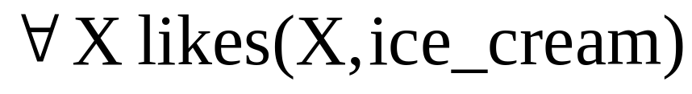

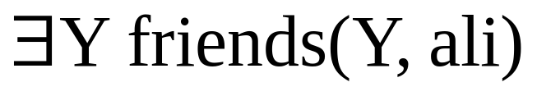
Variable quantifiers
universal quantifier (for all)
existential quantifier (there exists)

Slide 28
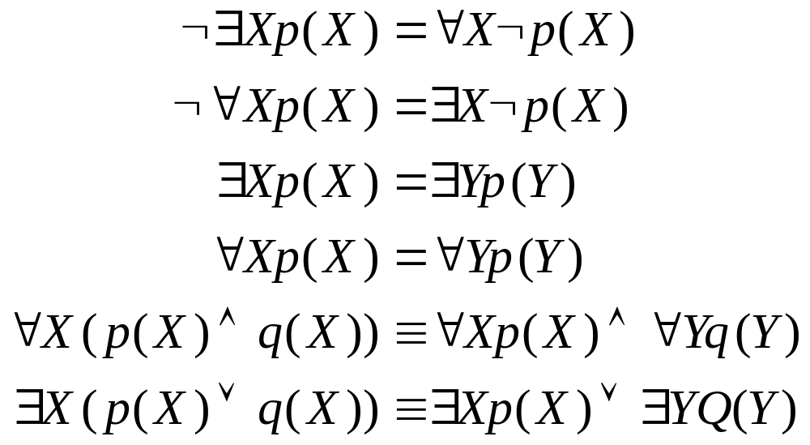
Some Properties of quantifiers

Slide 29
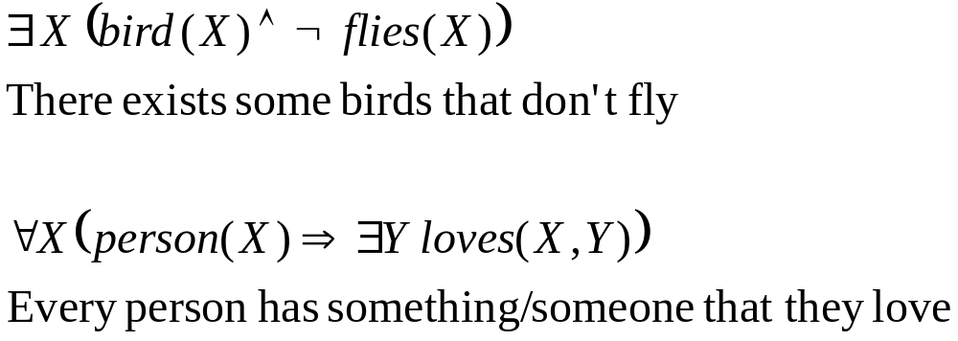
Examples of mapping between English language and predicate calculus

Slide 30
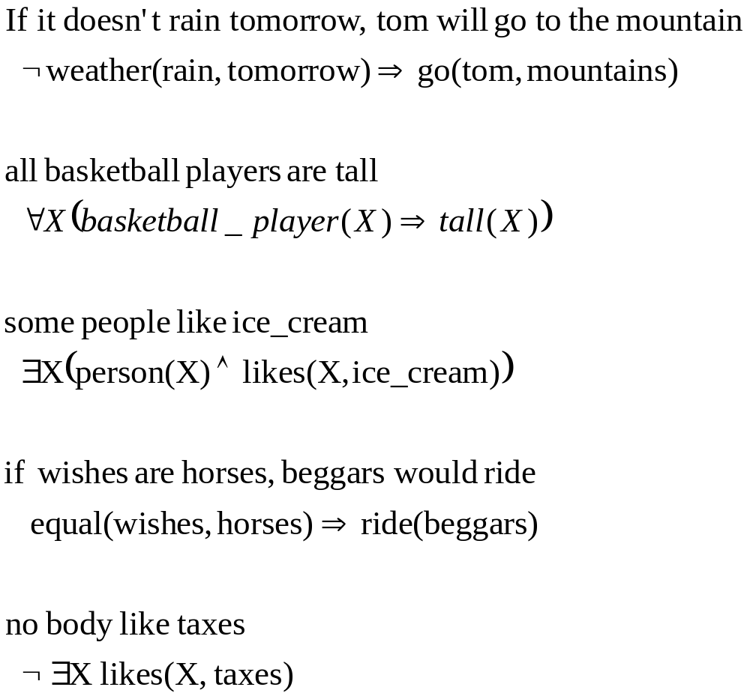
Examples of mapping between English language and predicate calculus

Slide 31
Quiz Translate from English into first order logic
Every hardworking student who attends his exams will pass
Every student who does his homework and revises his lectures is a hardworking student
ali revises his lectures and does his homework
ali attends all his exams

Slide 32
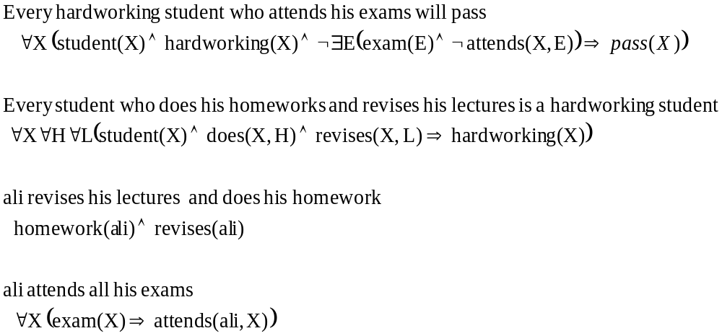
Quiz Translate from English into first order logic

Slide 33
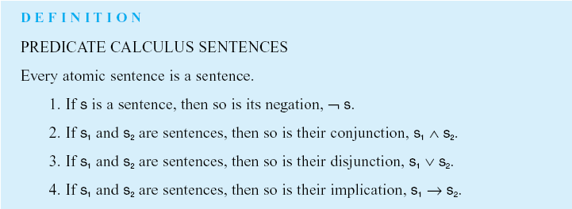
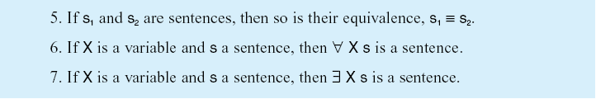
Luger: Artificial Intelligence, 5th edition. © Pearson Education Limited, 2005

Slide 34
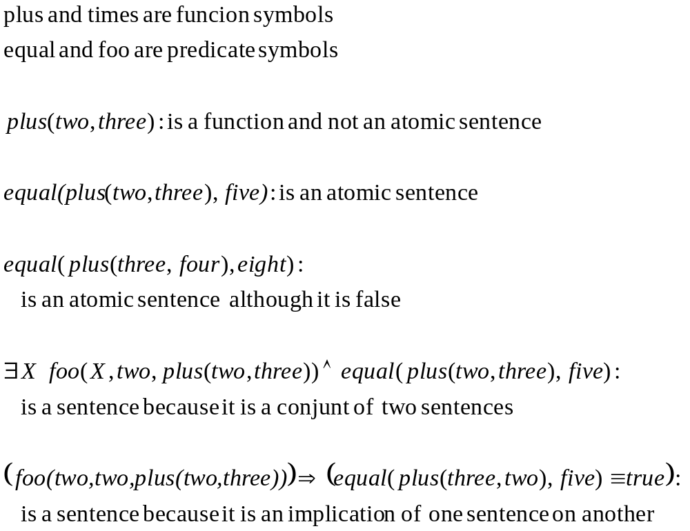
Test for well-formedness

Slide 35
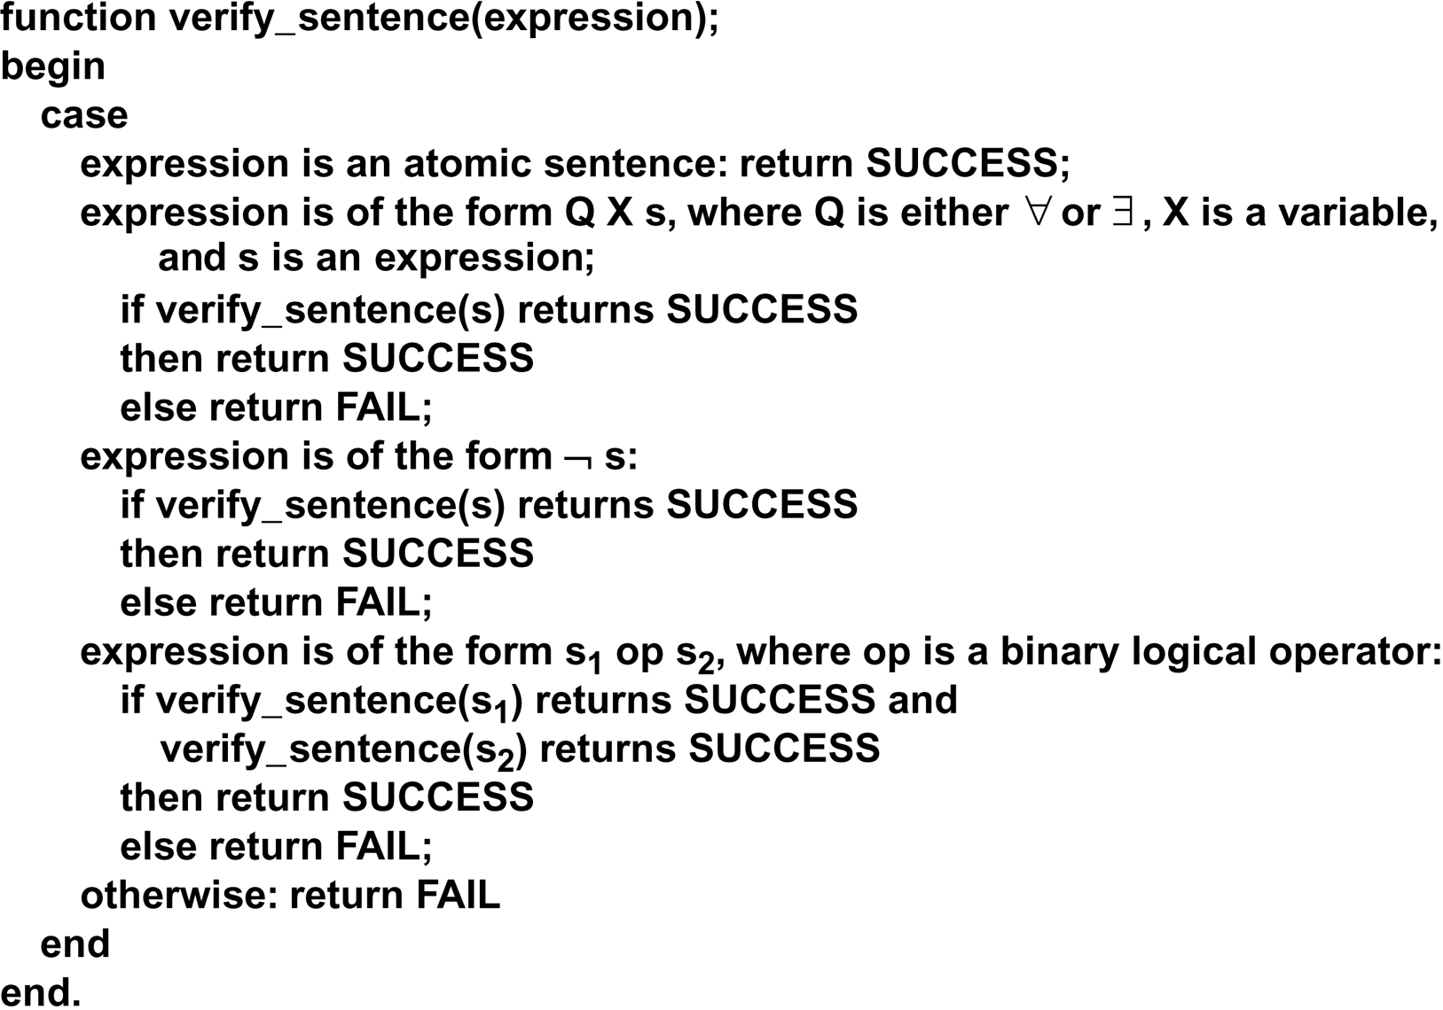
verify_sentence algorithm
Luger: Artificial Intelligence, 5th edition. © Pearson Education Limited, 2005

Slide 36
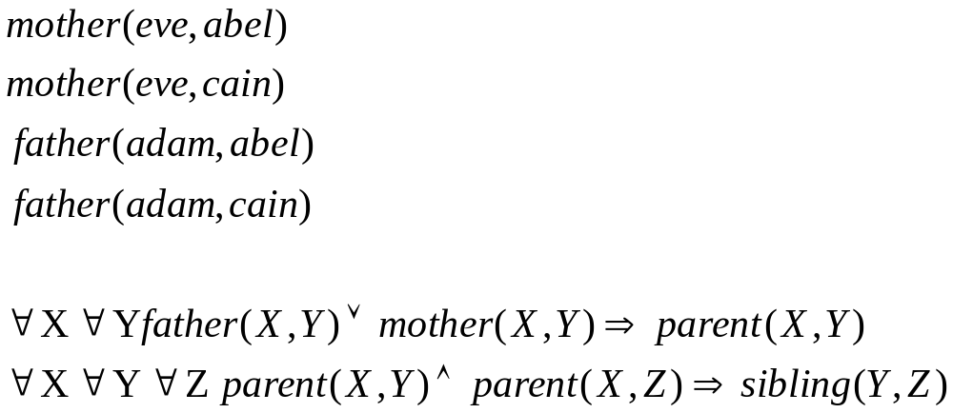
World description using predicate calculus

Slide 37
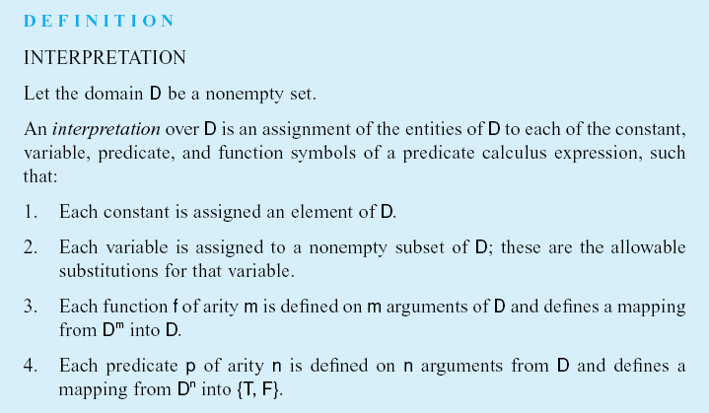
Luger: Artificial Intelligence, 5th edition. © Pearson Education Limited, 2005

Slide 38
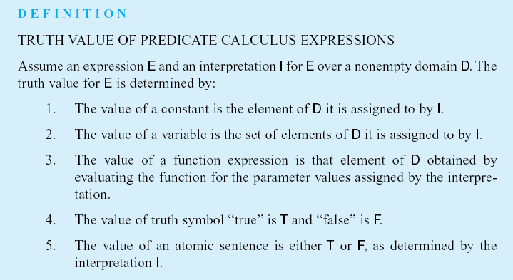
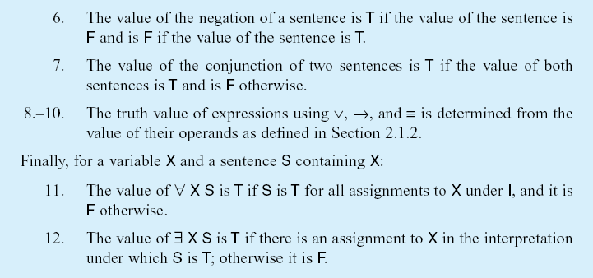
Luger: Artificial Intelligence, 5th edition. © Pearson Education Limited, 2005

Slide 39
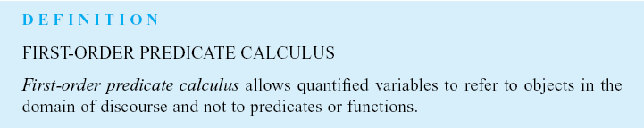
Luger: Artificial Intelligence, 5th edition. © Pearson Education Limited, 2005

Slide 40
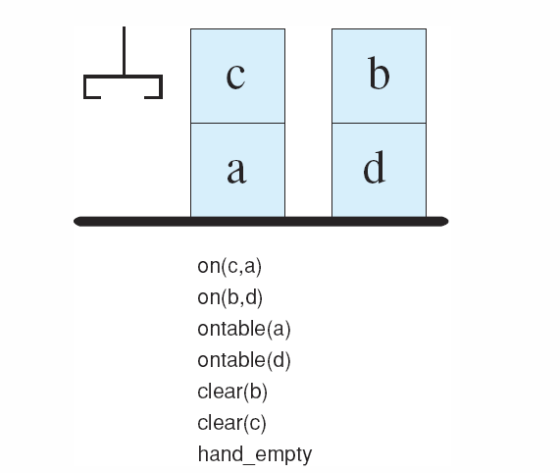
Figure 2.3: A blocks world with its predicate calculate description.
Note:
Predicate calculus is declarative. i.e. No timing or ordering is assumed.
PROLOG is an example of procedural semantics where expressions are evaluated over time.
Luger: Artificial Intelligence, 5th edition. © Pearson Education Limited, 2005

Slide 41
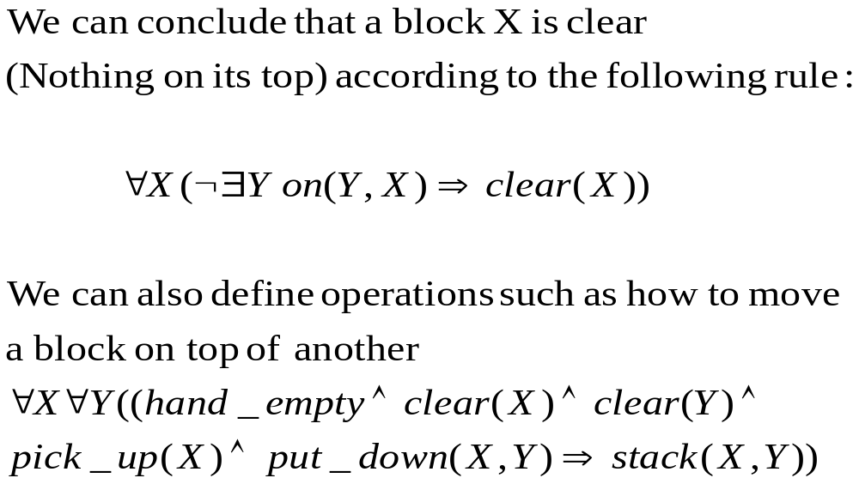
Blocks World - Continued

Slide 42
Inference Rules
Logical inference: The ability to infer (produce) new correct expressions (sentences) from a set of true assertions.
An expression X logically follows from a set of predicate calculus expressions S if every interpretation that satisfies S also satisfies X.

Slide 43
Inference Rules
Inference rule: A mechanism of producing new predicate calculus sentences from other sentences.
When every sentence X produced by an inference rule operating on set of sentences S logically follows from S, the inference rule is said to be sound.

Slide 44
Inference Rules
If the inference rule is able to produce every expression that logically follows from S, it is said to be complete.

Slide 45
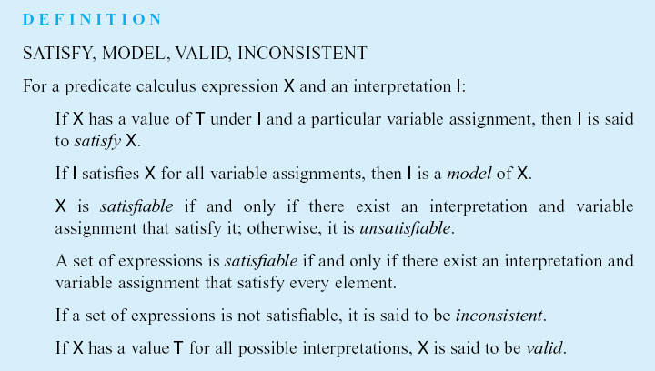
Luger: Artificial Intelligence, 5th edition. © Pearson Education Limited, 2005

Slide 46
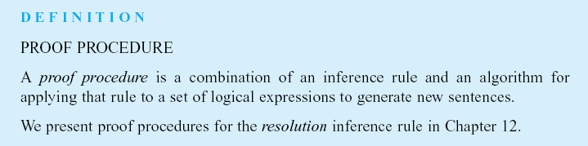
Luger: Artificial Intelligence, 5th edition. © Pearson Education Limited, 2005

Slide 47
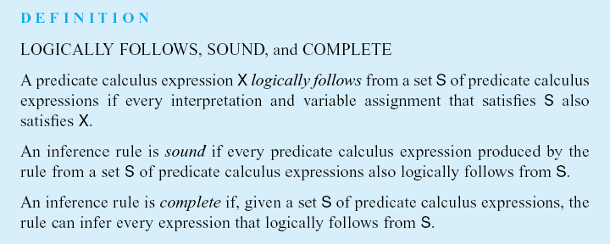
Luger: Artificial Intelligence, 5th edition. © Pearson Education Limited, 2005

Slide 48
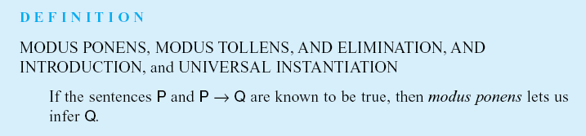
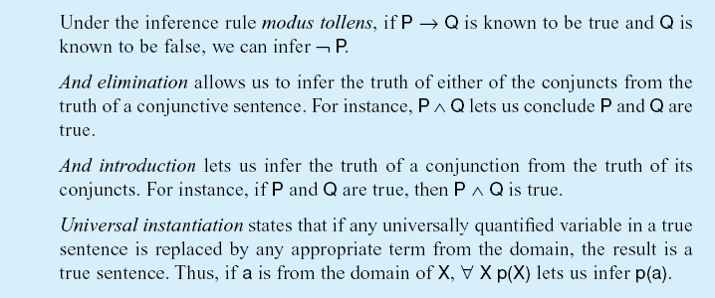
Sound
Luger: Artificial Intelligence, 5th edition. © Pearson Education Limited, 2005

Slide 49
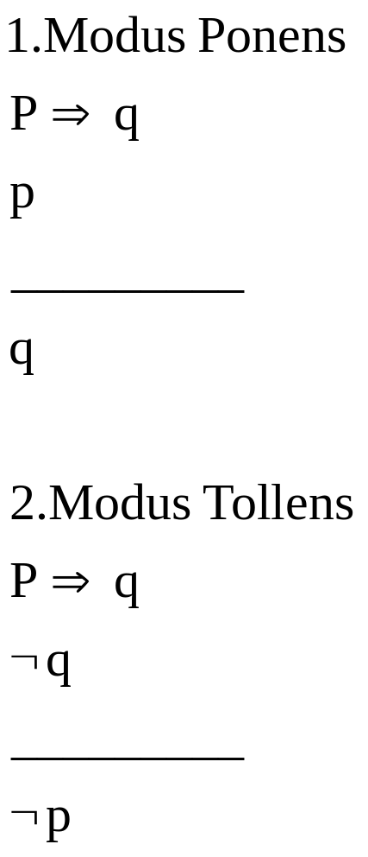
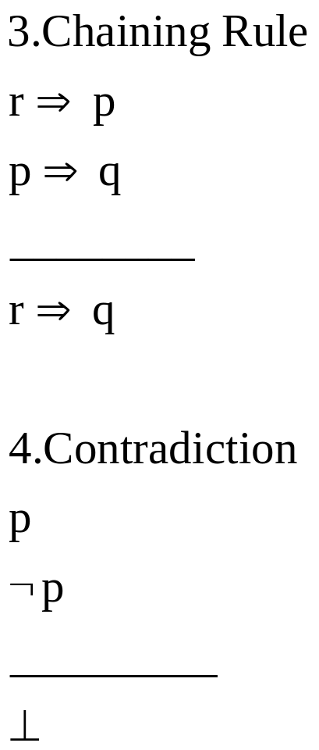
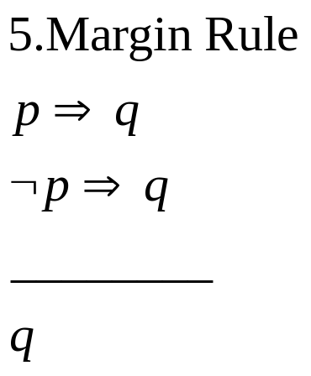
Inference Rules

Slide 50
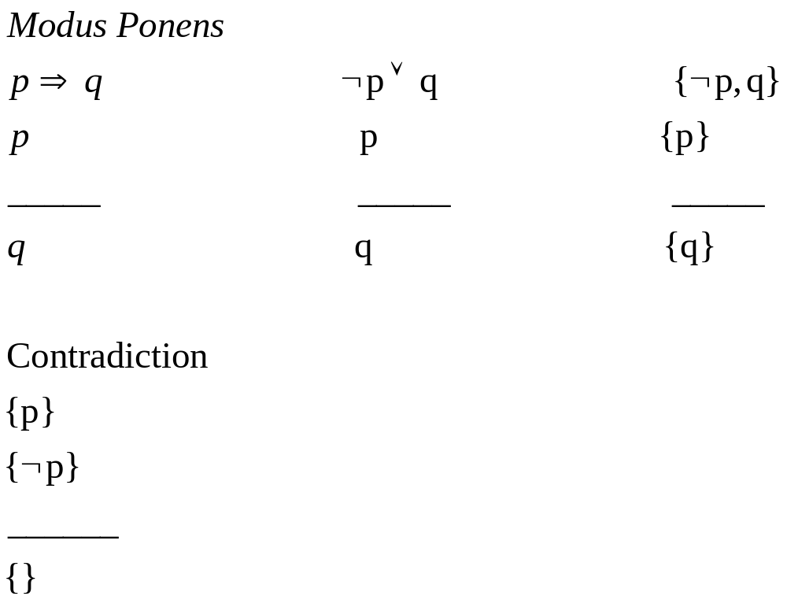

Slide 51
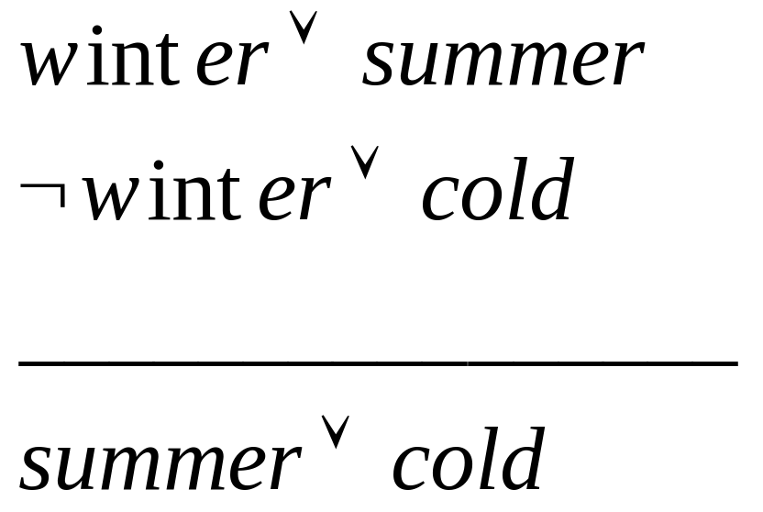
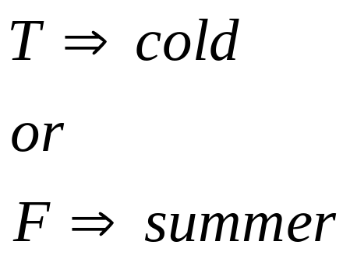
Resolution Inference Rule
winter

Slide 52
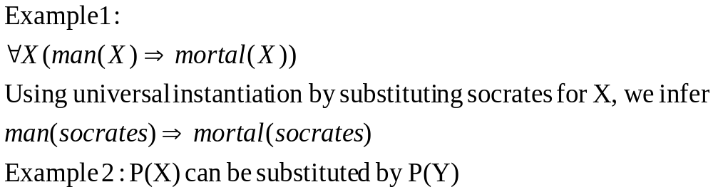
Unification
We need to check whether two expressions are the same or match?
Unification: An algorithm for determining the substitutions needed to make two predicate calculus expressions match.

Slide 53
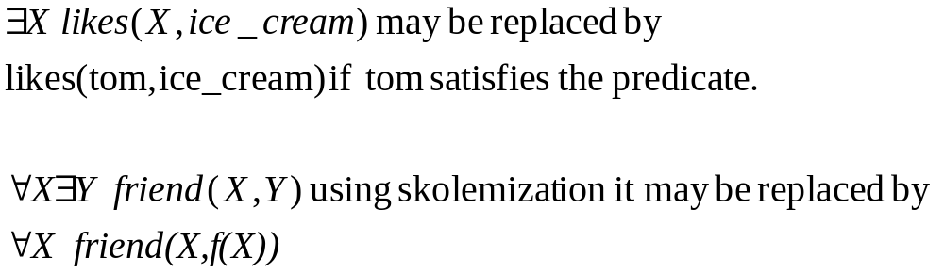
Elimination of there exists quantifier
Unification requires the elimination of existential quantifiers as it requires all variables be universally quantified to give freedom in substitutions.

Slide 54
Examples of substitutions
The expression:
foo(X, a, goo(Y))
Can yield many expressions using legal substitutions (bindings):
  foo(fred, a, goo(Z)) using {fred/X, Z/Y}
  foo(W, a, goo(jack)) using {W/X, jack/Y}
  foo(Z, a, goo(moo(Z))) using {Z/X, moo(Z)/Y}

Slide 55
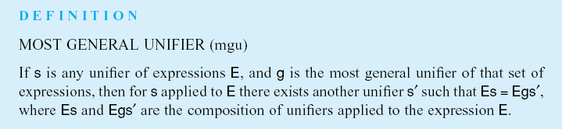
In unifying the expressions p(X) and p(Y) the substitution {Z/X, Z/Y} is more general than the substitution {fred/X, fred/Y}
Luger: Artificial Intelligence, 5th edition. © Pearson Education Limited, 2005

Slide 56
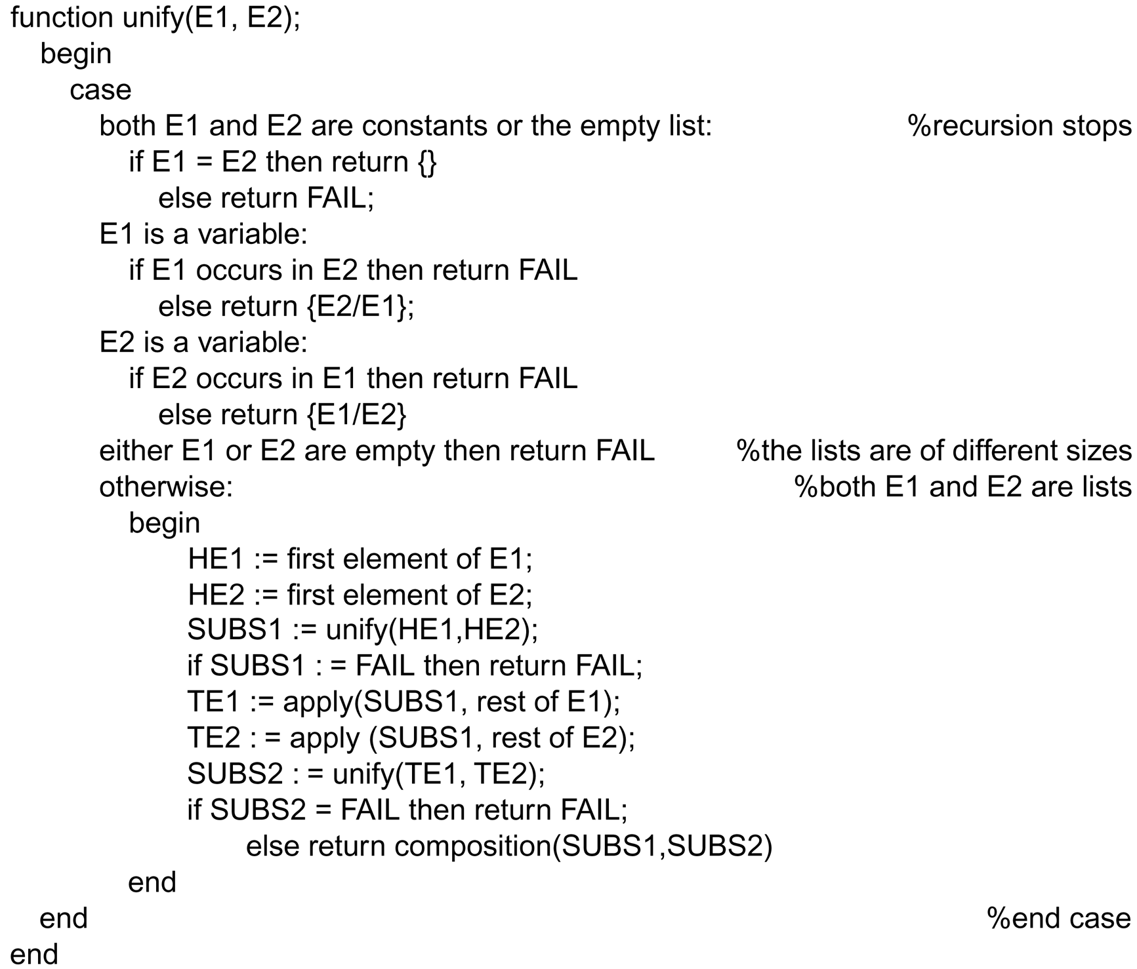
Luger: Artificial Intelligence, 5th edition. © Pearson Education Limited, 2005

Slide 57
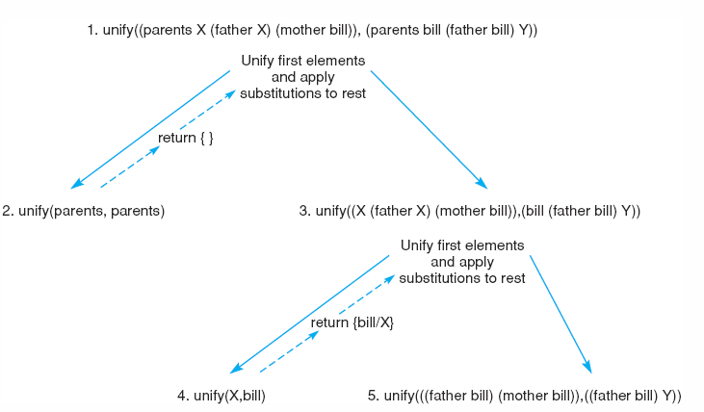
Figure 2.5: Further steps in the unification of
(parents X (father X) (mother bill)) and
(parents bill (father bill) Y).
Luger: Artificial Intelligence, 5th edition. © Pearson Education Limited, 2005

Slide 58
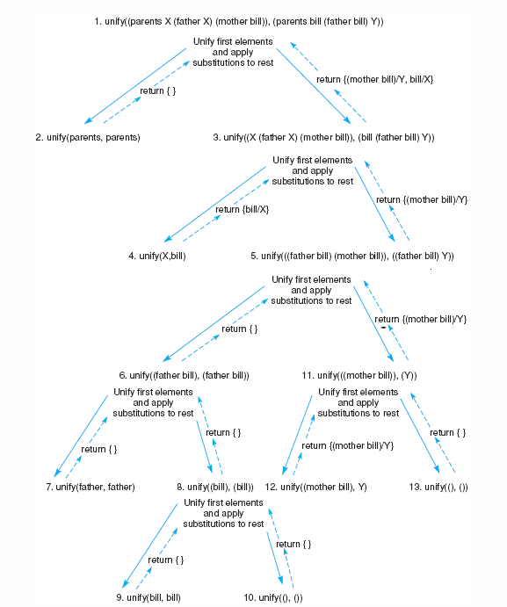
Figure 2.6: Final trace of the unification of (parents X (father X) (mother bill)) and (parents bill (father bill) Y).
Luger: Artificial Intelligence, 5th edition. © Pearson Education Limited, 2005
Notes:
OWEN: Insert fig 2.6

Slide 59
Unification Answer
{bill/X, (mother bill)/Y}

Slide 60
Sec 2.6: A Logic-Based Financial Advisor
If you have inadequate saving account, increase your savings regardless of your income.
If you have adequate saving account and adequate income, invest in stock market.
If you have adequate saving account but inadequate income, split your savings between your bank and an investment in stock market.

Slide 61
Sec 2.6: A Logic-Based Financial Advisor
Adequate saving corresponds to $5,000 for each dependent.
  Define function called minsavings(X)=5000*X
Adequate income means $15,000 plus $4,000 for each dependent.
  Define function called minincome(X)=15000+(4000*X)

Slide 62
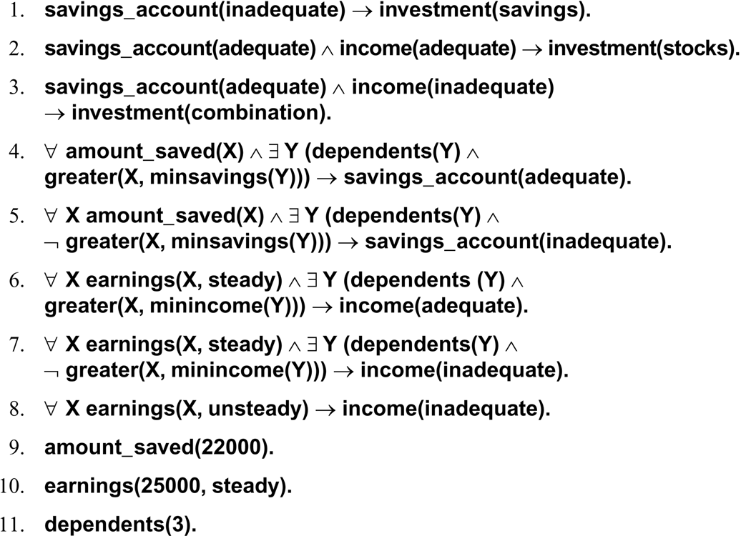
Luger: Artificial Intelligence, 5th edition. © Pearson Education Limited, 2005

Slide 63
Added Predicates
12. saving(adequate)
13. income(inadequate)
The conclusion is
      investment (combination)

