Slide 1
Structures and Strategies for State Space Search
3
3.0 Introduction
3.1 Graph Theory
3.2 Strategies for State Space Search
3.3 Using the State Space to
Represent Reasoning
with the Predicate
Calculus
3.4 Epilogue and References
3.5 Exercises
Additional references for the slides:
Russell and Norvig’s AI book.
Robert Wilensky’s CS188 slides: www.cs.berkeley.edu/~wilensky/cs188/lectures/index.html

Slide 2
Chapter Objectives
Learn the basics of state space representation
Learn the basics of search in state space
The agent model: Has a problem, searches for a solution.

Slide 3
Graph theory: The city of Königsberg
The city is divided by a river. There are two islands at the river. The first island is connected by two bridges to both riverbanks and is also connected by a bridge to the other island. The second island two bridges each connecting to one riverbank.
Question: Is there a walk around the city that crosses each bridge exactly once?
Swiss mathematician Leonhard Euler invented graph theory to solve this problem.

Slide 4
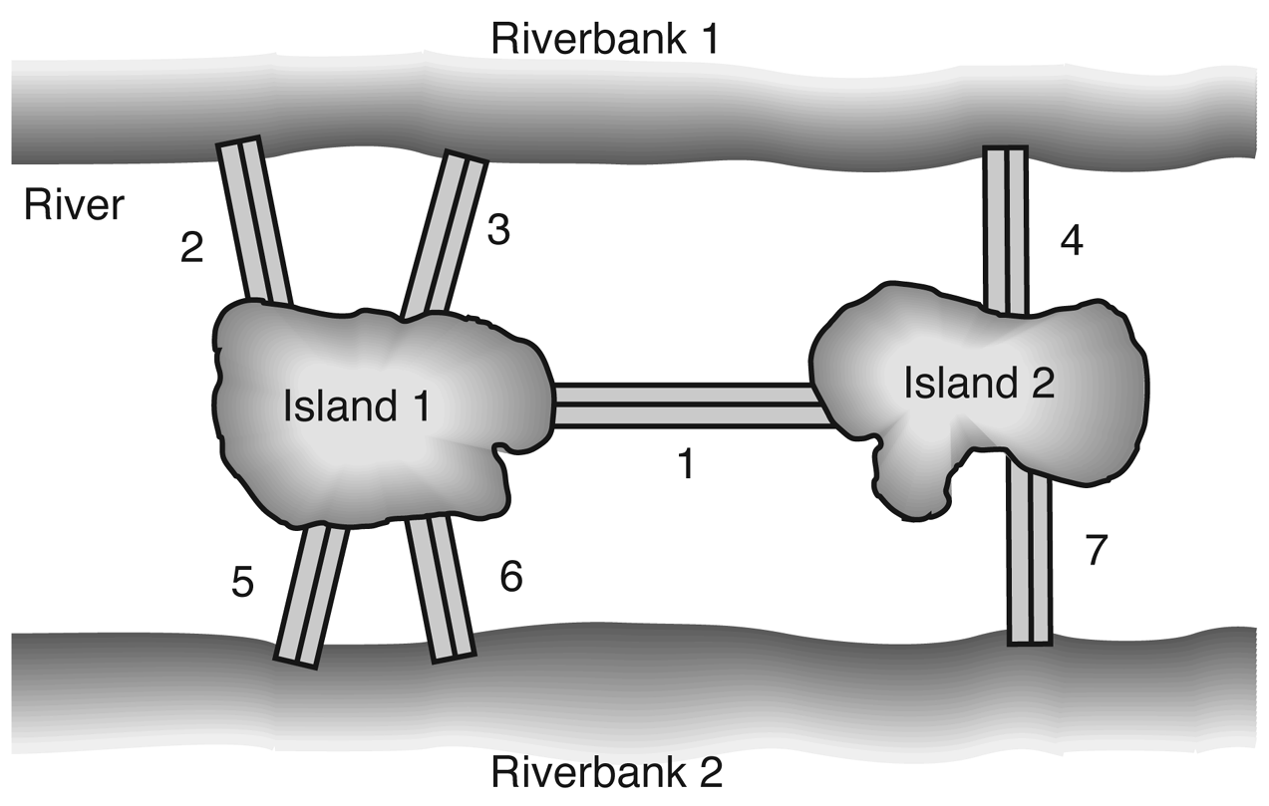
The city of Königsberg

Slide 5
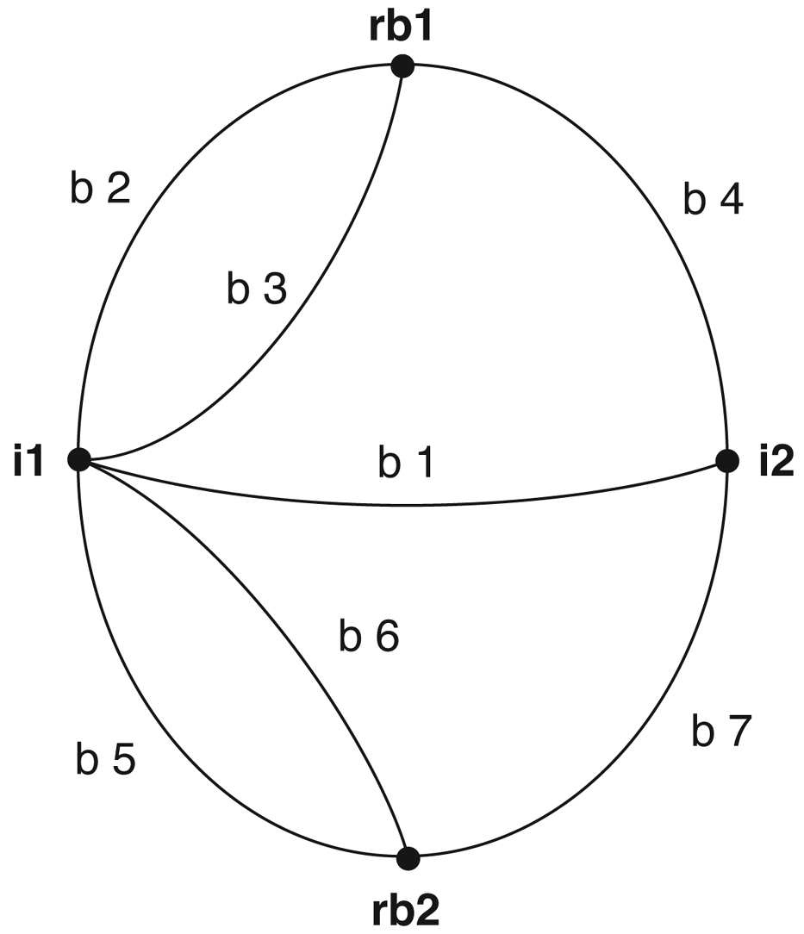
Graph of the Königsberg bridge system

Slide 6
Definition of a graph
A graph consists of
A set of nodes (can be infinite)
A set of arcs that connect pairs of nodes.
An arc is an ordered pair, e.g.,
(i1, rb1),
(rb1, i1).
Notes:
Notes: People often draw trees without directed arcs. It is implicit in the problem definition. In search, it is directed.

Slide 7
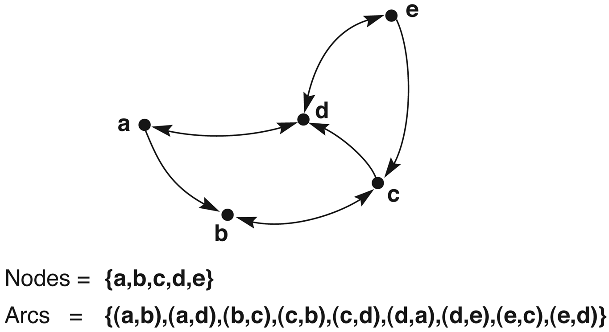
A labeled directed graph

Slide 8
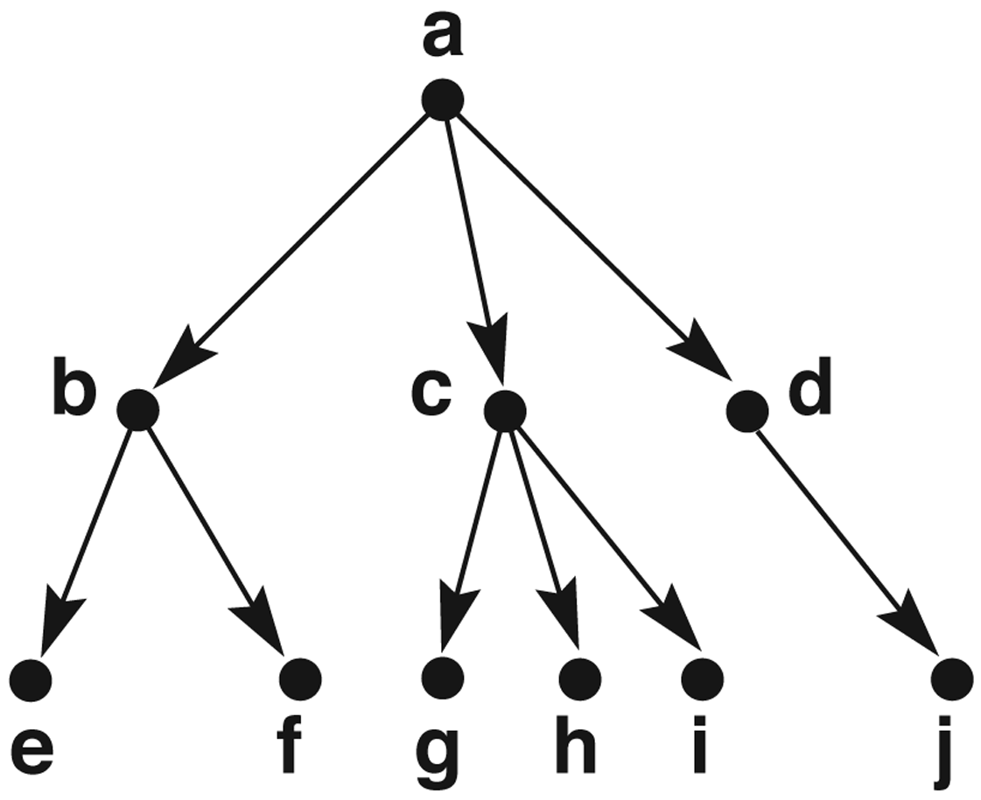
A rooted tree, exemplifying family relationships

Slide 9
Definition of a graph (cont’d)
A graph consists of nodes and arcs.
If a directed arc connects N and M, N is called the parent, and M is called the child. If N is also connected to K, M and K are siblings.
A rooted tree has a unique node which has no parents. The edges in a rooted tree are directed away from the root. Each node in a rooted tree has a unique parent.
Notes:
Notes: People often draw trees without directed arcs. It is implicit in the problem definition. In search, it is directed.

Slide 10
Definition of a graph (cont’d)
A leaf or tip node is a node that has no children (sometimes also called a dead end).
A path of length n is an ordered sequence of n+1 nodes such that the graph contains arcs from each node to the following ones.
E.g., [a b e] is a path of length 2.
On a path in a rooted graph, a node is said to be an ancestor of all the nodes positioned after it (to its right), as well as a descendant of all nodes before it (to its left).

Slide 11
Definition of a graph (cont’d)
A path that contains any node more than once is said to contain a cycle or loop.
A tree is a graph in which there is a unique path between every pair of nodes.
Two nodes are said to be connected if a path exists that includes them both.

Slide 12
A unifying view (Newell and Simon)
The problem space consists of:
a state space which is a set of states representing the possible configurations of the world
a set of operators which can change one state into another
The problem space can be viewed as a graph where the states are the nodes and the arcs represent the operators.

Slide 13
Searching on a graph (simplified)
Start with the initial state (root)
Loop until goal found
find the nodes accessible from the root

Slide 14
1 | 4 | 3
7 |  | 6
5 | 8 | 2
1 | 4 | 3
7 | 6 | 2
5 | 8

Slide 15
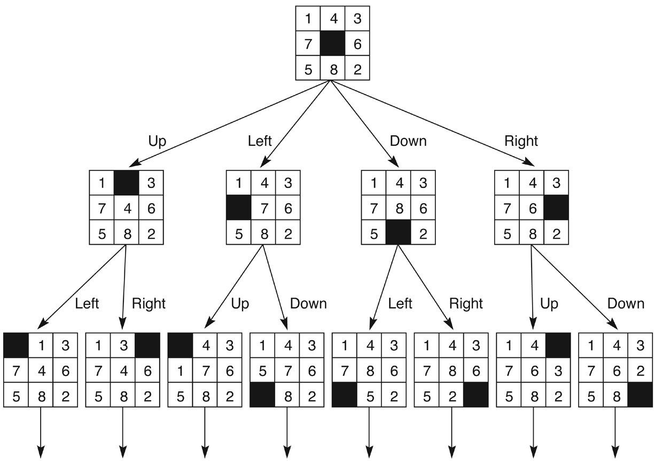
State space of the 8-puzzle generated by “move blank” operations

Slide 16
State space search
Represented by a four-tuple [N,A,S,GD], where:
N is the problem space
A is the set of arcs (or links) between nodes. These correspond to the operators.
S is a nonempty subset of N. It represents the start state(s) of the problem.
GD is a nonempty subset of N. It represents the goal state(s) of the problem. The states in GD are described using either:
a measurable property of the states
a property of the path developed in the
search (a solution path is a path from
node S to a node in GD )

Slide 17
The 8-puzzle problem as state space search
states: possible board positions
operators: one for sliding each square in each of four directions,
or, better, one for moving the blank square in each of four directions
initial state: some given board position
goal state: some given board position
Note: the “solution” is not interesting here, we need the path.

Slide 18
State space of the 8-puzzle (repeated)

Slide 19
Traveling salesperson problem as state space search
The salesperson has n cities to visit and must then return home. Find the shortest path to travel.
state space:
operators:
initial state:
goal state:

Slide 20
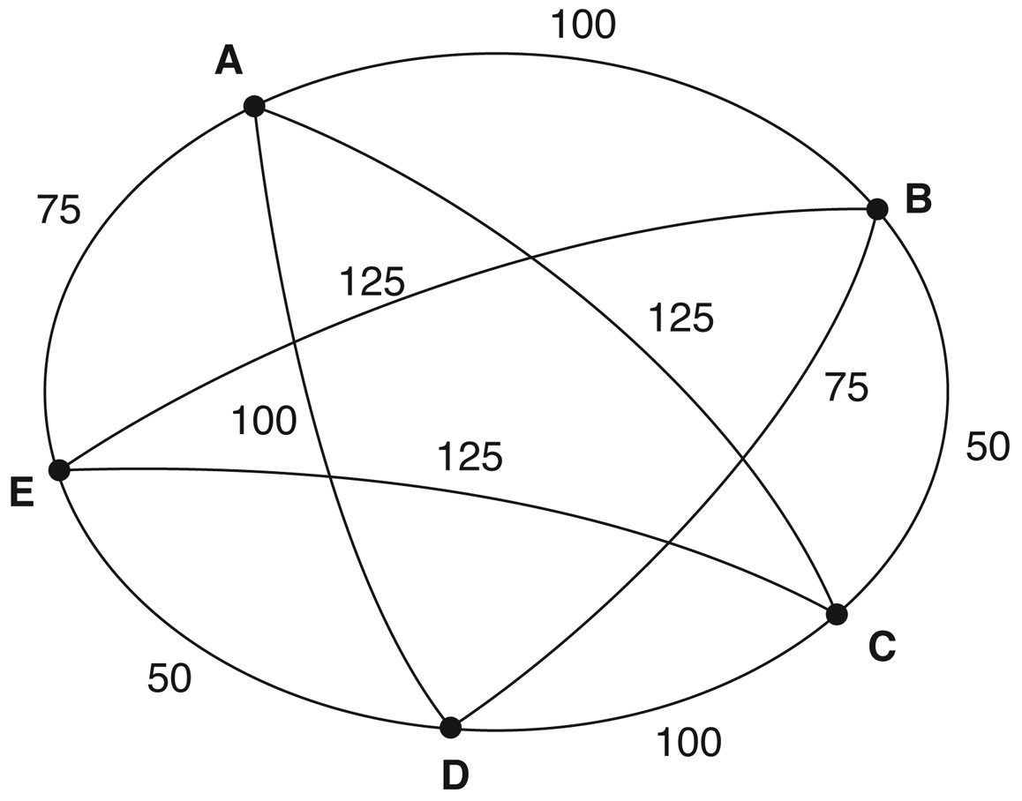
An instance of the traveling salesperson problem

Slide 21
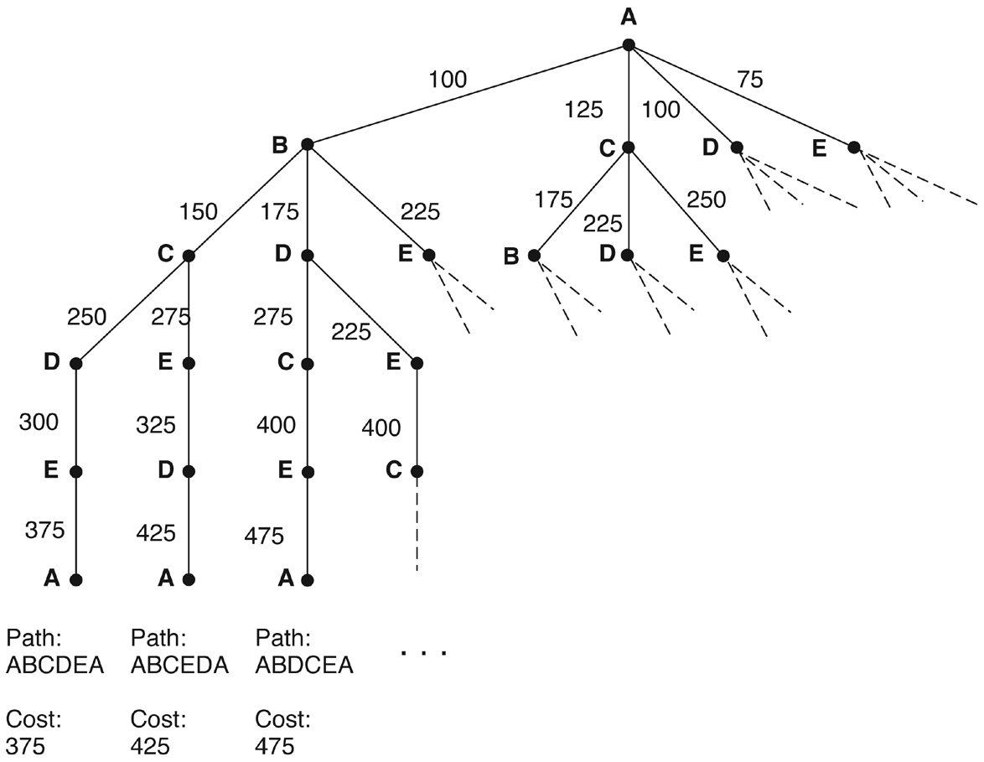
Search of the traveling salesperson problem. (arc label = cost from root)

Slide 22
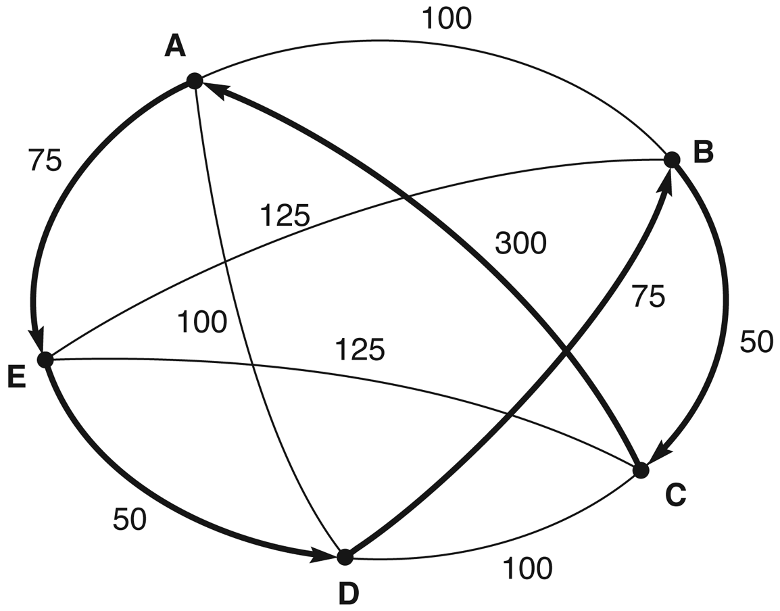
Nearest neighbor path
Nearest neighbor path = AEDBCA (550)
Minimal cost path = ABCDEA (375)

Slide 23
Tic-tac-toe as state space search
states:
operators:
initial state:
goal state:
Note: this is a “two-player” game

Slide 24
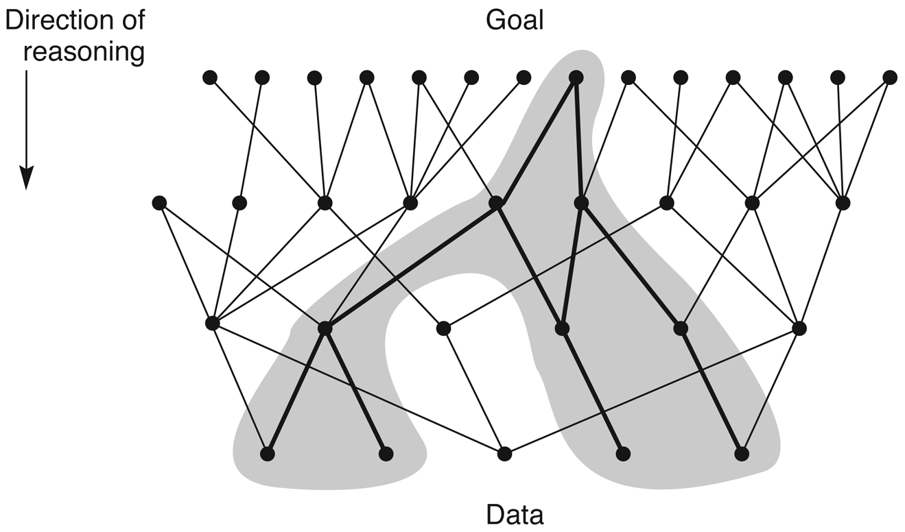
Goal-directed search

Slide 25
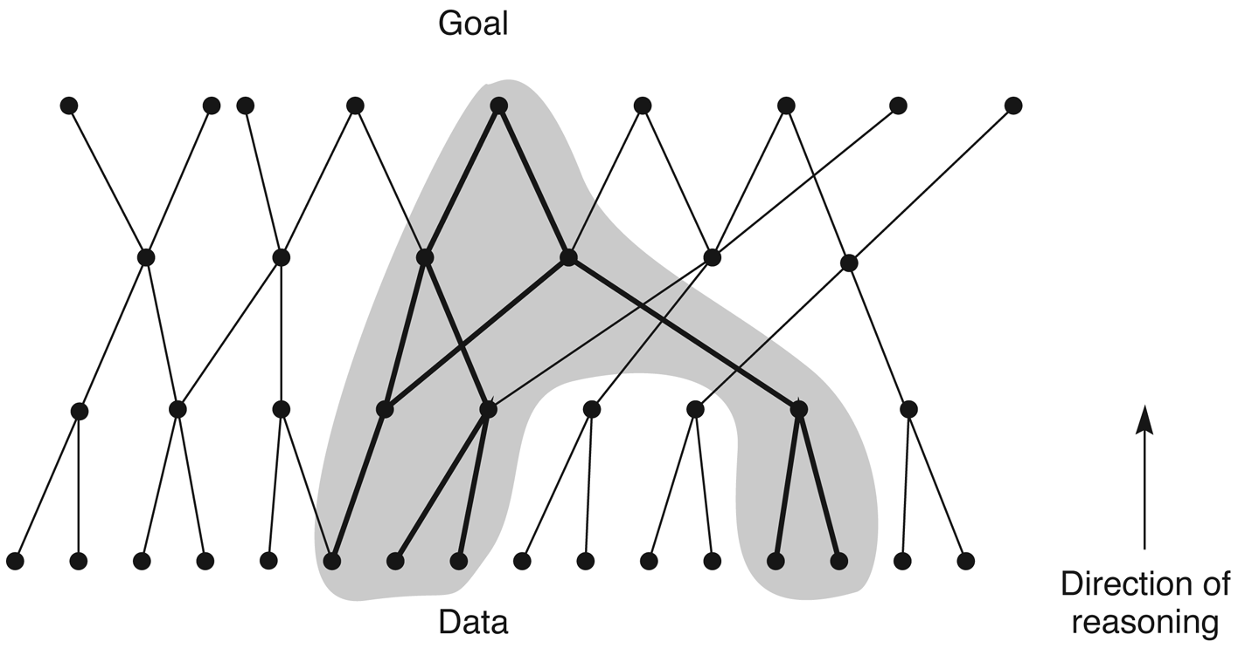
Data-directed search

Slide 26
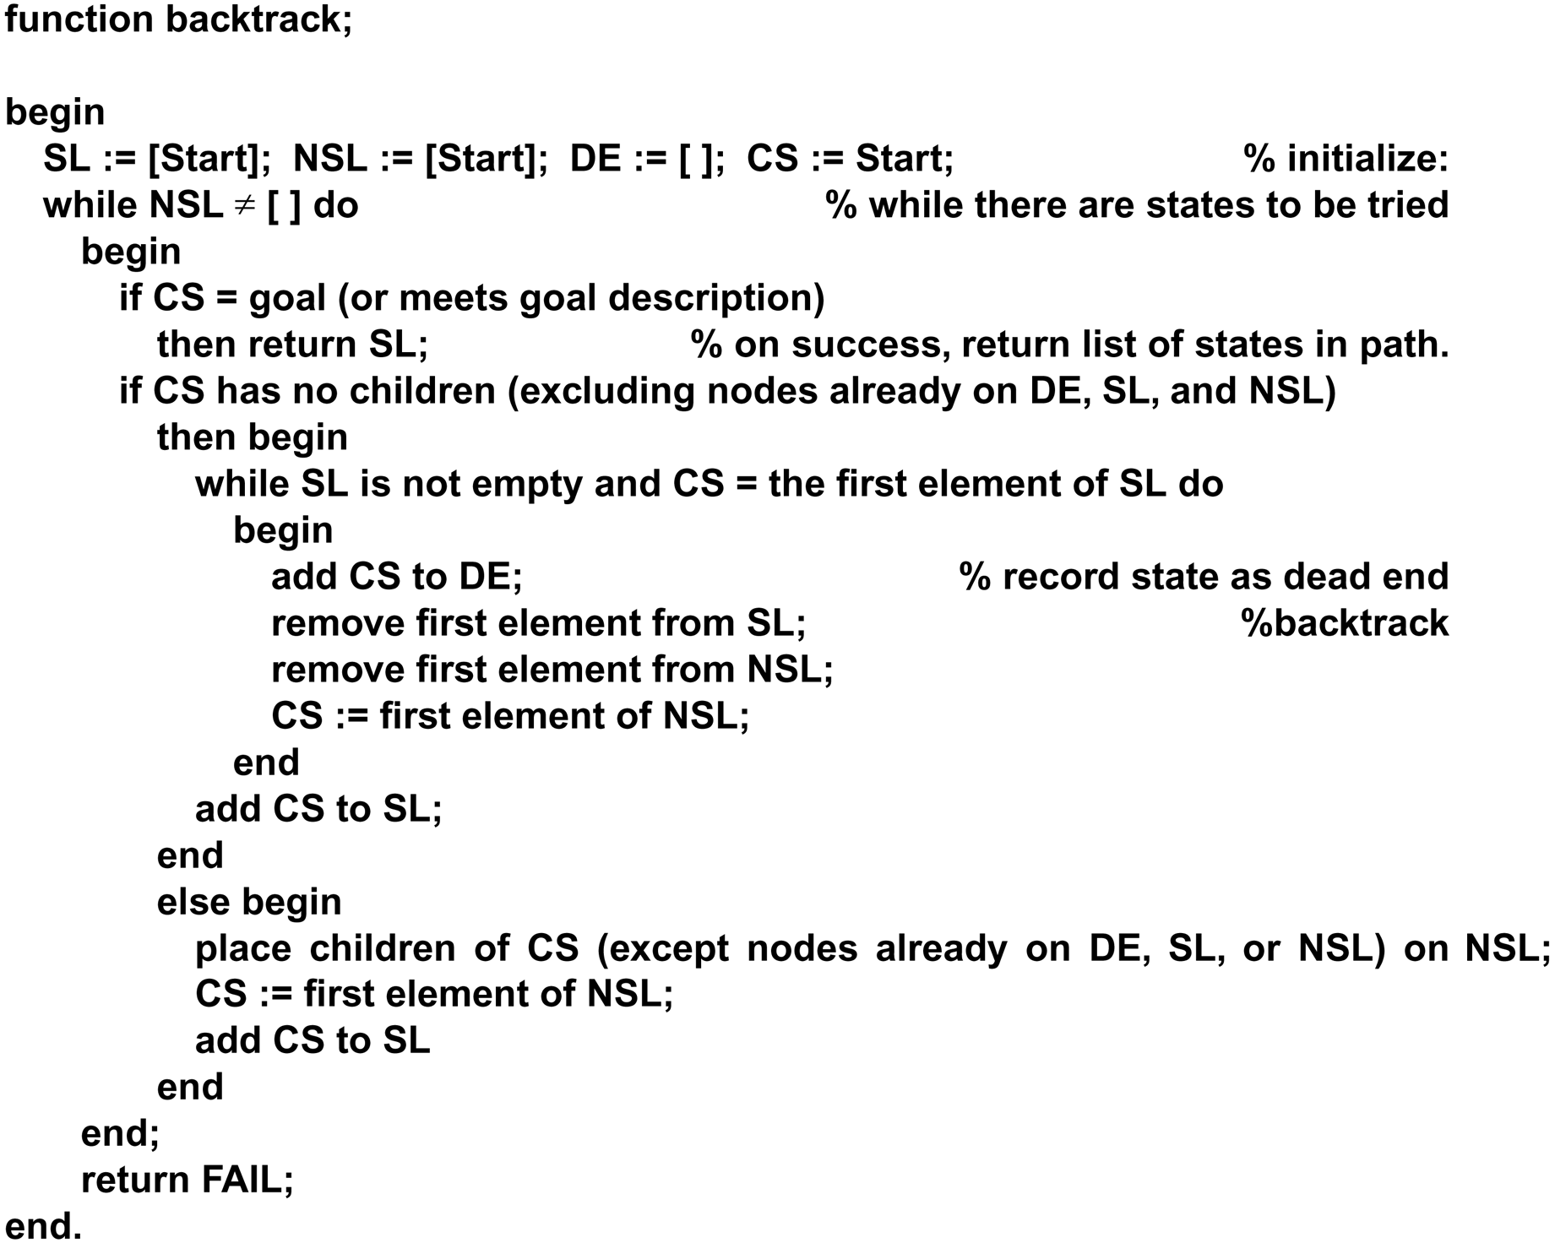

Slide 27
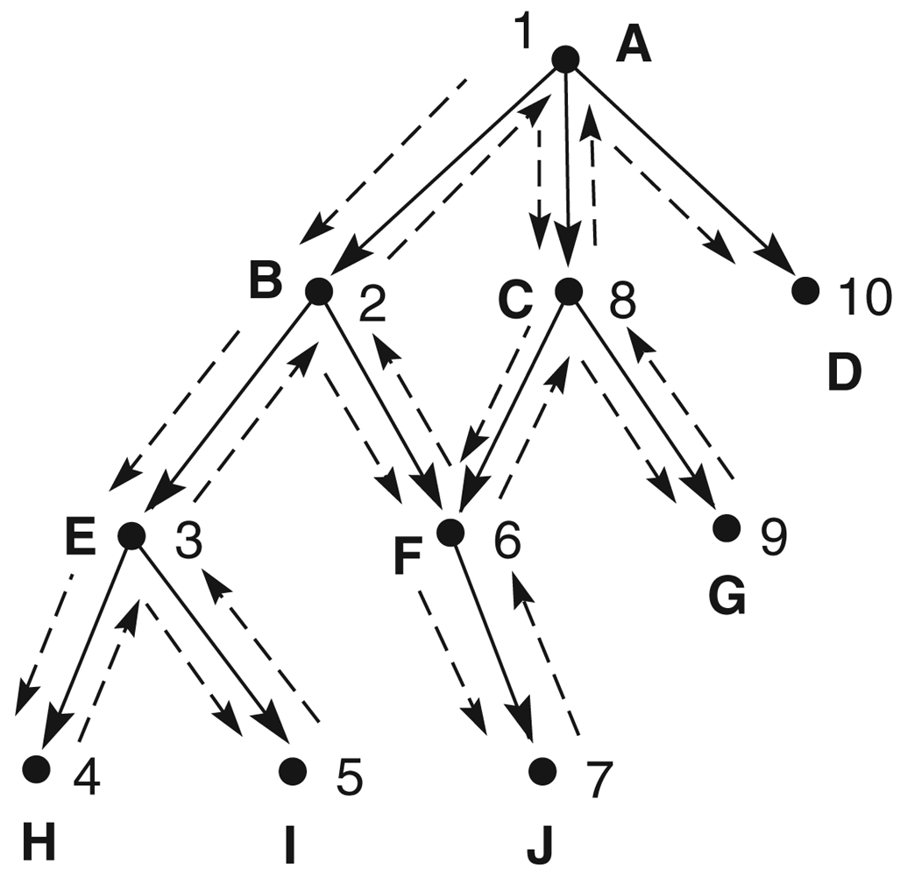
Trace of backtracking search (Fig. 3.12)

Slide 28
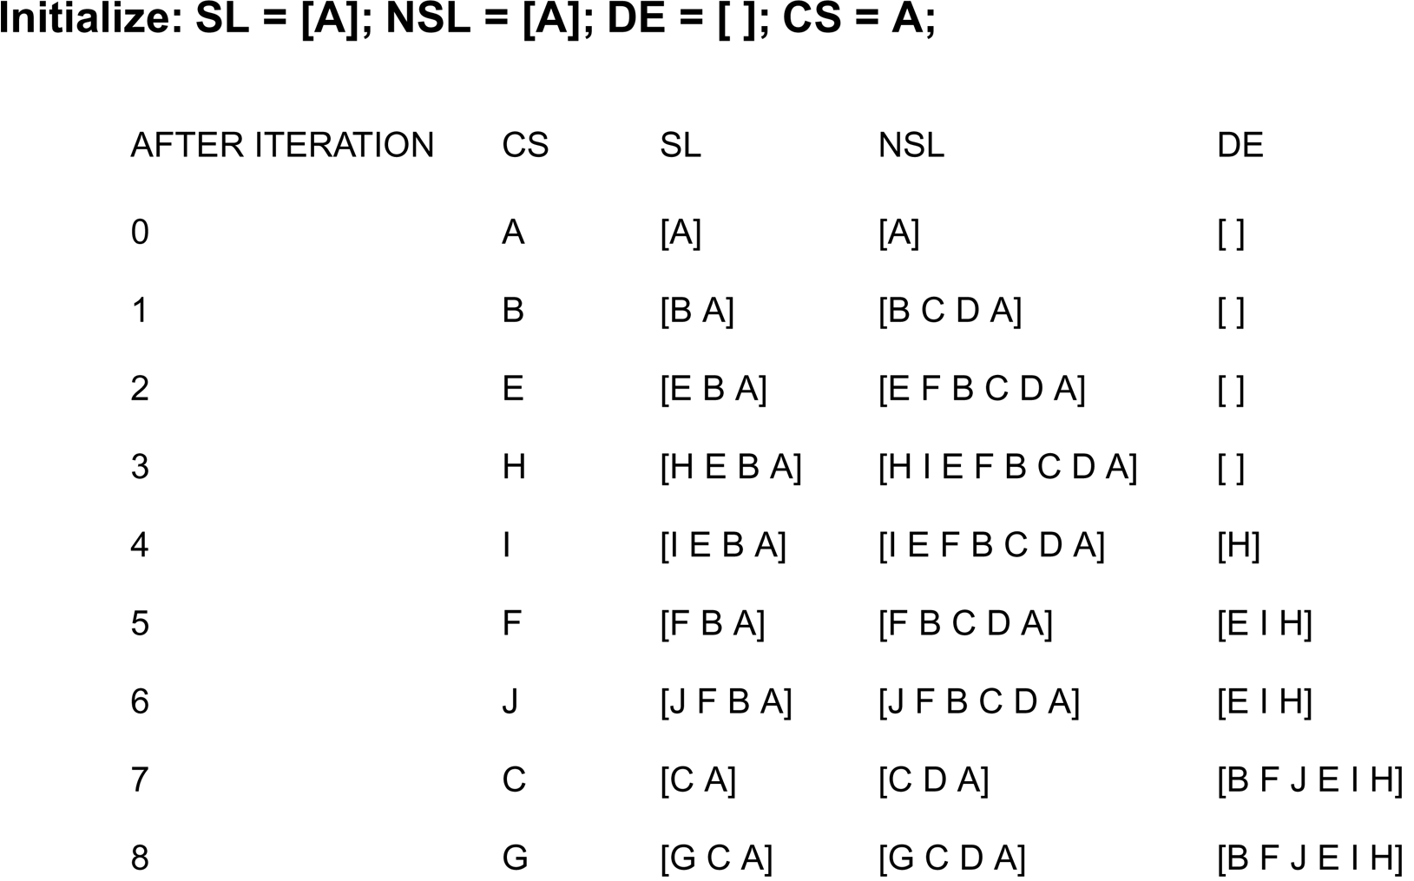
A trace of backtrack on the graph of
Fig. 3.12

Slide 29
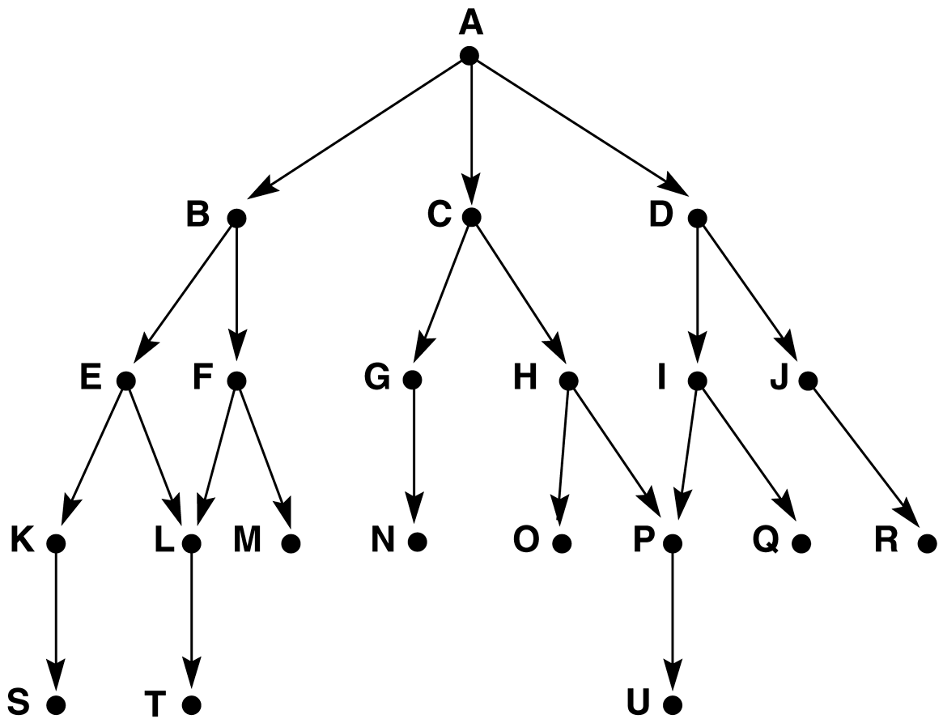
Graph for BFS and DFS (Fig. 3.13)

Slide 30
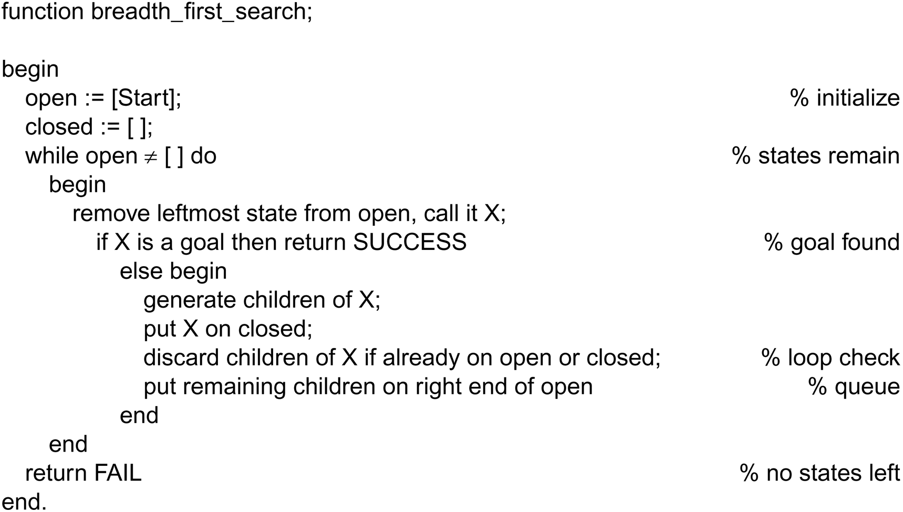
Breadth_first search algorithm

Slide 31
Breadth_first search algorithm
Open = [Start]
Closed = []
While Open <> []:
get S from Open
If S ɇ closed
add S to Closed
If S = Goal
Exit
else
generate S₁, S₂, …, S_{k}
add S to Open
end
Return Fail
end
Open is a queue

Slide 32
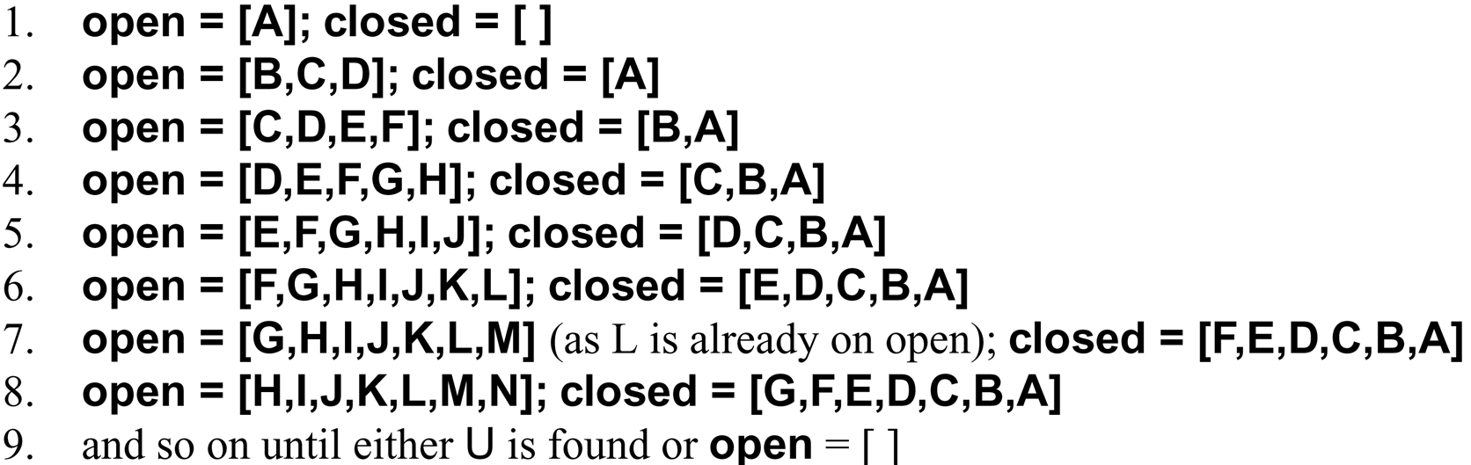
Trace of BFS on the graph of Fig. 3.13

Slide 33
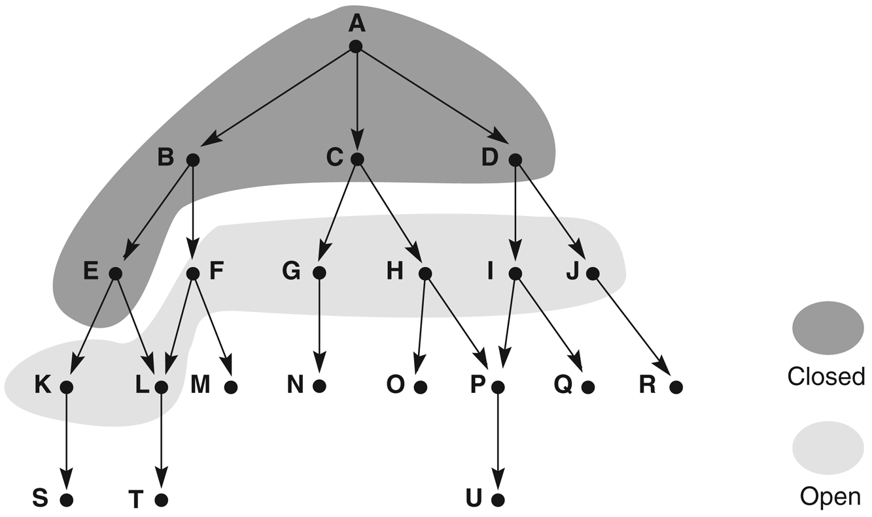
Graph of Fig. 3.13 at iteration 6 of BFS

Slide 34
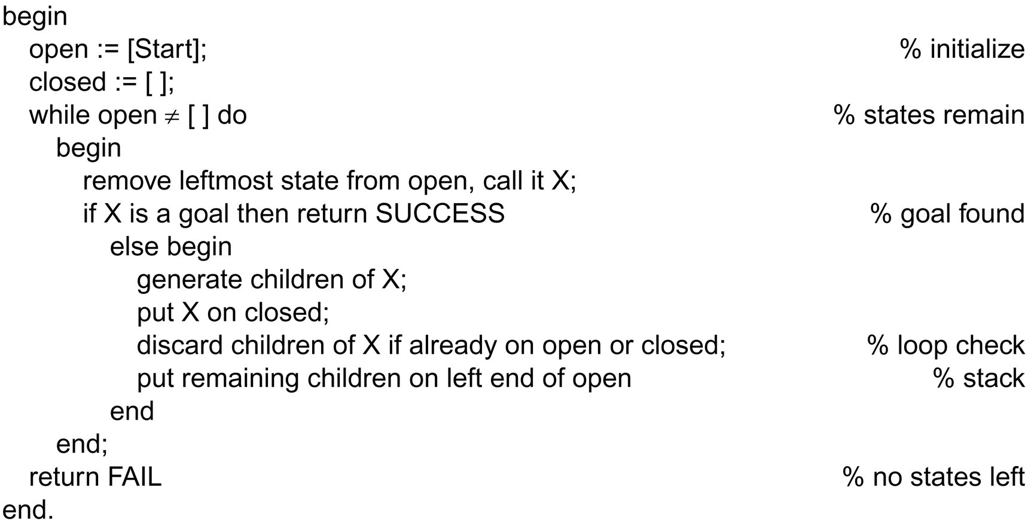
Depth_first_search algorithm

Slide 35
Depth_first_search algorithm
Open = [Start]
Closed = []
While Open <> []:
get S from Open
If S ɇ closed
add S to Closed
If S = Goal
Exit
else
generate S₁, S₂, …, S_{k}
add S to Open
end
Return Fail
end
Open is a stack
a search algorithm must determine the order in which states are examined in the tree or the graph.

Slide 36
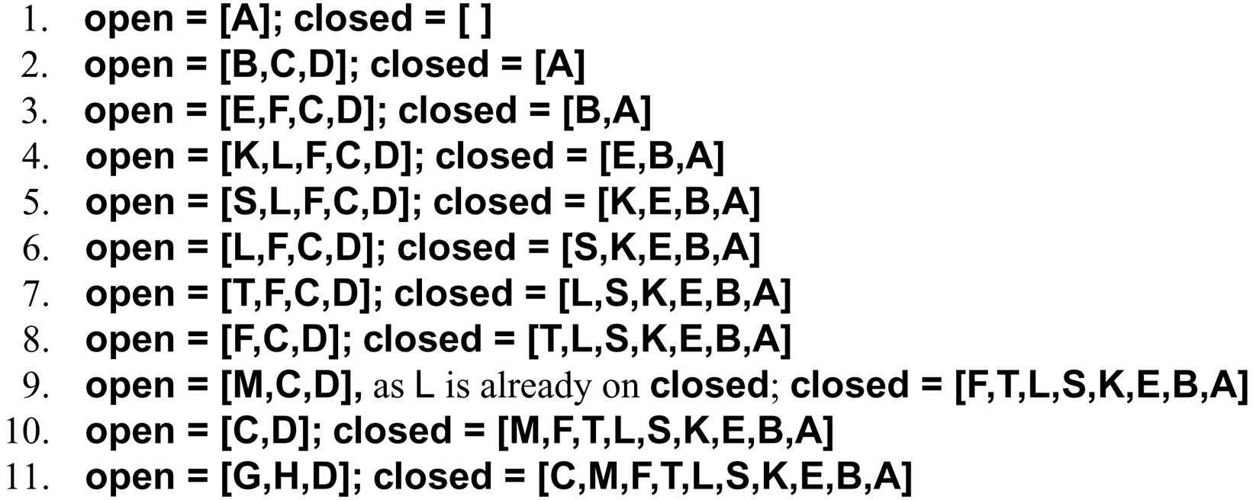
Trace of DFS on the graph of Fig. 3.13

Slide 37
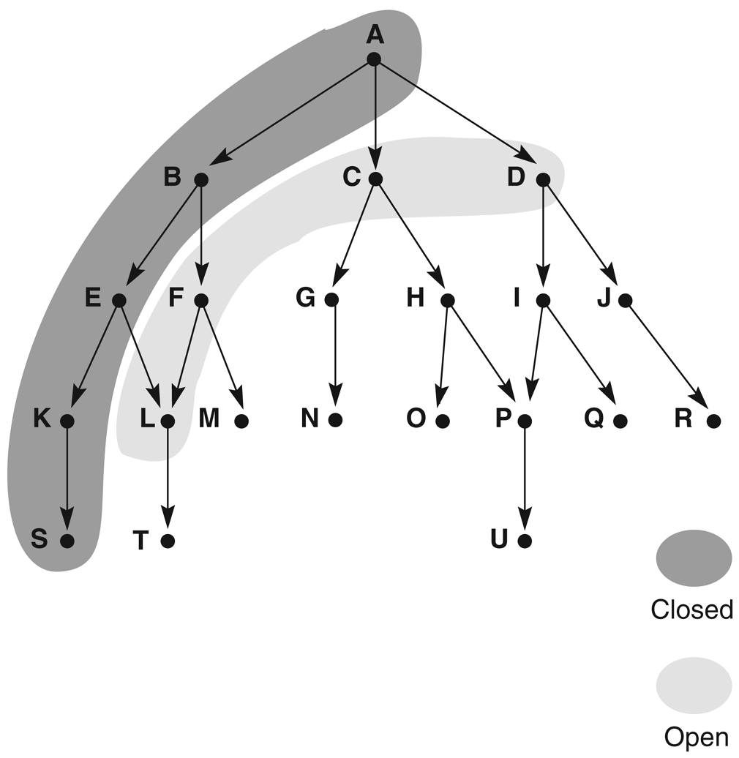
Graph of Fig. 3.13 at iteration 6 of DFS

Slide 38
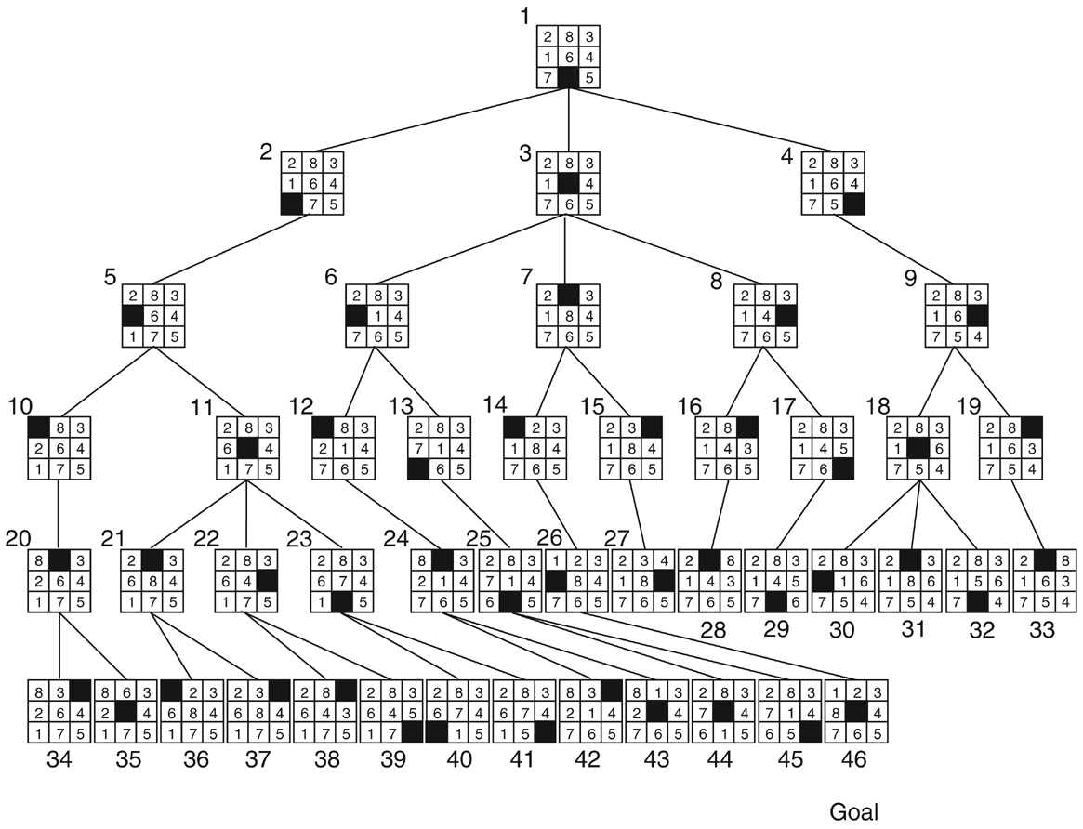
BFS, label = order state was removed from OPEN

Slide 39
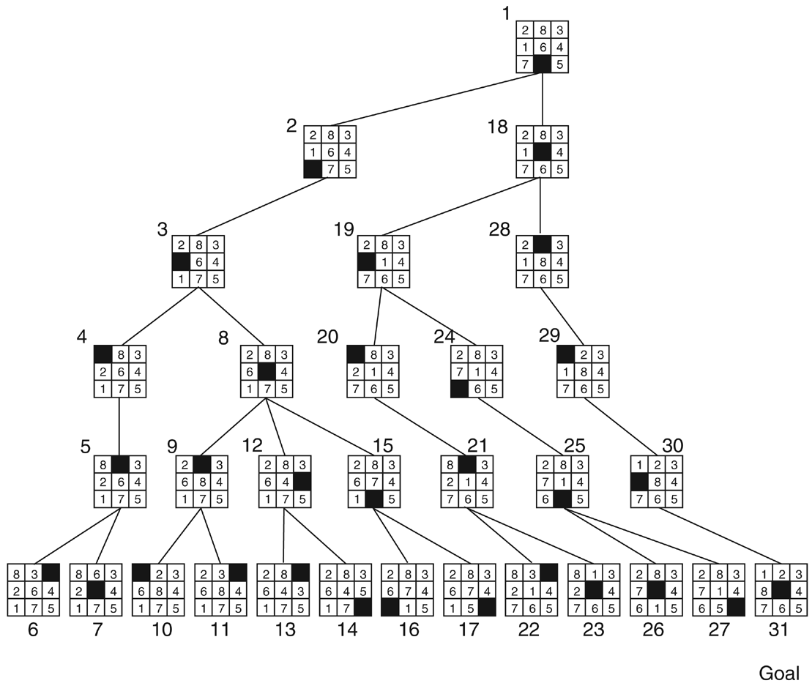
DFS with a depth bound of 5, label = order state was removed from OPEN

Slide 40
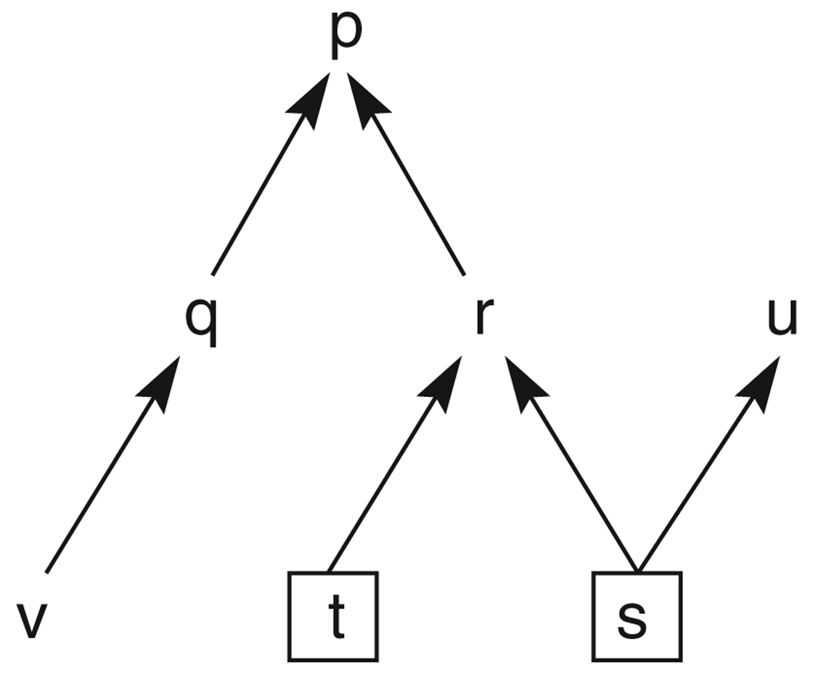
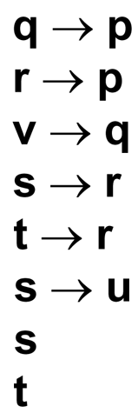
State space graph of a set of implications in propositional calculus

Slide 41
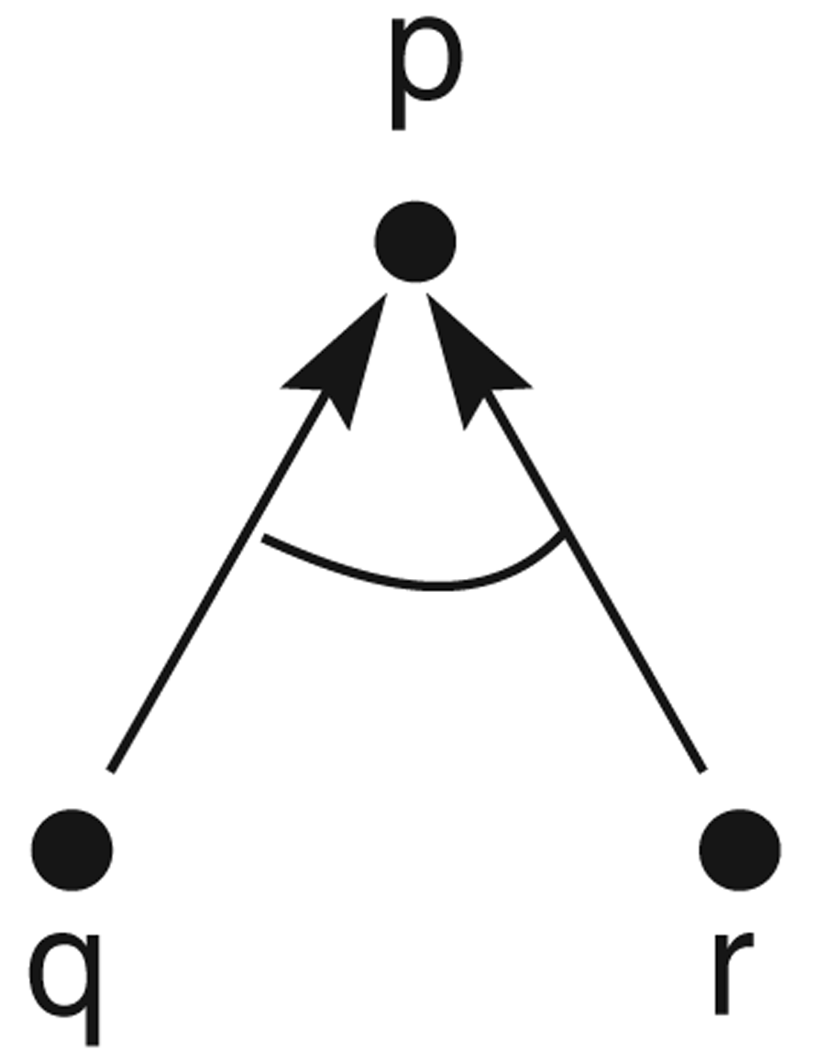
And/or graph of the expression q∧r→p

Slide 42
Hypergraph
A hypergraph consists of:
N: a set of nodes.
H: a set of hyperarcs.
Hyperarcs are defined by ordered pairs in which the first element of the pairs is a single node from N and the second element is a subset of N.
An ordinary graph is a special case of hypergraph in which all the sets of descendant nodes have a cardinality of 1.

Slide 43
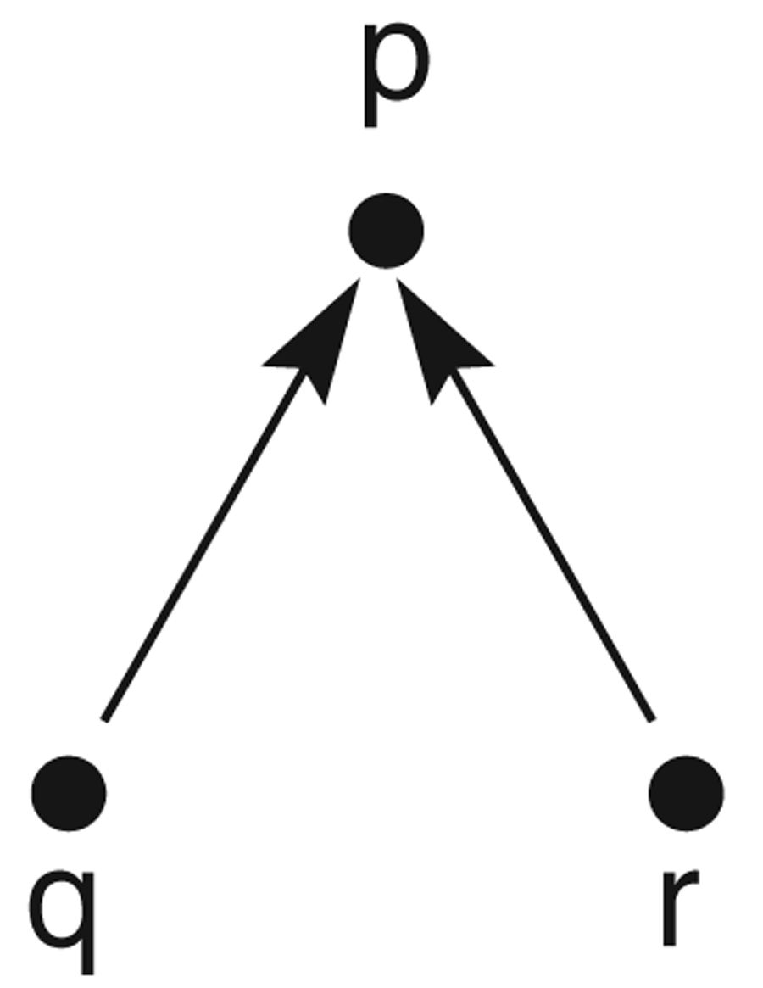
And/or graph of the expression q∨r→p

Slide 44
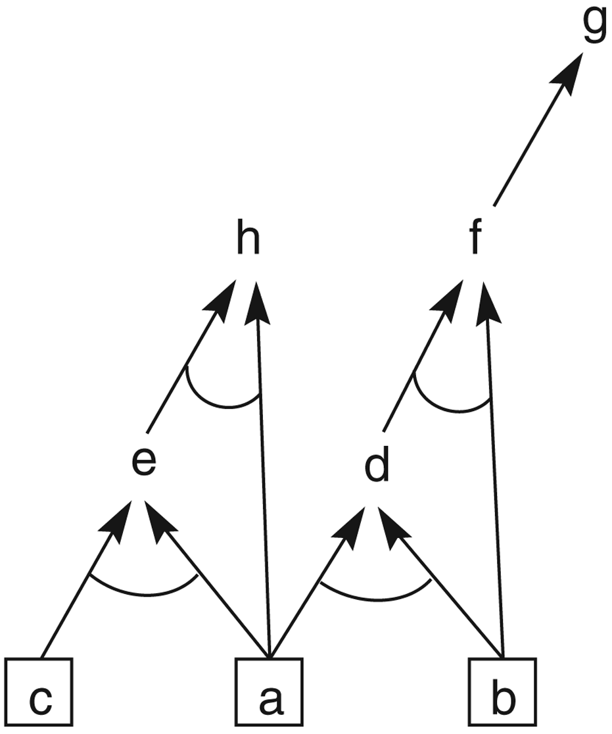
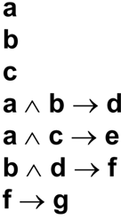
And/or graph of a set of propositional calculus expressions

Slide 45
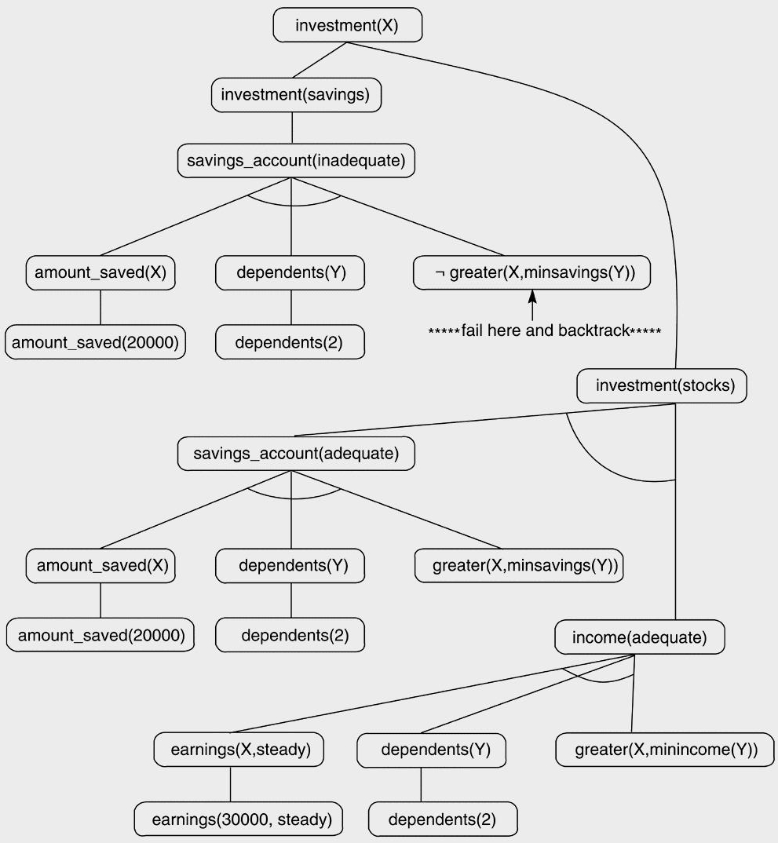

Slide 46
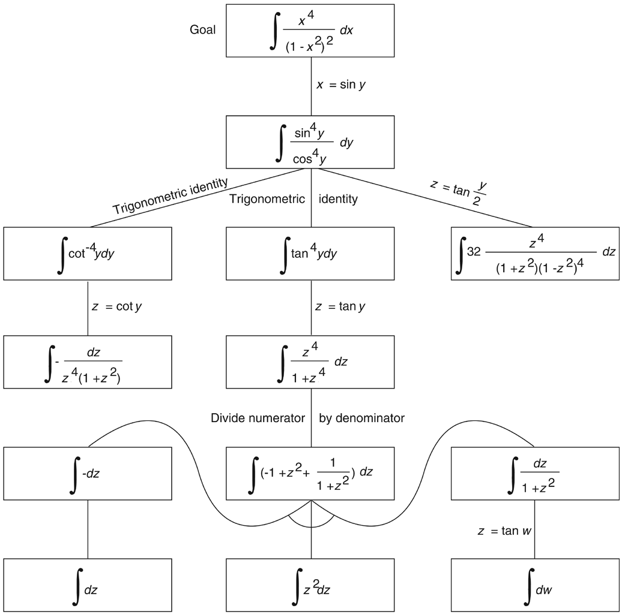
And/or graph of the part of the state space for integrating a function (Nilsson 1971)

Slide 47
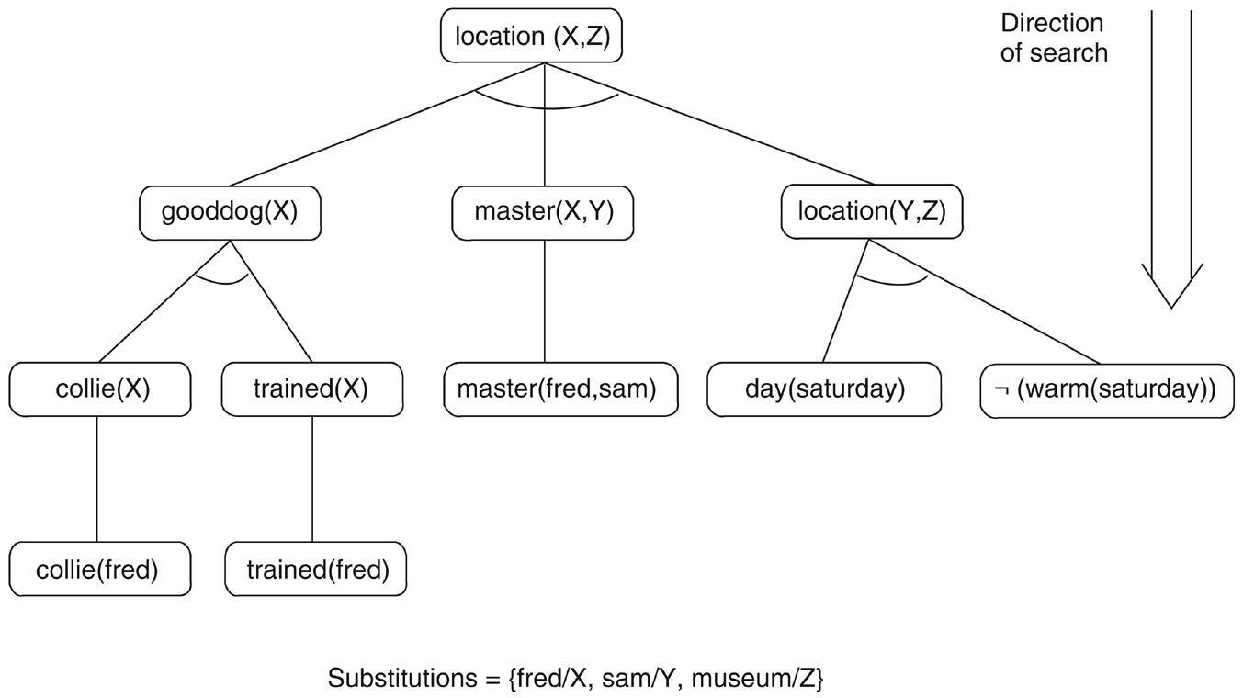
The solution subgraph showing that fred is at the museum

Slide 48
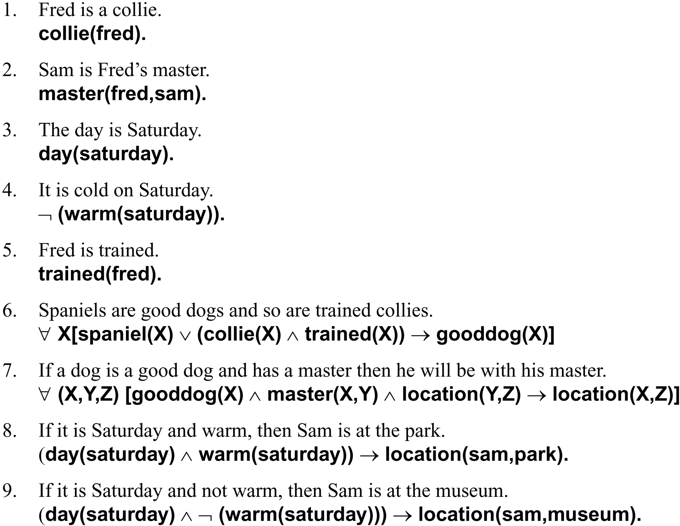
Facts and rules for the example

Slide 49
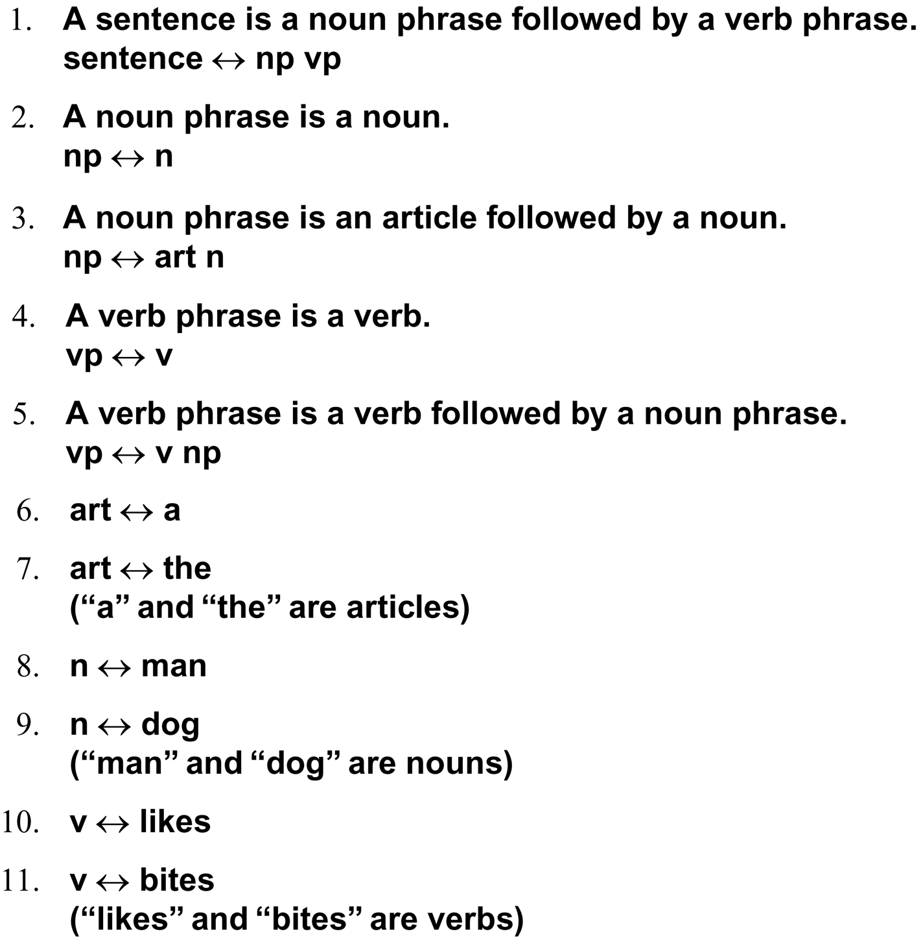
Five rules for a simple subset of English grammar

Slide 50
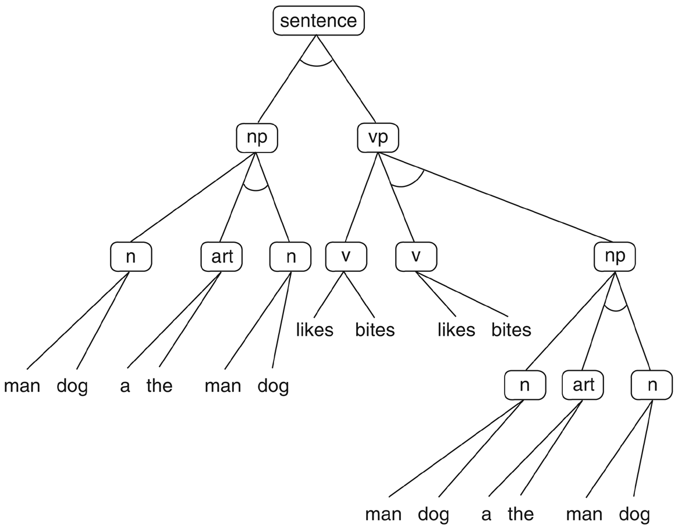
Figure 3.25: And/or graph for the grammar of Example 3.3.6. Some of the nodes (np, art, etc.) have been written more than once to simplify drawing the graph.

Slide 51
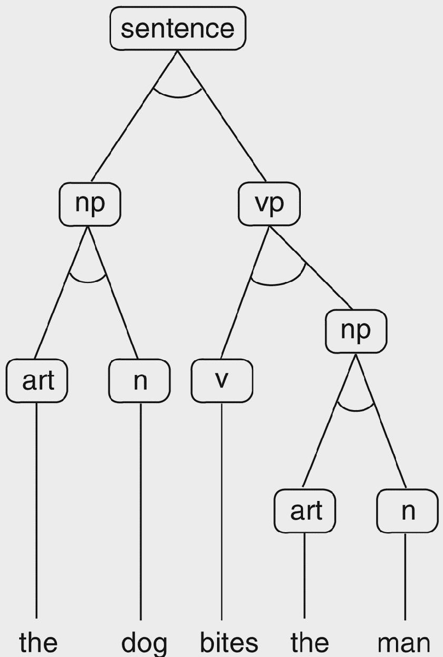
Parse tree for the sentence

Slide 52
“Blind search”
BFS and DFS are blind in the sense that they have no knowledge about the problem at all other than the problem space
Such techniques are also called brute-force search, uninformed search, or weak methods
Obviously, we can’t expect too much from these, but they provide
  Worst-case scenarios
  A basis for more interesting algorithms later on

Slide 53
BFS and DFS
Worst case scenarios are equally bad (exponential)
How to evaluate search algorithms
  Completeness: a search algorithm is complete if it is guaranteed to find a solution when one exists
  Quality of solution: usually the path cost
  Time cost of finding the solution: usually in terms of number of nodes generated or examined
  Memory cost of finding the solution: how many nodes do we have to keep around during the search

Slide 54
Evaluating BFS
Complete?
Yes
Optimal quality solution?
Yes
Time required in the worst case
O(b^{d})
Memory required in the worst case (in OPEN)
O(b^{d})
where b is the branching factor, d is the depth of the solution

Slide 55
Evaluating DFS
Complete?
Yes (only if the tree is finite)
Optimal quality solution?
No
Time required in the worst case
O(b^{m})
Memory required in the worst case (in OPEN)
O(bm)
where b is the branching factor, m is the maximum depth of the tree

Slide 56
Example search problems
Puzzles: missionaries and cannibals, cryptarithmetic, 8-puzzle, 15-puzzle, Rubik’s cube, n-queens, the Tower of Hanoi, …
2-player games: chess, checkers, Chinese Go, …
Proving theorems in logic and geometry
Path finding
“Industrial” problems: VLSI layout design, assembling a complex object
“AI problems”: speech recognition, planning, …

Slide 57
The importance of the problem space
The choice of a problem space makes a big difference
in fact, finding a good abstraction is half of the problem
Intelligence is needed to figure out what problem space to use
still poorly understood: the human problem solver is conducting a search in the space of problem spaces

