Slide 1


HEURISTIC SEARCH
4.0 Introduction
4.1 An Algorithm for Heuristic Search
4.2 Admissibility, Monotonicity, and Informedness
4.3 Using Heuristics I n Games
4.4 Complexity Issues
4.5 Epilogue and References
4.6 Exercises
George F Luger
ARTIFICIAL INTELLIGENCE 5th edition
Structures and Strategies for Complex Problem Solving
Luger: Artificial Intelligence, 5th edition. © Pearson Education Limited, 2005

Slide 2
Heuristic
“The study of the methods and rules of discovery and invention” George Polya, 1945.
Heuristic in state space search
Rules for choosing those branches in a state space that are most likely to lead to an acceptable problem solution
It is used in domains like game playing and theorem proving where heuristic is the only practical solution.
We need a criterion and algorithm to implement search.

Slide 3
When to employ heuristics?
A Problem may not have an exact solution because of ambiguous problem statement or available data.
  e.g. In Medical systems, given symptoms may have several causes.
  Doctors use heuristics to choose the most likely diagnosis.
  e.g. Vision problem, several possible interpretations of a possible scene

Slide 4
When to employ heuristics?
Exact solution may exist but its computational cost is expensive.
  e.g. Chess state space grows exponentially, or factorially with the depth, i.e. combinatorially explosive growth.
  A solution may not be found in practical time.
  Search in the most promising path

Slide 5
Heuristics fail
Heuristics are fallible as it is only a guess.
Although this guess is based on experience and intuition.
Heuristics may find a suboptimal solution or fail to find a solution as it depends on limited information such as the current state.

Slide 6
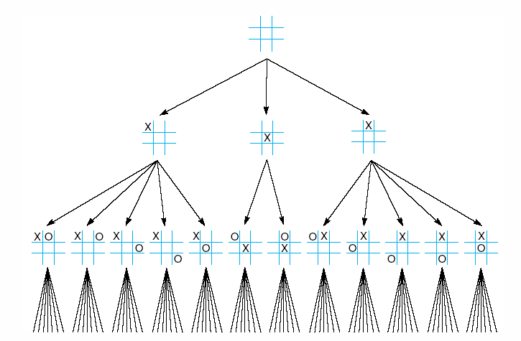
Fig 4.1 First three levels of the tic-tac-toe state space reduced by symmetry
Exhaustive search has 9! states
Using symmetry it reduces to
12X7!
Luger: Artificial Intelligence, 5th edition. © Pearson Education Limited, 2005

Slide 7
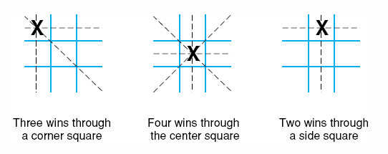
Fig 4.2 The “most wins” heuristic applied to the first children in tic-tac-toe.
Luger: Artificial Intelligence, 5th edition. © Pearson Education Limited, 2005

Slide 8
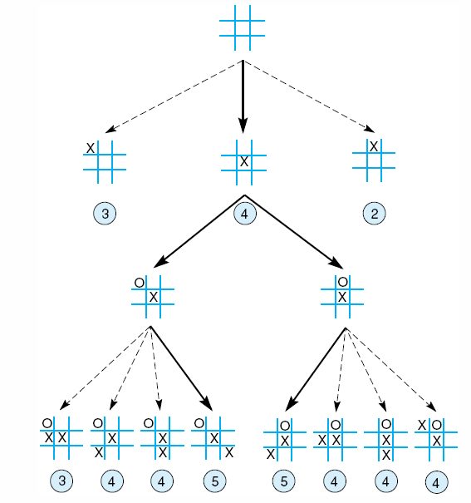
Fig 4.3 Heuristically reduced state space for tic-tac-toe.
Luger: Artificial Intelligence, 5th edition. © Pearson Education Limited, 2005

Slide 9
Heuristic Search
Hill-Climbing (Greedy).
Best First Search.
N-Beam First.

Slide 10
Hill Climbing
Evaluate children of current state.
The best child is selected for further expansion neither its siblings nor its parents are retained.
It is similar to a blind mountain climber.
  Go uphill along the steepest path until you can no further up.
It keeps no history, therefore it cannot recover from failures.

Slide 11
Hill Climbing
Problem with hill climbing is their tendency to stuck at local maxima (minima).
If it reaches a state that has a better evaluation than its children, the algorithm halts.
It may never reach the overall best.

Slide 12
Heuristic Search
Hill-Climbing (Gready):
  -ve:
    Locam minima (Maxima)
    Flat Area (Equal Heuristics)

Slide 13
Hill Climbing
In 8-tile puzzle, may be we need to move from a state where 2 tiles are out of place to the goal, we need to pass through a state where there are 3 states out of place.
In hill climbing and such algorithms without backtracking or other recovery mechanism, no way to distinguish between local and global maxima(minima).

Slide 14
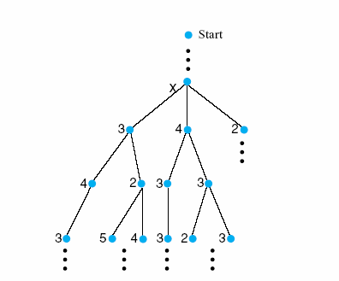
Fig 4.4 The local maximum problem for hill-climbing with 3-level look ahead
Luger: Artificial Intelligence, 5th edition. © Pearson Education Limited, 2005
Notes:
Insert fig 4.4

Slide 15
Self Reading
Study Samuel’s (1959) Checker program

Slide 16
Dynamic Programming
Dynamic programming (forward-backward) by bellman, 1956.
When using probabilities it is called Viterbi algorithm.
Search restricted memory cases in problems involved multiple interacting subproblems.

Slide 17
Dynamic Programming
DP keeps track of and reuses subproblems already searched and solved within the solution of the larger problems.
e.g. Fibonnacci series: reuse subseries solution.
Subproblem caching sometimes is called memorizing partial subgoals.
  Possible applications, string matching, spell checking.

Slide 18
Dynamic Programming- Application 1
Find optimal global alignment of two strings
BAADDCABDDA
BBADCBA
One possible solution is
BAADDCABDDA
BBADC B A

Slide 19

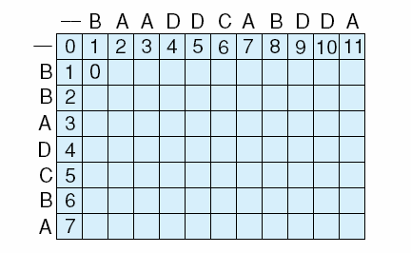
Fig 4.5 The initialization stage and first step in completing the array for character alignment using dynamic programming.
There are three possible costs for creating the current state:
if a character is shifted along in the shorter string for better possible alignment, the cost is 1 and is recorded by the array’s column score.
If a new character is inserted, the cost is 1 and reflected in the array’s row score.
If the characters to be aligned are different, shift and insert, the cost is 2;
or if they are identical the cost is 0; this is reflected in the array’s diagonal.
the increasing +1s in the first row and column reflect the continued shifting or insertion of characters to the “_” or empty string.
Luger: Artificial Intelligence, 5th edition. © Pearson Education Limited, 2005
Notes:
Insert fig 4.5 WITH BAADDCABDDA
BBADC B A

Slide 20
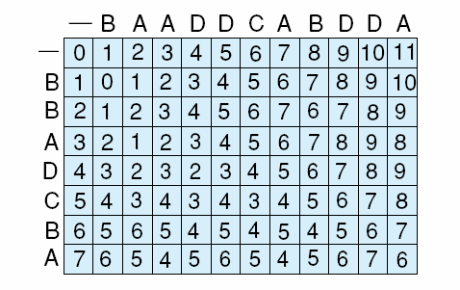
Fig 4.6 The completed array reflecting the maximum alignment information for the strings.
In the forward stage of the dynamic programming algorithm, we fill the array from the upper left corner by considering the partial matching successes to the current point of the solution.
That is, the value of the intersection of row x and column y, (x, y), is a function
(for the minimum alignment problem, the minimum cost) of one of the three values in row x - 1 column y, row x - 1 column y - 1, or row x column y - 1. These three array locations hold the alignment information up to the present point of the solution.
If there is a match of characters at location (x, y) add 0 to the value at location (x - 1, y - 1), if there is no match add 2 (for shift and insert).
We add 1 by either shifting the shorter character string (add to the previous value of column y) or inserting a character (add to the previous value of row x).
Luger: Artificial Intelligence, 5th edition. © Pearson Education Limited, 2005

Slide 21
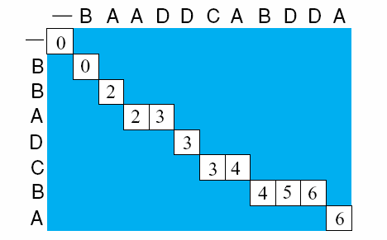
Fig 4.7 A completed backward component of the dynamic programming example giving one (of several possible) string alignments.
the backward stage of the algorithm.
We begin this process at the maximum row
column value.
From there we move back through the array, at each step selecting one of the immediate state’s predecessors that produced the present state (from the forward stage), i.e, one of either the diagonal, row, or column that produced that state.
Whenever there is a forced decreasing difference, we select the previous diagonal, as that is where the match came from; otherwise we use the value of the preceding row or column.
Luger: Artificial Intelligence, 5th edition. © Pearson Education Limited, 2005

Slide 22
Dynamic Programming- Application 2
Find minimum difference.
e.g. Building an intelligent spell checker.
To correct a certain word using list of words in our dictionary.
What is the best approximation? Minimum difference?
Could also be used in speech recognition. What is the best word that approximates string of phonemes?

Slide 23
Dynamic Programming- Application 2
Spell checker should produce and ordered list of the most likely words similar to a word that you tried to spell but you misspelled.
How we can measure the difference?
Possible definition: The number of insertions, deletions, and replacements necessary to change the incorrect word into a correct one (Levenshtein distance).

Slide 24
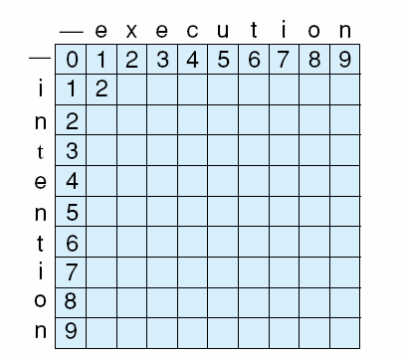
Fig 4.8 Initialization of minimum edit difference matrix between intention and execution (adapted from Jurafsky and Martin, 2000).
Cost of insertion, deletion is 1
Cost of replacement is 2
Luger: Artificial Intelligence, 5th edition. © Pearson Education Limited, 2005
Notes:
Insert fig 4.8

Slide 25
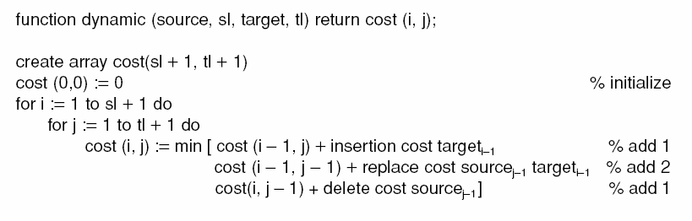
Luger: Artificial Intelligence, 5th edition. © Pearson Education Limited, 2005

Slide 26
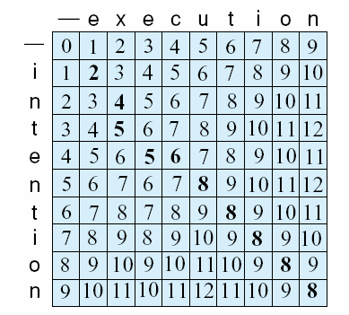
Fig 4.9 Complete array of minimum edit difference between intention and execution (adapted from Jurafsky and Martin, 2000) (of several possible) string alignments.
Intention
ntention delete I, cost 1
etention replace n with e, cost 2
exention replace t with x, cost 2
exenution insert u, cost 1
execution replace n with c, cost 2
Luger: Artificial Intelligence, 5th edition. © Pearson Education Limited, 2005

Slide 27
Heuristic Search
Best First Search:
  It starts with the best child
  It may keep exploring one branch at the expense of other branches, so it may not find the goal state
  Memory requirements:
    Worst case: as bad as breadth-first search
    Best case: as good as depth-first search

Slide 28
Heuristic Search
N-Beam First:
  Keeps N-Best children (N: 4, 5, 6, 7) and it discards the others.
  Avoids the risk of keeping one child and discarding the other children.
  It uses a heuristic function that takes into consideration how far is the state from the initial state.
  Away solutions gets bad heuristic value

Slide 29
4.2 The Best-first search
It uses a priority queue to recover from local maxima and dead ends problem that may occur in hill climbing.
It uses list to maintain states:
  open : keeps track of the current fringe of the search.
  Close: Records states already visited.

Slide 30
4.2 The Best-first search
One added step: order states in open according to some heuristic (how close they are to a goal).
By doing this order: the most promising state is considered first.

Slide 31
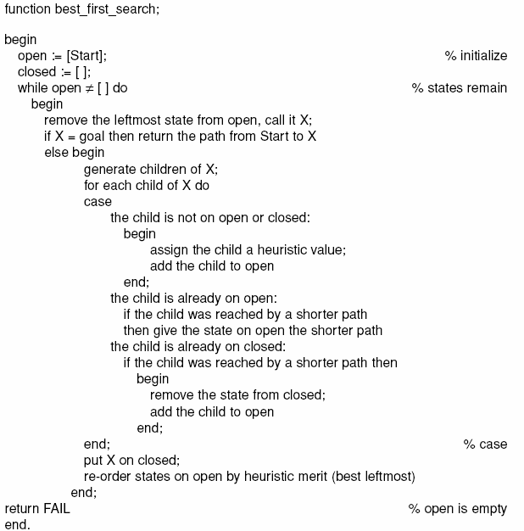
Luger: Artificial Intelligence, 5th edition. © Pearson Education Limited, 2005

Slide 32
Best_first search algorithm
Open = [Start, V₀]
Closed = []
While Open <> []:
get (S_{i}, V_{i}) from Open
If (S_{i}, V_{i}) ɇ closed
add (S_{i}, V_{i}) to Closed
If S_{i} = Goal
Exit
else
generate S₁, S₂, …, S_{k}
Compute V₁, V₂, …, V_{k}
add (S_{i}, V_{i}) to Open
which is an ↓ order list of pairs (S_{i}, V_{i})
according to V_{i}
end
Return Fail
end
V = h(S)

Slide 33
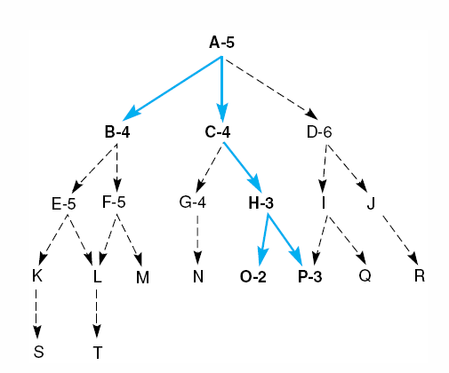
Fig 4.10 Heuristic search of a hypothetical state space.
Luger: Artificial Intelligence, 5th edition. © Pearson Education Limited, 2005

Slide 34
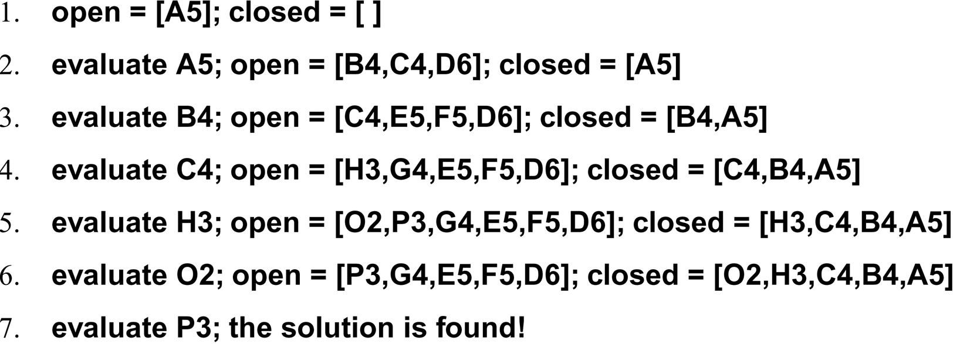
A trace of the execution of best_first_search for Figure 4.4
Luger: Artificial Intelligence, 5th edition. © Pearson Education Limited, 2005

Slide 35
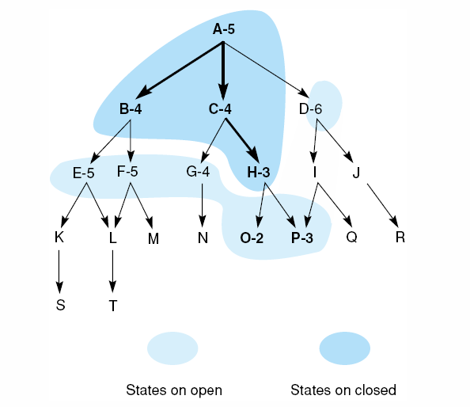
Fig 4.11 Heuristic search of a hypothetical state space with open and closed states highlighted.
Luger: Artificial Intelligence, 5th edition. © Pearson Education Limited, 2005

Slide 36
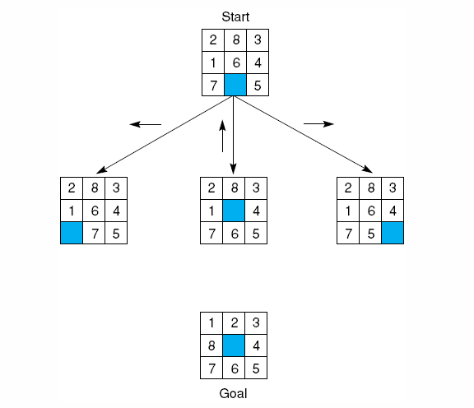
Fig 4.12 The start state, first moves, and goal state for an example-8 puzzle.
Luger: Artificial Intelligence, 5th edition. © Pearson Education Limited, 2005
Notes:
Insert fig 4.12

Slide 37
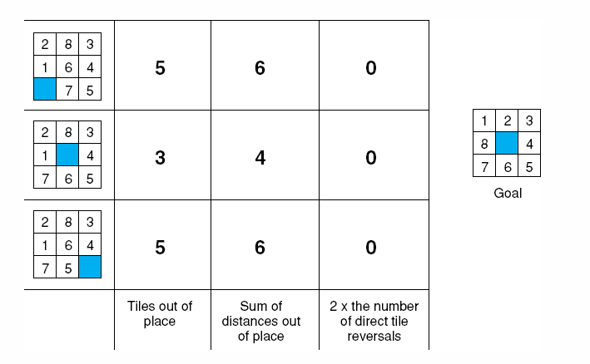
Fig 4.14 Three heuristics applied to states in the 8-puzzle.
Luger: Artificial Intelligence, 5th edition. © Pearson Education Limited, 2005

Slide 38
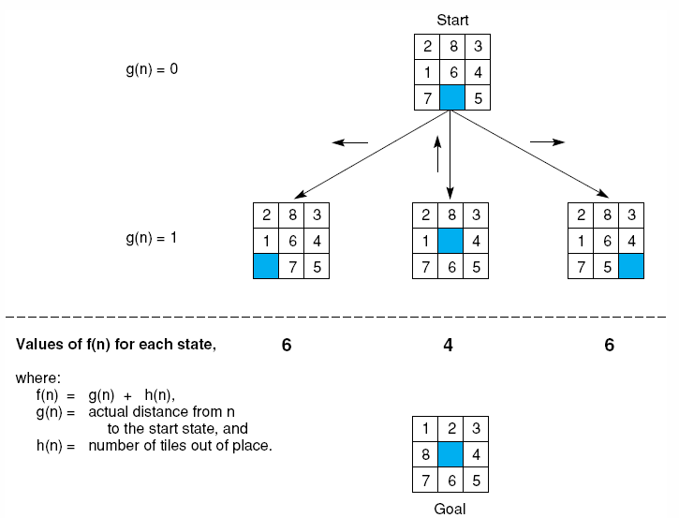
Fig 4.15 The heuristic f applied to states in the 8-puzzle.
Luger: Artificial Intelligence, 5th edition. © Pearson Education Limited, 2005
Notes:
Insert fig 4.15

Slide 39
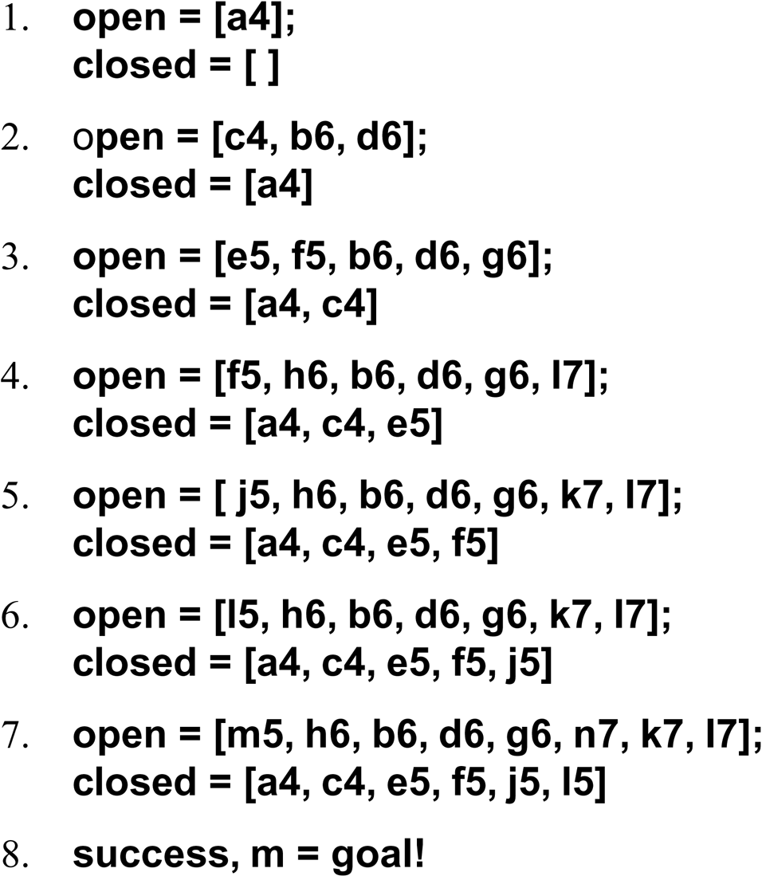
The successive stages of open and closed that generate this graph are:
Luger: Artificial Intelligence, 5th edition. © Pearson Education Limited, 2005

Slide 40
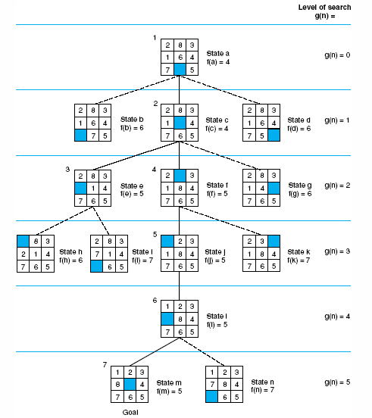
Fig 4.16 State space generated in heuristic search of the 8-puzzle graph.
Luger: Artificial Intelligence, 5th edition. © Pearson Education Limited, 2005
Notes:
Insert fig 4.16

Slide 41
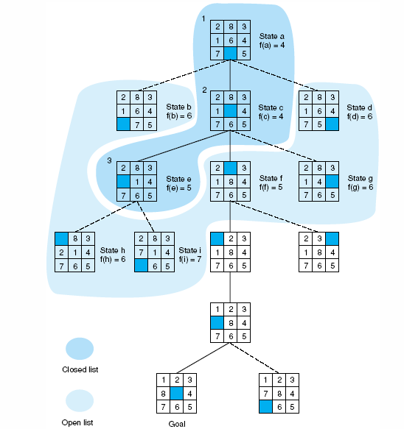
Fig 4.17 Open and closed as they appear after the 3rd iteration of heuristic search
Luger: Artificial Intelligence, 5th edition. © Pearson Education Limited, 2005

Slide 42
Games (like 8-tile puzzle) and search
Why study heuristics in games
Search space is large → requires pruning.
Games may have many possible heuristics.
Knowledge representation is easy, therefore we can focus on heuristic than representation.
A single heuristic can be applied in the whole graph as states are represented uniformly.

Slide 43
Confidence
A set of confidence rules for financial advisor problems.
saving_account(adequate)^income(adequate) → investment(stock) with confidence=0.75
How we can assign such confidence?
How we can combine rules?
More than one rule produce the same conclusion, then what to do?

Slide 44
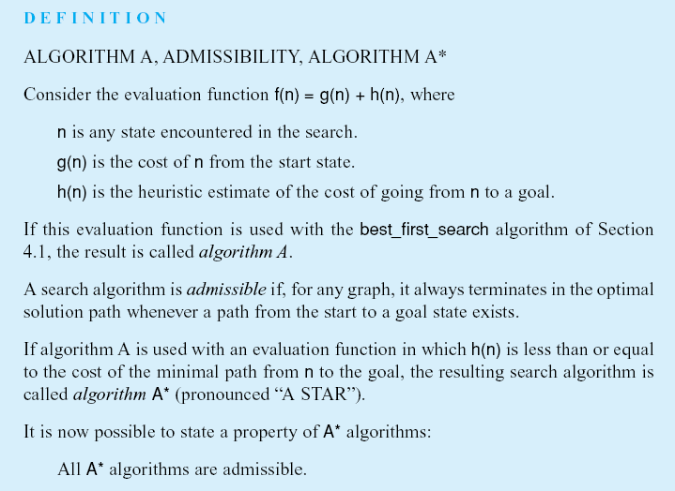
Breadth-first search is admissible as it guarantees to find shortest path
A* : when h(n)<=h*(n)
Luger: Artificial Intelligence, 5th edition. © Pearson Education Limited, 2005
Notes:
Insert def box page 146

Slide 45
Heuristic Function
f(n) = g(n) + h(n)
f: Heuristic function
g: Distance between the current state and the initial state
h: Distance between the current state and the goal state

Slide 46
Heuristic Function
A Algorithm: Is a best-first search algorithm that uses a heuristic function of the form
f(n) = g(n) + h(n)
A* Algorithm
  if h(n) ≤ h*(n)
    h(n): Heuristic
    h*(n): The actual length (distance) of the shortest path between the goal state and state n.
    h(n) : Should NOT be under/over estimated
    A* Algorithm is admissible
    When h(n)= 0 , then f(n) = g(n) → breadth first search (admissible)

Slide 47
Heuristic 8-Tile puzzle
h1(n) = 0
h2(n) =# of tiles out of place
h3(n) = Sum(Distance between each tile and its correct position).
h1(n) ≤ h2(n) ≤ h3(n) ≤ h*(n)
h3(n) is the closest to h*, neither over nor under estimation, it is more informed.

Slide 48
Informedness
Informedness: if we have two heuristics h1(n) and h2(n), if h1(n) ≤ h2(n) for all n
h2(n) is said to be more informed than h1(n)
A more informed heuristic explores fewer states

Slide 49
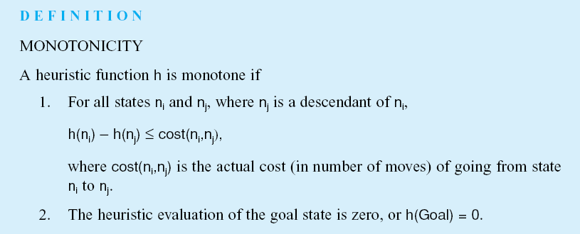
Luger: Artificial Intelligence, 5th edition. © Pearson Education Limited, 2005
Notes:
Insert def box, pg 147

Slide 50
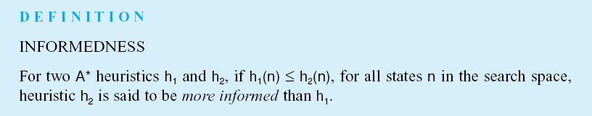
Note: as calculating the heuristic function requires processing time, then we should have a trade-off between the use of heuristic to reduce the search size and the complexity.
Luger: Artificial Intelligence, 5th edition. © Pearson Education Limited, 2005
Notes:
Insert def box, pg 148

Slide 51
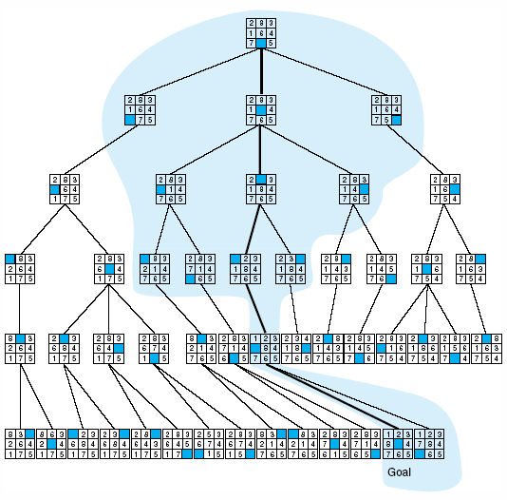
Fig 4.18 Comparison of state space searched using heuristic search with space searched by breadth-first search. The proportion of the graph searched heuristically is shaded. The optimal search selection is in bold. Heuristic used is f(n) = g(n) + h(n) where h(n) is tiles out of place.
Luger: Artificial Intelligence, 5th edition. © Pearson Education Limited, 2005

Slide 52
4.4 Heuristic in games
One-player vs. Two-player games.
In the latter, we have an opponent with hostile and unpredictable moves,
This allows for better exploring heuristic options.
The search will be more difficult

Slide 53
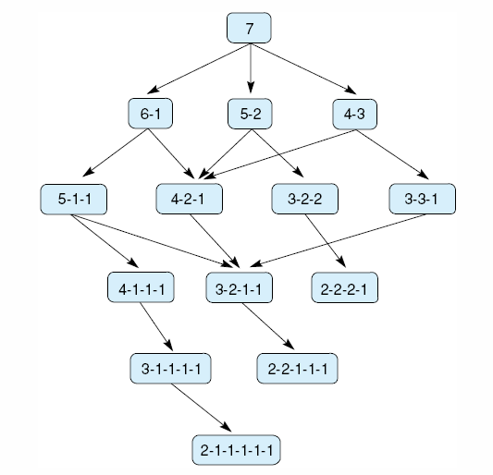
Fig 4.19 State space for a variant of nim. Each state partitions the seven matches into one or more piles.
Nim game with 7 tokens.
Small state space can be exhaustively searched.
Luger: Artificial Intelligence, 5th edition. © Pearson Education Limited, 2005

Slide 54
Nim game and Minimax
The main difficulty is to consider the actions of your opponents.
Assumption: the opponent is using the same knowledge of the state space as you use.
This assumption provides a reasonable basis for predicting the opponent’s behaviour.
Minimax searches the state space under this assumption.
One player is called MIN and the other is called MAX.

Slide 55
Minimax
The names MIN and MAX came from historical reasons.
MAX represents a player trying to win (maximize) her advantage.
MIN represents a player trying to MINimize MAX’s score, minimizes MAX’S chances to win.
  MIN makes moves that makes MAX position worse.
Leaves are labelled. 1 or 0 to indicate if it is a win for MAX or MIN.

Slide 56
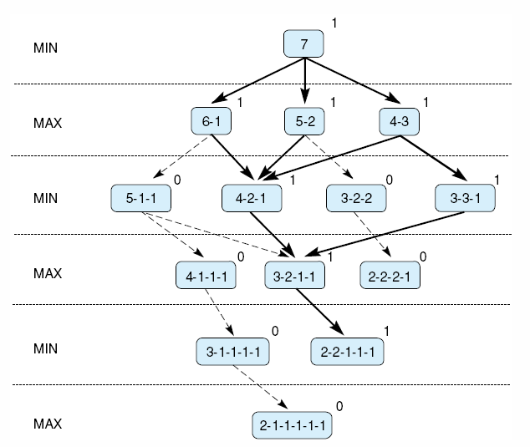
Fig 4.20 Exhaustive minimax for the game of nim. Bold lines indicate forced win for MAX. Each node is marked with its derived value (0 or 1) under minimax.
Parent is MAX: give it the maximum value among its children
Parent is MIN: give it the minimum value among its children
Luger: Artificial Intelligence, 5th edition. © Pearson Education Limited, 2005
Notes:
Insert fig 4.20

Slide 57
MINIMAX in more complicated (Larger) search space
In large state space, it is not usually possible to reach the leaves.
Normally we expand up to a certain level (n-ply look-ahead).
We cannot assign values to the leaves as we don’t know the values of its children.
Instead, we use heuristics to assign values to the nodes.

Slide 58
MINIMAX in more complicated (Larger) search space
The value the is propagated to the root reflects the best value.
Q: how to measure the advantage of one player over another? Many Possible Heuristics.

Slide 59
MINIMAX in more complicated (Larger) search space
Some possible heuristics in chess
The difference in the number of pieces with your opponent.
# of your pieces - # of your opponents pieces.
Consider the type of pieces queen, king, rook, or ordinary checker.
Locations of pieces over the board.

Slide 60
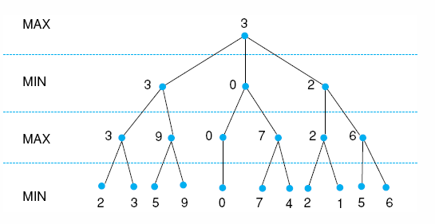
Fig 4.21 Minimax to a hypothetical state space. Leafstates show heuristic values; internal states show backed-up values.
Luger: Artificial Intelligence, 5th edition. © Pearson Education Limited, 2005
Notes:
Insert fig 4.21

Slide 61
Notes on a n-fly
A heuristically promising path may lead to bad situation.
  You may take your opponent rook but later you may lose your queen.
This is called horizon effect, the effect of choosing a heuristic that may lead to a lost game.
Search deeper in exceptionally promising states.

Slide 62
Notes on a n-fly
Possible research:
What is the difference between the estimate of minimax and minimax of estimates.
Deeper search with minimax evaluation does not always mean better search.
Resources:
  Textbook: P 154.
  Pearl (1984)

Slide 63
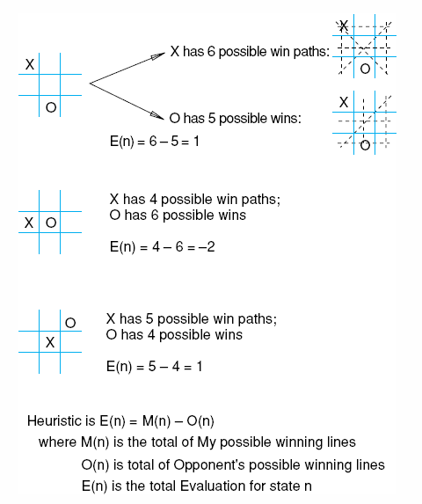
Fig 4.22 Heuristic measuring conflict applied to states of tic-tac-toe.
Luger: Artificial Intelligence, 5th edition. © Pearson Education Limited, 2005

Slide 64
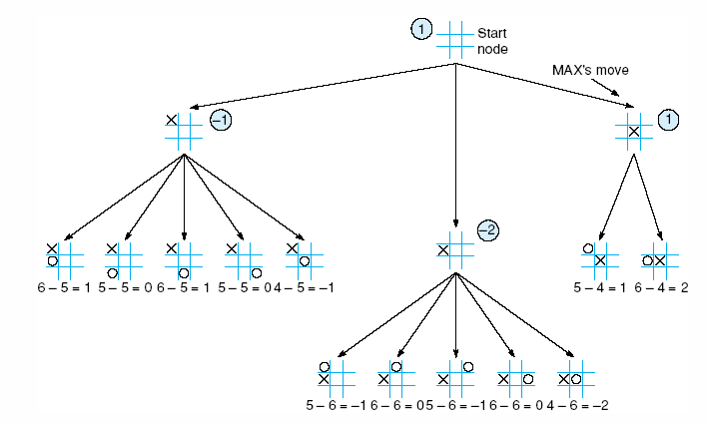
Fig 4.23 Two-ply minimax applied to the opening move of tic-tac-toe, from Nilsson (1971).
Luger: Artificial Intelligence, 5th edition. © Pearson Education Limited, 2005

Slide 65
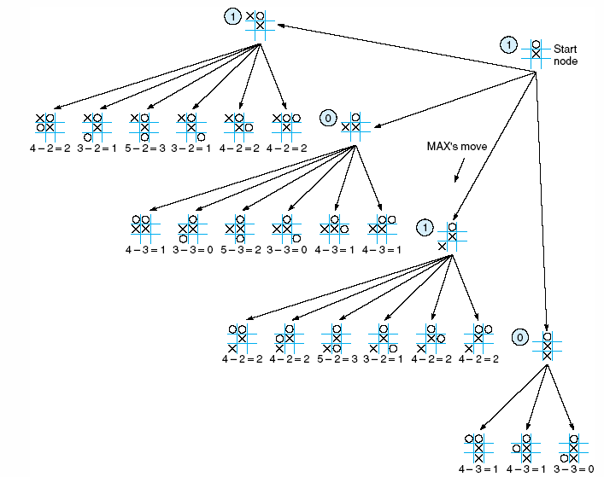
Fig 4.24 Two ply minimax, and one of two possible MAX second moves, from Nilsson (1971).
Luger: Artificial Intelligence, 5th edition. © Pearson Education Limited, 2005

Slide 66
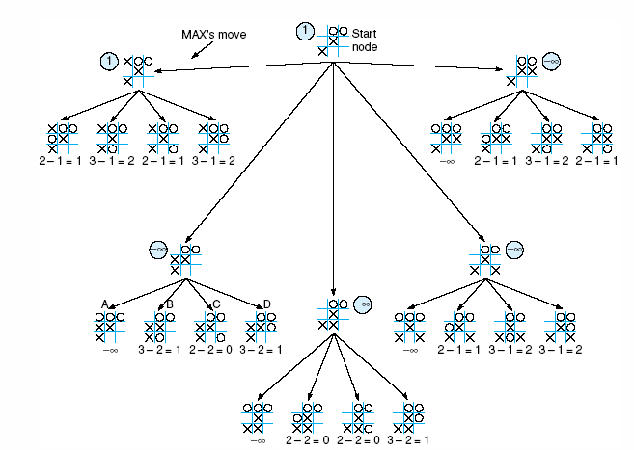
Fig 4.25 Two-ply minimax applied to X’s move near the end of the game, from Nilsson (1971).
Luger: Artificial Intelligence, 5th edition. © Pearson Education Limited, 2005

Slide 67
Alpha-beta procedure
Alpha-beta pruning attempts to improve search efficiency by ignoring some un useful branches.
Work as in depth-first and create two values during the search: alpha and beta.
  alpha value: associated with max nodes, can never decrease.
  Beta value: associated with min nodes, can never increase.

Slide 68
Alpha-beta procedure
If alpha value for a max node is 6, do not consider any child node with that would return a value less than 6.
That child and all of its children are pruned.
Current alpha is the worst possible value.
In the same way if the value of beta is 5, it does not need to consider any child node with value greater than 5.

Slide 69
Alpha-beta procedure
Rules for search termination:
Search can be stopped below any MIN node having a beta value less than or equal to the alpha value of any of its MAX node ancestors.
Search can be stopped below any MAX node having an alpha value greater than or equal to the beta value of any of its MIN node ancestors.

Slide 70
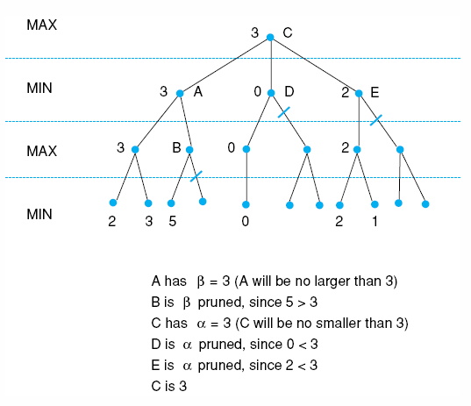
Fig 4.26 Alpha-beta pruning applied to state space of Fig 4.21. States without numbers are not evaluated.
Luger: Artificial Intelligence, 5th edition. © Pearson Education Limited, 2005

Slide 71
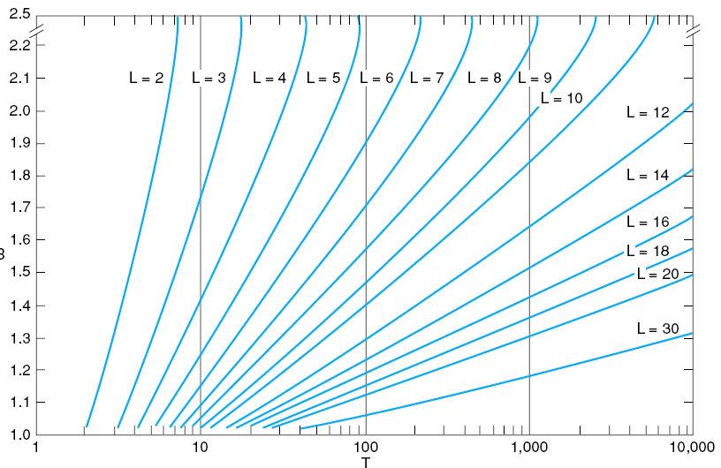
Fig 4.27 Number of nodes generated as a function of branching factor, B, for various lengths, L, of solution paths. The relating equation is T = B(B^{L} – 1)/(B – 1), adapted from Nilsson (1980).
Luger: Artificial Intelligence, 5th edition. © Pearson Education Limited, 2005

Slide 72
Complexity
Reduce the size of open by saving only few states in it, beam search.
This reduces the search space, but it may remove the best or the only solution

Slide 73
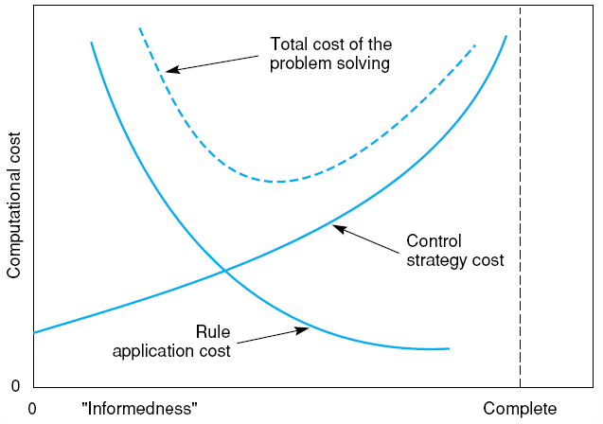
Fig 4.28 Informal plot of cost of searching and cost of computing heuristic evaluation against informedness of heuristic, adapted from Nilsson (1980).
Luger: Artificial Intelligence, 5th edition. © Pearson Education Limited, 2005

Slide 74

Exercise 4.5
Fig 4.29 The sliding block puzzle.
Luger: Artificial Intelligence, 5th edition. © Pearson Education Limited, 2005

Slide 75
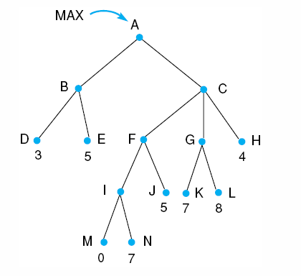
Exercise 4.13:
Fig 4.30.
Luger: Artificial Intelligence, 5th edition. © Pearson Education Limited, 2005

Slide 76
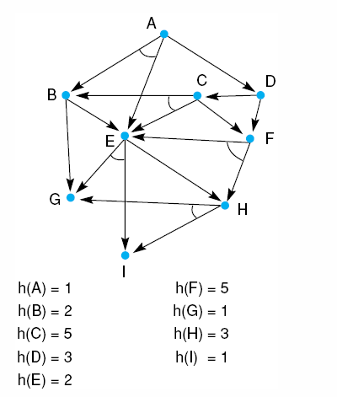
Exercise 4.17:
Fig 4.31.
Luger: Artificial Intelligence, 5th edition. © Pearson Education Limited, 2005

