Slide 1

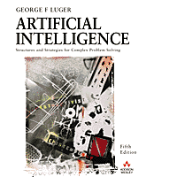
Building Control Algorithms For State Space Search.
5.0 Introduction
5.1 Recursion-Based Search
5.2 Production Systems
5.3 The Blackboard Architecture for Problem Solving
5.4 Epilogue and References
5.5 Exercises
George F Luger
ARTIFICIAL INTELLIGENCE 5th edition
Structures and Strategies for Complex Problem Solving
Luger: Artificial Intelligence, 5th edition. © Pearson Education Limited, 2005

Slide 2
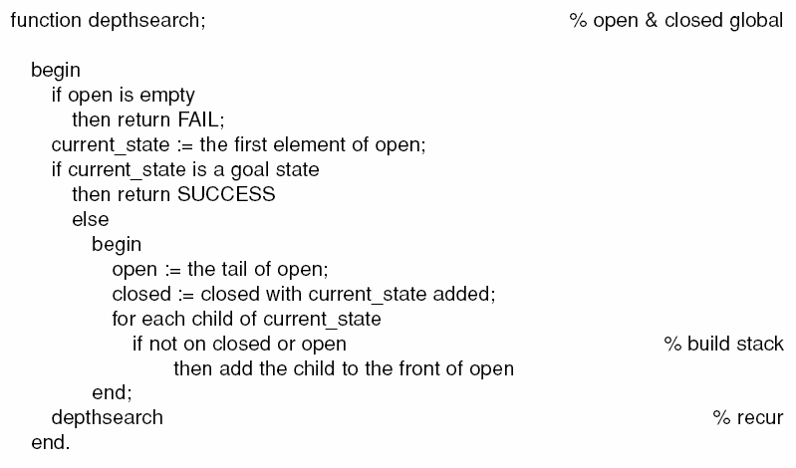
Luger: Artificial Intelligence, 5th edition. © Pearson Education Limited, 2005

Slide 3
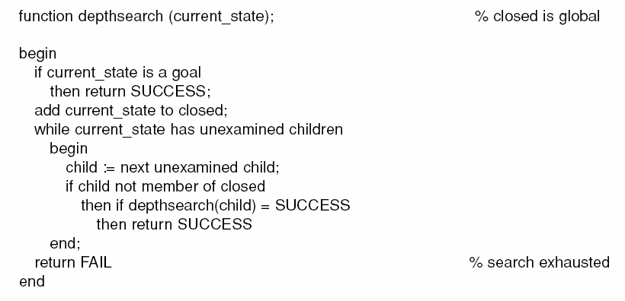
Luger: Artificial Intelligence, 5th edition. © Pearson Education Limited, 2005

Slide 4
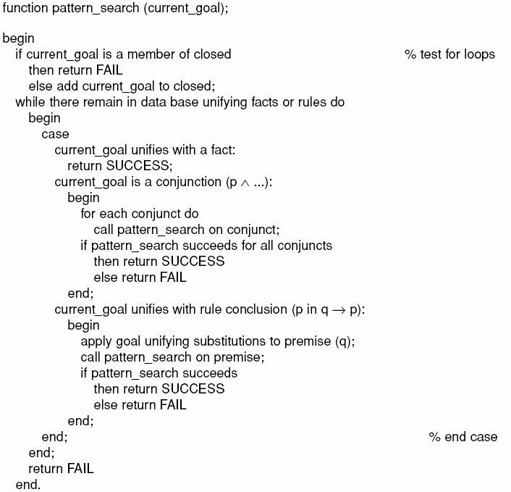
Luger: Artificial Intelligence, 5th edition. © Pearson Education Limited, 2005

Slide 5
6.2 Production Systems
Used for implementing search algorithms and for modelling human problem solving.
It provides pattern-directed control of a problem solving process and consists of:
  A set of production rules,
  A Working memory,
  A recognize-act control cycle.

Slide 6
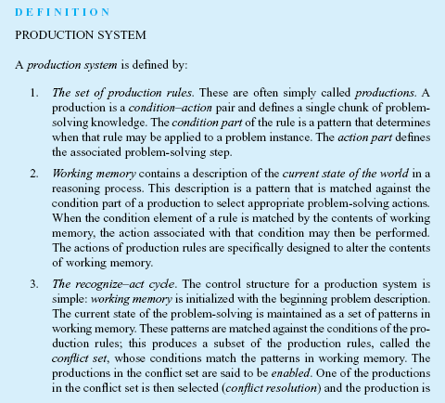
Luger: Artificial Intelligence, 5th edition. © Pearson Education Limited, 2005

Slide 7
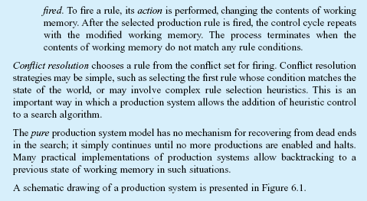
Luger: Artificial Intelligence, 5th edition. © Pearson Education Limited, 2005

Slide 8
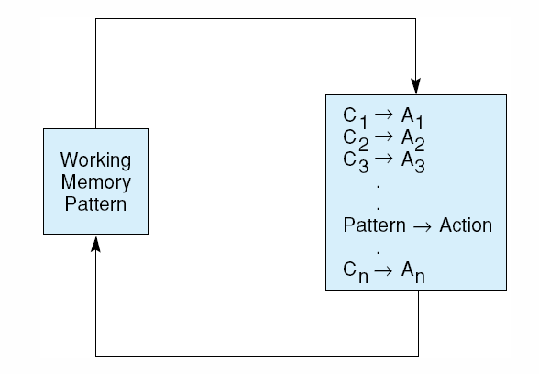
Fig 6.1 A production system. Control loops until working memory pattern no longer matches the conditions of any productions.
Luger: Artificial Intelligence, 5th edition. © Pearson Education Limited, 2005

Slide 9
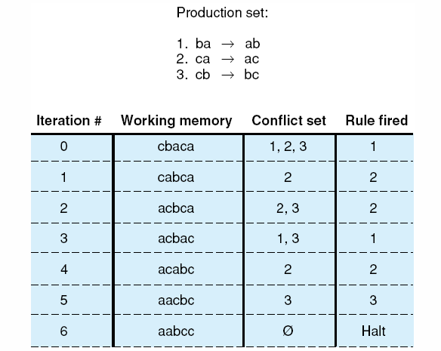
Fig 6.2 Trace of a simple production system used for sorting a string composed of letters a,b, and c.
Luger: Artificial Intelligence, 5th edition. © Pearson Education Limited, 2005

Slide 10
Production System and Cognition
Human subjects were monitored in problem-solving activities such as chess and solving problems in predicate logic.
The human behaviour (protocol) like verbal description and eye movement was recorded, broken down and coded into rules.

Slide 11
Production System and Cognition
These rules are used to construct a problem behaviour graph.
Production system is used to implement search in this graph.
The productions correspond to the problem-solving skills in the human’s long term memory.
The working memory represents short-term memory.

Slide 12
Production System and Cognition
Production system provides a model for encoding human expertise in the form of rules and designing a pattern-driven search algorithms.

Slide 13
Production System and Expert systems
Production system not necessarily assumed to actually model human problem-solving behaviour, but:
As it provides:
  modularity of rules.
  Separation of knowledge and control
  Separation of working memory and problem-solving knowledge.
Therefore, it is an ideal tool for designing and building expert systems.

Slide 14
Production System Languages and systems
AI languages:
  OPS (Official Production System)
  OPS5
  CLIPS – C implementation
  JESS – Java implementation

Slide 15
Examples of Production Systems

Slide 16
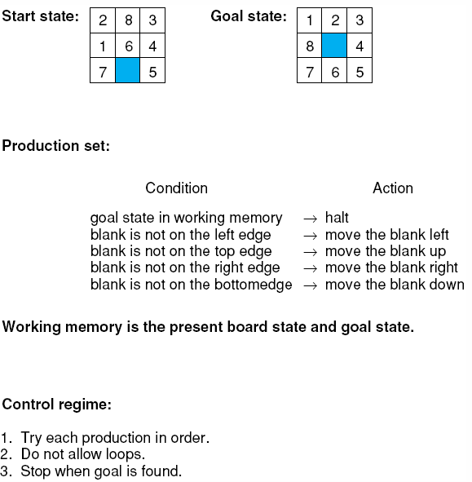
Fig 6.3 The 8-puzzle as a production system.
Luger: Artificial Intelligence, 5th edition. © Pearson Education Limited, 2005

Slide 17
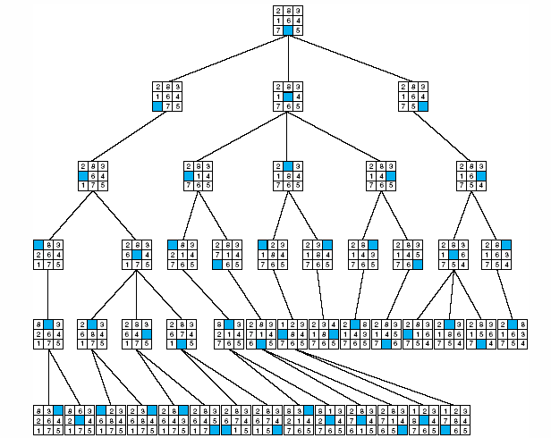
Fig 6.4 The 8-puzzle searched by a production system with loop detection and depth-bound , from Nilsson (1971).

Slide 18
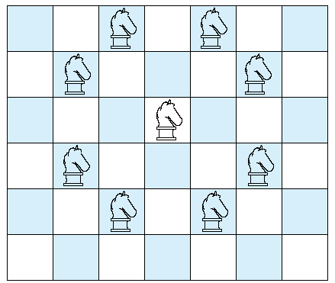
Fig 6.5 Legal moves of a chess knight.
Luger: Artificial Intelligence, 5th edition. © Pearson Education Limited, 2005

Slide 19
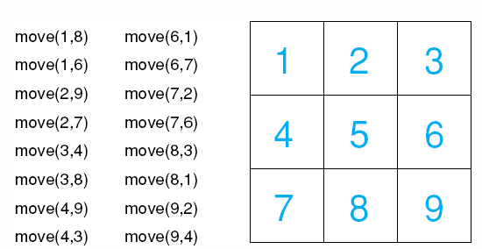
Fig 6.6 a 3 x 3 chessboard with move rules for the simplified knight tour problem.
Luger: Artificial Intelligence, 5th edition. © Pearson Education Limited, 2005

Slide 20
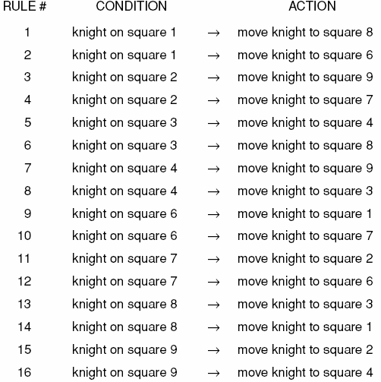
Table 6.1 Production rules for the 3 x 3 knight problem.
Luger: Artificial Intelligence, 5th edition. © Pearson Education Limited, 2005

Slide 21
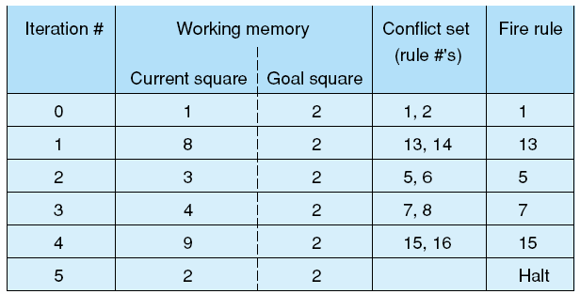
Fig 6.7 A production system solution to the 3 x 3 knight’s tour problem.
Luger: Artificial Intelligence, 5th edition. © Pearson Education Limited, 2005

Slide 22
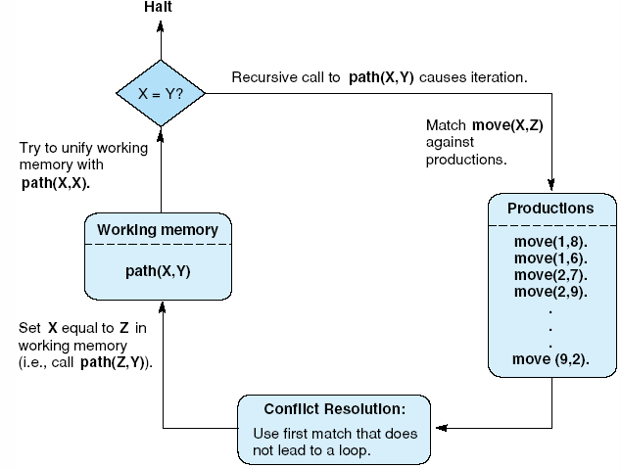
Fig 6.8 The recursive path algorithm as production system.
Luger: Artificial Intelligence, 5th edition. © Pearson Education Limited, 2005

Slide 23
Control of search - Data-driven or goal-driven
In data-driven we begin by problem description and infer new knowledge by applying the production rules.
Initial knowledge and inferred knowledge is placed in the working memory.
When the condition of one rule matched the working memory, this rule is fired and the action is added to the working memory.
This continues until a goal state is reached.

Slide 24
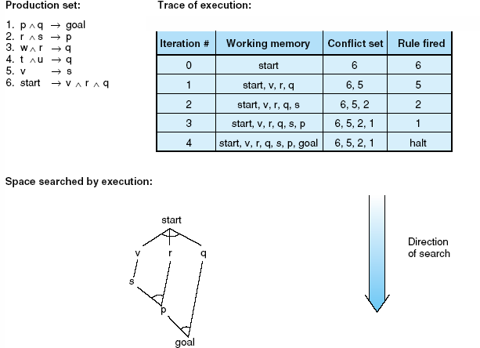
Fig 6.9 Data-driven search in a production system.
Conflict resolution strategy:
Choose the enabled rule that has fired least recently (or not at all).
Luger: Artificial Intelligence, 5th edition. © Pearson Education Limited, 2005

Slide 25
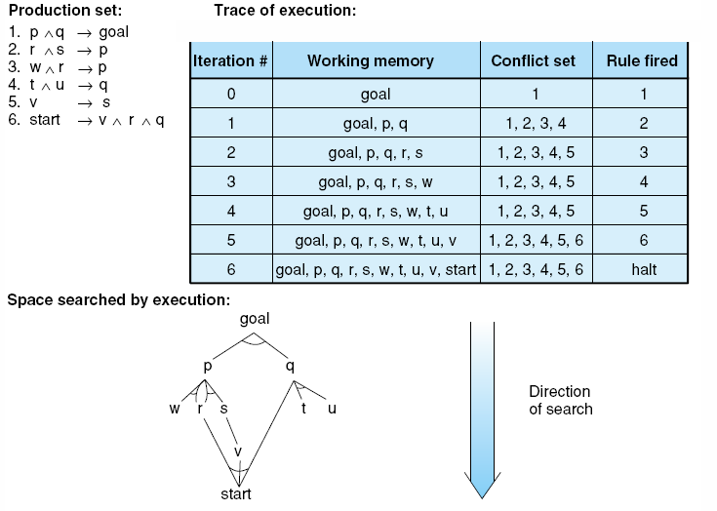
Fig 6.10 Goal-driven search in a production system.
Luger: Artificial Intelligence, 5th edition. © Pearson Education Limited, 2005

Slide 26
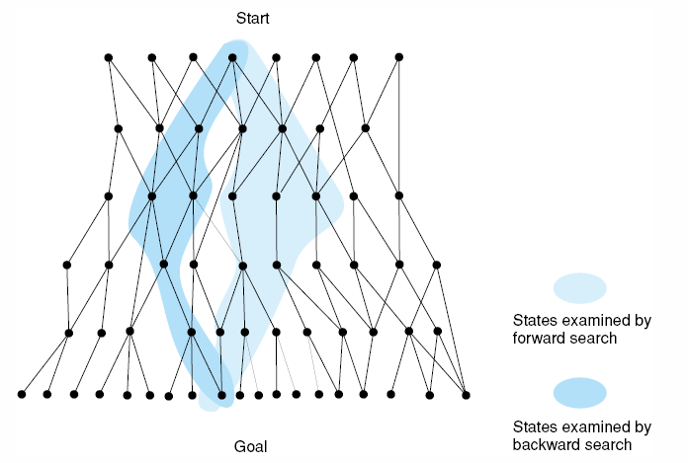
Complexity of the search in either approach is measured by the branching factor or penetrance
Fig 6.11 Bidirectional search missing in both directions, resulting in excessive search.
Luger: Artificial Intelligence, 5th edition. © Pearson Education Limited, 2005

Slide 27
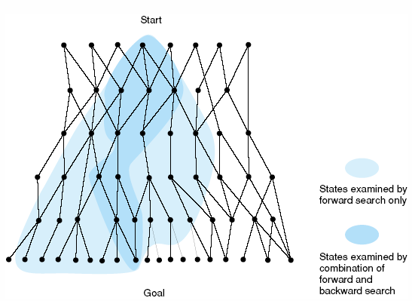
Fig 6.12 Bidirectional search meeting in the middle, eliminating much of the space examined by unidirectional search.
Luger: Artificial Intelligence, 5th edition. © Pearson Education Limited, 2005

Slide 28
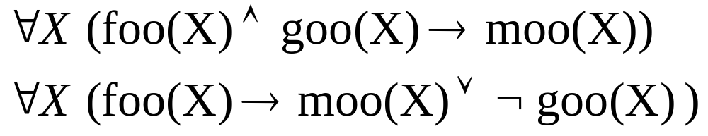
Control of search - through Rule structure
The above relations are equivalent but as structure (syntax) is different, this affect their applicability.

Slide 29
Control of search - through conflict Resolution
Simplest strategy choose the first rule the matches the working memory.
Strategies in OPS5
Refraction: Once a rule is fired, it may not fire again until the working memory that match its conditions have been modified. Discourage looping
Recency: Prefer rules that matches the pattern that most recently added to the working memory. Focuses on a single line of reasoning.
Specificity: Use more specific problem-specific rule than to use more general once. More specific rules has more conditions (matches fewer rules).

Slide 30
Major advantages of production systems for artificial intelligence
Separation of Knowledge and Control
A Natural Mapping onto State Space Search
Modularity of Production Rules
Pattern-Directed Control
Opportunities for Heuristic Control of Search
Tracing and Explanation
Language Independence
A Plausible Model of Human Problem-Solving
Luger: Artificial Intelligence, 5th edition. © Pearson Education Limited, 2005

Slide 31
Major advantages of production systems for artificial intelligence
Separation of Knowledge and Control:
  Elegant model for separation of knowledge and control.
  Control provided through act-recognize cycle.
  Problem-specific knowledge is encoded through the rules.
  Knowledge or control can be modified without the need to modify the other component.
A Natural Mapping onto State Space Search
  Successive states (contents) of the working memory form the nodes in state space graph.
  Production rules represent the set of transitions between states.
  Conflict resolution represent selection of a branch.
Luger: Artificial Intelligence, 5th edition. © Pearson Education Limited, 2005

Slide 32
Major advantages of production systems for artificial intelligence
Modularity of Production Rules:
  No interaction between rules.
  They interact only through the change of working memory.
  No rule can call another rule.
  They can not change the value used in another rule.
  The independence supports incremental development of (expert) systems.
Pattern-Directed Control:
  Rules can be fired in any sequence which adds flexibility.
Opportunities for Heuristic Control of Search:
  Several heuristics can be used in search, i.e. Conflict resolution.
Luger: Artificial Intelligence, 5th edition. © Pearson Education Limited, 2005

Slide 33
Major advantages of production systems for artificial intelligence
  Tracing and Explanation:
    Easy to trace system.
    Each rule represents a problem solving step.
    The chain of rules used represents the solution path (human’s line of reasoning).
    In programming languages, single line of code is most likely meaningless.
Language Independence:
  Independent of representation used in rules and working memory as soon it supports pattern matching.
  Predicate calculus is used for presentation and modus ponens inference although other presentations may be used.
  Predicate calculus involves inference with certainty.
  Other languages that may work with probabilities (uncertainty).
Luger: Artificial Intelligence, 5th edition. © Pearson Education Limited, 2005

Slide 34
Major advantages of production systems for artificial intelligence
A Plausible Model of Human Problem-Solving (Newell and simon, 1972):
  Good way to model human problem solving especially in cognitive science research.
Luger: Artificial Intelligence, 5th edition. © Pearson Education Limited, 2005

Slide 35
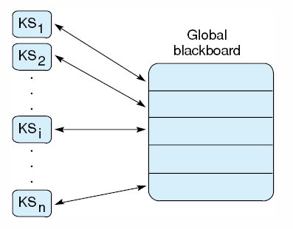
Fig 6.13 Blackboard architecture
Luger: Artificial Intelligence, 5th edition. © Pearson Education Limited, 2005

