Slide 1
Computer Security:
Principles and Practice
Fourth Edition, Global Edition
By: William Stallings and Lawrie Brown
Notes:
Lecture slides prepared for “Computer Security: Principles and Practice”, 4/e, GE, by William Stallings and Lawrie Brown, Chapter 14 “IT Security Management and Risk Assessment”.

Slide 2
Chapter 14
IT Security Management
and Risk Assessment
Notes:
In previous chapters, we discussed a range of technical and administrative measures that
can be used to manage and improve the security of computer systems and networks. In
this chapter and the next, we look at the process of how to best select and implement
these measures to effectively address an organization’s security requirements. As we
noted in Chapter 1, this involves examining three fundamental questions:
1. What assets do we need to protect?
2. How are those assets threatened?
3. What can we do to counter those threats?

Slide 3
IT Security Management Overview
What assets need to be protected
How are those assets threatened
What can be done to counter those threats
Is the formal process of answering the questions:
Ensures that critical assets are sufficiently protected in a cost-effective manner
Security risk assessment is needed for each asset in the organization that requires protection
Provides the information necessary to decide what management, operational, and technical controls are needed to reduce the risks identified
Notes:
IT security management is the formal process of answering these questions, ensuring
that critical assets are sufficiently protected in a cost-effective manner. More specifically,
IT security management consists of first determining a clear view of an organization’s IT
security objectives and general risk profile. Next, an IT security risk assessment is needed
for each asset in the organization that requires protection; this assessment must answer
the three key questions listed above. It provides the information necessary to decide
what management, operational, and technical controls are needed to either reduce
the risks identified to an acceptable level or otherwise accept the resultant risk. This
chapter will consider each of these items. The process continues by selecting suitable
controls and then writing plans and procedures to ensure these necessary controls
are implemented effectively. That implementation must be monitored to determine if
the security objectives are met. The whole process must be iterated, and the plans and
procedures kept up-to-date, because of the rapid rate of change in both the technology
and the risk environment. We discuss the latter part of this process in Chapter 15. The
following chapters, then, address specific control areas relating to physical security in
Chapter 16, human factors in Chapter 17, and auditing in Chapter 18.

Slide 4
Table 14.1
ISO/IEC 27000 Series of Standards on IT Security Techniques
Notes:
The discipline of IT security management has evolved considerably over the last few
decades. This has occurred in response to the rapid growth of, and dependence on, networked
computer systems and the associated rise in risks to these systems. In the last
decade a number of national and international standards have been published. These
represent a consensus on the best practice in the field. The International Standards
Organization (ISO) has revised and consolidated a number of these standards
into the ISO 27000 series. Table 14.1 details a number of recently adopted
standards within this family. In the United States, NIST has also produced a number
of relevant standards, including NIST SP 800-18 (Guide for Developing Security
Plans for Federal Information Systems, February 2006), NIST SP 800-30 (Guide
for Conducting Risk Assessments, September 2012), and NIST SP 800-53 (Security
and Privacy Controls for Federal Information Systems and Organizations, January
2015). NIST also released the “Framework for Improving Critical Infrastructure
Cybersecurity ”in 2014, to provide guidance to organizations on systematically managing
cybersecurity risks. With the growth of concerns about corporate governance
following events such as the global financial crisis and repeated incidences of the
loss of personal information by government organizations and other businesses,
auditors for such organizations increasingly require adherence to formal standards
such as these.

Slide 5
IT Security Management
IT SECURITY MANAGEMENT: A process used to achieve and maintain appropriate levels of confidentiality, integrity, availability, accountability, authenticity, and reliability. IT security management functions include:
Determining organizational IT security objectives, strategies, and policies
Determining organizational IT security requirements
Identifying and analyzing security threats to IT assets within the organization
Identifying and analyzing risks
Specifying appropriate safeguards
Monitoring the implementation and operation of safeguards that are necessary in order to cost effectively protect the information and services within the organization
Developing and implementing a security awareness program
Detecting and reacting to incidents
Notes:
[ISO13335] provides a conceptual framework for managing security. It defines
IT security management as follows:
IT SECURITY MANAGEMENT: A process used to achieve and maintain appropriate
levels of confidentiality, integrity, availability, accountability, authenticity, and reliability.
IT security management functions include:
• determining organizational IT security objectives, strategies, and policies
• determining organizational IT security requirements
• identifying and analyzing security threats to IT assets within the organization
• identifying and analyzing risks
• specifying appropriate safeguards
• monitoring the implementation and operation of safeguards that are necessary in
order to cost effectively protect the information and services within the organization
• developing and implementing a security awareness program
• detecting and reacting to incidents

Slide 6
Notes:
This process is illustrated in Figure 14.1 (adapted from figure 1 in ISO27005 (Information security risk management, 2005) and
figure 1 in ISO13335, part 3]), with a particular
focus on the internal details relating to the risk assessment process. IT security management
needs to be a key part of an organization’s overall management plan. Similarly,
the IT security risk assessment process should be incorporated into the wider risk
assessment of all the organization’s assets and business processes. Hence, unless senior
management in an organization are aware of, and support, this process, it is unlikely
that the desired security objectives will be met and contribute appropriately to the
organization’s business outcomes. Note that IT management is not something undertaken
just once. Rather it is a cyclic process that must be repeated constantly in order
to keep pace with the rapid changes in both IT technology and the risk environment.

Slide 7
Notes:
The iterative nature of this process is a key focus of ISO 31000 (Risk management-
Principles and guidelines, 2009), and is specifically applied to the security risk management
process in ISO 27005. This standard details a model process for managing
information security that comprises the following steps:
Plan: Establish security policy, objectives, processes and procedures;
perform risk assessment; develop risk treatment plan
with appropriate selection of controls or acceptance of risk.
Do: Implement the risk treatment plan.
Check: Monitor and maintain the risk treatment plan.
Act: Maintain and improve the information security risk management
process in response to incidents, review, or identified
changes.
This process is illustrated in Figure 14.2, which can be aligned with Figure 14.1.
The outcome of this process should be that the security needs of the interested parties
are managed appropriately.

Slide 8
Organizational Context and Security Policy
Maintained and updated regularly
Using periodic security reviews
Reflect changing technical/risk environments
Examine role and importance of IT systems in organization
First examine organization’s IT security:
Objectives - wanted IT security outcomes
Strategies - how to meet objectives
Policies - identify what needs to be done
Notes:
The initial step in the IT security management process comprises an examination of
the organization’s IT security objectives, strategies, and policies in the context of the
organization’s general risk profile. This can only occur in the context of the wider
organizational objectives and policies, as part of the management of the organization.
Organizational security objectives identify what IT security outcomes should be
achieved. They need to address individual rights, legal requirements, and standards
imposed on the organization, in support of the overall organizational objectives.
Organizational security strategies identify how these objectives can be met. Organizational
security policies identify what needs to be done. These objectives, strategies, and
policies need to be maintained and regularly updated based on the results of periodic
security reviews to reflect the constantly changing technological and risk environments.
To help identify these organizational security objectives, the role and importance
of the IT systems in the organization is examined. The value of these systems
in assisting the organization achieve its goals is reviewed, not just the direct costs of
these systems. Questions that help clarify these issues include the following:
• What key aspects of the organization require IT support in order to function
efficiently?
• What tasks can only be performed with IT support?
• Which essential decisions depend on the accuracy, currency, integrity, or
availability of data managed by the IT systems?
• What data created, managed, processed, and stored by the IT systems need
protection?
• What are the consequences to the organization of a security failure in their IT
systems?
If the answers to some of the above questions show that IT systems are important
to the organization in achieving its goals, then clearly the risks to them should be
assessed and appropriate action taken to address any deficiencies identified. A list
of key organization security objectives should result from this examination.
Once the objectives are listed, some broad strategy statements can be developed.
These outline in general terms how the identified objectives will be met in a consistent
manner across the organization. The topics and details in the strategy statements
depend on the identified objectives, the size of the organization, and the importance
of the IT systems to the organization. The strategy statements should address the
approaches the organization will use to manage the security of its IT systems.

Slide 9
Security Policy
Needs to address:
Scope and purpose including relation of objectives to business, legal, regulatory requirements
IT security requirements
Assignment of responsibilities
Risk management approach
Security awareness and training
General personnel issues and any legal sanctions
Integration of security into systems development
Information classification scheme
Contingency and business continuity planning
Incident detection and handling processes
How and when policy reviewed, and change control to it
Notes:
Given the organizational security objectives and strategies, an organizational
security policy is developed that describes what the objectives and strategies are and
the process used to achieve them. The organizational or corporate security policy
may be either a single large document or, more commonly, a set of related documents.
This policy typically needs to address at least the following topics:
• The scope and purpose of the policy
• The relationship of the security objectives to the organization’s legal and
regulatory obligations, and its business objectives
• IT security requirements in terms of confidentiality, integrity, availability,
accountability, authenticity, and reliability, particularly with regard to the
views of the asset owners
• The assignment of responsibilities relating to the management of IT security
and the organizational infrastructure
• The risk management approach adopted by the organization
• How security awareness and training is to be handled
• General personnel issues, especially for those in positions of trust
• Any legal sanctions that may be imposed on staff, and the conditions under
which such penalties apply
• Integration of security into systems development and procurement
• Definition of the information classification scheme used across the organization
• Contingency and business continuity planning
• Incident detection and handling processes
• How and when this policy should be reviewed
• The method for controlling changes to this policy
The intent of the policy is to provide a clear overview of how an organization’s IT
infrastructure supports its overall business objectives in general, and more specifically
what security requirements must be provided in order to do this most
effectively.

Slide 10
Management Support
IT security policy must be supported by senior management
Need IT security officer
To provide consistent overall supervision
Liaison with senior management
Maintenance of IT security objectives, strategies, policies
Handle incidents
Management of IT security awareness and training programs
Interaction with IT project security officers
Large organizations need separate IT project security officers associated with major projects and systems
Manage security policies within their area
Notes:
It is critical that an organization’s IT security policy has full approval and buy-in
by senior management. Without this, experience shows that it is unlikely that sufficient
resources or emphasis will be given to meeting the identified objectives and achieving
a suitable security outcome. With the clear, visible support of senior management, it is
much more likely that security will be taken seriously by all levels of personnel in the
organization. This support is also evidence of concern and due diligence in the management
of the organization’s systems and the monitoring of its risk profile.
Because the responsibility for IT security is shared across the organization,
there is a risk of inconsistent implementation of security and a loss of central
monitoring and control. The various standards strongly recommend that overall
responsibility for the organization’s IT security be assigned to a single person, the
organizational IT security officer. This person should ideally have a background in
IT security. The responsibilities of this person include:
• Oversight of the IT security management process
• Liaison with senior management on IT security issues
• Maintenance of the organization’s IT security objectives, strategies, and policies
• Coordination of the response to any IT security incidents
• Management of the organization-wide IT security awareness and training
programs
• Interaction with IT project security officers
Larger organizations will need separate IT project security officers associated with
major projects and systems. Their role is to develop and maintain security policies
for their systems, develop and implement security plans relating to these systems,
handle the day-to-day monitoring of the implementation of these plans, and assist
with the investigation of incidents involving their systems.

Slide 11
Security Risk Assessment
Critical component of process
Ideally examine every organizational asset
Not feasible in practice
Approaches to identifying and mitigating risks to an organization’s IT infrastructure:
Informal
Detailed risk
Combined
Baseline
Notes:
We now turn to the key risk management component of the IT security process.
This stage is critical, because without it there is a significant chance that resources
will not be deployed where most effective. The result will be that some risks are
not addressed, leaving the organization vulnerable, while other safeguards may be
deployed without sufficient justification, wasting time and money. Ideally every
single organizational asset is examined, and every conceivable risk to it is evaluated.
If a risk is judged to be too great, then appropriate remedial controls are deployed to
reduce the risk to an acceptable level. In practice this is clearly impossible. The time
and effort required, even for large, well-resourced organizations, is clearly neither
achievable nor cost effective. Even if possible, the rapid rate of change in both IT
technologies and the wider threat environment means that any such assessment
would be obsolete as soon as it is completed, if not earlier! Clearly some form of
compromise evaluation is needed.
Another issue is the decision as to what constitutes an appropriate level of
risk to accept. In an ideal world the goal would be to eliminate all risks completely.
Again, this is simply not possible. A more realistic alternative is to expend an amount
of resources in reducing risks proportional to the potential costs to the organization
should that risk occur. This process also must take into consideration the likelihood
of the risk’s occurrence. Specifying the acceptable level of risk is simply prudent
management and means that resources expended are reasonable in the context of
the organization’s available budget, time, and personnel resources. The aim of the
risk assessment process is to provide management with the information necessary for
them to make reasonable decisions on where available resources will be deployed.
Given the wide range of organizations, from very small businesses to global
multinationals and national governments, there clearly needs to be a range of alternatives
available in performing this process. There are a range of formal standards that
detail suitable IT security risk assessment processes, including ISO 13335, ISO 27005,
ISO 31000, and NIST SP 800-30. In particular, ISO 13335 recognizes four approaches
to identifying and mitigating risks to an organization’s IT infrastructure:
• Baseline approach
• Informal approach
• Detailed risk analysis
• Combined approach
The choice among these will be determined by the resources available to the organization
and from an initial high-level risk analysis that considers how valuable the IT systems
are and how critical to the organization’s business objectives. Legal and regulatory
constraints may also require specific approaches. This information should be determined
when developing the organization’s IT security objectives, strategies, and policies.

Slide 12
Notes:
A number of national and international standards document the expected formal
risk analysis approach. These include ISO 27005, ISO 31000, NIST SP 800-30,
and [SASN13]. This approach is often mandated by government organizations
and associated businesses. These standards all broadly agree on the process used.
Figure 14.3 (reproduced from figure 5 in NIST SP 800-30) illustrates a typical
process used.

Slide 13
Terminology
Asset: A system resource or capability of value to its owner that requires protection
Threat: A potential for a threat source to exploit a vulnerability in some asset, which if it occurs may compromise the security of the asset and cause harm to the asset’s owner
Vulnerability: A flaw or weakness in an asset’s design, implementation, or operation and management that could be exploited by some threat
Risk: The potential for loss computed as the combination of the likelihood that a given threat exploits some vulnerability to an asset, and the magnitude of harmful consequence that results to the asset’s owner
Notes:
The next step in the process is to identify the threats or risks the assets are exposed
to. This directly addresses the second of our three fundamental questions: “How
are those assets threatened?” It is worth commenting on the terminology used here.
The terms threat and risk, while having distinct meanings, are often used interchangeably
in this context. There is considerable variation in the definitions of these
terms, as seen in the range of definitions provided in the cited standards. The following
definitions will be useful in our discussion:
The relationship among these and other security concepts is illustrated in Figure 1.2.
The goal of this stage is to identify potentially significant risks to the assets
listed. This requires answering the following questions for each asset:
1. Who or what could cause it harm?
2. How could this occur?

Slide 14
Asset Identification
Last component is to identify assets to examine
Draw on expertise of people in relevant areas of organization to identify key assets
Identify and interview such personnel
Asset
“anything that needs to be protected” because it has value to the organization and contributes to the successful attainment of the organization’s objectives
Notes:
The last component of this first step in the risk
assessment is to identify the assets to examine. This directly addresses the first of
the three fundamental questions we opened this chapter with: “What assets do
we need to protect?” An asset is “anything that needs to be protected” because
it has value to the organization and contributes to the successful attainment of
the organization’s objectives. As we discuss in Chapter 1, an asset may be either
tangible or intangible. It includes computer and communications hardware
infrastructure, software (including applications and information/data held on these
systems), the documentation on these systems, and the people who manage and
maintain these systems. Within the boundaries identified for the risk assessment,
these assets need to be identified and their value to the organization assessed. It is
important to emphasize again that while the ideal is to consider every conceivable
asset, in practice this is not possible. Rather the goal here is to identify all assets
that contribute significantly to attaining the organization’s objectives and whose
compromise or loss would seriously impact on the organization’s operation.
[SASN13] describes this process as a criticality assessment that aims to identify
those assets that are most important to the organization.
While the risk assessment process is most likely being managed by security
experts, they will not necessarily have a high degree of familiarity with the
organization’s operation and structures. Thus they need to draw on the expertise
of the people in the relevant areas of the organization to identify key assets and
their value to the organization. A key element of this process step is identifying
and interviewing such personnel. Many of the standards listed previously include
checklists of types of assets and suggestions for mechanisms for gathering the
necessary information. These should be consulted and used. The outcome of this
step should be a list of assets, with brief descriptions of their use by, and value to,
the organization.

Slide 15
Asset Identification – in Healthcare System
The main asset is healthcare system is patient records which is called Electronic Health Record (EHR).
Other assets such as: healthcare devices such as remote patient monitoring devices, employees information, insurance companies, public information about the organization etc.

Slide 16
Asset Identification – in Healthcare System
Assets Valuation:
One of the key steps to performing a security risk assessment is to determine the value of the assets that require protection.
For example, the value of EHR is greater than the value of public information about their physicians.

Slide 17
Threat Identification
Availability
Authenticity
Reliability
Accountability
Integrity
Anything that might hinder or prevent an asset from providing appropriate levels of the key security services
Confidentiality
A threat is:
Notes:
Answering the first of these questions involves
identifying potential threats to assets. In the broadest sense, a threat is anything
that might hinder or prevent an asset from providing appropriate levels of the key
security services: confidentiality, integrity, availability, accountability, authenticity,
and reliability. Note that one asset may have multiple threats, and a single threat
may target multiple assets.

Slide 18
Threat Sources
Threats may be
Natural
Man-made
Accidental or deliberate
Any previous experience of attacks seen by the organization also needs to be considered
Evaluation of human threat sources should consider:
Motivation
Capability
Resources
Probability of attack
Deterrence
Notes:
A threat may be either natural or human-made and may be accidental or
deliberate. This is known as the threat source or threat agent. The classic natural threat sources are
those often referred to as acts of God, and include damage caused by fire, flood,
storm, earthquake, and other such natural events. It also includes environmental
threats such as long-term loss of power or natural gas. Or it may be the result of
chemical contamination or leakage. Alternatively, a threat source may be a human
agent acting either directly or indirectly. Examples of the former include an insider
retrieving and selling information for personal gain or a hacker targeting the organization’s
server over the Internet. An example of the latter includes someone writing
and releasing a network worm that infects the organization’s systems. These
examples all involved a deliberate exploit of a threat. However, a threat may also
be a result of an accident, such as an employee incorrectly entering information on
a system, which results in the system malfunctioning.
Identifying possible threats and threat sources requires the use of a variety of
sources, along with the experience of the risk assessor. The chance of natural threats
occurring in any particular area is usually well known from insurance statistics. Lists
of other potential threats may be found in the standards, in the results of IT security
surveys, and in information from government security agencies. The annual computer
crime reports, such as those by CSI/FBI and by Verizon in the United States,
and similar reports in other countries, provide useful general guidance on the broad
IT threat environment and the most common problem areas. Standards, such as
NIST SP 800-30 Appendix D with a taxonomy of threat sources, and Appendix E with
examples of threats, may also assist here.
However, this general guidance needs to be tailored to the organization and
the risk environment it operates in. This involves consideration of vulnerabilities in
the organization’s IT systems, which may indicate that some risks are either more or
less likely than the general case. Where an organization’s security concerns are sufficiently
high that threats need to be specifically identified, threat scenarios can be
modelled, developed, and analyzed, as described in NIST SP 800-30. Organization’s define
threat scenarios to describe how the tactics, techniques, and procedures employed
by an attacker can contribute to, or cause, harm. The possible motivation of deliberate
attackers in relation to the organization should be considered as potentially
influencing this variation in risk. In addition, any previous experience of attacks seen
by the organization needs to be considered, as that is concrete evidence of risks that
are known to occur. When evaluating possible human threat sources, it is worth considering
their reason and capabilities for attacking this organization, including their:
• Motivation: Why would they target this organization; how motivated are they?
• Capability: What is their level of skill in exploiting the threat?
• Resources: How much time, money, and other resources could they deploy?
• Probability of attack: How likely and how often would your assets be targeted?
• Deterrence: What are the consequences to the attacker of being identified?

Slide 19
Threat – Healthcare System
Examples of threats in healthcare system:
Data Breaches
DDOS Attacks
Ransomware
Modification to lab results.
Phishing Attacks

Slide 20
Vulnerability Identification
Identify exploitable flaws or weaknesses in organization’s IT systems or processes
Determines applicability and significance of threat to organization
Need combination of threat and vulnerability to create a risk to an asset
Outcome should be a list of threats and vulnerabilities with brief descriptions of how and why they might occur
Notes:
Answering the second of these questions, “How
could this occur?” involves identifying flaws or weaknesses in the organization’s IT
systems or processes that could be exploited by a threat. This will help determine
the applicability of the threat to the organization and its significance. Note that
the mere existence of some vulnerability does not mean harm will be caused to
an asset. There must also be a threat source for some threat that can exploit the
vulnerability for harm. It is the combination of a threat and a vulnerability that
creates a risk to an asset.
Again, many of the standards listed previously include checklists of threats
and vulnerabilities and suggestions for tools and techniques to list them and to
determine their relevance to the organization. The outcome of this step should be
a list of threats and vulnerabilities, with brief descriptions of how and why they
might occur.

Slide 21
Vulnerability – Healthcare System
Example of Vulnerabilities:
Outdated Software Systems.
Lack of Cybersecurity Awareness.
Insecure Communication.

Slide 22
Analyze Risks
Specify likelihood of occurrence of each identified threat to asset given existing controls
Specify consequence should threat occur
Derive overall risk rating for each threat
Risk = probability threat occurs x cost to organization
Hard to determine accurate probabilities and realistic cost consequences
Use qualitative, not quantitative, ratings
Notes:
Having identified key assets and the likely threats and vulnerabilities they are
exposed to, the next step is to determine the level of risk each of these poses to the
organization. The aim is to identify and categorize the risks to assets that threaten
the regular operations of the organization. Risk analysis also provides information
to management to help managers evaluate these risks and determine how best to
treat them. Risk analysis involves first specifying the likelihood of occurrence of
each identified threat to an asset, in the context of any existing controls. Next, the
consequence to the organization is determined, should that threat eventuate. Lastly,
this information is combined to derive an overall risk rating for each threat. The
ideal would be to specify the likelihood as a probability value and the consequence
as a monetary cost to the organization should it occur. The resulting risk is then
simply given as
Risk = (Probability that threat occurs) x (Cost to organization)
This can be directly equated to the value the threatened asset has for the organization,
and hence specify what level of expenditure is reasonable to reduce the
probability of its occurrence to an acceptable level. Unfortunately, it is often
extremely hard to determine accurate probabilities, realistic cost consequences,
or both. This is particularly true of intangible assets, such as the loss of confidentiality
of a trade secret. Hence, most risk analyses use qualitative, rather than
quantitative, ratings for both these items. The goal is then to order the resulting
risks to help determine which need to be most urgently treated, rather than to
give them an absolute value.

Slide 23
Analyze Existing Controls
Existing controls used to attempt to minimize threats need to be identified
Security controls include:
Management
Operational
Technical processes and procedures
Use checklists of existing controls and interview key organizational staff to solicit information
Notes:
Before the likelihood of a threat can be specified,
any existing controls used by the organization to attempt to minimize threats need
to be identified. Security controls include management, operational, and technical
processes and procedures that act to reduce the exposure of the organization to
some risks by reducing the ability of a threat source to exploit some vulnerabilities.
These can be identified by using checklists of existing controls, and by interviewing
key organizational staff to solicit this information.

Slide 24
Analyze Existing Controls

Slide 25
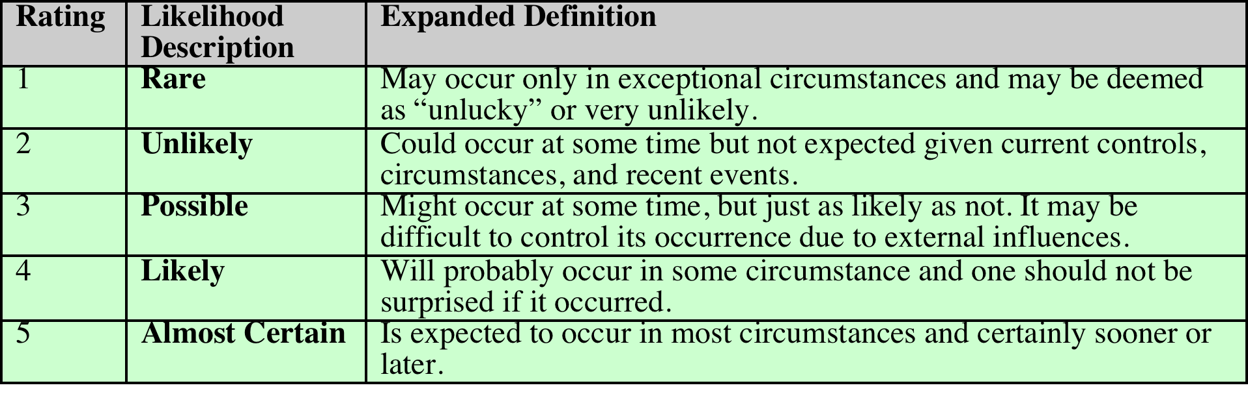
Table 14.2
Risk Likelihood
Notes:
Having identified existing controls, the likelihood
that each identified threat could occur and cause harm to some asset needs to
be specified. The likelihood is typically described qualitatively, using values and
descriptions such as those shown in Table 14.2. While the various risk assessment
standards all suggest tables similar to these, there is considerable variation in their
detail. The selection of the specific descriptions and tables used is determined at
the beginning of the risk assessment process, when the context is established.
There will very likely be some uncertainty and debate over exactly which rating
is most appropriate. This reflects the qualitative nature of the ratings, ambiguity
in their precise meaning, and uncertainty over precisely how likely it is that some
threat may eventuate. It is important to remember that the goal of this process is
to provide guidance to management as to which risks exist, and provide enough
information to help management decide how to most appropriately respond. Any
uncertainty in the selection of ratings should be noted in the discussion on their
selection, but ultimately management will make a business decision in response to
this information.
The risk analyst takes the descriptive asset and threat/vulnerability details
from the preceding steps in this process and, in light of the organization’s overall
risk environment and existing controls, decides the appropriate rating. This
estimation relates to the likelihood of the specified threat exploiting one or
more vulnerabilities to an asset or group of assets, which results in harm to the
organization. The specified likelihood needs to be realistic. In particular, a rating
of likely or higher suggests that this threat has occurred sometime previously. This
means past history provides supporting evidence for its specification. If this is
not the case, then specifying such a value would need to be justified on the basis
of a significantly changed threat environment, a change in the IT system that
has weakened its security, or some other rationale for the threat’s anticipated
likely occurrence. In contrast, the Unlikely and Rare ratings can be very hard to
quantify. They are an indication that the threat is of concern, but whether it could
occur is difficult to specify. Typically such threats would only be considered if the
consequences to the organization of their occurrence are so severe that they must
be considered, even if extremely improbable.

Slide 26
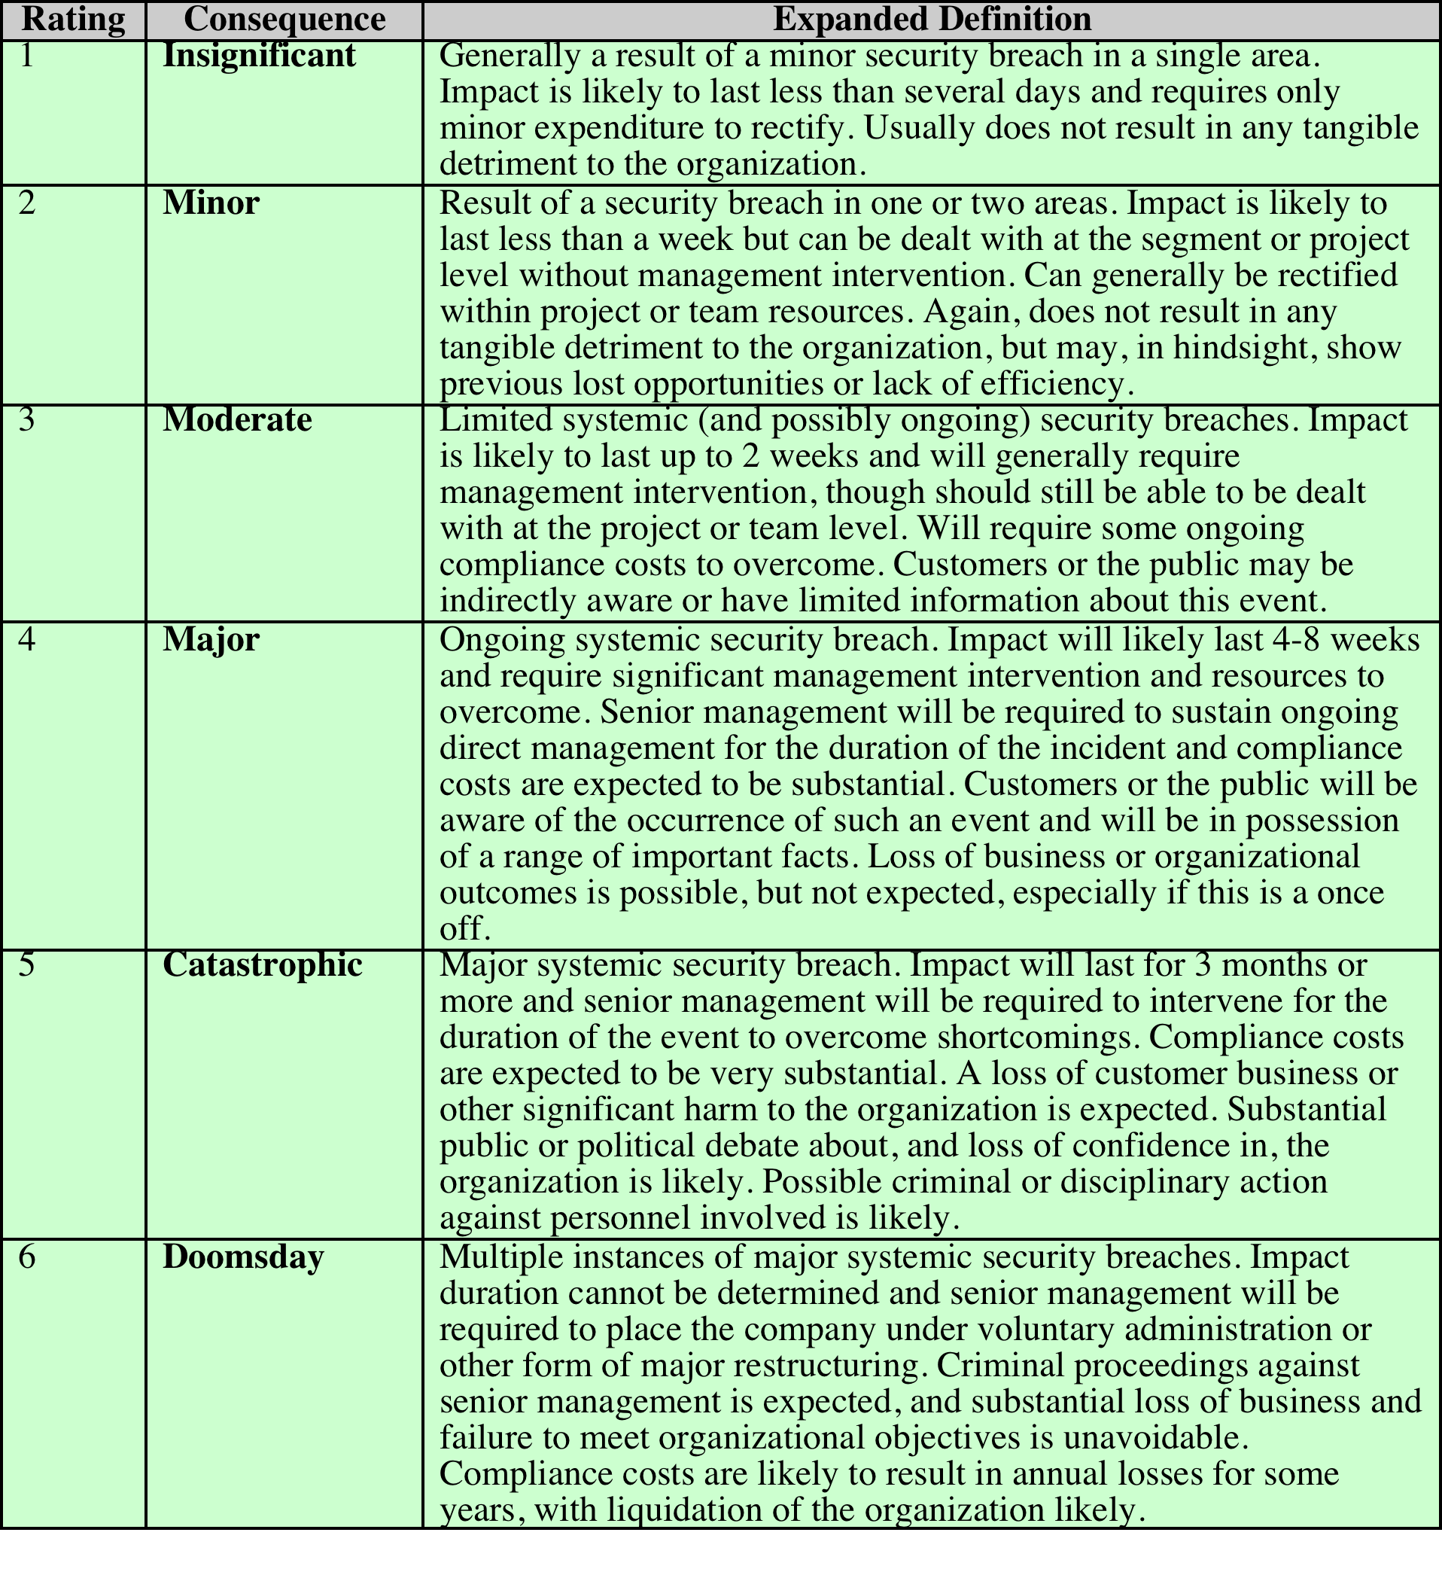
Table 14.3 Risk Consequences
(Table can be found on pages
476-477 in textbook)
Notes:
The analyst must then
specify the consequence of a specific threat eventuating. Note this is distinct from,
and not related to, the likelihood of the threat occurring. Rather, consequence
specification indicates the impact on the organization should the particular threat
in question actually eventuate. Even if a threat is regarded as rare or unlikely, if
the organization would suffer severe consequence should it occur, then it clearly
poses a risk to the organization. Hence, appropriate responses must be considered.
A qualitative descriptive value, such as those shown in Table 14.3, is typically used
to describe the consequence. As with the likelihood ratings, there is likely to be
some uncertainty as to the best rating to use.
This determination should be based upon the judgment of the asset’s owners,
and the organization’s management, rather than the opinion of the risk analyst. This
is in contrast with the likelihood determination. The specified consequence needs to
be realistic. It must relate to the impact on the organization as a whole should this
specific threat eventuate. It is not just the impact on the affected system. It is possible
that a particular system (a server in one location, for example) might be completely
destroyed in a fire. However, the impact on the organization could vary from it being
a minor inconvenience (the server was in a branch office, and all data were replicated
elsewhere) to a major disaster (the server had the sole copy of all customer
and financial records for a small business). As with the likelihood ratings, the consequence
ratings must be determined knowing the organization’s current practices and
arrangements. In particular, the organization’s existing backup, disaster recovery,
and contingency planning, or lack thereof, will influence the choice of rating.

Slide 27
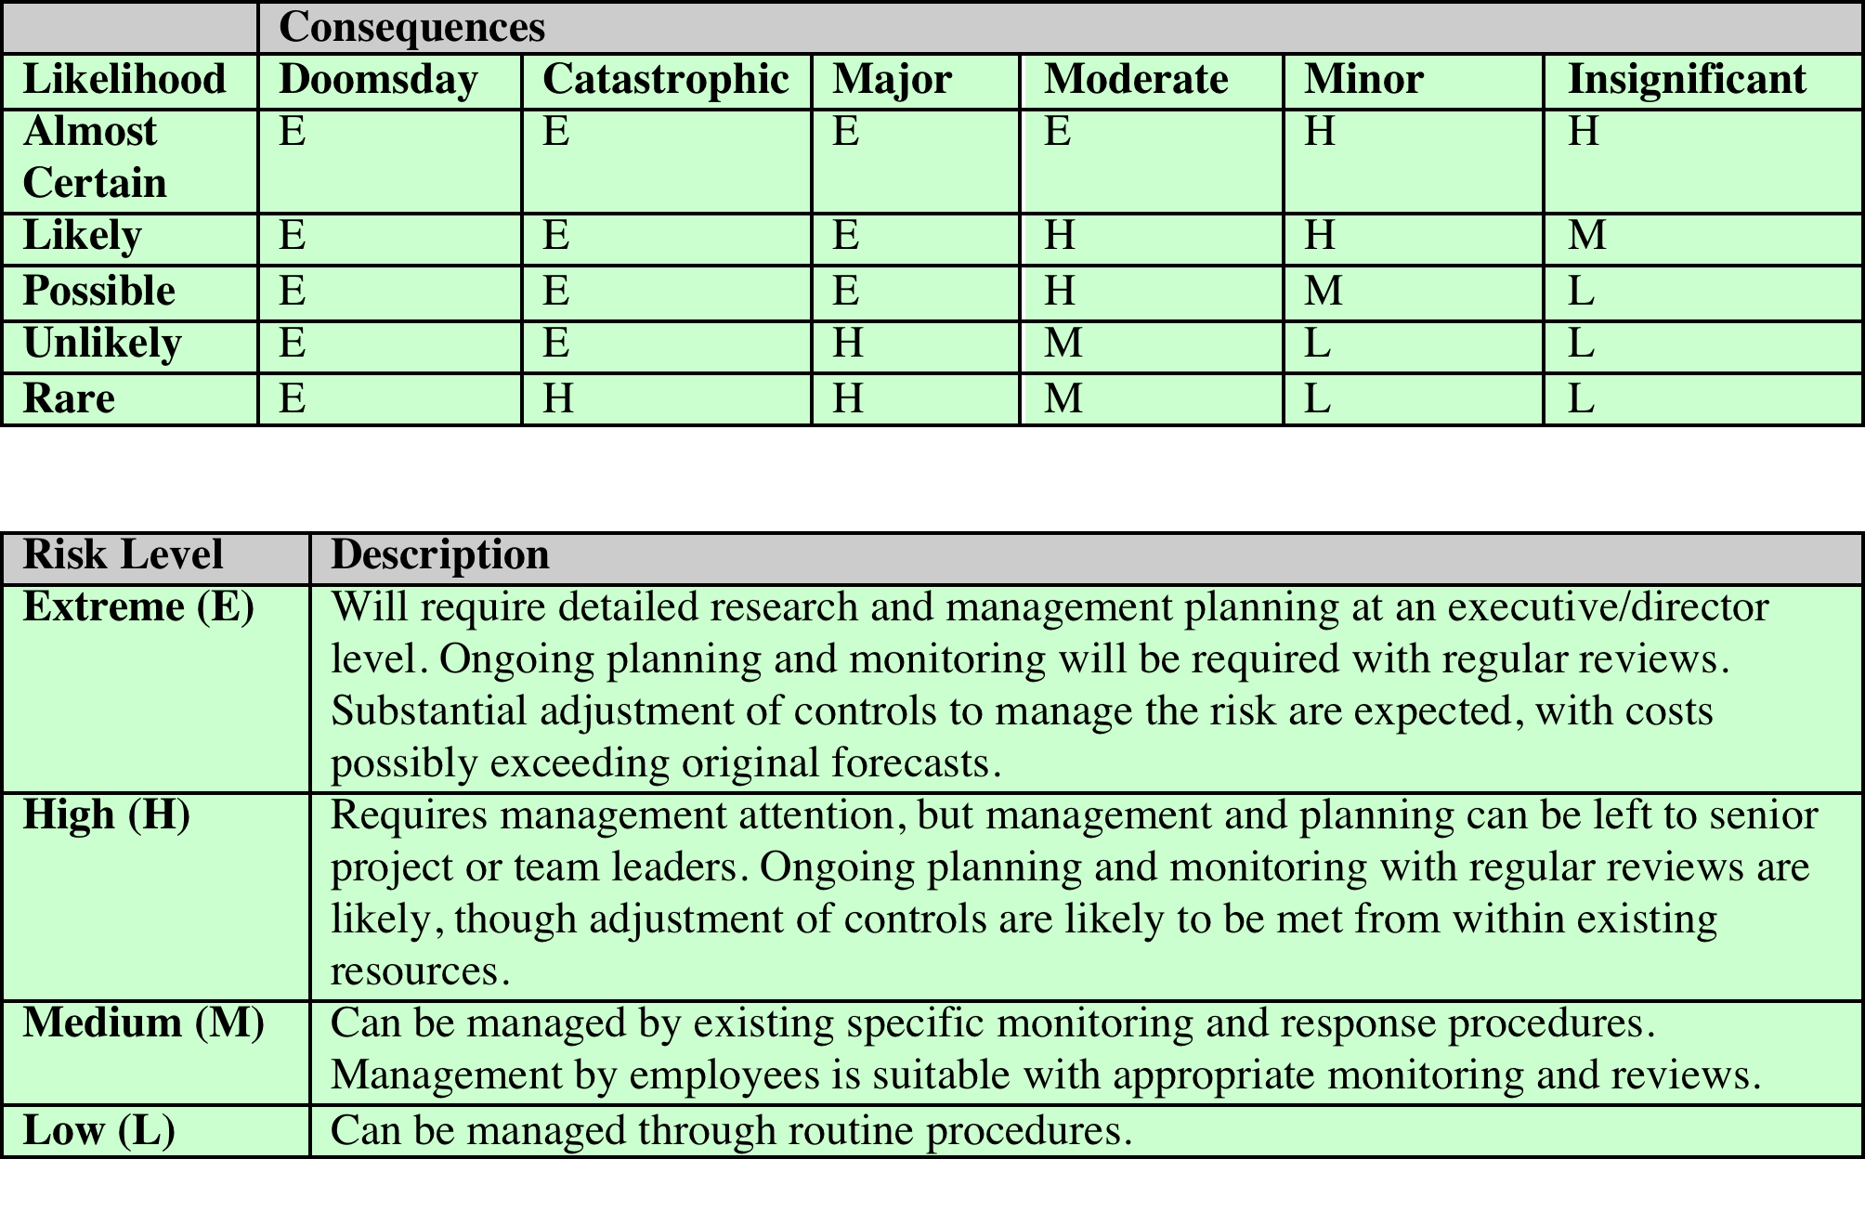
Table 14.4 Risk Level Determination and Meaning
Notes:
Once the likelihood and consequence
of each specific threat have been identified, a final level of risk can be assigned.
This is typically determined using a table that maps these values to a risk level,
such as those shown in Table 14.4. This table details the risk level assigned to each
combination. Such a table provides the qualitative equivalent of performing the
ideal risk calculation using quantitative values. It also indicates the interpretation
of these assigned levels.

Slide 28
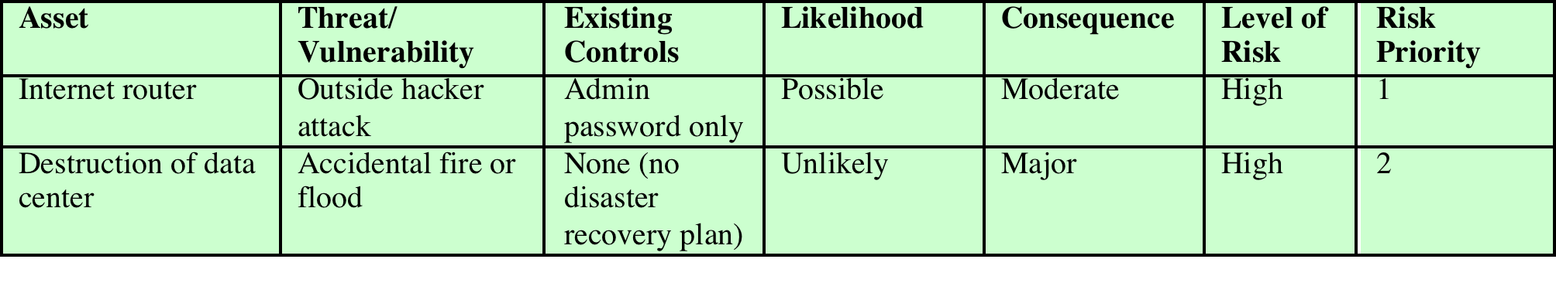
Table 14.5 Risk Register
Notes:
The results of the risk analysis
process should be documented in a risk register. This should include a summary
table such that shown in Table 14.5 . The risks are usually sorted in decreasing
order of level. This would be supported by details of how the various items
were determined, including the rationale, justification, and supporting evidence
used. The aim of this documentation is to provide senior management with
the information needed to make appropriate decisions as how to best manage
the identified risks. It also provides evidence that a formal risk assessment process
has been followed if needed, and a record of decisions made with the reasons for
those decisions.
Once the details of potentially significant risks are determined, management needs
to decide whether it needs to take action in response. This would take into account
the risk profile of the organization and its willingness to accept a certain level of
risk, as determined in the initial establishing the context phase of this process. Those
items with risk levels below the acceptable level would usually be accepted with no
further action required. Those items with risks above this will need to be considered
for treatment.

Slide 29
Notes:
Typically the risks with the higher ratings are those that need action most urgently.
However, it is likely that some risks will be easier, faster, and cheaper to address
than others. In the example risk register shown in Table 14.5, both risks were rated
High. Further investigation reveals that a relatively simple and cheap treatment
exists for the first risk by tightening the router configuration to further restrict possible
accesses. Treating the second risk requires developing a full disaster recovery
plan, a much slower and more costly process. Hence management would take the
simple action first to improve the organization’s overall risk profile as quickly as
possible. Management may even decide that for business reasons, given an overall
view of the organization, some risks with lower levels should be treated ahead of
other risks. This is a reflection of both limitations in the risk analysis process in the
range of ratings available and their interpretation, and of management’s perspective
of the organization as a whole.
Figure 14.5 indicates a range of possibilities for costs versus levels of risk.
If the cost of treatment is high, but the risk is low, then it is usually uneconomic
to proceed with such treatment. Alternatively, where the risk is high and the cost
comparatively low, treatment should occur. The most difficult area occurs between
these extremes. This is where management must make a business decision about the
most effective use of their available resources. This decision usually requires a more
detailed investigation of the treatment options.

Slide 30
Risk Treatment Alternatives
Risk acceptance
Choosing to accept a risk level greater than normal for business reasons
Risk avoidance
Not proceeding with the activity or system that creates this risk
Risk transfer
Sharing responsibility for the risk with a third party
Reduce consequence
Modifying the structure or use of the assets at risk to reduce the impact on the organization should the risk occur
Reduce likelihood
Implement suitable controls to lower the chance of the vulnerability being exploited
Notes:
There are five broad alternatives
available to management for treating identified risks:
Risk acceptance: Choosing to accept a risk level greater than normal for business
reasons. This is typically due to excessive cost or time needed to treat the
risk. Management must then accept responsibility for the consequences to the
organization should the risk eventuate.
• Risk avoidance: Not proceeding with the activity or system that creates this
risk. This usually results in loss of convenience or ability to perform some
function that is useful to the organization. The loss of this capability is traded
off against the reduced risk profile.
• Risk transfer: Sharing responsibility for the risk with a third party. This is
typically achieved by taking out insurance against the risk occurring, by entering
into a contract with another organization, or by using partnership or joint
venture structures to share the risks and costs should the threat eventuate.
• Reduce consequence: By modifying the structure or use of the assets at risk
to reduce the impact on the organization should the risk occur. This could
be achieved by implementing controls to enable the organization to quickly
recover should the risk occur. Examples include implementing an off-site
backup process, developing a disaster recovery plan, or arranging for data and
processing to be replicated over multiple sites.
• Reduce likelihood: By implementing suitable controls to lower the chance of
the vulnerability being exploited. These could include technical or administrative
controls such as deploying firewalls and access tokens, or procedures such
as password complexity and change policies. Such controls aim to improve the
security of the asset, making it more difficult for an attack to succeed by reducing the
vulnerability of the asset.
If either of the last two options is chosen, then possible treatment controls
need to be selected and their cost effectiveness evaluated. There is a wide range
of available management, operational, and technical controls that may be used.
These would be surveyed to select those that might address the identified threat
most effectively and to evaluate the cost to implement against the benefit gained.
Management would then choose among the options as to which should be adopted
and plan for their implementation. We introduce the range of controls often used
and the use of security plans and policies in Chapter 15 and provide further details
of some specific control areas in Chapters 16 – 18 .

Slide 31
Summary
IT security management
Organizational context and security policy
Security risk assessment
Baseline approach
Informal approach
Detailed risk analysis
Combined approach
Detailed security risk analysis
Context and system characterization
Identification of threats/risks/vulnerabilities
Analyze risks
Evaluate risks
Risk treatment
Case study: Healthcare System
Notes:
Chapter 14 summary.

