Slide 1
Association Analysis: Basic Concepts and Algorithms
© Tan,Steinbach, Kumar Introduction to Data Mining 4/18/2004 <number>

Slide 2
Introduction
With massive amounts of data continuously being collected and stored in databases, many industries are becoming interested in mining association rules from their databases.
For example, the discovery of interesting association relationships among huge amounts of business transaction records can help catalog design, cross-marketing, and other business decision making processes.

Slide 3
What is Association rule mining?
Association rule mining is a procedure which is meant to find frequent patterns, correlations, associations, or causal structures from data sets found in various kinds of databases such data warehousing
Given a set of transactions, association rule mining aims to find the rules which enable us to predict the occurrence of a specific item based on the occurrences of the other items in the transaction.

Slide 4
Association rule mining
So in a given transaction with multiple items, it tries to find the rules that govern how or why such items are often bought together.
Cases include:
  What products are often purchased together eg. (bread & milk)
  What are subsequent purchases after buying antecedence purchases eg. (PC & mouse)

Slide 5
Association rule mining
Some of the applications of association rule mining:
Basket data analysis - is to analyze the association of purchased items in a single basket or single purchase as per the examples given above.
Cross marketing - is to work with other businesses that complement your own, not competitors. For example, vehicle dealerships and manufacturers have cross marketing campaigns with oil and gas companies for obvious reasons.
Catalog design - the selection of items in a business’ catalog are often designed to complement each other so that buying one item will lead to buying of another. So these items are often complements or very related.

Slide 6
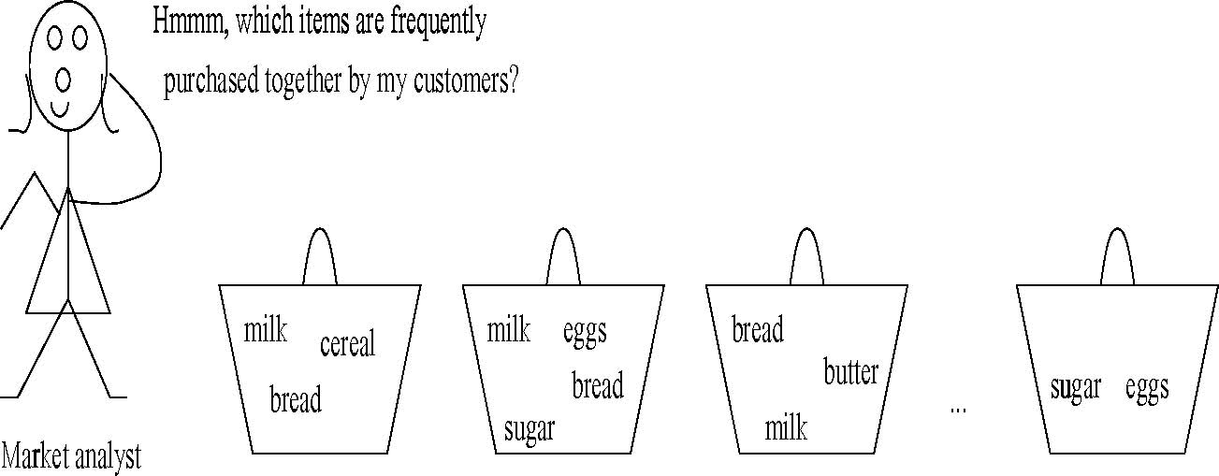
market basket analysis
SHOPPING BASKETS

Slide 7
Items and Transactions
  An item: an article in a basket, or an attribute-value pair
  A transaction: items purchased in a basket; it may have TID (transaction ID)
  A transactional dataset: A set of transactions

Slide 8
Itemsets and Association Rules
An itemset is a set of items.
  E.g., {milk, bread, cereal} is an itemset.
A k-itemset is an itemset with k items.
Given a dataset D, an itemset X has a (frequency) count in D.
An association rule is about relationships between two disjoint itemsets X and Y
X ⇒ Y
It presents the pattern when X occurs, Y also occurs

Slide 9
Use of Association Rules
Association rules do not represent any sort of causality or correlation between the two itemsets.
  X ⇒ Y does not mean X causes Y, so no Causality
  X ⇒ Y can be different from Y ⇒ X, unlike correlation
Notes:
A 100-year old furniture giant (W…) claimed bankruptcy, who started the brochure shopping in the US.

Slide 10

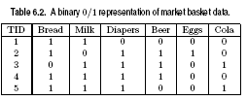
Market-Basket Transactions
Many business enterprises accumulate large quantities of data from their day-to-day operations.
For example, huge amounts of customer purchase data are collected daily at the checkout counters of grocery stores, as illustrated in the table, commonly known as Market-Basket Transactions.

Slide 11
Market-Basket Transactions
Retailers are interested in analyzing the data to learn about the purchasing behavior of their customers.
Such valuable information can be used to support a variety of business-related applications such as marketing promotions, inventory management, and customer relationship management.

Slide 12
Mining Association Rules
A common strategy adopted by many assiciation rule mining algs. is to decompose the problem into two major steps:
  Frequent Itemset Generation
    Generate (find) all itemsets whose support ≥ minsup
  Rule Generation
    Generate high confidence rules from each frequent itemset,
Frequent itemset generation is still computationally more expensive.

Slide 13
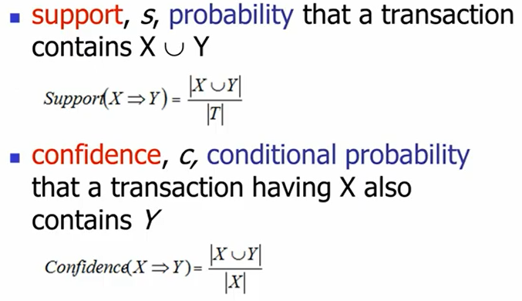
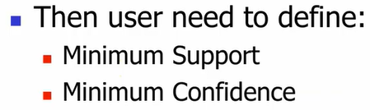
Association Rules: Support & Confidence
Support Count
Total # of Transactions
Total # of occurrences of X
Open: Support-Confidence-Lift-Simple-Example.ppt

Slide 14
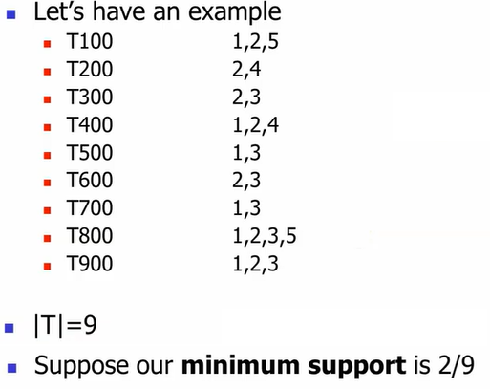
Association Rules: Support & Cofidence

Slide 15
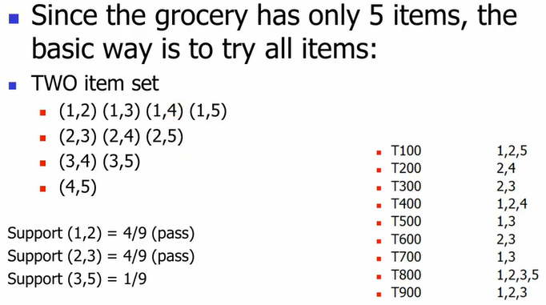
Association Rules: Support & Cofidence

Slide 16
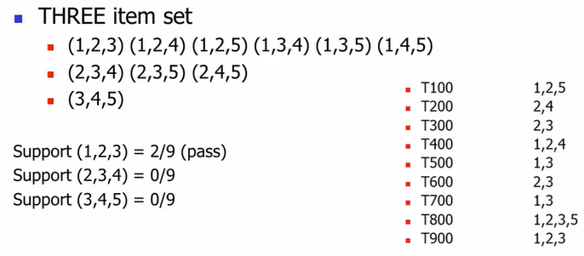
Association Rules: Support & Cofidence

Slide 17
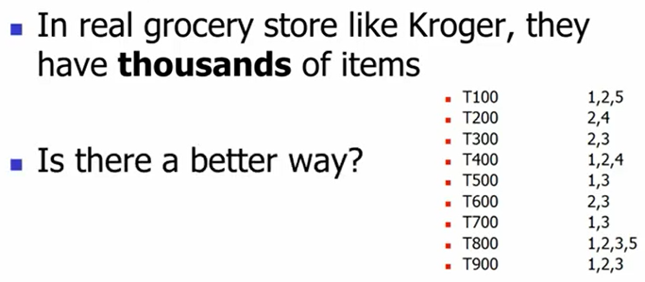
Association Rules: Support & Cofidence

Slide 18
Scalable Frequent Itemset Mining Methods
Apriori: A Candidate Generation-and-Test Approach
ECLAT: Frequent Pattern Mining with Vertical Data Format
FP-Growth (or FP-Tree): A Frequent Pattern-Growth Approach

Slide 19
The Apriori Algorithm (Pseudo-Code)
C_{k}: Candidate itemset of size k
L_{k} : frequent itemset of size k
L₁ = {frequent items};
for (k = 1; L_{k} !=∅; k++) do begin
C_{k+1} = candidates generated from L_{k};
for each transaction t in database do
  increment the count of all candidates in C_{k+1} that are contained in t
L_{k+1} = candidates in C_{k+1} with min_support
end
return ∪_{k} L_{k};

Slide 20


Illustrating Apriori Principle
Found to be Infrequent
Pruned supersets

Slide 21
Apriori Algorithm: Example
Table-1: Transactional Data
TID | List of item IDs
T100 | I1, I2, I5
T200 | I2, I4
T300 | I2, I3
T400 | I1, I2, I4
T500 | I1, I3
T600 | I2, I3
T700 | I1, I3
T800 | I1, I2, I3, I5
T900 | I1, I2, I3

Slide 22
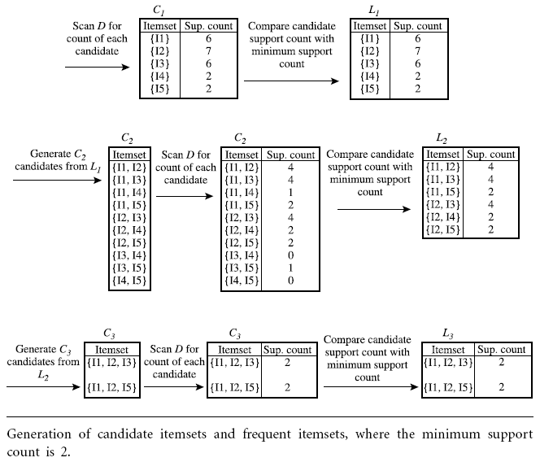
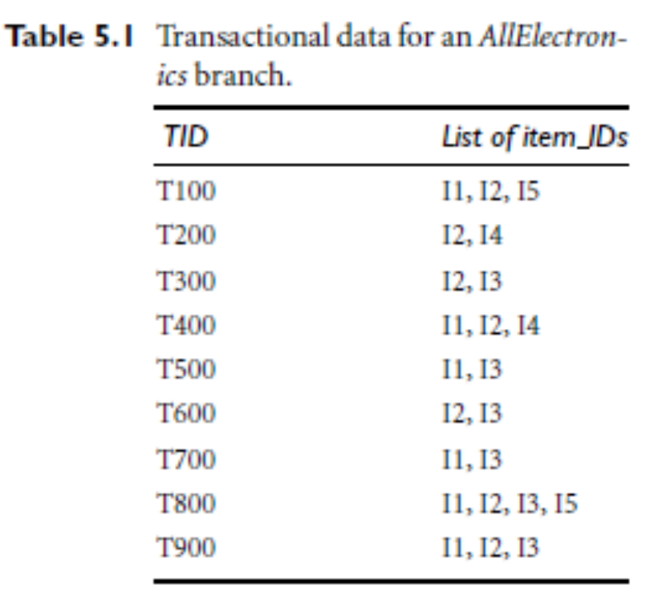

Slide 23
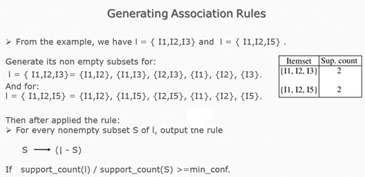
Apriori Algorithm: Generating Association Rules
https://www.youtube.com/watch?v=BpsLUSgnV7g&list=PLcwiPi5eRFbKmp5LexKI29U_xX81qcOvo&index=5

Slide 24
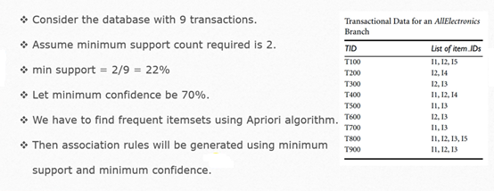
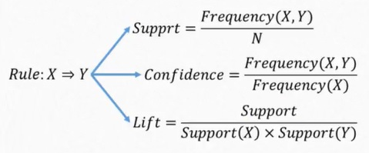
Apriori Algorithm: Generating Association Rules
https://www.youtube.com/watch?v=BpsLUSgnV7g&list=PLcwiPi5eRFbKmp5LexKI29U_xX81qcOvo&index=5

Slide 25
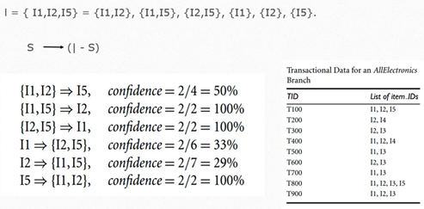
Apriori Algorithm: Generating Association Rules
If the minimum confidence threshold is, say, 70%, then only the second, third, and last rules are output, because these are the only ones generated that are strong.

Slide 26
Apriori Adv/Disadv
Advantages:
  Uses large itemset property.
  Pruning property
  Easy to implement.
Disadvantages:
Major computational challenges:
  Multiple scans of transaction database → Huge memory
  Huge number of candidates -> Computational Complexity

Slide 27
Apriori Algorithm
YouTube Watch
https://www.youtube.com/watch?v=BpsLUSgnV7g&list=PLcwiPi5eRFbKmp5LexKI29U_xX81qcOvo&index=2
Code: Apriori_items22.py

Slide 28
Improving Apriori’s Efficiency
“How can we further improve the efficiency of Apriori-based mining?”
Many variations of the Apriori algorithm have been proposed that focus on improving the efficiency of the original algorithm.
Several of these variations are summarized as follows:
ECLAT*: Frequent Pattern Mining with Vertical Data Format
FP-Growth (or FP-Tree): A Frequent Pattern-Growth Approach
*ECLAT :Equivalence CLASS Transformation.

Slide 29
Mining Frequent Itemsets Using Vertical Data Format
The Apriori method mine frequent patterns from a set of transactions in TID-itemset format ( {TID : itemset}),
where TID is a transaction-id and itemset is the set of items bought in transaction TID.
This data format is known as horizontal data format.
Alternatively, data can also be presented in item-TID set format (that is, {item : TID set}), where item is an item name, and TID set is the set of transactions. This format is known as vertical data format.
Notes:
A 100-year old furniture giant (W…) claimed bankruptcy, who started the brochure shopping in the US.

Slide 30
Mining Frequent Itemsets Using Vertical Data Format
Example: Consider the horizontal data format of the transaction database, D, of Table-1;
IT can be transformed into the vertical data format shown in Table-2 by scanning the data set once.
Notes:
A 100-year old furniture giant (W…) claimed bankruptcy, who started the brochure shopping in the US.

Slide 31
Mining Frequent Itemsets Using Vertical Data Format
Table-1: Transactional Data
TID | List of item IDs
T100 | I1, I2, I5
T200 | I2, I4
T300 | I2, I3
T400 | I1, I2, I4
T500 | I1, I3
T600 | I2, I3
T700 | I1, I3
T800 | I1, I2, I3, I5
T900 | I1, I2, I3

Slide 32
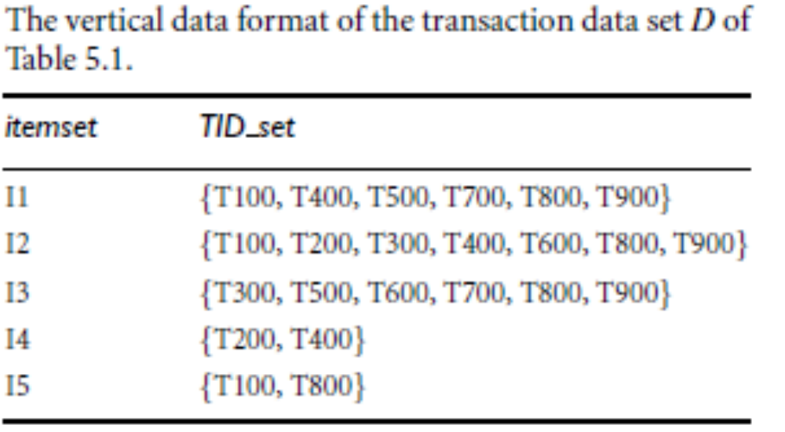
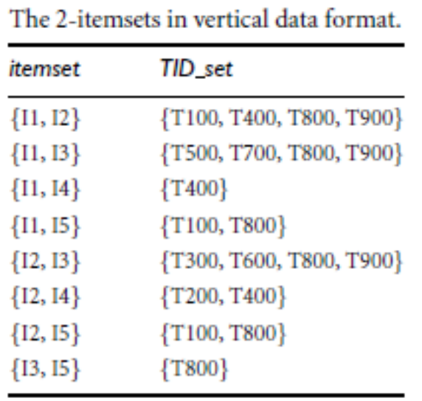
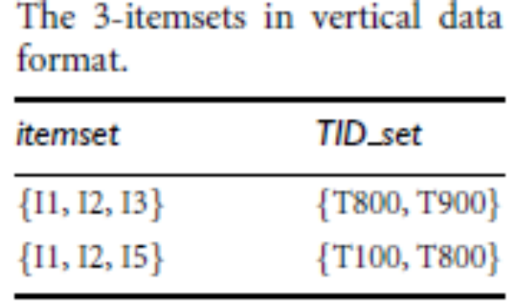
Mining Frequent Itemsets Using Vertical Data Format

Slide 33
Mining Frequent Itemsets Using Vertical Data Format
Advantages:
  The length of the TlD-lists shrinks as we progress to larger sized itemsets
Disadvantages:
The initial set of TlD-lists may be too large to fit into main memory.

Slide 34
Apriori (Vetical) Algorithm
YouTube Watch
https://www.youtube.com/watch?v=yR3y73fZMVI

Slide 35
Frequent Pattern-Growth (FP-growth)
Bottlenecks of the Apriori approach
  Breadth-first (i.e., level-wise) search
  Candidate generation and test
    Often generates a huge number of candidates
The FPGrowth Approach (J. Han, J. Pei, and Y. Yin, SIGMOD’ 00)
  Depth-first search
  Avoid explicit candidate generation
It compresses the database representing frequent items into a frequent-pattern tree, or FP-tree, which retains the itemset association information.

Slide 36

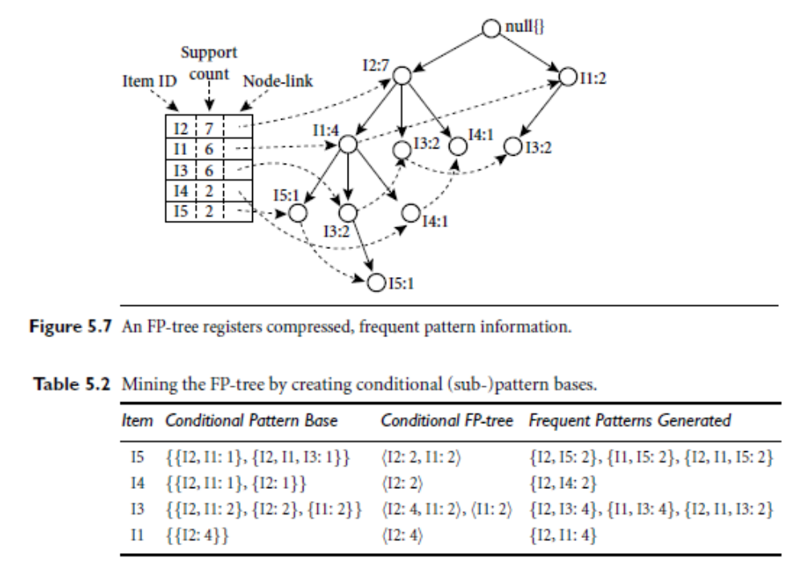

FP-growth: Example

Slide 37
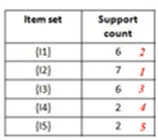
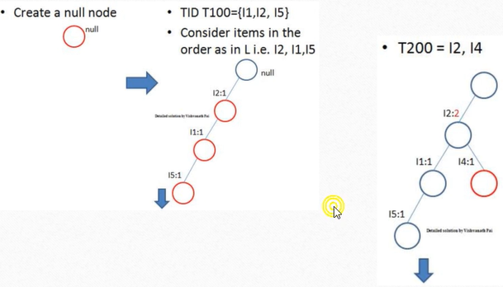
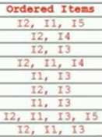
FP-growth: Example
https://www.youtube.com/watch?v=UbR1qXuIeJY&list=PLcwiPi5eRFbKmp5LexKI29U_xX81qcOvo&index=3

Slide 38
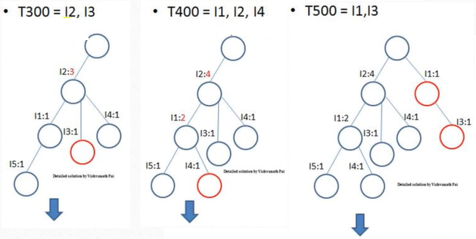
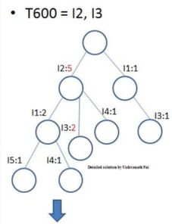
FP-growth: Example Cont.

Slide 39
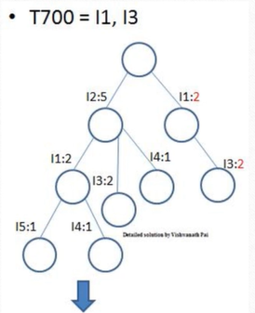
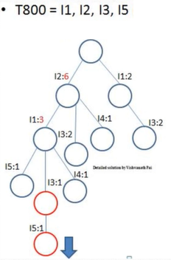
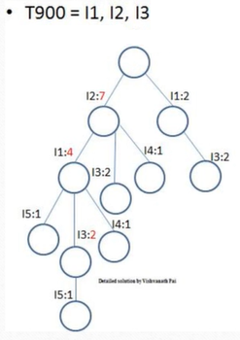
FP-growth: Example Cont.

Slide 40
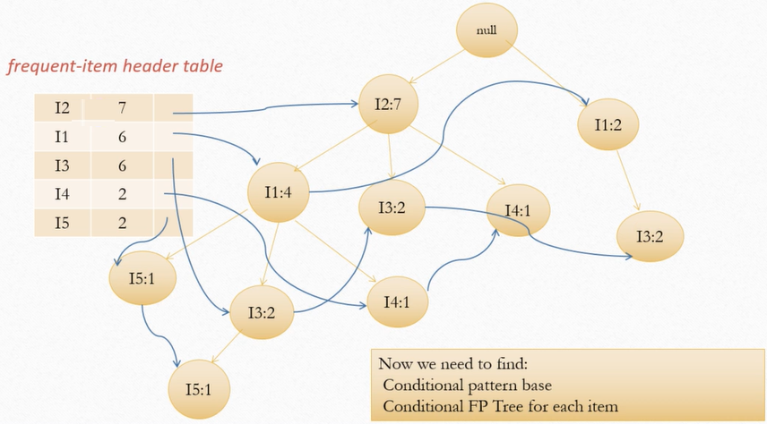
FP-growth: Example Cont.
https://www.youtube.com/watch?v=UbR1qXuIeJY&list=PLcwiPi5eRFbKmp5LexKI29U_xX81qcOvo&index=3

Slide 41
FP-growth: Example Fin

Slide 42
Benefits of the FP-tree Structure
Completeness
  Preserve complete information for frequent pattern mining
  Never break a long pattern of any transaction
Compactness
  Reduce irrelevant info—infrequent items are gone
  Items in frequency descending order: the more frequently occurring, the more likely to be shared
  Never be larger than the original database (not count node-links and the count field)

Slide 43
FP-growth: The Example in Details
YouTube Watch
https://www.youtube.com/watch?v=UbR1qXuIeJY&list=PLcwiPi5eRFbKmp5LexKI29U_xX81qcOvo&index=3

