Slide 1
Data Mining:
Concepts and Techniques
(3rd ed.)
— Classification —
Jiawei Han, Micheline Kamber, and Jian Pei
University of Illinois at Urbana-Champaign &
Simon Fraser University
©2011 Han, Kamber & Pei. All rights reserved.

Slide 2
Chapter 8. Classification
Classification: Basic Concepts

Slide 3
Classification: Formal Definition
Given a database D={t₁,t₂,…,t_{n}} and a set of classes C={C₁,…,C_{m}}, the Classification Problem is to define a mapping f:DC where each t_{i} is assigned to one class.
Actually divides D into equivalence classes.
Prediction is similar, but may be viewed as having infinite number of classes.

Slide 4
Classification—A Two-Step Process
Model construction: describing a set of predetermined classes
  Each tuple/sample is assumed to belong to a predefined class, as determined by the class label attribute
  The set of tuples used for model construction is training set
  The model is represented as classification rules, decision trees, or mathematical formulae
Model usage: for classifying future or unknown objects
  Estimate accuracy of the model
    The known label of test sample is compared with the classified result from the model
    Accuracy rate is the percentage of test set samples that are correctly classified by the model
    Test set is independent of training set, otherwise over-fitting will occur
  If the accuracy is acceptable, use the model to classify data tuples whose class labels are not known

Slide 5
Training, Test and Validation Sets
Training set: A set of examples used for learning, that is to fit the parameters of the classifier.
Test set: A set of examples used only to assess the performance of a fully-specified classifier.
Validation set: A set of examples used to tune the parameters of a classifier, for example to choose the number of hidden units in a neural network.

Slide 6



Process (1): Model Construction
Classification
Algorithms
Training
Data
Classifier
(Model)
IF rank = ‘professor’
OR years > 6
THEN tenured = ‘yes’

Slide 7




Process (2): Using the Model in Prediction
Classifier
Testing
Data
Unseen Data
(Jeff, Professor, 4)
Tenured?

Slide 8
Classification Examples
Teachers classify students’ grades as A, B, C, D, or F.
Identify mushrooms as poisonous or edible.
Predict when a river will flood.
Identify individuals with credit risks.
Speech recognition
Pattern recognition

Slide 9
Classification Ex: Grading
If x >= 90 then grade =A.
If 80<=x<90 then grade =B.
If 70<=x<80 then grade =C.
If 60<=x<70 then grade =D.
If x<50 then grade =F.
What is the grade for a new x?
  Classify x
x
<90
>=90
x
A
<80
>=80
x
B
<70
>=70
x
C
<50
>=60
F
D

Slide 10
Issues: Data Preparation
Data cleaning
  Preprocess data in order to reduce noise and handle missing values
Relevance analysis (feature selection)
  Remove the irrelevant or redundant attributes
Data transformation
  Generalize and/or normalize data

Slide 11
Issues: Evaluating Classification Methods
Accuracy
  classifier accuracy: predicting class label
  predictor accuracy: guessing value of predicted attributes
Speed
  time to construct the model (training time)
  time to use the model (classification/prediction time)
Robustness: handling noise and missing values
Scalability: efficiency in disk-resident databases
Interpretability
  understanding and insight provided by the model
Other measures, e.g., goodness of rules, such as decision tree size or compactness of classification rules

Slide 12
Issues: Underfitting and Overfitting
Underfitting and Overfitting are two factors that contribute to the poor performance of DM (machine learning) systems.
Underfitting occurs when a model has not learnt the patterns in the training data well and is unable to generalize adequately on the new data. An underfit model performs poorly on training data and produces incorrect predictions.
Overfitting occurs when a model performs exceptionally well on training data but poorly on test data (fresh data).

Slide 13
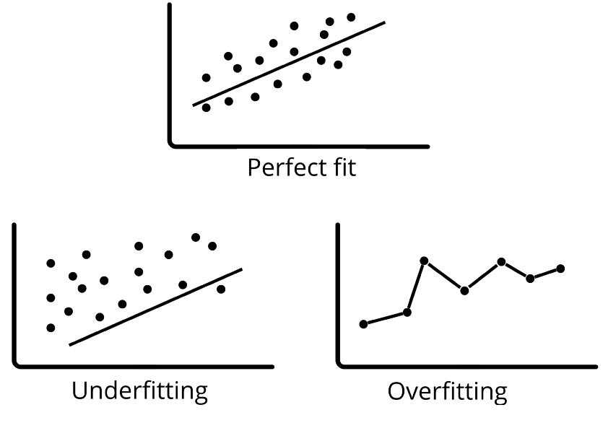
Issues: Underfitting and Overfitting

Slide 14
Issues: Underfitting and Overfitting
Reasons for underfitting
  Low variance and high bias
  The amount of the training dataset utilised is insufficient.
  The model is rather simplistic.
  raining data has not been cleaned and contains noise.
Techniques to reduce underfitting:
  Increase the model’s complexity.
  Expand the amount of features by undertaking feature engineering.
  Take out the noise from the data.
  To improve outcomes, increase the number of epochs or the period of training.

Slide 15
Issues: Underfitting and Overfitting
Reasons for overfitting
  Low bias and high variance
  The model is rather complicated.
  The amount of training data is insufficient
Techniques to reduce overfitting:
  Increase the training data.
  Model complexity should be reduced.
  Early termination during the training phase.
  Low bias and variance (check the following link)
  https://www.javatpoint.com/bias-and-variance-in-machine-learning#:~:text=High%2DBias%2C%20Low%2DVariance,underfitting%20problems%20in%20the%20model.

