Slide 1
Classification Algorithms: Part-2
Decision Tree Induction
Rule-Based Classification
Bayes Classification Methods
Model Evaluation and Selection
Classification and Feature Selection
Summary

Slide 2
Decision Tree Introduction
A decision tree is a structure that includes a root node, branches and leaf nodes.
Each internal node denotes a test on an attribute, each branch denotes the outcome of the test, and each leaf node holds a class label. The topmost node in the tree is the root node.
Benefits:
  Easy to comprehend
  Easy to interpret
  Provides a clear visualization of the algorithm

Slide 3

Decision Tree Induction: An Example
Training data set: Buys_computer
Resulting tree:
age?
<=30
overcast
>40
31..40
student?
yes
credit rating?
no
yes
excellent
fair
no
yes
no
yes

Slide 4
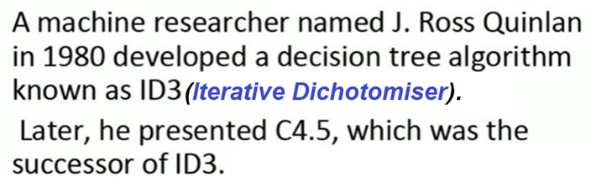
Decision Tree: History
https://www.youtube.com/watch?v=kJa_ad98KQ4&t=304s

Slide 5
Algorithm for Decision Tree Induction
Basic algorithm: a greedy algorithm (i.e. nonbacktracking)
  Tree is constructed in a top-down recursive divide-and-conquer manner
  At start, all the training examples are at the root
  Attributes are categorical (if continuous-valued, they are discretized in advance) age:
  Examples are partitioned recursively based on selected attributes
  Test attributes are selected on the basis of a heuristic or statistical measure (e.g., information gain)
31..40 -> mddle-aged

Slide 6
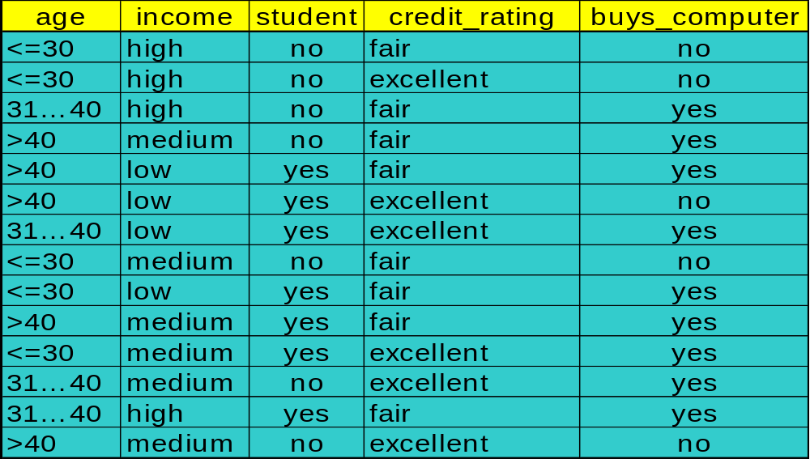
Attribute Selection: Information Gain
Class = Y: buys_computer = “yes”: (9)
Class = N: buys_computer = “no”: (5)

Slide 7



Attribute Selection Measure: Information Gain (Steps)
Let p_{i} be the probability that an arbitrary tuple in D belongs to class C_{i}, estimated by |C_{i, D}|/|D|; compute each of the following:
Expected information (entropy) for the entire data set, D:
Information (entropy) for each attribute, A, to split D into v categories in A)
Information gained by branching on attribute A:
Select the attribute with the highest information gain
Notes:
I : the expected information needed to classify a given sample
E (entropy) : expected information based on the partitioning into subsets by A

Slide 8
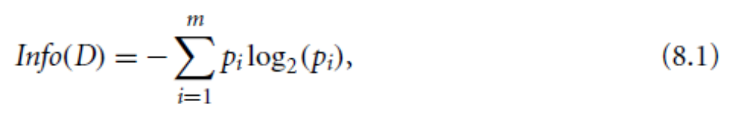
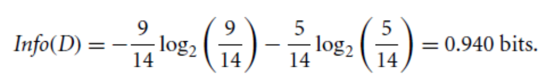
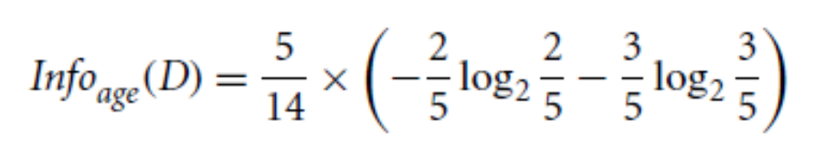
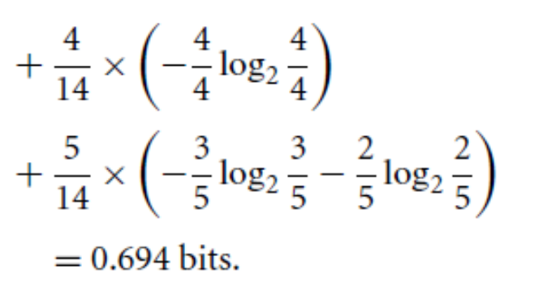
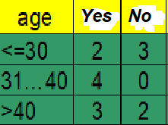
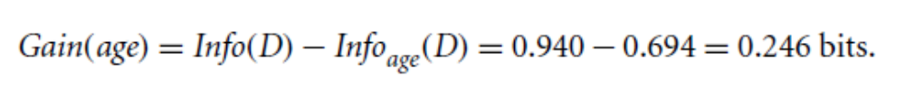
Attribute Selection: Information Gain
To find the splitting criterion for these tuples, we must compute the information gain of each attribute.
We first compute the expected information (entropy) needed to classify a tuple in D:
Next, we need to compute the expected information requirement for each attribute. Let’s start with the attribute age.
Hence, the gain in information from such a partitioning would be:

Slide 9
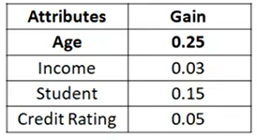
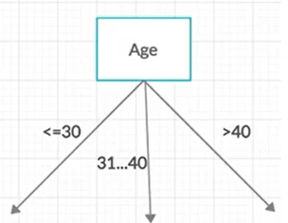
Attribute Selection: Information Gain
The attribute with the maximum gain
is selected as the splitting attribute

Slide 10
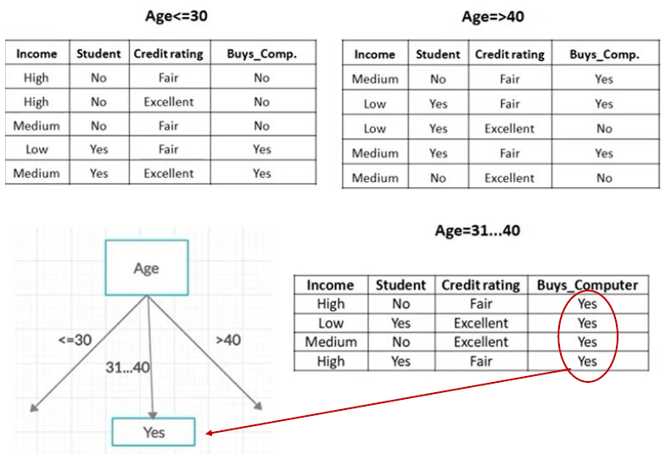
Attribute Selection: Information Gain
Continue for the rest of the attributes …

Slide 11
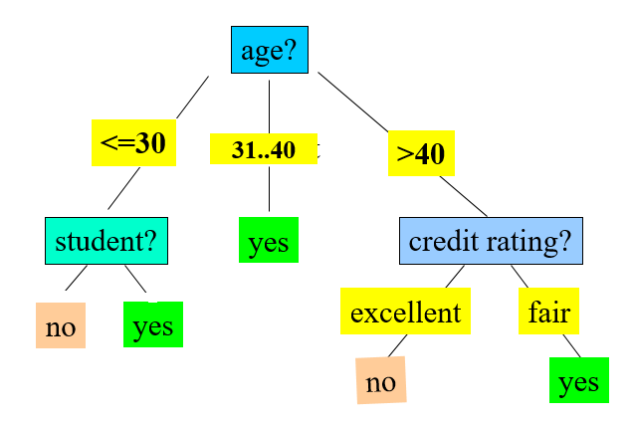
Attribute Selection: Information Gain: continued
Data to be classified:
X = (age <=30, Income = medium, Student = yes, Credit_rating = Fair)
To continue: https://www.youtube.com/watch?v=47MOP240lZs&list=PLS5J_kYlArq7NnTLozsMLdyAq8apovSdb&index=6

Slide 12

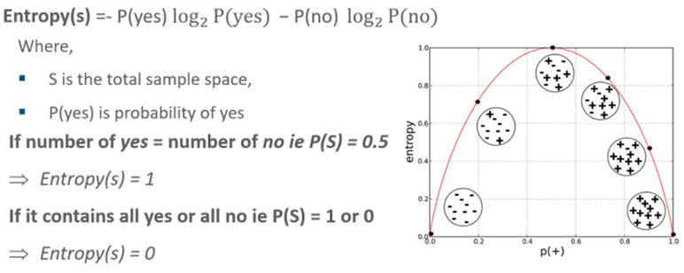
Brief Review of Entropy: some rules
Entropy is highest in the middle when the bubble is evenly split between positive and negative instances.

Slide 13
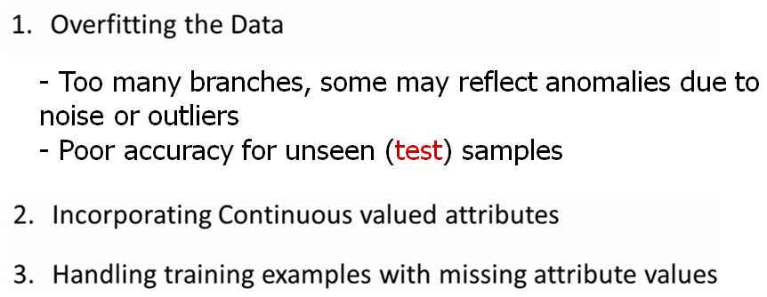
Issues in Decision Tree Learning

Slide 14
Random Forest

Slide 15
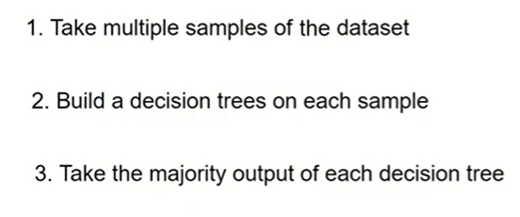
Random Forest algorithm steps

Slide 16
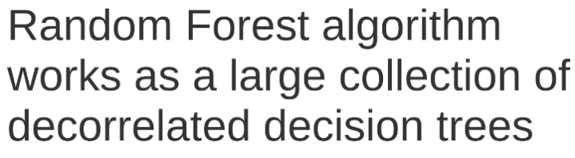
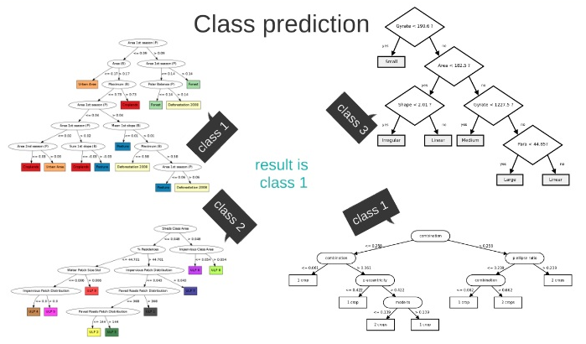
Random Forest algorithm Example
Voting
How Random Forest algorithm works: Thales Sehn Korting, 2019

Slide 17
Chapter 8. Classification: Basic Concepts
Classification: Basic Concepts
Decision Tree Induction
Rule-Based Classification
Bayes Classification Methods
Model Evaluation and Selection
Summary

Slide 18
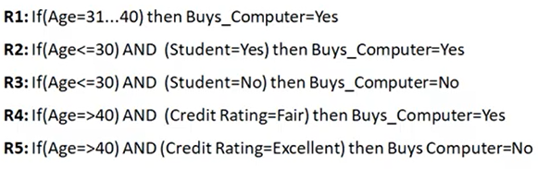
Rule Extraction from a Decision Tree
Rules are easier to understand than large trees
One rule is created for each path from the root to a leaf
Each attribute-value pair along a path forms a conjunction: the leaf holds the class prediction
age?
<=30
31..40
>40
student?
yes
credit rating?
no
yes
excellent
fair
no
yes
no
yes
Data to be classified:
X = (age <=30, Income = medium, Student = yes, Credit_rating = Fair)
Example: Rule extraction from our buys-computer decision-tree

Slide 19
Chapter 8. Classification: Basic Concepts
Classification: Basic Concepts
Decision Tree Induction
Rule-Based Classification
Bayes Classification Methods
Model Evaluation and Selection
Summary

Slide 20
Bayesian Classification: Why?
A statistical classifier: performs probabilistic prediction, i.e., predicts class membership probabilities
Foundation: Based on Bayes’ Theorem.
Performance: A simple Bayesian classifier, naïve Bayesian classifier, has comparable performance with decision tree and selected neural network classifiers
Incremental: Each training example can incrementally increase/decrease the probability that a hypothesis is correct — prior knowledge can be combined with observed data
Standard: Even when Bayesian methods are computationally intractable, they can provide a standard of optimal decision making against which other methods can be measured

Slide 21
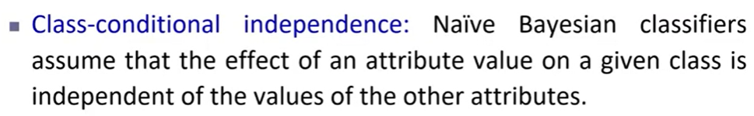

Bayesian Classification: Why?

Slide 22
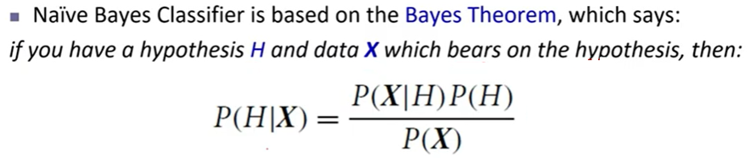
Bayes’ Theorem: Basics
  P(H): prior probability: the initial probability (Probability of hypothesis before observing the evidence).
    E.g., X will buy computer, regardless of age, income, …
  P(X): marginal Probability: probability that sample data is observed
  P(X|H): likelihood probability: the probability of observing the sample X, given that the hypothesis holds.
  P(H|X): posterior probability: Probability of hypothesis H on the observed event X.

Slide 23
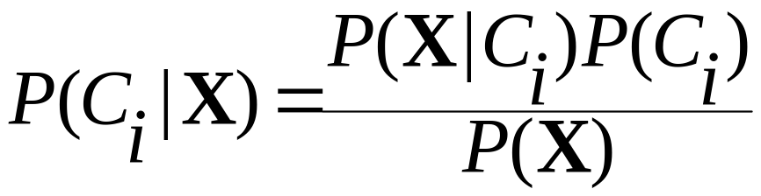

Classification Is to Derive the Maximum Posteriori
Let D be a training set of tuples and their associated class labels, and each tuple is represented by an n-D attribute vector X = (x₁, x₂, …, x_{n})
Suppose there are m classes C₁, C₂, …, C_{m}.
Classification is to derive the maximum posteriori, i.e., the maximal P(C_{i}|X)
This can be derived from Bayes’ theorem
Since P(X) is constant for all classes, only
  needs to be maximized

Slide 24

Naïve Bayes Classifier
A simplified assumption: attributes are conditionally independent (i.e., no dependence relation between attributes):
This greatly reduces the computation cost: only counts the class distribution.

Slide 25

Naïve Bayes Classifier: Training Dataset
Class:
C1:buys_computer = ‘yes’
C2:buys_computer = ‘no’
Data to be classified:
X = (age <=30,
Income = medium,
Student = yes
Credit_rating = Fair)

Slide 26
Naïve Bayes Classifier: An Example
P(C_{i}): P(buys_computer = “yes”) = 9/14 = 0.643
P(buys_computer = “no”) = 5/14= 0.357
Compute P(X|C_{i}) for each class
  P(age = “<=30” | buys_computer = “yes”) = 2/9 = 0.222
  P(age = “<= 30” | buys_computer = “no”) = 3/5 = 0.6

Slide 27
Naïve Bayes Classifier: An Example
P(C_{i}): P(buys_computer = “yes”) = 9/14 = 0.643
P(buys_computer = “no”) = 5/14= 0.357
Compute P(X|C_{i}) for each class
  P(age = “<=30” | buys_computer = “yes”) = 2/9 = 0.222
  P(age = “<= 30” | buys_computer = “no”) = 3/5 = 0.6
  P(income = “medium” | buys_computer = “yes”) = 4/9 = 0.444
  P(income = “medium” | buys_computer = “no”) = 2/5 = 0.4
  P(student = “yes” | buys_computer = “yes) = 6/9 = 0.667
  P(student = “yes” | buys_computer = “no”) = 1/5 = 0.2
  P(credit_rating = “fair” | buys_computer = “yes”) = 6/9 = 0.667
  P(credit_rating = “fair” | buys_computer = “no”) = 2/5 = 0.4
X = (age <= 30 , income = medium, student = yes, credit_rating = fair)
P(X|C_{i}) : P(X|buys_computer = “yes”) = 0.222 x 0.444 x 0.667 x 0.667 = 0.044
P(X|buys_computer = “no”) = 0.6 x 0.4 x 0.2 x 0.4 = 0.019
P(X|C_{i})*P(C_{i}) : P(X|buys_computer = “yes”) * P(buys_computer = “yes”) = 0.028
P(X|buys_computer = “no”) * P(buys_computer = “no”) = 0.007
Therefore, X belongs to class (“buys_computer = yes”)

Slide 28
Naïve Bayes Classifier: An Example
Watch:
https://www.youtube.com/watch?v=AvJWlwlz7Dw

Slide 29

Avoiding the Zero-Probability Problem
Naïve Bayesian prediction requires each conditional prob. be non-zero. Otherwise, the predicted prob. will be zero
Ex. Suppose a dataset with 1000 tuples, income=low (0), income= medium (990), and income = high (10)
Use Laplacian correction (or Laplacian estimator)
  Adding 1 to each case

Slide 30
Continuous-valued Problem
Naïve Bayesian works well on categorical values!
Suppose we have Continuous values?
We have 2 options:
Option1: Numerical variables need to be transformed to their categorical counterparts (binning) before construction their frequency tables.
Option2: is to use the distribution of the numerical variable to have good guess of the frequency.
  For example, one common practice is to assume normal distribution for numerical variables.

Slide 31

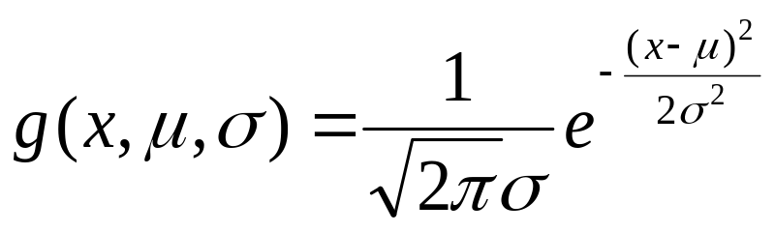
Naïve Bayes Classifier
If A_{k} is continuous-valued, P(x_{k}|C_{i}) is usually computed based on normal (Gaussian) distribution with a mean μ and standard deviation σ
  and P(x_{k}|C_{i}) is

Slide 32
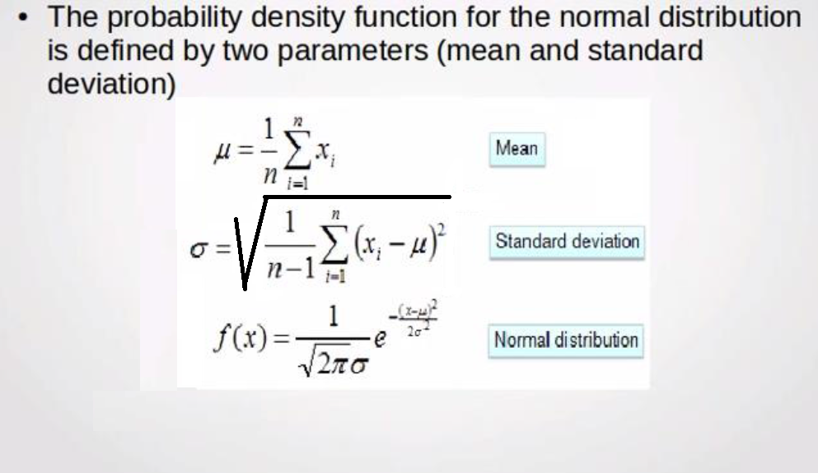
Normal (Gaussian) distribution

Slide 33
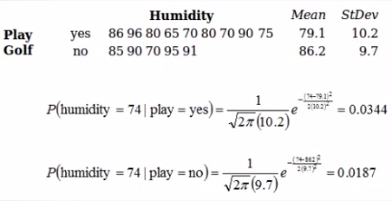
Example: Play Golf
Classify the value (74)?
Max
Watch this video:
https://www.youtube.com/watch?v=RPtYRm2tboA

Slide 34
Naïve Bayes Classifier: Comments
Advantages
  Easy to implement
  Good results obtained in most of the cases
Disadvantages
  Assumption: class conditional independence, therefore loss of accuracy
  Practically, dependencies exist among variables
    E.g., hospitals: patients: Profile: age, family history, etc.
      Symptoms: fever, cough etc., Disease: lung cancer, diabetes, etc.
    Dependencies among these cannot be modeled by Naïve Bayes Classifier

Slide 35
Chapter 8. Classification: Basic Concepts
Classification: Basic Concepts
Decision Tree Induction
Rule-Based Classification
Bayes Classification Methods
Model Evaluation and Selection
Summary

Slide 36
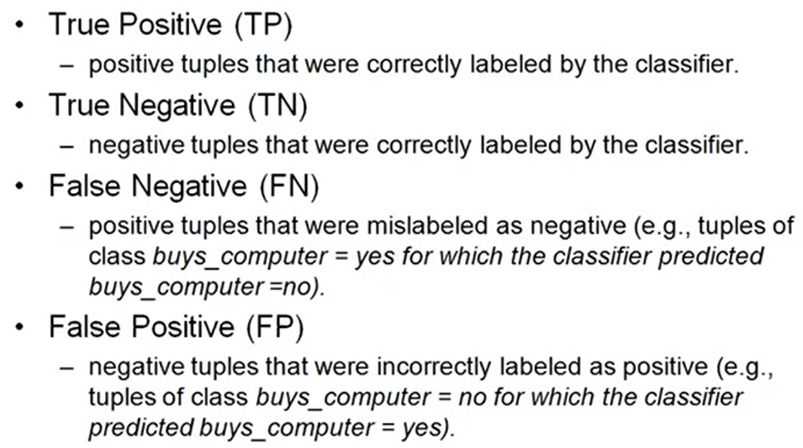
Classifier Evaluation Metrics: Confusion Matrix
Confusion Matrix:
Actual class\Predicted class | C1 | ¬ C1
C1 | True Positives (TP) | False Negatives (FN)
¬ C1 | False Positives (FP) | True Negatives (TN)

Slide 37
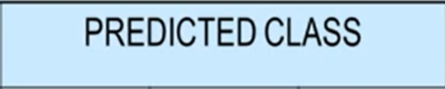
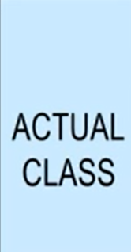
Classifier Evaluation Metrics: Confusion Matrix
Example of Confusion Matrix:
Actual class\Predicted class | buy_computer = yes | buy_computer = no | Total
buy_computer = yes | 6954 (TP) | 46 (FN) | 7000
buy_computer = no | 412 (FP) | 2588 (TN) | 3000
Total | 7366 | 2634 | 10000
May have extra rows/columns to provide totals

Slide 38
Classifier Evaluation Metrics: Accuracy, Error Rate, Sensitivity and Specificity
A\P | C | ¬C
C | TP | FN | P
¬C | FP | TN | N
 | P’ | N’ | All
Class Imbalance Problem:
  One class may be rare, e.g. fraud, or HIV-positive
  Significant majority of the negative class and minority of the positive class
  Sensitivity: True Positive recognition rate
    Sensitivity = TP/P
  Specificity: True Negative recognition rate
    Specificity = TN/N
Classifier Accuracy, or recognition rate: percentage of test set tuples that are correctly classified
  Accuracy = (TP + TN)/All
Error rate: 1 – accuracy, or
  Error rate = (FP + FN)/All

Slide 39



Classifier Evaluation Metrics:
Precision and Recall, and F-measures
Precision: exactness – what % of tuples that the classifier labeled as positive are actually positive
  Perfect score is 1.0
Recall: completeness – what % of positive tuples did the classifier label as positive?
Perfect score is 1.0
F measure (F₁ or F-score): harmonic mean of precision and recall,
Perfect F measure score = (2 * 1.0 * 1.0) / (1.0 + 1.0) = (2 * 1.0) / 2.0 = 1.0

Slide 40
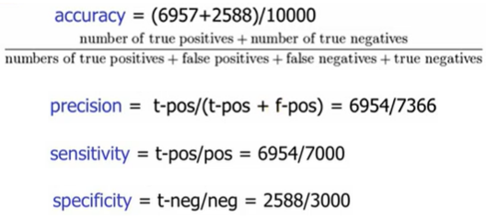
Classifier Evaluation Metrics:
Results for some measures:
= 95.45%
= 94.40%
= 99.34%
= 86.27%
Actual class\Predicted class | buy_computer = yes | buy_computer = no | Total
buy_computer = yes | 6954 (TP) | 46 (FN) | 7000
buy_computer = no | 412 (FP) | 2588 (TN) | 3000
Total | 7366 | 2634 | 10000

Slide 41
Classifier Evaluation Metrics
Very good videos:
Lecture 5-1: Classification- Basic Concepts, Descision Trees, and Model Evaluation(cc)
https://www.youtube.com/watch?v=R4FVgLxviLQ

Slide 42
Methods of Estimation
Holdout method
  Given data is randomly partitioned into two independent sets
    Training set (e.g., 2/3) for model construction
    Test set (e.g., 1/3) for accuracy estimation
    Random sampling: a variation of holdout
    Repeat holdout k times, accuracy = avg. of the accuracies obtained
Cross-validation (k-fold, where k = 10 is most popular)
  Randomly partition the data into k mutually exclusive subsets, each approximately equal size

Slide 43
Chapter 8. Classification: Basic Concepts
Classification: Basic Concepts
Decision Tree Induction
Rule-Based Classification
Bayes Classification Methods
Model Evaluation and Selection
Classification and Feature Selection
Summary

Slide 44
Classification and Feature Selection
Feature selection, the process of finding and selecting the most useful features in a dataset, is a crucial step of the machine learning pipeline.
Unnecessary features decrease training speed, decrease model interpretability, and, most importantly, decrease generalization performance on the test set.

Slide 45
Cheat Sheets for AI, Neural Networks, Machine Learning, Deep Learning & Big Data
https://becominghuman.ai/cheat-sheets-for-ai-neural-networks-machine-learning-deep-learning-big-data-678c51b4b463

Slide 46
Chapter 8. Classification: Basic Concepts
Classification: Basic Concepts
Decision Tree Induction
Rule-Based Classification
Bayes Classification Methods
Model Evaluation and Selection
Classification and Feature Selection
Summary

Slide 47
Summary
Classification is a form of data analysis that extracts models describing important data classes.
Effective and scalable methods have been developed for decision tree induction, Naive Bayesian classification, rule-based classification, and many other classification methods.
Evaluation metrics include: accuracy, sensitivity, specificity, precision, recall, F measure, and F_{ß} measure.

