Slide 1
Classification & Prediction

Slide 2
Prediction
“What if we would like to predict a continuous value, rather than a categorical label?”
Numeric prediction is the task of predicting continuous (or ordered) values for given input.
For example, we may wish to predict the salary of college graduates with 10 years of work experience, or the potential sales of a new product given its price.

Slide 3
Prediction
By far, the most widely used approach for numeric prediction (hereafter referred to as prediction) is regression, a statistical methodology that was developed by Sir Frances Galton (1822– 1911), a mathematician who was also a cousin of Charles Darwin.
In fact, many texts use the terms “regression” and “numeric prediction” synonymously.

Slide 4
Classification and Prediction?
(Numerical) prediction is similar to classification
  construct a model
  use model to predict continuous or ordered value for a given input
Prediction is different from classification
  Classification refers to predict categorical class label
  Prediction models continuous-valued functions
Major method for prediction: regression
  model the relationship between one or more independent or predictor variables and a dependent or response variable
Regression analysis
  Linear and multiple linear regression
  Non-linear regression
  Other regression methods: generalized linear model, Poisson regression, log-linear models, regression trees

Slide 5
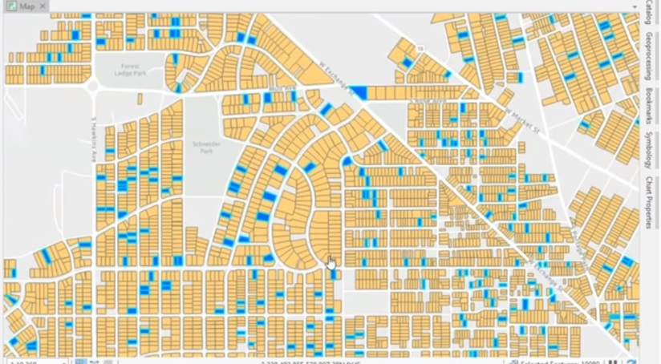
Regression: Example
Forecasting the price of real estate in Ohio: the price is collected for the houses in “blue” (10% of all houses). So, we need to build a model that will predict the prices for all houses.
https://www.youtube.com/watch?v=bau-WFw1HpQ

Slide 6
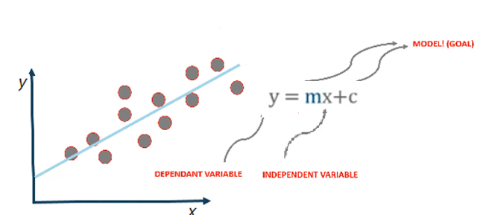
Linear Regression
https://www.youtube.com/watch?v=E5RjzSK0fvY

Slide 7
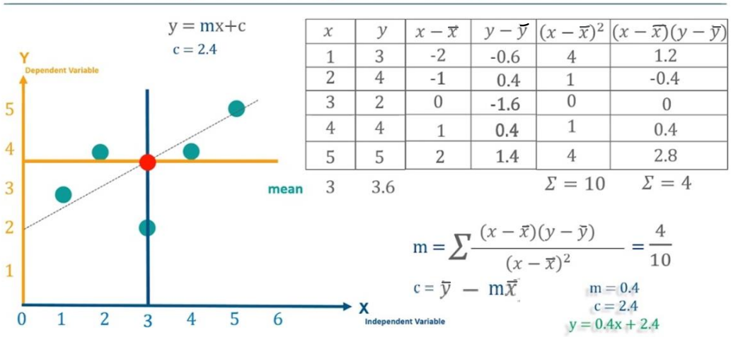
Linear Regression Example
https://www.youtube.com/watch?v=E5RjzSK0fvY

Slide 8
Linear Regression
Evaluating Regression Models

Slide 9
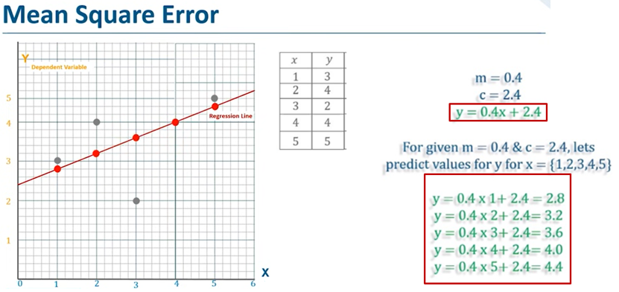
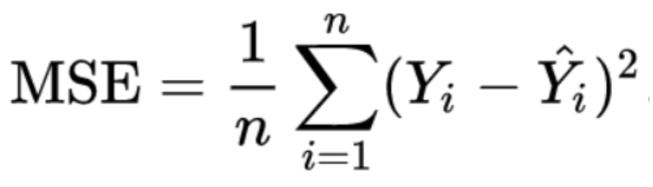

Linear Regression: Evaluation
y = Actual value, ŷ = Predicted value

Slide 10
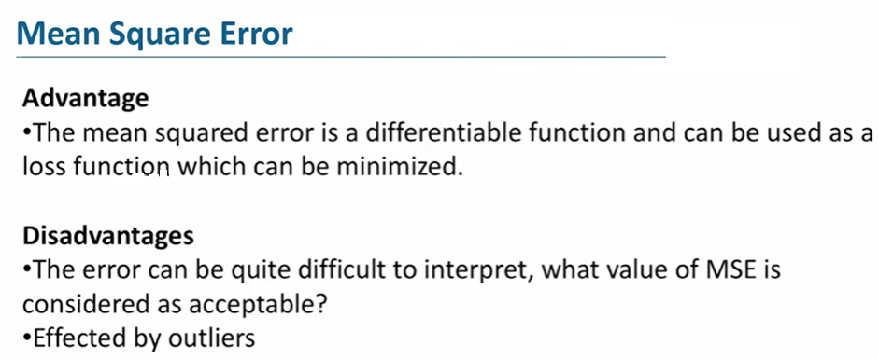
Linear Regression: Evaluation

Slide 11
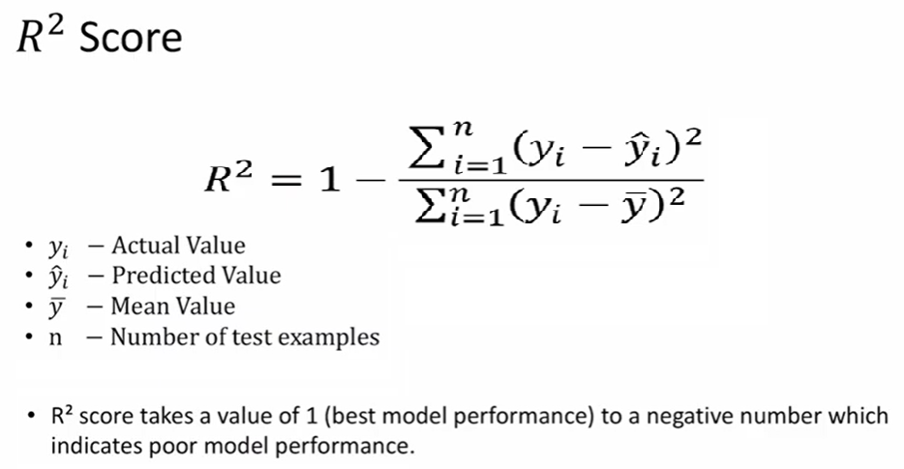
Linear Regression: Evaluation

Slide 12
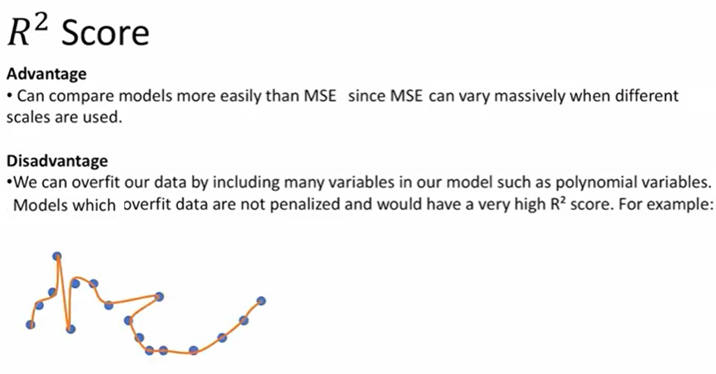
Linear Regression: Evaluation

Slide 13


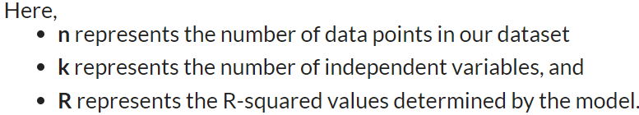
Linear Regression: Evaluation
The Adjusted R-squared takes into account the number of independent variables used for predicting the target variable. In doing so, we can determine whether adding new variables to the model actually increases the model fit.
Adjusted R² is always less than or equal to R². A value of 1 indicates a model that perfectly predicts values in the target field. A value that is less than or equal to 0 indicates a model that has no predictive value. In the real world, adjusted R² lies between these values.

Slide 14
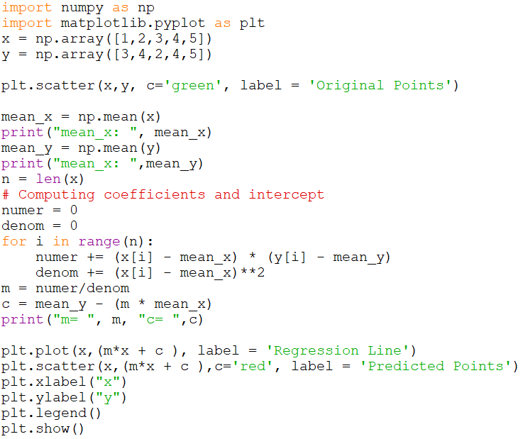
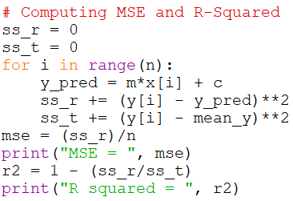

Linear Regression: Python Code

Slide 15
Linear Regression
Video and Python Exercise:
https://www.youtube.com/watch?v=8jazNUpO3lQ
Evaluating Regression Models:
https://python.plainenglish.io/evaluating-regression-models-cb02ba075e16

