Slide 1
Clustering part-1

Slide 2
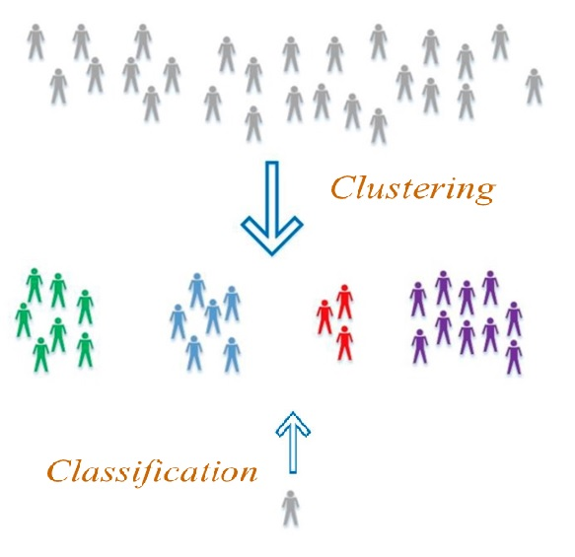
Clustering vs Classification

Slide 3
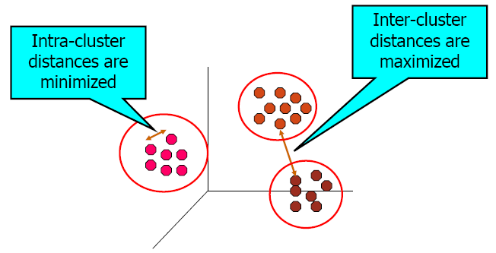
Clustering: Introduction
Clustering plays an important role in a wide variety of fields including data mining, artificial intelligence, pattern recognition, and medical sciences.
The goal of clustering is to discover the natural groups (or clusters) of objects in data sets.
The objects in a group will be similar (or related) to one another and different from (or unrelated to) the objects in other groups

Slide 4
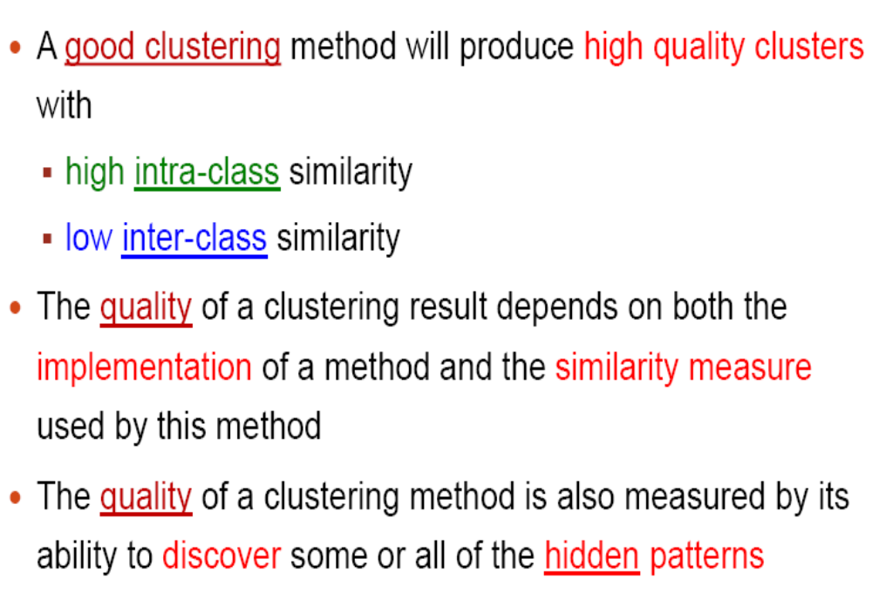
Clustering Issues

Slide 5
Types of Clustering methods
Existing clustering methods can be classified into 5 categories:
Partitioning Methods
Hierarchical Methods
Density-Based Methods
Grid-Based Methods
Model-Based Methods

Slide 6
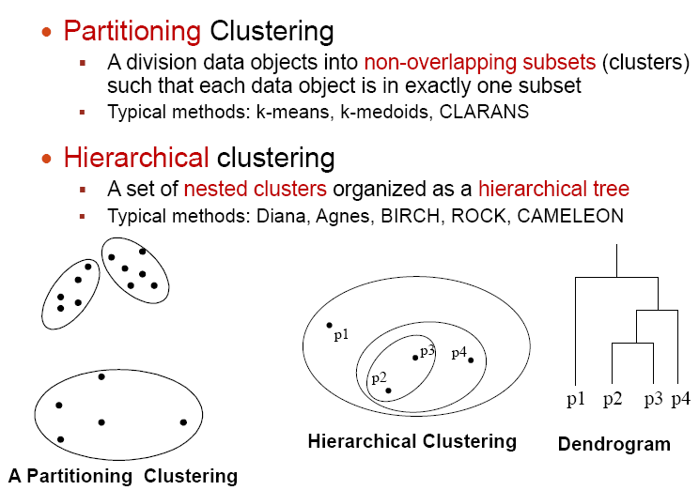
Types of Clustering methods

Slide 7
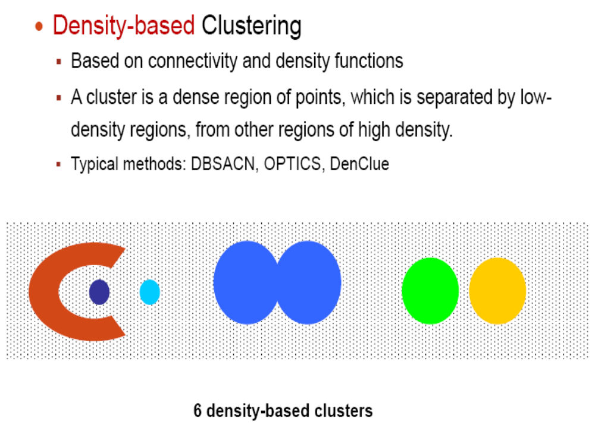
Types of Clustering methods

Slide 8
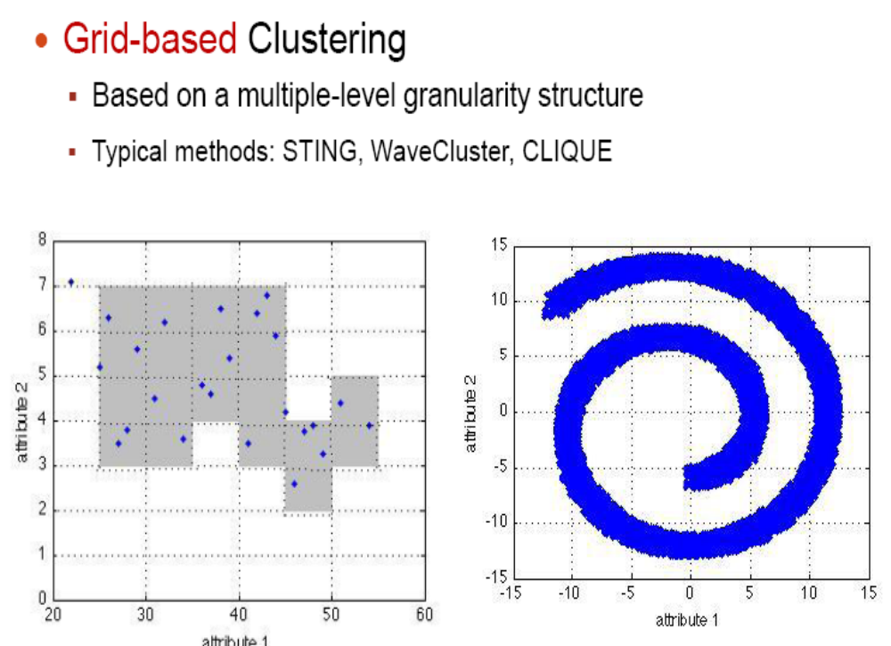
Types of Clustering methods

Slide 9
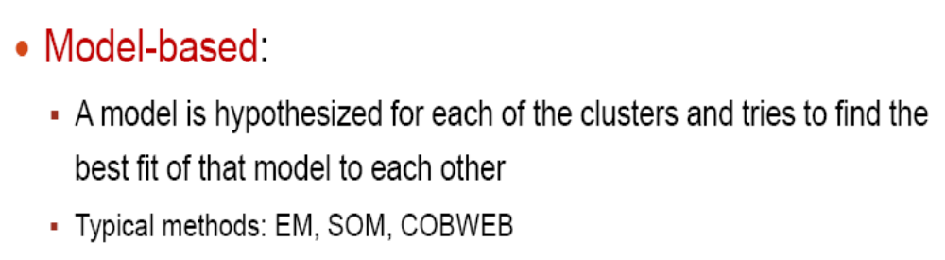
Types of Clustering methods

Slide 10
Types of Clustering methods
Existing clustering methods can be classified into 5 categories:
Partitioning Methods
Hierarchical Methods
Density-Based Methods
Grid-Based Methods
Model-Based Methods

Slide 11
Partitioning Clustering
It has been reported that the clusters produced by a partitioning method are of high quality.
Therefore, developing partitioning methods has been one of the main focuses of cluster analysis research and many partitioning methods have been developed based on k-means, fuzzy clustering methods or k-medoids.
These methods try to find a “good” partitioning in the sense that objects in the same cluster are close or related to each other, while objects of different clusters are far or different from each other.

Slide 12
K-Means Clustering Method (Algorithm)
The k-means algorithm starts with a random initial partition and keeps reassigning the objects to clusters based on the similarity between the objects and the cluster centers until there is no reassignment of any object from one cluster to another.

Slide 13
K-Means Example: how it works
Go to k-means.ppt

Slide 14

K-Means Algorithm
Number of clusters, K, must be specified
Each cluster is associated with an averaged point called cluster center (or centroid)
Each point is assigned to the cluster with the closest centroid
The basic algorithm is very simple:

Slide 15
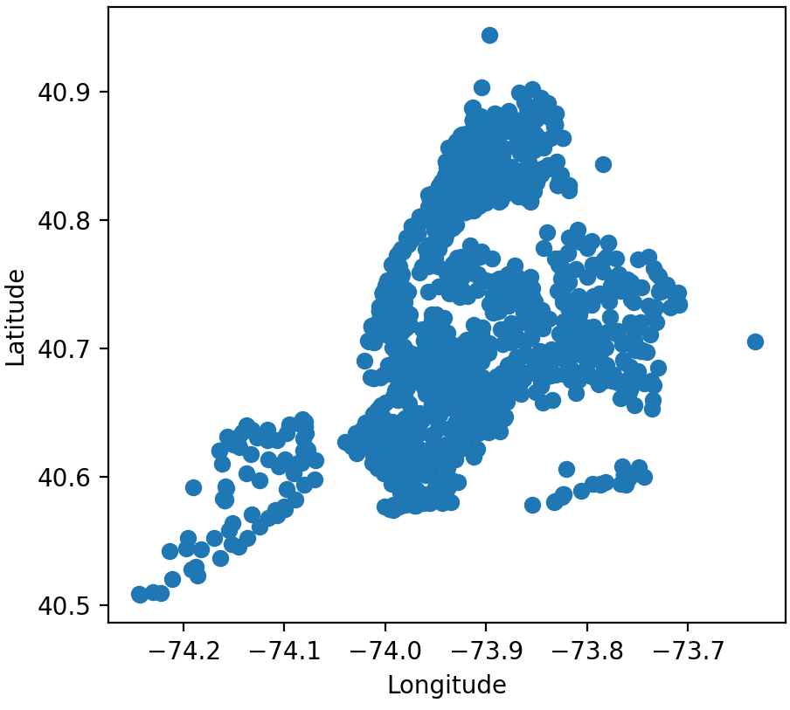
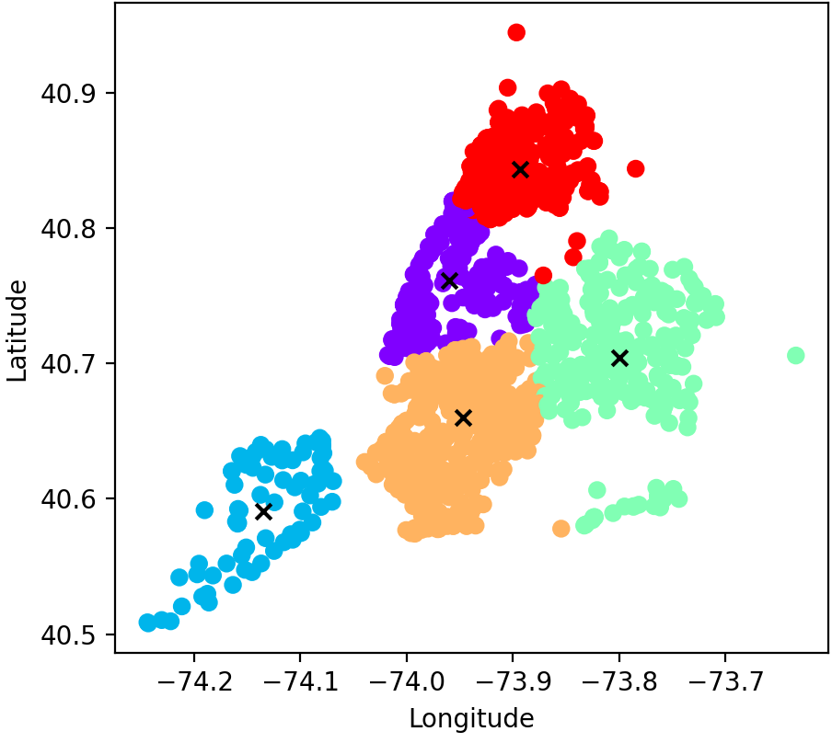
K-Means: Pyhton Example
K-Means NY-Public-Schools:
k-means-NY-LonLat-Dspaly-Data.py & k-means-NY-LonLat-Save-LABELS.py
Run: ArcGIS-NY-Schools-CSV-Layer-Labels-Centroids.html
Run: k-means-NY-LonLat-Save-LABELS-Folium-dist.html

Slide 16
K-Means: closest centroids via Distances
Distances: calculate similarity and dissimilarity between data points.
Manhattan distance is calculated as:
|x1 — x2| + |y1 — y2|,
Euclidean distance is computed as:
square root of (x1 — x2)² + (y1 — y2)².
The smaller the distance, the more similarity between each instance. The larger the distance, the less similarity the instances share.

Slide 17
K-Means: Example - 1D
Given the data set {2, 4, 10, 12, 3, 20, 30, 11, 25}; (N = 9)
Apply k-means alg. with k=2, initial centroids:{m1 = 2, m2 = 4}, using Manhattan distance.
Iter-1: compute distances and find the clusters:
Data Set (D) | 2 | 4 | 10 | 12 | 3 | 20 | 30 | 11 | 25
d(D,m1) 2 | 0 | 2 | 8 | 10 | 1 | 18 | 28 | 9 | 23
d(D,m2) 4 | 2 | 0 | 6 | 8 | 1 | 16 | 26 | 7 | 21
C1 = {2, 3};
C2 = {4, 10, 12, 20, 30, 11, 25};

Slide 18
K-Means: Example - 1D
Iter-2
m1 = (2 + 3)/2 = 2.5
m2 = (4 +10 + 12 + 20 + 30 + 11 + 25)/7 = 16
Data Set (D) | 2 | 4 | 10 | 12 | 3 | 20 | 30 | 11 | 25
d(D,m1) 2.5 | 0.5 | 1.5 | 7.5 | 9.5 | 0.5 | 17.5 | 29.5 | 8.5 | 22.5
d(D,m2) 16 | 14 | 12 | 6 | 4 | 13 | 4 | 14 | 5 | 5
C1 = {2, 4, 3};
C2 = {10, 12, 20, 30, 11, 25};

Slide 19
K-Means: Example - 1D
Iter-3
m1 = (2 + 3 + 4)/3 = 3
m2 = (10 + 12 + 20 + 30 + 11 + 25)/6 = 18
Data Set (D) | 2 | 4 | 10 | 12 | 3 | 20 | 30 | 11 | 25
d(D,m1) 3 | 1 | 1 | 7 | 9 | 0 | 17 | 27 | 8 | 22
d(D,m2) 18 | 16 | 14 | 8 | 6 | 15 | 2 | 12 | 7 | 7
C1 = {2, 4, 10, 3};
C2 = {12, 20, 30, 11, 25};

Slide 20
K-Means: Example - 1D
Iter-4
m1 = (2 + 4 + 10 + 3)/4 = 4.75
m2 = (12 + 20 + 30 + 11 + 25)/5 = 19.6
Data Set (D) | 2 | 4 | 10 | 12 | 3 | 20 | 30 | 11 | 25
d(D,m1) 4.47
d(D,m2) 19.6
Continue …

Slide 21
K-Means: Example - 1D
Repeat the process until no change in m1 and m2
Final results:
C1 = {2, 4, 10, 12, 3, 11};
C2 = {20, 30, 25};
m1 = (2 + 4 + 10 + 12 + 3 + 11)/6 = 7
m2 = (20 + 30 + 25)/3 = 25

Slide 22
K-Means: Example - 2D
2-D example:
Unsupervised Learning: Introduction to K-mean Clustering
https://www.youtube.com/watch?v=_S5tvagaQRU&list=PLTrfnl2vPj4q_6th1fe9N5DDVAVHxSyjs&index=7

Slide 23
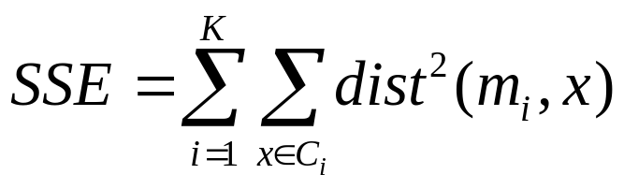
Evaluating K-means Clusters
Most common measure is Sum of Squared Error (SSE)
  For each point, the error is the distance to the nearest cluster
  To get SSE, we square these errors and sum them.
  x is a data point in cluster C_{i} and m_{i} is the representative point for cluster C_{i}
    can show that m_{i} corresponds to the center (mean) of the cluster
  Given two sets of clusters, we prefer the one with the smallest error
  One easy way to reduce SSE is to increase K, the number of clusters
    A good clustering with smaller K can have a lower SSE than a poor clustering with higher K

Slide 24
K-Means: Advantages and Disadvantages
Advantages
Relatively simple to implement.
Scales to large data sets.
Guarantees convergence.
Easily adapts to new examples.
Disadvantages
Dependent on initial values (clusters).
Number of clusters (How many clusters-K).
Sensitive to outliers.

Slide 25
Solutions to Initial Centroids Problem
Multiple runs
select the one with smallest Sum of Square Error (SSE)
Sample and use hierarchical clustering to determine initial centroids
Select more than k initial centroids and then select among these initial centroids the most widely separated
Other methods …

Slide 26
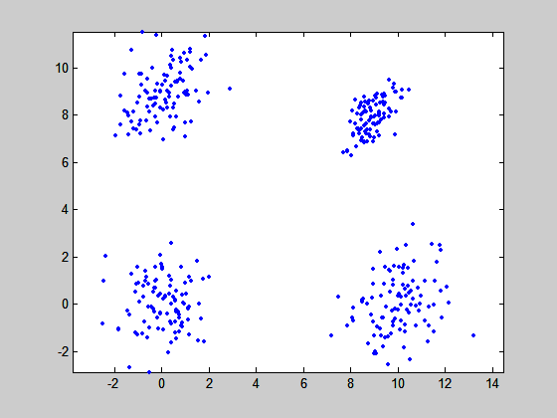
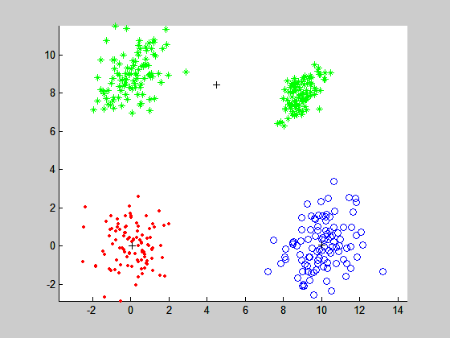
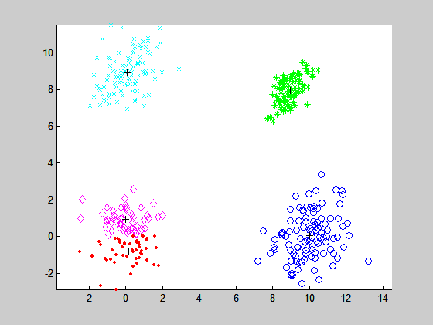
How many clusters?
K=?
K=3 K=5
K=4

Slide 27
Solutions to Number Of Classes (k) Problem
Subjective judgement from the analyst
Empirical method
  # of clusters ≈√n/2 for a dataset of n points
Elbow method
Other methods (eg. Silhouette coefficient)

Slide 28
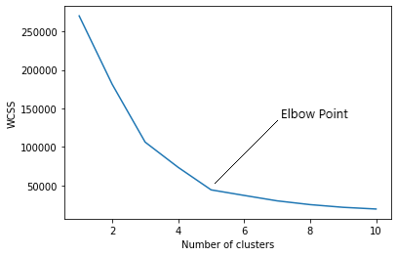
Solutions to Number Of Classes (k) Problem
Elbow method through WCSS:
WCSS — within-cluster sum of squares
= Sum of the distance of each point from the center

Slide 29
Solutions to Number Of Classes (k) Problem
Silhouette coefficient
Silhouette coefficient measures the quality of a clustering and determines how each point lies within its cluster. It measures cluster cohesion which is the space between clusters and cluster separation.
The silhouette coefficient can vary between –1 and +1.
A coefficient close to +1 means that the instance is well inside its own cluster and far from other clusters, while a coefficient close to 0 means that it is close to a cluster boundary, and finally a coefficient close to –1 means that the instance may have been assigned to the wrong cluster.

Slide 30
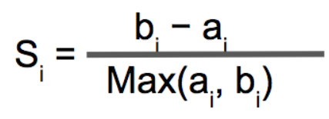
Solutions to Number Of Classes (k) Problem
Silhouette coefficient
silhouette coefficient is calculated as:
Where,
S(i): The silhouette coefficient of i th instance.
a(i): The mean distance of a point i to all other points in the same cluster; if a(i) is small, cluster cohesion is good, as all of the points are close together.
b(i): The mean distance of a point i to the instances of the closest cluster; if b(i) is large, cluster separation is good, as the nearest cluster is far apart.
If a(i) is small and b(i) is large, the Silhouette Coefficient is high.

Slide 31
Solutions to Number Of Classes (k) Problem
Silhouette coefficient
The Silhouette Score is calculated by getting the mean of the Silhouette Coefficients over all the instances.
The value of k that yields the highest Silhouette Score is known as the optimal k.

Slide 32
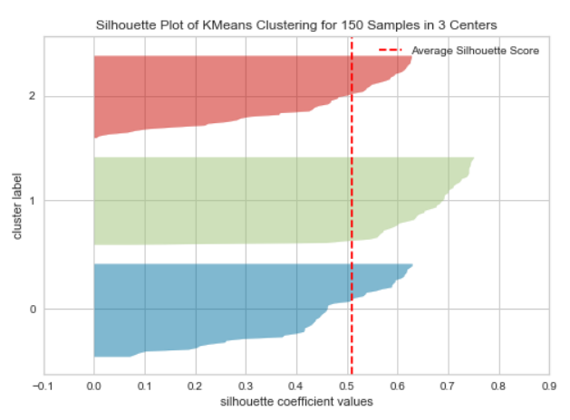
Solutions to Number Of Classes (k) Problem
Silhouette diagram
The Silhouette diagram contains one knife shape per cluster:
The width of a knife shape
represents the number of
instances in the cluster.
The bar length represents
the Silhouette Coefficient
for each instance.
The dashed line indicates
the average silhouette score.
https://towardsdatascience.com/4-useful-clustering-methods-you-should-know-in-2021-ac61301e968e

Slide 33
K-Means: Pyhton Example
k-means-2D-Plot.py

Slide 34
Hard vs. soft clustering
Hard clustering: Each document belongs to exactly one cluster
  More common and easier to do
Soft clustering: A document can belong to more than one cluster.

Slide 35
Fuzzy C-Means Algorithm
The Fuzzy C-means Clustering (FCM) algorithm is a data clustering algorithm in which each data point belongs to a cluster to a degree specified by a membership grade.
“fuzzy” here means “not sure”, which indicates that it’s a soft clustering method.
A Fuzzy clustering algorithms have been the subject of intensive research during the past three decades. The Fuzzy C-Means algorithm (FCM) is the best known and the most widely used fuzzy clustering techniques.

Slide 36
Fuzzy C-Means Algorithm
The FCM algorithm determines the cluster centers c_{i} and the membership matrix U using the following steps:
Step [1]: Initialize the membership matrix U with random values between 0 and 1 such that the constraints in Equation (1) are satisfied.
Step [2]: Calculate c fuzzy cluster centers c_{i}, i = 1, …, c, using Equation (3).
Step [3]: Compute the objective function according to Equation (2). Stop if either it is below a certain tolerance value or its improvement over previous iteration is below a certain threshold, ε.
Step [4]: Compute a new U using Equation (4). Go to step 2.
The time complexity of the FCM algorithm is estimated as O(nk2) for each iteration, where n is the number of objects and k is the number of fuzzy clusters.

Slide 37
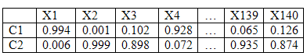
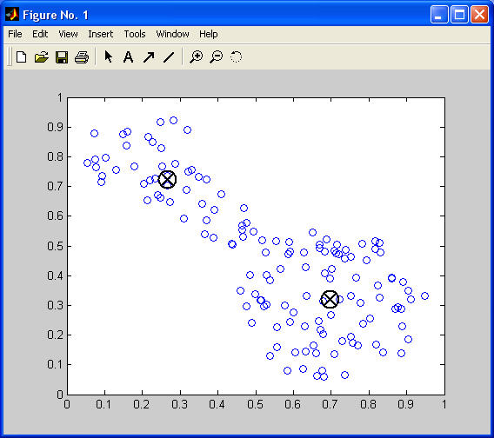
Fuzzy C-Means Example: 2 clusters
To illustrate the FCM algorithm, we consider the data set fcmdata.dat of the MATLAB package that consists of 140 points in R2.
Assume that we want to determine a fuzzy partition with two clusters (i.e., C = 2). Then we obtain part of the U matrix shown in the Table

Slide 38
K-medoid methods
K-medoid methods are partitioning clustering methods that partition a data set into k groups or clusters.
K objects are selected, which are centrally located (or optimal representative objects) in the constructed clusters, called medoids, and the clustering method is called
k-medoid method.
various k-medoids methods have been published
PAM: k-medoid
CLARA : PAM on samples
CLARANS: Randomized re-sampling
K-medoid methods use real objects to represent the clusters
Initial Medoids

Slide 39
Partitioning Around Medoids (PAM)
the Partitioning Around Medoids (PAM) method starts by selecting an initial set of medoids and iteratively replaces each one of the selected medoids by one of the non-selected medoids in the data set as long as the sum of dissimilarities between the objects and their closest medoids is improved.
The process is iterated until the criterion function converges.

Slide 40
PAM Alg.
  Given k
  Randomly pick k instances as initial medoids
  Assign each instance to the nearest medoid x
  Calculate the objective function
    the sum of dissimilarities of all instances to their nearest medoids
  Randomly select an instance y
  Swap x by y if the swap reduces the objective function for all x
  Repeat (3-6) until no change

Slide 41
PAM: Example
YouTube:
Clustering: Limitations of K-means, K-Medoids, DBSCAN:
https://www.youtube.com/watch?v=sUzuNK0OVFw

Slide 42
PAM
Strength
PAM is more robust than k-means in the presence of noise and outliers because a medoid is less influenced by outliers or other extreme values than a mean
Weakness
PAM works efficiently for small data sets but does not scale well for large data sets.
  O(k(n-k)² ) for each iteration
where n is # of data,k is # of clusters

Slide 43
CLARA
Other partitioning methods based on PAM were published, such as CLARA and CLARANS.
CLARA (Clustering Large Applications) creates multiple samples of objects randomly from the entire data set and then applies PAM to each of the samples.
CLARA requires multiple scans of the entire data set, which ends up in an extra CPU time.
Strength: deals with larger data sets than PAM
Weakness:
  Efficiency depends on the sample size
  A good clustering based on samples will not necessarily represent a good clustering of the whole data set if the sample is biased

Slide 44
CLARANS
The CLARANS (Clustering Large Applications based on Randomized Search) method stems from the work done on PAM and CLARA.
It relies on a randomized search of a graph to find the medoids which represent the clusters.
Strength : More efficient and scalable than both PAM and CLARA
Weakness:
It has been reported that the CLARANS method has a high time complexity, estimated as O(n2) for each iteration.
In addition, it has been reported that the deficiency of the method is that it does not function well when high dimensional data is applied.

