Slide 1
Clustering-2
Hierarchical Clustering

Slide 2
Hierarchical Clustering
Hierarchical Clustering techniques are a second important category of clustering methods.
As with K-means, these approaches are relatively old compared to many clustering algorithms, but they still enjoy widespread use.

Slide 3


Hierarchical Clustering
Hierarchical Clustering produces a set of nested clusters organized as a hierarchical tree
Can be visualized as a dendrogram
  A tree like diagram that records the sequences of merges or splits

Slide 4
Strengths of Hierarchical Clustering
Do not have to assume any particular number of clusters
  Any desired number of clusters can be obtained by ‘cutting’ the dendrogram at the proper level
They may correspond to meaningful taxonomies
  Example in biological sciences (e.g., animal kingdom, phylogeny reconstruction, …)

Slide 5
Hierarchical Clustering
Two main types of hierarchical clustering
  Agglomerative:
    Start with the points as individual clusters
    At each step, merge the closest pair of clusters until only one cluster (or k clusters) left
    Bottom Up
  Divisive:
    Start with one, all-inclusive cluster
    At each step, split a cluster until each cluster contains an individual point (or there are k clusters)
    Top Down

Slide 6
Hierarchical Clustering
Traditional hierarchical algorithms use a similarity or distance matrix
  Merge or split one cluster at a time
Step 0
Step 1
Step 2
Step 3
Step 4
agglomerative
(AGNES)
a
a b
b
a b c d e
c
c d e
d
d e
e
divisive
(DIANA)
Step 4
Step 3
Step 2
Step 1
Step 0

Slide 7
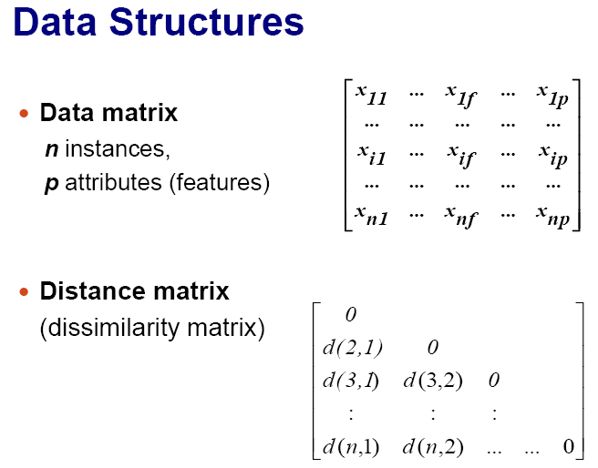
Hierarchical Clustering

Slide 8
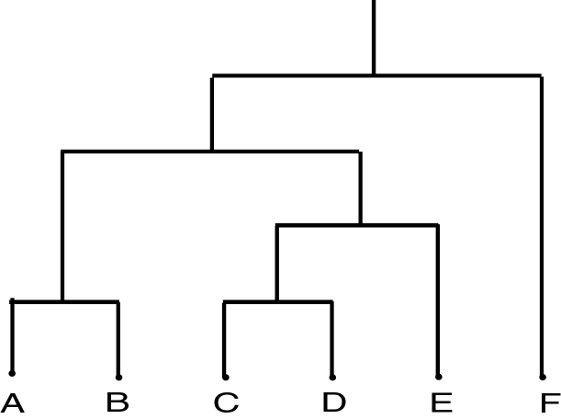
Dendrogram
Dendrogram: a tree data structure which illustrates hierarchical clustering techniques.
Each level shows clusters for that level.
  Leaf – individual clusters
  Root – one cluster
A cluster at level i is the union of its children clusters at level i+1.

Slide 9
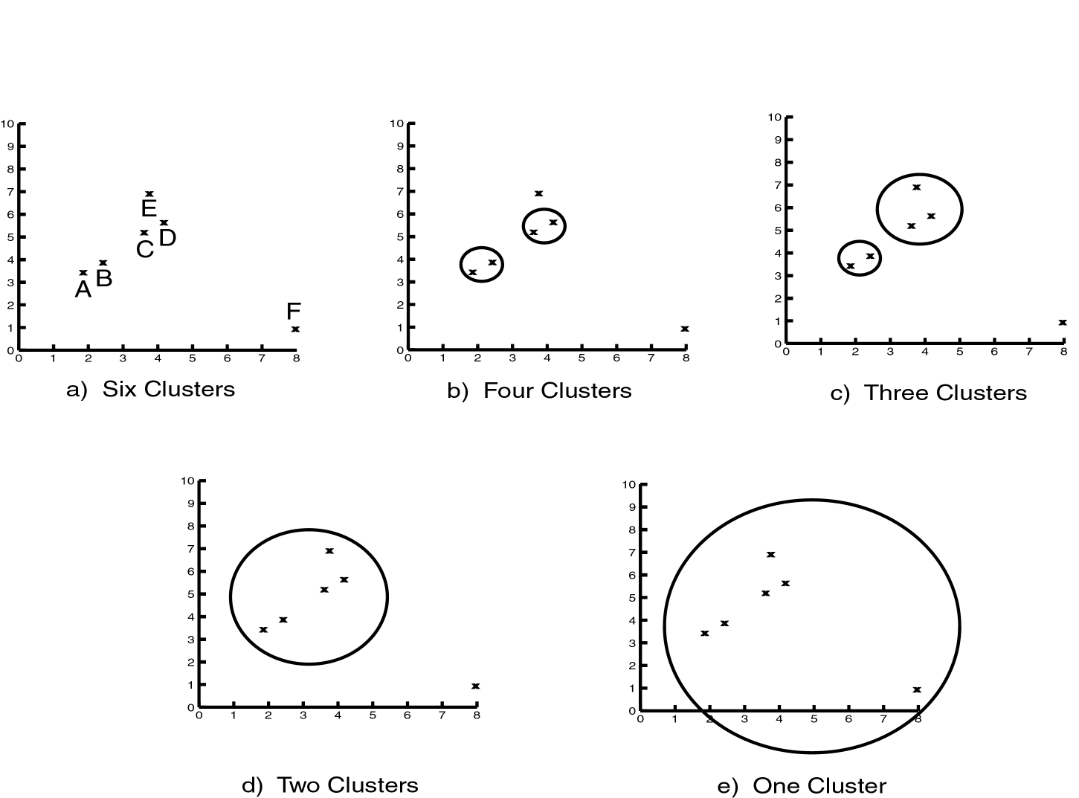
Levels of Clustering

Slide 10
Hierarchical Clustering
Agglomerative hierarchical clustering techniques are by far the most common and.
In this course, we will focus exclusively on agglomerative methods.

Slide 11
Agglomerative Clustering Algorithm
Agglomerative Clustering are most popular hierarchical clustering technique
Basic algorithm is straightforward
  Compute the proximity matrix
  Let each data point be a cluster
  Repeat
  Merge the two closest clusters
  Update the proximity matrix
  Until only a single cluster remains
Key operation is the computation of the proximity of two clusters
  Different approaches to defining the distance between clusters distinguish the different algorithms

Slide 12
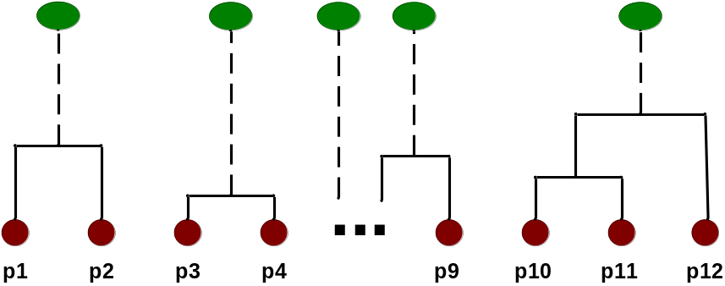
Intermediate Situation
After some merging steps, we have some clusters
C1
C2
C3
C4
C5
C1
C2
C3
C3
C4
C4
C5
Proximity Matrix
C1
C2
C5

Slide 13

Intermediate Situation
We want to merge the two closest clusters (C2 and C5) and update the proximity matrix.
C1
C2
C3
C4
C5
C1
C2
C3
C3
C4
C4
C5
Proximity Matrix
C1
C2
C5

Slide 14
After Merging
The question is “How do we update the proximity matrix?”
C2 U C5
C1
C3
C4
C1
?
C2 U C5
? ? ? ?
C3
C3
?
C4
C4
?
Proximity Matrix
C1
C2 U C5

Slide 15
How to Define Inter-Cluster Distance
p1
p2
p3
p4
p5
. . .
p1
Similarity?
p2
p3
p4
p5
MIN
MAX
Group Average
.
.
.
Proximity Matrix

Slide 16
How to Define Inter-Cluster Similarity
p1
p2
p3
p4
p5
. . .
p1
p2
p3
p4
p5
MIN
MAX
Group Average
.
.
.
Proximity Matrix

Slide 17
How to Define Inter-Cluster Similarity
p1
p2
p3
p4
p5
. . .
p1
p2
p3
p4
p5
MIN
MAX
Group Average
.
.
.
Proximity Matrix

Slide 18
How to Define Inter-Cluster Similarity
p1
p2
p3
p4
p5
. . .
p1
p2
p3
p4
p5
MIN
MAX
Group Average
.
.
.
Proximity Matrix

Slide 19
Agglomerative Hierarchical Algorithms
Single Link
Complete Link
Average Link

Slide 20
Agglomerative Hierarchical Algorithms:Distances
Single Link: (MIN) distance between points
Complete Link: (MAX) largest distance between points
Average Link: average distance between points

Slide 21
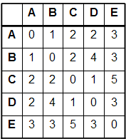
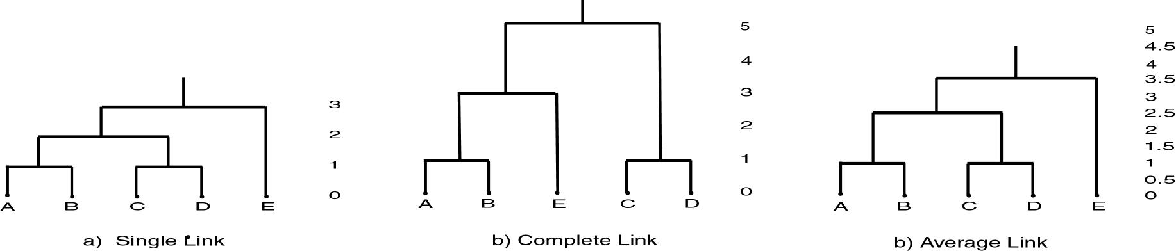
Example

Slide 22
(Single Link) Example
For a given Distance Matrix apply Agglomerative approach and draw Dendrogram using Single link approach.
 | A | B | C | D | E
A | 0
B | 1 | 0
C | 2 | 2 | 0
D | 2 | 5 | 3 | 0
E | 3 | 4 | 6 | 6 | 0

Slide 23
(Single Link) Example
Solution:
Step1:
- Find the nearest (closest) pair in the distance matrix:
- The closest pair: ‘A’ and ‘B’ with distance = 1.
Merge ‘A’ and ‘B’ as ‘AB’.
Update the distance matrix as follows:
d((AB),C) = min{d(A,C), d(B,C)}
= min{2,2} = 2
d((AB),D) = min{d(A,D), d(B,D)}
= min{2,5} = 2
d((AB),E) = min{d(A,E), d(B,E)}
= min{3,4} = 3
Rest of distances as not touched.
 | A | B | C | D | E
A | 0
B | 1 | 0
C | 2 | 2 | 0
D | 2 | 5 | 3 | 0
E | 3 | 4 | 6 | 6 | 0
 | A, B | C | D | E
A, B | 0
C | 2 | 0
D | 2 | 3 | 0
E | 3 | 6 | 6 | 0

Slide 24
(Single Link) Example
Solution:
Step2:
- Find the nearest (closest) pair in the distance matrix:
- The closest pair: ‘AB’ and ‘C’ with dist = 2.
Merge ‘AB’ and ‘C’ as ‘ABC’.
Update the distance matrix as follows:
d((ABC),D) = min{d(A,D), d(B,D), ), d(C,D),}
= min{2,5,3} = 2
d((ABC),E) = min{d(A,E), d(B,E), ), d(C,E),}
= min{3,4,6} = 3
Rest of distances as not touched.
 | A, B | C | D | E
A, B | 0
C | 2 | 0
D | 2 | 3 | 0
E | 3 | 6 | 6 | 0
Comes first!
 | A, B, C | D | E
A, B, C | 0
D | 2 | 0
E | 3 | 6 | 0

Slide 25
(Single Link) Example
Solution:
Step3:
- Find the nearest (closest) pair in the distance matrix:
- The closest pair: ‘ABC’ and ‘D’ with dist = 2.
Merge ‘ABC’ and ‘D’ as ‘ABCD’.
Update the distance matrix as follows:
d((ABCD),E) = min{d(A,E), d(B,E), ), d(CE), ), d(D,E)}
= min{3,4,6,6} = 3
Finished.
 | A, B, C | D | E
A, B, C | 0
D | 2 | 0
E | 3 | 6 | 0
 | A, B, C, D | E
A, B, C, D | 0
E | 3 | 0

Slide 26
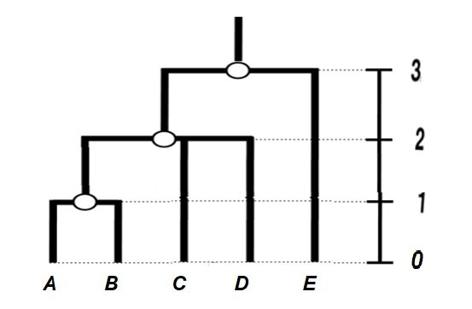
(Single Link) Example - Dendrogram

Slide 27
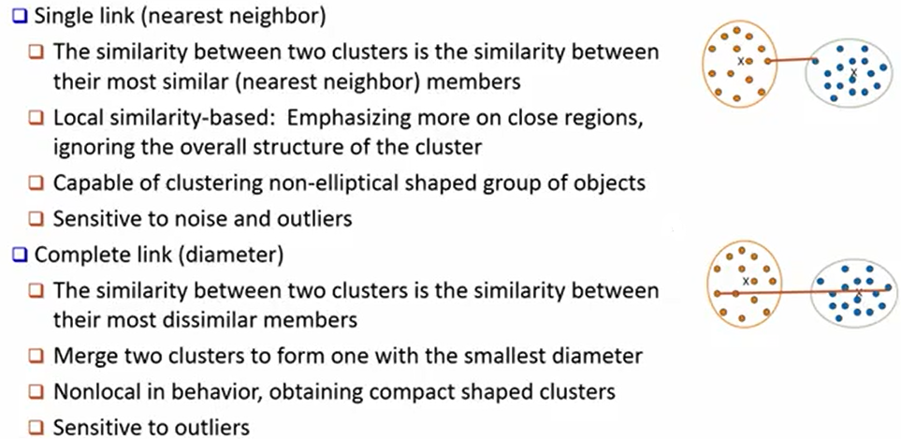
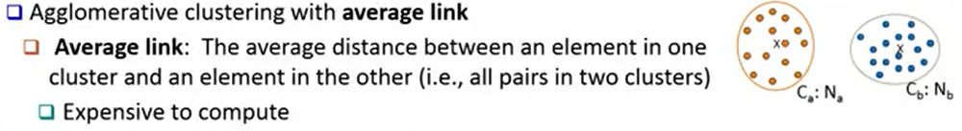
Agglomerative Algorithms: Comparison

Slide 28
Hierarchical Clustering: Time and Space requirements
O(N²) space since it uses the proximity matrix.
  N is the number of points.
O(N³) time in many cases
  There are N steps and at each step the size, N², proximity matrix must be updated and searched
  Complexity can be reduced to O(N² log(N) ) time with some cleverness

Slide 29
Strengths of Hierarchical Clustering
Do not have to assume any particular number of clusters
  Any desired number of clusters can be obtained by ‘cutting’ the dendrogram at the proper level
They may correspond to meaningful taxonomies
  Example in biological sciences (e.g., animal kingdom, phylogeny reconstruction, …)

Slide 30
Hierarchical Clustering: Problems and Limitations
Once a decision is made to combine two clusters, it cannot be undone
No global objective function is directly minimized
Different schemes have problems with one or more of the following:
  Sensitivity to noise and outliers
  Difficulty handling clusters of different sizes and non-globular shapes
  Breaking large clusters

Slide 31
Hierarchical Clustering: Problems and Limitations
Run:
HierarchicalClustering.py

