Slide 1
Clustering
Partitioning Methods
Hierarchical Methods
Density-Based Methods
Grid-Based Methods
Model-Based Methods

Slide 2
Density-Based Clustering Methods
Density-Based Clustering refers to unsupervised learning methods that identify distinctive groups/clusters in the data, based on the idea that a cluster in data space is a contiguous (dense) region of high point density, separated from other such clusters by contiguous regions of low point density.
Major features:
  Discover clusters of arbitrary shape
  Handle noise
  One scan
  Need density parameters as termination condition

Slide 3
Density-Based Clustering Methods
Several interesting studies:
  DBSCAN: Ester, et al. (KDD’96)
  OPTICS: Ankerst, et al (SIGMOD’99).
  DENCLUE: Hinneburg & D. Keim (KDD’98)
  CLIQUE: Agrawal, et al. (SIGMOD’98) (more grid-based)

Slide 4
Density-Based Clustering: Basic Concepts
  Core points: These points are in the interior of a density-based cluster. A point is a core point if the number of points within a given neighborhood around the point as determined by the distance function and a user specified distance parameter, Eps, exceeds a certain threshold, MinPts, which is also a user-specified parameter.
Border points: A border point is not a core point, but falls within the neighborhood of a core point. A border point can fall within the neighborhood of several core points.
Noise points: A noise point is any point that is nether a core point nor a border point.

Slide 5
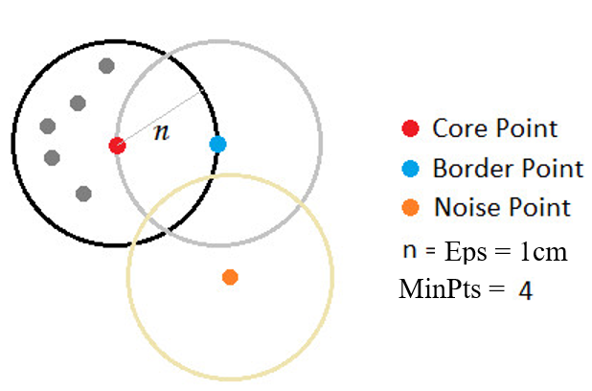
Density-Based Clustering: Basic Concepts

Slide 6
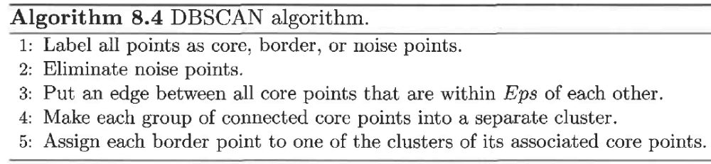
DBSCAN Algorithm

Slide 7
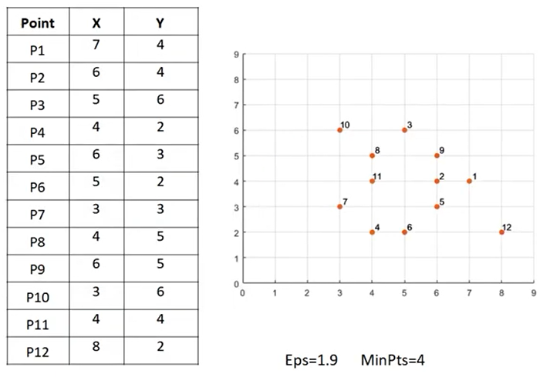
DBSCAN Example
Given a data set, find(if any) core, border, noise points,
With Eps = 1.9 and MinPts = 4?
https://www.youtube.com/watch?v=jqKAAVEwX9M

Slide 8
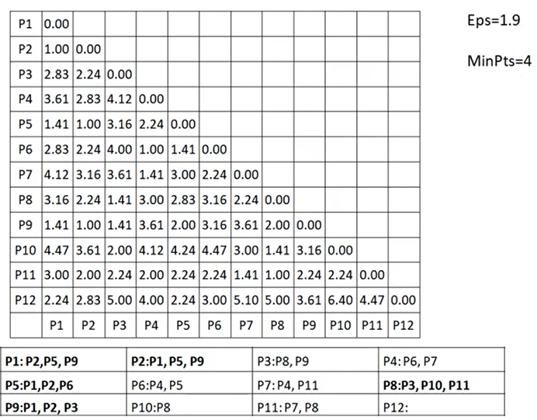
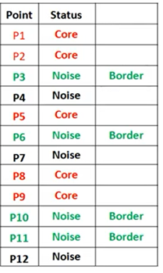
DBSCAN Example
Given the distance matrix:

Slide 9
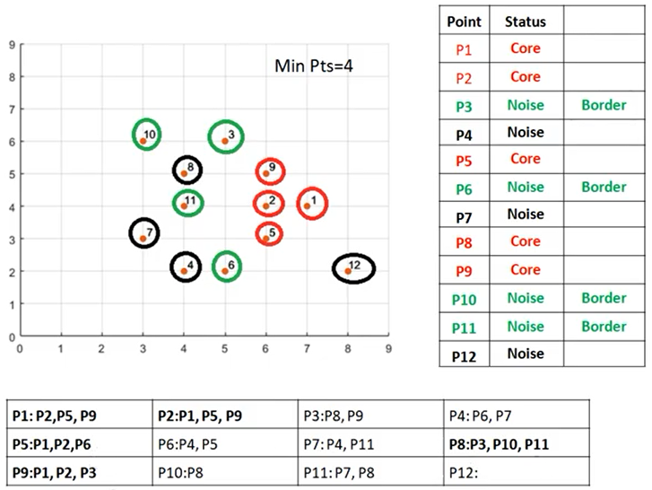
DBSCAN Example
Solution:

Slide 10
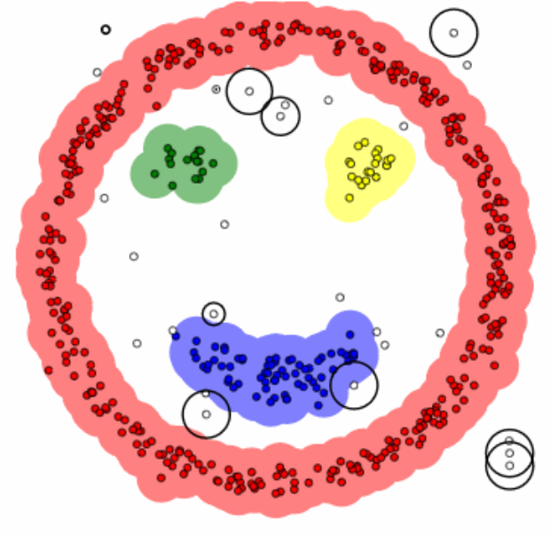
DBSCAN Algorithm
GIF file from:
https://www.kdnuggets.com/2020/04/dbscan-clustering-algorithm-machine-learning.html
Run: DBSCAN.gif

Slide 11
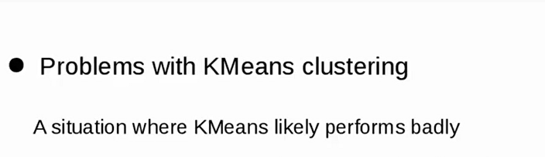
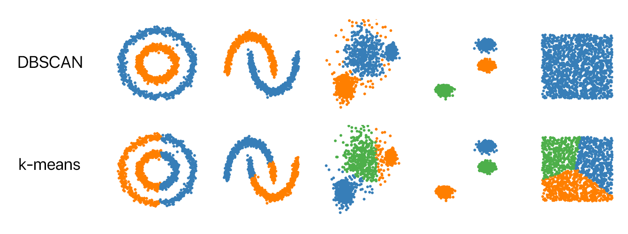
DBSCAN vs k-means

Slide 12
DBSCAN: Python Example
Run: DBSCAN-KMEANS.py

Slide 13
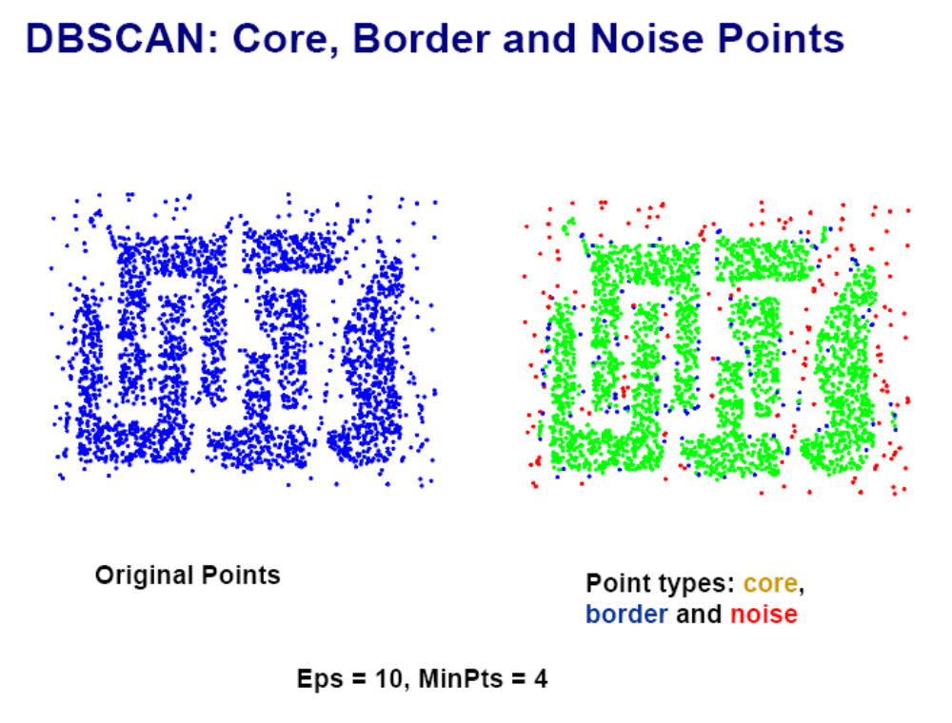
CHAMELEON (Clustering Complex Objects)

Slide 14
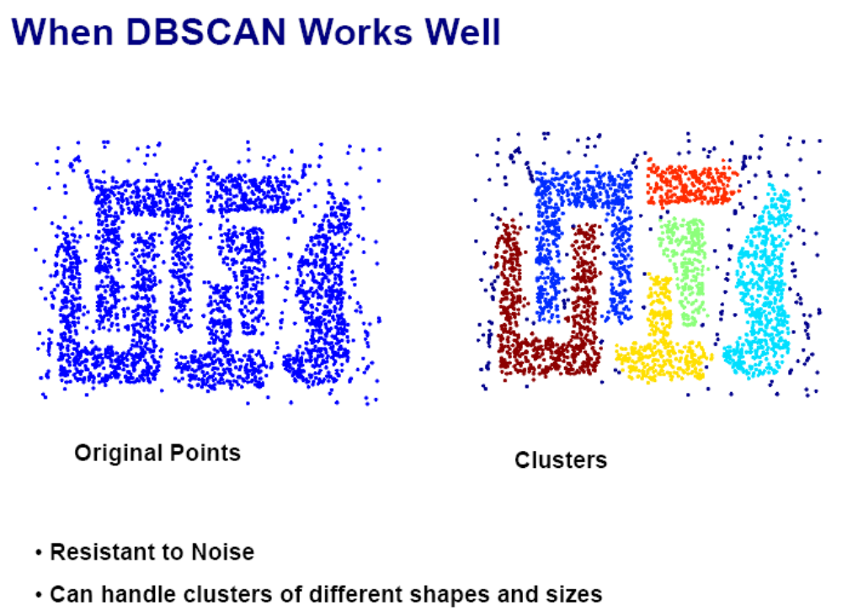
DBSCAN

Slide 15
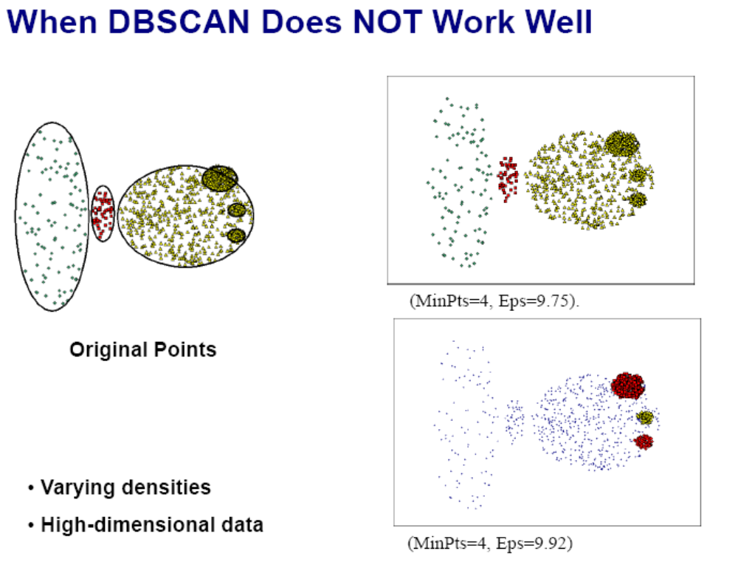
DBSCAN

Slide 16



DBSCAN: Sensitive to Parameters

Slide 17
Clustering
Partitioning Methods
Hierarchical Methods
Density-Based Methods
Grid-Based Methods
Model-Based Methods

Slide 18
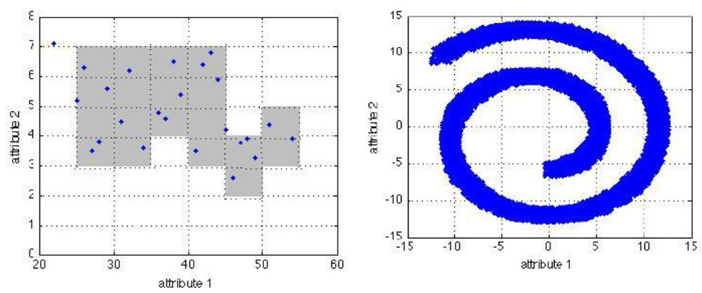
Grid-Based Clustering Method
Using multi-resolution grid data structure
data space is divided into cells
clustering operations are performed on the grid data structure

Slide 19
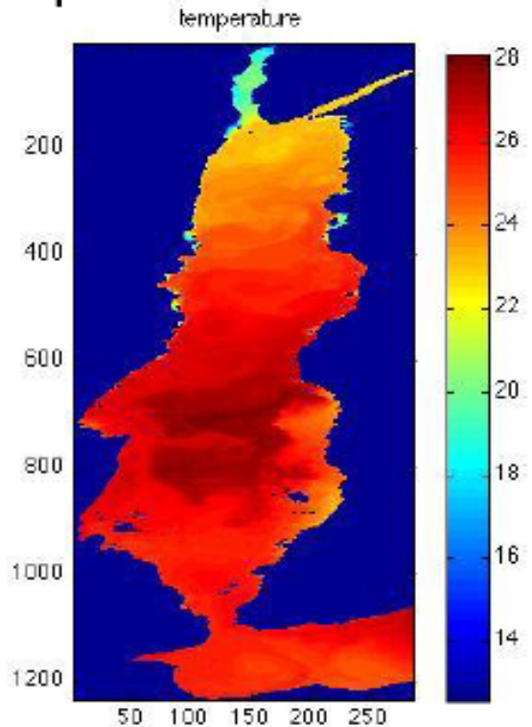
Grid-Based Clustering Method
Specially useful on spatial data clustering
Spatial data --- geographically referenced data
temperature levels

Slide 20
Grid-Based Clustering Method
Several interesting methods
  STING (a STatistical INformation Grid approach) by Wang, Yang and Muntz (1997)
  WaveCluster by Sheikholeslami, Chatterjee, and Zhang (VLDB’98)
    A multi-resolution clustering approach using wavelet method
  CLIQUE: Agrawal, et al. (SIGMOD’98)
    Both grid-based and subspace clustering

Slide 21
CLIQUE (Clustering In QUEst)
Agrawal, Gehrke, Gunopulos, Raghavan (SIGMOD’98)
Automatically identifying subspaces of a high dimensional data space that allow better clustering than original space
CLIQUE can be considered as both density-based and grid-based
  It partitions each dimension into the same number of equal length interval
  It partitions an m-dimensional data space into non-overlapping rectangular units
  A unit is dense if the fraction of total data points contained in the unit exceeds the input model parameter
  A cluster is a maximal set of connected dense units within a subspace

Slide 22
CLIQUE: The Major Steps
Partition the data space and find the number of points that lie inside each cell of the partition.
Identify the subspaces that contain clusters using the Apriori principle
Identify clusters
  Determine dense units in all subspaces of interests
  Determine connected dense units in all subspaces of interests.
Generate minimal description for the clusters
  Determine maximal regions that cover a cluster of connected dense units for each cluster
  Determination of minimal cover for each cluster

Slide 23
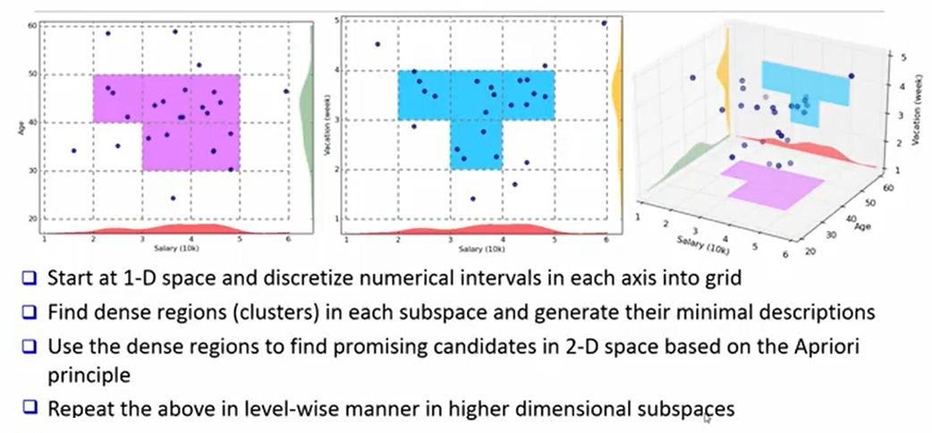
CLIQUE: Example-Salary-Age-Vacation
Find the clusters based on 3-D intersections

Slide 24
Strength and Weakness of CLIQUE
Strength
  automatically finds subspaces of the highest dimensionality such that high density clusters exist in those subspaces
  insensitive to the order of records in input and does not presume some canonical data distribution
  scales linearly with the size of input and has good scalability as the number of dimensions in the data increases
Weakness
  The accuracy of the clustering result may be degraded at the expense of simplicity of the method

