Slide 1
Types of Clustering methods
Existing clustering methods can be classified into 5 categories:
Partitioning Methods
Hierarchical Methods
Density-Based Methods
Grid-Based Methods
Model-Based Methods

Slide 2
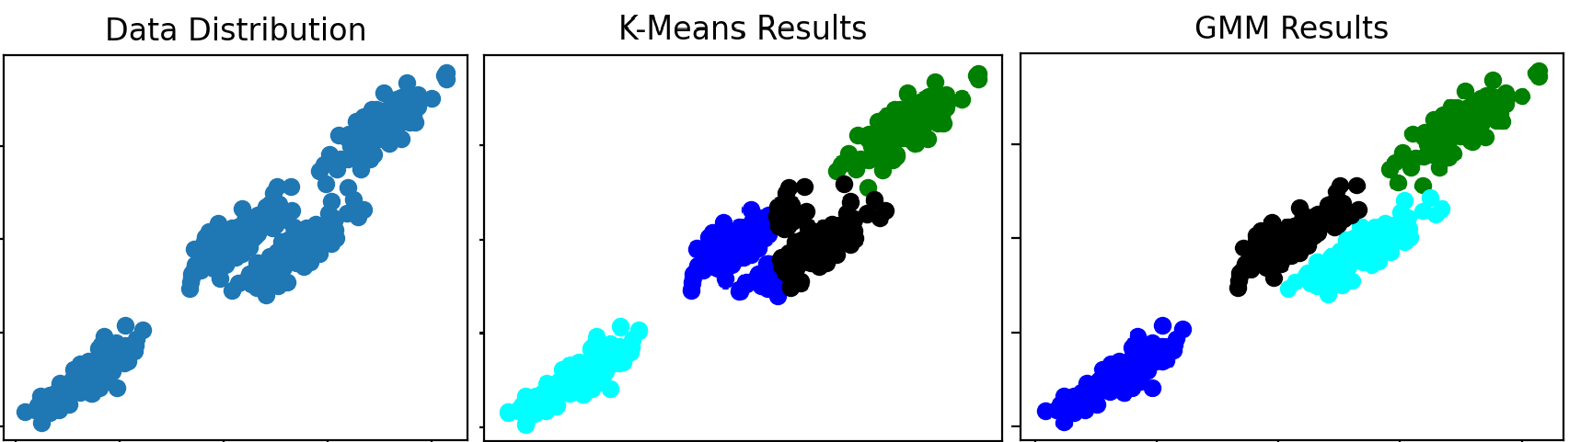
Clustering Using Mixture Models
K-means VS Mixture Models: EM-GMM_VS_KMEANS.py
Run: EM-GMM_VS_KMEANS.py

Slide 3
Clustering Using Mixture Models
This section considers clustering based on statistical models. It is often convenient and effective to assume that data has been generated as a result of a statistical process and to describe the data by finding the statistical model that best fits the data, where the statistical model is described in terms of a distribution and a set of parameters for that distribution.
Mixture models model the data by using a number of statistical distributions.
Each distribution corresponds to a cluster and the parameters of each distribution provide a description of the corresponding cluster, typically in terms of its center and spread.

Slide 4
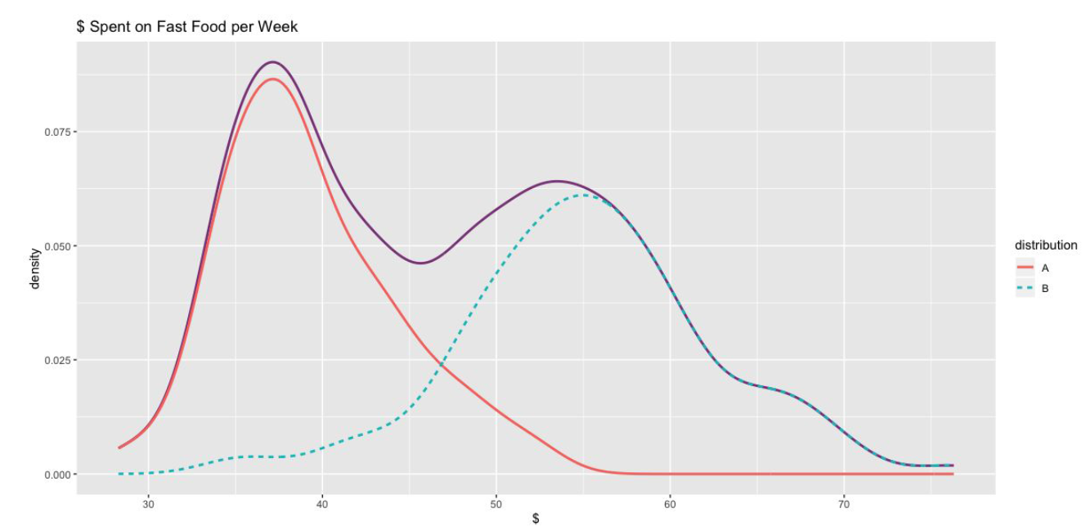
Clustering Using Mixture Models
A mixture model with 2 distributions representing 2 clusters.
https://github.com/cmparlettpelleriti/CPSC392ParlettPelleriti

Slide 5
Clustering Using Mixture Models
The idea is to model the set of data points as arising from a mixture of distributions
  Typically, normal (Gaussian) distribution is used
  But other distributions have been very profitably used
Clusters are found by estimating the parameters of the statistical distributions using the Expectation-Maximization (EM) algorithm
    k-means is a special case of this approach
    Provides a compact representation of clusters
    The probabilities with which point belongs to each cluster provide a functionality similar to fuzzy clustering.

Slide 6
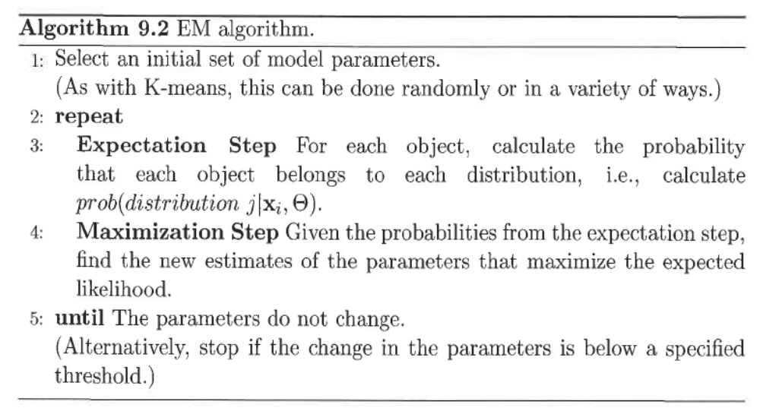
Clustering Using Mixture Models
The Expectation-Maximization (EM) algorithm makes an initial guess for the parameters (μ_{j}, σ_{j}) , and then iteratively improves these estimates.
θ_{j} = (μ_{j}, σ_{j})

Slide 7
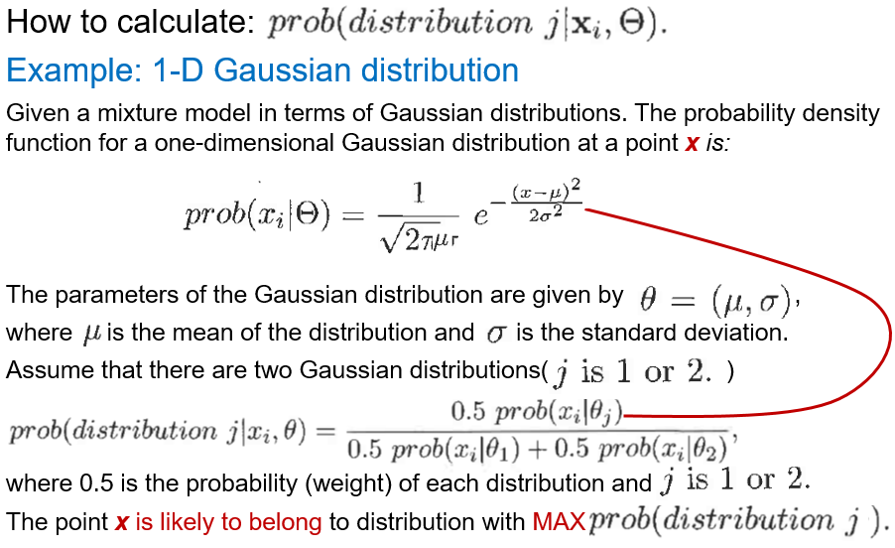
Clustering Using Mixture Models

Slide 8
Constraint-Based Cluster Analysis?
Clustering a new point: there is a higher probability to be in cluster 1 (red distribution)
80% red
20% blue

Slide 9
Clustering Using Mixture Models
Python implementation to segment images:
What is GMM and how to use it for Image segmentation:
https://www.youtube.com/watch?v=kkAirywakmk&list=PLZsOBAyNTZwbIjGnolFydAN33gyyGP7lT&index=53

Slide 10
Constraint-Based Cluster Analysis?
e.g., an ATM allocation problem: obstacle & desired # clusters?

Slide 11

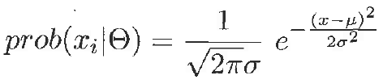





Clustering Using Mixture Models
How to calculate:
Example: 1-D Gaussian distribution
Given a mixture model in terms of Gaussian distributions. The probability density function for a one-dimensional Gaussian distribution at a point x is:
The parameters of the Gaussian distribution are given by ,
where is the mean of the distribution and is the standard deviation.
Assume that there are two Gaussian distributions( )
where 0.5 is the probability (weight) of each distribution and
The point x is likely to belong to distribution with MAX

Slide 12
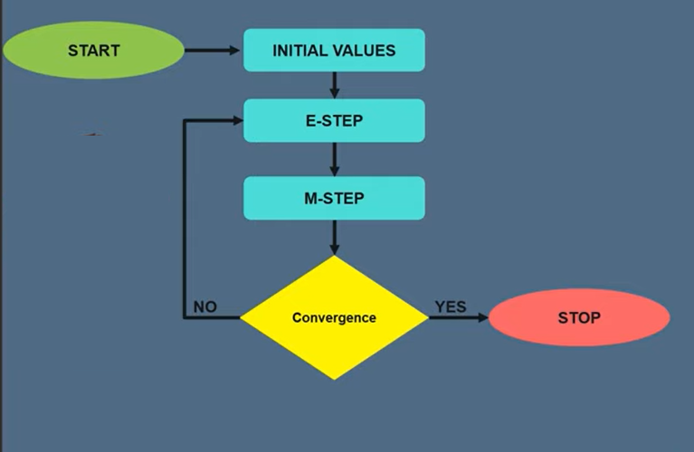
Expectation-Maximization (EM) algorithm

