Slide 1

Chapter 15
Connecting LANs,
Backbone Networks,
and Virtual LANs
15.<number>
Copyright © The McGraw-Hill Companies, Inc. Permission required for reproduction or display.

Slide 2
15-1 CONNECTING DEVICES
In this section, we divide connecting devices into five different categories based on the layer in which they operate in a network.
Topics discussed in this section:
Passive Hubs
Active Hubs
Bridges
Two-Layer Switches
Routers
Three-Layer Switches
Gateways
15.<number>

Slide 3

Figure 15.1 Five categories of connecting devices
15.<number>

Slide 4

Figure 15.2 A repeater connecting two segments of a LAN
15.<number>

Slide 5

Note
A repeater connects segments of a LAN.
15.<number>

Slide 6
Note
A repeater forwards every frame;
it has no filtering capability.
15.<number>

Slide 7
Note
A repeater is a regenerator,
not an amplifier.
15.<number>

Slide 8

Figure 15.3 Function of a repeater
15.<number>

Slide 9

Figure 15.4 A hierarchy of hubs
15.<number>

Slide 10
Note
A bridge has a table used in
filtering decisions.
15.<number>

Slide 11

Figure 15.5 A bridge connecting two LANs
15.<number>

Slide 12
Note
A bridge does not change the physical (MAC) addresses in a frame.
15.<number>

Slide 13

Figure 15.6 A learning bridge and the process of learning
15.<number>

Slide 14

Figure 15.11 Routers connecting independent LANs and WANs
15.<number>

Slide 15
15-2 BACKBONE NETWORKS
A backbone network allows several LANs to be connected. In a backbone network, no station is directly connected to the backbone; the stations are part of a LAN, and the backbone connects the LANs.
Topics discussed in this section:
Bus Backbone
Star Backbone
Connecting Remote LANs
15.<number>

Slide 16
Note
In a bus backbone, the topology
of the backbone is a bus.
15.<number>

Slide 17
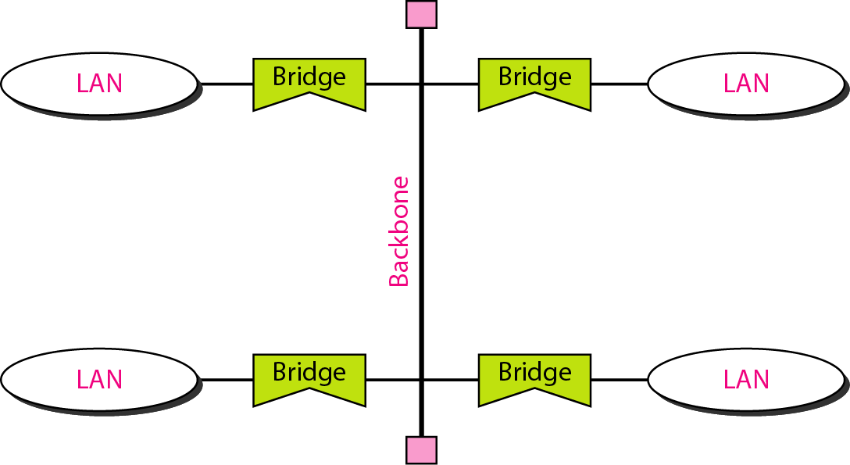
Figure 15.12 Bus backbone
15.<number>

Slide 18
Note
In a star backbone, the topology of the backbone is a star;
the backbone is just one switch.
15.<number>

Slide 19
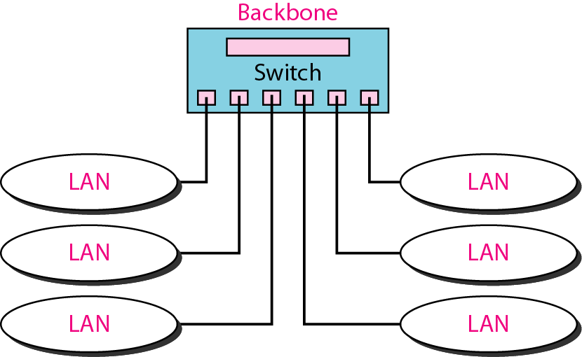
Figure 15.13 Star backbone
15.<number>

Slide 20
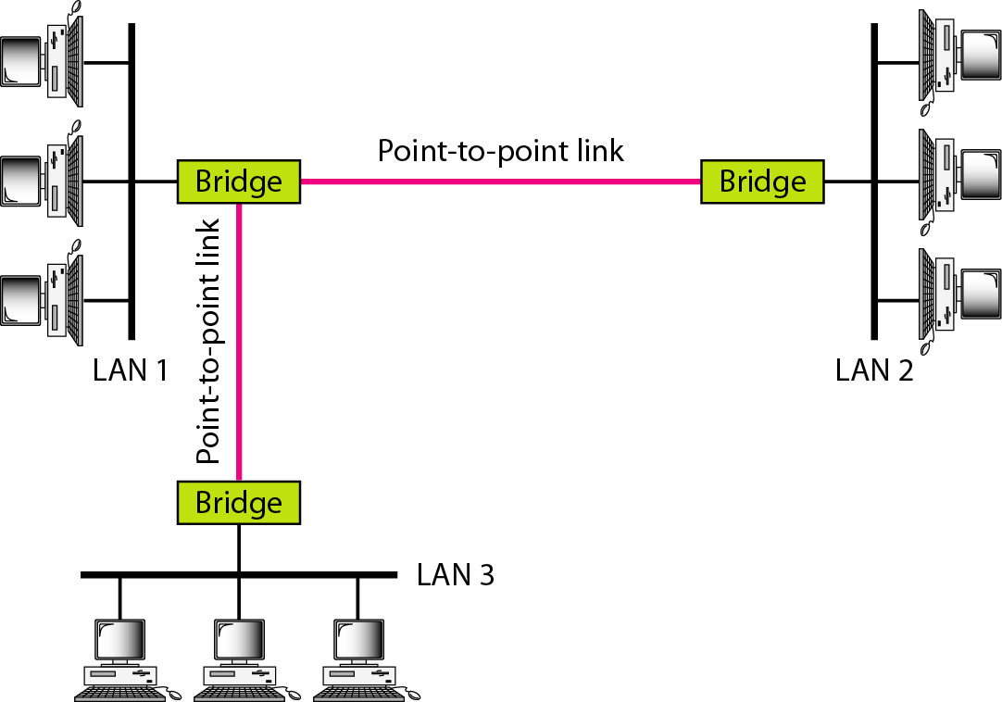
Figure 15.14 Connecting remote LANs with bridges
15.<number>

Slide 21
Note
A point-to-point link acts as a LAN in a remote backbone connected by
remote bridges.
15.<number>

Slide 22
15-3 VIRTUAL LANs
We can roughly define a virtual local area network (VLAN) as a local area network configured by software, not by physical wiring.
Topics discussed in this section:
Membership
Configuration
Communication between Switches
IEEE Standard
Advantages
15.<number>

Slide 23
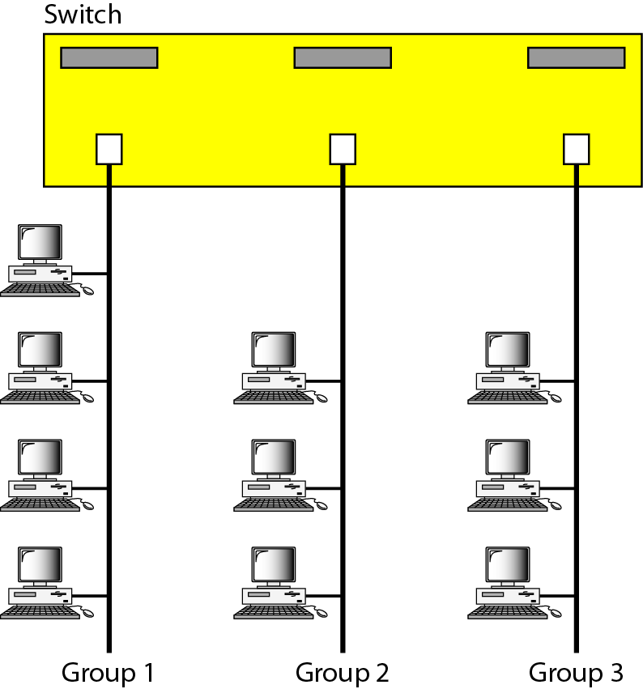
Figure 15.15 A switch connecting three LANs
15.<number>

Slide 24

Figure 15.16 A switch using VLAN software
15.<number>

Slide 25

Figure 15.17 Two switches in a backbone using VLAN software
15.<number>

Slide 26
Note
VLANs create broadcast domains.
15.<number>

