Slide 1

Chapter 20
Network Layer:
Internet Protocol
20.<number>
Copyright © The McGraw-Hill Companies, Inc. Permission required for reproduction or display.

Slide 2
20-1 INTERNETWORKING
In this section, we discuss internetworking, connecting networks together to make an internetwork or an internet.
Topics discussed in this section:
Need for Network Layer
Internet as a Datagram Network
Internet as a Connectionless Network
20.<number>

Slide 3

Figure 20.1 Links between two hosts
20.<number>

Slide 4

Figure 20.2 Network layer in an internetwork
20.<number>

Slide 5

Figure 20.3 Network layer at the source, router, and destination
20.<number>

Slide 6

Figure 20.3 Network layer at the source, router, and destination (continued)
20.<number>

Slide 7

Note
Switching at the network layer in the Internet uses the datagram approach to packet switching.
20.<number>

Slide 8
Note
Communication at the network layer in the Internet is connectionless.
20.<number>

Slide 9
20-2 IPv4
The Internet Protocol version 4 (IPv4) is the delivery mechanism used by the TCP/IP protocols.
Topics discussed in this section:
Datagram
Fragmentation
Checksum
Options
20.<number>

Slide 10

Figure 20.4 Position of IPv4 in TCP/IP protocol suite
20.<number>

Slide 11

Figure 20.5 IPv4 datagram format
20.<number>

Slide 12


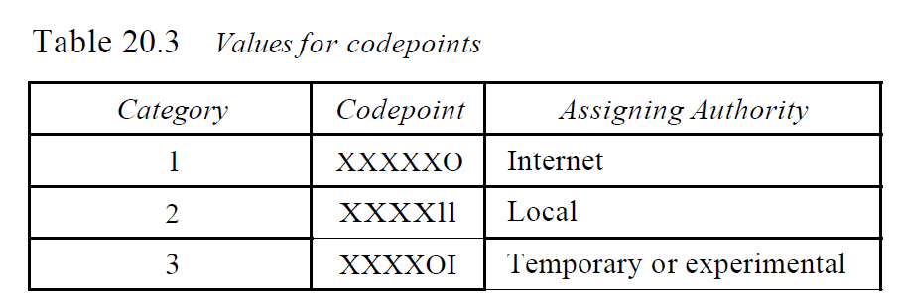
Figure 20.6 Service type or differentiated services
IETF has changed the interpretation and name of this 8-bit field. This field, previously called service type, is now called differentiated services. We show both interpretations
The precedence subfield was part of version 4, but never used.
Table 20.3 Values for Codepoints
TOS: Although a bit can be either 0 or 1, one and only one of the bits can have the value of 1 in each datagram.
20.<number>

Slide 13

Table 20.2 Default types of service
20.<number>

Slide 14
Note
The total length field defines the total length of the datagram including the header.
Length of data =total length - header length
20.<number>

Slide 15

Figure 20.7 Encapsulation of a small datagram in an Ethernet frame
20.<number>

Slide 16


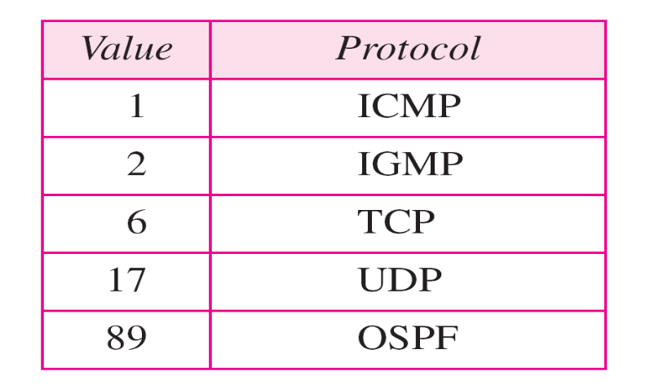
Figure 20.8 Protocol field and encapsulated data
Protocol. This 8-bit field defines the higher-level protocol that uses the services of the IPv4 layer. An IPv4 datagram can encapsulate data from several higher-level protocols such as TCP, UDP, ICMP, and IGMP. This field specifies the final destination protocol to which the IPv4 datagram is delivered. In other words, since the IPv4 protocol carries data from different other protocols, the value of this field helps the receiving network layer know to which protocol the data belong (see Figure 20.8).
20.<number>

Slide 17

Example 20.1
An IPv4 packet has arrived with the first 8 bits as shown:
01000010
The receiver discards the packet. Why?
Solution
There is an error in this packet. The 4 leftmost bits (0100) show the version, which is correct. The next 4 bits (0010) show an invalid header length (2 × 4 = 8). The minimum number of bytes in the header must be 20. The packet has been corrupted in transmission.
20.<number>

Slide 18
Example 20.2
In an IPv4 packet, the value of HLEN is 1000 in binary. How many bytes of options are being carried by this packet?
Solution
The HLEN value is 8, which means the total number of bytes in the header is 8 × 4, or 32 bytes. The first 20 bytes are the base header, the next 12 bytes are the options.
20.<number>

Slide 19
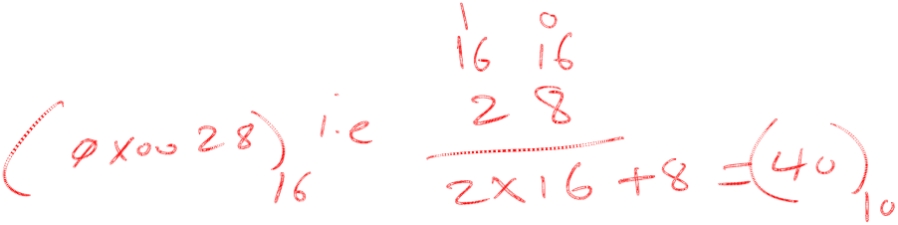
Example 20.3
In an IPv4 packet, the value of HLEN is 5, and the value of the total length field is 0x0028. How many bytes of data are being carried by this packet?
Solution
The HLEN value is 5, which means the total number of bytes in the header is 5 × 4, or 20 bytes (no options). The total length is 40 bytes, which means the packet is carrying 20 bytes of data (40 − 20).
20.<number>

Slide 20

Example 20.4
An IPv4 packet has arrived with the first few hexadecimal digits as shown.
0x45000028000100000102 . . .
How many hops can this packet travel before being dropped? The data belong to what upper-layer protocol?
Solution
To find the time-to-live field, we skip 8 bytes. The time-to-live field is the ninth byte, which is 01. This means the packet can travel only one hop. The protocol field is the next byte (02), which means that the upper-layer protocol is IGMP.
Time to live. A datagram has a limited lifetime in its travel through an Internet. This field will be decremented by each visited router.
20.<number>

Slide 21

Figure 20.9 Maximum transfer unit (MTU)
20.<number>

Slide 22

Table 20.5 MTUs for some networks
20.<number>

Slide 23

Figure 20.10 Flags used in fragmentation
20.<number>

Slide 24


Figure 20.11 Fragmentation example
Figure 20.11 shows a datagram with a data size of 4000 bytes fragmented into three fragments. The bytes in the original datagram are numbered 0 to 3999. The first fragment carries bytes 0 to 1399. The offset for this datagram is 0/8 = O. The second fragment carries bytes 1400 to 2799; the offset value for this fragment is 1400/8 = 175. Finally, the third fragment carries bytes 2800 to 3999. The offset value for this fragment is 2800/8 =350. Remember that the value of the offset is measured in units of 8 bytes.
20.<number>

Slide 25

Figure 20.12 Detailed fragmentation example
20.<number>

Slide 26
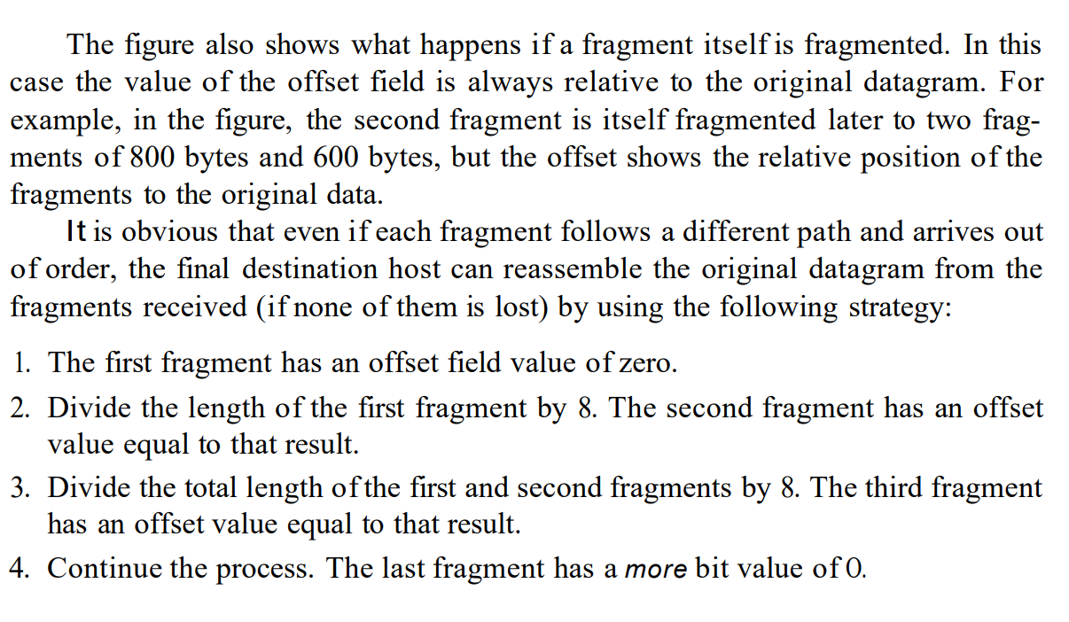
20.<number>

Slide 27
Example 20.5
A packet has arrived with an M bit value of 0. Is this the first fragment, the last fragment, or a middle fragment? Do we know if the packet was fragmented?
Solution
If the M bit is 0, it means that there are no more fragments; the fragment is the last one. However, we cannot say if the original packet was fragmented or not. A non-fragmented packet is considered the last fragment.
20.<number>

Slide 28
Example 20.6
A packet has arrived with an M bit value of 1. Is this the first fragment, the last fragment, or a middle fragment? Do we know if the packet was fragmented?
Solution
If the M bit is 1, it means that there is at least one more fragment. This fragment can be the first one or a middle one, but not the last one. We don’t know if it is the first one or a middle one; we need more information (the value of the fragmentation offset).
20.<number>

Slide 29
Example 20.7
A packet has arrived with an M bit value of 1 and a fragmentation offset value of 0. Is this the first fragment, the last fragment, or a middle fragment?
Solution
Because the M bit is 1, it is either the first fragment or a middle one. Because the offset value is 0, it is the first fragment.
20.<number>

