Slide 1

Chapter 24
Congestion Control and
Quality of Service
24.<number>
Copyright © The McGraw-Hill Companies, Inc. Permission required for reproduction or display.

Slide 2
24-1 DATA TRAFFIC
The main focus of congestion control and quality of service is data traffic. In congestion control we try to avoid traffic congestion. In quality of service, we try to create an appropriate environment for the traffic. So, before talking about congestion control and quality of service, we discuss the data traffic itself.
Topics discussed in this section:
Traffic Descriptor
Traffic Profiles
24.<number>

Slide 3

Figure 24.1 Traffic descriptors
24.<number>

Slide 4

Figure 24.2 Three traffic profiles
24.<number>

Slide 5
24-2 CONGESTION
Congestion in a network may occur if the load on the network—the number of packets sent to the network—is greater than the capacity of the network—the number of packets a network can handle. Congestion control refers to the mechanisms and techniques to control the congestion and keep the load below the capacity.
Topics discussed in this section:
Network Performance
24.<number>

Slide 6

Figure 24.3 Queues in a router
24.<number>

Slide 7
24-3 CONGESTION CONTROL
Congestion control refers to techniques and mechanisms that can either prevent congestion, before it happens, or remove congestion, after it has happened. In general, we can divide congestion control mechanisms into two broad categories: open-loop congestion control (prevention) and closed-loop congestion control (removal).
Topics discussed in this section:
Open-Loop Congestion Control
Closed-Loop Congestion Control
24.<number>

Slide 8

Figure 24.5 Congestion control categories
24.<number>

Slide 9

Figure 24.6 Backpressure method for alleviating congestion
24.<number>

Slide 10

Figure 24.7 Choke packet
24.<number>

Slide 11
24-5 QUALITY OF SERVICE
Quality of service (QoS) is an internetworking issue that has been discussed more than defined. We can informally define quality of service as something a flow seeks to attain.
Topics discussed in this section:
Flow Characteristics
Flow Classes
24.<number>

Slide 12

Figure 24.15 Flow characteristics
24.<number>

Slide 13
24-6 TECHNIQUES TO IMPROVE QoS
In Section 24.5 we tried to define QoS in terms of its characteristics. In this section, we discuss some techniques that can be used to improve the quality of service. We briefly discuss four common methods: scheduling, traffic shaping, admission control, and resource reservation.
Topics discussed in this section:
Scheduling
Traffic Shaping
Resource Reservation
Admission Control
24.<number>

Slide 14

Figure 24.16 FIFO queue
24.<number>

Slide 15

Figure 24.17 Priority queuing
24.<number>

Slide 16

Figure 24.18 Weighted fair queuing
24.<number>

Slide 17
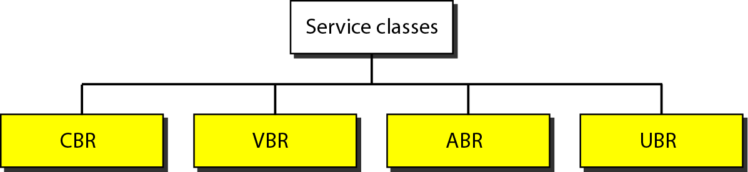
Figure 24.30 Service classes
CBR The constant-bit-rate (CBR) class is designed for customers who need real– time audio or video services. The service is similar to that provided by a dedicated line such as a T line. VBR The variable-bit-rate (VBR) class is divided into two subclasses: real-time (VBR-RT) and non-real-time (VBR-NRT). VBR-RT is designed for those users who need real-time services (such as voice and video transmission) and use compression techniques to create a variable bit rate. VBR-NRT is designed for those users who do not need real-time services but use compression techniques to create a variable bit rate. ABR The available-bit-rate (ABR) class delivers cells at a minimum rate. If more network capacity is available, this minimum rate can be exceeded. ABR is particularly suitable for applications that are bursty. UBR The unspecified-bit-rate (UBR) class is a best-effort delivery service that does not guarantee anything. Figure 24.31 shows the relationship of different classes to the total capacity of the network.
24.<number>

Slide 18
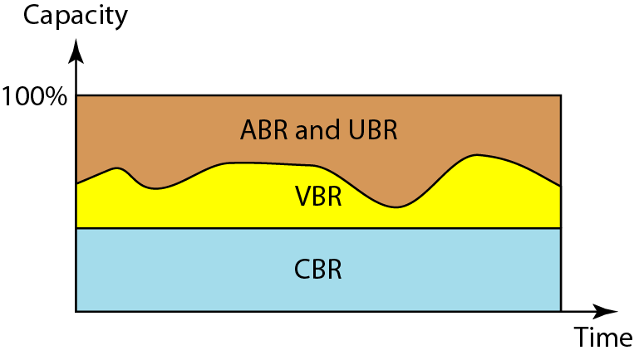
Figure 24.31 Relationship of service classes to the total capacity of the network
24.<number>

