Slide 1
معالجة اللغات الطبيعية Natural Language Processing (1905380)
The University of Jordan
Instructor
Dr. Majdi Sawalha
Artificial Intelligence Department King Abdullah II School of Information Technology The University of Jordan
sawalha.majdi@ju.edu.jo
Office hours: 12:30 – 13:30 SUN, TUE, THU

Slide 2
Part II: Syntax Chapter 12: Formal Grammars of English

Slide 3
Outline
Constituency
Context-Free Grammars
Treebanks
Dependency grammars

Slide 4
Syntax
Syntax: from Greek syntaxis “setting out together, arrangement’’
Refers to the way words are arranged together, and the relationship between them.
Distinction:
Prescriptive grammar: how people ought to talk
Descriptive grammar: how they do talk
Goal of syntax is to model the knowledge of that people unconsciously have about the grammar of their native language

Slide 5
Syntax
Why should we care?
Grammar checkers
Question answering
Information extraction
Machine translation

Slide 6
Context-Free Grammars (CFG)
Capture constituency and ordering
Ordering:
What are the rules that govern the ordering of words and bigger units in the language?
Constituency:
How words group into units and how the various kinds of units behave

Slide 7
Constituency
E.g., Noun phrases (NPs)
Three parties from Brooklyn
A high-class spot such as Mindy’s
The Broadway coppers
They
Harry the Horse
The reason he comes into the Hot Box
How do we know these form a constituent?

Slide 8
Constituency (II)
They can all appear before a verb:
Three parties from Brooklyn arrive…
A high-class spot such as Mindy’s attracts…
The Broadway coppers love…
They sit
But individual words can’t always appear before verbs:
*from arrive…
*as attracts…
*the is
*spot is…
Must be able to state generalizations like:
Noun phrases can occur before verbs

Slide 9
Constituency (III)
Preposing and postposing:
On September 17th, I’d like to fly from Atlanta to Denver
I’d like to fly on September 17th from Atlanta to Denver
I’d like to fly from Atlanta to Denver on September 17th.
But not:
*On September, I’d like to fly 17th from Atlanta to Denver
*On I’d like to fly September 17th from Atlanta to Denver

Slide 10
Context-Free Grammars
The most commonly used mathematical system for modeling constituent structure in English and other languages.
A context-free grammar consists of a set of rules or productions, each of which expresses the ways that symbols of the language can be grouped and ordered together, and a lexicon of words and symbols.

Slide 11
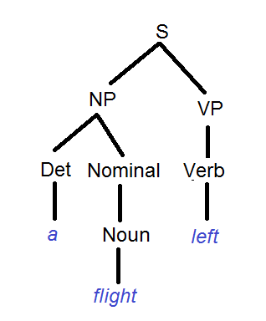
CFG example
Parse Tree
→
to the right : is an ordered list of one or more terminals and non-terminals.
to the left: is a single non-terminal symbol expressing some cluster or generalization.
S → NP VP
NP → Det NOMINAL
NOMINAL → Noun
VP → Verb
Det → a
Noun → flight
Verb → left
Symbols:
Terminal symbols correspond to words in language (“flight”, “left”)
Lexicon is a set of rules that these terminal symbols
Non-terminal symbols express clusters or generalizations

Slide 12
CFGs: set of rules
S → NP VP
This says that there are units called S, NP, and VP in this language
That an S consists of an NP followed immediately by a VP
Doesn’t say that that’s the only kind of S
Nor does it say that this is the only place that NPs and VPs occur

Slide 13
Generativity
As with Finite State Automatons, you can view these rules as either analysis or synthesis machines
Generate strings in the language
Reject strings not in the language
Impose structures (trees) on strings in the language
Used to define grammatical vs. ungrammatical sentences
A “generative grammar” is NOT only for producing/generating of output sentences,
it is also for analysis/parsing of input sentences

Slide 14
Derivations
A derivation is a sequence of rules applied to a string that accounts for that string
Covers all the elements in the string
Covers only the elements in the string

Slide 15
Derivations as Trees
S
NP
VP
NP
Nominal
Pronoun
Verb
Det
Noun
Noun
I
prefer
a
morning
flight
bracketed notation: represents a parse tree in a more compact format.
[S [NP [Pro I]] [VP [V prefer] [NP [Det a] [Nom [N morning] [Nom [N flight]]]]]]

Slide 16
CFGs more formally
A context-free grammar has 4 parameters
(“is a 4-tuple”)
N : A set of non-terminal symbols (“variables”)
Σ : A set of terminal symbols (disjoint from N)
R: A set of rules productions , each of the form
A → β
Where A is a non-terminal and β is a string of symbols from the infinite set of strings (Σ ∪ N)*
S: A designated start symbol

Slide 17
Parsing
Parsing is the process of taking a sentence and a grammar and returning one (or more) parse tree(s) for that sentence.
(more on parsing algorithms later…)
If the parser fails – it cannot build a parse-tree for the sentence – then EITHER the sentence is ungrammatical OR the grammar is “not good enough” (it is hard to write down every grammar rule for general English!)

Slide 18
Context- free?
The notion of context in Context Free Grammars has nothing to do with the ordinary meaning of the word context
All it really means is that the non-terminal on the left-hand side of a rule is out there all by itself (free of context)
A → B C
Means that I can rewrite an A as a B followed by a C regardless of the context in which A is found

Slide 19
Key Constituents of English grammar
Sentences
Noun phrases
Verb phrases
Prepositional phrases

Slide 20
Sentence-Types
Declaratives: A plane left
S → NP VP
Imperatives: Leave!
S → VP
Yes-No Questions: Did the plane leave?
S → Aux NP VP
WH Questions: When did the plane leave?
S → WH Aux NP VP

Slide 21
NPs
NP → Pronoun
I came, you saw it, they conquered
NP → Proper-Noun
Los Angeles is west of Texas
John Hennessy is the president of Stanford
NP → Det Noun
The president
NP → Nominal
Nominal → Noun Noun
A morning flight to Denver

Slide 22
PPs
PP → Preposition NP
From LA
To the store
On Tuesday morning
With lunch

Slide 23
Recursion
We’ll have to deal with rules such as the following where the non-terminal on the left also appears somewhere on the right (directly)
NP → NP PP [[The flight] [to Boston]]
VP → VP PP [[departed Miami] [at noon]]

Slide 24
Recursion
Of course, this is what makes syntax (and parsing) interesting
Flights from Denver
Flights from Denver to Miami
Flights from Denver to Miami in February
Flights from Denver to Miami in February on a Friday
Flights from Denver to Miami in February on a Friday under $300
Flights from Denver to Miami in February on a Friday under $300 with lunch

Slide 25
Recursion
[[Flights] [from Denver]]
[[[Flights] [from Denver]] [to Miami]]
[[[[Flights] [from Denver]] [to Miami]] [in February]]
[[[[[Flights] [from Denver]] [to Miami]] [in February]] [on a Friday]]
Etc.
NP → NP PP

Slide 26
Implications of recursion and context-freeness
If you have a rule like
VP -> V NP
It only cares that the thing after the verb is an NP
It doesn’t have to know about the internal affairs of that NP

Slide 27
The point
VP → V NP
(I) hate
flights from Denver
flights from Denver to Miami
flights from Denver to Miami in February
flights from Denver to Miami in February on a Friday
flights from Denver to Miami in February on a Friday under $300
flights from Denver to Miami in February on a Friday under $300 with lunch

Slide 28
nltk parsing example using CFG for nltk 3.0 (http://www.nltk.org/book/ch08.html )
While hunting in Africa, I shot an elephant in my pajamas. How he got into my pajamas, I don't know.
>>> groucho_grammar = nltk.CFG.fromstring("""
S -> NP VP
PP -> P NP
NP -> Det N | Det N PP | 'I'
VP -> V NP | VP PP
Det -> 'an' | 'my'
N -> 'elephant' | 'pajamas'
V -> 'shot'
P -> 'in'""")
>>> groucho_grammar
<Grammar with 13 productions>
>>> sent = ['I', 'shot', 'an', 'elephant', 'in', 'my', 'pajamas']
>>>parser = nltk.ChartParser(groucho_grammar)
>>> print(groucho_grammar)
Grammar with 13 productions (start state = S)
S -> NP VP
PP -> P NP
NP -> Det N
NP -> Det N PP
NP -> 'I'
VP -> V NP
VP -> VP PP
Det -> 'an'
Det -> 'my'
N -> 'elephant'
N -> 'pajamas'
V -> 'shot'
P -> 'in'
This grammar permits the sentence to be analyzed in two ways, depending on whether the prepositional phrase in my pajamas describes the elephant or the shooting event.

Slide 29
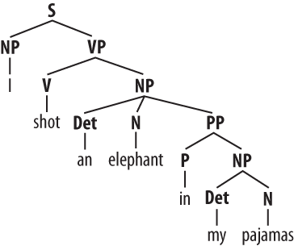
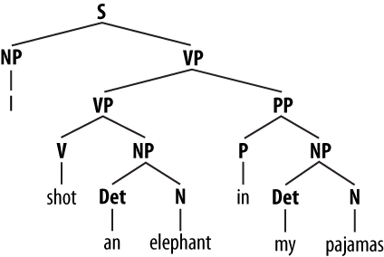
nltk parsing example using CFG for nltk 3.0 (http://www.nltk.org/book/ch08.html )
>>> for tree in parser.parse(sent):
print(tree)
((S
(NP I)
(VP
(VP (V shot) (NP (Det an) (N elephant)))
(PP (P in) (NP (Det my) (N pajamas)))))
(S
(NP I)
(VP
(V shot)
(NP (Det an) (N elephant) (PP (P in) (NP (Det my) (N pajamas))))))
Writing Your Own Grammars
>>> grammar1 = nltk.data.load('file:mygrammar.cfg')
>>> rd_parser = nltk.RecursiveDescentParser(grammar1)

Slide 30
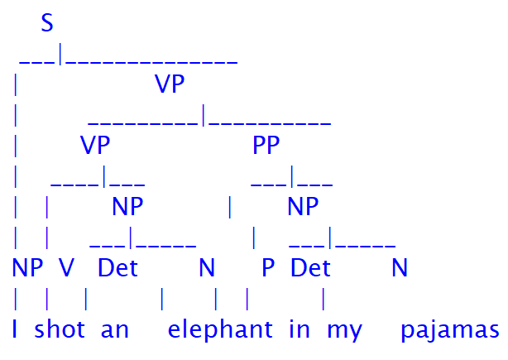
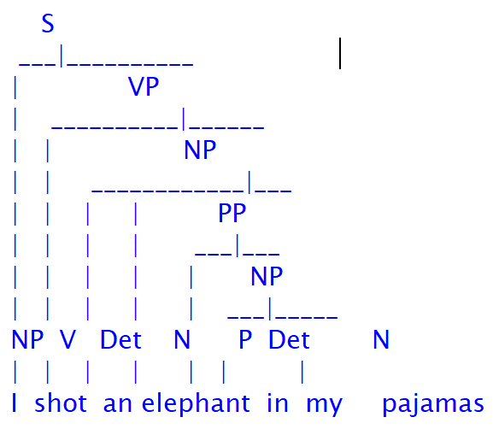
nltk parsing example using CFG for nltk 3.0 (http://www.nltk.org/book/ch08.html )
>>> for tree in parser.parse(sent):
tree.pretty_print()
Notice that there's no ambiguity concerning the meaning of any of the words; e.g. the word shot doesn't refer to the act of using a gun in the first sentence, and using a camera in the second sentence.

Slide 31
Context Free Grammar
grammar1 = nltk.CFG.fromstring("""
S -> NP VP
VP -> V NP | V NP PP
PP -> P NP
V -> "saw" | "ate" | "walked"
NP -> "John" | "Mary" | "Bob" | Det N | Det N PP
Det -> "a" | "an" | "the" | "my"
N -> "man" | "dog" | "cat" | "telescope" | "park"
P -> "in" | "on" | "by" | "with"
""")

Slide 32
Recursive Descent Parser
>>> sent = "Mary saw Bob".split()
>>> rd_parser = nltk.RecursiveDescentParser(grammar1)
>>> for tree in rd_parser.parse(sent):
print(tree)
(S (NP Mary) (VP (V saw) (NP Bob)))
>>> for tree in rd_parser.parse(sent):
tree.pretty_print()
S
____|___
| VP
| ___|___
NP V NP
| | |
Mary saw Bob

Slide 33
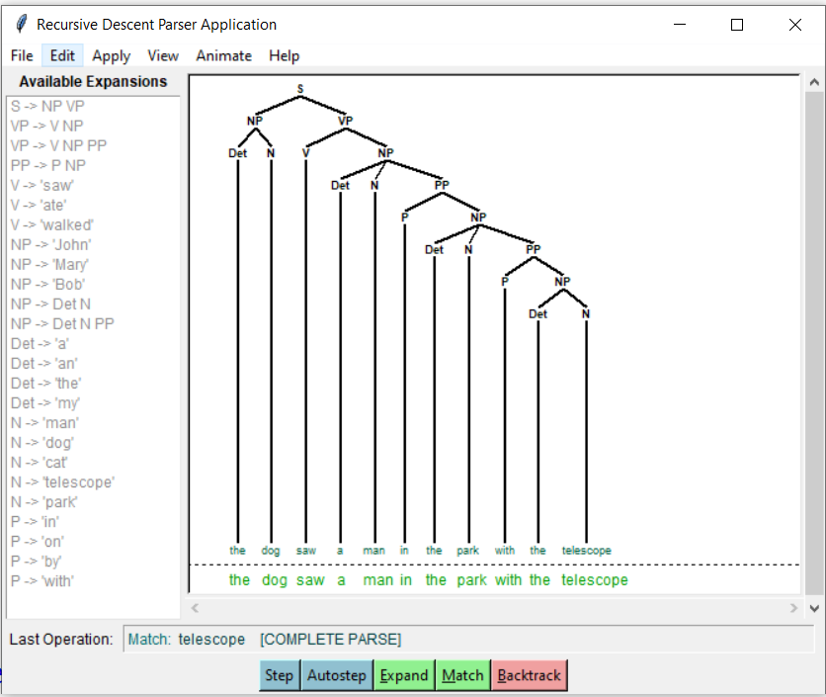
nltk.app.rdparser()

Slide 34
Shift Reduce Parser
>>> sr_parser = nltk.ShiftReduceParser(grammar1)
>>> sent = 'Mary saw a dog'.split()
>>> for tree in sr_parser.parse(sent):
print(tree)
(S (NP Mary) (VP (V saw) (NP (Det a) (N dog))))
>>> for tree in sr_parser.parse(sent):
tree.pretty_print()
S
________|___
| VP
| _______|___
| | NP
| | ___|___
NP V Det N
| | | |
Mary saw a dog

Slide 35
The Left-Corner Parser
>>> lc_parser = nltk.LeftCornerChartParser(grammar1)
>>> for tree in lc_parser.parse(sent):
print(tree)
(S (NP Mary) (VP (V saw) (NP (Det a) (N dog))))
>>>for tree in lc_parser.parse(sent):
tree.pretty_print()
S
________|___
| VP
| _______|___
| | NP
| | ___|___
NP V Det N
| | | |
Mary saw a dog

Slide 36
Treebanks
Context-free grammar rules of the type that can be used, to assign a parse tree to any sentence.
A treebank is a corpus in which every sentence is syntactically annotated with a parse tree.
The Penn Treebank project has produced treebanks from the Brown, Switchboard, ATIS, and Wall Street Journal corpora of English,
as well as treebanks in Arabic and Chinese.
Prague Dependency Treebank for Czech,
the Negra treebank for German

Slide 37
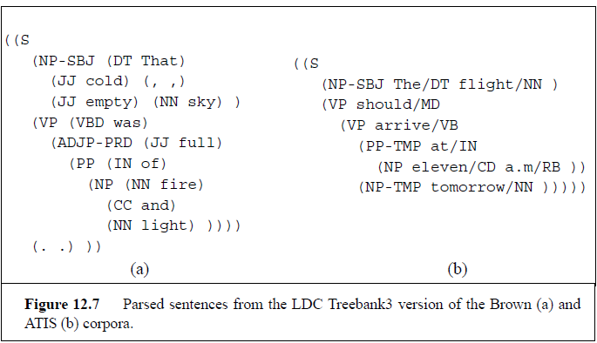
Example: The Penn Treebank Project

Slide 38
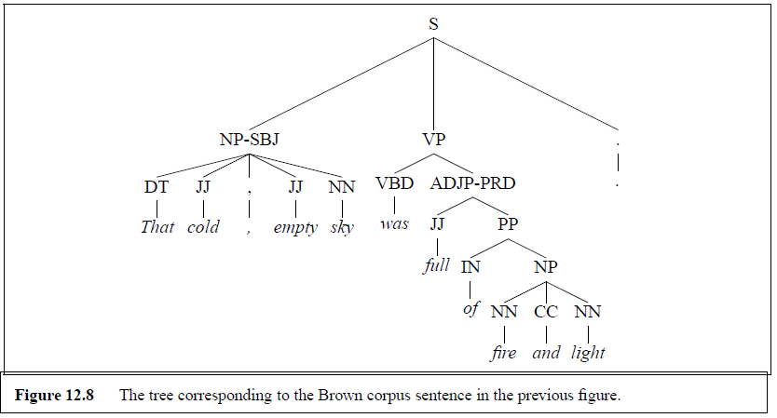
Example: The Penn Treebank Project

Slide 39
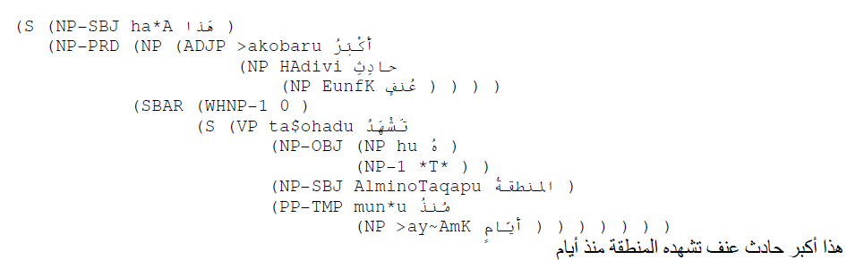
Arabic Penn Treebank
https://www.ldc.upenn.edu/collaborations/current-projects/bolt/annotation/treebank

Slide 40
from nltk.corpus import treebank
>>> from nltk.corpus import treebank
>>> t = treebank.parsed_sents('wsj_0001.mrg')[0]
>>> print(t)
(S
(NP-SBJ
(NP (NNP Pierre) (NNP Vinken))
(, ,)
(ADJP (NP (CD 61) (NNS years)) (JJ old))
(, ,))
(VP
(MD will)
(VP
(VB join)
(NP (DT the) (NN board))
(PP-CLR (IN as) (NP (DT a) (JJ nonexecutive) (NN director)))
(NP-TMP (NNP Nov.) (CD 29))))
(. .))

Slide 41
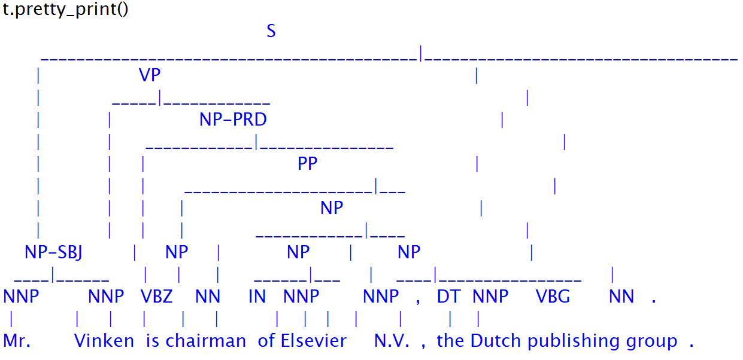

Slide 42
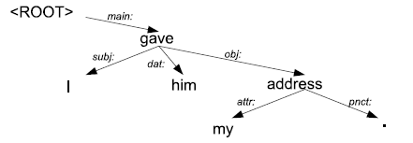
DEPENDENCY GRAMMARS
Dependency grammars are becoming quite important in speech and language processing
the syntactic structure of a sentence is described purely in terms of words and binary semantic or syntactic relations between these words.

Slide 43
DEPENDENCY GRAMMARS
Description | Argument dependencies
Nominal subject | nsubj
Clausal subject | csubj
Direct object | Dobj
Indirect object | iobj
Object of preposition | pobject
Description | Modifier Dependencies
Temporal modifier | tmod
Appositional modifier | appos
Determiner | det
Prepositional modifier | prep
hid
nsubj
dobj
They
letter
det
on
the
shelf
det
the
They hid the letter on the shelf

Slide 44
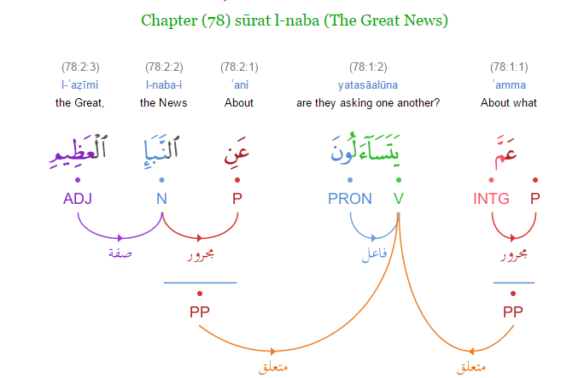
DEPENDENCY GRAMMARS
strong predictive parsing power: knowing the identity of the verb can help in deciding which noun is the subject or the object.
their ability to handle languages with relatively free word order.
Example of Quranic Arabic sentence form the Quranic Arabic Corpus
http://corpus.quran.com/treebank.jsp?chapter=78&verse=1&token=1

Slide 45
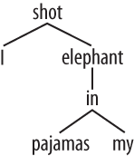
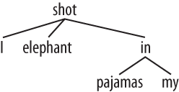
dependency grammar in NLTK
>>> groucho_dep_grammar = nltk.DependencyGrammar.fromstring ("""
'shot' -> 'I' | 'elephant' | 'in'
'elephant' -> 'an' | 'in'
'in' -> 'pajamas'
'pajamas' -> 'my‘
""")
>>> pdp = nltk.ProjectiveDependencyParser(groucho_dep_grammar)
>>> sent = 'I shot an elephant in my pajamas'.split()
>>> trees = pdp.parse(sent)
>>> for tree in trees:
print(tree)
(shot I (elephant an (in (pajamas my))))
(shot I (elephant an) (in (pajamas my)))
>>> print groucho_dep_grammar
Dependency grammar with 7 productions
'shot' -> 'I'
'shot' -> 'elephant'
'shot' -> 'in'
'elephant' -> 'an'
'elephant' -> 'in'
'in' -> 'pajamas'
'pajamas' -> 'my'

Slide 46
for tree in trees:
tree.pretty_print()
shot
___|______
| elephant
| ______|________
| | in
| | |
| | pajamas
| | |
I an my
shot
_____|________
| | in
| | |
| elephant pajamas
| | |
I an my

Slide 47
13.4 Dynamic Programming Parsing Methods
Dynamic programming provides a frame work for solving parsing ambiguity.
dynamic programming approaches systematically fill in tables of solutions to sub-problems. When complete, the tables contain the solution to all the sub-problems needed to solve the problem as a whole.
the three most widely used methods are:
the Cocke-Kasami-Younger (CKY) algorithm,
the Earley algorithm,
Chart Parsing.

Slide 48
CKY Parsing
the grammars used with it must be in Chomsky Normal Form (CNF).
grammars in CNF are restricted to rules of the form A → B C, or A → w.
The right-hand side of each rule must expand to either two nonterminals or to a single terminal.
any context-free grammar can be converted into a corresponding CNF grammar that accepts exactly the same set of strings as the original grammar.

Slide 49
Converting a generic CFG into one represented in CNF
rules that mix terminals with non-terminals on the right-hand side:
Introduce a new dummy non-terminal that covers only the original terminal.
INF-VP → to VP CONVERTED INF-VP → TO VP, TO → to.
rules that have a single non-terminal on the right called (unit production):
rewrite the right-hand side of the original rules with the right-hand side of all the non-unit production rules that they ultimately lead to.
if A ∗⇒ B by a chain of one or more unit productions, and B→γ is a non-unit production in our grammar, then we add A →γ for each such rule in the grammar, and discard all the intervening unit productions.

Slide 50
rules where the right-hand side’s length is greater than two:
Introduce a new non-terminals that spread the longer sequences over several new productions.
Formally, if we have a rule like
A → B Cγ
we replace the leftmost pair of non-terminals with a new non-terminal and introduce a new production result in the following new rules.
X1 → B C
A → X1 γ
the rule S → Aux NP VP would be replaced by the two rules S → X1 VP and X1 → Aux NP.

Slide 51
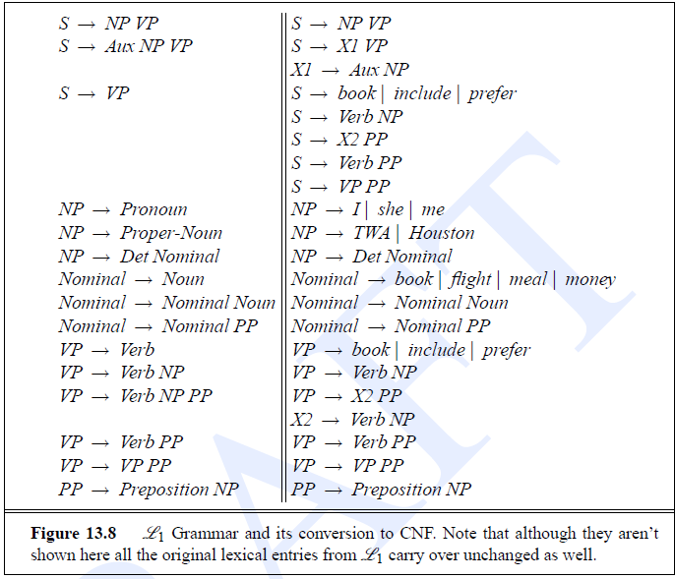
L1 in CNF

Slide 52
CKY Recognition
With our grammar now in CNF, each non-terminal node above the part-of-speech level in a parse tree will have exactly two daughters.
A simple two-dimensional matrix can be used to encode the structure of an entire tree.
For a sentence of length n, we will be working with the upper-triangular portion of an (n+1)×(n+1) matrix.
Each cell [i, j] in this matrix contains a set of non-terminals that represent all the constituents that span positions i through j of the input.
indexes are pointing at the gaps between the input words (0 Book 1 that 2 flight 3).
It follows then that the cell that represents the entire input resides in position [0,n] in the matrix.

Slide 53
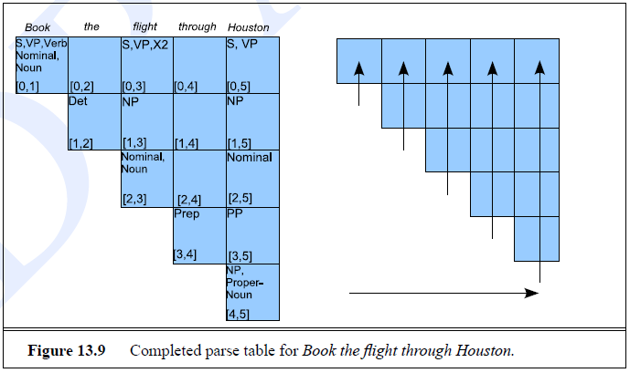
Book the flight through Houston

Slide 54
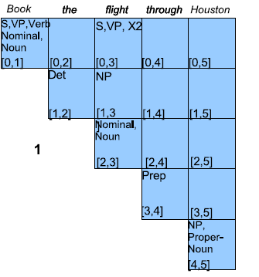
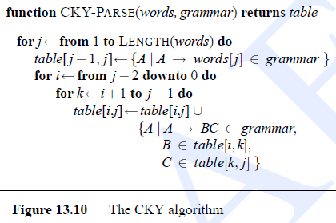
CKY Parsing
S1, VP, X2
S2, VP
S3
NP
Nominal
PP

