Slide 1
LLM.int8(): 8-bit Matrix Multiplication for Transformers at Scale
Tim Dettmers, Mike Lewis, Younes Belkada, Luke Zettlemoyer
Presented by: Viswa Raj

Slide 2
Introduction
LLMs are demanding
Require substantial memory, often beyond consumer GPUs
Current 8-bit quantization methods save memory but degrade performance as model size grows
Goal of this paper
Develop an 8-bit quantization method that:
Reduces memory requirements
Maintains accuracy, even at large scales (up to 175B parameters)

Slide 3
Quantization
Quantization
Reduces the precision of model weights from 32-bit to 8-bit
Saves memory and improves speed, allowing large models to run on consumer hardware
Why do we care?
Lower precision uses less memory
Smaller weights allow quicker calculations
Issues w/ 8-bit quantization:
Reducing to 8-bit often harms model accuracy
Most methods fail to maintain performance for models over 350M parameters

Slide 4
LLM.int8()
LLM.int8()
An 8-bit quantization method tailored for large models
Efficiently handles up to 175B parameters without sacrificing accuracy, making large models accessible on consumer GPUs
Core Components (2 steps):
8-bit Vector-wise Quantization: Improves precision by using separate normalization for each vector
Mixed-Precision Decomposition: Handles extreme values with 16-bit precision, ensuring no performance loss

Slide 5
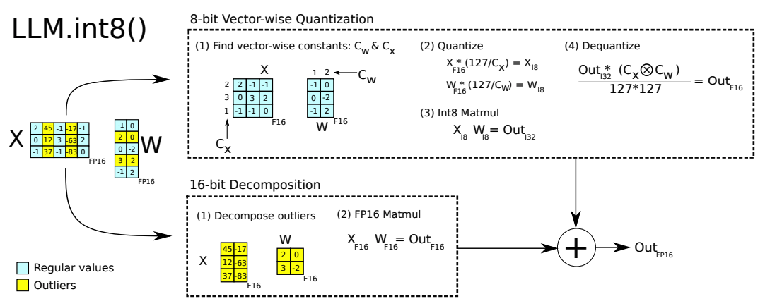
LLM.int8()
Notes:
Figure 2: Schematic of LLM.int8(). Given 16-bit floating-point inputs Xf16 and weights Wf16, the features and weights are decomposed into sub-matrices of large magnitude features and other values. The outlier feature matrices are multiplied in 16-bit. All other values are multiplied in 8-bit. We perform 8-bit vector-wise multiplication by scaling by row and column-wise absolute maximum of Cx and Cw and then quantizing the outputs to Int8. The Int32 matrix multiplication outputs Outi32 are dequantization by the outer product of the normalization constants Cx ⊗ Cw. Finally, both outlier and regular outputs are accumulated in 16-bit floating point outputs.

Slide 6
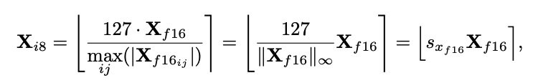
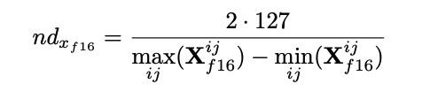


8-bit Data Types and Quantization
Absmax quantization
Scales by the max absolute value, ideal for zero-centered data but vulnerable to outliers
Zeropoint quantization
Uses affine transformation to map to [-127, 127], beneficial for asymmetric data distributions
Does this by scaling normalized dynamic range and then shifting by the zeropoint
Notes:
Affine transformation is a linear mapping method that preserves points, straight lines, and planes. Sets of parallel lines remain parallel after an affine transformation. The affine transformation technique is typically used to correct for geometric distortions or deformations that occur with non-ideal camera angles.
For example, for ReLU outputs, in absmax quantization all values in [−127, 0) go unused, whereas in zeropoint quantization the full [−127, 127] range is used. Z

Slide 7
8-bit Vector-wise Quantization
Vector-wise Quantization
A quantization technique that uses separate scaling for each row and column of a matrix, ensuring more accurate 8-bit quantization
Enhances precision by adjusting for variations across each row and column
Retains model accuracy better than single-scaling methods
How It Works
Applies a unique normalization constant to each vector before converting to 8-bit, reducing the impact of outliers on the overall matrix
Notes:
Uses absmax vector wise quantiziation

Slide 8

Mixed-Precision Decomposition
High Level
Selectively applies 16-bit precision to handle outliers while keeping most values in 8-bit
How it works
Identifies extreme values, or outliers, that exceed a magnitude threshold α = 6.0
Outliers are processed in 16-bit, while the remaining 99.9% of data is processed in 8-bit
Notes:
We find that given input matrix Xf16 ∈ R s×h , these outliers occur systematically for almost all sequence dimensions s but are limited to specific feature/hidden dimensions h. As such, we propose mixed-precision decomposition for matrix multiplication where we separate outlier feature dimensions into the set O = {i|i ∈ Z, 0 ≤ i ≤ h}, which contains all dimensions of h which have at least one outlier with a magnitude larger than the threshold α. In our work, we find that α = 6.0 is sufficient to reduce transformer performance degradation close to zero. Using Einstein notation where all indices are superscripts, given the weight matrix Wf16 ∈ R h×o , mixed-precision decomposition for matrix multiplication is defined as follows: where Sf16 is the denormalization term for the Int8 inputs and weight matrices Xi8 and Wi8. This separation into 8-bit and 16-bit allows for high-precision multiplication of outliers while using memory-efficient matrix multiplication with 8-bit weights of more than 99.9% of values. Since the number of outlier feature dimensions is not larger than 7 (|O| ≤ 7) for transformers up to 13B parameters, this decomposition operation only consumes about 0.1% additional memory.

Slide 9
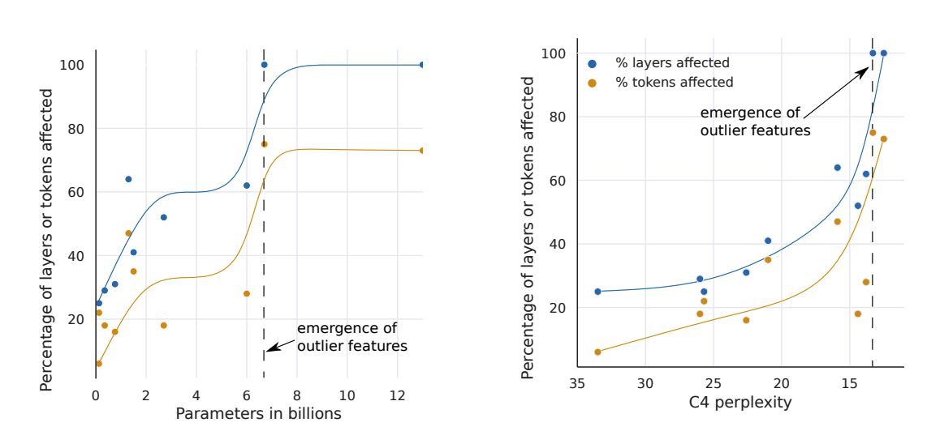
Outlier Features
Notes:
Once the phase shift occurs, outliers are present in all layers and in about 75% of all sequence dimensions. While (a) suggest a sudden phase shift in parameter size, (b) suggests a gradual exponential phase shift as perplexity decreases. The stark shift in (a) co-occurs with the sudden degradation of performance in quantization method
if we treat any feature with a magnitude 6 or larger as an outlier feature. For the number of layers affected by outliers, we find that outlier features are systematic in large models: they either occur in most layers or not at all. On the other hand, they are probabilistic in small models: they occur sometimes in some layers for each sequence

Slide 10
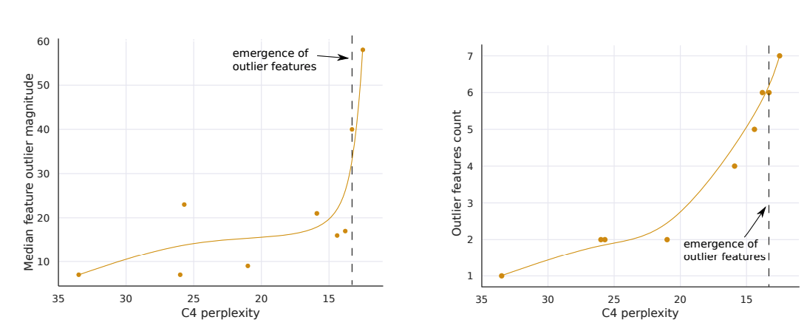
Outlier Features
Notes:
we set the outlier features to zero before feeding the hidden states Xl into the attention projection layers and then compare the top-1 softmax probability with the regular softmax probability with outliers. We do this for all layers independently, meaning we forward the regular softmax probabilities values to avoid cascading errors and isolate the effects due to the outlier features. We also report the perplexity degradation if we remove the outlier feature dimension (setting them to zero) and propagate these altered, hidden states through the transformer. As a control, we apply the same procedure for random non-outlier feature dimensions and note attention and perplexity degradation.

Slide 11
Outlier Features (Takeaway)
Emergence by model size
Smooth emergence by perplexity
Impact of outlier magnitude
Outliers and perplexity relationship
Notes:
Sudden Emergence of Outliers by Model Size:
“Between 6B and 6.7B parameters, large outlier features suddenly appear in all transformer layers. This correlates with a spike in layers affected, from 65% to 100%.”
“Quantization failures start occurring at this model scale, as outlier features disrupt precision.”
Smooth Emergence by Perplexity:
“Measured by perplexity, outlier features emerge gradually with decreasing perplexity. This suggests that outliers are tied to perplexity trends rather than sudden size thresholds.”
“Detecting outliers early could be possible by monitoring perplexity trends in smaller models.”
Impact of Outlier Magnitude on Quantization:
“When outliers appear in all layers, their large magnitude and uneven distribution significantly disrupt Int8 precision.”
“At 6.7B parameters, outlier magnitudes exceed the 8-bit range, leading to empty quantization bins and loss of information.”
Relationship Between Outliers and Perplexity:
“Outlier features increase as perplexity decreases, not directly with model size. This suggests perplexity is a stronger predictor of outlier emergence than size alone.”
“Model size is a factor, but perplexity appears to be a primary determinant in reaching the phase shift.”

Slide 12
Experimental Setup
Models
Tested on models from 125M to 175B parameters, including GPT-3, OPT-175B, and BLOOM.
Methodology
Applied 8-bit quantization with mixed-precision for outliers, compared to 16-bit baselines.
Metrics
Perplexity for accuracy
Inference speed (tokens/sec) for performance
Memory utilization for GPU efficiency
Environment
NVIDIA A100 GPU cluster, with single and multi-GPU setups for comprehensive benchmarking.

Slide 13
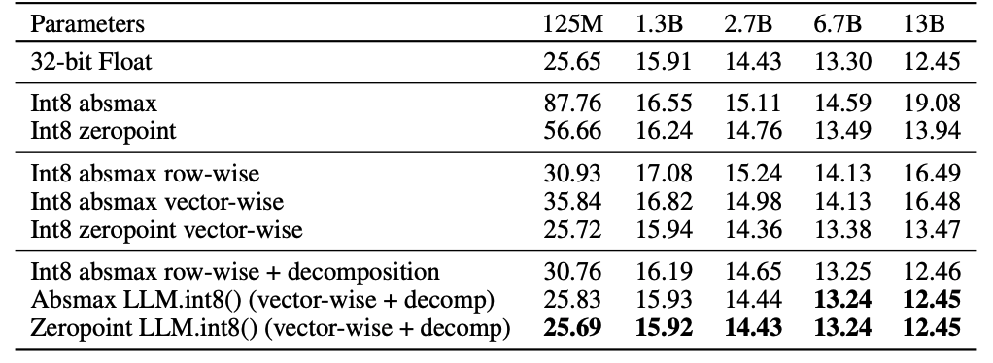
Results
Maintains perplexity compared to 16-bit precision up to 175B parameters
2x speed in matrix multiplication
Nearly the same per-token generation speed compared to 16-bit models
Notes:
We see that absmax, row-wise, zeropoint, and vector-wise quantization leads to significant performance degradation as we scale, particularly at the 13B mark where 8-bit 13B perplexity is worse than 8-bit 6.7B perplexity. If we use LLM.int8(), we recover full perplexity as we scale. Zeropoint quantization shows an advantage due to asymmetric quantization but is no longer advantageous when used with mixed-precision decomposition

Slide 14
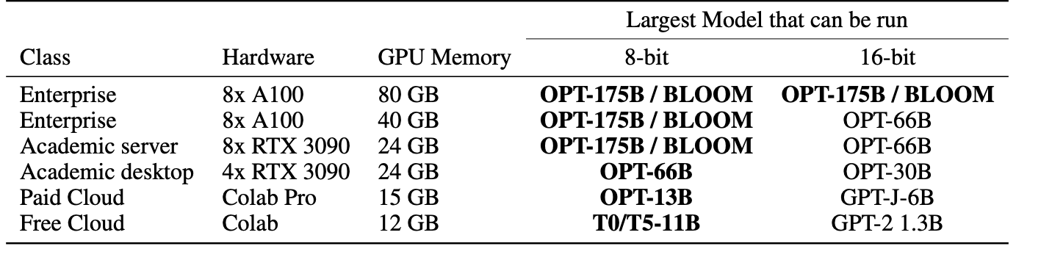
Results
Notes:
Table 2: Different hardware setups and which methods can be run in 16-bit vs. 8-bit precision. We can see that our 8-bit method makes many models accessible that were not accessible before, in particular, OPT-175B/BLOOM.

Slide 15
Limitations and Future Work
Current Limitations
Limited speed gains for models under 6.7B parameters
Accuracy depends on efficient outlier detection
Currently applicable to inference only, not training
Future Directions
Optimize CUDA kernels to improve speed across all model sizes
Explore FP8 quantization for a balance between precision and efficiency
Investigate methods to extend LLM.int8() for training large models

Slide 16
AWQ: Activation-aware Weight Quantization for On-Device LLM Compression and Acceleration
MIT, Shanghai Jiao Tong University, NVIDIA, Tsinghua University, MIT-IBM Watson AI Lab, UMass Amherst
MLSys'24 Best Paper
Presented by: Arijus Trakymas

Slide 17
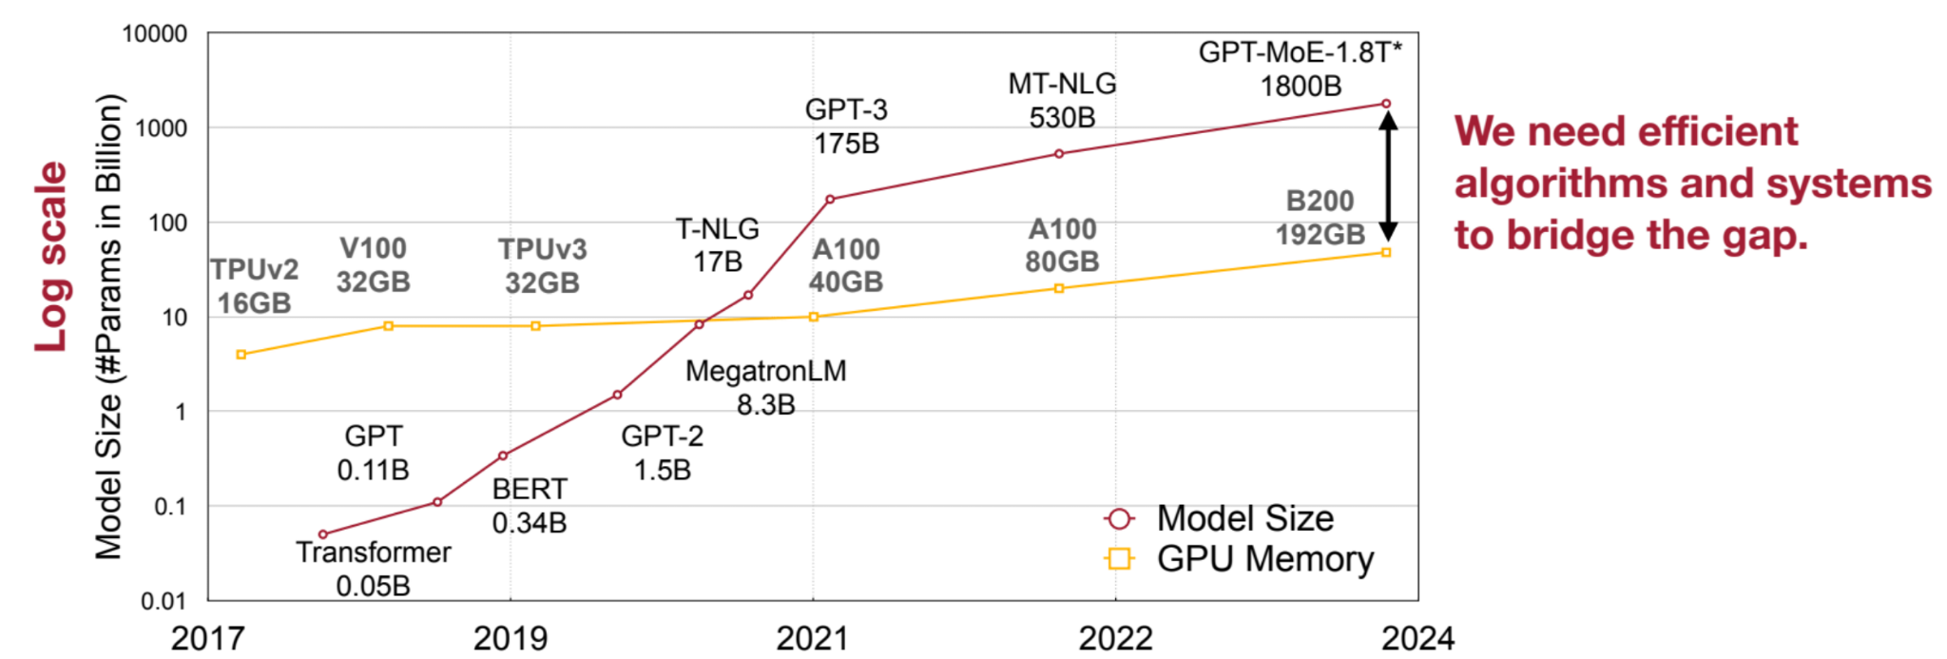
Problem - Large Language Models are expensive
Model sizes are exploding, hardware is being outpaced
Need for compression methods & efficient way to run LLMs
High cost to run LLM
GPT-3 w/ 175B requires 360GB (FP16)
[1]

Slide 18
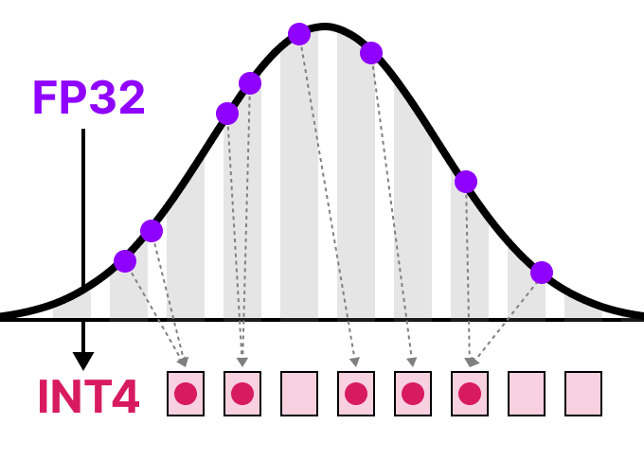
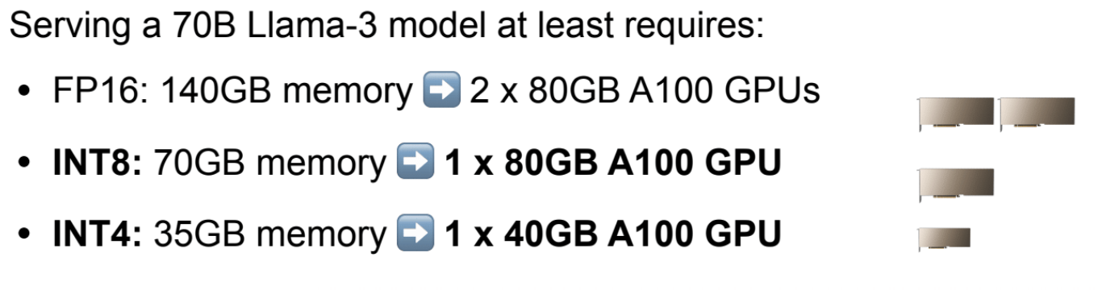
Solution - Quantization
Quantization
process of mapping input values from a large set to output values in a smaller set
Lowers bit width which improves efficiency
[1], [2]

Slide 19
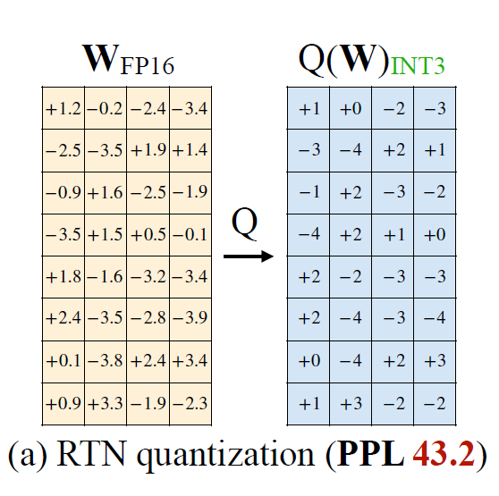
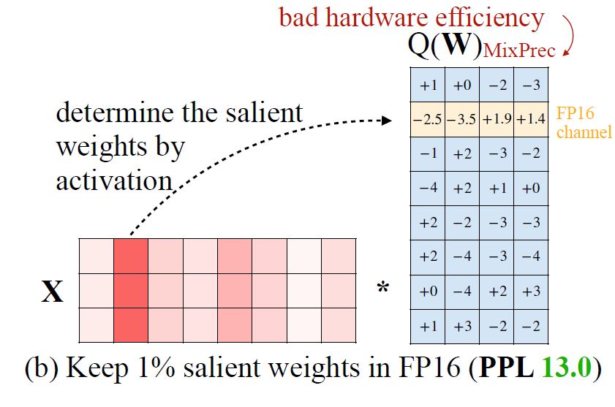
Solution - Mixed precision approach
Quantizing all weights leads to performance loss
Can skip quantization of salient weights to boost performance
How to select salient weights?
Selecting weights by activation magnitude boosts performance
How to avoid mixed precision weights?

Slide 20
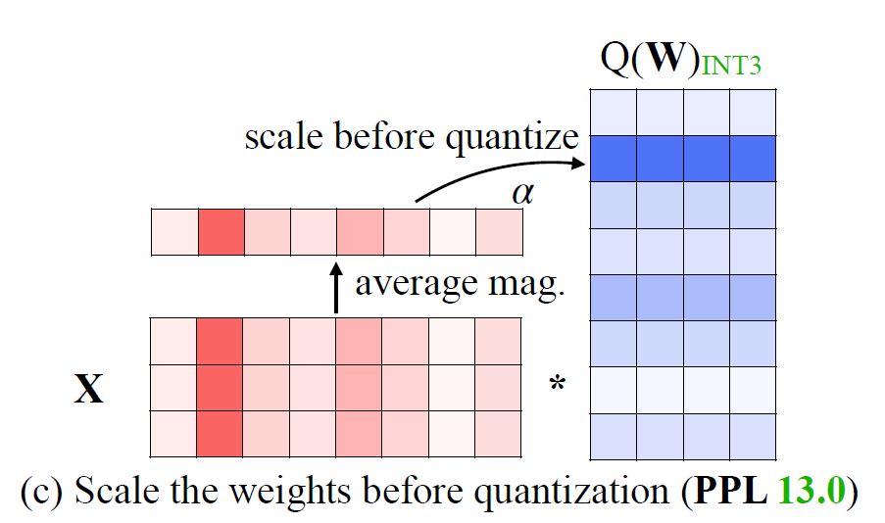
Solution - Scale up salient weights
Need alternative method to reduce quantization error of salient weight
Per-channel scaling
Idea: we scale up weights and not increase quantization error

Slide 21
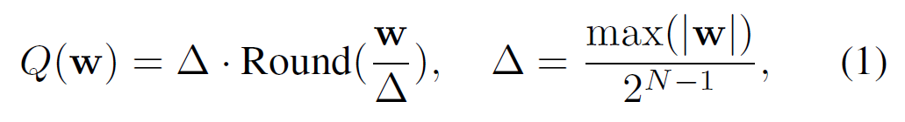
Solution - Scale up salient weights
Rounds up weights
Quantization scalar
Q(w) = quantization error for linear layer y = wx
N is quantization bits
Round maps floating point to integer

Slide 22
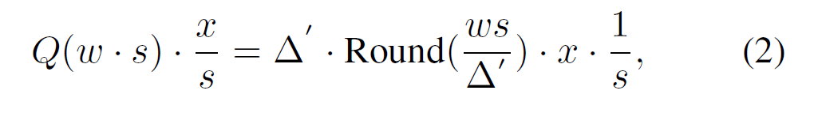
Solution - Scale up salient weights
Take into account scale
Same equation now with scaling factor.
Scaling up results in avg. error of ~ 0.25
Scaling up single element usually does not change max
Therefore delta prime is approximately equal to delta

Slide 23
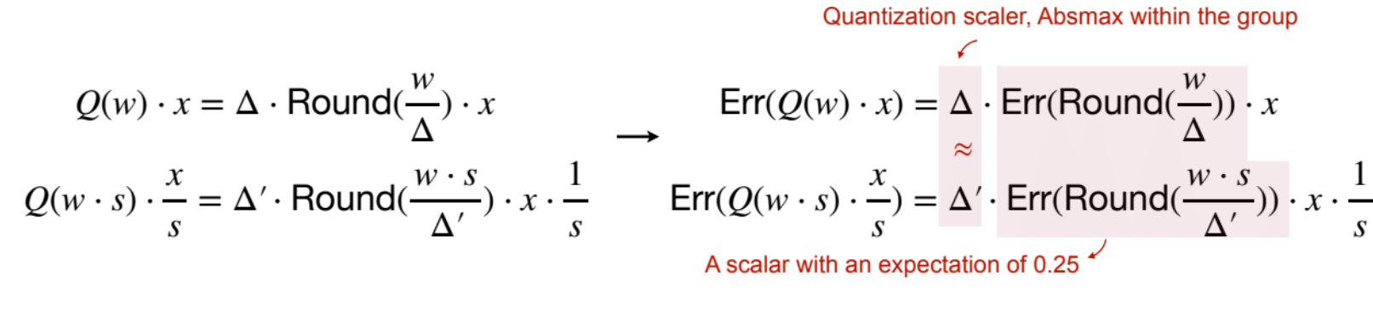
Solution - Scale up salient weights
Dominant error term
s > 1
Intuition: relative error is smaller for weight w, assuming s is not too large

Slide 24
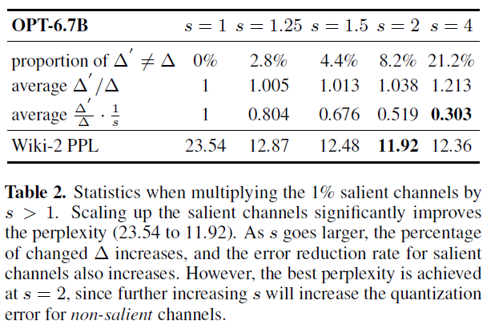
Solution - Activation-aware Scaling
Verify idea
Scale up 1% salient weights
Relative error increases for non-salient channels
Consideration of activation awareness for salient channels

Slide 25
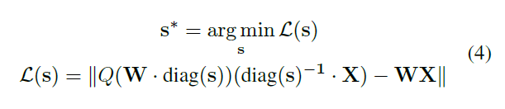
Solution - Activation-aware Scaling
Original weights (FP16)
Per input scaling factor
Input features (subset of pre-training dataset)
Need to find optimal scaling factor
Use calibration set of features

Slide 26

Solution - Activation-aware Scaling
Avg. magnitude of activation
Hyperparameter to balance salient/non-salient channels
Saliency of weight channels determined by average activation magnitude
Do grid search to find alpha in interval of [0, 1]
0 means no scaling, 1 most aggressive
Search objective is mean square root error for activation

Slide 27
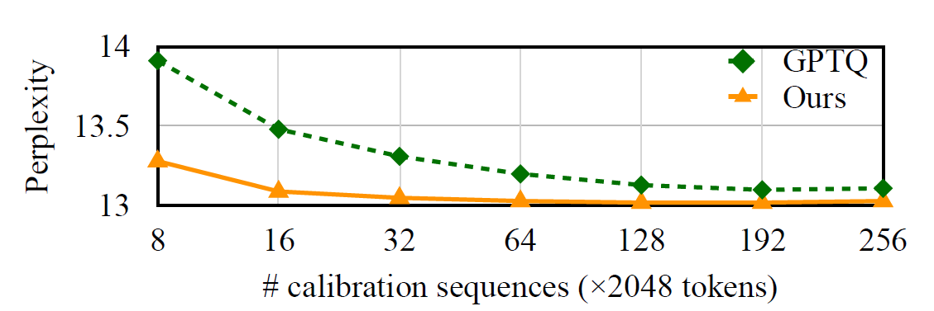
Advantages
Accurate, simple/easy to implement
Hardware friendly; high efficiency
Minimal reliance on the calibration set
Better robustness outside of calibration set

Slide 28
Limitations
4-bit weight, 16-bit activation (W4A16)
Different data types for memory access & computation
Dequantization needs to be incorporated into primary compute loop to ensure optimal performance
Authors implement TinyChat to address this - maintenance & support long term?

Slide 29
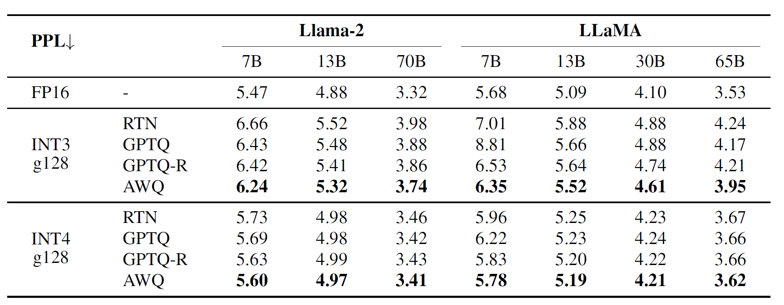
AWQ Results

Slide 30
Related work - GPTQ
One-shot weight quantization method based on approximate second-order information
Focus is to minimize squared error of weights
Compress down to 3 / 4 bits

