Slide 1
LLaMA 3
Presented by Steven and Enguang
Notes:
Mindset and methodologies behind spending 10s of M of $ to train an LLM

Slide 2
From Transformers to LLMs
GPT 1 (Sutskever, 2018): large-scale pretraining (Sutskever, 2018)
Supervised fine-tuning for downstream tasks
Decoder only

Slide 3
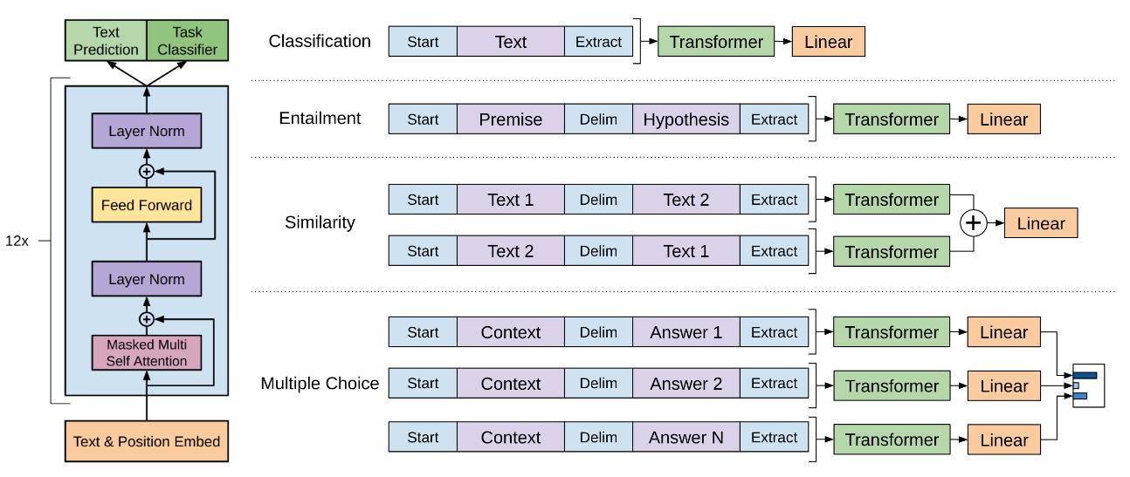
From Transformers to LLMs
GPT 1 (Sutskever, 2018): large-scale pretraining

Slide 4
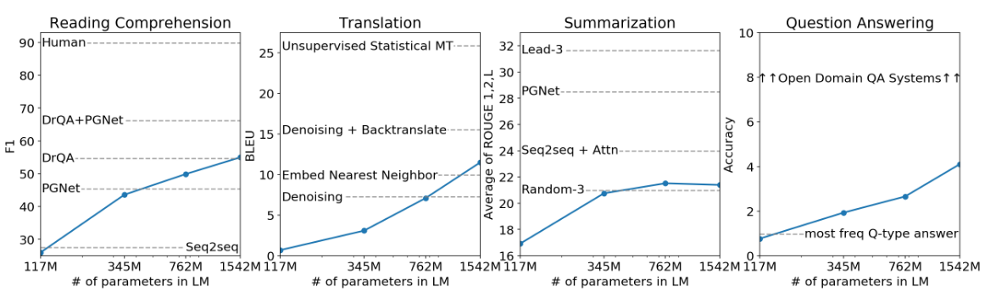
From Transformers to LLMs
GPT 2 (Sutskever, 2019): scaling up
117M (GPT-1) -> 1.5 B
First glimpse of scaling law

Slide 5
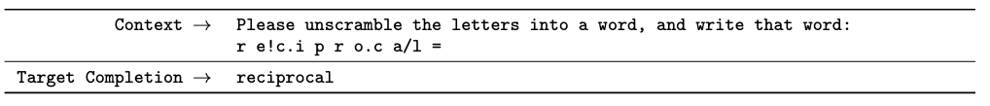
From Transformers to LLMs
GPT 3 (Sutskever, 2020): few-shot learning
1.5B -> 175B
Translation, question answering, and summarization for zero/few shot prompts
No fine-tuning for downstream tasks

Slide 6
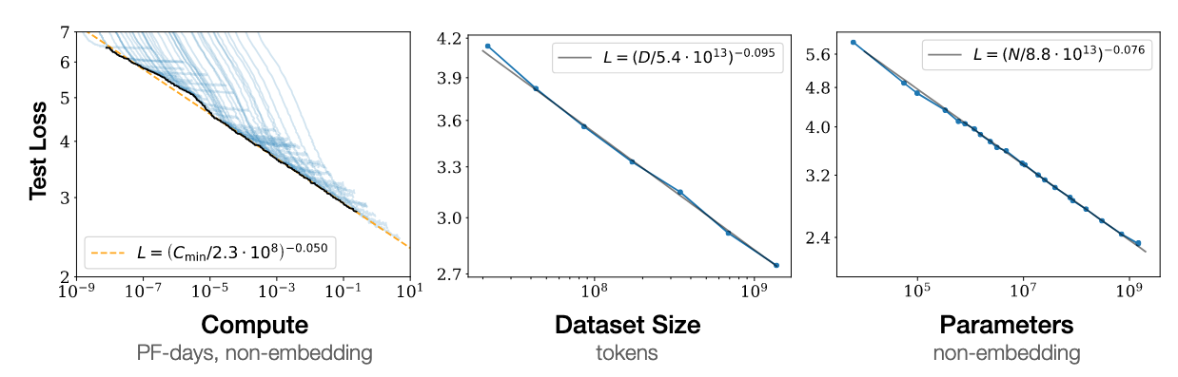
From Transformers to LLMs
GPT 3 (Sutskever, 2020): few-shot learning
Power law continues for 2 orders of magnitude
Notes:
Scaling is a power-law function of model size

Slide 7
Scaling Law: GPT-3
Compute required = model size ✕ iterations ✕ batch size (data)
Given a fixed amount of compute, how do we allocate between these?

Slide 8
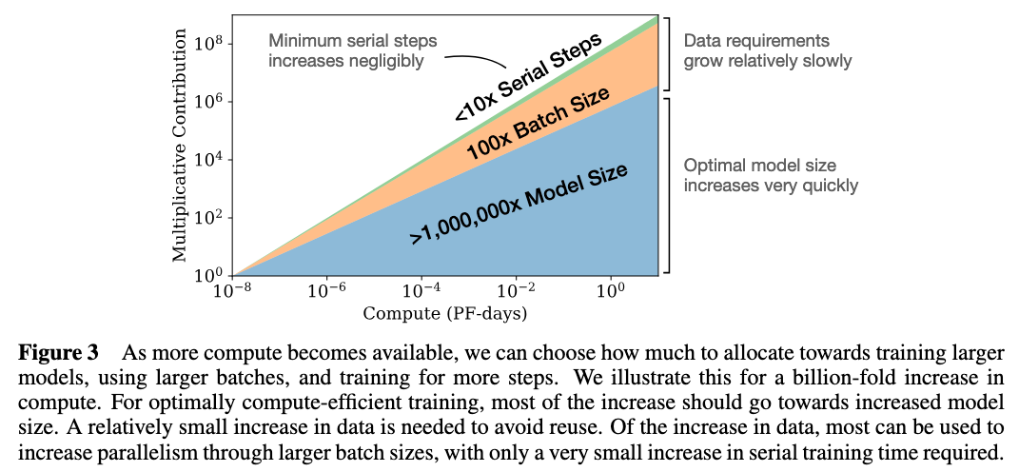
Scaling Law: GPT-3
Notes:
Better to spend compute training a large model than to train a smaller model with more data

Slide 9
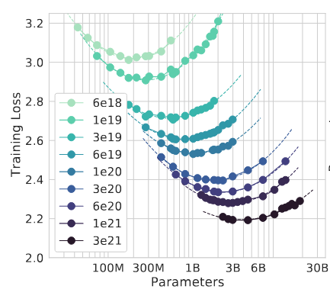
Scaling Law: Chinchilla
Notes:
However, OpenAI’s scaling law isn’t exactly correct
The original llama paper followed the Chinchilla scaling law but found 7B model continues to scale on far more tokens than predicted

Slide 10
Scaling Law: Chinchilla
OpenAI models were underfit for their capacity
Compute optimal: data should roughly scale with model size
Notes:
The original llama paper followed the Chinchilla scaling law but found 7B model continues to scale on far more tokens than predicted

Slide 11
Scaling Up: LLaMA 3
Existing laws doesn’t forecast benchmark performance
Scaling laws might not scale
Estimated using pre-training runs with much smaller compute
Might be noisy

Slide 12
Scaling Up: LLaMA 3
Establish the correlation between
model and negative log-likelihood on downstream tasks
negative log-likelihood with task accuracy

Slide 13
Scaling Up: LLaMA 3
Train using compute between 6e8 and 1e22 FLOPs
Adjust cosine annealing schedule with trajectory length
OpenAI didn’t do this

Slide 14
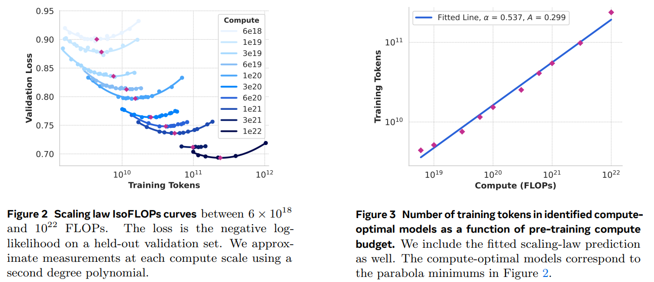
Scaling Up: LLaMA 3
Notes:
Over some point it’s just overfitting, the left and right figure convey the same meaning. Connect the left figure’s dot gives you the second figure.

Slide 15

Scaling Up: LLaMA 3
total compute
optimal number of training tokens
Notes:
Over some point it’s just overfitting, the left and right figure convey the same meaning. Connect the left figure’s dot gives you the second figure.

Slide 16
Multi-Modality

Slide 17
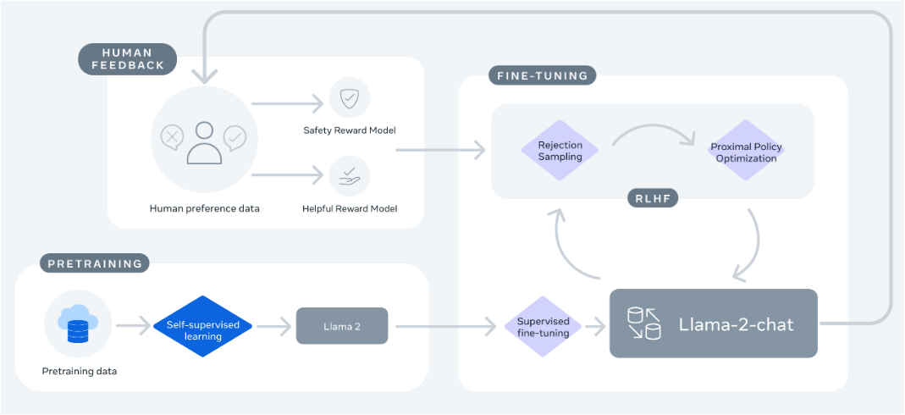
Training Overview
DPO

Slide 18
Multi-Modality
Image
Video
Speech

Slide 19
Multi-modality
Image
Self-supervised training encoder on image-text pairs
Adapter that feeds image representation in cross-attention layers
Trained on image-text pair for alignment
LLM parameters frozen during adapter training

Slide 20
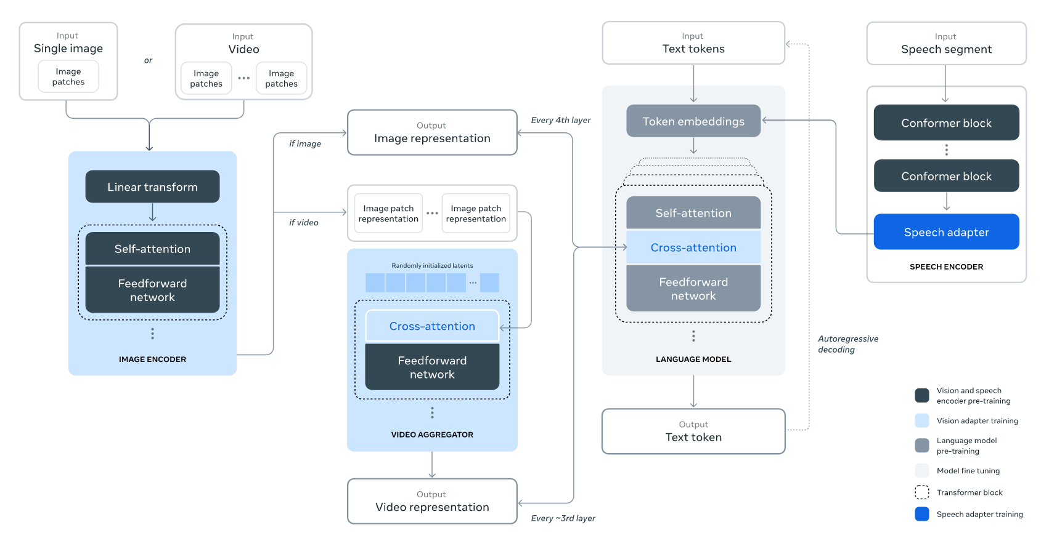
Multi-Modality

Slide 21
Multi-modality
Image
Video
Trained on top of image adapter on video-text pairs

Slide 22
Multi-Modality

Slide 23
Multi-modality
Image
Video
Speech
Adapter that converts speech to token representation

Slide 24
Multi-Modality

Slide 25
Scaling the System

Slide 26
Scaling Up the System
Llama 3 405B is trained on
16K H100 80 GB (577M worth)
Intra node: NVLink
Inter node: RDMA over Converged Ethernet
400 Gbps between GPU
Notes:
Each HGX node is 290 K
NVLink is 100 GB/s

Slide 27
4-D Parallelism
Tensor
Pipeline
Context
Fully-Sharded Data

Slide 28
Context Parallel
Challenge: KV cache for long sequences hits the memory wall
Solution: partition KV cache over multiple GPUs
All-gather for KV pairs during forward pass
Reduce-scatter during backward propagation

Slide 29
Fully Sharded Data Parallel
Challenge: GPU memory wall
HBM and sometimes even system memory can’t fit model and optimizer states
Solution: shard each layer over multiple GPUs

Slide 30
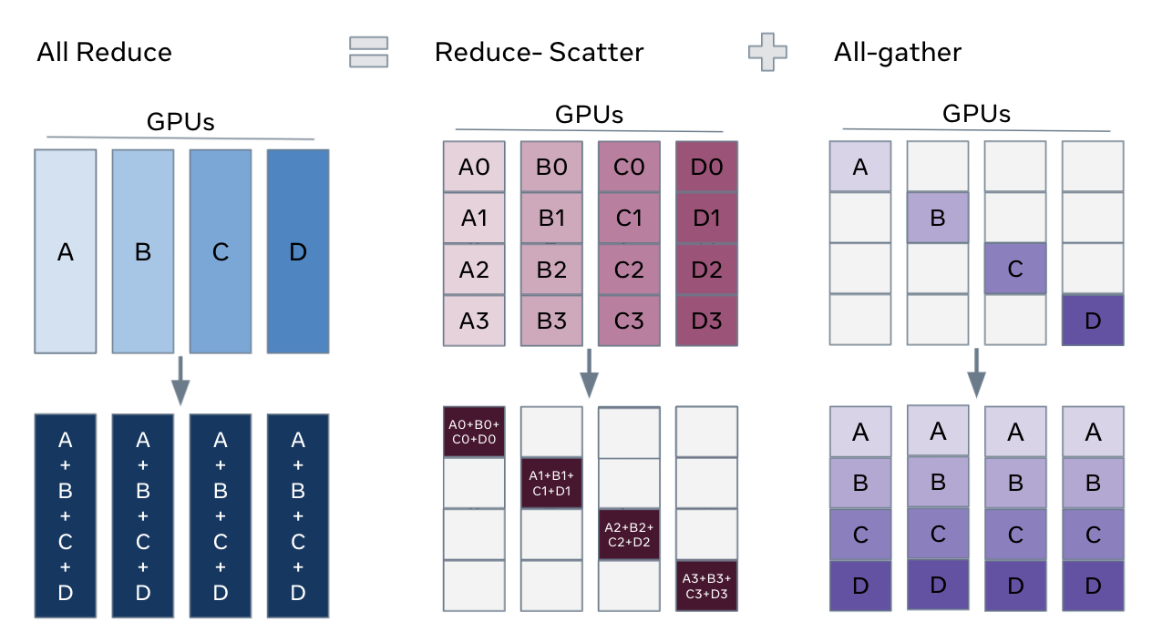
Recap: Collective Operations
Image source: https://engineering.fb.com/2021/07/15/open-source/fsdp/

Slide 31
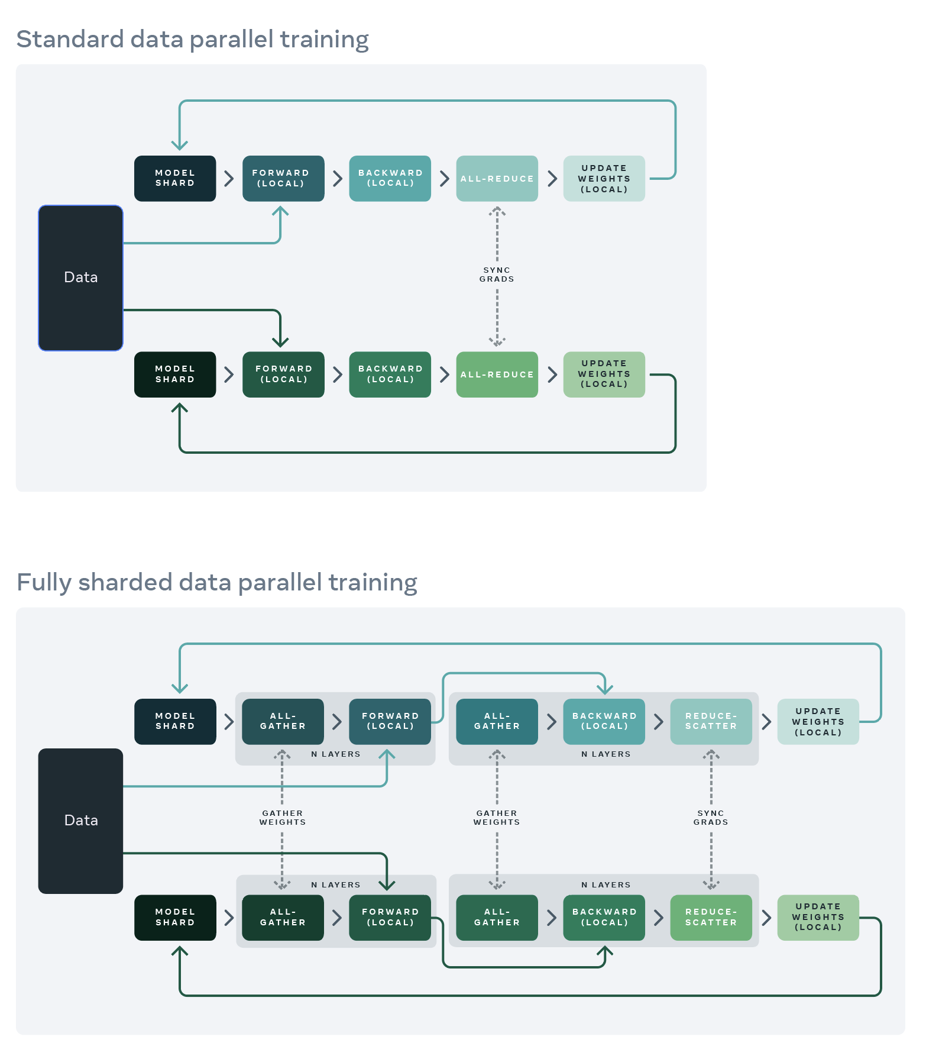
Distributed Data Parallel (DDP)
Image source: https://engineering.fb.com/2021/07/15/open-source/fsdp/

Slide 32
Fully Sharded Data Parallel
Image source: https://engineering.fb.com/2021/07/15/open-source/fsdp/

Slide 33
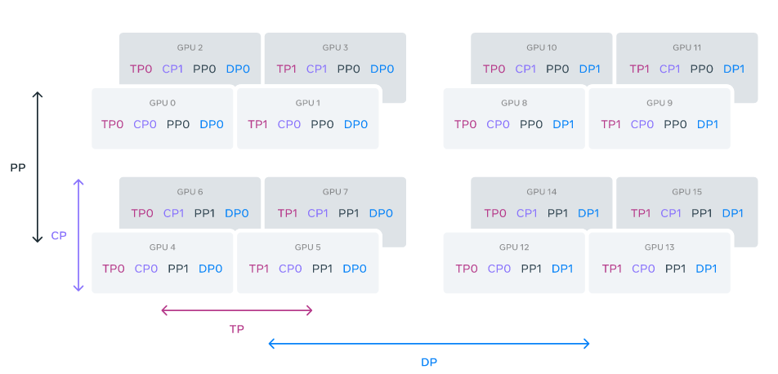
4-D Parallelism
Image source: Llama Team, 2024

Slide 34
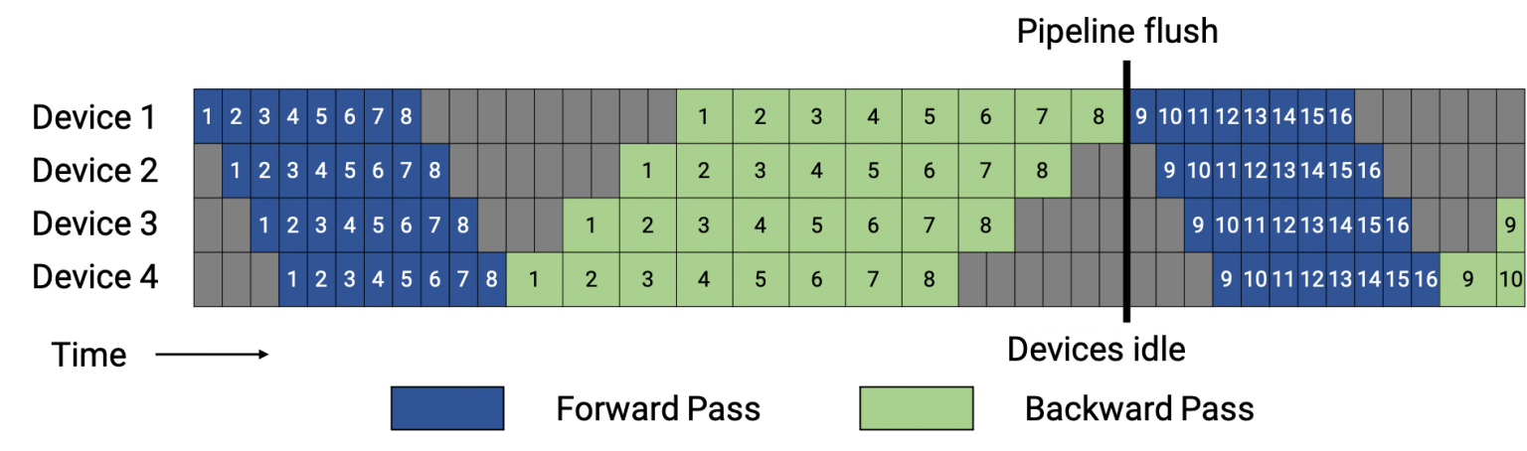
Bubbles in PP

Slide 35
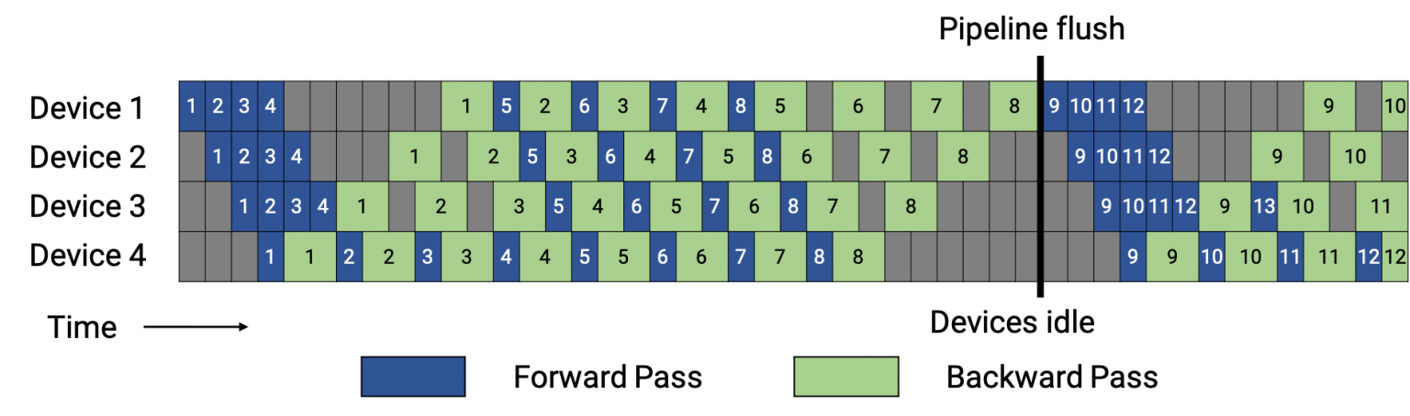
The 1-Forward-1-Backward (1F1B) Schedule

Slide 36
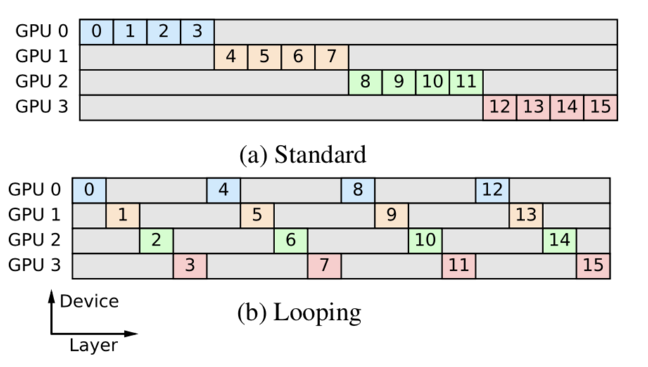
BFS and DFS Schedules
Does the layer partition need to be consecutive?

Slide 37
BFS and DFS Schedules
DFS: prioritize earlier microbatches
BFS: prioritize earlier stages

Slide 38
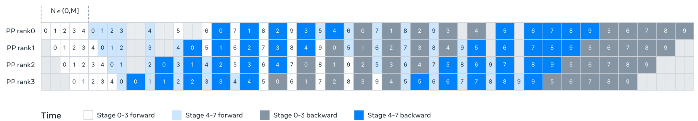
Scheduling
Key insight: N is tunable
Image source: Llama Team, 2024
Notes:
1) fewer micro-batches than the number of stages when we have batch size limit at large scale; or
(2) more micro-batches to hide point-to-point communication, finding a sweet spot between DFS and breadth first schedule (BFS) for the best communication and memory efficiency.

Slide 39
Post-Training

Slide 40
Post-training
Definition: Post-training refers to the process that follows initial pre-training where the model is further optimized using supervised fine-tuning (SFT), human feedback, and preference alignment techniques.
Importance: Pre-training gives the model a rich understanding of language, but post-training refines this understanding to better align with human instructions and preferences.
Objective: This phase helps improve model behavior for specific tasks like coding, multilinguality, reasoning, and tool use.

Slide 41
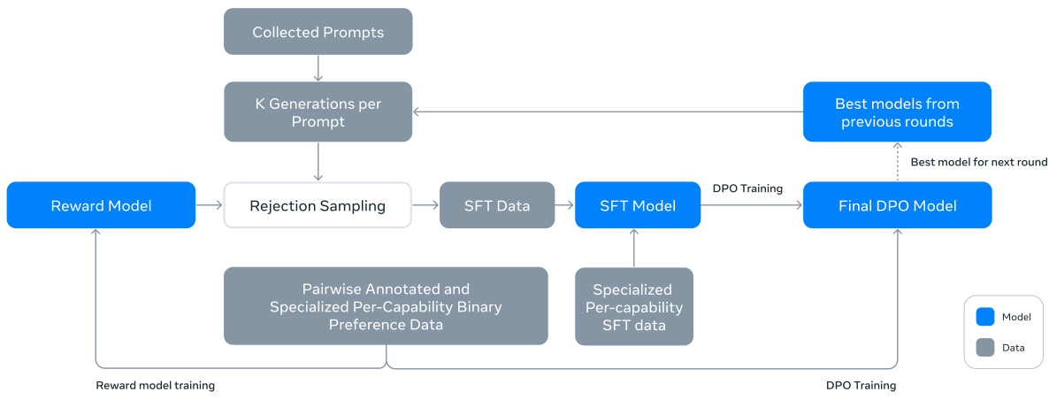
DPO data
Notes:
We do this for 6 rounds. The process starts with collecting prompts from various sources. These prompts are input questions, tasks, or instructions that will be used to fine-tune the model.
For each collected prompt, the model generates multiple responses, denoted as K generations. These responses are then used to select the best possible output through the next process, which is rejection sampling.
In rejection sampling, the generated responses (K generations) for each prompt are evaluated by a reward model. The reward model ranks these responses based on their quality and preference. The best response is selected and passed forward.

Slide 42
Reward modeling
Ranking System:
The reward model is designed to rank or score different candidate responses generated by the LLM. It doesn’t generate text itself, but rather assesses the quality of text generated by the LLM.
Training Based on Human Preferences:
The reward model is trained on human-annotated preference data, where humans rank or label different responses to a prompt based on which ones they find more desirable or aligned with task-specific goals (e.g., accuracy, clarity, helpfulness).
Scoring and Ranking:
For each input prompt, the LLM generates multiple candidate responses. The reward model is then used to score these responses based on how well they align with the training data (i.e., the human-annotated preferences).

Slide 43
Reward modeling
Pairwise Preference Data:
Human annotators rank pairs of responses (edited > chosen > rejected).
Optionally, an “edited” response can be included for further refinement.
Train the Reward Model:
The model learns to score responses based on human rankings.
It maximizes the likelihood of assigning a higher score to the preferred response.
Final Output: The reward model continuously selects and ranks the best responses, ensuring the language model is fine-tuned to better align with human feedback.

Slide 44
Supervised Fine-Tuning (SFT)
Supervised Fine-Tuning (SFT) is the process of training a pre-trained language model on a curated dataset of human-annotated or synthetically generated examples to align its behavior with human expectations for specific tasks.
Process:
Data Collection:
Collect a set of prompts and their corresponding ideal responses (human-written or synthetically generated).
Fine-Tuning:
Fine-tune the model using this dataset to improve its performance on task-specific outputs.
The model is trained using cross-entropy loss, focusing on producing accurate, high-quality responses.
Notes:
We also do task-specific training with SFT

Slide 45
Direct Preference Optimization(DPO)
How DPO Works:
Human Feedback Collection:
Human annotators compare multiple model-generated responses to the same prompt, ranking them by preference (e.g., "better" or "worse").
Training Process:
LLaMA 3 is fine-tuned using pairwise preference data to prefer the responses that rank higher, optimizing for user-preferred outcomes.
Preference-Based Loss:
The model learns to directly optimize its output by comparing the likelihood of preferred responses over less preferred ones.
Benefits of DPO:
Efficiency: Simplifies the alignment process compared to traditional RL-based methods (e.g., RLHF).
Improved Response Quality: Produces more aligned, human-preferred outputs for tasks like instruction following and conversation.
Safety: Helps the model avoid harmful or inappropriate content by favoring safer responses.
Notes:
DPO is used to align the model’s outputs with human preferences, ensuring that LLaMA 3 generates responses that are helpful, accurate, and safe.

Slide 46
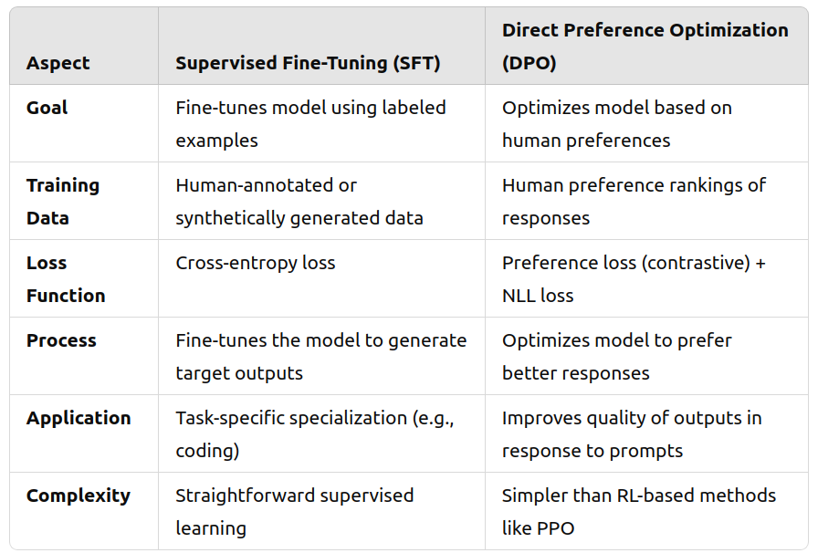

Slide 47
Rejection sampling
Generate Multiple Candidate Outputs:
The number of candidates typically ranges from 10 to 30 outputs for each input prompt.
These outputs are produced by running the prompt through the model multiple times, with slight variations in sampling, such as through different random seeds.
Evaluate Responses Using a Reward Model:
Once the candidates are generated, rewarding model is used to evaluate each candidate response.
The reward model assigns a score to each response based on how well it aligns with desired qualities (correctness, clarity, fluency, or helpfulness).
Efficient Training:
Rejection sampling provides a way to automate the selection of high-quality outputs using the reward model. This makes the fine-tuning process more efficient and scalable.
Notes:
Rejection sampling is a technique used during the post-training phase of large language models, like Llama 3, to improve the quality of generated outputs. The goal of rejection sampling is to select the best response from a set of generated outputs for a given prompt, based on a reward model or scoring mechanism.By leveraging multiple candidate responses, the model can be fine-tuned to prefer outputs that align better with human preferences and task requirements. Reward model quality is IMPORTANT

Slide 48
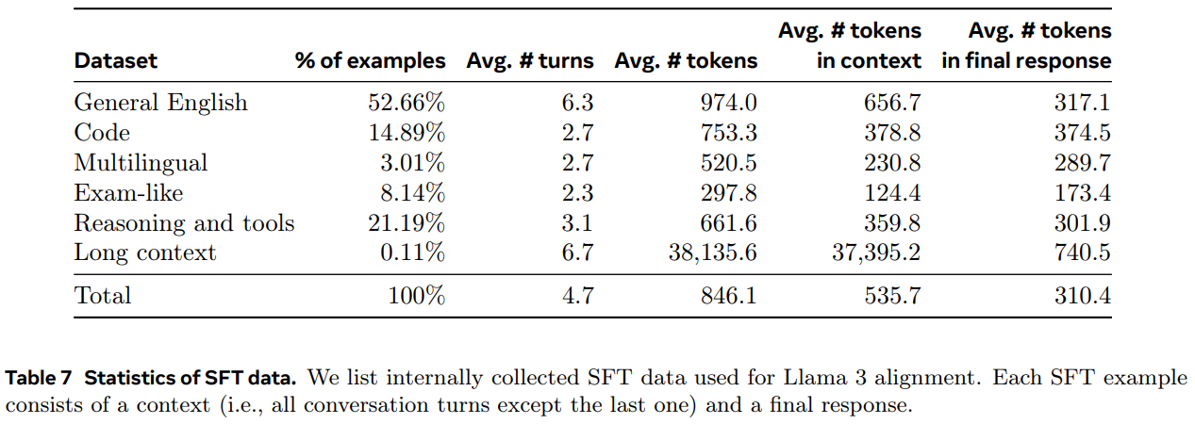
Data mix on SFT
Notes:
We use capability-specific data for SFT training, as shown in table.

Slide 49
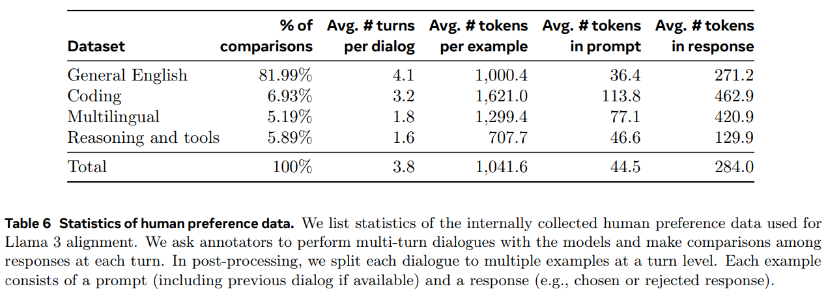
Data mix on preference data
Notes:
Well, DPO is for alignment, so we did not use many task-specific data

Slide 50
Code
Enhancing Code Fine-Tuning with Execution Feedback
Synthetic Data Generation:
Problem Description Generation:
Generated diverse programming problems from random code snippets to cover a broad range of topics.
Solution Generation:
LLaMA 3 generated solutions, improving with prompts that included best practices and explanation comments.
Correctness Analysis and Iterative Self-Correction
Correctness Testing:
Static Analysis: Ensures syntactic correctness (e.g., linting, syntax checks).
Unit Tests: Model-generated tests catch runtime errors and validate functionality.
Error Feedback:
Failed solutions are revised based on feedback (stdout, stderr, etc.).
Model improves by fixing code or adjusting tests, with 20% of solutions self-corrected.
Iterative Fine-Tuning:
Multiple rounds of fine-tuning refine the model, progressively improving performance with each round.
Notes:
Initial Challenges:
Training LLaMA 3 (405B) on its own generated data degraded performance.
Solution: Introduced execution feedback to help the model learn from mistakes.

Slide 51
Code
Programming Language Translation:
Challenge: Performance gap between common languages (e.g., Python/C++) and less common ones (e.g., Typescript/PHP) due to limited training data.
Solution:
Translate code from common to less common languages using LLaMA 3 prompts.
Ensure quality with syntax parsing, compilation, and execution checks.
Impact: Significant performance improvement in less common languages.
Backtranslation for Documentation & Explanations:
Procedure:
Generate: Use LLaMA 3 to generate code documentation or explanations.
Backtranslate: Ask the model to regenerate the original code from the generated documentation.

Slide 52
Math and Reasoning
Key Challenges:
Lack of Prompts:
As math questions get more complex, fewer valid prompts exist for Supervised Fine-Tuning (SFT), making it hard to diversify training datasets.
Lack of Ground Truth Chain of Thought:
Reasoning requires step-by-step solutions, but there is often a shortage of ground truth Chain of Thought (CoT) examples to guide the model.
Incorrect Intermediate Steps:
Model-generated reasoning steps may be inaccurate, leading to incorrect final answers.
Teaching Models to Use External Tools:
Incorporating tools like code interpreters enhances reasoning by combining code execution with text-based reasoning.

Slide 53
Math and Reasoning
Approaches to Overcome Reasoning Challenges in LLaMA 3
Addressing Lack of Prompts:
Convert pre-training data from math contexts into question-answer formats for SFT.
Create a taxonomy of mathematical skills and source relevant prompts from human annotators.
Augmenting Training Data with Step-Wise Reasoning:
Use LLaMA 3 to generate and filter step-by-step solutions.
Apply self-verification where LLaMA 3 checks its own reasoning.
Filtering Incorrect Reasoning:
Train reward models to filter out incorrect reasoning traces.
Interleaving Code and Text:
Solve problems with a combination of textual reasoning and Python code, using code execution as feedback to ensure reasoning correctness.
Learning from Feedback and Mistakes:
Simulate human feedback by correcting incorrect reasoning traces, allowing the model to iteratively improve through error correction.

Slide 54
Hallucinations
Approach:
Focus on aligning the model to “know what it knows” rather than adding new knowledge.
Implement a hallucination-first approach to limit incorrect responses.
Knowledge Probing Process:
Data Extraction: Extract snippets from the model’s pre-training data.
Question Generation: Use LLaMA 3 to generate factual questions based on these snippets.
Response Sampling: Sample multiple responses from the model to each question.
Correctness Scoring: Compare responses with the original data and score based on factual accuracy.
Informativeness Scoring: Assess the informativeness of the responses.
Refusal Generation: Encourage the model to refuse answering when it consistently provides incorrect yet informative responses.
Goal:
Encourage LLaMA 3 to avoid answering questions it lacks knowledge about, thereby reducing hallucinations and limiting the spread of misinformation.

Slide 55
Thank you [End]

