Slide 1
identical parallel machine scheduling using genetic algorithm
1. Minimisation of total tardiness for identical parallel machine scheduling using genetic algorithm
2. A genetic algorithm for minimizing the makespan in the case of scheduling identical parallel machines
3. Genetic algorithms for the optimal common due date assignment and the optimal scheduling policy in parallel machine earliness/tardiness scheduling problems
4. Scheduling identical parallel batch processing machines to minimise makespan using genetic algorithms

Slide 2
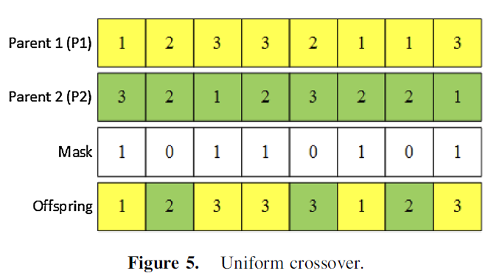
交配1(右半)
Step1. 生成長度為N的{0, 1}陣列
Step2. 逢1拉P1；逢0拉P2
備註:不論左半或者右辦，若交配率為0.6，則出現1的概率也要等於0.6

Slide 3
突變1
右半->生成長度為N的[0, 1]陣列，若<=突變率，則該位置就進行重置，即隨機生成[1, M]。注意，新的gene不可以原先的gene相同

Slide 4
交配2
雙點交配

Slide 5
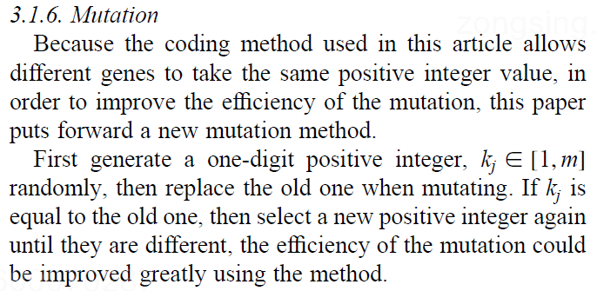
突變2
注意，新的gene不可以原先的gene相同

Slide 6

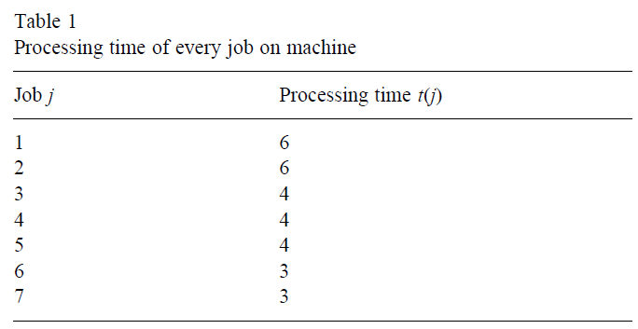
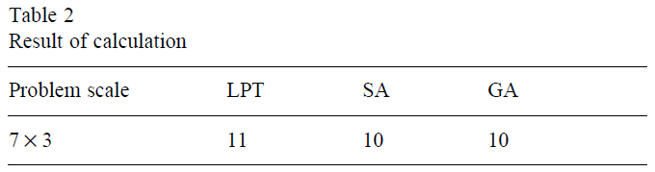
測試函數1

Slide 7

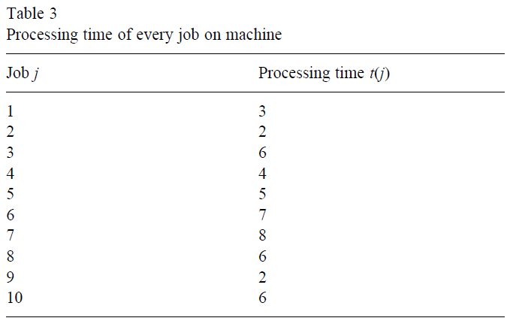
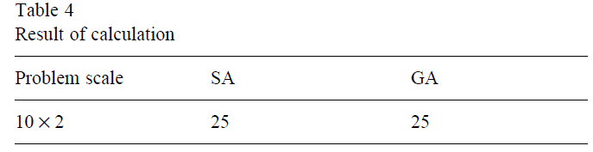
測試函數

Slide 8

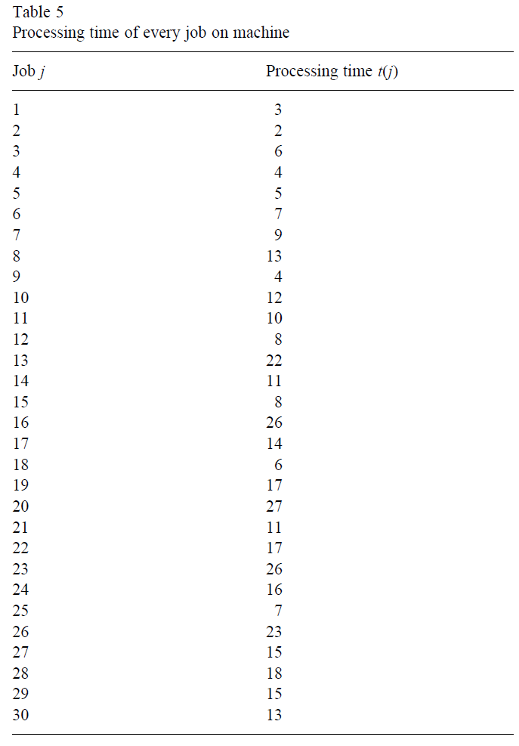
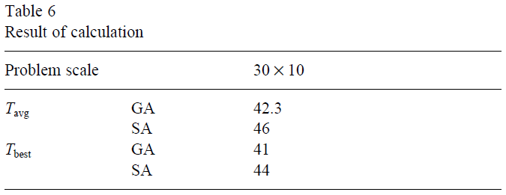
測試函數

