Slide 1


GIT AND GITHUB
Version Control

Slide 2
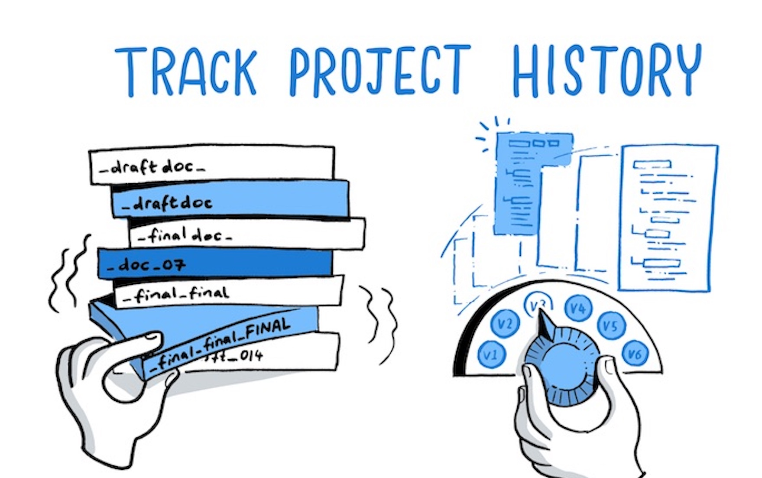
WHAT IS GIT?
Git is a version control system that is free and open source.
What is Version Control?
Version control, also known as source control, is the practice of tracking and managing changes to software code. Version control systems are software tools that help software teams manage changes to source code over time.

Slide 3
Repository
Project or the folder or place where your project is kept.

Slide 4
GITHUB
WHAT IS GITHUB?
GitHub is a code hosting platform for collaboration and version control. It’s a website that you can host your repository online.
https://github.com/

Slide 5
Basic Git Command
git config --global user.name “[firstname lastname]”
#set a name that is identifiable for credit when review version history
git config --global user.email “[valid-email]”
#set an email address that will be associated with each history marker
git config --global color.ui auto
#set automatic command line coloring for Git for
git clone [url]
#retrieve an entire repository from a hosted location via URL

Slide 6
Basic Git Command (Con.)
git log
#show all commits in the current branch’s history
git status
#show modified files in working directory
git add [file]
#add a file as it looks now to your next commit (stage)
git reset [file]
#unstage a file while retaining the changes in working directory

Slide 7
Basic Git Command (Con.)
git checkout [file]
#reset your specific file to default
git commit -m “[descriptive message]”
#commit your staged files
git push
#Transmit local branch commits to the remote repository branch
git pull
#download content from a remote repository and immediately update the local repository to match that content

Slide 8
THANK YOU
Do you have any questions? Bunthart.koy@acledaaib.onmicrosoft.com Telegram @koybunthart

