Slide 1
MOOSE-Chem2: Exploring LLM Limits in Fine-Grained Scientific Hypothesis Discovery via Hierarchical Search
Zonglin Yang

Slide 2
Motivation
Lack details
fine-grained hypothesis discovery
Not yet best exploit LLM’s capacity and potential
Notes:
Method, theoretical and empirical analyses

Slide 3

Fine-grained Hypothesis Discovery
$h_{c} →Method→h_{f}$
$h_{f}=\{h_{c},d_{1}, …, d_{m}\}$
$d$ represents:
Adding an element/detail
Deleting an existing element/detail
$d∈D$
$P\left(h_{f} | b, h_{c}\right)$
$=P(\{d_{1},…,d_{m}\}|b, h_{c},D)$
$\left|D\right|=n$
Complexity: $C_{n}^{m}= \frac{n!}{m!\left(n−m\right)!}$

Slide 4

Challenges
$D$ is implicit
$|D|$ can be very large
Complexity ($C_{n}^{m}$) is intractable

Slide 5
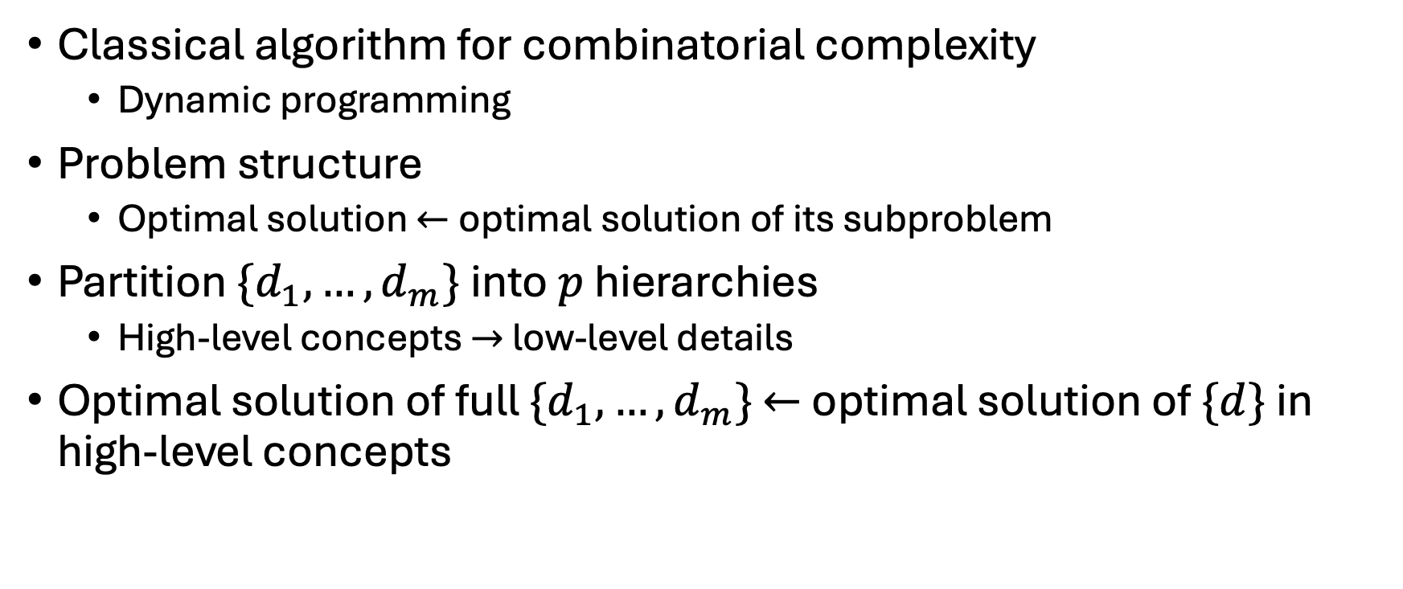
Intractable Complexity
Classical algorithm for combinatorial complexity
Dynamic programming
Problem structure
Optimal solution $←$optimal solution of its subproblem
Partition $\{d_{1},…,d_{m}\}$ into $p$ hierarchies
High-level concepts $→$ low-level details
Optimal solution of full $\{d_{1},…,d_{m}\}$ $←$ optimal solution of $\{d\}$ in high-level concepts

Slide 6
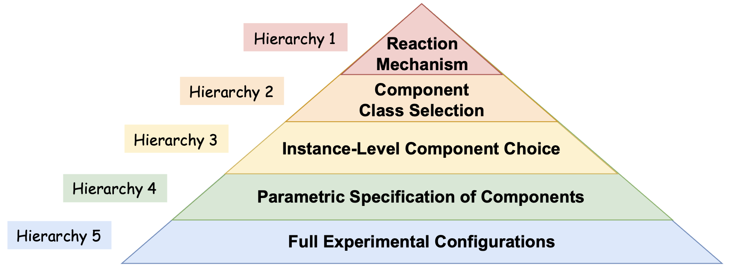
Example Hierarchy for Chemistry

Slide 7
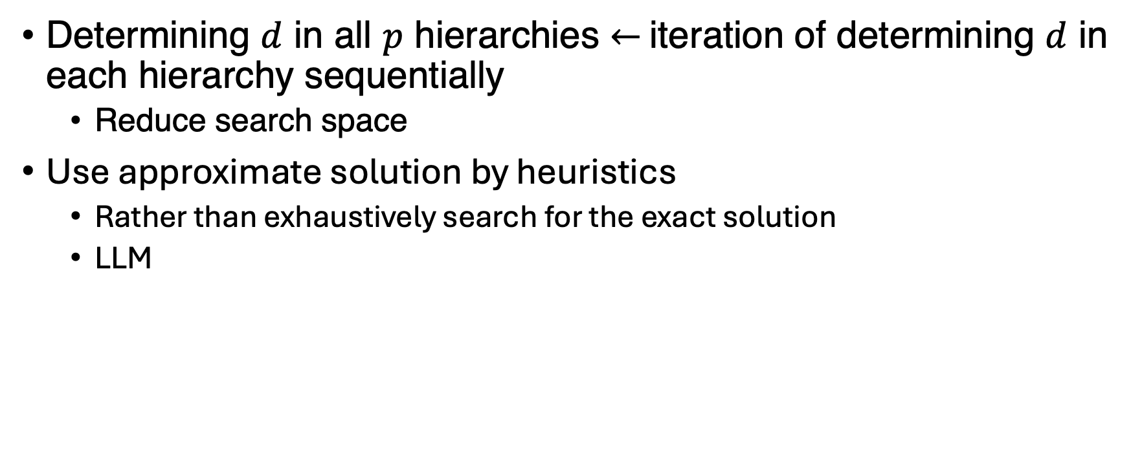
Intractable Complexity
Determining $d$ in all $p$ hierarchies $←$ iteration of determining $d$ in each hierarchy sequentially
Reduce search space
Use approximate solution by heuristics
Rather than exhaustively search for the exact solution
LLM
Notes:
Now we have simplified the problem of determining d in all p hierarchies into the iteration of determining d in each hierarchy sequentially. Nonetheless, even within a single hierarchy, the number of candidates remains combinatorically large.
Use LLM to propose d by heuristics

Slide 8
Motivation
Lack details
fine-grained hypothesis discovery
Not yet best exploit LLM’s capacity and potential
Notes:
Method, theoretical and empirical analyses

Slide 9
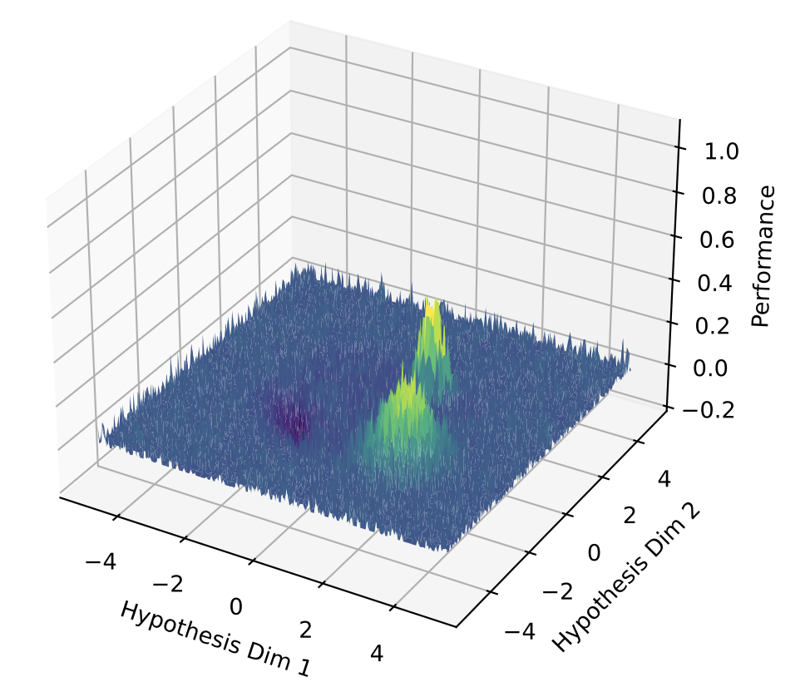
Exploit LLM’s Upper Limit
Definition of upper limit
Of all the hypotheses an LLM can possibly generate, the one that the LLM itself consider the best
Consider a latent space
x-axis: hypothesis
y-axis: internal reward from LLM
Upper limit:
The global maximum of the latent space
In practice
Searching for a better local maximum

Slide 10
Exploit LLM’s Upper Limit
How human scientist do
To think of a hypothesis that themselves would think the best for experiment
Notes:
A framework capturing better local optimum automatically gets better as LLMs becomes better.

Slide 11
Challenge: Exploit LLM’s Upper Limit
Very rugged reward landscape
Difficult for optimization
Method: the hierarchical design
Smoothen the reward landscape by averaging

Slide 12
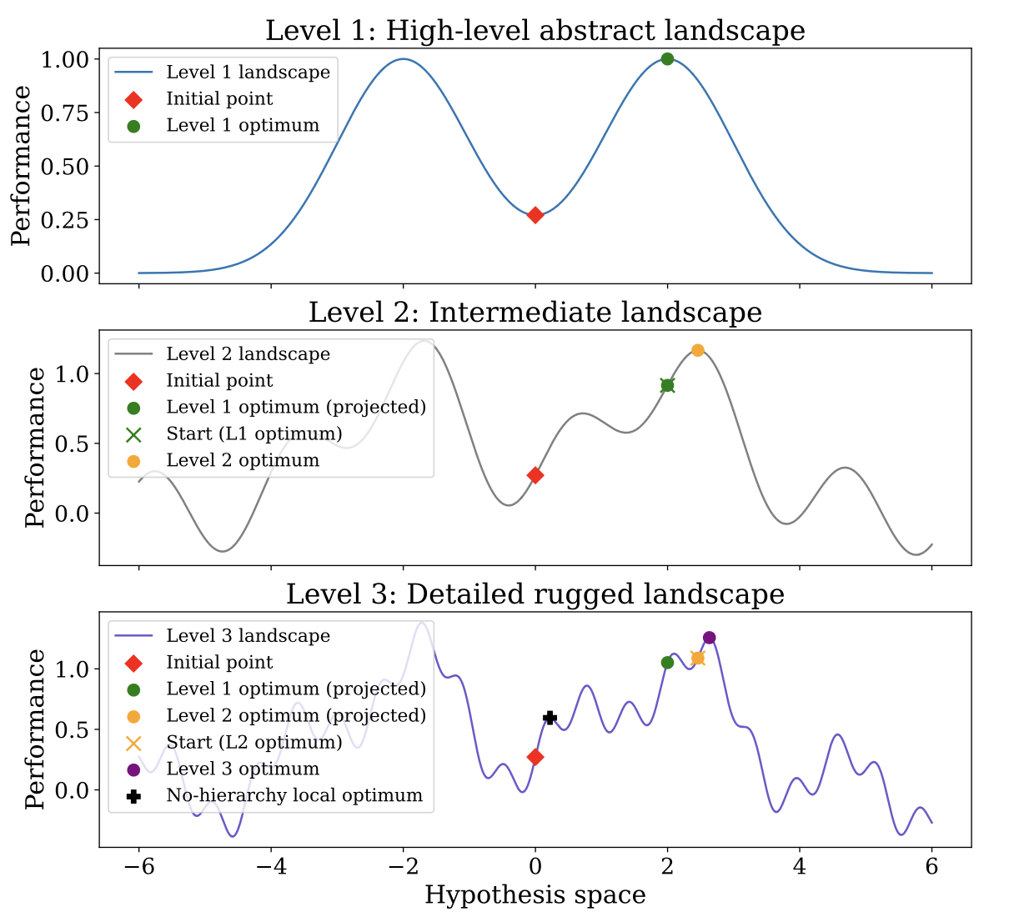

Slide 13
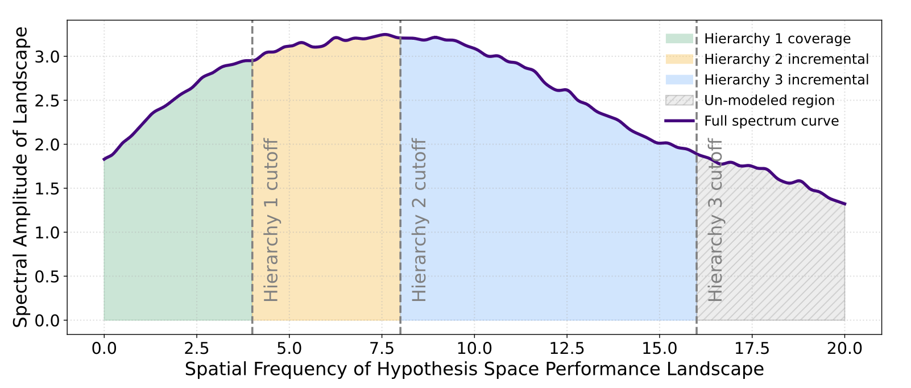
Low-Pass Filtering on Reward Landscape

Slide 14
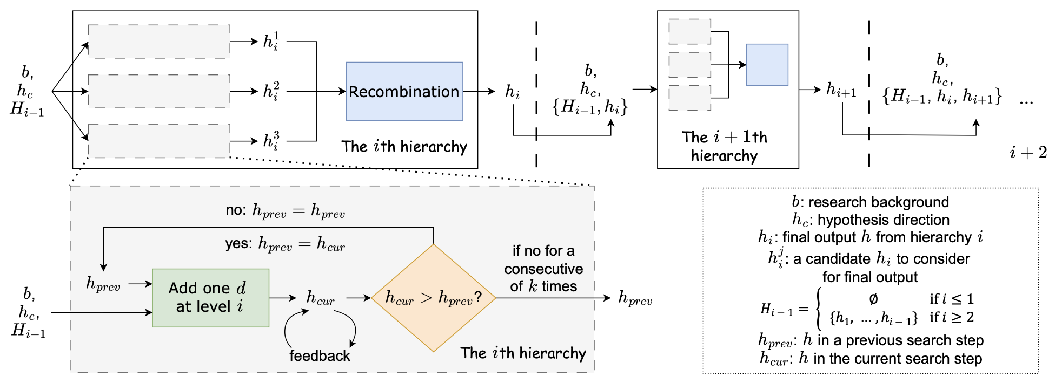
Method

Slide 15

Research Questions
How to reach to better local optimum?
Does it really better?
Reward landscape $←$ Multiple diverse LLMs
Reward landscape $←$ Multiple same LLMs

Slide 16
Benchmark
Extend TOMATO-Chem
51 papers published in good venues
Research background
Fine-grained hypothesis

Slide 17
Evaluation
LLM pairwise evaluation
Which one is better optimum?
Reference-based evaluation
How many details in annotated fine-grained hypothesis are recalled?

Slide 18
Baselines
Greedy Search
Greedy Search + Self-consistency
Notes:
The baselines are also ablations

Slide 19
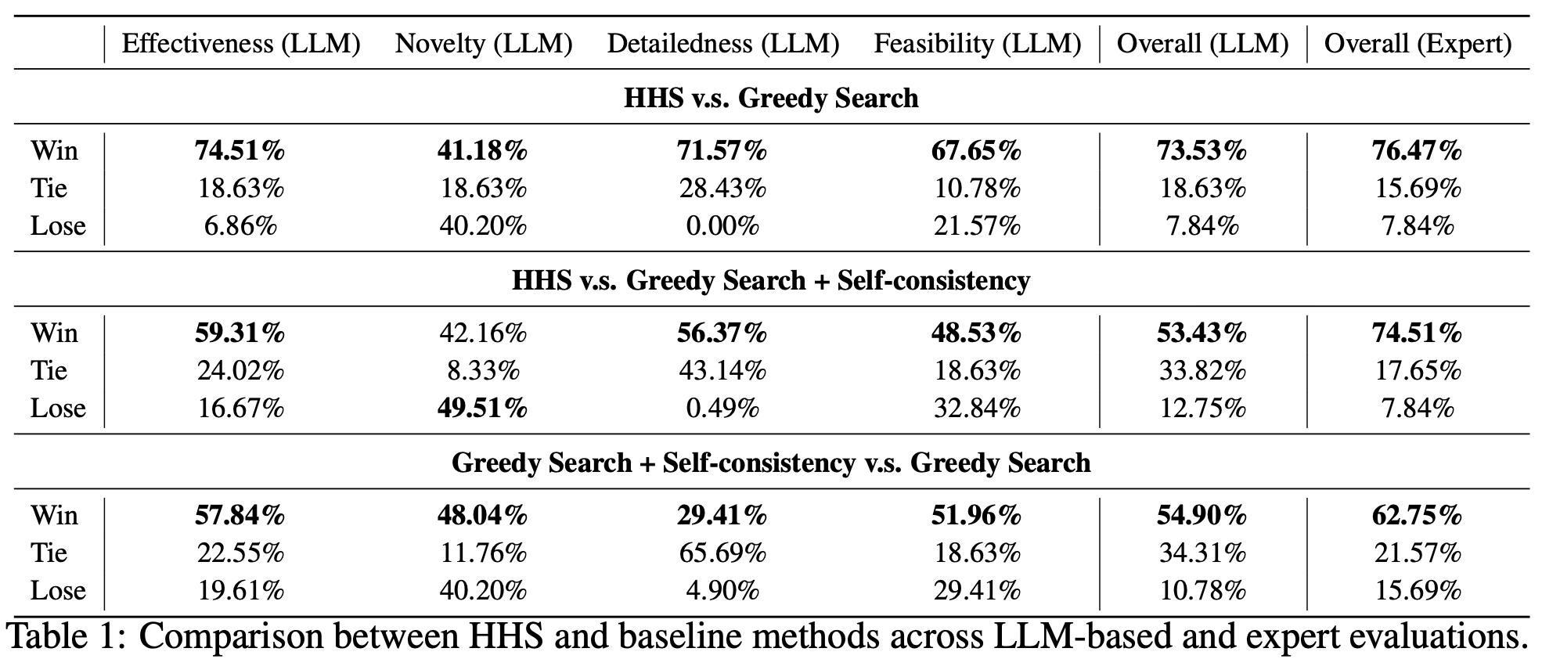
Question 1: How to reach to better local optimum?

Slide 20
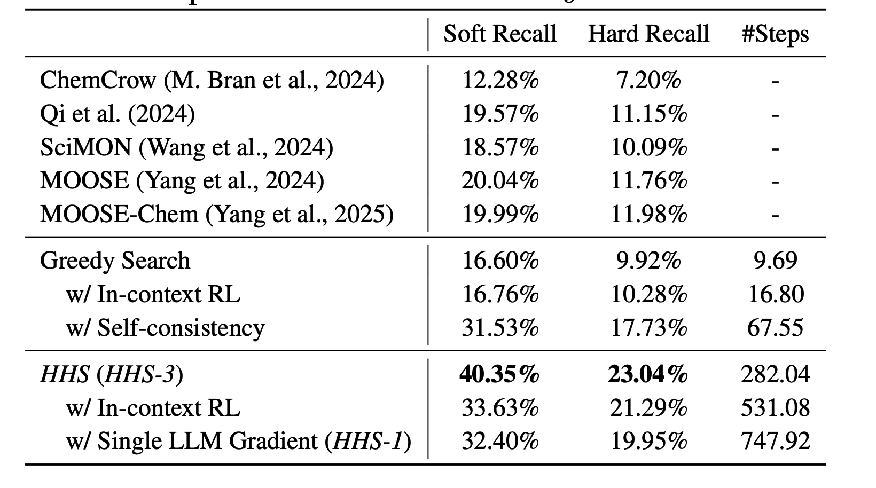
Question 2: Does it really better?

Slide 21
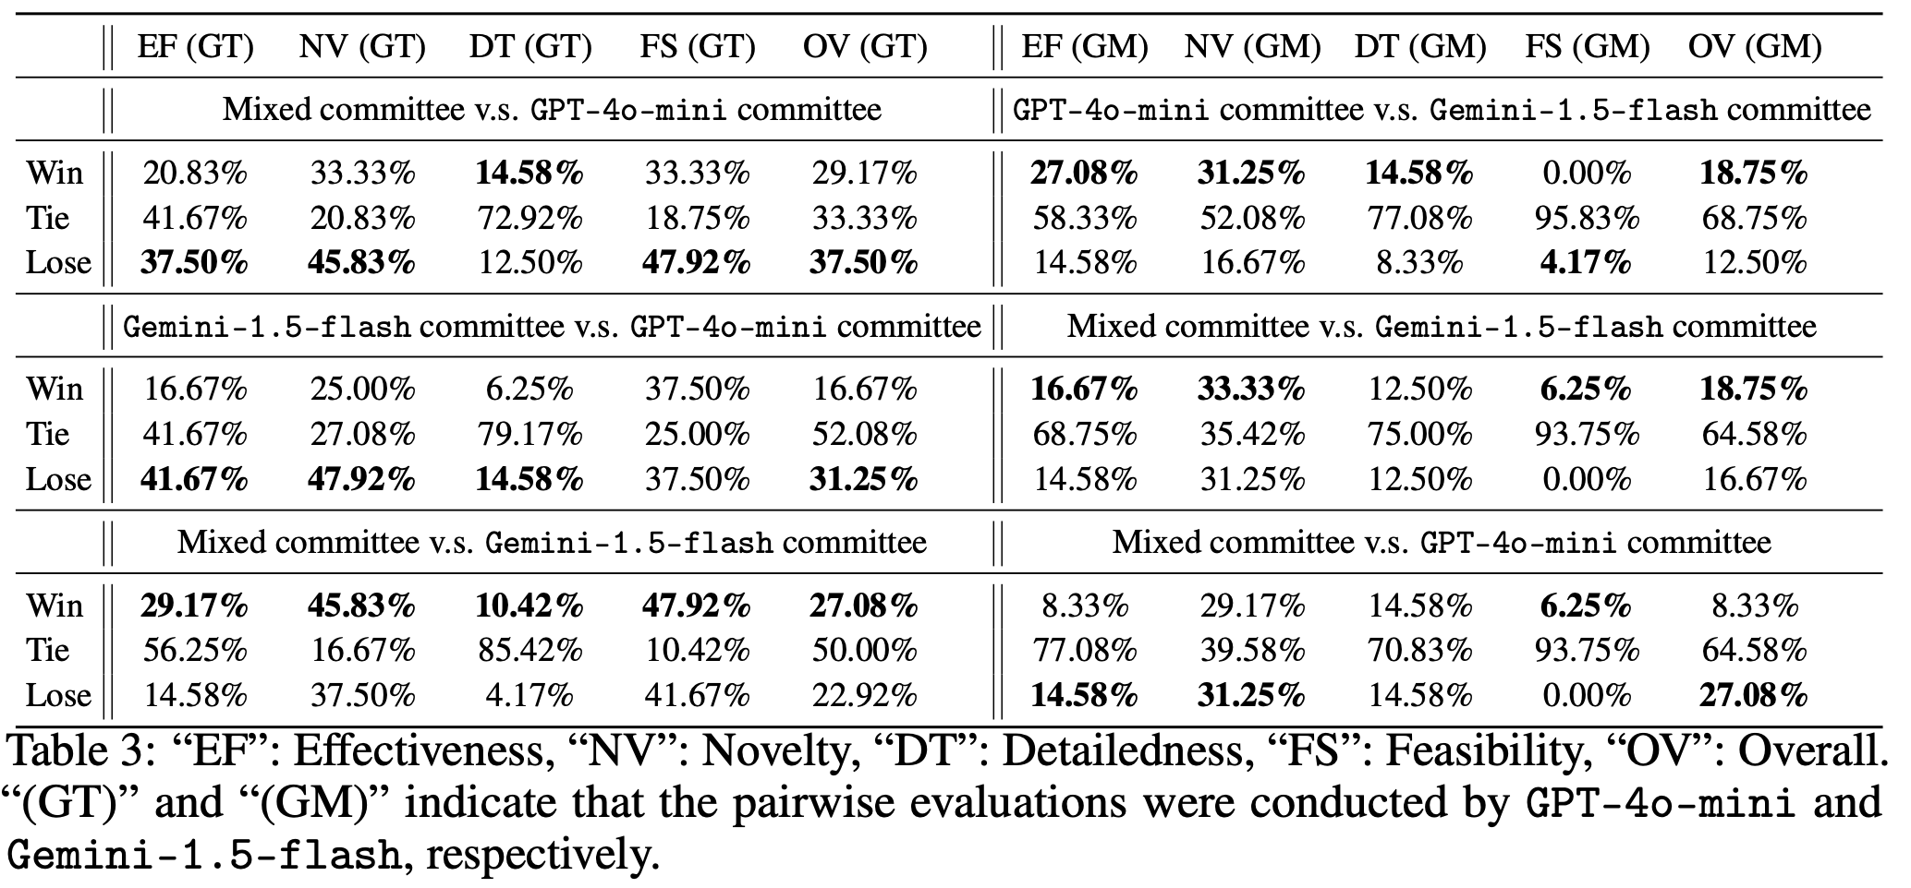

Question 3: Reward landscape $←$ Multiple Diverse LLMs

Slide 22
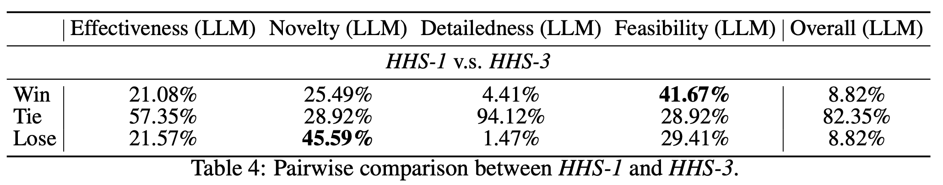

Question 4: Reward landscape $←$ Multiple Same LLMs

Slide 23


Thank you!
Q & A
My Twitter
Code

