Slide 1




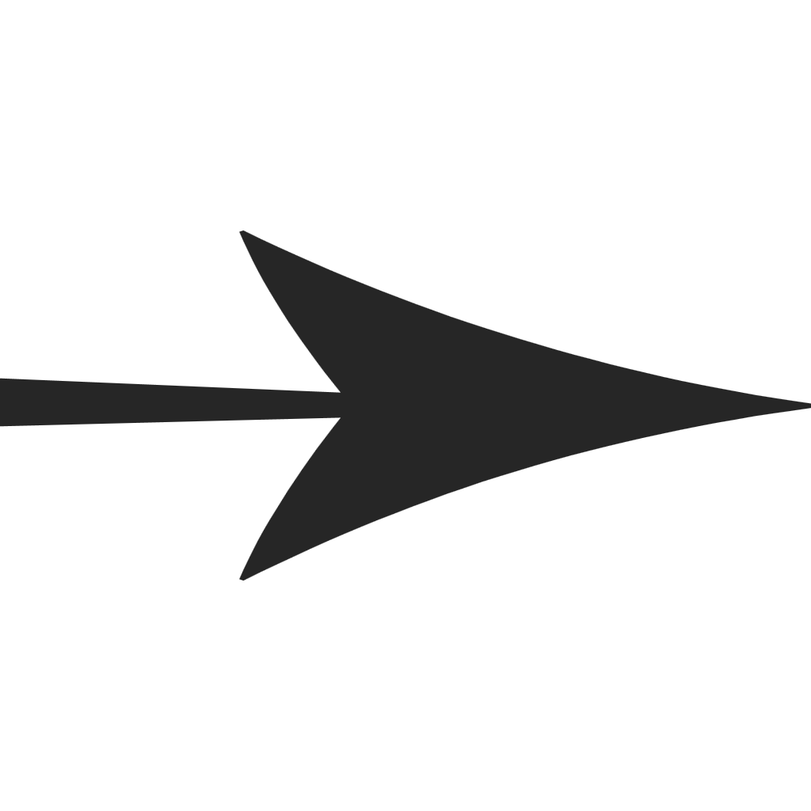











e_{j}
R
...
Positive samples
l = 2
u_{i}
v_{j+}
R
...
Negative samples
l = 1
u_{i}
v_{j-}
e_{u}
Reverse
BPR Loss
Interaction View
User-Item Interaction Graph
Sample R user-item pairs
$$\tilde{E0}$$
Difussion Loss
FC(.)
$$\tilde{E0}$$
l = 2
u’_{i}
i
e₁
E_{t}
Concat
T
l = 1
μ_{θ} (e_{t} ,t)
...
Forward
q(E_{t}|E₋₁ )
u’’_{i}
...
...
...
E₀
e_{R}
User-User Social Graph
Social View
E₀
E_{t-1}
E_{t}
Graph-based Collaborative Pattern Encoder
Social Diffusion Encoder
Joint Training

Slide 2
e_{j}
R
...
Positive samples
l = 2
u_{i}
v_{j+}
R
...
Negative samples
l = 1
u_{i}
v_{j-}
e_{u}
Reverse
BPR Loss
Interaction View
User-Item Interaction Graph
Sample R user-item pairs
$$\tilde{E0}$$
Difussion Loss
FC(.)
$$\tilde{E0}$$
l = 2
u’_{i}
i
e₁
E_{t}
Concat
T
l = 1
μ_{θ} (e_{t} ,t)
...
Forward
q(E_{t}|E₋₁ )
u’’_{i}
...
...
...
E₀
e_{R}
User-User Social Graph
Social View
E₀
E_{t-1}
E_{t}
Graph-based Collaborative Pattern Encoder
Social Diffusion Encoder
Joint Training

Slide 3






$$u$$
$$v_{+}$$
$$\frac{1}{2}\left(\frac{{\overline{α}}_{t−1}}{1−{\overline{α}}_{t−1}}−\frac{{\overline{α}}_{t}}{1−{\overline{α}}_{t}}\right)$$
Noise Scheduler
$${\tilde{E}}_{0}$$
$$ℒ_{bpr}$$
$$×$$
$$t =$$
Denoised
$$−$$
$$+$$
$${\left\|∗\right\|}_{2}^{2}$$
Sample
Step $t$
$$1$$
$$u$$
$$v_{−}$$
Noise Degree
lookup
$$ℒ_{diff}$$
Loss
$$2$$
U-I
$$E_{0}$$
$$E_{t}$$
3
$$𝒢_{r}=(𝒰,𝒱,ℰ_{r})$$
$${\tilde{E}}_{0}$$
4
$$l=1, 2, 3,…$$
U-I Train. Batch
Model Optimization Objectives
$$𝒢_{s}=(𝒰,ℰ_{s})$$
U-U
Forward Process
Reverse Process
lookup
Concat
…
…
…
$t$ steps
…
$$q(E_{t}|E_{t−1})$$
Step
Embed.
Collaborative & Social Graph
Graph Embedding Learning
$$E_{0}$$
$$E_{1}$$
$$E_{2}$$
$$E_{t}$$
$${\tilde{E}}_{0}$$
Diffusion-based Social Relation Denoising

Slide 4
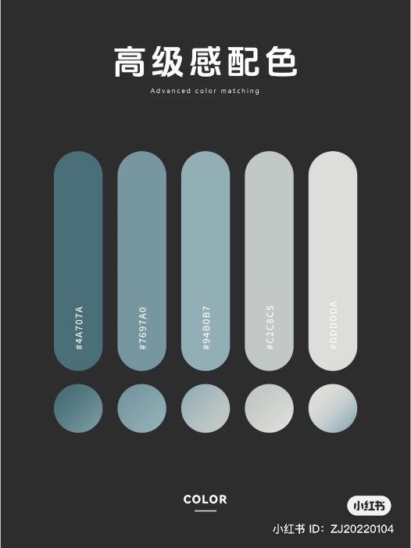












$$u$$
$$v_{+}$$
$$\frac{1}{2}\left(\frac{{\overline{α}}_{t−1}}{1−{\overline{α}}_{t−1}}−\frac{{\overline{α}}_{t}}{1−{\overline{α}}_{t}}\right)$$
Noise Scheduler
$${\tilde{E}}_{0}$$
$$ℒ_{bpr}$$
$$×$$
$$t =$$
Denoised
$$−$$
$$+$$
$${\left\|∗\right\|}_{2}^{2}$$
Sample
Step $t$
$$1$$
$$u$$
$$v_{−}$$
Noise Degree
lookup
$$ℒ_{diff}$$
Loss
$$2$$
U-I
$$E_{0}$$
$$E_{t}$$
3
$${\tilde{E}}_{0}$$
4
Collaborative & Social Graph
$$l=1, 2, 3,…$$
U-I Train. Batch
Model Optimization Objectives
U-U
lookup
Forward Process
Reverse Process
Concat
…
…
…
$t$ steps
…
$$q(E_{t}|E_{t−1})$$
Step
Embed.
$$E_{0}$$
$$E_{1}$$
$$E_{2}$$
$$E_{t}$$
$${\tilde{E}}_{0}$$
Graph Embedding Learning
Diffusion-based Social Relation Denoising
$$ℒ_{bpr}$$
$$+$$
$$ℒ_{diff}$$
$$u$$
$$E_{t}$$
$$v$$
$$\frac{1}{2}\left(\frac{{\overline{α}}_{t−1}}{1−{\overline{α}}_{t−1}}−\frac{{\overline{α}}_{t}}{1−{\overline{α}}_{t}}\right)$$
Weight Sequence
Recommendation
u
$$×$$
$$t =$$
$$u′$$
$$v′$$
$$E_{t}$$
v
$${\left\|∗\right\|}_{2}^{2}$$
…
$$1$$
$$ℒ_{bce}$$
$$+$$
$$ℒ_{diff}$$
Loss
Noise Level
Classification
$$2$$
Target graph representation
$$E_{s}^{∗}$$
$${H′}_{0}$$
$${\tilde{H}}_{0}$$
$$H_{t}$$
…
Model Optimization Objectives
T
$$𝒢_{t}=(𝒰,𝒱,ℰ_{r})$$
$$l=1, 2, 3,…$$
$$V_embed$$
$$U_embed$$
Forward Process
Reverse Process
Favorite
Cart
Fuse
Agg(.)
…
…
…
$$U\sim (1,T)$$
…
View
Click
$$q(H_{t}|H_{t−1})$$
$𝒢_{s}$={$𝒢_{1}$... $𝒢_{n}\}$
Heterogeneous representation
$$H_{0}$$
$$H_{1}$$
$$H_{2}$$
$$H_{t}$$
Step
Embed.
$${\tilde{H}}_{0}$$
Collaborative Heterogeneous Graphs
Graph Embedding Learning
Heterogeneous Relation Diffusion

