Slide 1
CS5330 Pattern Recognition and Computer Vision
Ryan Bockmon, Ph.D.

Slide 2
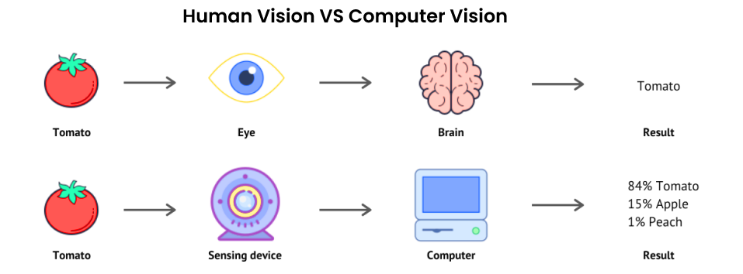
What is Computer Vision (CV)?
Computer vision is - a field of “artificial intelligence” (AI) enabling computers to derive information from images, videos and other inputs.

Slide 3
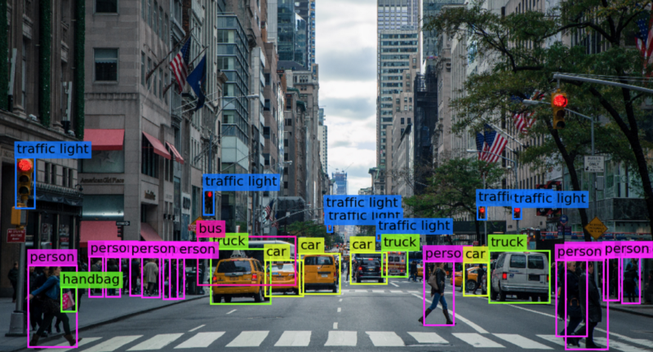

Slide 4
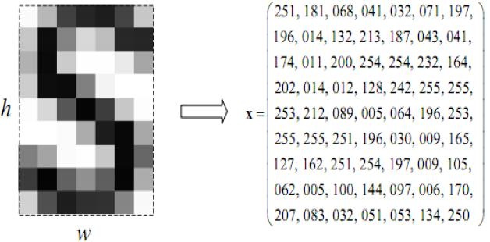
What is an Image?
A digital image is an image composed of picture elements, also known as pixels, each with finite, discrete quantities of numeric representation for its intensity or gray level that is an output from its two-dimensional functions fed as input by its spatial coordinates denoted with x, y on the x-axis and y-axis, respectively.

Slide 5
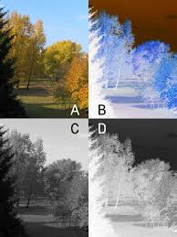
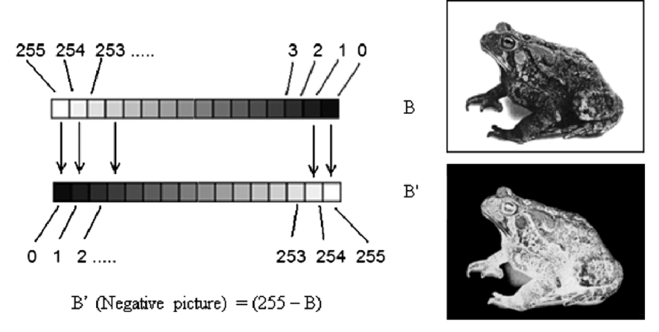
Old CV – Math Based Image Processing
Math based image manipulation

Slide 6
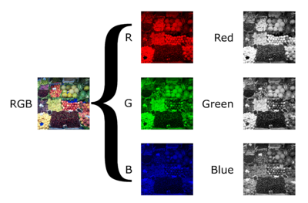
Grey Scale

Slide 7
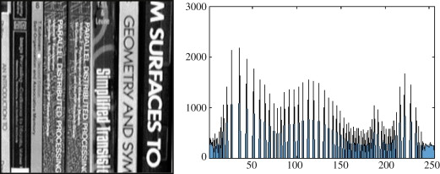
Histograms

Slide 8
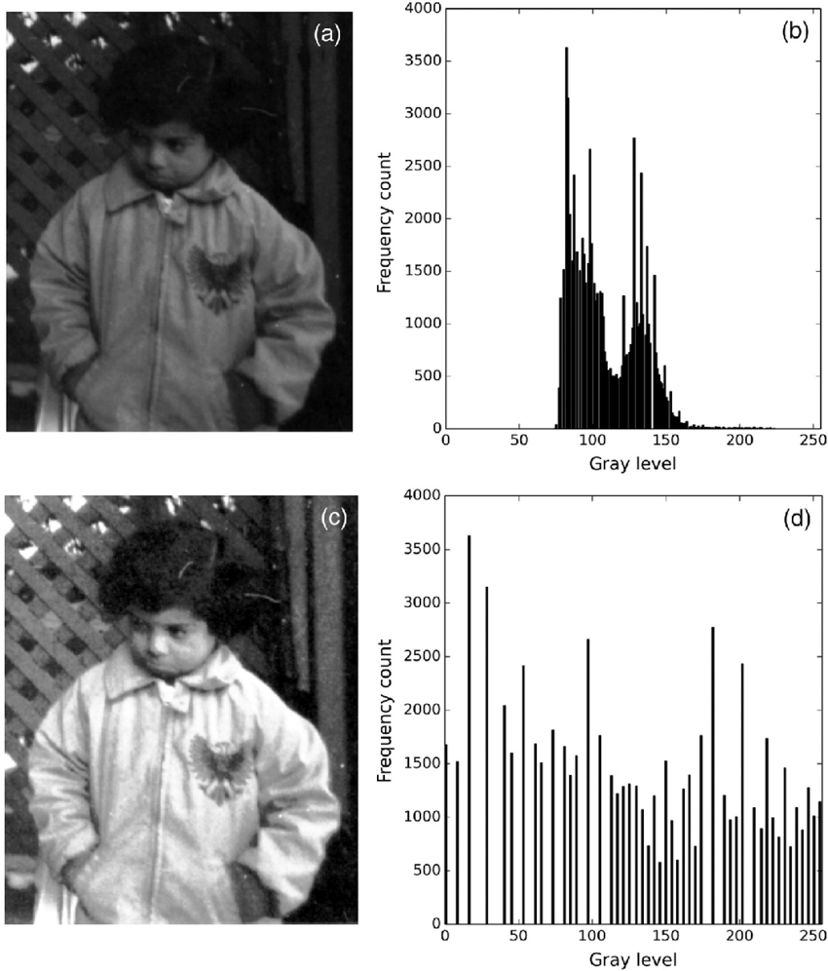
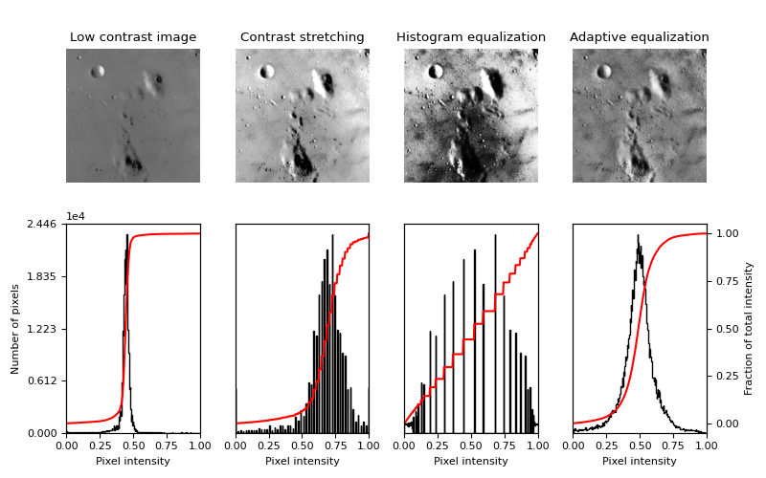
Histogram Equalization

Slide 9
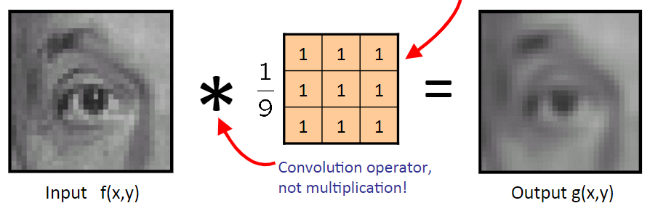
Image Filtering

Slide 10
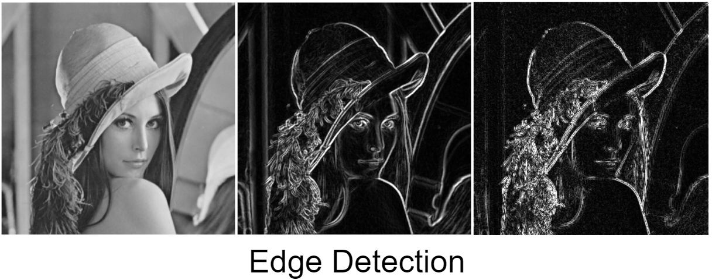

Slide 11
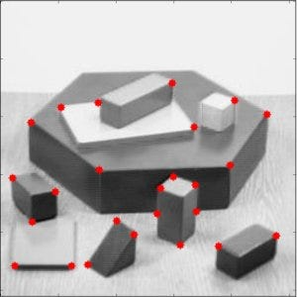
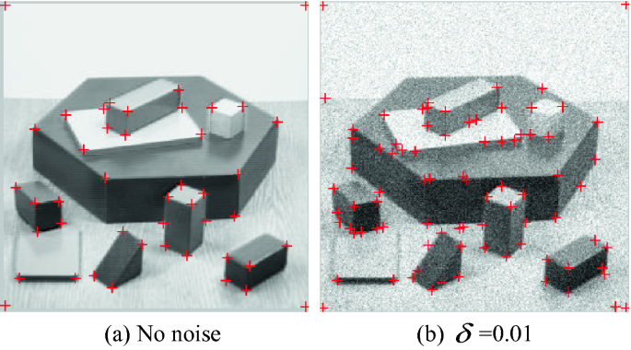
Corner Detection

Slide 12
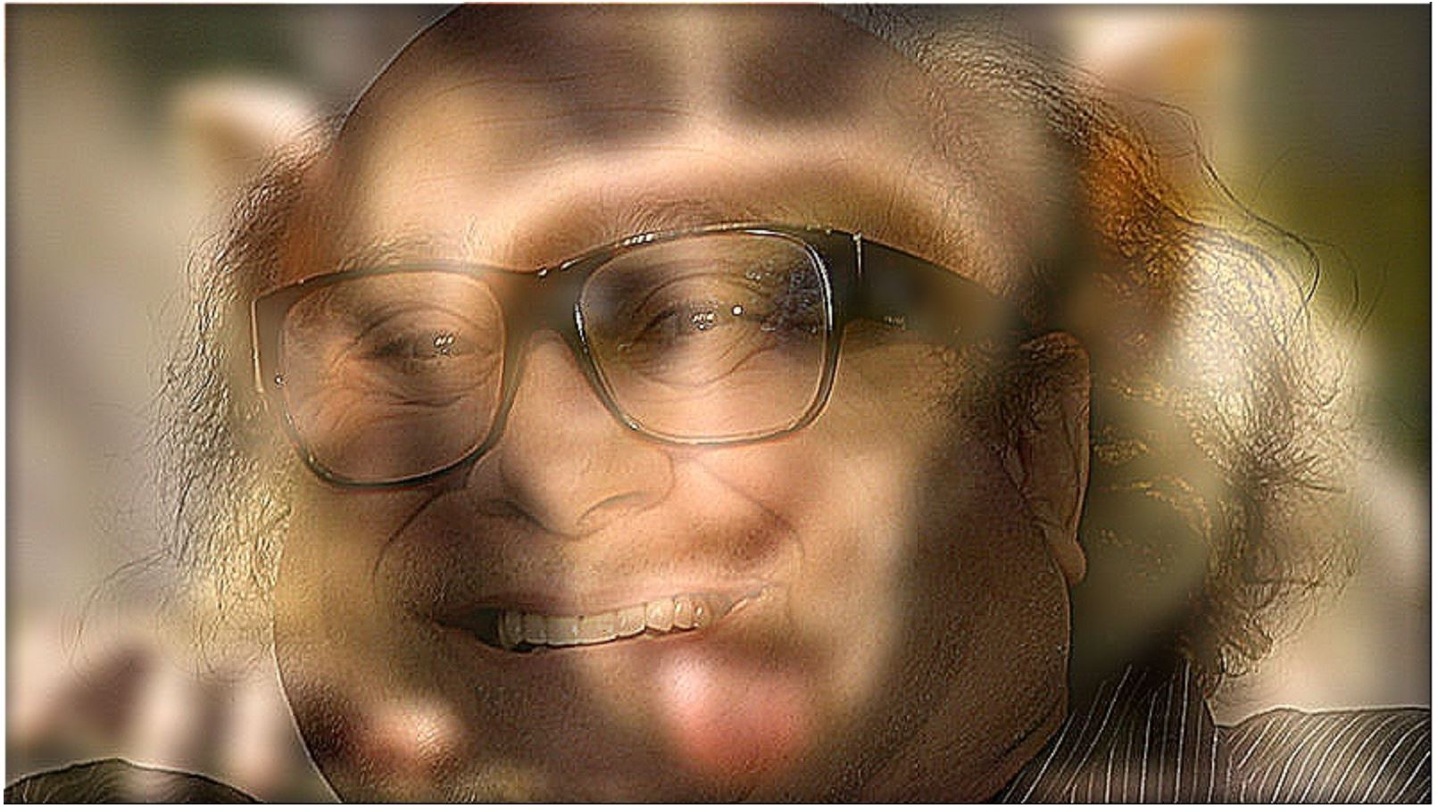
Image Morphing

Slide 13
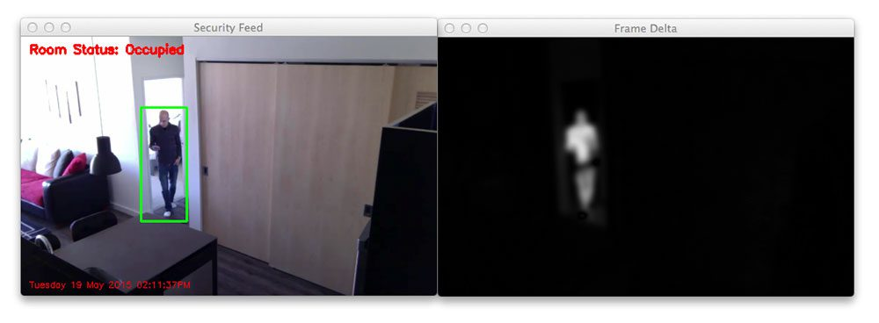
Video - Movement Detection

Slide 14
New Age CV – Deep Learning
Object Detection

Slide 15
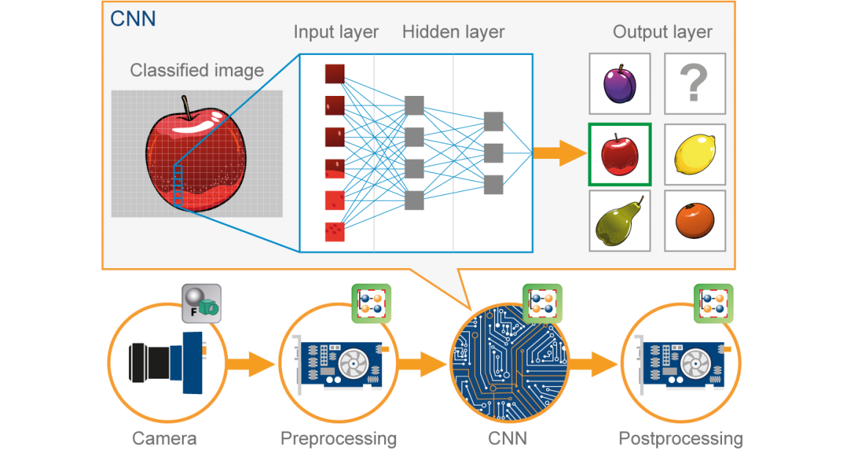
Image Classification

Slide 16
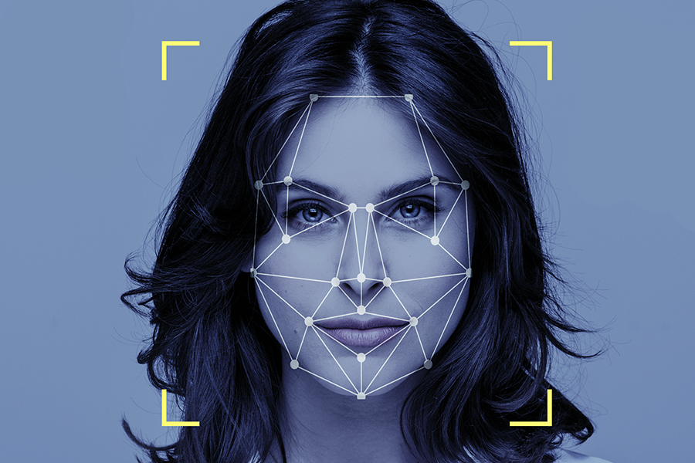
Face Recognition

Slide 17
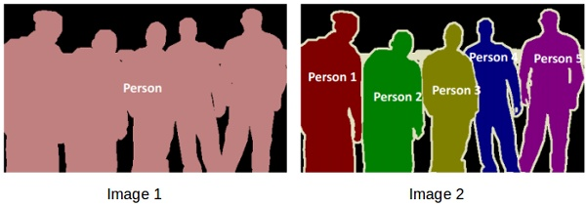
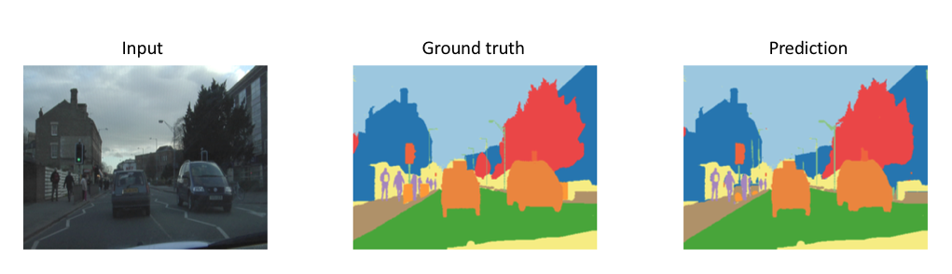
Image Segmentation

Slide 18
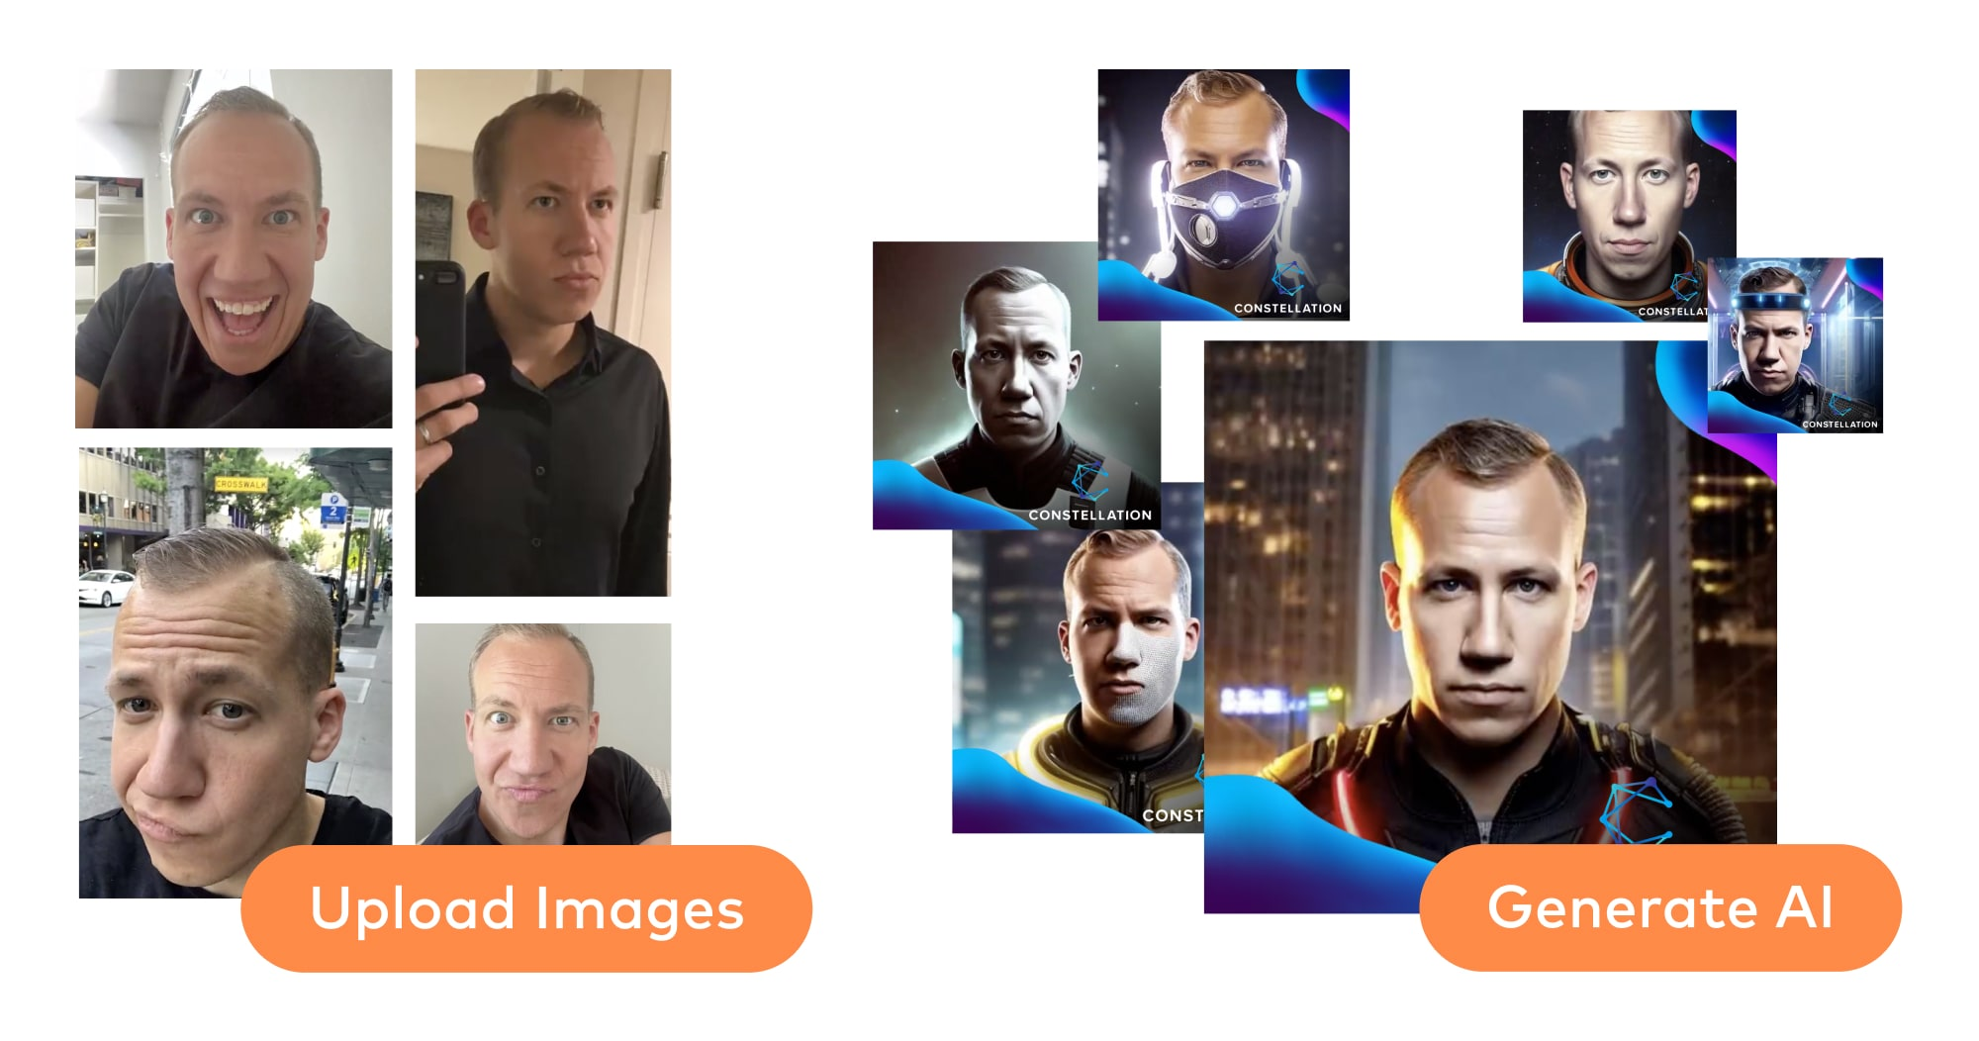
Generative AI

